Slide 1
DSD HW1
Speaker: Daniel
Date: 2023/03/07

Slide 2
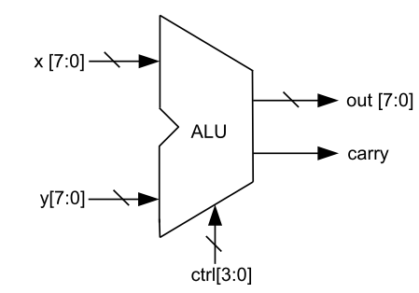
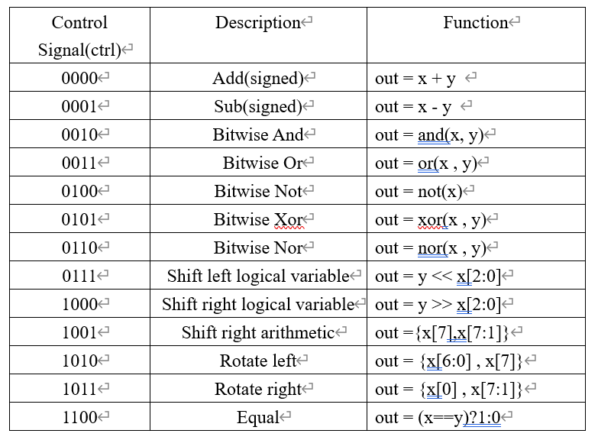
Problem 1: 8-bit Arithmetic Logic Unit
Implement 8-bit ALU with following functions
Ex. Add(signed)
x= 8'b10010110(-106) y= 8'b00101101(45) Ans: 9’b1_11000011(-61)
→ carry = 1, out = 8’b11000011
Notes:
Carry就是x, y運算後的第9個bit

Slide 3
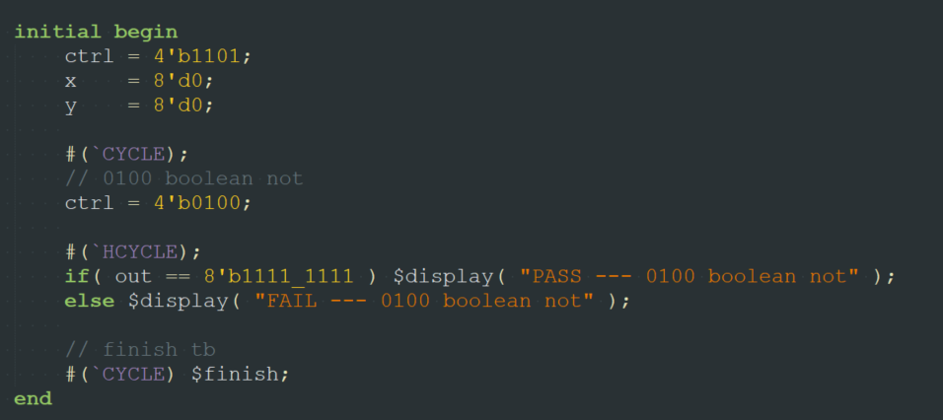
Problem 1: 8-bit Arithmetic Logic Unit
(1) Implement RTL (use continuous assignment, assign) model of the ALU
(2) Implement RTL (use procedural assignment, always block) model of the ALU
(3) Modify the given testbench to verify all functions in your design are correct
Only test Boolean not
Notes:
你們要把tb的值改一下測試正確性

Slide 4
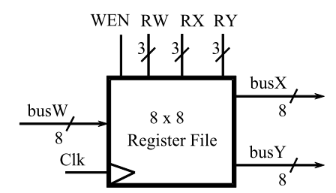
Problem 2. 8x8 Register File
Implement a 8 x 8 register file which can support read and write operation
Notes:
register file的busX, busY要在什麼時候讀值?
busX和busY一直根據RX、RY讀取register的值，write在正緣根據WEN寫入，read的話，接成combinational logic! 就是根據RX直接access register file的值。
這裡要你們自己寫tb來generate資料，測試正確性

Slide 5
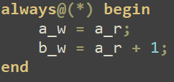
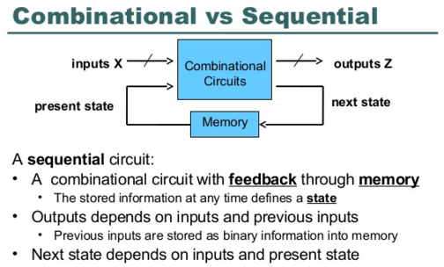
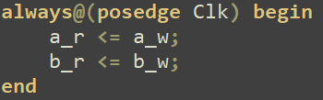
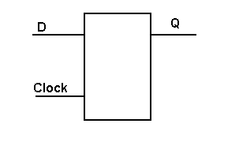
Flip-flop
a_w -> a_nxt
Combinational circuit
Sequential circuit
a_r -> a
a_w,
b_w
a_r,
b_r
a_w,
b_w

Slide 6
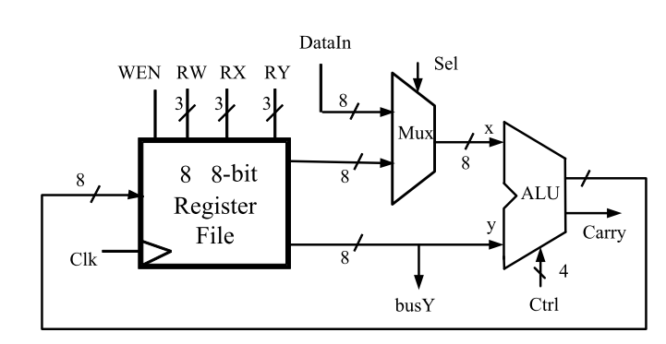
Problem 3. Simple Calculator
Combine the previous two designs (ALU, Register File) into a simple calculator unit
Notes:
記得把你們的alu和register file的module加進去

Slide 7
Report
ALU: Screenshot the waveform result in nWave of alu_assign & alu_always, describe how you verify the correctness
Register file: Screenshot the waveform result in nWave of register_file, describe how you verify the correctness.
Bonus (5%): Write down what you found. Feel free to share your experience. (Ex: some mistakes you spend a lot of time, your environment, naming method)

Slide 8
Note
Continuous assignment
LHS has to be wire type
always statement
LHS has to be reg type
Don’t use non-synthesizable syntax
Port
input
within the module, input must be declared as type wire(net), externally, they can connect to a type reg or wire
output
within the module, output can be declared as type reg or wire(default wire), externally they must always connect to net(wire)
if output port used in an always statement, the port must be redeclared as type reg, e.g. output reg carry;
Notes:
HW2的討論區也開在FB社團了，大家有問題可以上去發問

