Slide 1
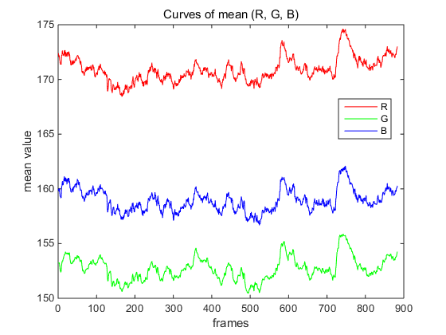
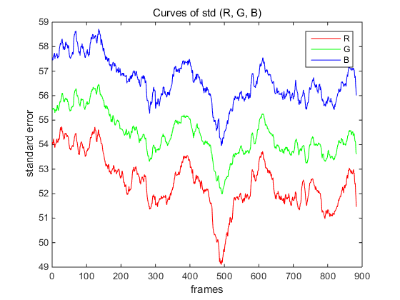
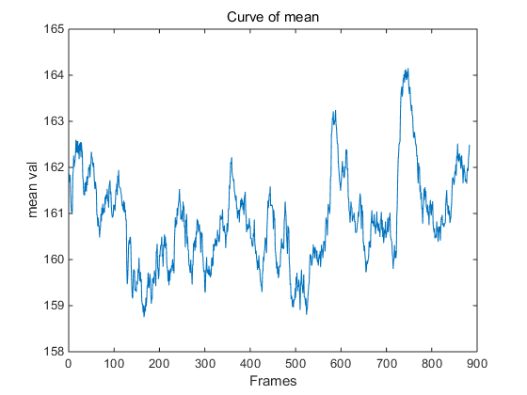
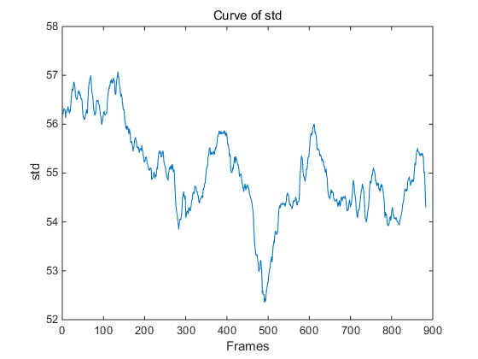
Experiment 1(wrist)
Before amplifying | After amplifying | Cutting ROI

Slide 2
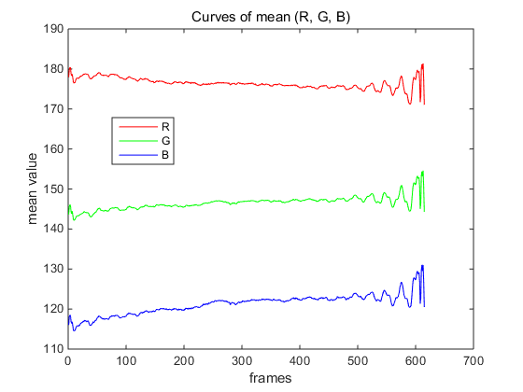
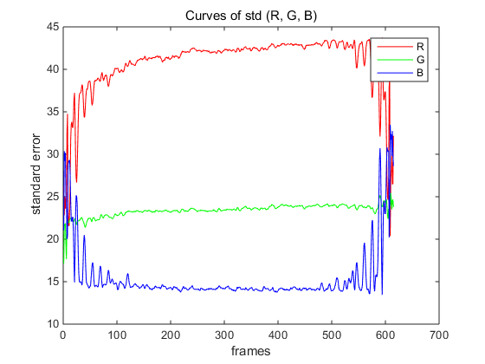
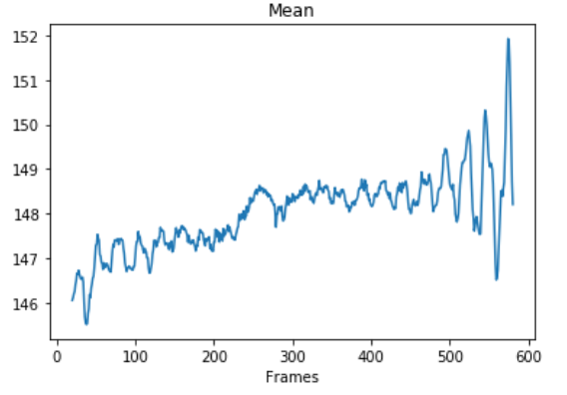
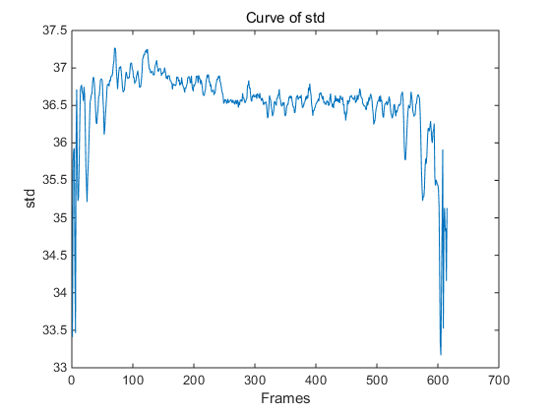
Experiment 2((colored blue Motion!))
Before amplifying | After amplifying | Cutting ROI

Slide 3
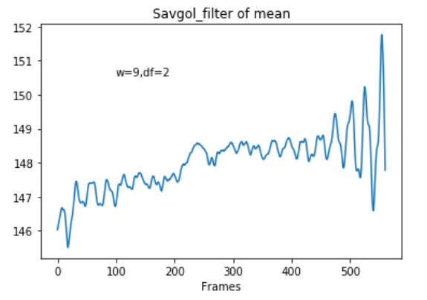
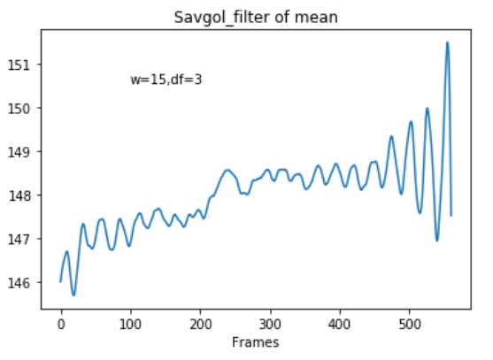
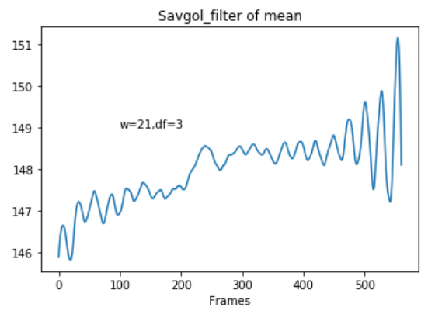
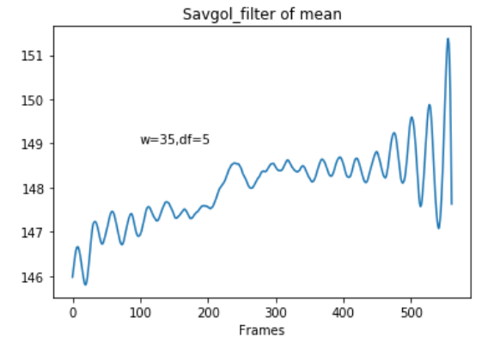
Savgol Filter
(noise reduction; keeping shape and width)

Slide 4
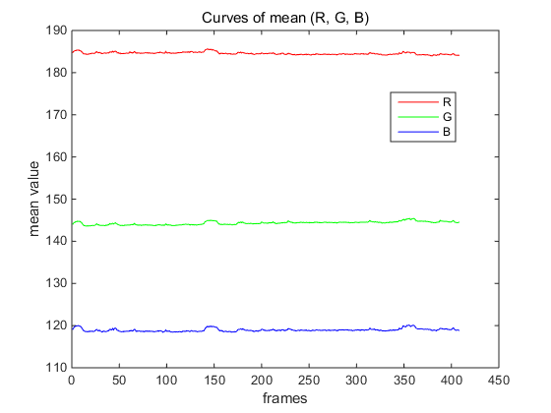
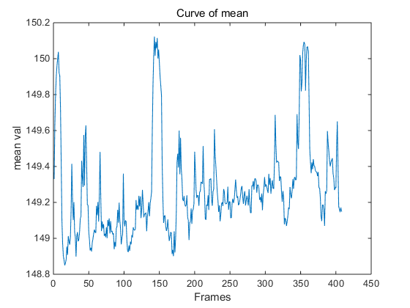
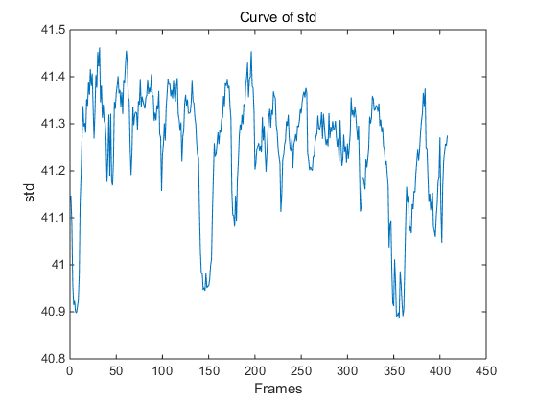
Experiment 3(colored blue)
Parameters: sample400loCutoff15hiCutoff25alpha15sigma10
Before amplifying | After amplifying | Cutting ROI

Slide 5
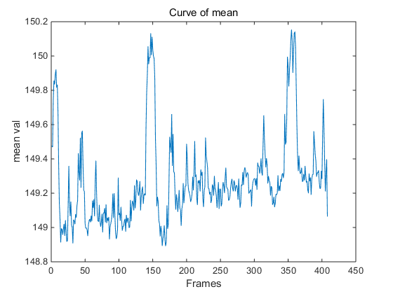
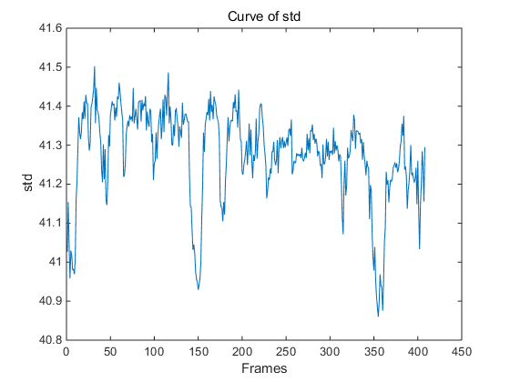
Experiment 4(colored blue)
Parameters: sample60loCutoff15hiCutoff25alpha15sigma10
Before amplifying | After amplifying | Cutting ROI_x000b_

Slide 6
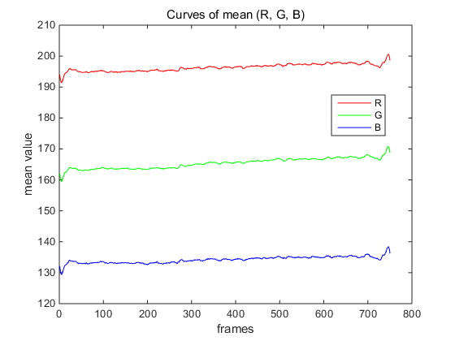
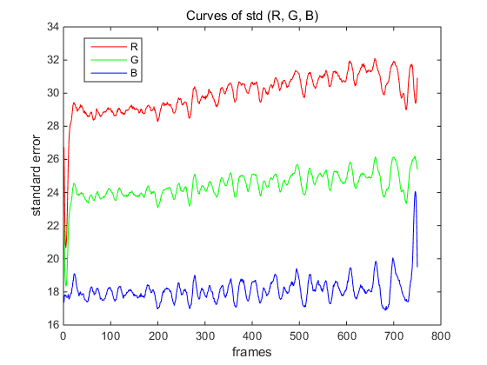
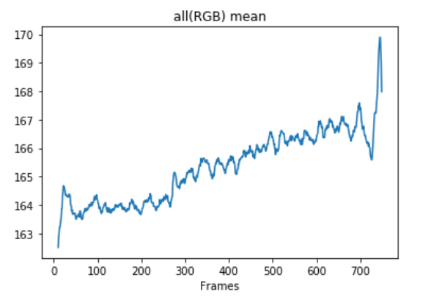
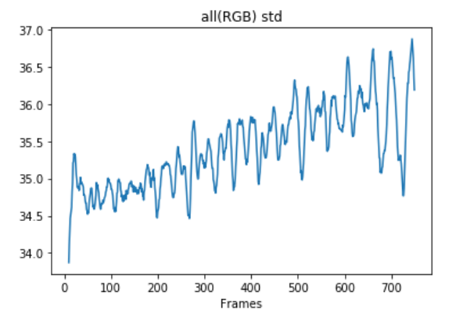
Experiment 5(colored blue25s)
Parameters: sample30loCutoff0.5hiCutoff2.5alpha10sigma3
Before amplifying | After amplifying | Cutting ROI_x000b_

Slide 7
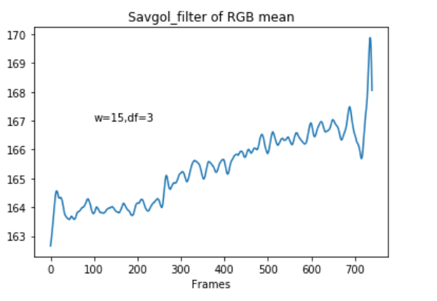
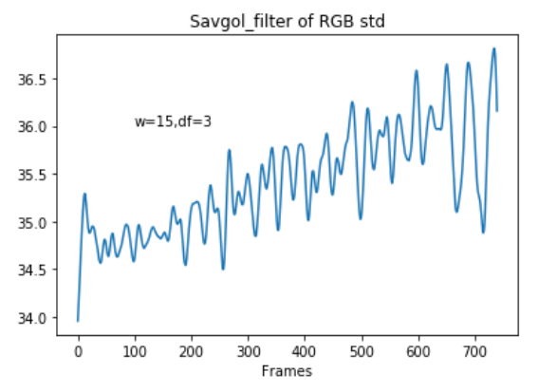
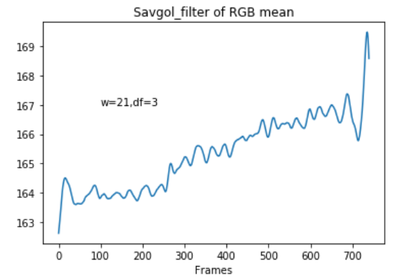
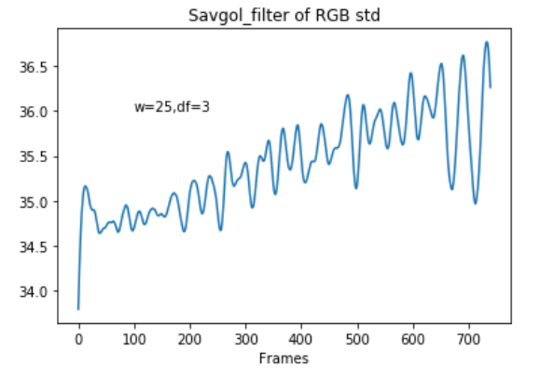
Savgol Filter RGB mean&std
(noise reduction; keeping shape and width)

Slide 8
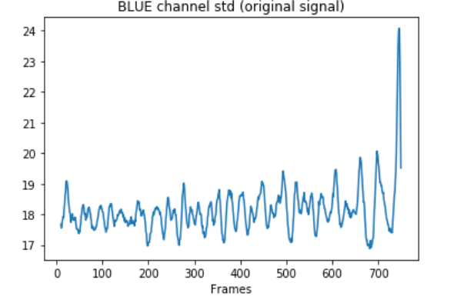
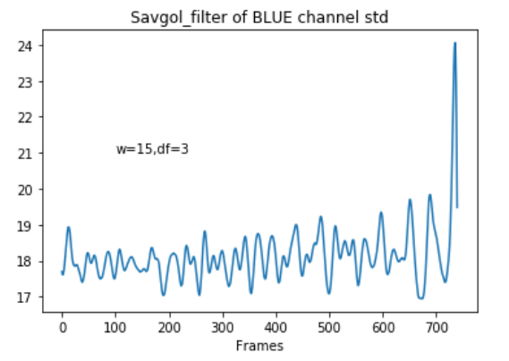
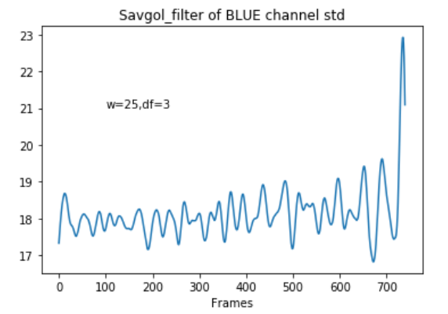
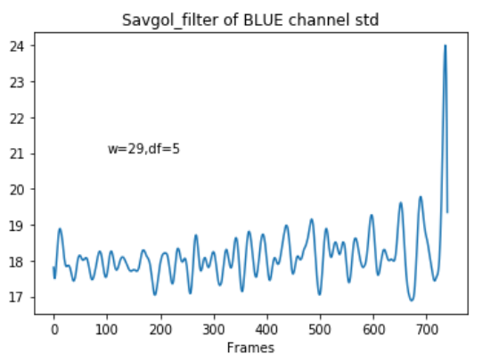
Savgol Filter BLUE mean&std
(noise reduction; keeping shape and width)

Slide 9
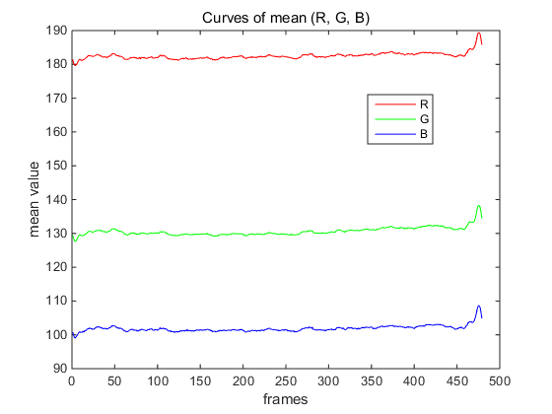
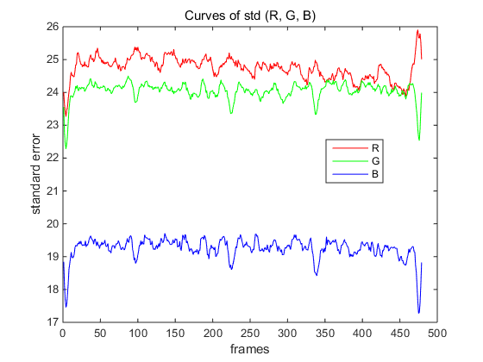
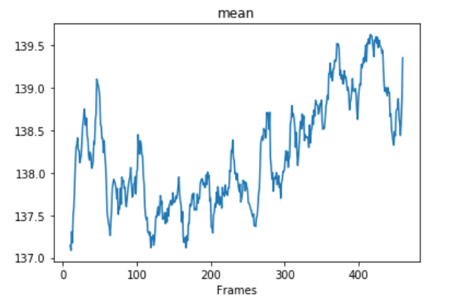
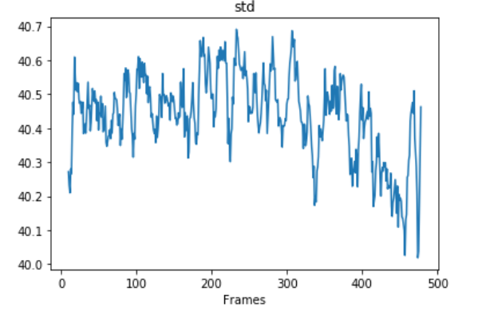
Experiment 6(colored Red)
Parameters: sample30loCutoff0.5hiCutoff3alpha10sigma3
Before amplifying | After amplifying | Cutting ROI_x000b_

Slide 10
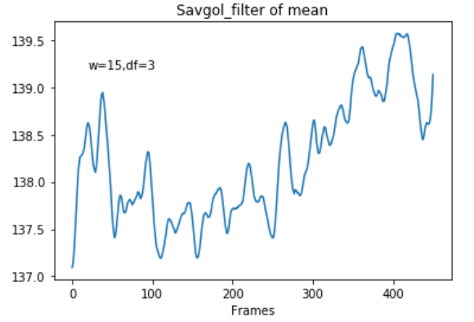
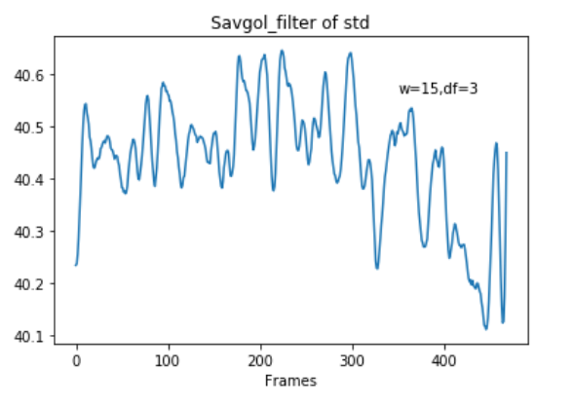
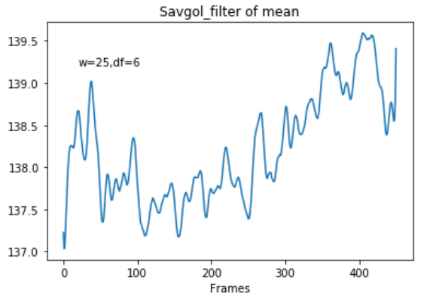
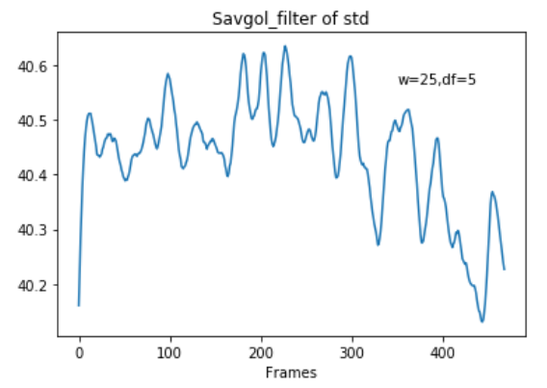
Savgol Filter RGB mean&std
(noise reduction; keeping shape and width)
para1
para2

Slide 11
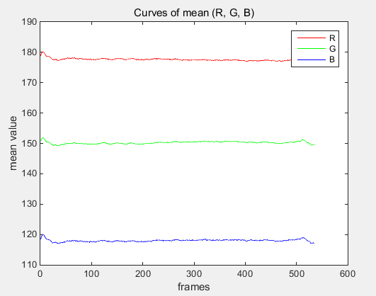
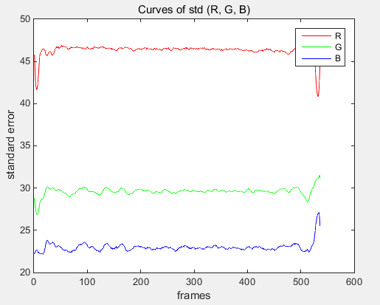
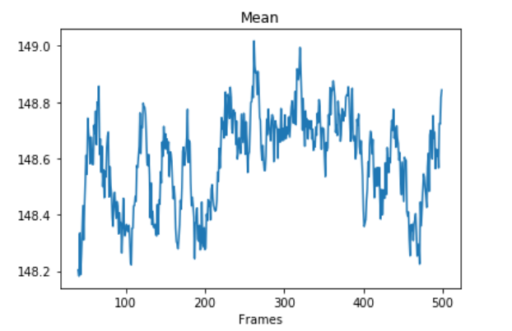
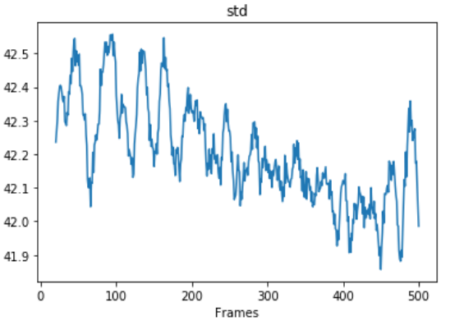
Experiment 7(colored Green)
Parameters: sample30loCutoff0.5hiCutoff2.5alpha15sigma5
Before amplifying | After amplifying | Cutting ROI_x000b_

Slide 12
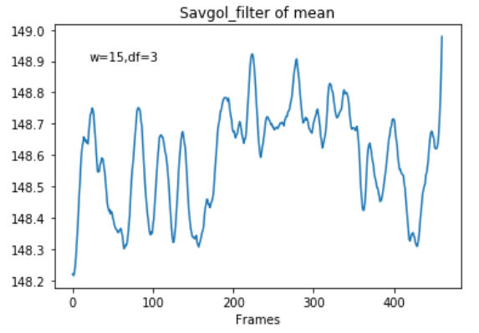
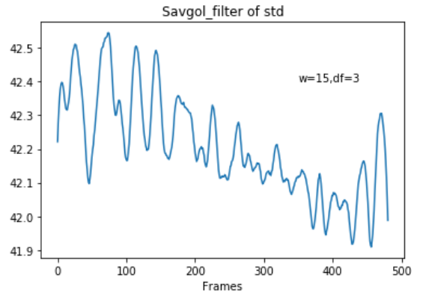
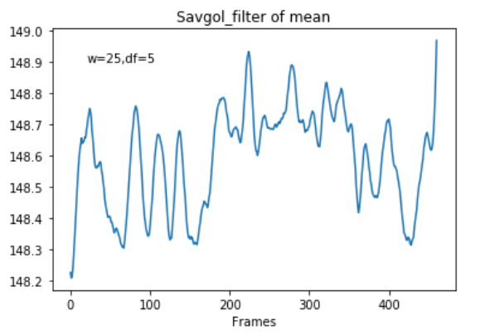
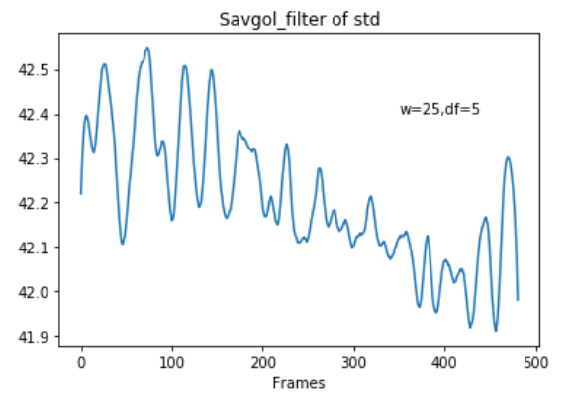
Savgol Filter RGB mean&std
(noise reduction; keeping shape and width)
para1
para2

Slide 13
To do list
Step0: Record the true heart rate;
Step1: Remove global motion by “phaseAmplifyLargeMotions”;
Step2: Cutting smaller size RIO;
Step2.1: ROI mean & std
Step2.2: Choosing a significant line in ROI and then Flattern;
Step3: FIR filter

Slide 14
Comparsion of “with large motion” and “without large motion”

Slide 15
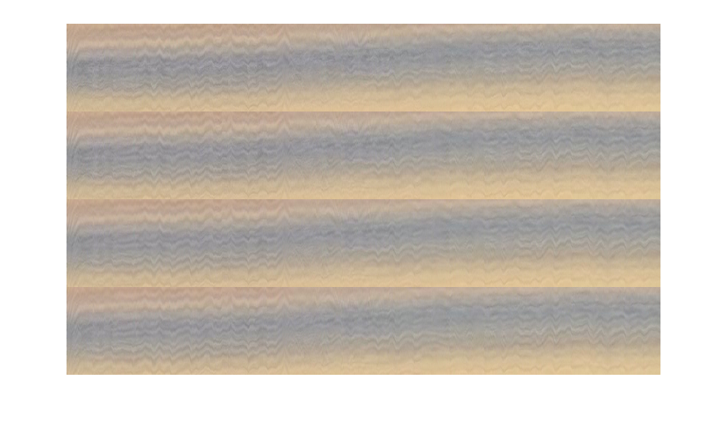
Experiment 8 (Blue with large motion)
Parameters: sample30loCutoff0.5hiCutoff2.5alpha15sigma5
Before amplifying | After amplifying | Cutting ROI

Slide 16
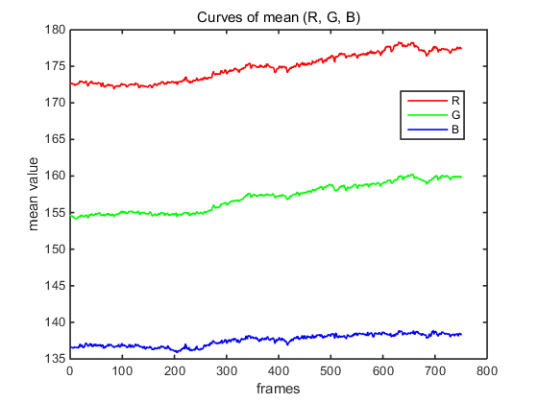
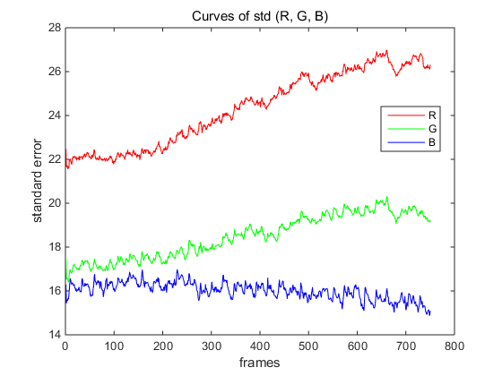
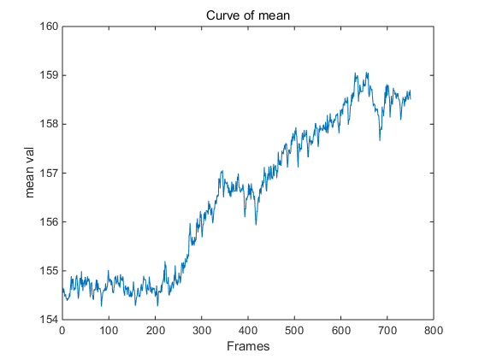
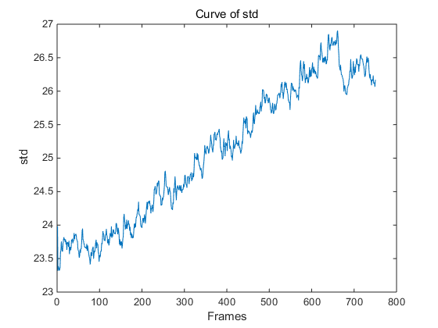

Slide 17
Experiment 8 (Blue with large motion)
Parameters: sample30loCutoff0.5hiCutoff2.5alpha15sigma5
Before amplifying | After amplifying | Cutting ROI

Slide 18





Slide 19

Experiment 9 (White without large motion)
Parameters: sample30loCutoff0.8hiCutoff1.8alpha50sigma5

Slide 20


Slide 21


Slide 22


Slide 23

Optical Flow

Slide 24



Slide 25


Slide 26


