Slide 1





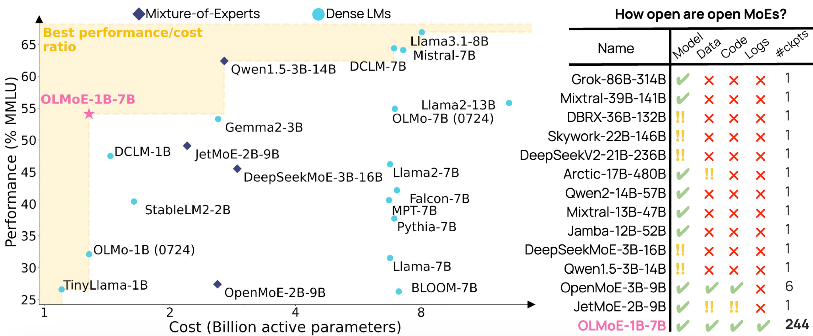
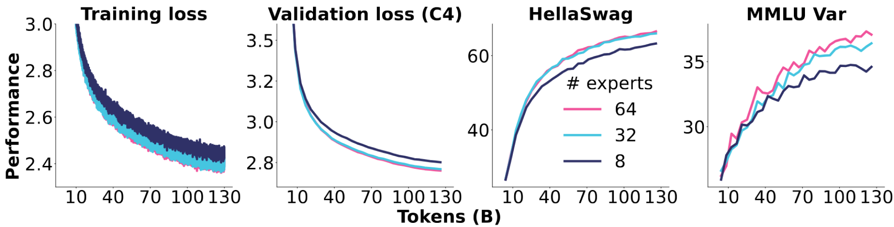
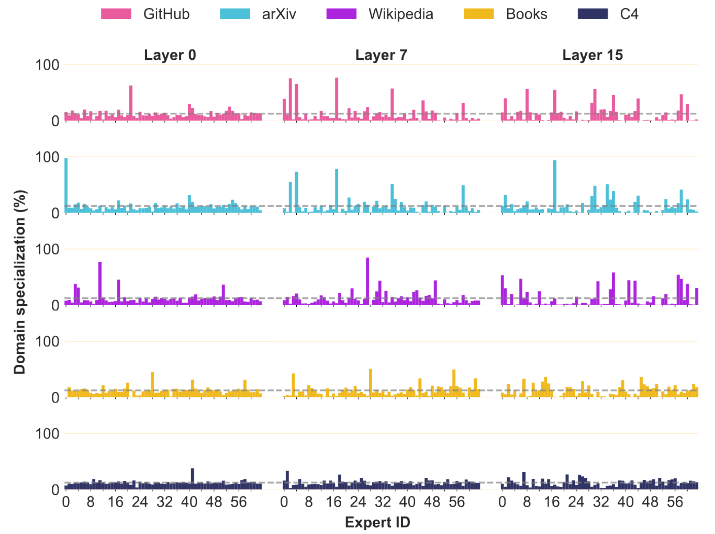
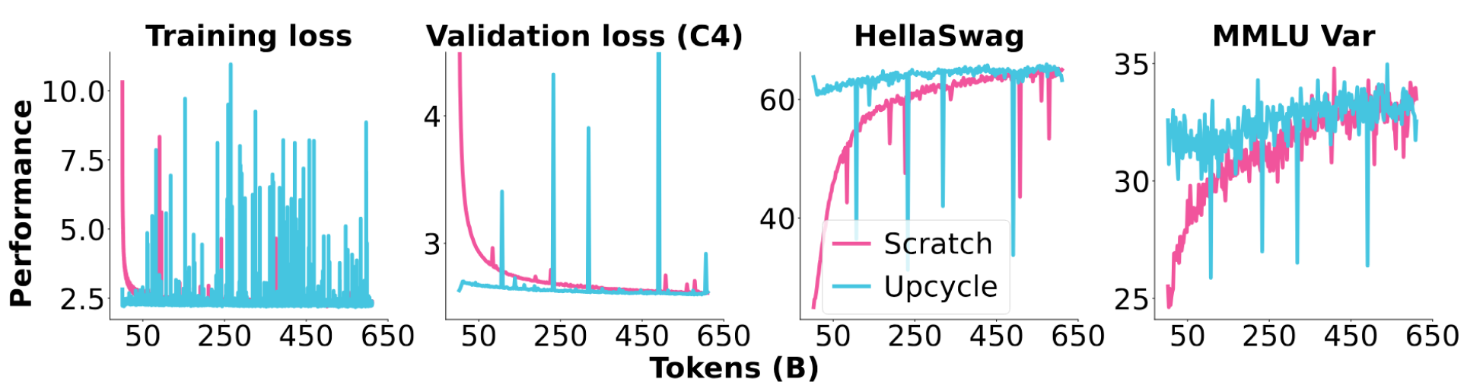
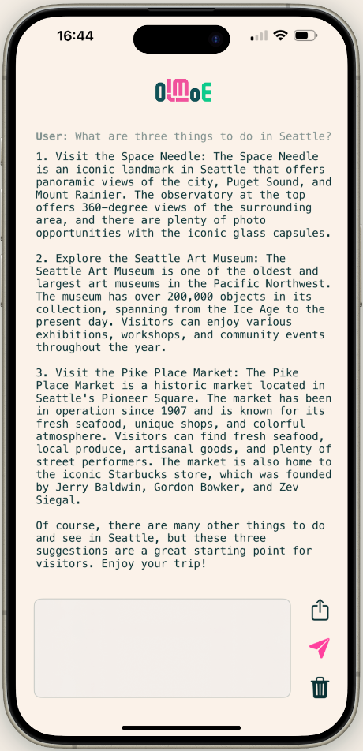
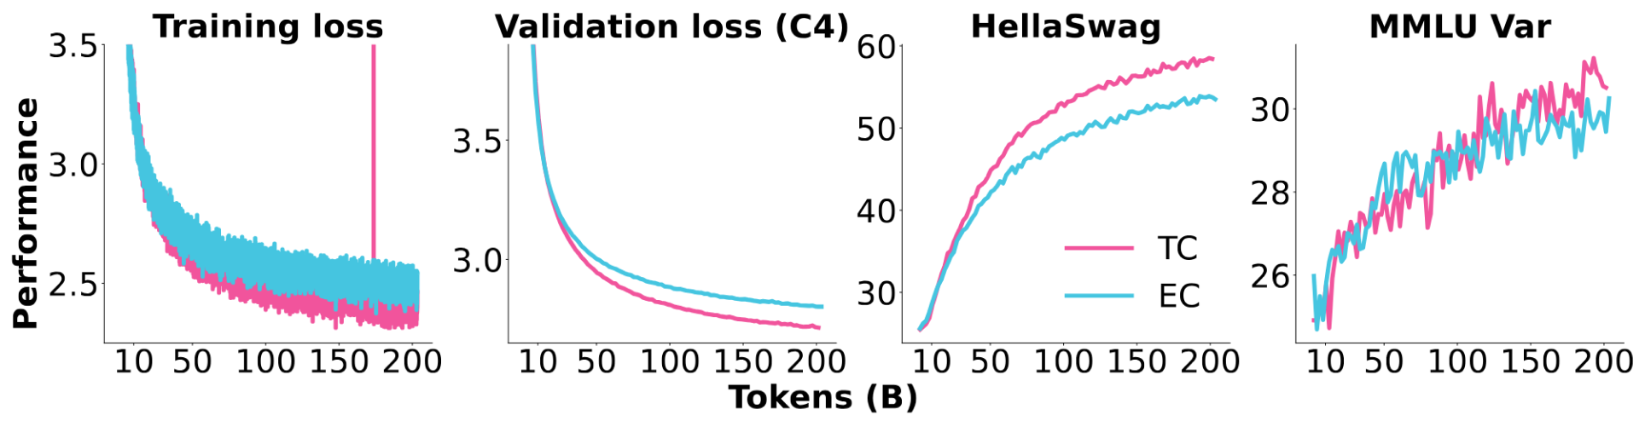
Open Mixture-of-Experts Language Models
Number of Experts?
Domain Specialization?
64
64
32
32
8
8
Sparse Upcycling?
Token Choice vs Expert Choice?
Scratch
Upcycled
Token
Expert
Niklas Muennighoff, Luca Soldaini, Dirk Groeneveld, Kyle Lo, Jacob Morrison, Sewon Min, Weijia Shi, Pete Walsh, Oyvind Tafjord, Nathan Lambert, Yuling Gu, Shane Arora, Akshita Bhagia, Dustin Schwenk, David Wadden, Alexander Wettig, Binyuan Hui, Tim Dettmers, Douwe Kiela, Ali Farhadi, Noah A. Smith, Pang Wei Koh, Amanpreet Singh, Hannaneh Hajishirzi
Runs locally 110 tokens per second on your iPhone! 👉

