Slide 1
EarthRanger 2025 slide template MAKE A COPY

Slide 2
Tips for successful presentations
Don’t add too much text. Aim for ~3 bullet points max.
Making multiple slides is more engaging for the audience. Multiple photos? Consider showing one full-size one on each slide.
Explain your point using your voice, rather than writing it in a slide
Use speaker notes to add details for yourself, rather than reading off slides
Use Manrope font for all text
Ensure that titles are the same placement, font, and size on each slide (not jumping up or down vertically)
Access templates in Google slides by clicking “Layout” in the toolbar above

Slide 3
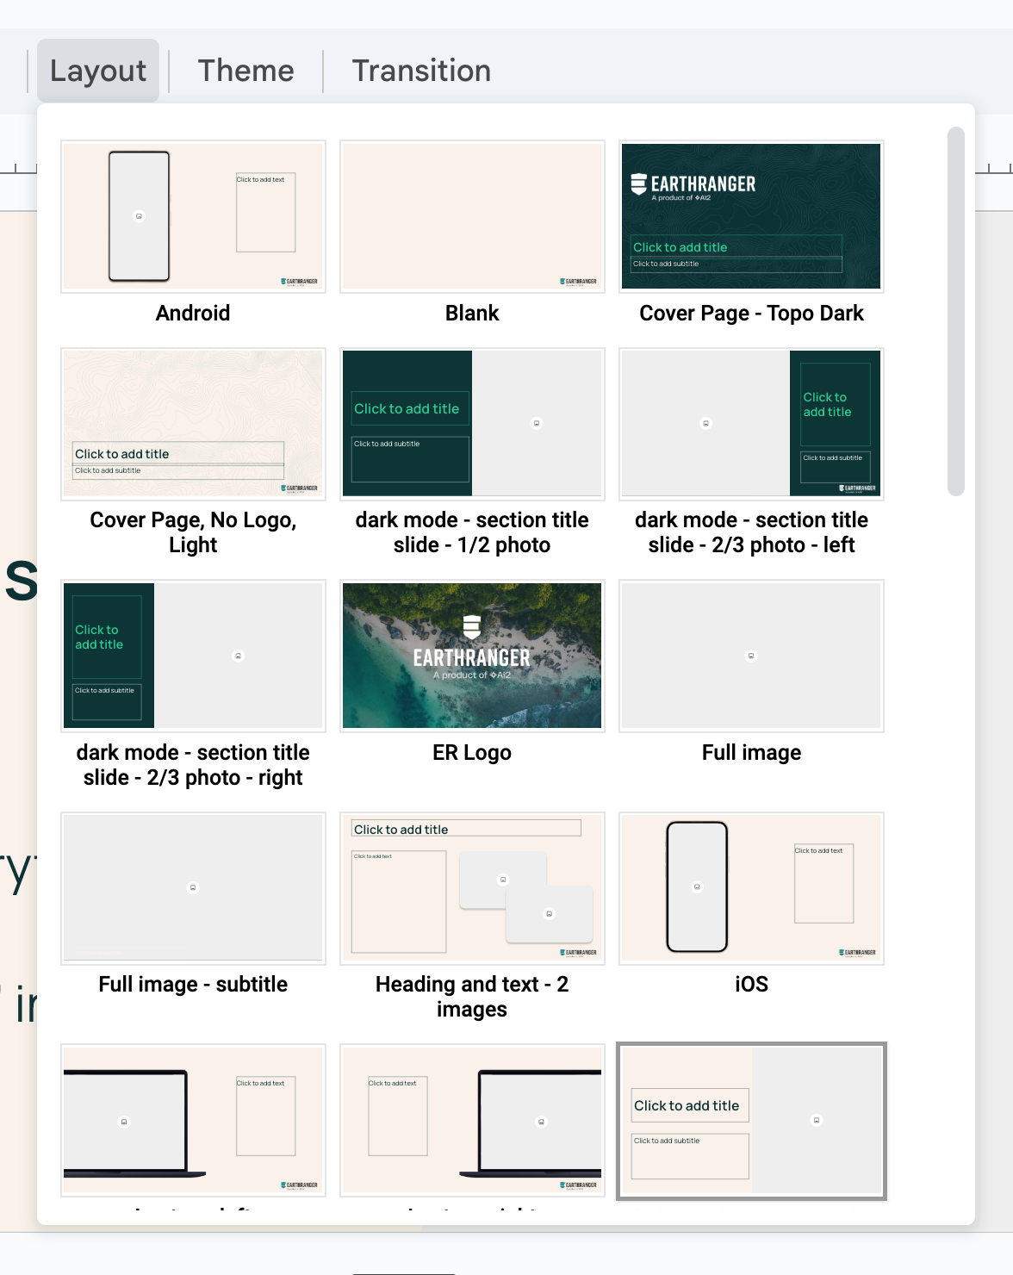
How to change the slide template
Deselect everything on the page
Click “Layout”
Select the template

Slide 4
To change the background
Deselect everything on the page
Click Background in the toolbar
Select a new image

Slide 5
How to apply this theme to an existing presentation
Open the presentation your existing presentation
Deselect everything on the page
Click “Theme” in the upper toolbar
Click “Import theme” in the bottom right
Search “2025 earthranger slide template”
Click on the matching result (this slide deck) and click “Insert”
Click the slide icon again and click “Import theme”
Most importantly, check each slide to make sure nothing has shifted badly. Adjust any slides that didn’t transition well

Slide 9
If you have fewer than 5 agenda items
See next slide for the agenda template
Delete the text boxes you don’t need
Draw a box that matches the color of the background over the divider lines you don’t need

Slide 29
Using mobile phone mockups
On iOS and Android layouts, the bezel and/or camera is overlaid as a separate layer on top of the image you will be placing into the image placeholder. Please don’t move them.
Simply replace the placeholder with your screenshot and leave the rest in place

Slide 30


Slide 31


Slide 39
Where can I find good icons?
Ai2 has an account for Noun Project.
You can find the login credentials in 1Password
If you don’t already have access to 1Password, please message #it in Slack and request to be added to the Shared Vault
Once you find your icon
In Noun Project, change the color to HEX #0A3235 for light slide layouts or #FAF2E9 for dark slide layouts
Export as .png and add image to your slide as normal

Slide 42
Tables
 | Column 1 | Column 2 | Column 3
Row 1 | Text
Row 2

Slide 43
When placing text over photography
Avoid photography with a busy background
Choose images with enough blank space that the text doesn’t overlap with the focus of the photo
See examples below

Slide 46


Slide 47
