Slide 1
Quadratic Assignment Problem (QAP)
Problem statement, state of the art, and my conjecture by Allen Brubaker

Slide 2
Topics
Introduction to QAP
2 Examples
Definition
Applications and Difficulty
Background
Algorithms – Exact, Approximate, Heuristics, Meta-Heuristics
Benchmarks (QAPLib), 4 problem types
State of the Art
Tabu Search (TS)
Genetic Algorithm (GA)
My Research
Guided Local Search (GLS) and Flaws
Proposed modifications
Contributions

Slide 3
Example 1 – Keyboard Layout
QWERTY designed to limit speed to mitigate jamming mechanical typewriters
Goal: Find a new layout to minimize total typing effort
Motivation – Increase productivity for all typists → more money → rich → retire early
Problem Components
Problem Size: n = # keys = # keyslots.
Assign n Keys (the item) to n Key Slots (the location).
Distance Matrix (D): Distance between every pair of key slots (Symmetrical)
Flow Matrix: (F) Amount of movement between every pair of keys. (How to calculate?)
A Solution (p): A permutation or one-to-one mapping between all keys to slots.
Solution quality: Objective function: solution → total cost or flow*distance
Problem Statement
n! permutations or solutions.
Find best solution that minimizes objective function.
Infeasible to evaluate every permutation for large values of n (>25).
Can find good solutions without iterating through every one?

Slide 4
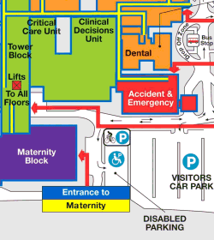
Example 2 – Hospital Layout
How to best assign facilities to rooms in a hospital?
Motivation: Decrease total movement of hospital faculty and patients → more patients attended to → more lives saved
Problem Components
Problem Size: n = # facilities = # rooms.
Assign n facilities (maternity, ER, Critical Care) to n rooms (the location).
Distance Matrix (D): Distance between every pair of rooms
Flow Matrix: (F) Amount of traffic between every pair of facilities, (flow of patients, doctors, etc.)
A Solution (p): A permutation or one-to-one mapping between all facilities to rooms.
Solution quality: Objective function: solution → total cost or flow*distance between all assigned pairs.
Problem Statement
n! permutations or solutions or floor plans (labels not structure changes!).
Find best solution that minimizes objective function.
Infeasible to evaluate every permutation for large values of n (>25).
Can find good solutions without iterating through every one?

Slide 5

Quadratic Assignment Problem (QAP)
Hospital and keyboard layout are examples of QAP.
Combinatorial Optimization Problem (CO): Enumerate a finite set of permutations in search of an optimal one.
Problem: Assign a set of $n$ facilities to another set of $n$ locations in an optimal manner.
Problem Inputs: n x n Distance and Flow matrices to define flows between facilities and distances between locations.
Solution: Single permutation or one-to-one mapping a facility to a location.
1957 Koopmans-Beckmann QAP Formulation
Given two matrices $F=\left[f_{ij}\right]$ and $D=\left[d_{ij}\right]$, find the following permutation $π^{∗}∈Π^{n}$
$$π^{∗}=\underset{π∈ Π^{n}}{argmin}\left\{ \sum_{i=1}^{n}{\sum_{j=1}^{n}{d_{ij}∗f_{π_{i}π_{j}} }}\right\}$$

Slide 6
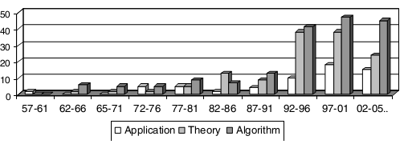
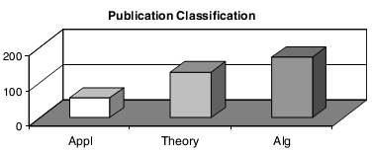
Publication Trends
Distribution of QAP publications since 1957 with respect to three categories: applications, theory (formulations, complexity studies, and lower bounding techniques), and algorithms, which theory naturally points. [1]
Distribution of articles by 5-year periods since 1957 by category. Explosion of interest in theory and alg. developments since 1992. [1]
Trend: Small interest until mid-70s. Emergence of meta-heuristics in 1980s coupled with QAP consideration as classical challenge (benchmark) and complexity attracted more attention. Finally, 1990’s evolution in computing technology, more ram, parallel and meta computing promoted better solutions and exactly solving larger problems (n≈30) [1].

Slide 7
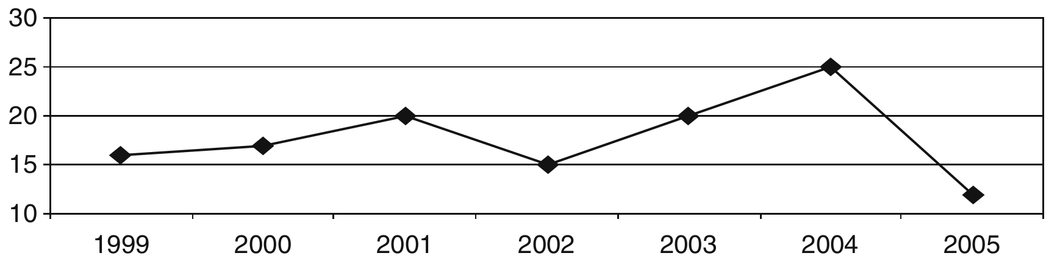
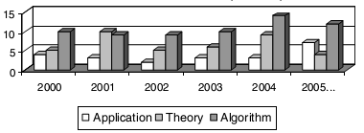
Recent Publication Trends
Steady increase of QAP publications in recent years. [1]
Interest in algorithms remains very strong, theoretical developments are cyclical, while applications gathers moderate interest. [1]

Slide 8
Applications in Multiple Sciences
Authors | Subject [1] | Publication Years
Koopmans & Beckmann | Proposed QAP as mathematical model | 1957
Steinberg | Minimize the number of connections in a backboard wiring with QAP | 1961
Heffley | Applied QAP to economic problems | 1972
White & Francis | Assigning new facilities (police posts, supermarkets, schools) to serve clients | 1974
Geoffrion & Graves | Scheduling problems | 1976
Krarup & Pruzan | Applied QAP to archeology | 1978
Hubert | Applied QAP in statistical analysis | 1987
Forsberg | Used QAP in the analysis of reaction chemistry | 1994
Brusco & Stahl | In numerical analysis | 2000
Wess & Zeitlhofer | The problem of memory layout optimization in signal processors | 2004
Ben-David & Malah | Error control in communications | 2005

Slide 9
Applications in Location Problem
“Nevertheless, the facilities layout problem is the most popular application for the QAP” [1]
Authors | Subject [1] | Publication Years
Hopkins & Dickney | Assignment of buildings in a university campus | 1972
Pollatschek | Design of typewriter keyboards and control panels | 1976
Elshafei | In hospital planning | 1977
Bos | Forest management | 1993
Beenjaafar | In facilities layout for minimizing work-in-process (WIP) | 2002
Miranda | Placement of electronic components | 2005

Slide 10

Complexity
Proven NP-Complete – No exact polynomial-time algorithm exists unless P=NP. Thus, QAP is exactly solvable in exponential-time.
Sahni and Gonzales (1976) proved that even finding an $ε$-approximation algorithm is also NP-complete.
The largest, non-trivial instances solved to optimality today is of size n=30! . It remains intractable (infeasible in adequate time) for problems larger than this.
QAP is considered the “hardest of the hard” of all combinatorial optimization problems [3,8] due to abysmal performance of exact algorithms on all but the smallest instance sizes.
Many famous combinatorial optimization problems are special cases of QAP: Traveling salesman (TSP), max-clique, bin-packing, graph partitioning, band-width reduction problems.
A brute-force enumeration approach is a bad idea: n =10! = 3,628,800 solutions n= 20! = 2,432,902,008,176,640,000 solutions n = 30! = 265,252,859,812,191,058,636,308,480,000,000 solutions where each evaluation of a solution is calculated in $O(n^{2})$

Slide 11
Introduction Summary
Quadratic Assignment Problem (QAP) is a combinatorial optimization problem of finding the optimal assignment of facilities to locations given flow and distance matrices by minimizing the sum of the products of assigned distances/flows.
Popular problem in theory, application, and algorithm development
Excellent classical challenge/benchmark for algorithms especially meta-heuristics
Applicable to various sciences including archeology, chemistry, communications, economics especially in location problem including hospital planning, forest management, circuit layout
Excessively complex np-complete problem due to poor performance of exact algorithms.
Many combinatorial optimization problems can be reformulated as QAP.

Slide 12
Algorithmic Developments
Solution/Fitness Landscape
Algorithms
Exact
Heuristics
Meta-Heuristics
Benchmarks
QAP-Lib
4 Types of instances
Fitness-distance correlation
Room for meta-heuristic research improvement

Slide 13

Solution/Fitness Landscape
Performance of algorithms depend strongly on shape of underlying search space [3].
Mountainous region with hills, craters, and valleys.
Performance strongly depends on ruggedness of landscape, distribution of valleys, craters, and local minima in search space, number of local minima (low points)
Defined by [3]
Set of all possible solutions S
Objective function assigning $s∈S$ fitness value f(s).
Distance measure d(s,s’) giving distance between solutions s, s’
Fitness landscape determines the shape of the search space as encountered by a local search algorithm.

Slide 14
Exact Algorithms
Algorithms for QAP can be divided into 3 main categories: Exact, Heuristics, and Meta-heuristics.
Exact algorithms guarantee output of a global optimal solution with the tradeoff of exorbitant runtime inefficiency.
These consist of branch-and-bound procedures, dynamic programming, and cutting plane techniques, or a combination of the two.
Branch-and-bound are the most pervasive.
Employ implicit enumeration and avoid total enumeration of feasible solutions by means of lower-bound calculation that allow branches of the solution space to be confidently ignored.
Exact algorithm performance depends on quality and speed of lower bounds calculations. (Best lower bounds are closer to the actual optimal)
Different lower bounds: Gilmore-Lawler, semi-definite programming, reformulation-linearization, lift-and-project techniques.
In recent years, implementing branch-and-bound techniques in parallel computing has been used for better and faster results. Success however pivotally depends on hardware technological improvements.

Slide 15

Heuristics
In-exhaustively samples the solution space only .
Heuristics give no guarantee of producing a certain solution, whether optimal or within a constant 1+$ε$ of optimality.
Much faster than exact approaches.
Generally may produce good quality solutions most of the time
Good heuristics produce pseudo-optimal values within seconds for n<=30 and good results in minutes for n<=100 of QAP.
Pseudo-optimal: an assumedly yet unproven optimal solution produced by many heuristics for a given problem instance [3].
3 Subdivisions [1]
Constructive
Partially Enumerative
Improvement

Slide 16

Constructive Heuristics
Explores solution space by constructing new solutions rather than enumerating existing ones.
Example
Given two empty sets: A, B, heuristic H, and $a,b∈\{1..n\}$
Repeat until termination criteria met
Repeat until $\left|A\right|, \left|B\right|,|π|=n$
Using H, find $a∉A, b∉B | π_{a}=b$
$A=A∪\left\{a\right\}, B=B∪\{b\}$
Generally good at exploring solution space however unable to produce finely tuned results well (exploitation).
Performs much better when uses an improvement heuristic (local search algorithm) to refine or finely tune crudely constructed solutions.

Slide 17
Limited Enumerative Heuristics
Exact enumerative algorithm bounded by constraints.
Methodically enumerates permutations within certain bounds and subject to methods used to guide the enumeration to favorable areas.
Can only guarantee optimality if allowed to complete full enumerative process.
To be considered feasible, it must be bounded
Limit iterations, execution time, or quality of successive solutions
If no improvement for some iterations, decrease upper bound to result in larger jumps in the search tree [7]
Performance depends on
Process used for enumerating
Quality of information gleaned to guide enumeration trajectory
Termination criteria used

Slide 18

Improvement Heuristics
Most common heuristic method for QAP [1]
Also known as local search algorithms
Construct $π$ (permutation of size n)
Repeat until no improvement is found (Local Optimum)
Find best solution in local neighborhood of solutions induced by swapping all pairs (or triplets, etc.) of elements of current solution.
Swap to produce next solution
Local Neighborhood: 2-Exchange, 3-Exchange, …, → slower, better
N-Exchange $≡$ enumerative exact algorithm
Selection Criterion: First-exchange (fast, non-optimal), Best-exchange (slow, optimal)
Example: Best 2-Exchange Local Neighborhood
$\frac{n∗\left(n−1\right)}{2}$swaps or solutions to evaluate using objective function
Downside: Stuck at the first local optimum
Strategies: Restart on new solution, perturb local optimum, temporarily allow worsening solution swaps.

Slide 19
Meta-Heuristics
Emerged early 1990’s as heuristics applicable to general CO problems.
Considered a heuristic, hence can be constructive or improvement.
Best performing heuristics, more complex
General problem-agnostic frameworks utilizing simpler heuristic concepts such as local improvement techniques along with various schemes to sample favorable locations in solution landscape.
How?
Constuctive: Utilize adaptive memories (pheromones, pool of solutions, recency matrix), perturbation
Improvement: forbid recent swaps, modify solution landscape, vary local neighborhood size
Balancing exploration/diversification vs exploitation/intensification

Slide 20
QAP Metaheuristic Applications
Subdivided into 2 main categories: natural process metaphors, theoretical/experimental considerations
Nature-based QAP Metaheuristics
Inspired from natural processes such as ant foraging behavior (ACO), evolution/natural selection (GA), metallurgical annealing (SA)
Simulated annealing (SA) [9–12], evolution strategies [13], genetic algorithms (GA) [14–17], scatter search (ScS) [18], ant colony optimization (ACO) [5], [19], [20], and neural networks (NN) and markov chains
Theory/Experiment-Based QAP Metaheuristics
Tabu search (TS) [4], [6], [21–25], greedy randomized adaptive search procedure (GRASP) [26], variable neighborhood search (VNS) [16], [20], guided local search [27], [28], iterated local search (ILS), and hybrid heuristics (HA) [29–31]
Hybrids are generally more successful: SA+GA, SA+TS, NN+TS, GA+TS
“GA hybrids all proved more promising than pure GA alone” [1].
Improved by parallelization/distribution.
Simulated Annealing, Ant Colony Optimization, Variable Neighborhood Search

Slide 21
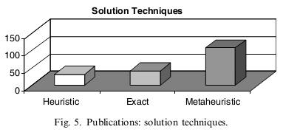
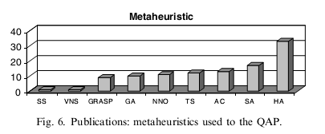
Algorithm Publications to 2005 [1]

Slide 22
Constructive Meta-heuristics
Can be grouped/unified under the term Adaptive Memory Programming (AMP). [16]
1. Initialize the memory
2. Repeat, until a stop criterion is satisfied
a. Construct a new provisory solution, using the information contained in the memory.
b. Improve the provisory solution with a local search (LS).
c. Update the memory.
Examples: Ant Colony Optimization, Genetic Algorithm, GRASP, Scatter Search
Only works on problems with an inherent structure to exploit/learn from.

Slide 23
Algorithm Summary
3 Types of QAP Algorithms
Exact Algorithms: guarantee global optimum, very slow, n<=30, may use lower-bounds to excise branches and expedite enumeration
Heuristics: Estimate, cannot guarantee optimum, fast, n>30
Constructive: Construct permutations at each iteration
Limited Enumerative: Exhaustive enumeration subject to constraints
Improvement: Start with a solution and iteratively improve by favorable swaps based on a local neighborhood and selection criteria.
Meta-heuristics: Complex heuristics with methods to sample search space.
Nature Based: Genetic Algorithm, Simulated Annealing, Ant Colony
Theory Based: Tabu Search, Iterated Local Search, Hybrids

Slide 24
Benchmark – QAPLIB
QAPLIB – Centralized benchmarking source for QAP across literature
Originated 2002, updated regularly, maintained at University of Pennsylvania School by Peter Hahn.
Contains valuable resources: problem statement, comparison of lower bounds, surveys and dissertations of QAP, various algorithm code (RoTS, SA, FANT, Bounds), prominent researchers of QAP, references, and benchmarks.
Benchmark Resources: 134 problem instances of size n=12-256, 15 different instances (Bur, Chr, Els, Esc, Had, Kra, Lipa, Nug, Rou, Scr, Ste, Tai, Tho, Wil), 4 different main types, each problem consists of flow and distance matrices, 32 problems not exactly solved yet (heuristics used)
Each Problem:
For small solvable n: optimal permutation, corresponding exact algorithm
For larger n: best-known solution quality, corresponding meta-heuristic, tightest lower bound algorithm, lower bound, relative percent of best known above lower bound.

Slide 25

Instance Types – Type I
4 Main QAP Instance Types found at QAPLIB.
Methodology and efficiency of algorithms largely depends on the type of problem being solved.
Type I – Unstructured, randomly generated Instances
Tai-a (n=5-100), Rou (n=10-20)
Hardest in practice to solve
Uniform random generation of distance, flow matrices, $rand∈[0..99]$
Easy to find good solutions (1-2%) but hard to find best because difference between local optima is small [34]: $\lim_{n→∞}\left(f(π^{∗}\right)−f(π ̃))=0$
Best handled by improvement (iterative) approaches and not constructive because no inherent structure to adapt to.
Pseudo-optimal values found for n<=35; hazardous to consider optimum of larger sizes have been found [34]

Slide 26

Instance Type II, IV
Type II – Non-uniform, Random Flows on Grids [34]
Rectangular tiling/grid constituted of $n_{1} x n_{2}$ squares of unit size.
Location is a square, distance is Manhattan distance between squares $d\left(x,y\right)=\left|x_{1}−y_{1}\right|+|x_{2}−y_{2}|$.
Flows randomly non-uniformly generated (some structure)
Symmetrical, Multiple global optimal solutions
Nug, Sko, Wil
Type IV – Structured, larger real-life-like Instances
Tai-b – Created by Taillard to combat small size of real-life problems.
Modeled to resemble distribution of real-life problems with non-uniform random generation process based on quadrants in a circle, Euclidean distances, and non-uniform generation of flows.
Tai-b sizes span from n=12-150

Slide 27
Instance Type III
Instance Type III – Structured, Real-life instances
Sparse: Flow matrices have many zero entries
Structured: Entries in flow matrix are clearly not uniformly distributed and can be found by examining local optima [34]
Easier: Smaller sizes coupled with adaptable structure
Solved: Solved either optimally (Els), or pseudo-optimally (Ste, Bur)
Steinberg’s Problem, Ste (1961) – backboard wiring problem, Manhattan and Euclidian distances, n=36, flows are number of connections between backboard componants.
Elshafei’s Problem, Els (1977) – hospital placement, minimize total daily user travel distance, Euclidian distance, differing floor penalties, n=19
Burkard and Offermann’s Problems, Bur (1977) – Best Typewriter Keyboard for various languages, flow is frequency of appearance of two letters in given language, key slot distance, n=26
Taillard’s Density of Grey, Tai-c (1994) – Density of grey (minimize sum of intensities of electrical repulsion forces), remains unsolved, n=256

Slide 28
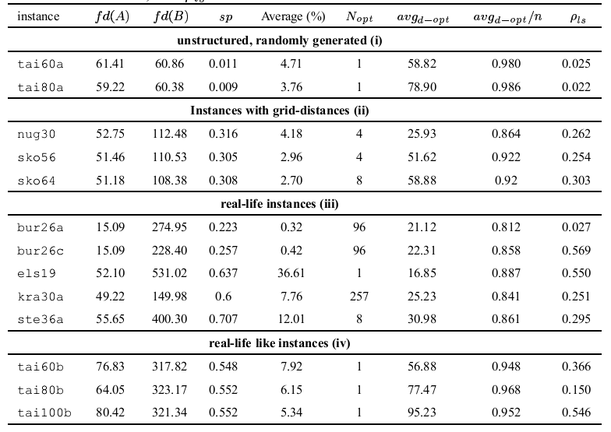

Fitness-Distance Correlation Analysis (FDC) [5]
5000 local optima distance to best-known solution.
Flow/Distance Dominance = (100*standard deviation/mean), high flow (distance) dominance indicates that a large part of overall flow (distance) is dominated by few items. (Relative Standard Dev.)
Distance(local,best) = Number of locations with different facilities
P = correlation coefficient, measure of how well correlated a set of data is (how well data fits a linear regression versus the mean), measure of structuredness.
$Avg_{d−opt}$ = Average distance to best known solution. Measures spread of good solutions over landscape.
High structure/correlation → Optimal solutions well determine the preferred locations of items. The more locations for items a solution has in common with an optimal solution, the better the solution is.
Type I vs Type II,III,IV: no structure, dense, local optima well dispersed → harder.

Slide 29
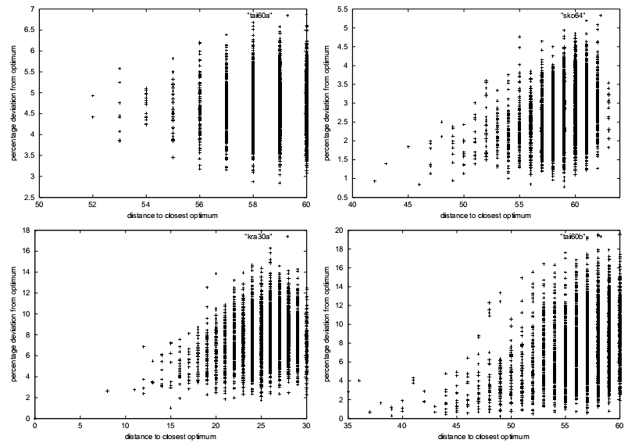
Fitness-Distance Correlation Analysis (FDC) [5]
X-Axis: Distance to closest optimum
Y-Axis: Solution quality (smaller is better)
Upper-Left → Bottom-Right: Type I, II, III, IV
Type I vs Type II,III,IV: nearly no correlation (no structure to exploit), good solutions are spread out much more → Harder

Slide 30
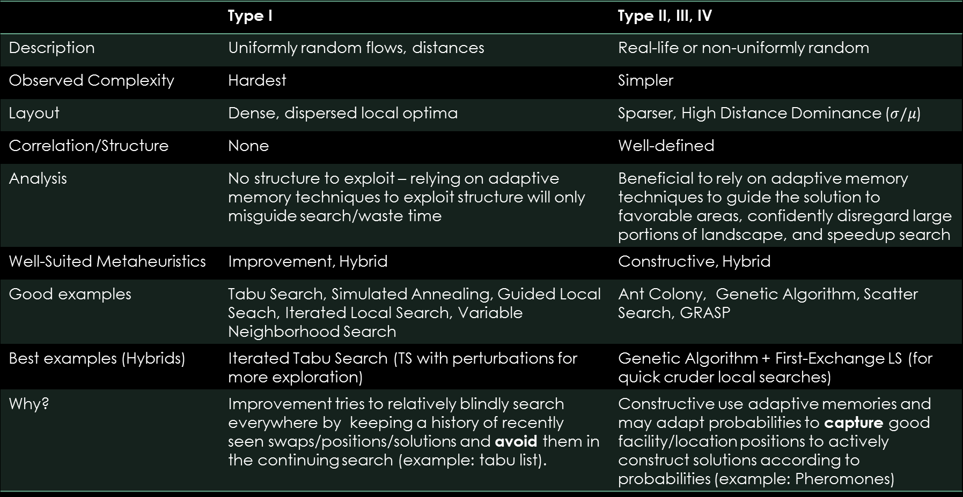
Summary
 | Type I | Type II, III, IV
Description | Uniformly random flows, distances | Real-life or non-uniformly random
Observed Complexity | Hardest | Simpler
Layout | Dense, dispersed local optima | Sparser, High Distance Dominance ($σ/μ$)
Correlation/Structure | None | Well-defined
Analysis | No structure to exploit – relying on adaptive memory techniques to exploit structure will only misguide search/waste time | Beneficial to rely on adaptive memory techniques to guide the solution to favorable areas, confidently disregard large portions of landscape, and speedup search
Well-Suited Metaheuristics | Improvement, Hybrid | Constructive, Hybrid
Good examples | Tabu Search, Simulated Annealing, Guided Local Seach, Iterated Local Search, Variable Neighborhood Search | Ant Colony, Genetic Algorithm, Scatter Search, GRASP
Best examples (Hybrids) | Iterated Tabu Search (TS with perturbations for more exploration) | Genetic Algorithm + First-Exchange LS (for quick cruder local searches)
Why? | Improvement tries to relatively blindly search everywhere by keeping a history of recently seen swaps/positions/solutions and avoid them in the continuing search (example: tabu list). | Constructive use adaptive memories and may adapt probabilities to capture good facility/location positions to actively construct solutions according to probabilities (example: Pheromones)

Slide 31
State of the Art
Tabu Search (TS)
Description
Robust Tabu Search (RoTS)
Iterated Tabu Search (ITS) (Best for Type I)
Genetic Algorithm (GA)
Description
GA + RoTS (Best for Type II)
GA + Fast Local Descent (Best for Type IV)
My Approach: Modification of Guided Local Search (GLS)

Slide 32
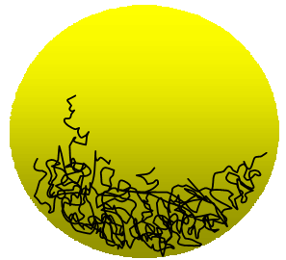

Tabu Search
Improvement Meta-heuristic stemming from theoretical considerations (not nature based)
Well-fit for Type I instances (uniformly random distances, flows)
Process
Start with initial solution
Record swaps and forbid them for $O\left(1\right)$ or $O(n)$ iterations.
At each iteration find and take the single best move in current local neighborhood that is not forbidden or satisfies some aspiration criteria such as improving the best-known solution seen thus far.
Features
Traverse past local optima: accepts best of non-forbidden solutions.
Limited Exploration: Recording swaps and limiting the local neighborhood to non-recently visited swaps/solutions
Weakness [6]
Perhaps too exploitive/intensive/exhaustive, without enough exploration/diversification
Succumbs to larger cycling (repeated sequences in search configurations)
Weak in escaping basins of attractions (big sinkholes).
Confined search trajectory (chaos attractors)

Slide 33

Robust Tabu Search (RoTS)
Tabu list $T=[t_{ij}]$recorded in a matrix instead of list for $O(1)$ lookups.
Each entry $t$records the iteration number that $π_{i}=j$ is strictly forbidden
Dynamic Tabu length $μ∈(.9n,1.1n)$ (changed every iteration)
2 Aspiration Criterion
Global Best - Ignore forbidden status if it results in a best-seen solution
Iteration Constrained – Force a swap if not used in past static $t∈(2n^{2},5n^{2}$) iterations (chosen a-priori)
Observations
Simple: Implemented in a page of code
Useful: Prevalent in many state of the art hybrids as the local search used (short runs of $5n$ common), ACO+RoTS, GA+RoTS, ILS+RoTS=ITS
Accurate: Finds pseudo-optimal solutions for most small and medium-sized problems of up to n=64
More Exploratory: Use of iteration constrained aspiration criterion, escape basins of attractions, mitigate cycling
Results: Best-known values for Tai80b, Tai100b, Sko72, Sko90 (Types II, IV)

Slide 34

Iterated Tabu Search (ITS)
Short runs of modified RoTS’
RoTS’ of length $n^{2}$ on Type I and $n$ on Type II, III, IV
RoTS’ modified to halve tabu matrix on global best, periodic steepest descent, randomly ignoring tabu status, cycling tabu length instead of randomizing.
Increasingly perturb or mutate in between each RoTS run using pair-wise swaps.
Small perturbation: $φ=2≤n:$swap (2,3) → (3, 7).
Large perturbation: $φ=7≤n$: swap (5,1),(1,3),(3,8),(8,7),(7,12),(12,6),(6,4)
$μ$ cycles between ${[μ}_{min},μ_{max}$],$μ←μ_{max}←μ_{min}$ on new global best found
Observations
Vastly more exploratory: Smart perturbing samples more areas of the search space
Combats chaos attractors: Escapes basins of attractions and chaos attractors well
Results: Outperforms (speed, solution quality) other tabu searches, best-known solutions on tai50a, tai80a, and tai100a (hardest Type I)
It seems an improvement algorithm able to handle large Type I instances is able to excel on all other types if more exploration and less intensification is done, perhaps through parameter changes. The reverse is not true for constructive algorithms.

Slide 35

Genetic Algorithm
Constructive Meta-heuristic inspired from natural selection, evolution, survival of the fittest.
($μ$+$λ$)-GA
Seed pool of $μ$ solutions (using other algorithms or randomly)
Select $λ$ pairs of parents according to their relative fitness
Crossover each pair to create $λ$ offspring.
(Optional: Apply local search), Mutate offspring $λ′$ and add back to pool: $μ+λ^{′}$
Cull poor solutions: $μ$+$λ^{′}$→$μ$
Repeat until termination criterion met
Features
Culling should encourage niching and diversification (not just remove worst)
Population contains increasingly best local optima (hopefully diverse also)
Good features of parents are preserved if the offspring survives until the next generation.
Adaptive Memory: Memory in the form of a pool of good solutions.
Weak Exploitation: Crossover exploits favorable features in parents (hops around local optima)
Exploration: Mutation creates random diversity in the population.
Weakness
Lacks local exploitation: Crossover is a weak exploitation/weak exploration → offset by using local optimization (LS)
Slow: To be viable it needs a large pool, but running time is very high [16]
Accurate/Reliable on structured instances: Will find and exploit the structure of instances if there is one. [16]
Poor on unstructured instances: The essence of GA operates on the notion that good solutions lead to the best solution.

Slide 36

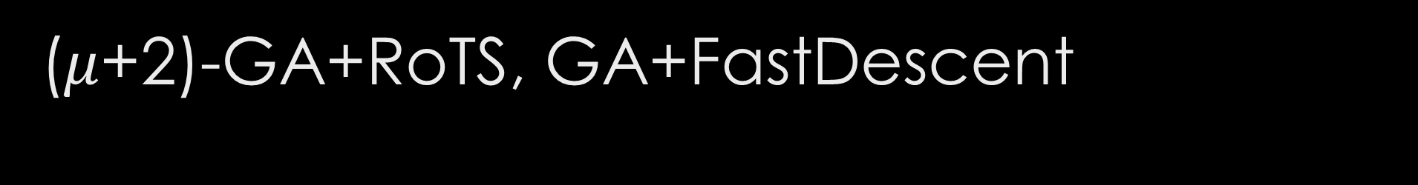
($μ$+2)-GA+RoTS, GA+FastDescent
Pure genetic approach (without local search) performs very badly [14].
GA+RoTS: Short $4n$ runs of RoTS as local optimization procedure.
GA+FastDescent: 2 runs of a FastDescent local search
FastDescent: Iterate through $\left({n \atop 2}\right)$ indices and swap every time improvement occurs.
Initial population: seeded with local optima (from $RoTS_{4n}$)
Population size: $μ$ = min(100,2$n$), $λ=2$
Parent Selection: Skewed probability of selecting $k^{th}$worst: $\frac{2k (μ−1)}{μ}$
Crossover: Special crossover designed for permutations [16]
Culling: Removes $λ$ worst solutions Mutation: None
Observations
Both excel at hardest of the structured instances: Types II, III, IV.
GA+RoTS: beats RoTS at 6 largest Sko100, Wil100 (Type II) instances finding new best-known values.
GA+FastDescent: beats RoTS at largest tai150b (Type IV) instance finding new best-known value.
Both perform poorly on the unstructured Type I instance. Perhaps longer RoTS runs of length $O\left(n^{2}\right)$ should be explored.
P1 | 3 | 1 | 2 | 7 | 4 | 6 | 5
P2 | 2 | 1 | 4 | 3 | 6 | 7 | 5
 |  | 1 |  |  |  |  | 5
 | 3 | 1 | 4 | 7 | 6 |  | 5
C | 3 | 1 | 4 | 7 | 6 | 2 | 5

Slide 37
Guided Local Search (GLS)
Improvement Meta-heuristic. Also known as Dynamic Local Search
Traverses past local optima by operating on a pliable solution landscape defined by an augmented objective function (objective function + penalties).
Continue steepest descent forever, but when at local optima apply penalties to features thus modifying augmented objective function.
Weaknesses:
Too much augmentation ➔ permanently deformed landscape
Needs stronger form of exploration.
My approach
Explore evaporation schemes to gradually reform landscape to original objective function landscape
Encourage exploration by inclusion of iteration constrained aspiration criterion (see RoTS)
Introduction of an intensification policy based on periodic executions of a steepest-descent search on the original objective function
Contribution
Robust extensions to the guided local search that may be applied to other combinatorial optimization problems
Innovative and competitive new approach for the QAP.

Slide 38
Conclusion
Quadratic Assignment Problem (QAP) is one of the hardest NP-Hard combinatorial optimization problems pertaining to assigning facilities to locations to minimize total distance*flow.
Applied to archeology, chemistry, communications, economics especially in location problem including hospital planning, forest management, circuit layout.
Meta-heuristics perform best due to relaxing quality demands.
Excellent benchmarks at QAP can be divided into the hardest unstructured (Type I) vs structured (Type II, III, IV)
Improvement algorithms (RoTS, ITS) is best on unstructured, while constructive algorithms is best on structured.
My approach: Modify Guided Local Search with evaporation/exploration mechanisms
Questions?

Slide 39
References
[1] E. M. Loiola, N. M. M. de Abreu, P. O. Boaventura-Netto, P. Hahn, and T. Querido, “A survey for the quadratic assignment problem,” European Journal of Operational Research, vol. 176, no. 2, pp. 657–690, Jan. 2007.
[2] P. M. Pardalos, F. Rendl, and H. Wolkowicz, “The quadratic assignment problem: A survey and recent developments,” in Proceedings of the DIMACS Workshop on Quadratic Assignment Problems, 1994, vol. 16.
[3] T. Stützle and M. Dorigo, “Local search and metaheuristics for the quadratic assignment problem,” 2001.
[4] E. Taillard, “Robust tabu search for the quadratic assignment problem,” Parallel computing, vol. 17, pp. 443–455, 1991.
[5] T. Stützle, “MAX-MIN ant system for quadratic assignment problems,” 1997.
[6] A. Misevicius, A. Lenkevicius, and D. Rubliauskas, “An implementation of the iterated tabu search algorithm for the quadratic assignment problem,” OR Spectrum, vol. 34, no. 3, pp. 665–690, 2012.
[7] C. Commander, “A survey of the quadratic assignment problem, with applications,” University of Florida, 2005.
[8] M. Bayat and M. Sedghi, “Quadratic Assignment Problem,” in Facility Location - Concepts, Models, Algorithms and Case Studies, R. Zanjirani Farahani and M. Hekmatfar, Eds. Heidelberg: Physica-Verlag HD, 2009, pp. 111–143.
[9] S. Amin, “Simulated jumping,” Annals of Operations Research, vol. 86, pp. 23–38, 1999.
[10] R. Burkard and F. Rendl, “A thermodynamically motivated simulation procedure for combinatorial optimization problems,” European Journal of Operational Research, vol. 17, no. June 1983, pp. 169–174, 1984.
[11] U. W. Thonemann, “Finding improved simulated annealing schedules with genetic programming,” IEEE Congress on Evolutionary Computation (CEC), vol. 1, no. 1, pp. 391–395, 1994.
[12] A. Misevicius, “A modified simulated annealing algorithm for the quadratic assignment problem,” Informatica, vol. 14, no. 4, pp. 497–514, 2003.
[13] V. Nissen, “Solving the quadratic assignment problem with clues from nature,” IEEE Transactions on Neural Networks, vol. 5, no. 1, pp. 66–72, 1994.
[14] C. Fleurent and J. Ferland, “Genetic hybrids for the quadratic assignment problem,” in DIMACS Series in Mathematics and Theoretical Computer Science, American Mathematical Society, 1994, pp. 173–187.
[15] T. Ostrowski and V. T. Ruoppila, “Genetic annealing search for index assignment in vector quantization,” Pattern Recognition Letters, vol. 18, no. 4, pp. 311–318, Apr. 1997.
[16] E. Taillard and L. Gambardella, “Adaptive memories for the quadratic assignment problem,” 1997.
[17] A. Misevicius, “An improved hybrid genetic algorithm: new results for the quadratic assignment problem,” Knowledge-Based Systems, vol. 17, no. 2–4, pp. 65–73, May 2004.
[18] T. Mautor, P. Michelon, and A. Tavares, “A scatter search based approach for the quadratic assignment problem,” IEEE Transactions on Evolutionary Computation, pp. 165–169, 1997.
[19] T. Stützle and M. Dorigo, “ACO algorithms for the quadratic assignment problem,” New ideas in optimization, pp. 33–50, 1999.
[20] L. Gambardella, E. Taillard, and M. Dorigo, “Ant colonies for the QAP,” 1997.
[21] H. Iriyama, “Investigation of searching methods using meta-strategies for quadratic assignment problem and its improvements,” 1997.
[22] A. Misevicius, “A tabu search algorithm for the quadratic assignment problem,” Computational Optimization and Applications, pp. 95–111, 2005.
[23] J. Skorin-Kapov, “Tabu search applied to the quadratic assignment problem,” ORSA Journal on computing, 1990.
[24] R. Battiti and G. Tecchiolli, “The reactive tabu search,” ORSA journal on computing, no. October 1992, pp. 1–27, 1994.
[25] E. Talbi, Z. Hafidi, and J. Geib, “Parallel adaptive tabu search for large optimization problems,” pp. 1–12, 1997.
[26] Y. Li, P. Pardalos, and M. Resende, “A greedy randomized adaptive search procedure for the quadratic assignment problem,” Quadratic assignment and related …, vol. 40, 1994.
[27] P. Mills, E. Tsang, and J. Ford, “Applying an extended guided local search to the quadratic assignment problem,” Annals of Operations Research, pp. 121–135, 2003.
[28] P. Mills, “Extensions to guided local search,” 2002.
[29] Y.-L. Xu, M.-H. Lim, Y.-S. Ong, and J. Tang, “A GA-ACO-local search hybrid algorithm for solving quadratic assignment problem,” Proceedings of the 8th annual conference on Genetic and evolutionary computation - GECCO ’06, p. 599, 2006.
[30] L.-Y. Tseng and S.-C. Liang, “A Hybrid Metaheuristic for the Quadratic Assignment Problem,” Computational Optimization and Applications, vol. 34, no. 1, pp. 85–113, Oct. 2005.
[31] J. M. III and W. Cedeño, “The enhanced evolutionary tabu search and its application to the quadratic assignment problem,” Genetic and Evolutionary Computation (GECCO), pp. 975–982, 2005.
[32] F. R. R.E. Burkard, E. Çela, S.E. Karisch, “QAPLib - A Quadratic Assignment Problem Library,” Journal of Global Optimization, 2011. [Online]. Available: http://www.seas.upenn.edu/qaplib/.
[33] F. Glover and M. Laguna, Tabu Search. Boston, MA: Springer US, 1997.
[34] E. Taillard, “Comparison of iterative searches for the quadratic assignment problem,” Location science, vol. 1994, 1995.

