Slide 1
Fast numerical computation, oh yeah!
A TensorFlow workgroup

Slide 2
Getting started
Upgrade to Python3
Pick an IDE
Pick a dataset
Version control / Documentation
Set goals for next week

Slide 3

Personal favorite IDE
PyCharm
Access to Professional version with student email
Why do I like it?
Easy virtual environment creation
Multiple project interpreters (if you need to swap between Python2.7 or Python3
IDE of choice in Google TF videos

Slide 4
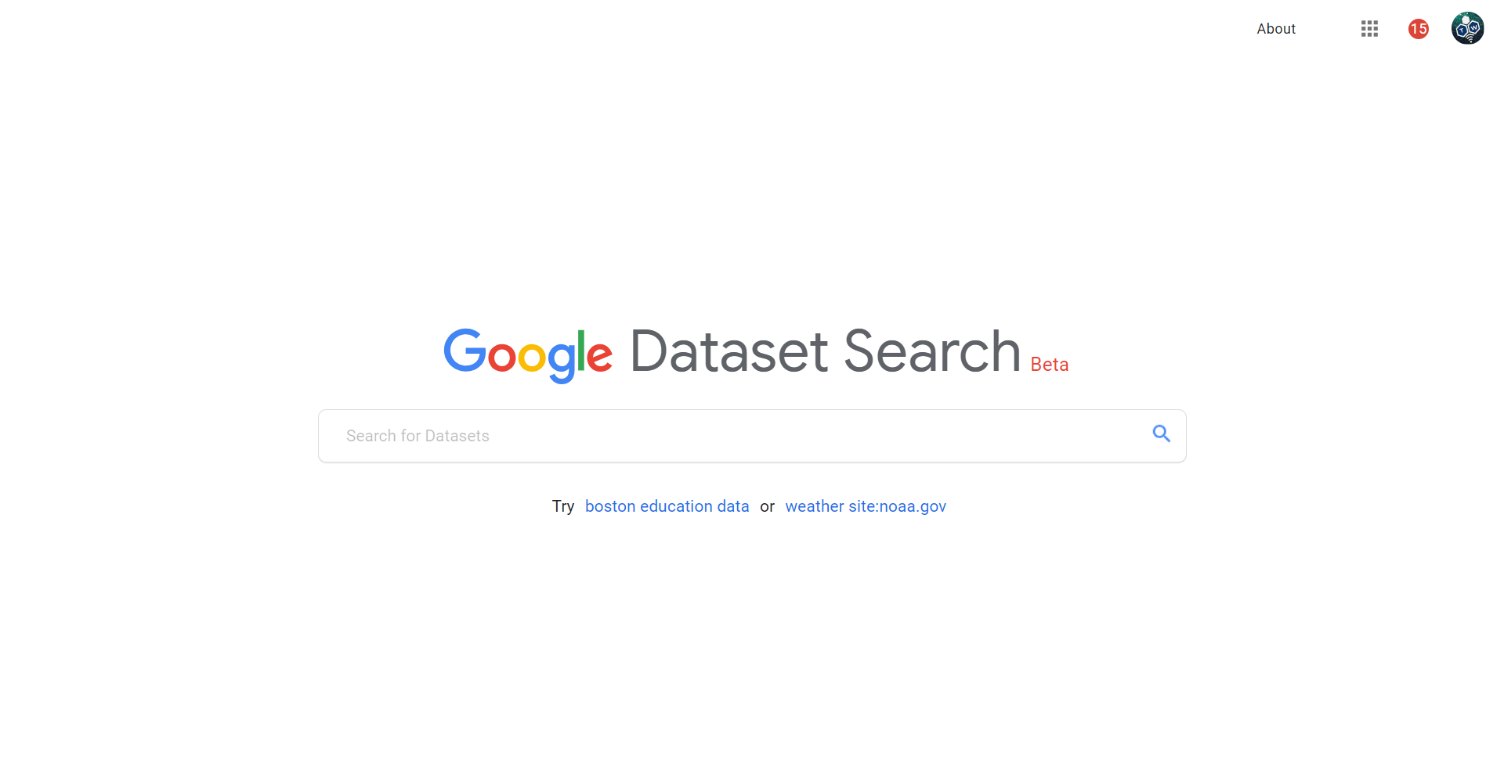
Picking datasets
https://toolbox.google.com/datasetsearch

Slide 5
Version control and documentation
Github (use student to get access to private and public repositories)
Backup python code and evaluated notebooks
Good coding guidelines
Portfolios / Websites

Slide 6
Keys to a good working group
Keeping each other accountable
Make notes about each other’s progress
During weekly meetings
Set deliverable goals
Recount progress
Discuss problems / issues
Discuss code?

