Slide 1
Release Workflow

Slide 2
Create a Jira Ticket
Go to https://jira.cbs-dtt.site
Go to Projects > Savings Change Team
Create a Test Story

Slide 3
Create an Analysis Subtask
Open the previously created Story
Click on ‘More’ and select ‘Create Subtask’
Set the ‘Summary’ field to ‘Analysis -Testing’ and click ‘Create’

Slide 4
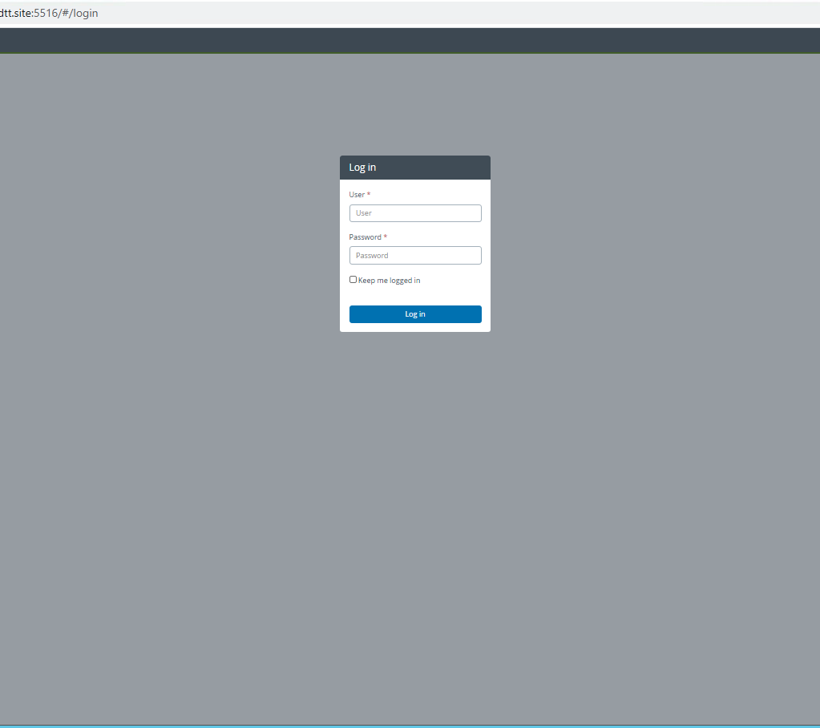
Login to Xebialabs Release
Login to Xebialabs with your provided user name and password

Slide 5
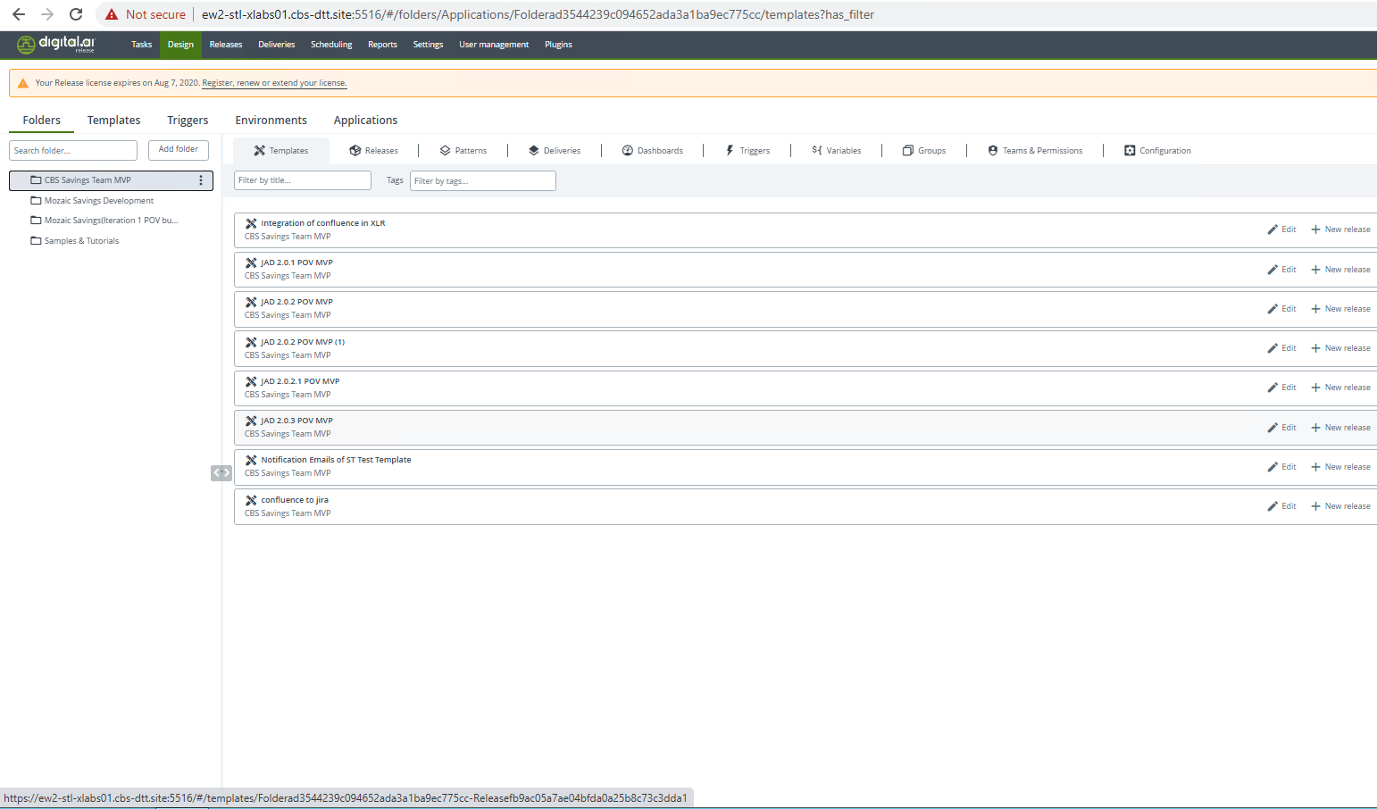
Go to Savings Release Plan
Navigate to Folders > CBS Savings Team MVP then Select the ‘JAD 2.0.3 POV MVP’ release

Slide 6
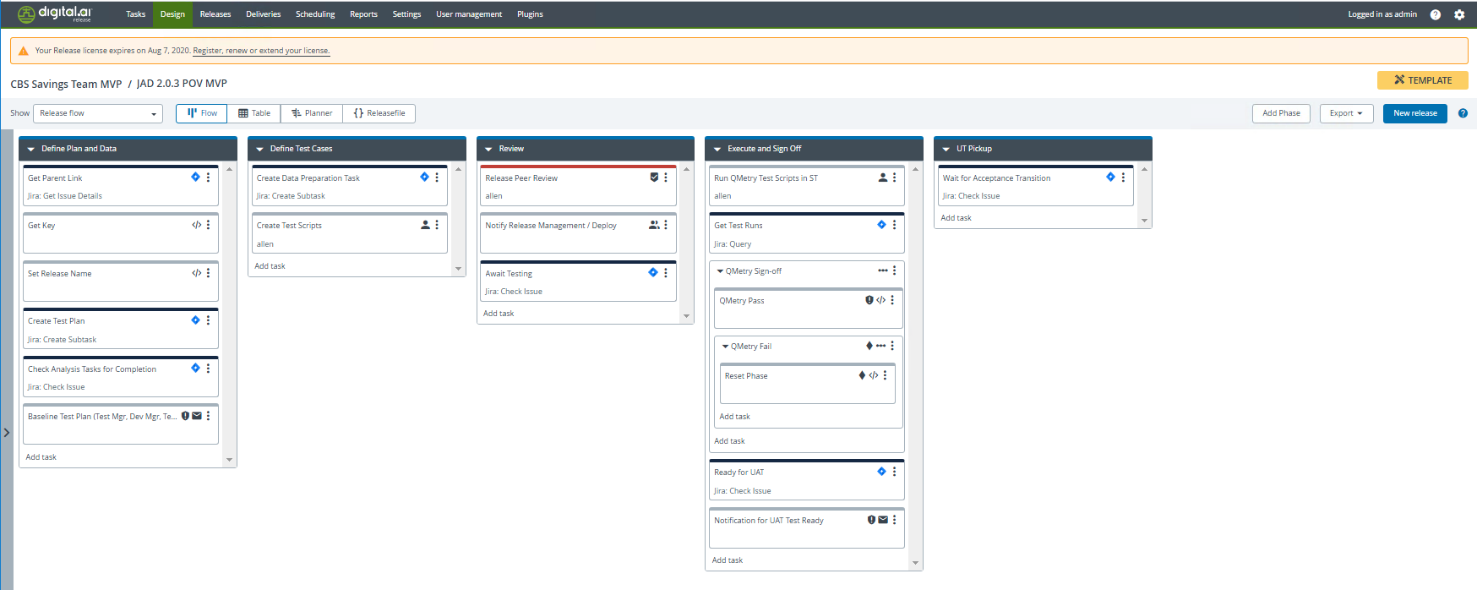
New Release
In the ‘JAD 2.0.3 MVP POV’ release plan click ‘New Release’

Slide 7
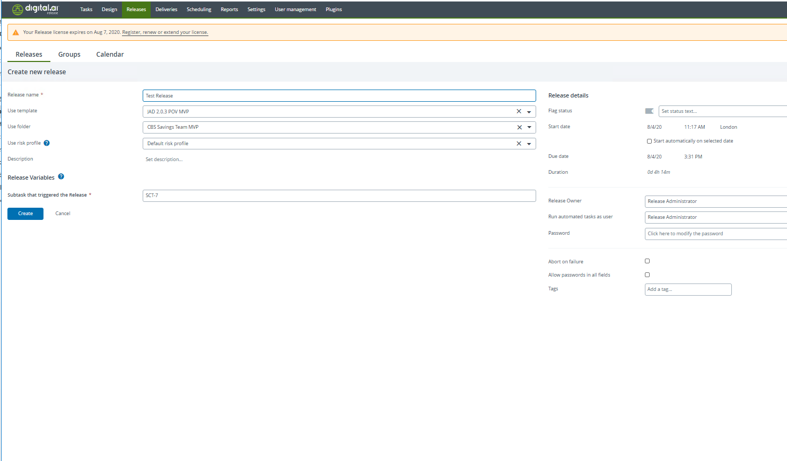
Initiate Release
Set the ‘Release Name’ field and populate the ‘Subtask that triggered the release’ variable field with the subtask number created at the start, i.e. SCT-7
Click ‘Create’ to initiate the release

Slide 8
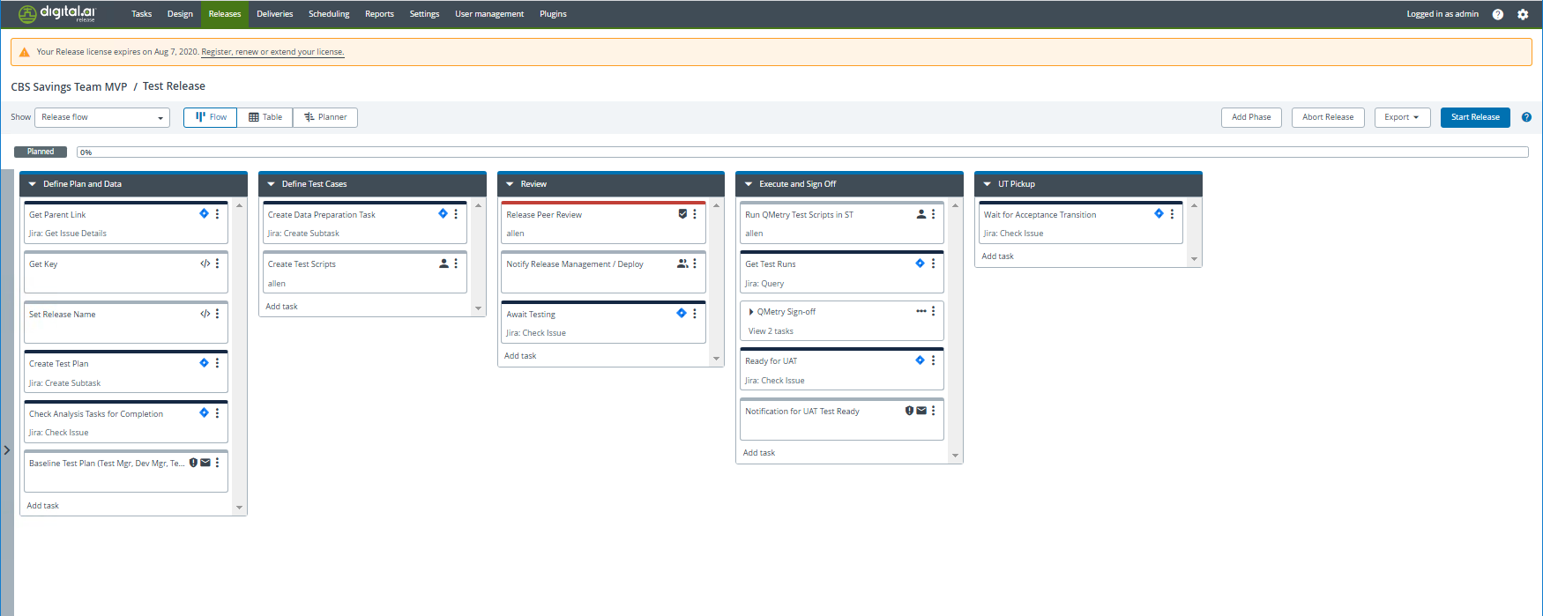
Initiate Release
In the newly create release, click ’Start Release’

Slide 9
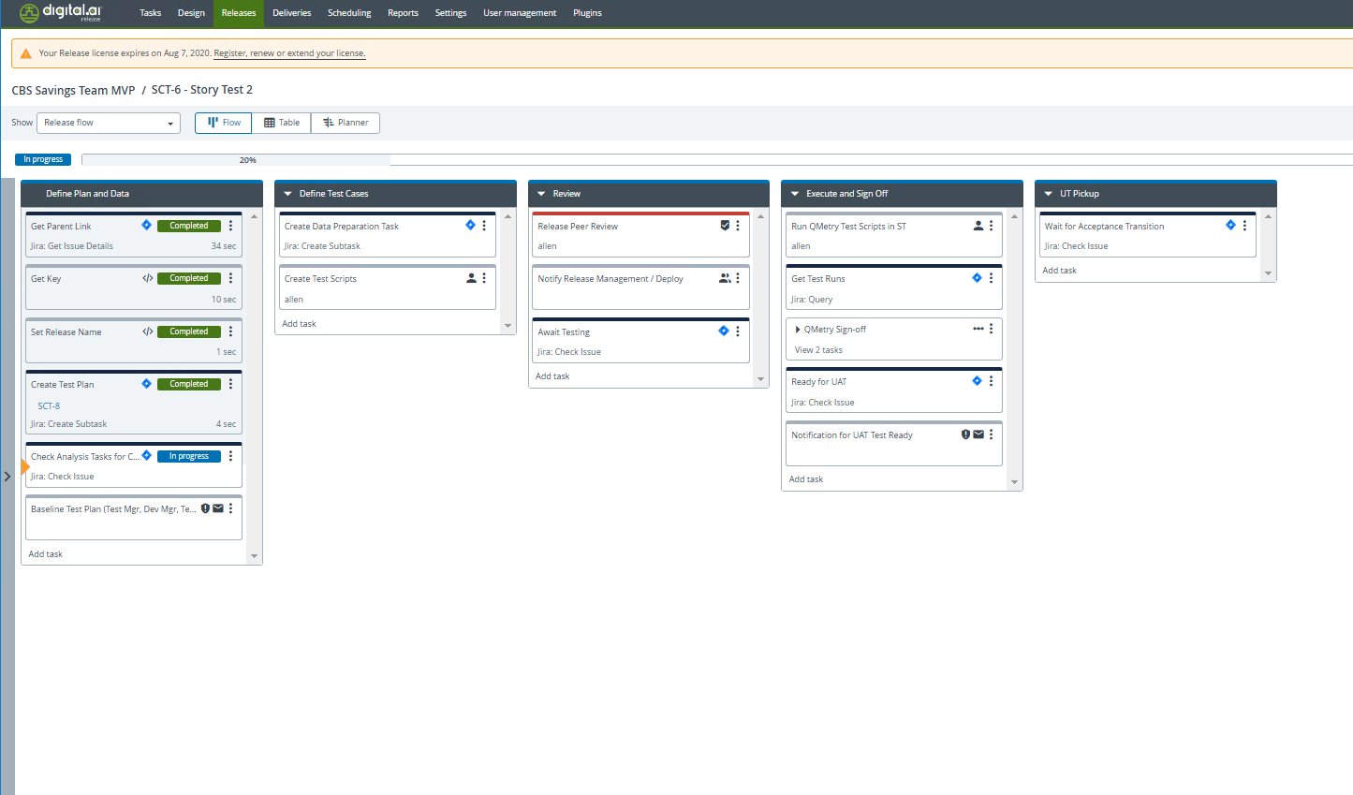
Complete Analysis Task
The flow will wait for the Analysis – Testing task to be completed before progressing. Complete this task in Jira to move forward.

Slide 10
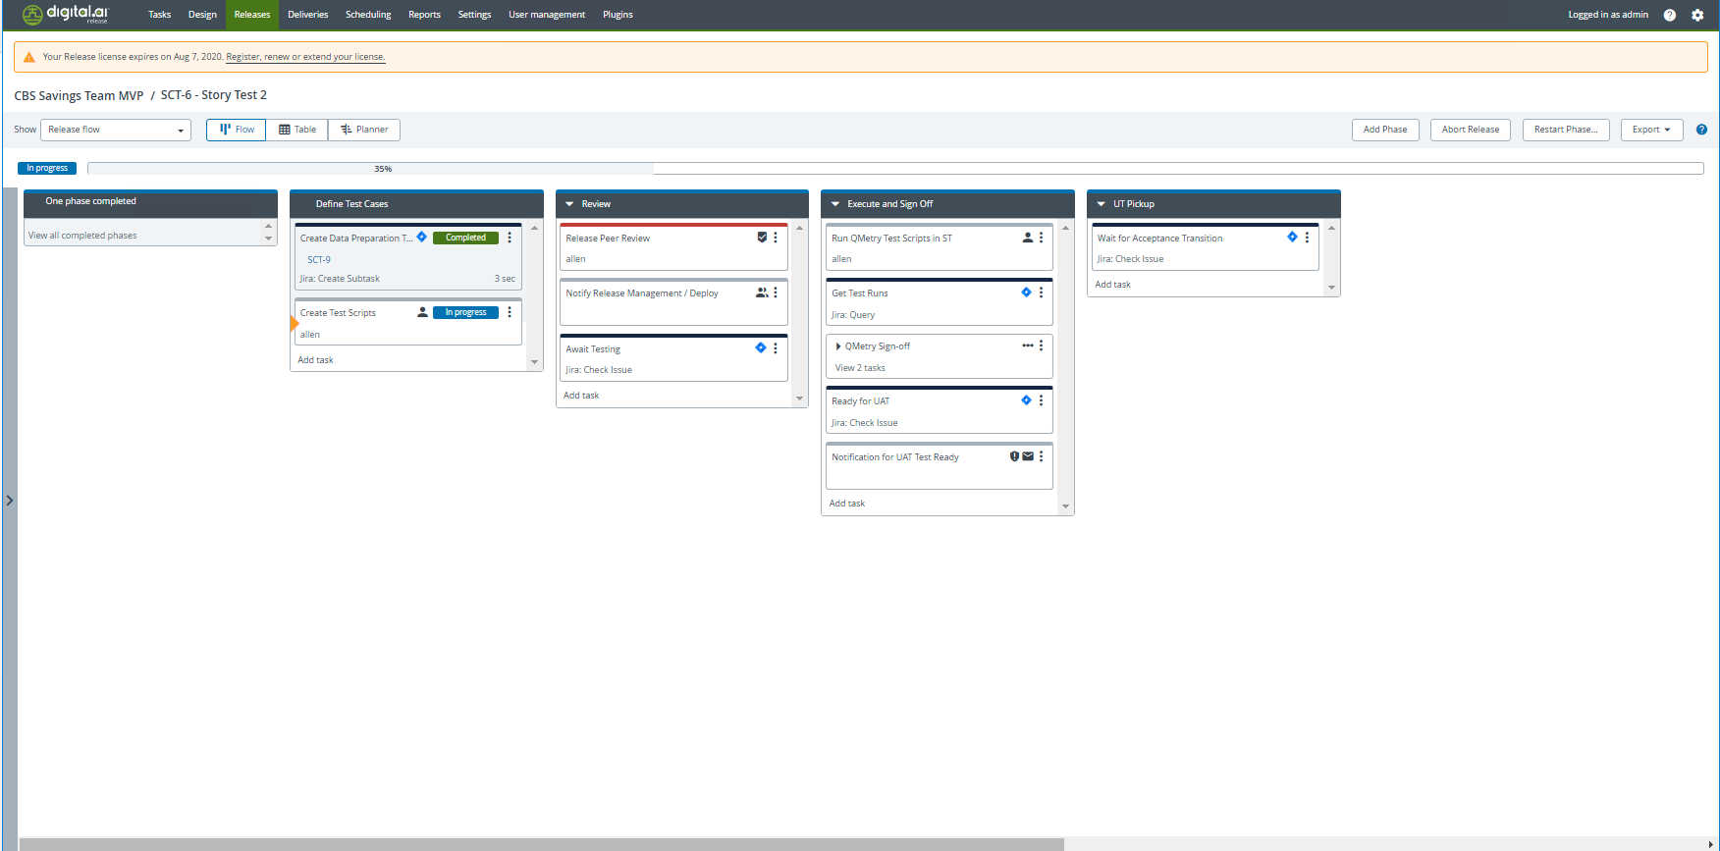
Completed Phases
As phases are completed, you can view the completed tasks by clicking on the ‘View all completed phases’ link on the left

Slide 11
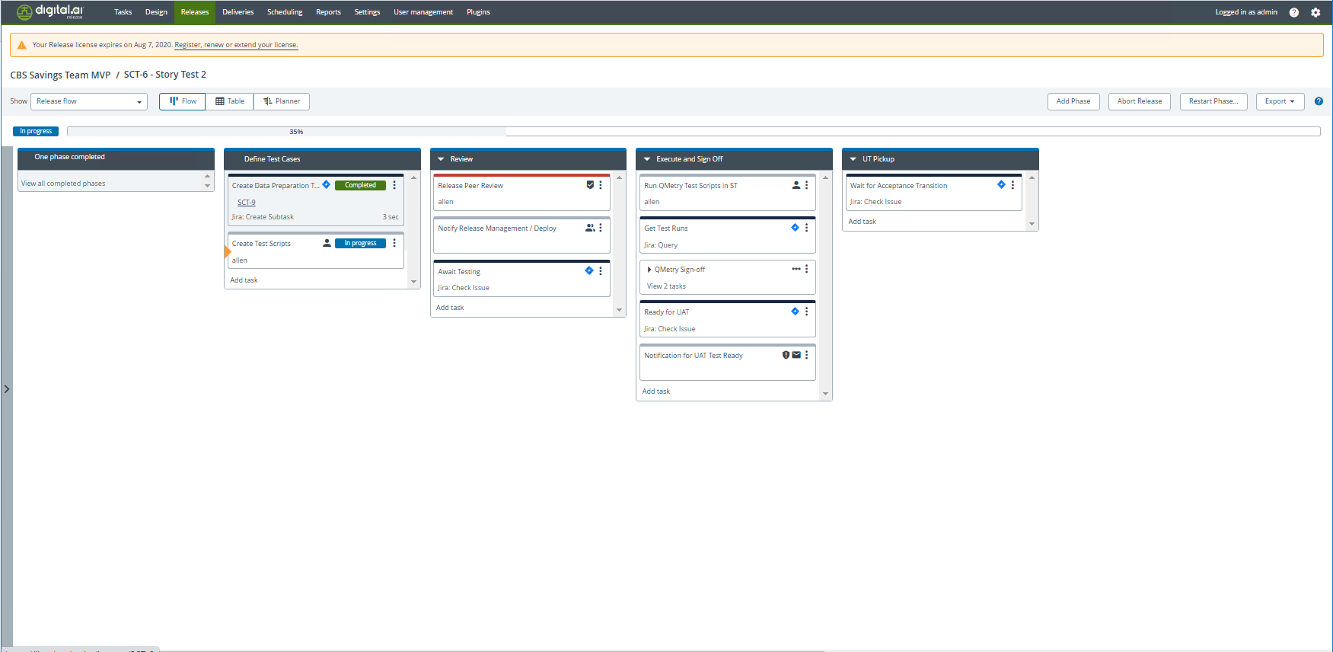
Created Ticket Links
You can view the referenced tickets for Jira automated tasks by clicking on the link embedded into the task tile

Slide 12
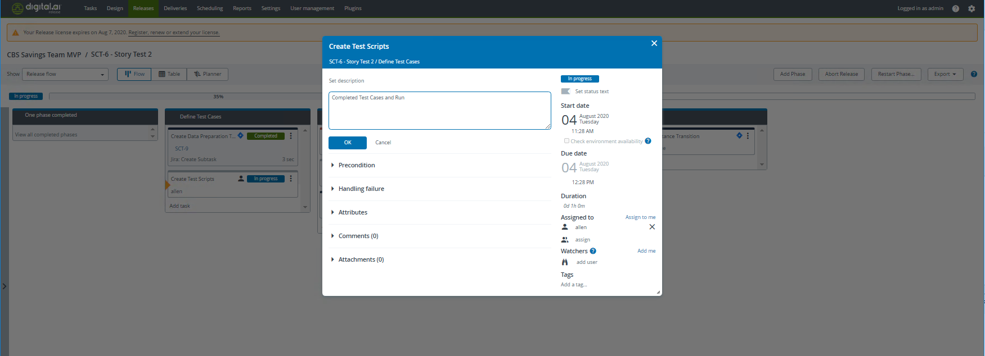
Create Test Scripts
In Jira, create some test cases and a test run as part of the parent story and then complete the manual task in Xebialabs to progress

Slide 13
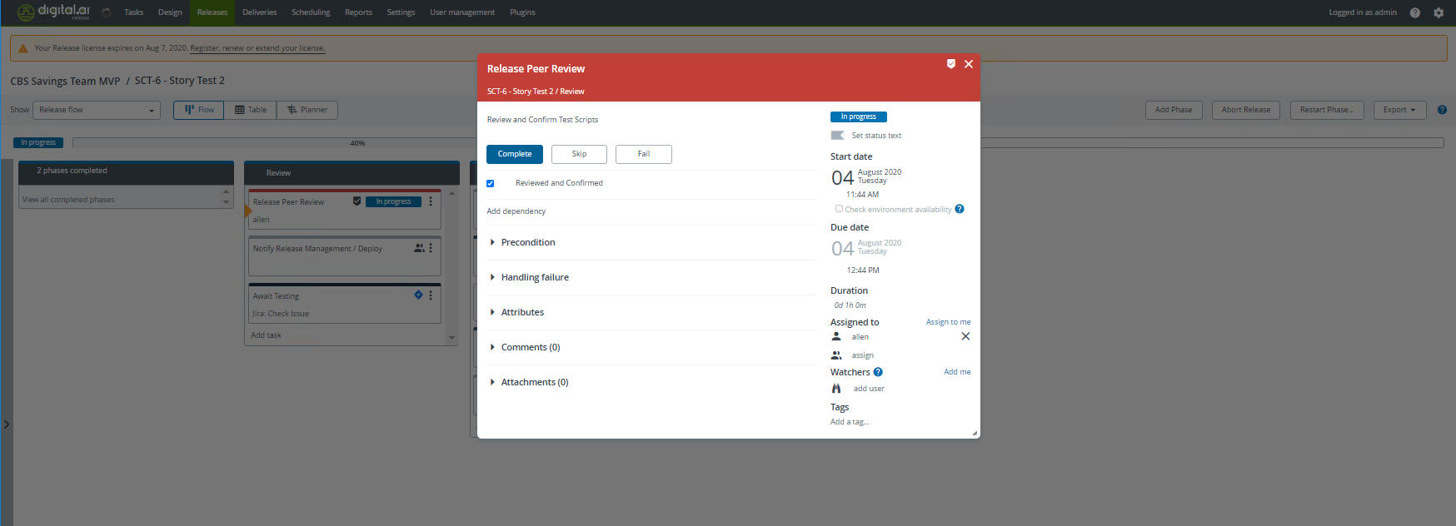
Pass the Gate
Complete the Gating ’Review’ task by checking the tick box and clicking ‘Complete’

Slide 14
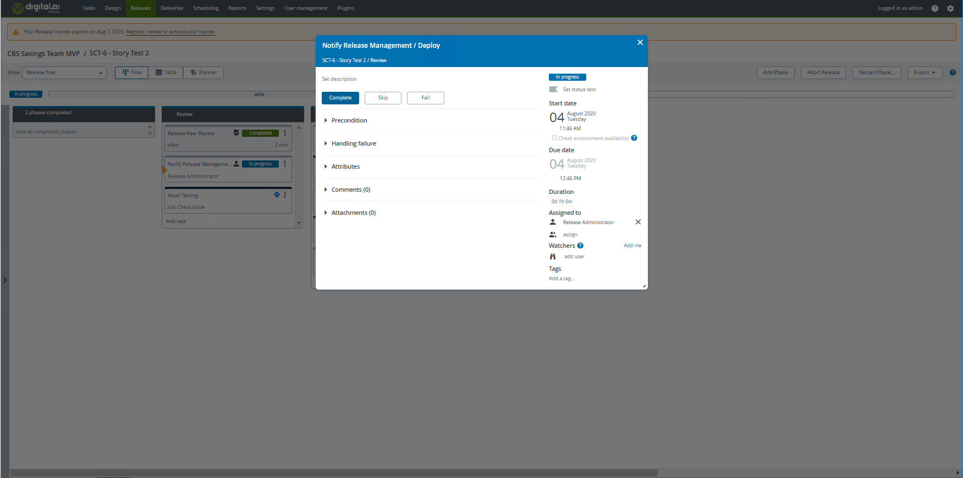
Notify Release Management
Complete the Notify Release Management task to progress

Slide 15
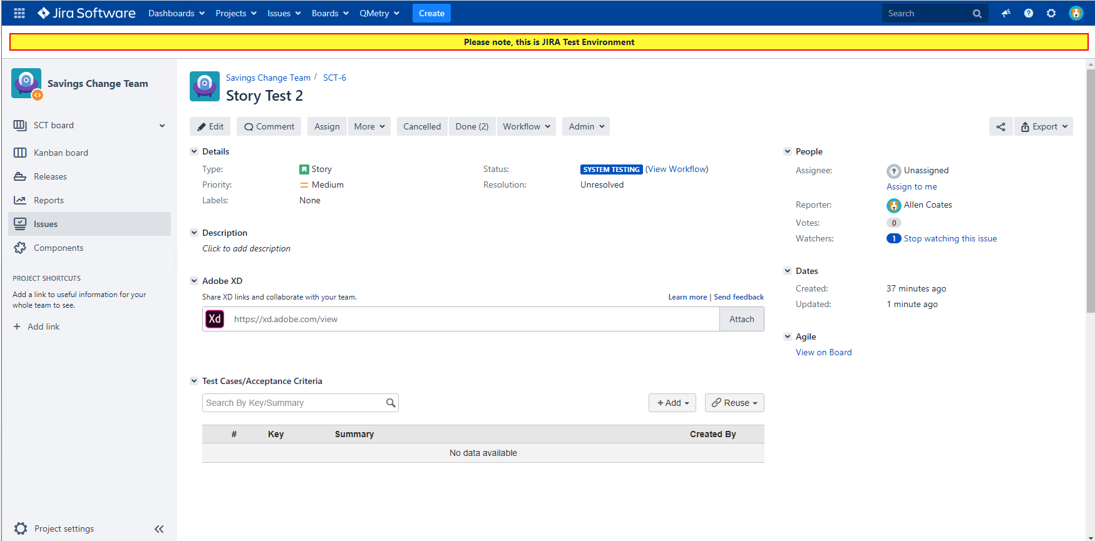
Transition Jira Issue to System Test
Go to Jira and move the issue to the System Testing phase to progress in Xebialabs.

Slide 16
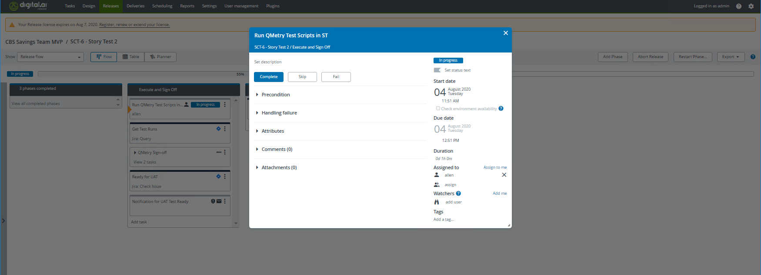
Run the Test
Complete the Test Run in Jira and then complete the ‘Run Qmetry Test Scripts In ST’ manual task

Slide 17
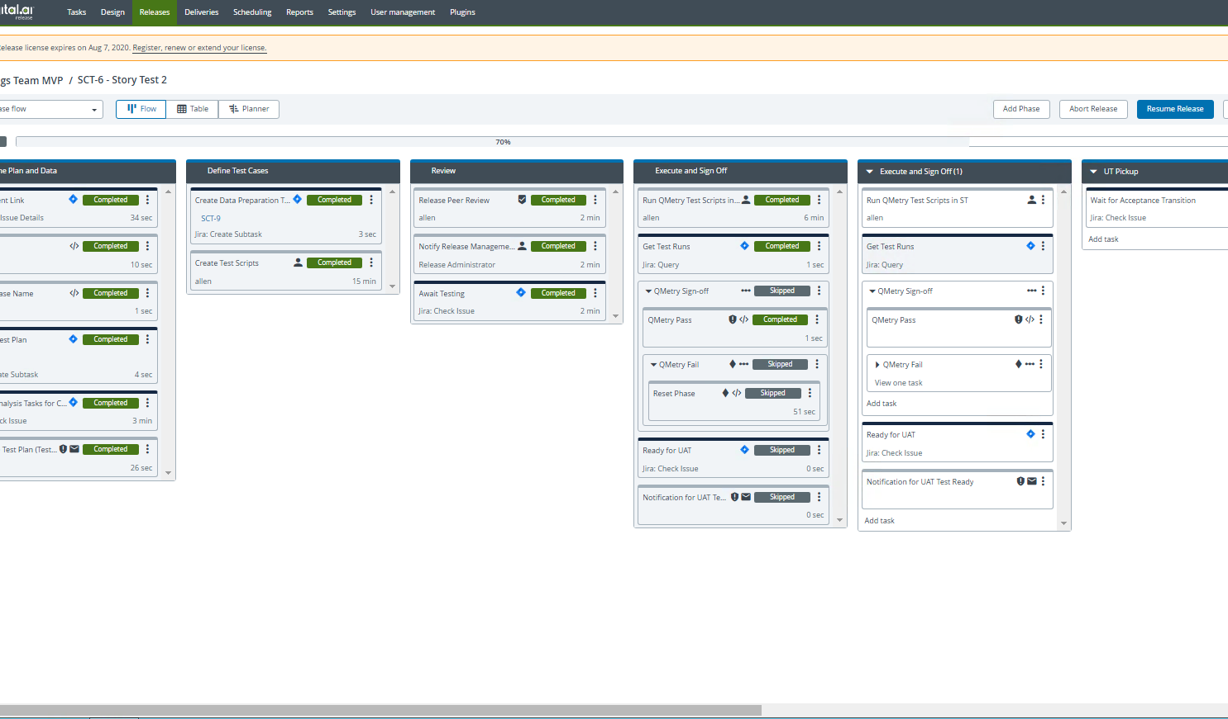
Test Failure
If the Test was failed, Xebialabs will automatically restart the phase and await new tests to be created so the Story can be retested. To resume the phase, select ‘Resume Release’

Slide 18
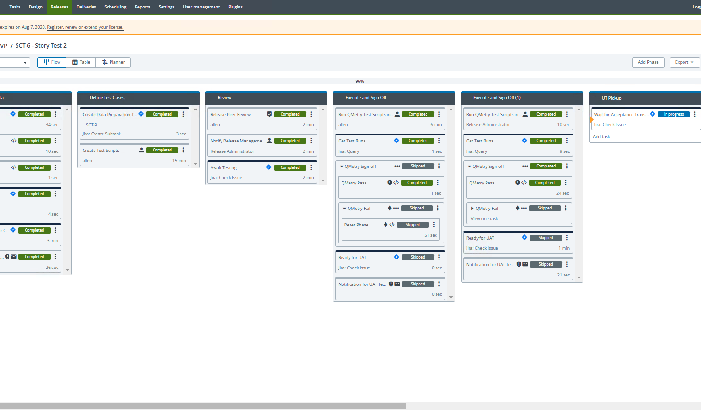
Transition to Business Testing
Once execution and sign off is completed, Xebialabs will await for UT handoff to be completed. To complete, transition the Jira story to the Business Testing phase.

