Slide 1
Explainable AI-Powered EV Charging Churn
Analytics Dashboard with Generative AI Insights
MODELS TESTED
Logistic Regression, Decision Tree, Random Forest, XGBoost
CMPS 592B | Allen Trevor Franklin
SELECTED: Random Forest
All three tuned finalists (Logistic Regression, Random Forest, XGBoost) landed within ~1-2 points of each other. Random Forest was kept since it edges out on test AUC and integrates directly with SHAP.
The Pivot
A synthetic EV dataset from Kaggle was tested first. ANOVA and chi-square tests showed no statistically significant relationship between any feature and any potential target, confirming the data was randomized. The project pivoted to a peer-reviewed real-world dataset (Baek, Lee & Kim, Scientific Data, 2024) with genuine behavioral signal.
69.2%
test accuracy
0.705
ROC-AUC (cross-validated)
2,336
72,856
56.1%
43.9%
Validated with 5-fold cross-validation, threshold sensitivity testing, and 5-seed stability checks.
subscribed EV users
real charging sessions
baseline churn rate
retention rate
Churn defined as: no charging session within 60 days of the end of the one-year observation window (subscribed users only).

Slide 2
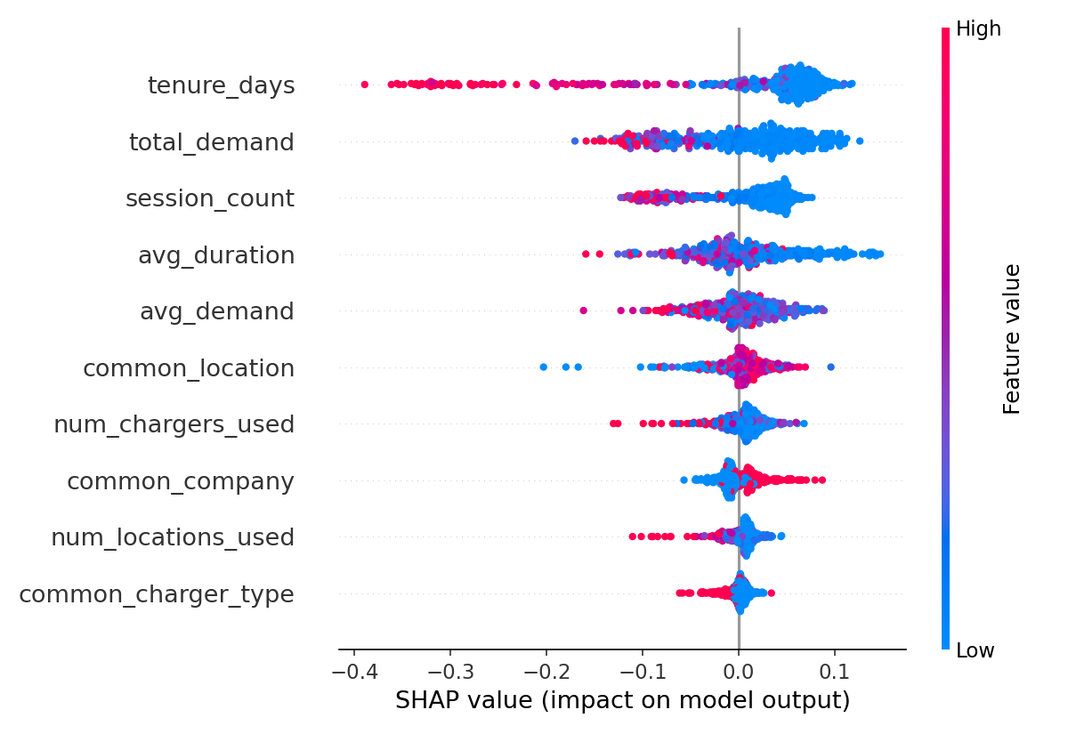
Explainability: What Drives Churn
SHAP (SHapley Additive exPlanations) on the tuned Random Forest model
TOP CHURN DRIVERS
1
Tenure (days)
Strongest predictor by far. Longer-tenured users are far less likely to churn.
2
Total energy demand
Heavier total usage over the year correlates with staying active.
3
Session count
More frequent charging sessions signal an engaged, retained user.
Cross-checked independently: Logistic Regression coefficients agree, tenure has the largest-magnitude coefficient of any feature.

Slide 3
Model Comparison & Validation
Best tuned version of each model, engineered features, same train/test split
Model | CV AUC | Test Accuracy | Test AUC
Logistic Regression | 0.7425 | 0.6838 | 0.6959
Random Forest (selected) | 0.7407 | 0.6923 | 0.7046
XGBoost | 0.7445 | 0.6902 | 0.7016
BOTTOM LINE
Improvement over untuned baseline:
+5.1 pts
accuracy (64.1% → 69.2%)
All three tuned models land within ~1-2 points of each other, the predictive ceiling is set by the available features, not by model choice. Random Forest was kept as the primary model since it edges out on test AUC and integrates directly with SHAP.
AUC held steady (0.703 → 0.705), indicating the model was already near the ceiling this feature set allows.
ROBUSTNESS CHECKS PASSED
5-fold cross-validation confirms results are not a single-split fluke
Threshold sensitivity tested at 30 / 60 / 90 days to justify the churn definition
5 different random seeds confirm stable performance (± ~2% accuracy, ± ~1% AUC)
Feature engineering (behavioral ratios) added ~4 points of accuracy over raw features

