Slide 1

Data-Driven College Match Reproducible IPEDS Pipeline and Baseline Outcome Modeling
Group 8
Name|Name|Name|Name

Slide 2
Project Overview
Objective: Build an institution-level decision-support workflow using public higher-ed data
Challenge: Public data has institution-level outcomes, not student-level application histories
Goal: Predict institutional graduation-outcome strength as a proxy for student decision support
Constraint-aware approach: Use transparent, reproducible, auditable transformations

Slide 3
Data Inputs
Core institutional sources: HD, IC, FLAGS
Added predictive sources: ADM, SFA, COST1, COST2
Long-format cohort sources: EF, GR
Common join key: UNITID

Slide 4
Pipeline Logic
01: Audit Inputs and Join Coverage
Derives an institution-level graduation outcome target from gr2024.csv—computing gr_completion_rate_150 from CHRTSTAT=13/12 and binary y_grad_outcome_high via median split—and writes project_target_unitid.csv and project_target_report.json.
Profiles all source CSVs (rows, columns, missingness, UNITID completeness), computes cross-file UNITID overlap, and writes audit artifacts to data_audit_summary.csv, unitid_join_coverage.json, and input_inventory.csv.
04: Flatten EF/GR long-format cohort data to one row per UNITID
converts long-format ef2024a.csv and gr2024.csv into one-row-per-UNITID aggregate features and writes longformat_unitid_features.csv plus longformat_unitid_features_report.json.
02: Build unified analysis base
Merges analysis_base.csv with project_target_unitid.csv, selects/cleans baseline features, and writes model input modeling_ready.csv and column-role dictionary variable_map.csv.
Trains logistic-regression and random-forest baselines on modeling_ready.csv, evaluates holdout performance (accuracy/precision/recall/F1/ROC-AUC), and writes baseline_metrics.json and baseline_feature_importance.csv.
Left-joins one-row-per-UNITID sources (hd, ic, flags, adm, sfa, cost1, cost2, and derived longfmt) into a source-prefixed master table and writes analysis_base.csv and analysis_base_join_report.json.
05: Build project target from graduation cohort outcomes
03: Build modeling-ready dataset
06: Train baseline models + export metrics
Order is intentional

Slide 5
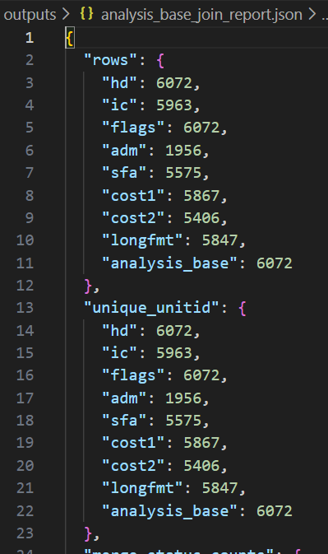
Data Quality and Coverage
Full institutional frame retained from HD: 6,072 institutions
Input inventory includes row counts, UNITID cardinality, and file checksums
Long-format handling prevents row explosion during merges
Coverage diagnostics exported for each merge stage
Sample table
Join snapshot

Slide 6
Long-Format Feature Engineering (EF/GR)
EF and GR are multi-row-per-institution; direct join is unsafe
Flattened into institution-level aggregates (counts, means, maxima, diversity of cohort/status codes)
Output: 5,847 rows × 53 features
Source:
longformat_unitid_features.csv
longformat_unitid_features_report.json

Slide 7
Analysis Base Construction
Left-join strategy anchored on HD preserves universe consistency
Source-prefixed columns ensure traceability
Final analysis base: 6,072 rows × 1,592 columns
Source:
analysis_base.csv
analysis_base_join_report.json

Slide 8
Target Definition (Project-Aligned)
Continuous target: graduation completion ratio gr_completion_rate_150 = sum(CHRTSTAT=13) / sum(CHRTSTAT=12)
Binary target for baseline classification: y_grad_outcome_high
1 if completion ratio ≥ median, else 0
Valid target rows: 3,636 (balanced 1,818 / 1,818)
Source:
project_target_report.json
project_target_unitid.csv

Slide 9
Modeling-Ready Dataset + Baseline Performance
Modeling-ready shape: 3,636 rows × 39 columns
Leakage-aware feature set: institutional context + admissions + aid + cost + flattened EF features
Baseline test performance:
Logistic Regression ROC-AUC: 0.882
Random Forest ROC-AUC: 0.911
Random Forest Accuracy: 0.824, F1: 0.822
Source:
modeling_ready.csv
baseline_metrics.json
baseline_feature_importance.csv

Slide 10
Interpretation, Limits, and Next Steps
Interpretation: Pipeline and baseline indicate strong signal in institutional attributes and cost/admissions context
Limits: Institution-level proxy target; no student-level applicant trajectories
Next steps:
Calibrate thresholding and probability outputs
Add fairness and subgroup diagnostics
Build recommendation/ranking layer and dashboard
Convert pipeline outputs into decision-support UI
We now have a reproducible backbone and can shift from data engineering to product-facing decision support.

