Slide 1
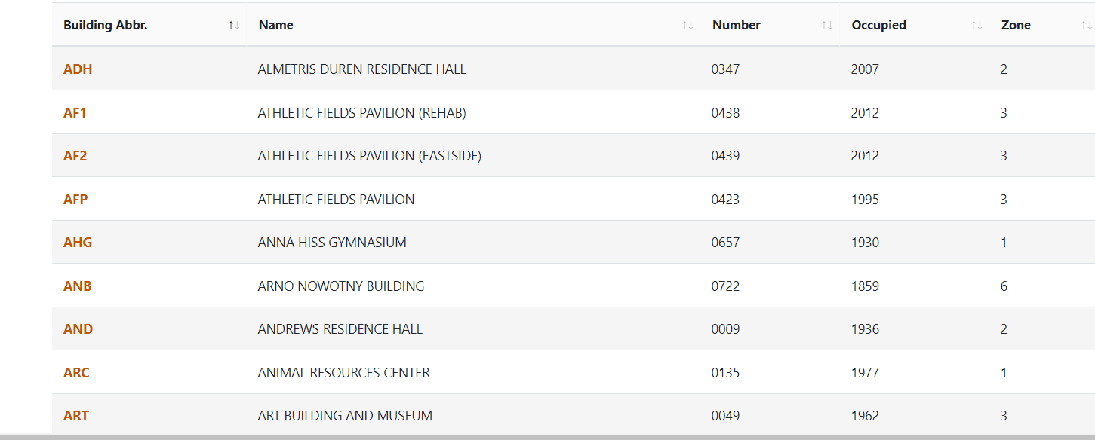

Slide 2
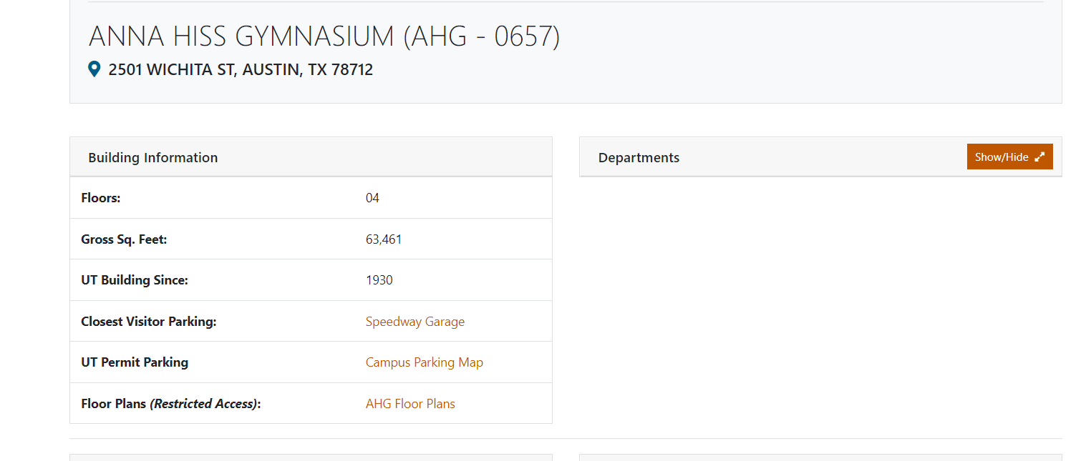
Energy Predictions under climate change
A2
2020
Cooling
Please pick a climate
change scenario
Please pick a year
Results
Note: when you click the buttons :
First: you pick a scenario, so it should have 3 options A2, B1, A1B
Second: will give options as 2020, 2025
2030, 2035,2040….till 2100 every 5 years. So it should have a total of 16 options
Third: Cooling or heating consumption

Slide 3
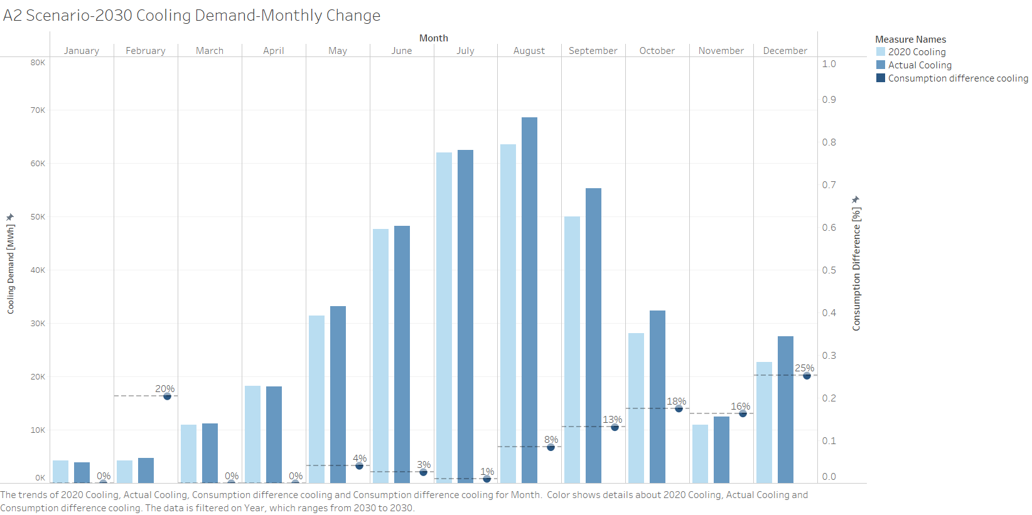
Energy Predictions under climate change
A2
2020
Cooling
Please pick a climate
change scenario
Please pick a year
Results

Slide 4
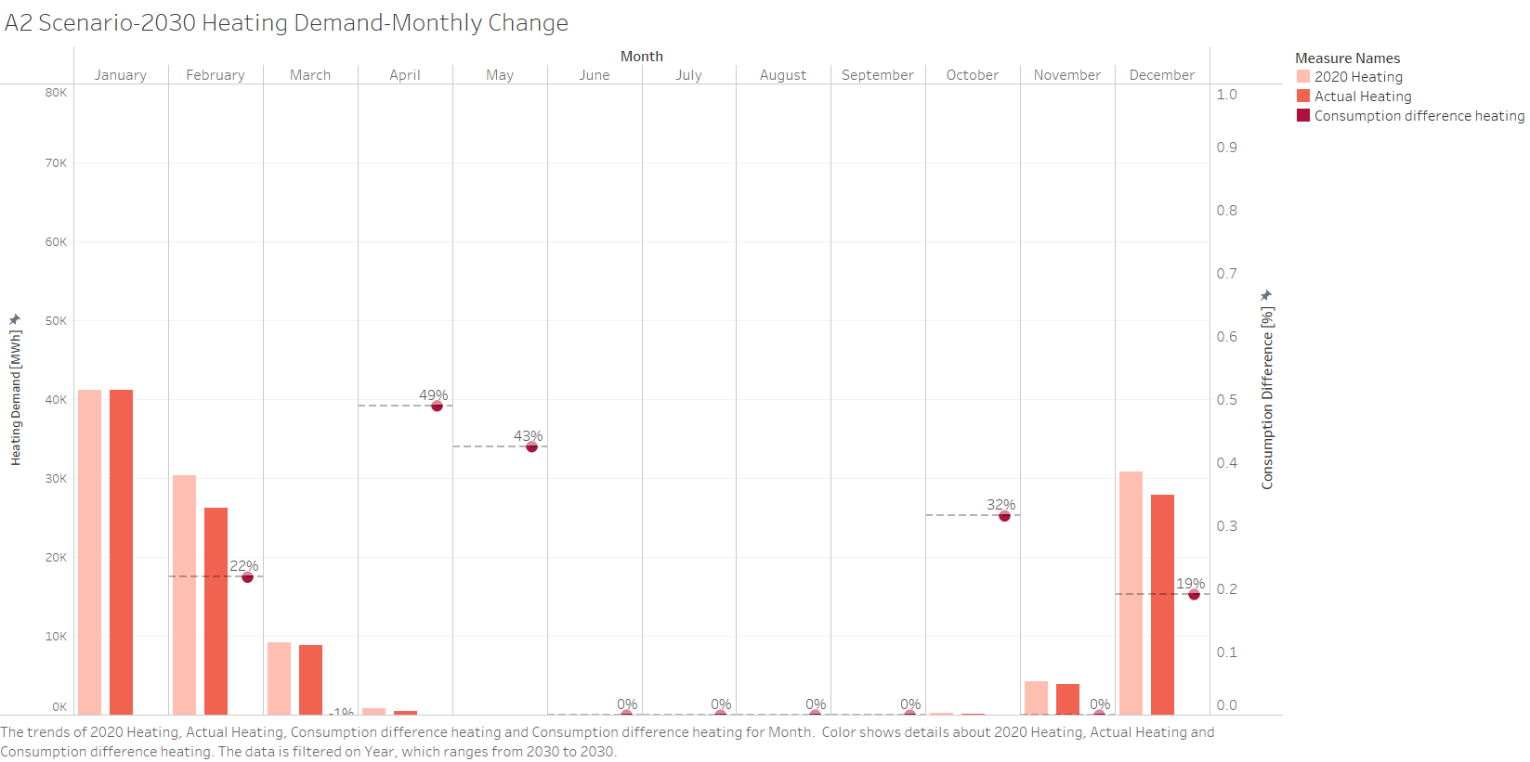
Energy Predictions under climate change
A2
2020
Heating
Please pick a climate
change scenario
Please pick a year
Results

