Slide 1
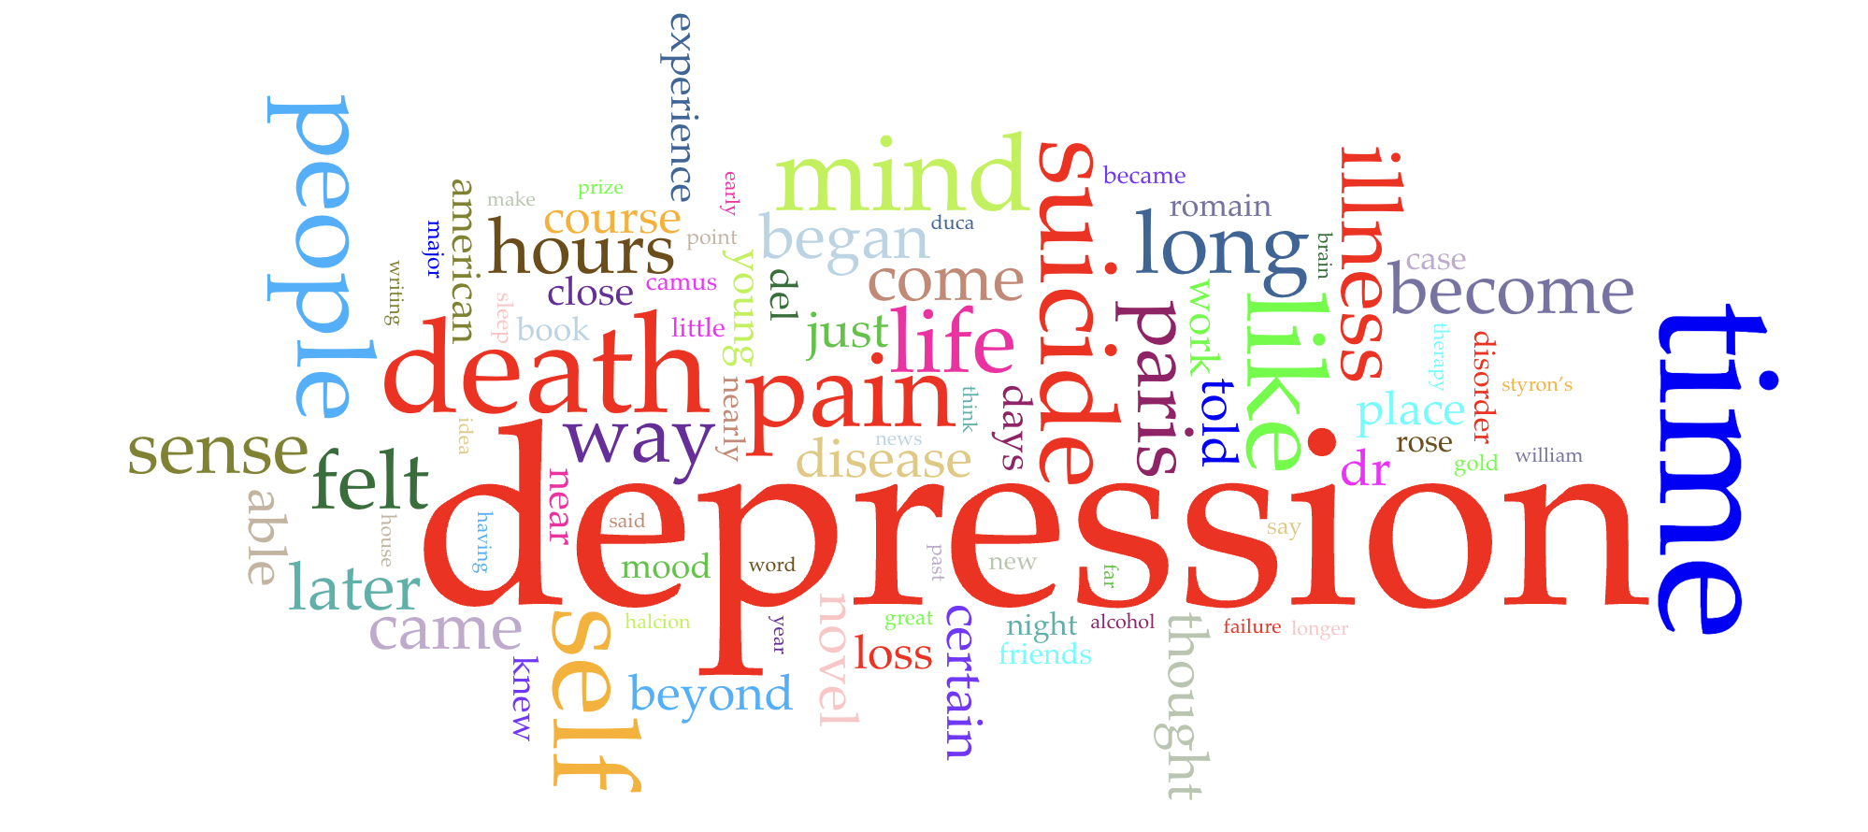
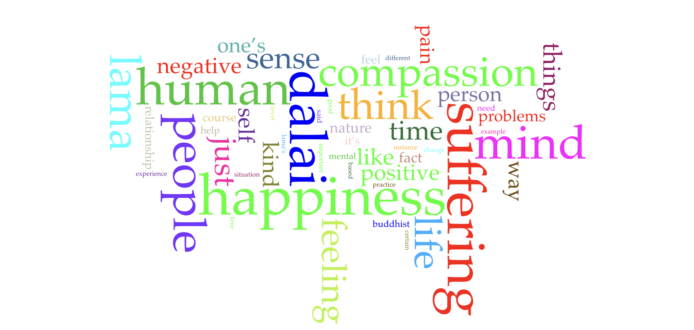
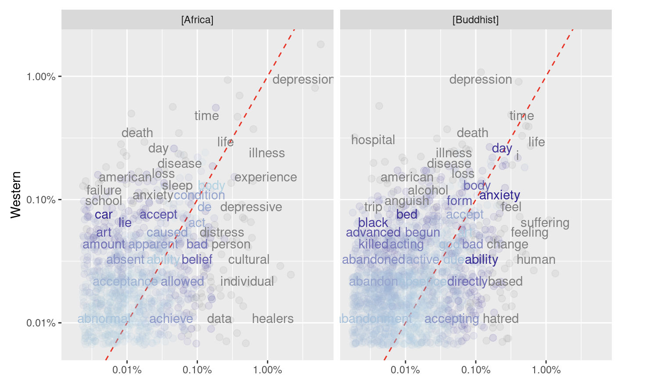
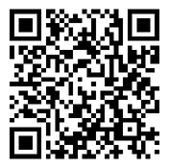

For the text analysis assignment, I looked at the relationship between culture and emotions, with a focus on depression. This topic is particularly interesting because it explores how cultural factors can influence the experience and expression of depression, which we discussed in my colloquium called Emotions. My focus was on Western, Eastern, and African societies.
Text Analysis: Cross-Cultural Texts about Depression
By analysing the graph to the left, I was able to look at the language that is used in different societies when expressing depression
Findings
Cultural Variations
Western Perspective:
Seen as a medical condition.
Eastern Perspective:
Viewed as a personal weakness or imbalance.
Medical vs. Personal Frameworks:
Western Societies:
Focus on diagnosing and treating depression as an illness.
Eastern Societies
Spiritual practices like meditation are emphasized.
Scan this QR code to read more about this topic...
Allen Kayesu
Intro to Digital Humanities
FALL 2023

