Slide 1
DB final project
BY
ALLEN VU
PETER BECICH

Slide 2
System description
what system did you build?
A system that would allow users to translate Japanese to English and the other way around.

Slide 3
Use case description
what are the most important interactions between a user and the system?
Translate any Japanese word (in forms of hiragana, katakana, romaji, or kanji) to english
Translate English word/compound to Japanese word (in forms mentioned above)

Slide 4
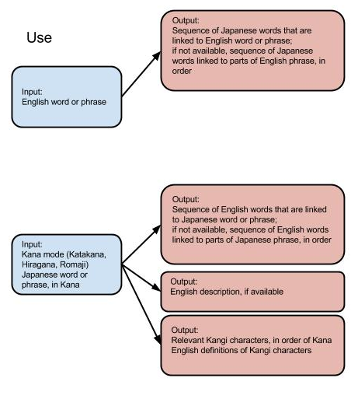

Slide 5
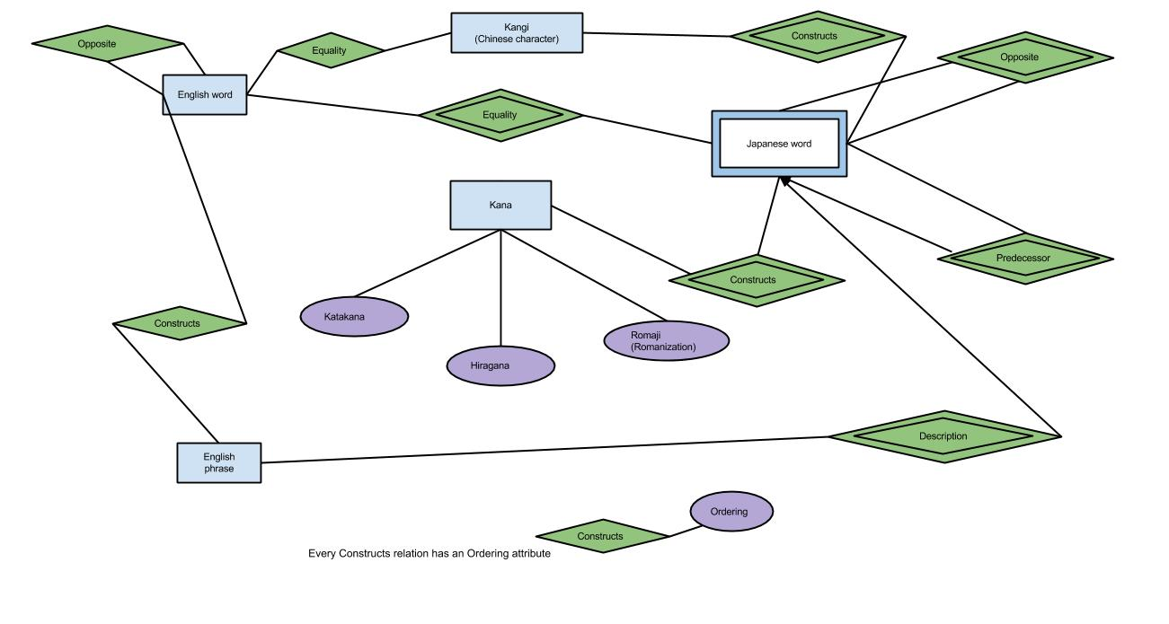
Japanese-English ER diagram

Slide 6
Relations
englishWord(ew_id, ew_word)
englishWordOpposite(ewo_englishWordID, ewo_oppositeID)
englishPhraseIndex(epi_ID)
englishPhrase(ep_ID , ep_englishwordID, ep_order)
japaneseWord(jw_WordID)
japaneseWordPredecessor(jwp_japaneseWordID, jpp_predecessorID)
japaneseWordOpposite(jwo_japaneseWordID, jpo_oppositeID)
japaneseWordDescription(jwd_japaneseWordID, jwd_englishPhraseID)
japaneseEnglishWordLink( jewl_linkID , jewl_japaneseWordID, jewl_englishWordID, jewl_japaneseWordOrder, jewl_englishWordOrder)
japaneseEnglishWordLinkIndex (jewli_linkID)
japaneseWordKanaLink(jwkn_japaneseWordID, jwkn_kanaID, jwkn_order)
japaneseWordKangi(jwki_japaneseWordID, jwki_kangiID, jwki_order)
kanaSystem(kns_ID, kns_hiragana, kns_waseiEigo_id, kns_katakana, kns_romaji)
kanjiSystem(ks_kanjiID, ks_char,)
japaneseWordKanjiLink(jwki_japaneseWordID, jwki_kanjiID, jwki_order

Slide 7
Implementation details
Data were manually inputted
GUI written in Scala

Slide 8
