Slide 1

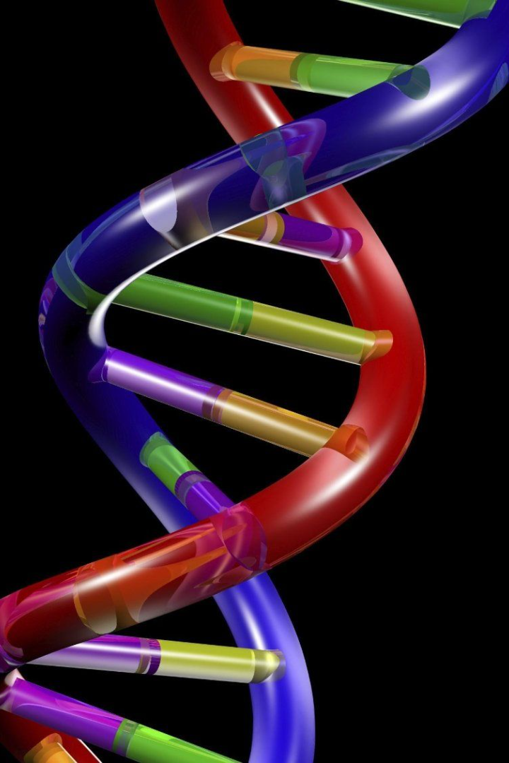
Introduction to Nucleic Acid Medicines: Emerging technology – RNA editing
Bowen Li, Ph.D.

Slide 2
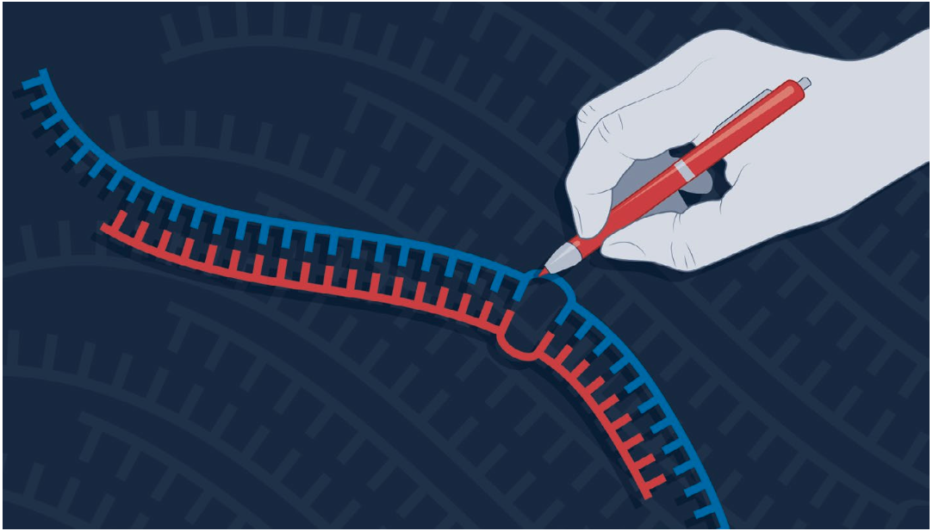
RNA editing
Compared to DNA editing, RNA editing can be:
Safer and Redosable
> DNA editing: inheritable and permanent off-target mutations
ADAR
mRNA
> Site-directed RNA editing alters transient RNA, will not induce permanent off-target mutations
gRNA
Nature Reviews Drug Discovery (Nat Rev Drug Discov) ISSN 1474-1784 (online) ISSN 1474-1776 (print)
https://doi.org/10.1038/d41573-024-00070-y

Slide 3
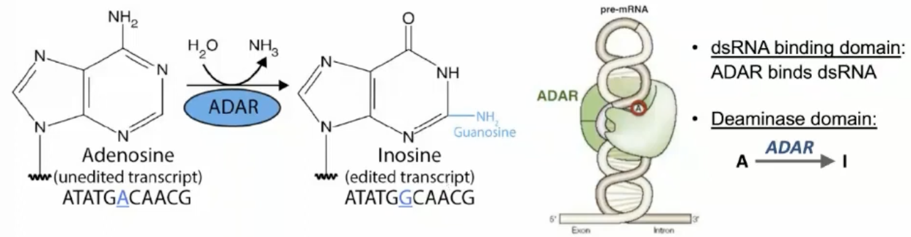
Adenosine to inosine (A-to-I) editing
RNA editing is a post-transcriptional RNA modification that introduces individual substitutions into RNA sequences
ADAR (Adenosine Deaminases Acting on RNA)
In mammals, two catalytically active ADARs are found, ADAR1 and ADAR2.
ADAR3 lacks deaminase activity but may play a role in regulating RNA editing through competitive antagonism with ADAR1 and ADAR2
Notes:
RNA editing is a widespread post-transcriptional mechanism that modifies specific RNA nucleotides without altering its template genomic DNA. The most prevailing RNA editing type in humans is adenosine to inosine (A to I) in which I is recognized as G by the translational machinery. The A-to-I conversion is catalyzed by adenosine deaminases that act on RNA (ADARs).
Each isoform contains N-terminal dsRNA binding domains (dsRBDs) followed by a C-terminal deaminase domain. ADAR3 lacks deaminase activity but may play a role in regulating RNA editing through competitive antagonism with ADAR1 and ADAR2
Substrate Specificity:
ADAR1 has a broader substrate specificity and can bind to various types of double-stranded RNA (dsRNA). It edits both coding and non-coding RNAs, including microRNAs and long non-coding RNAs.
ADAR2 typically exhibits more selectivity in substrate recognition. It is known for its role in editing specific sites within neurotransmitter receptor pre-mRNAs, such as the GluR-B Q/R site.
Cellular Localization:
ADAR1 is expressed ubiquitously and found in both the nucleus and the cytoplasm. It is involved in the editing of RNAs that are both nuclear and cytoplasmic. ADAR1 has two isoforms: the interferon-inducible p150, which is found in the cytoplasm and is involved in the innate immune response, and the constitutively expressed p110, which is primarily nuclear.
ADAR2 is mainly nuclear and edits pre-mRNAs and other nuclear-restricted RNAs. It is prominently expressed in the brain and has a significant role in editing transcripts involved in neuronal function.

Slide 4
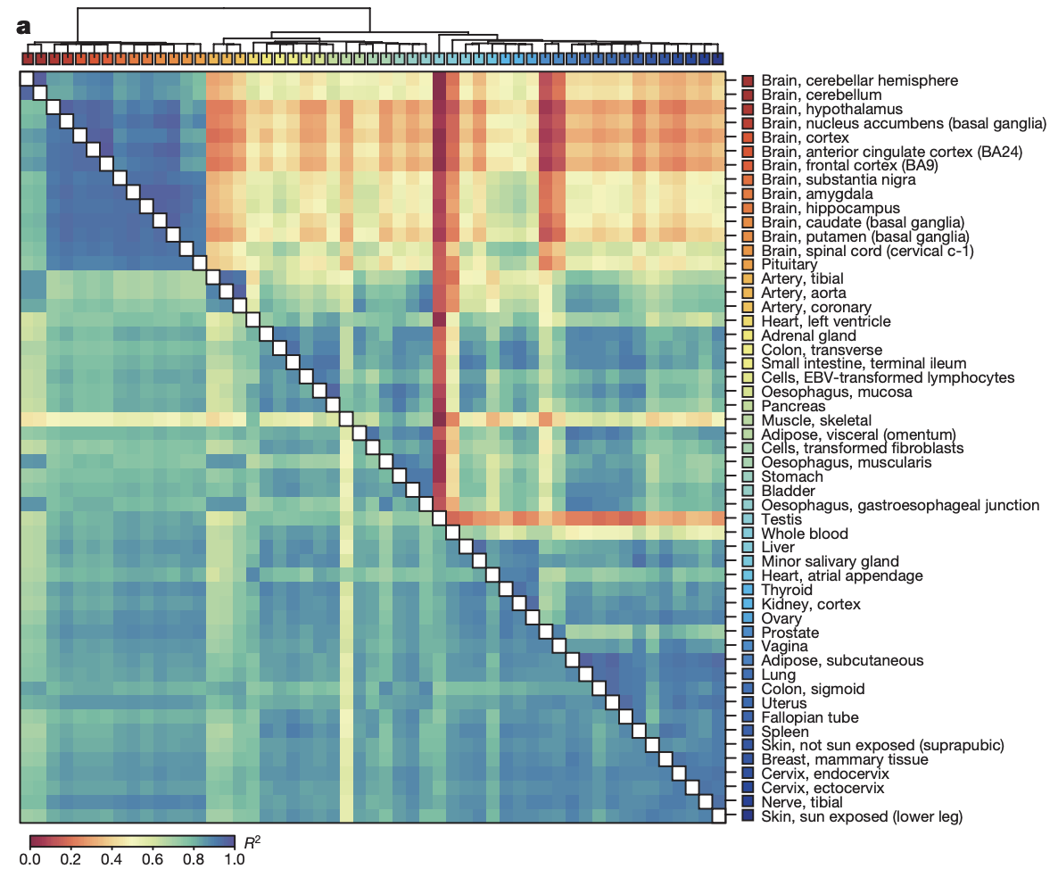
Dynamic landscape and regulation of RNA editing in mammals
Globally, ADAR1 is the primary editor of repetitive sites and ADAR2 is the primary editor of nonrepetitive coding sites, whereas the catalytically inactive ADAR3 predominantly acts as an inhibitor of editing.
Skeletal muscles show the lowest editing levels.
The top candidate negative regulator of editing was AIMP2, which encodes a component of the aminoacyl-tRNA synthetase complex. AIMP2 interacted with both ADAR1 and ADAR2, which reduces editing in muscles by enhancing the degradation of the ADAR proteins.
doi:10.1038/nature24041
Notes:
A comprehensive picture of the A-to-I editing landscape in human tissues was captured by profiling A-to-I editing in over 50 organs from over samples of the Genotype-Tissue Expression (GTEx) consortium.
ADAR1 and ADAR2 are the only A-to-I mRNA editors known in humans, but their mRNA expression shows only a poor correlation with A-to-I editing, depending on the tissue. This suggests that additional factors regulate editing.
Substrate Specificity:
ADAR1 has a broader substrate specificity and can bind to various types of double-stranded RNA (dsRNA). It edits both coding and non-coding RNAs, including microRNAs and long non-coding RNAs.
ADAR2 typically exhibits more selectivity in substrate recognition. It is known for its role in editing specific sites within neurotransmitter receptor pre-mRNAs, such as the GluR-B Q/R site.
Cellular Localization:
ADAR1 is expressed ubiquitously and found in both the nucleus and the cytoplasm. It is involved in the editing of RNAs that are both nuclear and cytoplasmic. ADAR1 has two isoforms: the interferon-inducible p150, which is found in the cytoplasm and is involved in the innate immune response, and the constitutively expressed p110, which is primarily nuclear.
ADAR2 is mainly nuclear and edits pre-mRNAs and other nuclear-restricted RNAs. It is prominently expressed in the brain and has a significant role in editing transcripts involved in neuronal function.

Slide 5
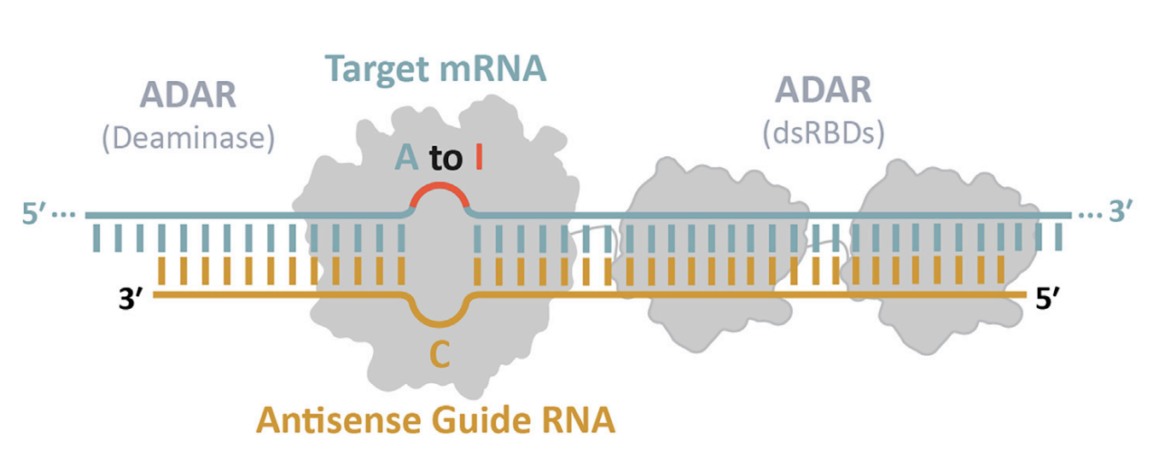
Site-directed RNA editing
doi.org/10.3389/fnmol.2023.1092913
Notes:
As an alternative to CRISPR Cas13, the recruitment of endogenous ADARs requires fewer components and reduces the potential for immune responses. However, the recruitment of endogenous ADARs also strongly relies on the abundance and substrate-specificity of ADAR family members. Importantly, recruiting endogenous ADARs relies on the efficient creation of RNA structures that are recognized by ADARs. This is typically achieved by introducing exogenous RNAs that basepair with endogenous substrate RNAs to generate these structures.

Slide 6
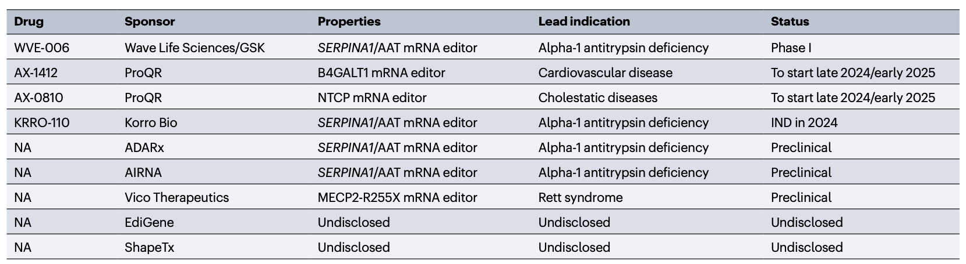
ADAR-base editors in and approaching the clinic
Nature Reviews Drug Discovery (Nat Rev Drug Discov) ISSN 1474-1784 (online) ISSN 1474-1776 (print)
https://doi.org/10.1038/d41573-024-00070-y

Slide 7
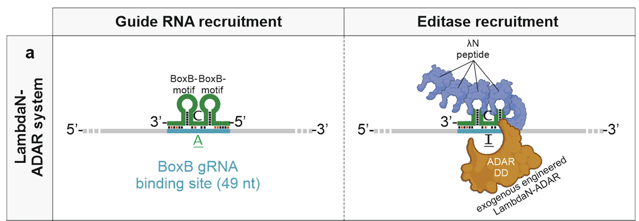
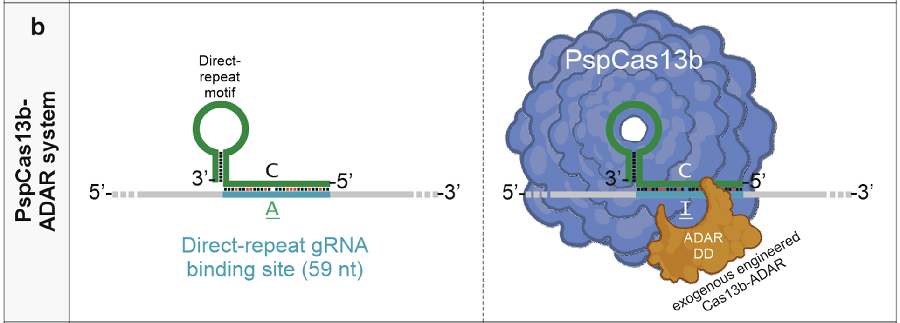
RNA editing using exogenous ADAR enzymes
λN-ADAR
Cas13-ADAR
Correction of mutations within the cystic fibrosis transmembrane conductance regulator by site-directed RNA editing. Proc. Natl Acad. Sci. USA 110, 18285–18290 (2013).
RNA editing with CRISPR–Cas13. Science 358, 1019–1027 (2017).
Notes:
The systems presented are the λN-ADAR system (on the left) and the Cas13-ADAR system (on the right). Both approaches are designed to facilitate adenosine-to-inosine (A-to-I) RNA editing by recruiting engineered ADAR enzymes to specific RNA sequences.
λN-ADAR System (Left Panel)
1. Guide RNA Recruitment: In this system, a guide RNA (gRNA) containing a BoxB motif binds to the target RNA. This motif interacts with a peptide (λN peptide) which is attached to the ADAR enzyme, thus helping to localize the enzyme to the target sequence.
2. Editase Recruitment: Once the λN peptide is bound to the BoxB motif on the guide RNA, it recruits the ADAR enzyme. The engineered ADAR, attached to the λN peptide, can then act on a specific adenosine (A) residue, converting it to inosine (I), which is read as guanosine (G) during translation, thereby altering the protein sequence if within a coding region.
This system is noted for its reliance on the λN peptide and BoxB motif interaction, which provides specificity in guiding ADAR to the target RNA region.
Cas13-ADAR System (Right Panel)
1. Guide RNA Recruitment: The Cas13b protein (PspCas13b variant) is used as the primary RNA-binding scaffold. A guide RNA with a direct-repeat motif is associated with Cas13b, directing the complex to a specific target sequence on the RNA.
2. Editase Recruitment: The engineered ADAR enzyme is fused to the Cas13b protein, allowing it to be brought to the targeted RNA region where it can convert specific adenosines to inosines. The ADAR enzyme remains localized to the site of interest due to its attachment to the Cas13b-gRNA complex.
This approach leverages the precision of the Cas13 system to bring ADAR to the target, making it an effective tool for site-specific RNA editing.

Slide 8
Limitations of exogenous ADAR editing systems
A guide RNA plus a protein component needs to be delivered;
Nonhuman protein domains are included;
Global off-targeting editing hampers clinical development
Harnessing ubiquitously expressed endogenous ADAR enzymes for RNA base editing.

Slide 9
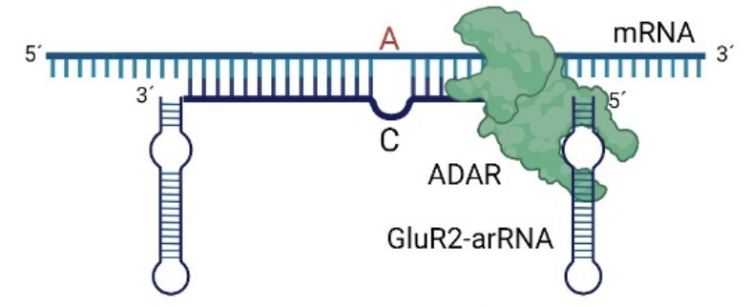
RNA editing using endogenous ADAR: GluR2-ADAR
2. Antisense region (ASR)
1. ADAR recruiting region (ARR)
doi.org/10.3389/fnmol.2023.1092913
Notes:
This slide illustrates RNA editing using the endogenous ADAR (Adenosine Deaminase Acting on RNA) enzyme specifically targeting the GluR2 receptor mRNA. The process depicted here relies on guiding the ADAR enzyme to the mRNA sequence through structural regions in the RNA itself, enabling adenosine-to-inosine (A-to-I) conversion at specific sites, which can influence protein function.
Key Components of the GluR2-ADAR Editing System
1. ADAR Recruiting Region (ARR):
• This region is a structured RNA segment that recruits the ADAR enzyme to the target RNA. The GluR2-arRNA (antisense RNA associated with the GluR2 receptor mRNA) has specific sequences and structures that allow it to bind with ADAR.
• The ARR serves as a docking site, positioning ADAR at a nearby target adenosine on the mRNA strand. This positioning is crucial for enabling selective A-to-I editing at the intended site, rather than affecting other adenosines in the mRNA.
2. Antisense Region (ASR):
• The ASR is a complementary sequence on the guide RNA that pairs with the target mRNA near the editing site.
• This region helps align the target adenosine (marked as “A” in red on the slide) with the ADAR enzyme, enhancing the specificity of the editing process.
• By forming a double-stranded RNA structure through base pairing, the ASR creates a recognition site that allows ADAR to identify and edit the specific adenosine to inosine (recognized as guanosine in translation).
Process Summary
In this system, the ADAR enzyme binds to the ARR, guided by the specific RNA structures in GluR2-arRNA. The ASR then aligns the ADAR enzyme with the targeted adenosine, where the enzyme performs the A-to-I conversion. This RNA editing event can impact the function of the GluR2 protein, which plays a critical role in neuronal function by affecting ion channel properties in the brain.

Slide 10
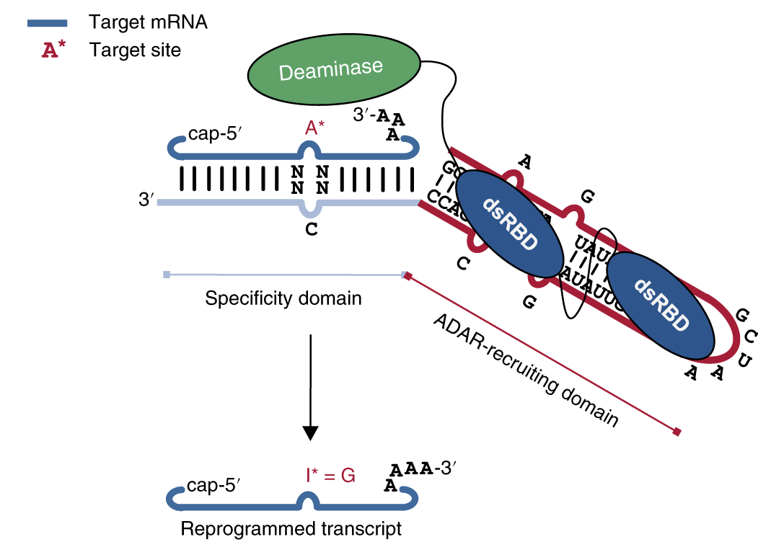
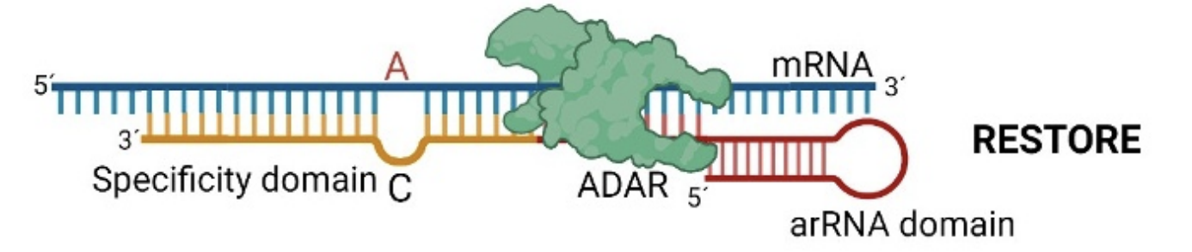
RNA editing using endogenous ADAR: RESTORE
RESTORE (Recruiting Endogenous ADAR to Specific Transcripts for Oligonucleotide-mediated RNA Editing) uses short (20–40 nucleotide) chemically modified ASO.
The modified gRNA is recruiting endogenous ADAR to the target location and is composed of two domains; 1) an invariant R/G ADAR recruiting domain to guide the endogenous ADAR to the gRNA-mRNA hybrid, and 2) the programmable specificity domain that dictates target mRNA binding
doi.org/10.1038/s41587-019-0013-6
Notes:
An improved system termed RESTORE (Recruiting Endogenous ADAR to Specific Transcripts for Oligonucleotide-mediated RNA Editing) uses short (20–40 nucleotide) chemically modified antisense oligonucleotides. ASOs comprise a programmable specificity domain that determines target mRNA binding and an invariant ADAR-recruiting domain to steer endogenous ADAR to the ASO:mRNA hybrid.
The modified gRNA is recruiting endogenous ADAR to the target location and is composed of two domains; 1) an invariant R/G ADAR recruiting domain to guide the endogenous ADAR to the gRNA-mRNA hybrid, and 2) the programmable specificity domain that dictates target mRNA binding [15,60]. The high potential of RESTORE for therapeutic application was shown by correcting mutations in disease-relevant transcripts. In fact, the ease and versatility of delivery of the ASO may simplify the clinical application through applying several delivery strategies for oligonucleotides considerably. Delivery could be achieved via liposomal nanoparticles or by linkage to moieties that facilitate cellular uptake such as Nacetylgalactosamine (GalNAc) which target hepatocytes. Several chemical modifications were applied and tested for the RESTORE guide RNAs to improve efficiency and specificity. These included 2ʹO-CH3, phosphorothioate linkage, and locked nucleic acids. While the former modifications are known to improve the stability of RNAs when introduced at their ends, it was surprising to see that also internal 2ʹO-CH3 additions helped to improve editing efficiency.

Slide 11
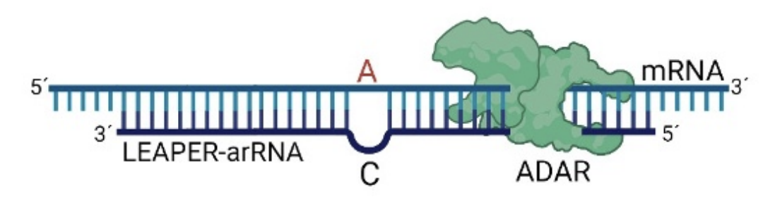
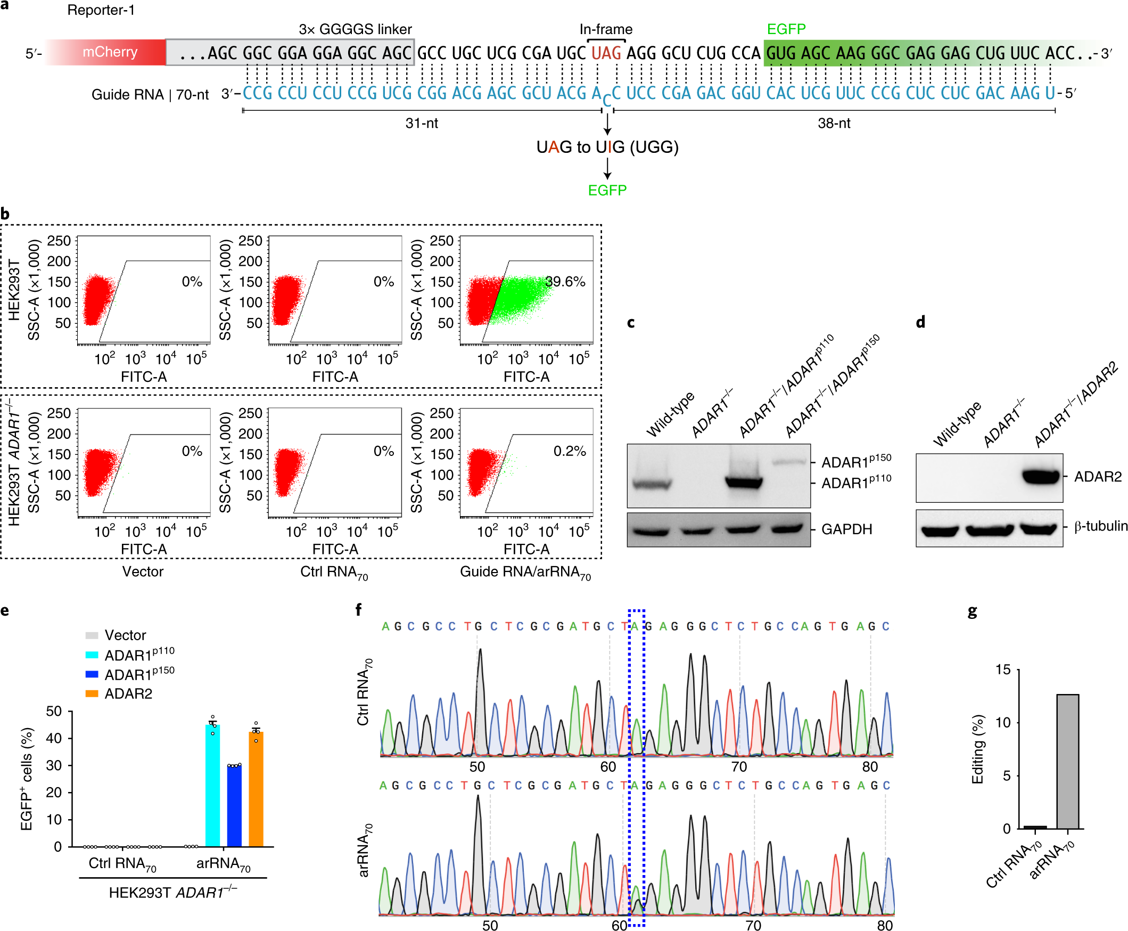
RNA editing using endogenous ADAR: LEAPER
LEAPER (Leveraging Endogenous ADAR for Programmable Editing of RNA) utilizes long antisense RNAs (71–191 nucleotides) to generate double-stranded regions to attract ADARs
https://doi.org/10.1038/s41587-019-0178-z
Notes:
LEAPER (Leveraging Endogenous ADAR for Programmable Editing of RNA) utilizes long antisense RNAs (71–191 nucleotides) to generate double-stranded regions to attract ADARs [67]. While LEAPER does not intend to mimic a particular substrate, the long regions resemble typical repeat-derived ADAR1 substrates that stimulate binding and editing by endogenous ADAR1. LEAPER shows an efficiency of up to 50% on endogenous targets and limited off-target editing [67]. Like in other approaches, the gRNA contains a single A-C mismatch at the target site to direct editing [67]. Interestingly, partial randomization of guide RNAs also allowed selection of optimized nucleotide compositions. Moreover, LEAPER was used to simultaneously target editing at different sites allowing multiplex editing through the use of several gRNAs [60]. The lack of specific chemical modifications in the RNA allows delivery by viral vectors, by transcriptionally active plasmids, or as a synthetic oligonucleotide into different cell types, including multiple human primary cell types.
A 70-nucleotide guide RNA targets a reporter mRNA that contains an mCherry fluorescent protein sequence followed by a premature stop codon (UAG). Editing this UAG to UIG (which functions as UGG, coding for tryptophan) restores the full reading frame and allows expression of EGFP (Enhanced Green Fluorescent Protein).
• Successful editing by LEAPER converts the stop codon to a codon for tryptophan, enabling the synthesis of EGFP, which serves as a measurable indicator of editing success.
The bar graph on the right shows the percentage of cells expressing EGFP (indicating successful editing) in different experimental conditions.
• Cells transfected with different ADAR constructs (ADAR1p110, ADAR1p150, and ADAR2) show varying levels of editing efficiency when paired with LEAPER-arRNA.
• The vector control and control RNA (Ctrl RNA) show no significant EGFP expression, indicating no editing. In contrast, cells transfected with ADAR and LEAPER-arRNA show high levels of EGFP expression, confirming that the LEAPER system effectively induces RNA editing.

Slide 12
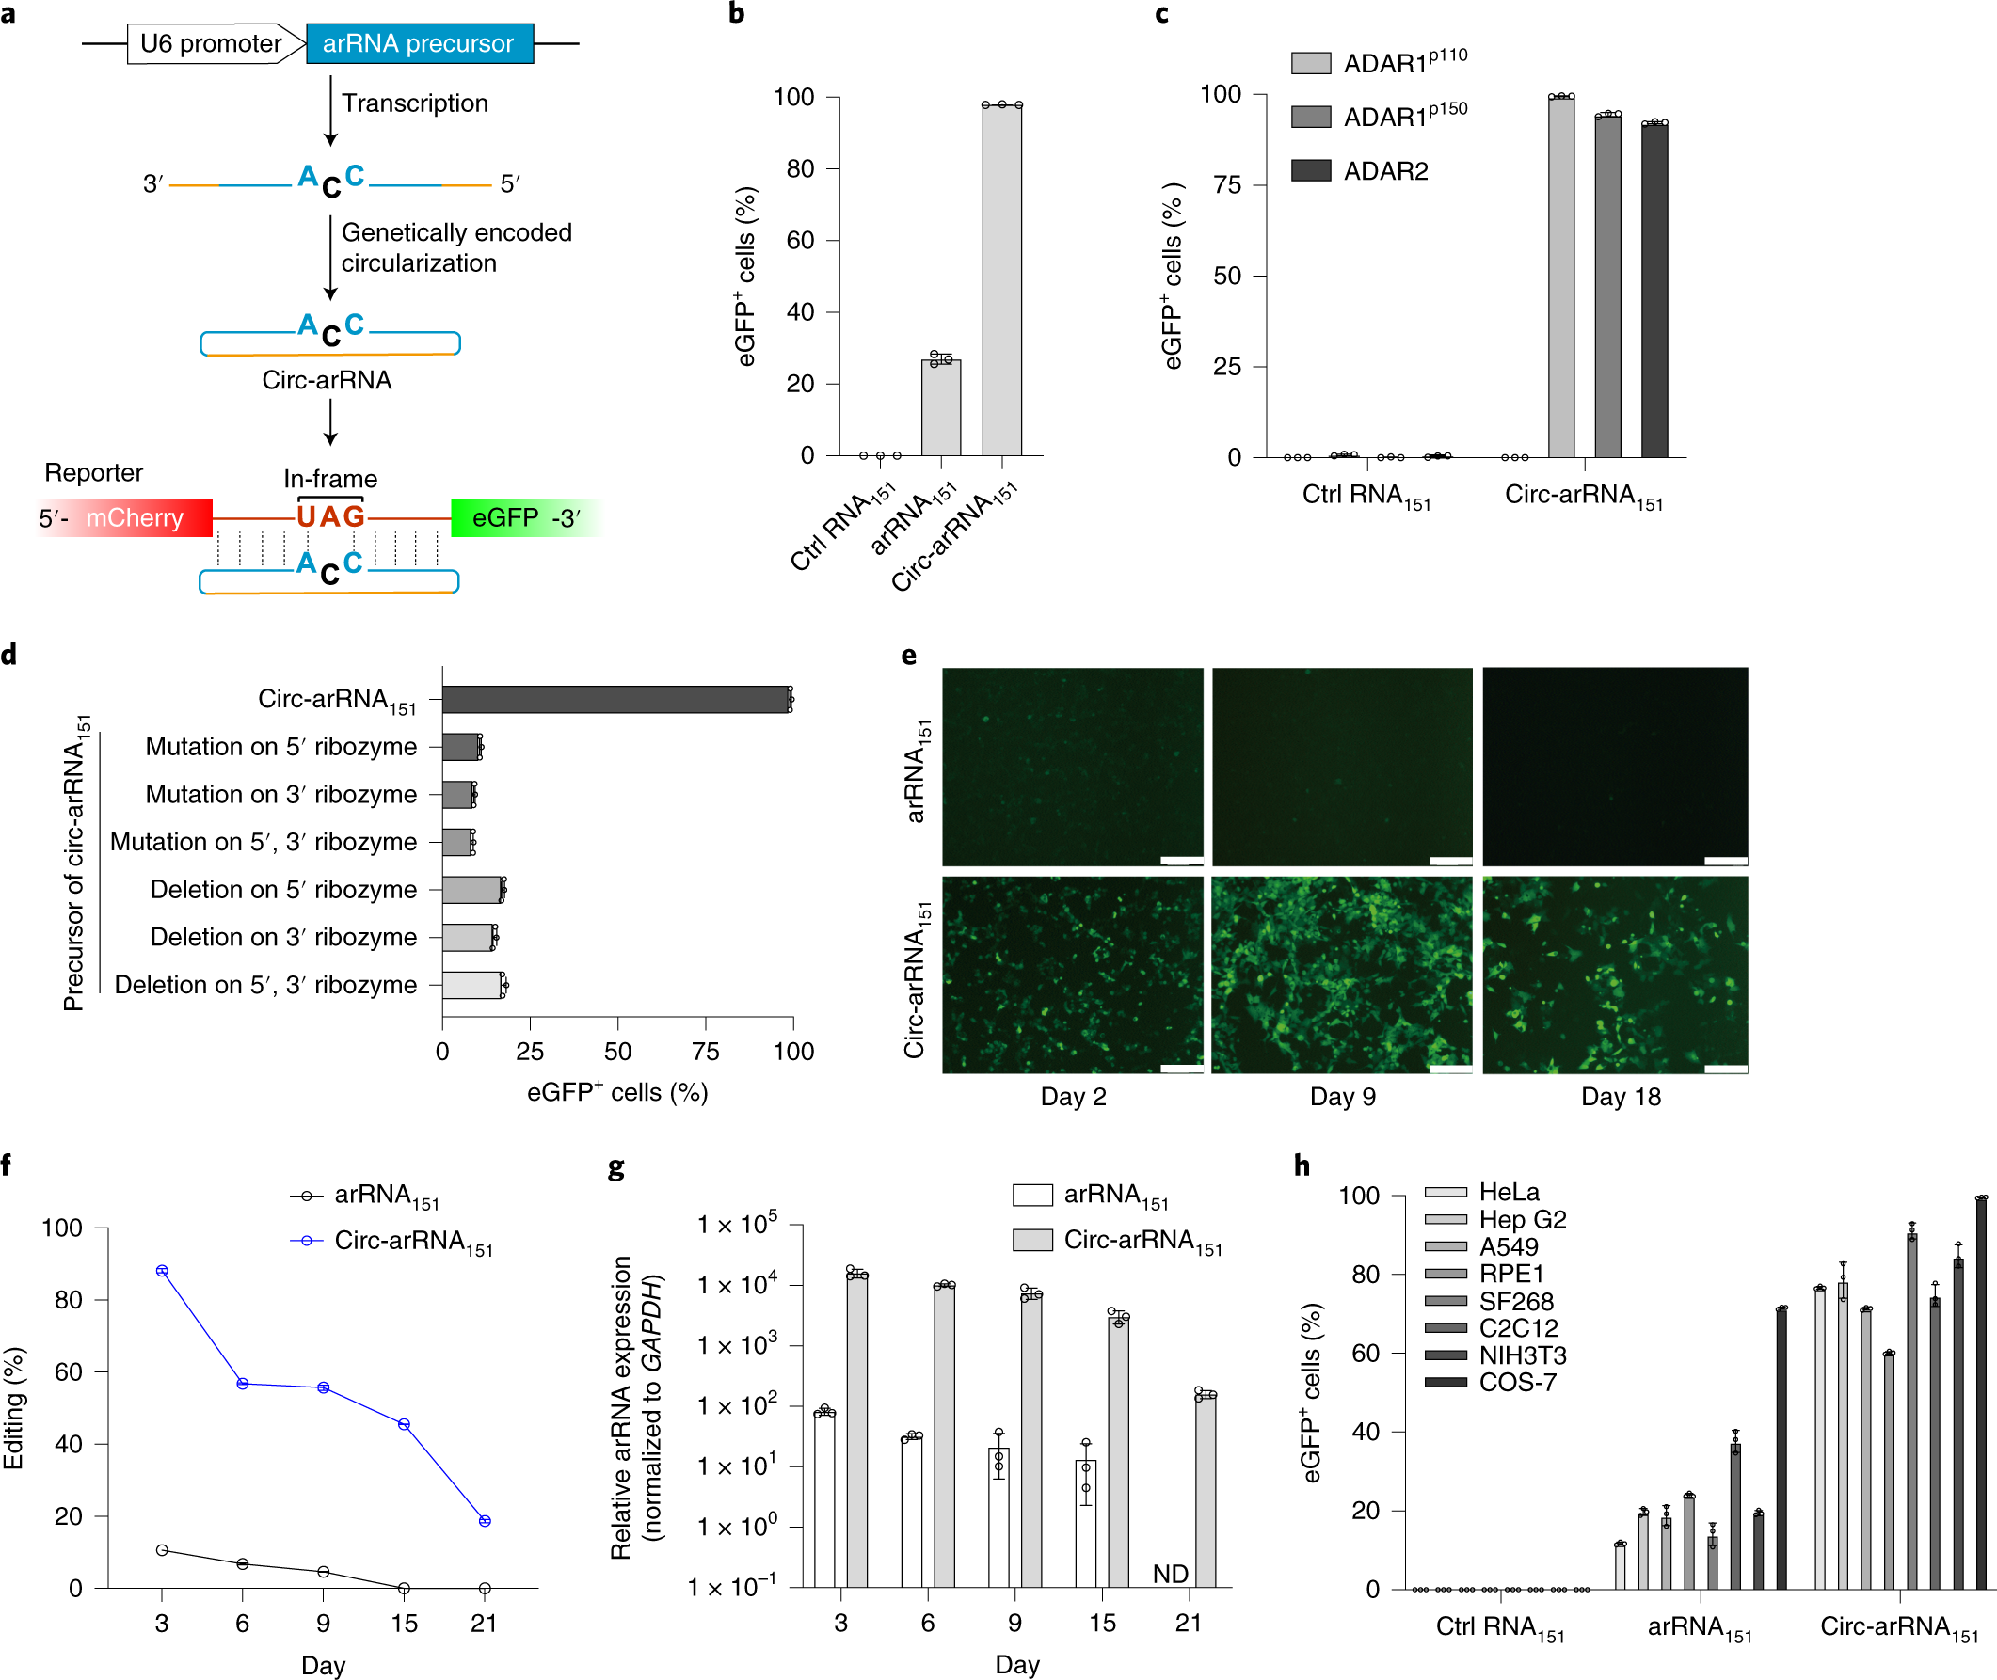
RNA editing using endogenous ADAR: LEAPER 2.0
doi.org/10.1038/s41587-021-01180-3
Notes:
Because of its safety and simplicity, LEAPER demonstrated considerable potential in scientific research and medical treatment. However, it has limitations. First, LEAPER suffered from limited editing efficiency as it employs endogenous editing enzymes. Second, there are chances for ADAR to deaminate certain adenosines within the double-stranded region formed by targeting RNA and arRNA, resulting in bystander off-target editing. Therefore, there is still room for improvement in LEAPER′s efficiency and specificity. In the paper, Yi et al . described an updated version of LEAPER termed “LEAPER 2.0”, in which they devised covalently closed circular arRNAs (circ-arRNA), instead of linear arRNA used in LEAPER, to recruit ADAR. This circ-arRNA, with significantly improved stability, achieved on average ~3-fold higher editing efficiency than their linear counterpart when expressed in cells or delivered as in vitro-transcribed circular RNA oligonucleotides. To lower off-target editing, they deleted uridines paired with potential off-target adenosines. This strategy eliminated nearly all bystander off-target editing. Engineered circ-arRNAs enhanced the editing efficiency and fidelity, as manifested by editing outcomes observed in endogenous CTNNB1 and mutant TP53 transcripts in cell culture. Delivery of circ-arRNAs using the adeno-associated virus in a mouse model of Hurler syndrome corrected the pathogenic point mutation and restored α-L-iduronidase catalytic activity, lowering glycosaminoglycan accumulation in the liver. As such, LEAPER 2.0 provides a new design of endogenous ADAR-recruiting RNA that enables more efficient and precise RNA editing with broad applicability for therapy and basic research.

Slide 13
RNA editing using endogenous ADAR: LEAPER 3.0
Mapping where ADAR actually contacts the duplex turns arRNA design into a structural problem
Three barriers inherited from LEAPER 2.0
ADAR's footprint on the duplex
Thousands of AlphaFold3 models of ADAR1/ADAR2–dsRNA complexes, analysed statistically and then tested by EMSA and reporter assays in cells.
1
Bystander editing
arRNAs pair over >100 bp, and ADAR edits adenosines all along the duplex, not just the intended one.
edited A
Target RNA
arRNA
2
Sequence context
ADAR prefers 5'-UAN. 5'-CAN and 5'-GAN sites edit poorly, which puts many disease alleles out of reach.
ADAR1
−4 to +24
ADAR2
−6 to +11
Pink flanks: the ADAR-covered peripheral region. No direct contact, yet structure there still tunes catalysis.
Design consequences
• Deaminase and DRBM domains sit asymmetrically, biased 3' of the edited A.
• A bulge inside the window kills editing; outside it, it tunes editing.
• A–C mismatches hold the deaminase under distortion; A–U pairs do not.
3
Single-base precision
Where target and bystander adenosines sit side by side, as in the SERPINA1 PiZZ CAAG codon, near-miss edits give the wrong amino acid.
Song et al., Cell 189, 4359–4376 (2026). https://doi.org/10.1016/j.cell.2026.04.047
Notes:
LEAPER 2.0 left us with three problems, and LEAPER 3.0 is the attempt to solve all three from structure rather than from screening.
Start with the problems on the left. First, bystander editing. An arRNA has to pair over more than a hundred base pairs to recruit ADAR efficiently, and ADAR will happily deaminate adenosines anywhere along that duplex. Second, sequence context. ADAR has an intrinsic preference hierarchy, 5'-UAN greater than AAN greater than CAN greater than GAN, so a large share of pathogenic sites, including roughly sixty percent of premature termination codon disorders, sit at motifs that edit poorly. Third, precision. When the target adenosine has another adenosine immediately next to it, as in the SERPINA1 PiZZ CAAG codon, editing the wrong one of the pair gives you arginine or glycine instead of the glutamate you wanted.
Now the approach on the right. The Wei lab used AlphaFold 3 to model ADAR1 and ADAR2 bound to double-stranded RNA. Individual predictions were unreliable, so they modelled thousands of duplexes and analysed the ensemble statistically. That gave them two maps: where the protein makes direct contact, and the larger footprint the protein covers.
The headline numbers are on this schematic. The composite interface formed by the deaminase domain and the double-stranded RNA binding motifs spans roughly minus four to plus twenty-four for ADAR1, and minus six to plus eleven for ADAR2, measured relative to the edited adenosine. Notice two things. The window is asymmetric, biased toward the three prime side. And ADAR2's footprint is shorter but reaches further on the five prime side, which is why the two isoforms will later want their bulges in different places.
The pink flanking region is the part I want you to remember, because it is the one that is easy to miss. It is covered by the protein but not contacted by it. Classical structures would say nothing happens there. It turns out that structure in that peripheral region strongly modulates catalysis, and that is where LEAPER 3.0 finds most of its efficiency gain.
One mechanistic point before we move on, because the next slide depends on it. Bulges inside the DRBM-binding region disrupt editing much more severely at A-U base pairs than at A-C mismatches. The A-C mismatch keeps the deaminase docked even when the duplex is locally distorted. That differential is the entire basis for selective bystander suppression, because your intended site is an A-C mismatch and your bystanders are A-U pairs.

Slide 14
LEAPER 3.0: dual-bulge arRNA design
One rule: internal bulges buy precision, external bulges buy efficiency, and the two combine
ADAR core binding window
A
Target
arRNAβ
C
External bulge (28/0 nt at −31)
boosts ADAR2 editing
Internal bulge (1/0 or 4/4 nt, +3 to +20)
blocks neighbouring A–U bystanders
External bulge (10/0 nt at +34)
boosts ADAR1 editing
USH2A c.11864G>A
39.8%
vs 25.3% with LEAPER 2.0 arRNA
mDMD C3197T
20.7%
vs 6.1%; a 5'-UAAAA site ADAR normally refuses
SERPINA1 PiZZ
29%
vs 12.8%, with adjacent bystanders suppressed
In vivo, AAV8-delivered circ-arRNAβ: 11.6% editing in the retina of USH2A mice │ 60.3% editing in PiZZ mouse liver with ~40% of transcripts precisely corrected, insoluble SERPINA1 aggregates reduced
Song et al., Cell 189, 4359–4376 (2026). https://doi.org/10.1016/j.cell.2026.04.047
Notes:
This is the payoff slide. LEAPER 3.0's guide is called arRNA-beta, where beta stands for bulge, and it is a circular arRNA carrying bulges in two functionally distinct places.
Look at the schematic. The internal bulge sits inside the ADAR binding window, between about plus three and plus twenty relative to the target adenosine. It can be as small as a single unpaired nucleotide, a one-slash-zero bulge, or a four-slash-four bulge where both strands loop out. Its job is suppression. Because A-U pairs are far more sensitive to local distortion than A-C mismatches, a single well-placed bulge switches off bystander editing across roughly twenty-four base pairs of duplex while your intended A-C site keeps editing. Note the window matters: a bulge between minus three and plus three sits right on the catalytic site and abolishes editing altogether.
The external bulges sit out in that peripheral region we discussed, outside any direct contact. These do the opposite: they raise efficiency. The optimum differs by isoform, and this is a nice example of structure predicting behaviour. ADAR1 responds to a bulge on the three prime side, around position plus thirty-four, typically a ten-slash-zero configuration. ADAR2 prefers the five prime side, around minus thirty-one, with a larger twenty-eight-slash-zero bulge. Because those positions are roughly symmetric about the site, you can install both in one guide, and then the same arRNA works whether the target cell is ADAR1-dominant, ADAR2-dominant, or mixed. That isoform robustness is a practical point for therapy, because you often do not control which isoform dominates in the target tissue.
The three results panels are the disease tests in HEK293T. Usher syndrome USH2A went from about twenty-five percent with a conventional arRNA to just under forty percent, with bystander editing largely suppressed. The mouse DMD site is the most interesting one scientifically: it is a 5'-UAAAA context, a stop codon that requires editing two consecutive adenosines, and conventional arRNA managed about six percent. With bulges it reached twenty percent. That is editing at a motif ADAR's own sequence preference says should not work, which is the claim that the editable sequence space has genuinely expanded. SERPINA1 PiZZ roughly doubled while suppressing the adjacent edits that would have produced lysine, arginine or glycine instead of glutamate.
The dark strip is the in vivo evidence. Subretinal AAV8 in a humanised USH2A mouse gave 11.6 percent editing, which the authors point out exceeds what dual-AAV Cas13 editors achieved in the same tissue, and the whole cassette fits in a single AAV because it needs under 800 base pairs, no protein. In the PiZZ liver model, 60.3 percent total editing with about forty percent of transcripts carrying the precise single-amino-acid correction, and histology showing fewer insoluble SERPINA1 globules.
Two questions worth sitting with. First, total editing of sixty percent but only forty percent precise: what accounts for the gap, and does it matter for a loss-of-function versus a gain-of-function disease? Second, everything in vivo here used AAV. What changes if you deliver the same circular arRNA as a lipid nanoparticle formulation instead?

Slide 15
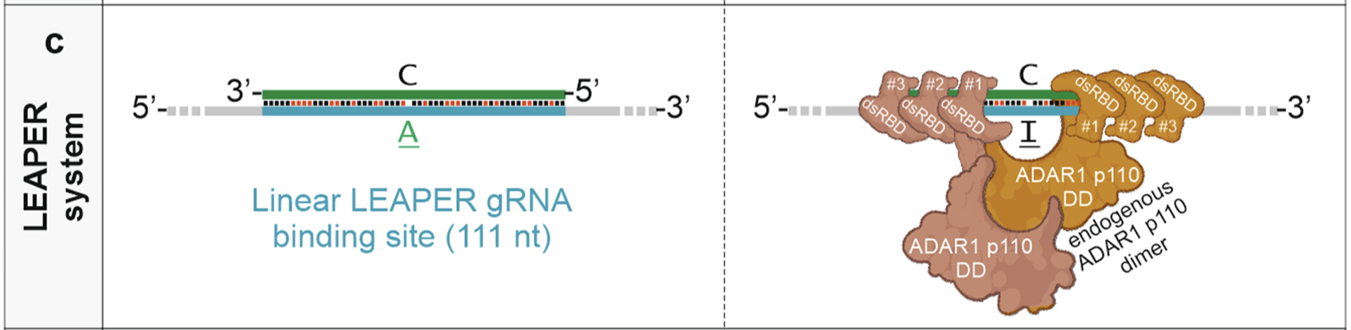

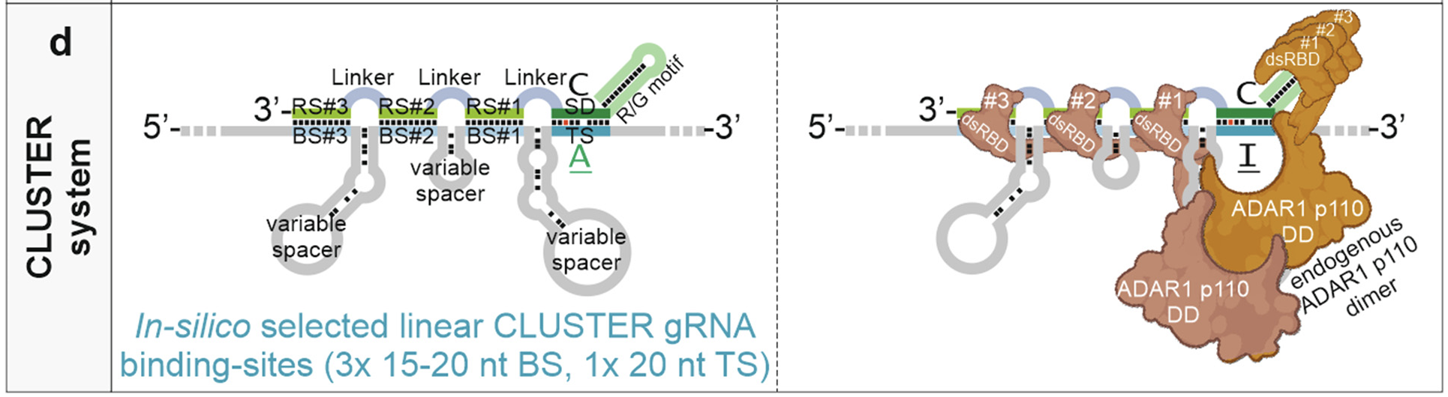

Harnessing endogenous ADAR enzymes by guide RNAs
LEAPER strategy:
CLUSTER strategy:
Programmable RNA editing by recruiting endogenous ADAR using engineered RNAs. Nat Biotechnol 37, 1059–1069 (2019). https://doi.org/10.1038/s41587-019-0178-z;
CLUSTER guide RNAs enable precise and efficient RNA editing with endogenous ADAR enzymes in vivo. Nat Biotechnol 40, 759–768 (2022). https://doi.org/10.1038/s41587-021-01105-0
Notes:
• Guide RNA Structure: LEAPER employs a single, linear guide RNA (gRNA) that is about 111 nucleotides in length. This gRNA binds to the target mRNA in a straightforward, complementary manner, forming a double-stranded RNA (dsRNA) structure at the editing site.
• ADAR Recruitment: LEAPER relies on a simple dsRNA structure to recruit ADAR. The ADAR enzyme binds to the gRNA-target RNA duplex and performs adenosine-to-inosine (A-to-I) editing at the target adenosine.
• Mechanism: The LEAPER system uses a single, long linear gRNA to recruit ADAR directly to a specific site on the mRNA for editing. This simplicity makes LEAPER efficient for single-site editing but limits its capability for more complex RNA structures or sequences.
• Applications: LEAPER is primarily used for editing single adenosines, making it effective for straightforward RNA editing applications, such as correcting specific mutations in disease-related mRNA.
CLUSTER (Clustered Guide RNAs for Enhanced ADAR Recruitment)
• Guide RNA Structure: CLUSTER uses a more complex design, with multiple short binding sites (15–20 nucleotides) and linkers organized in tandem. This configuration consists of multiple binding sites (labeled as BS#1, BS#2, BS#3) and a target site (TS) at the editing location.
• ADAR Recruitment: The multiple binding sites and linkers in the CLUSTER system enhance ADAR recruitment by providing multiple points of interaction. These clustered binding sites stabilize the interaction with ADAR, improving editing efficiency and precision. The multiple sites allow for stronger and potentially more specific binding to the target, facilitating editing in contexts where a single binding site might be insufficient.
• Mechanism: CLUSTER’s strategy uses multiple, in silico-designed binding sites and linkers to cluster ADAR around the target RNA region. This clustering enhances ADAR’s ability to focus on the target adenosine, increasing the likelihood and specificity of editing. The variable spacers and linkers allow the CLUSTER gRNA to adopt a more complex, stabilized structure.
• Applications: The CLUSTER system is useful in cases where higher editing efficiency or greater specificity is required, or in situations where single-guide strategies like LEAPER may not work well. The CLUSTER design is ideal for in vivo applications and challenging RNA targets that require more stable ADAR recruitment.

Slide 16

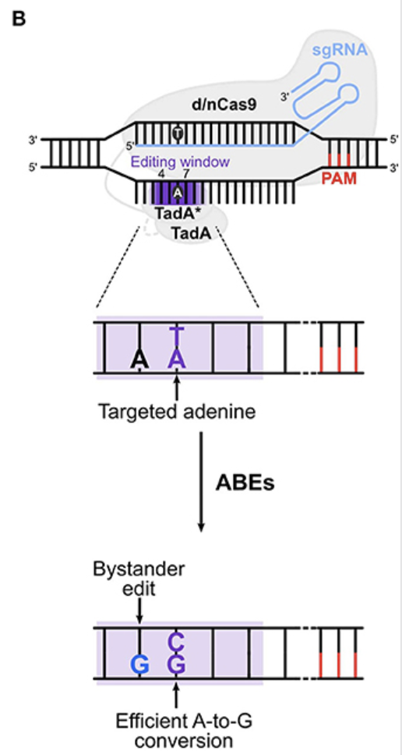
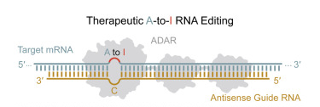
Massive bystander editing in gRNA-target RNA duplex
Factors Contributing to Bystander Editing
Duplex size
Editable Adenosines: the presence of highly editable A bases all over the duplex
ADAR Preferences in Base Neighboring Positions:
Both ADAR1 and ADAR2 prefer similar nearest neighboring bases (for example, U > A > C > G at the 5′ position relative to the target A and G > C ≈ A > U or G > C > U ≈ A at the 3′ position)
Dominant Triplets in Bystander Editing:
Bystander editing is dominated by a handful of preferred triplets, particularly all four 5′-UAN triplets (N = A, U, G or C), 5′-AAG and 5′-CAG
Notes:
This slide addresses the issue of bystander editing in RNA duplexes formed between guide RNAs (gRNAs) and target RNA during ADAR-mediated RNA editing. Bystander editing occurs when unintended adenosines near the target site are also edited due to the presence of ADAR enzymes, which can affect the specificity and safety of therapeutic RNA editing applications.
Key Components and Mechanism of Bystander Editing
1. gRNA-Target RNA Duplex Structure:
• The RNA duplex formed between the gRNA and the target mRNA is often large, typically 70–200 base pairs. This extensive duplex increases the likelihood that ADAR will encounter multiple editable adenosines (A sites) within the region, leading to off-target or “bystander” A-to-I (adenosine-to-inosine) edits.
• The presence of multiple adenosines in the duplex exposes many potential editing sites, which can lead to unintended modifications if ADAR binds to and edits these additional adenosines.
2. Factors Contributing to Bystander Editing:
• Duplex Size: The large duplex size increases the number of accessible adenosines for ADAR, creating more opportunities for off-target editing.
• Editable Adenosines: The widespread presence of editable adenosines across the duplex provides multiple potential sites for ADAR activity, which often leads to editing beyond the intended target adenosine.
3. ADAR Preferences in Base Neighboring Positions:
• Both ADAR1 and ADAR2 exhibit preferences for certain nucleotide sequences around the target adenosine, influencing where bystander edits are likely to occur.
• Preferred neighboring bases at the 5’ position relative to the target adenosine include U > A > C > G, while the preferences at the 3’ position are G > C > U ≈ A. These preferences guide ADAR toward specific triplet sequences within the duplex, which contributes to bystander editing in predictable patterns.
4. Dominant Triplets in Bystander Editing:
• Bystander editing tends to occur in certain nucleotide triplets that ADAR favors, specifically 5’-UAN (where N can be any nucleotide) and 5’-AAG or 5’-CAG.
• These triplets are common bystander sites, and the presence of such sequences within the RNA duplex increases the likelihood that ADAR will perform unintended edits.
5. Example of Unintended Bystander Editing:
• The figure on the left illustrates an example where ADAR edits the targeted adenosine but also makes edits at nearby bystander sites, leading to multiple A-to-I conversions across the duplex.

Slide 17
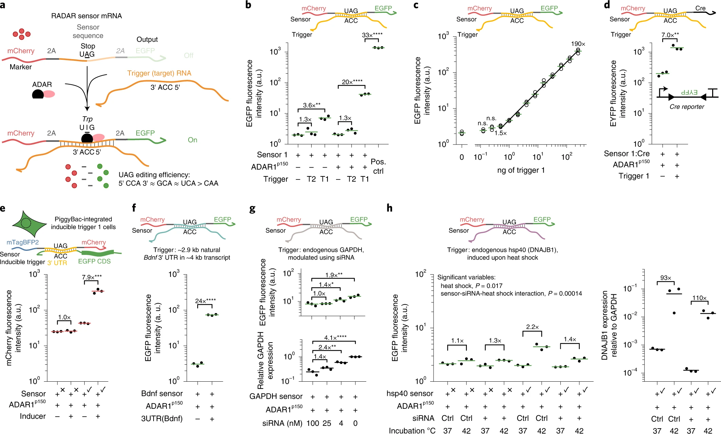
RNA switch using ADAR (RADAR)
doi.org/10.1038/s41587-022-01617-3
Notes:
This is the pivot point of the lecture. Everything up to here used ADAR to repair a transcript: LEAPER, RESTORE, CLUSTER, LEAPER 2.0 and 3.0 all treat the edit as the therapeutic product.
RADAR inverts that. The edit is no longer the goal, it is the readout. The system puts a stop codon in the path of a ribosome and lets ADAR remove it only when a chosen RNA is present in the cell. So instead of asking what can we correct, we are asking what can we detect, and then what can we make the cell do about it.
Keep one thing in mind as we go through the next four slides. Everything we learned about ADAR's preferences still applies: the A-C mismatch, the 5' neighbour preference, the long duplex requirement, the bystander problem. The difference is only in what we do with the inosine once it is there.

Slide 18
RADAR: a stop codon that ADAR can erase
The same enzyme used for repair, run in reverse: editing is the readout, not the goal
1. Sensor at rest
2. Target RNA binds
3. ADAR edits, output is made
CCA
marker CDS
UAG
output CDS
ADAR
UIG
read as UGG = Trp
One mRNA carries a marker protein, a sensor region, an in-frame UAG stop codon and the output protein.
The stop codon is the switch. Ribosomes translate the marker and halt, so only mCherry is made.
UAG
Endogenous or supplied ADAR deaminates that A to inosine. The ribosome reads inosine as G, so UAG becomes UIG and is decoded as tryptophan.
Translation reads through and the output protein appears, in proportion to how much trigger RNA is present.
The trigger transcript is reverse-complementary to the sensor, so the two form dsRNA.
A CCA codon is placed opposite the UAG, giving an A–C mismatch at the adenosine ADAR likes best.
Why the 3' UTR
Triggers are chosen in 3' UTRs: editing is more efficient there, ribosomes are less likely to melt the duplex, and bystander edits miss the coding sequence. 57% of human genes have a 3' UTR long enough.
Self-contained
2A sequences insulate the flanking coding regions, so one transcript carries sensing and output. No promoter engineering, and it works in Nicotiana, which has no ADAR of its own.
The baseline problem
Output in the absence of trigger sets the floor on dynamic range. Promoter choice matters most: SFFV gives near-autofluorescence baseline.
Kaseniit et al., Nat Biotechnol 41, 482–487 (2023). https://doi.org/10.1038/s41587-022-01493-x
Notes:
Now we flip the problem. Everything so far used ADAR to repair a transcript. RADAR uses ADAR to read one. The edit is not the therapeutic product, it is the signal.
Walk through the three steps. At rest, the sensor is a single mRNA with four parts: an optional marker coding sequence, a sensor region, an in-frame UAG stop codon, and the output coding sequence downstream. Because the stop codon sits between the marker and the output, ribosomes translate the marker, hit the stop, and fall off. Only mCherry is made. That is the off state.
Step two. The sensor region is designed to be reverse-complementary to a target RNA, which the authors call the trigger. When the trigger is present in the cell, the two hybridise and you get double-stranded RNA, which is the natural substrate for ADAR. The important design detail is that a CCA codon is positioned opposite the UAG. That places a cytosine across from the adenosine you want edited, creating an A-C mismatch, which as we saw earlier is ADAR's preferred local geometry.
Step three. ADAR deaminates that adenosine to inosine. The ribosome reads inosine as guanosine, so UAG becomes effectively UGG, which is tryptophan. The stop codon is gone, translation reads through, and the output protein is made. The output scales with trigger abundance, and in the paper the response is linear across two orders of magnitude of input plasmid.
Three design points on the bottom row. Why the three prime UTR? Three reasons: ADAR edits more efficiently there than in coding sequence, translating ribosomes in a coding region would tend to melt the duplex you need, and any bystander editing lands outside the protein-coding part of the trigger, so it is less likely to be harmful. Fifty-seven percent of human genes and seventy-three percent of mouse genes have a 3' UTR of at least ninety base pairs.
Second, the system is self-contained. 2A peptide sequences flank the sensor so that the coding regions on either side are insulated from the variable sensor sequence. There is no promoter engineering, no cell-type-specific cis-regulatory element to find. The proof that the mechanism needs nothing but ADAR is that it worked in Nicotiana benthamiana, a plant with no endogenous ADAR, once the authors supplied the enzyme.
Third, the honest limitation: baseline. Some output appears with no trigger at all, and that floor sets your dynamic range. The authors tested whether it comes from leaky editing or readthrough and concluded it probably does not; their current hypothesis is promoter-dependent cryptic splicing that skips over the stop codon. Choosing the SFFV promoter pushes baseline down to near autofluorescence. Worth noting as a reminder that in synthetic biology the off state is usually harder to engineer than the on state.

Slide 19
RADAR: how far the sensor can be pushed
Programmable by base pairing alone, and able to read sequence as well as abundance
Dynamic range
33×
Activation with a matched trigger and ADAR1 p150 supplementation. ADAR1 p150 was the most effective isoform tested.
Minimum duplex
72 bp
Performance holds down to 72 bp of pairing; a split design rescues a non-functional 36 bp sensor by borrowing 54 bp elsewhere in the same transcript.
Transcriptome coverage
>85%
Of human and mouse genes have at least one candidate trigger once 3' UTR, split, CDS and split-CDS designs are allowed.
Input sensitivity
34–59%
Of wild-type GAPDH levels, measured by siRNA titration. RADAR reads relative abundance, not absolute copy number.
Three capabilities a transcriptional reporter cannot match
What to be sceptical about
• Only a subset of sensors against endogenous triggers worked; performance is still hard to predict from sequence.
• 1–2.5% of reads carry bystander edits in the trigger, concentrated in the duplex.
• Most demonstrations used triggers overexpressed from transfected plasmids.
• Overexpressing ADAR to gain dynamic range is itself a perturbation of the host cell.
Logic. Concatenating two sensor sequences puts two stop codons in series, so both triggers are required: compact AND logic with no extra parts. OR logic follows from two sensors in parallel.
Sequence identity, not just level. Because ADAR reads the bases around the edited adenosine, RADAR tells TP53 R248W from R248Q, two mutations at the same codon with different invasive behaviour. Roughly 5% of ClinVar pathogenic variants are distinguishable this way.
Output amplification. Cre as the output converts a weak sensing event into a permanent genetic mark, at the cost of a higher baseline.
Kaseniit et al., Nat Biotechnol 41, 482–487 (2023). https://doi.org/10.1038/s41587-022-01493-x
Notes:
This slide is about what the system can actually do, and where I would push back if this were a paper you were reviewing.
Top row, the four numbers. Thirty-three-fold activation with a matched trigger when ADAR1 p150 is supplemented. Among the ADAR variants they tried, p150 gave the largest enhancement, which makes sense because p150 is the cytoplasmic isoform and the sensor mRNA is cytoplasmic.
Second, the duplex length. They started at 153 base pairs and shortened it. Performance largely held down to seventy-two base pairs. Below that it failed, but then they showed something clever: a non-functional thirty-six base pair sensor could be rescued by adding a second fifty-four base pair segment complementary to a different part of the same trigger transcript. That is the split design, and it matters because it lets you skip over inconvenient features: unwanted stop codons, strong secondary structure, miRNA binding sites, or the exact junction in a gene fusion.
Third, coverage. Once you allow 3' UTR, split, coding sequence, and split coding sequence designs, more than eighty-five percent of human and mouse genes have at least one candidate trigger. Pre-computed candidate lists are public, which is what makes this a platform rather than a one-off.
Fourth, and this is the real limitation: input sensitivity. Using siRNA knockdown of GAPDH as a tunable input, the sensor could not distinguish twenty-four from thirty-four percent of wild-type level, but was significantly elevated at fifty-nine percent and above. So RADAR reports relative abundance within a window. It is not a copy-number counter.
Bottom left, three things a promoter-based reporter cannot do. Logic is almost free here: concatenate two sensor sequences and you have two stop codons in series, so both triggers must be present. That is AND logic with no additional machinery, which is rare in synthetic biology. Second, and I think this is the most interesting claim in the paper, RADAR senses sequence identity, not only expression level. Because ADAR cares about the bases immediately around the edited adenosine, the sensor can discriminate TP53 R248W from R248Q, two mutations in the same codon that differ in invasiveness. The authors estimate around five percent of known or likely pathogenic ClinVar variants could be distinguished from their wild-type allele this way. Third, using Cre as the output turns a transient sensing event into a permanent genetic record, at the price of a higher baseline, since leaky Cre is also amplified.
Bottom right is the sceptic's column, and I want you to take it seriously. Of the sensors they designed against endogenous transcripts, only a subset were significantly above negative controls, and they could not fully explain why. One to two and a half percent of reads showed bystander edits in the trigger, which is editing someone else's mRNA as a side effect of measuring it. Most of the strong data used overexpressed triggers. And the dynamic range depends on overexpressing ADAR, which perturbs the cell you are trying to observe. For a sensing technology, that last point is a genuine conceptual tension.

Slide 20
RADARS: ADAR sensors that gate translation
Reprogrammable ADAR sensors: same stop-codon logic, rebuilt around the ribosome's behaviour
5' peptide
(236 aa mCherry)
MS2 loops × 5
ogRNA sensor region
UAG
out-of-frame
stops (+1, +2)
cargo CDS
Each added element attacks one source of trigger-independent output: self-folding of the guide, ribosome re-initiation downstream, and frame-shifted readthrough.
Activation gained step by step
Measured performance
• Detects transcripts down to 13 TPM (KRAS), and tracks siRNA knockdown with R > 0.86 against qPCR.
• Runs on endogenous ADAR alone: >35% stop-codon editing with no supplied p150, and still reports heat-shock induction of HSP70.
• Works as synthetic mRNA: in vitro transcribed sensor gave 28-fold activation after delivery.
Basic guide
20×
+ MS2 loops in an organised guide
~20×
+ 236-aa 5' peptide
163×
+ out-of-frame stop codons
277×
Cell-type identification
A SERPINA1-targeting sensor with a Cre cargo marked HepG2 cells and left A549 and HeLa untouched.
RNA-sensing cell death
The same guide with an inducible caspase-9 cargo killed HepG2 selectively, with no toxicity in the other two lines.
Multi-input logic
Guides fused in series gave a 36-fold AND gate on IL6 plus EGFP, versus 1.3–1.5-fold with either alone.
Jiang et al., Nat Biotechnol 41, 698–707 (2023). https://doi.org/10.1038/s41587-022-01534-5
Notes:
RADARS came out of the Abudayyeh and Gootenberg labs within weeks of RADAR, and it is the same core idea: a stop codon in a guide, erased by ADAR when the guide finds its target. What is worth your attention is that the engineering went in a different direction, and it is a good case study in how to raise signal to noise in a biological circuit.
The construct at the top reads left to right. There is a five prime peptide, a set of MS2 hairpin loops, the guide region itself, which they call an ogRNA for organised guide RNA, the UAG stop codon, out-of-frame stop codons, and then the cargo.
Here is the logic of each piece, and notice that every one of them attacks background rather than boosting signal. The MS2 hairpins interspersed through the guide give it secondary structure, which stops the long guide from folding on itself and creating an accidental double-stranded region that ADAR would edit with no target present. They also slow the ribosome, so it is less likely to barrel through the stop codon. The two-hundred-thirty-six amino acid five prime peptide exists because ribosome re-initiation after a stop codon depends on how long the upstream open reading frame is; a long one suppresses re-initiation. And the out-of-frame stop codons at plus one and plus two catch any ribosome that has slipped frame and would otherwise keep translating.
The ladder on the left is the result. A basic guide gives about twenty-fold. Organised guides with five MS2 sites, about the same but with much lower background. Adding the long five prime peptide takes it to one hundred sixty-three fold. Adding out-of-frame stops takes it to two hundred seventy-seven fold. The lesson is that nothing here made ADAR edit better. Every gain came from making the off state tighter.
On the right, the performance numbers that matter clinically. RADARS detected KRAS at thirteen transcripts per million, which is genuinely low abundance, and tracked siRNA knockdown across six genes with correlation above point eight six against qPCR. It runs on endogenous ADAR, achieving over thirty-five percent editing of the stop codon with no supplied enzyme, which turns it into a single-component system. And it works as synthetic mRNA: in vitro transcribed sensor delivered into cells gave twenty-eight-fold activation. That last point is the translational one, because it means you could in principle deliver an mRNA therapeutic that only translates its payload in the cells that carry a particular transcript.
The green strip is what you do with it. A SERPINA1-targeting sensor with a Cre cargo labelled HepG2 liver cells and left A549 and HeLa alone. Swap Cre for inducible caspase-9 and the same guide kills HepG2 selectively with no toxicity in the other lines. That is RNA-programmed cell killing without a cell-surface marker and without a promoter. And fusing guides in series gives a thirty-six-fold AND gate requiring both IL6 and EGFP, against one point three to one point five fold with either input alone.

Slide 21
RADAR and RADARS side by side
Two groups, one mechanism, different engineering priorities, and the same open questions
RADAR (Gao lab, Stanford)
RADARS (Abudayyeh / Gootenberg labs)
Core mechanism
Trigger RNA pairs with the sensor; ADAR edits an in-frame UAG to UIG; readthrough releases the output.
The same, with the guide rebuilt to minimise trigger-independent translation.
Reported activation
Up to 33× with ADAR1 p150 supplementation.
277× after stepwise guide engineering.
Detection floor
34–59% of wild-type GAPDH, by siRNA titration.
13 TPM (KRAS), with knockdown tracking R > 0.86.
ADAR requirement
Benefits strongly from exogenous ADAR1 p150.
Functional on endogenous ADAR alone; p150 improves it.
Distinctive strength
Discriminates single-nucleotide variants such as TP53 R248W vs R248Q; works in plants.
Low-abundance detection, synthetic mRNA delivery, caspase and Cre cargos for cell-selective action.
Shared open problems for the class to argue about
Does measuring a transcript change it? Both systems edit bystander adenosines in the trigger itself, and both work best with ADAR overexpressed, which alters editing genome-wide. Does the dsRNA trip innate immunity? RADARS saw no induction of IFNB1, MDA5, OAS1 or RIG-I in two cell lines, but neither paper tested primary cells. Can you predict a good sensor? Neither group can yet say from sequence alone which guide will work, which is the same design gap LEAPER 3.0 attacked structurally.
Kaseniit et al., Nat Biotechnol 41, 482–487 (2023) │ Jiang et al., Nat Biotechnol 41, 698–707 (2023)
Notes:
Let us put the two side by side, because they were published eight weeks apart and it is instructive to see two groups solve the same problem with different instincts.
The mechanism row is nearly identical, and that is the point: both are ADAR-dependent stop-codon switches. Where they differ is what each group decided was the bottleneck. The Gao lab treated it as a modularity and specificity problem, and their best results are about what the sensor can distinguish: single-nucleotide variants, gene fusions, logic, and function in a plant with no native ADAR. The Abudayyeh and Gootenberg labs treated it as a signal-to-noise problem and spent their effort on the off state, which is why their fold-activation number is an order of magnitude higher and why they can see a thirteen TPM transcript.
Be careful comparing the activation numbers directly. Thirty-three-fold and two hundred seventy-seven-fold are not measured on the same construct, the same reporter, or the same cells. Fold activation is a ratio, and you can raise it either by increasing the numerator or by suppressing the denominator. RADARS mostly did the latter. When you read synthetic biology papers, always ask whether a large fold change reflects a better on state or just a quieter off state, because those have different consequences downstream.
The ADAR requirement row is the one with the most practical weight. RADARS being functional on endogenous ADAR alone makes it a single-component system, which means one AAV, one mRNA, one plasmid. That matters for delivery in exactly the way the single-AAV argument mattered for LEAPER 3.0 two slides ago.
The red box is what I want you to leave with. Three problems neither paper solved. First, the observer effect: both systems edit bystander adenosines in the very transcript they are measuring, and both perform best when ADAR is overexpressed, which shifts editing across the whole transcriptome. You are perturbing the thing you are reading. Second, innate immunity. RADARS checked IFNB1, MDA5, OAS1 and RIG-I and found no induction in HEK293FT or HepG2, which is reassuring, but neither paper tested primary or immune cells, where dsRNA sensing is far more active. Third, predictability. Neither group can look at a candidate guide sequence and tell you whether it will work. Notice that this is precisely the gap LEAPER 3.0 went after from the structural side, and it is the most likely place where these two lines of work converge.
A question to take away: given what LEAPER 3.0 established about where bulges enhance or suppress ADAR activity, how would you redesign a RADAR sensor? You would want high editing at the stop codon and zero editing everywhere else in the duplex, which is exactly a dual-bulge problem.

