Slide 1


VXI AGENT ABSENT TRACKER
User Guide
Version 1.0 – SEPTEMBER 1, 2023
Version 1.0 – SEPTEMBER 1, 2023
Version 2.0 – MAY 18, 2024

Slide 2
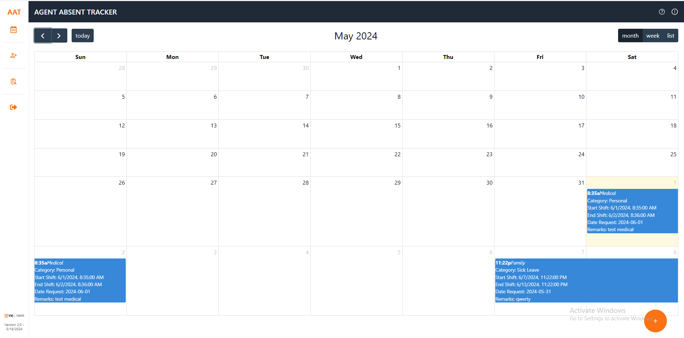
ADMIN HOME PAGE
FAQ
ADD USER
USER GUIDE
REPORTS
LOGOUT
ABSENT DATE REQUEST

Slide 3
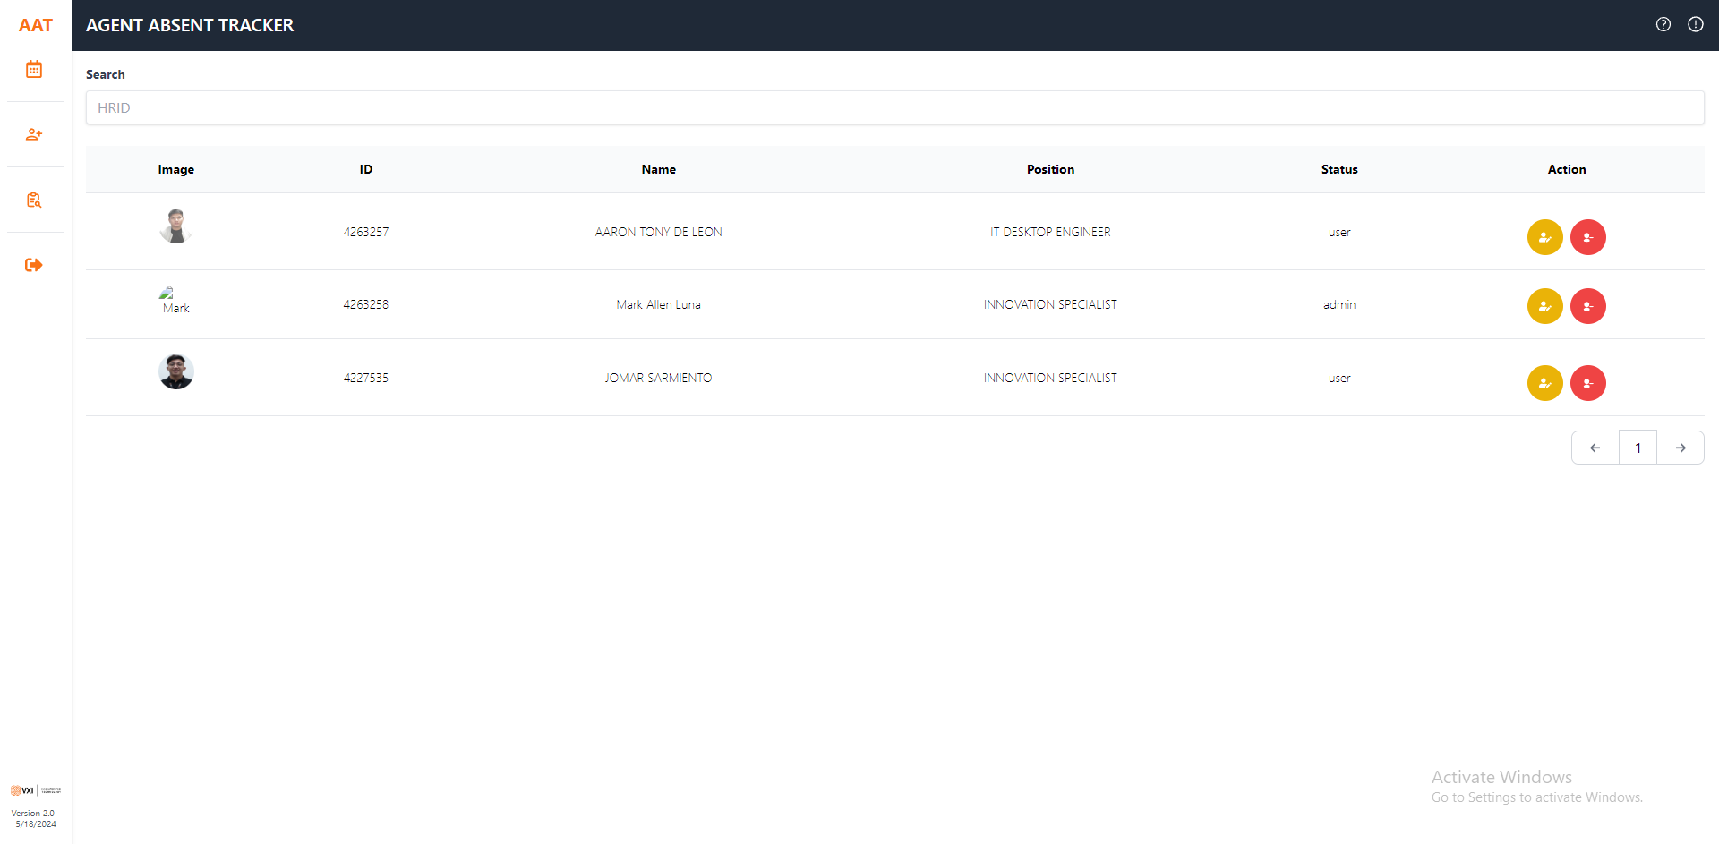
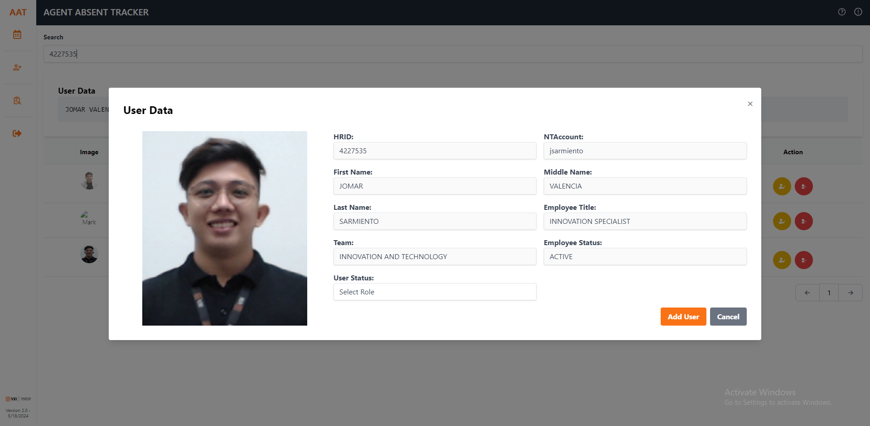
ADMIN ADD USER PAGE
Search HRID
DELETE USER
EDIT USER

Slide 4
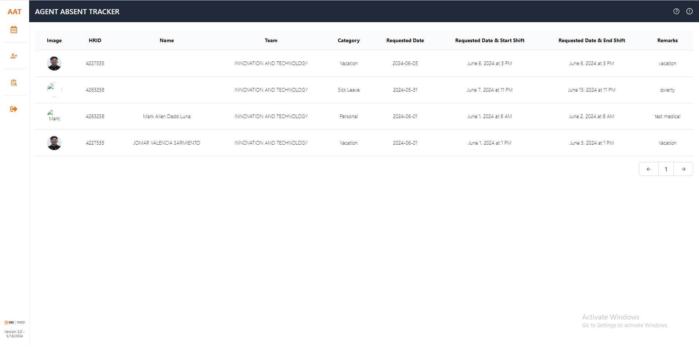
ADMIN REPORTS PAGE

Slide 5
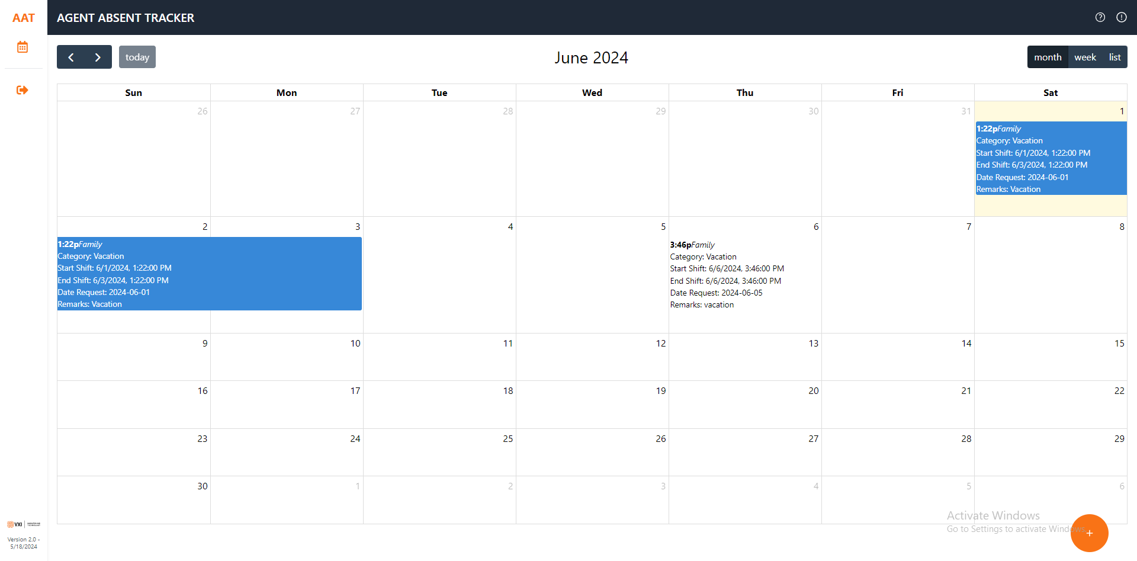
USER HOME PAGE
FAQ
USER GUIDE
ABSENT DATE REQUEST

Slide 6
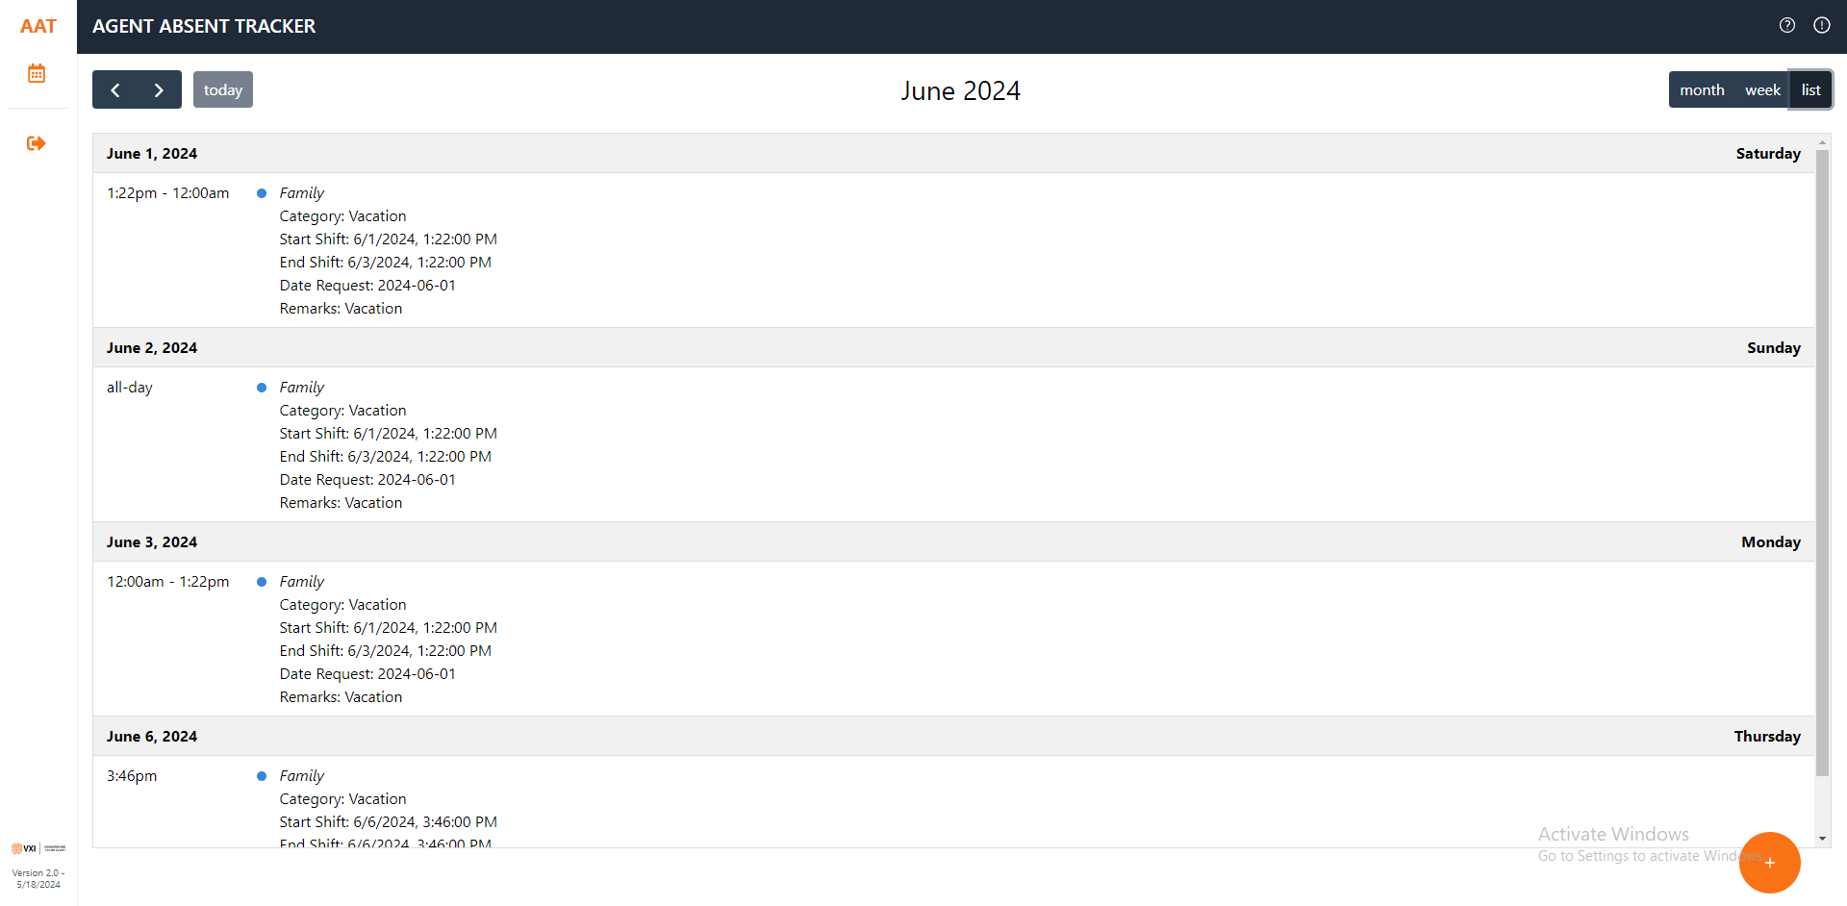
USER HOME PAGE
REQUEST LIST

Slide 7
Thank you!

