Slide 1

Attrition and Income Analysis
By Allen Miller

Slide 2
Purpose of the Study
Find the top 3 causes of attrition in the company
Create a model to accurately predict attrition in the company’s employees
Explore and present other business useful information
Create a model to accurately predict the monthly income of employees

Slide 3
What are the 3 main causes of attrition?
Job Level
Job Satisfaction
Years In Current Role

Slide 4
Predicting Attrition in Employees
Used Naive Bayes Model to predict the likelihood of attrition in employees
Model contained 22 variables such as:
Job Level
Job Satisfaction
Over Time
Years in Current Role
Etc..
Accurately Predicted No Attrition: 87.75% of the time
Accurately Predicted Yes Attrition: 61.03% of the time
Accurately Predicted Attrition No/Yes Combined: 83.25% of the time

Slide 5
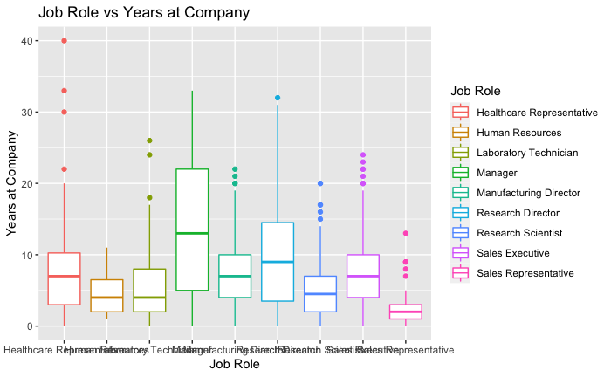
Exploring Time with Company by Job Role
Managers have the highest median time at the company
Also have a large range of time in the company
Sales Reps typically spend the shortest amount of time in the company
The median time is well below 5 years
75% of all Sales Reps spend less than 5 years with the company

Slide 6
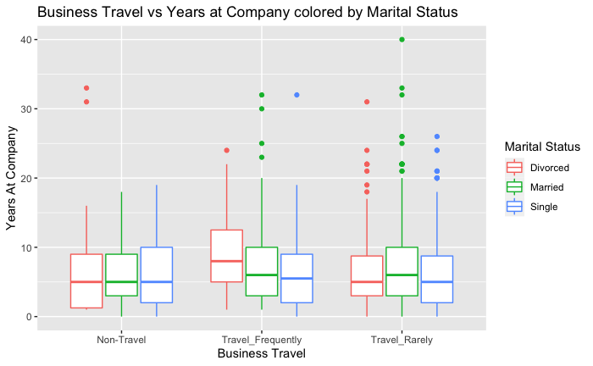
Exploring Years at Company by Business Travel and Marital Status
Divorced employees who travel frequently spend the most amount of time at the company
Single employees all have a median time at the company around 5 years regardless of frequency of business travel
All employees who travel for business typically spend more time with the company

Slide 7
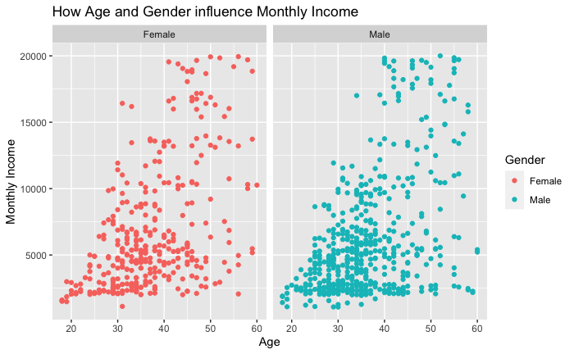
Exploring how Age and Gender can affect Monthly Income
There does appear to be significant correlation between an employee's age and their monthly income
Monthly Income appears to be similar regardless of gender given they have the same age

Slide 8
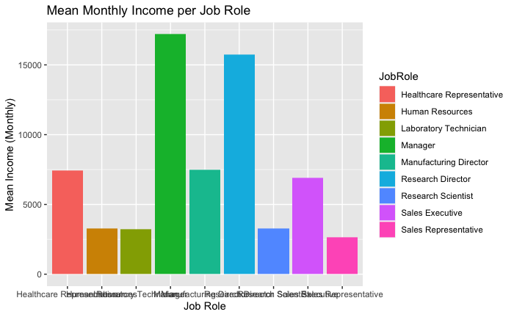
Exploring the Mean Monthly Income of each Job Role
Managers have the highest mean monthly income
Sales Reps have the lowest mean monthly income
33% of all Job Roles have a mean monthly income over 7,500
A little more than 50% of the Job Roles have a mean monthly income over 5,000
There are 4 Job Roles with a mean monthly income of around 2,500 or less

Slide 9
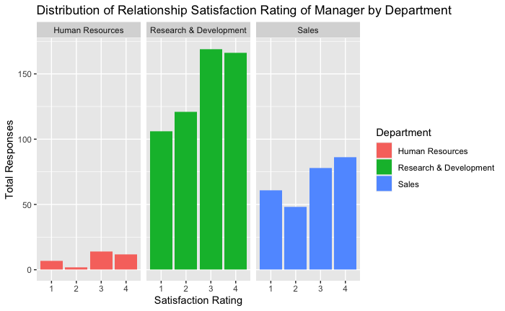
Exploring Manager Satisfaction Rating in each Department
Human Resources had the fewest responses
Ratings 1,3, and 4 have similar amounts of responses
Overall, most of the company is satisfied (ratings 3&4) with their manager

Slide 10
Predicting Monthly Income
We used Linear Regression to predict what an employee’s monthly income will be
11 selected variables such as:
Years At Company
Job Level
Over Time
Education
Etc.
RMSE measures how well our model fits with our observed values
Our RMSE was $1,018.21
Means our predicted value should be within $1,018.21 of the actual value

Slide 11
Questions?

