Slide 1

LINEAR SEARCH ALGORITHM
A Simple Sequential Searching Technique
Presented By
Mosiur Rahman
Student ID: IT-25008
Department of Information and Communication Technology (ICT)
Mawlana Bhashani Science and Technology University (MBSTU)
Course: Data Structure
Course Teacher: Mr. Mehedi Hasan
8 August 2026

Slide 2
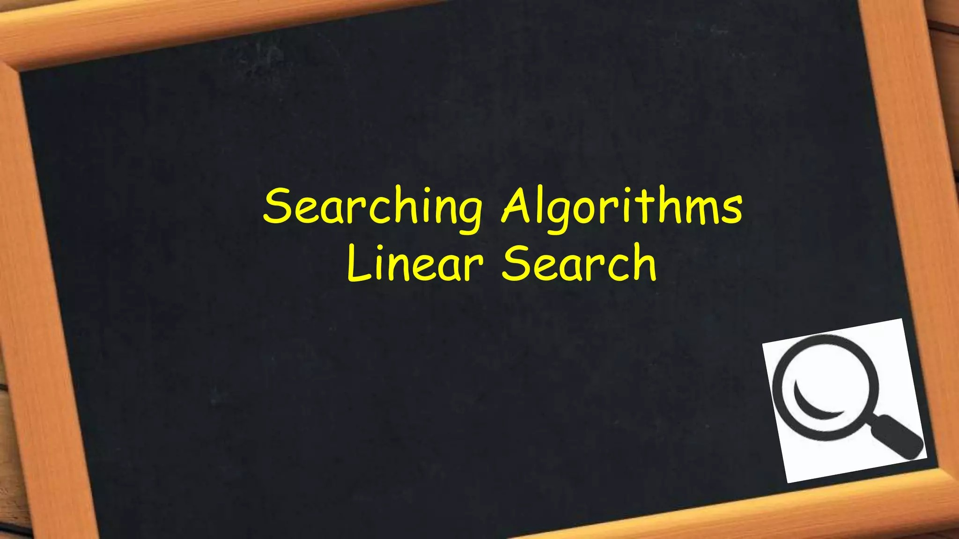

Slide 3
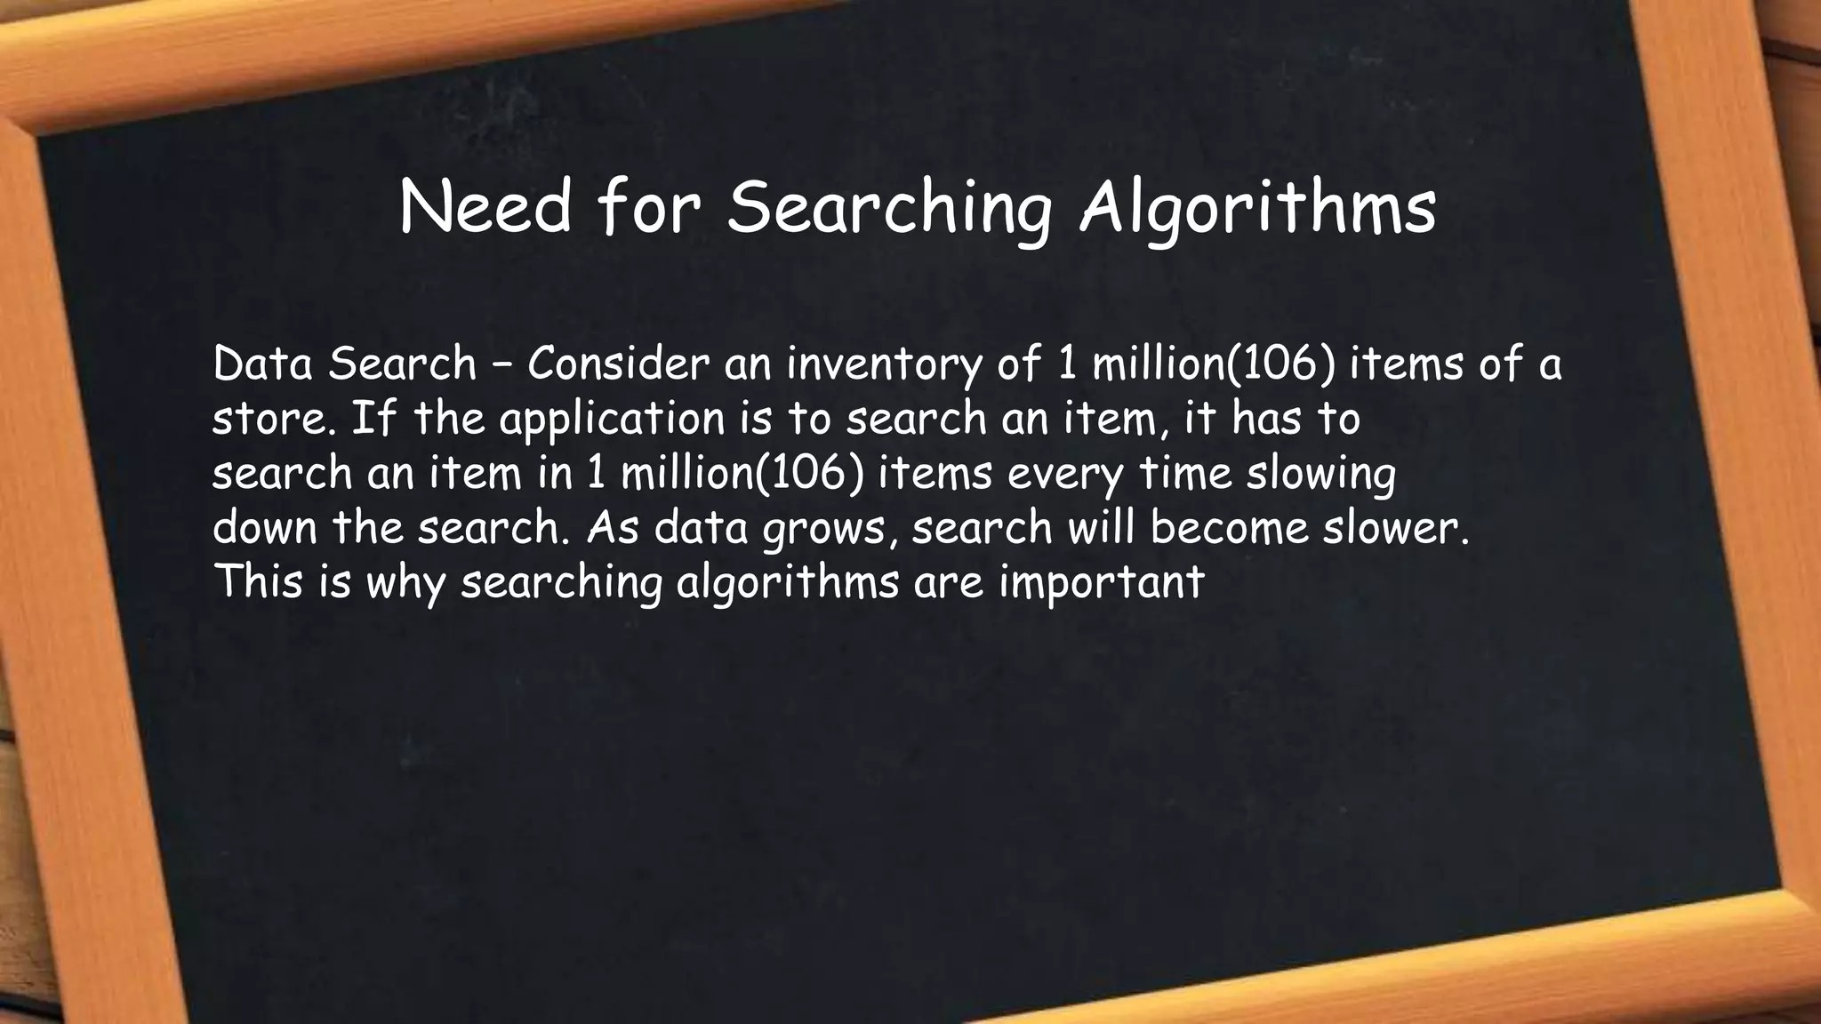

Slide 4
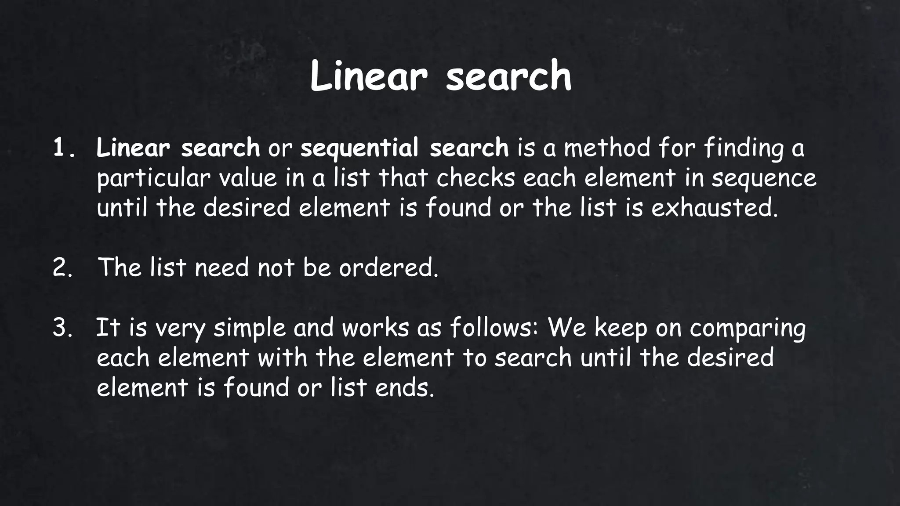

Slide 5
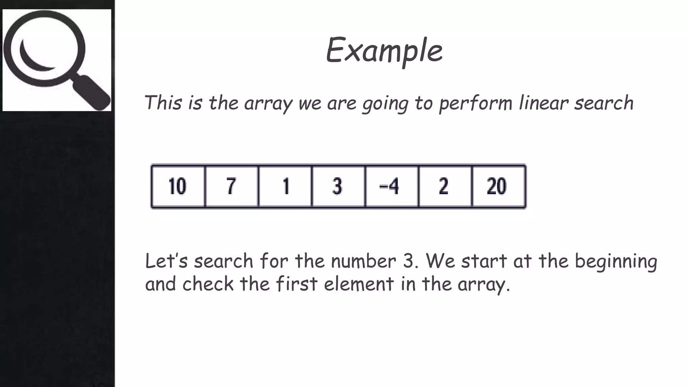

Slide 6
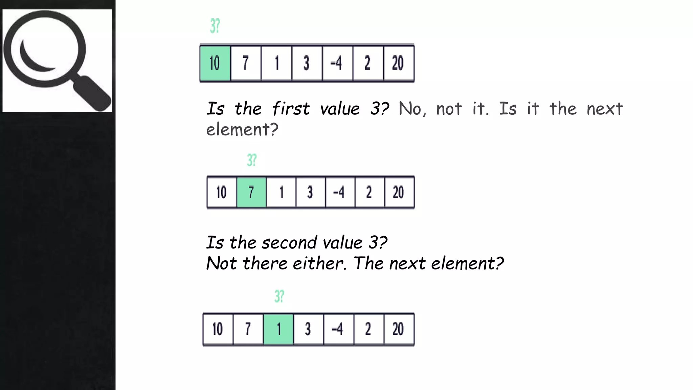

Slide 7
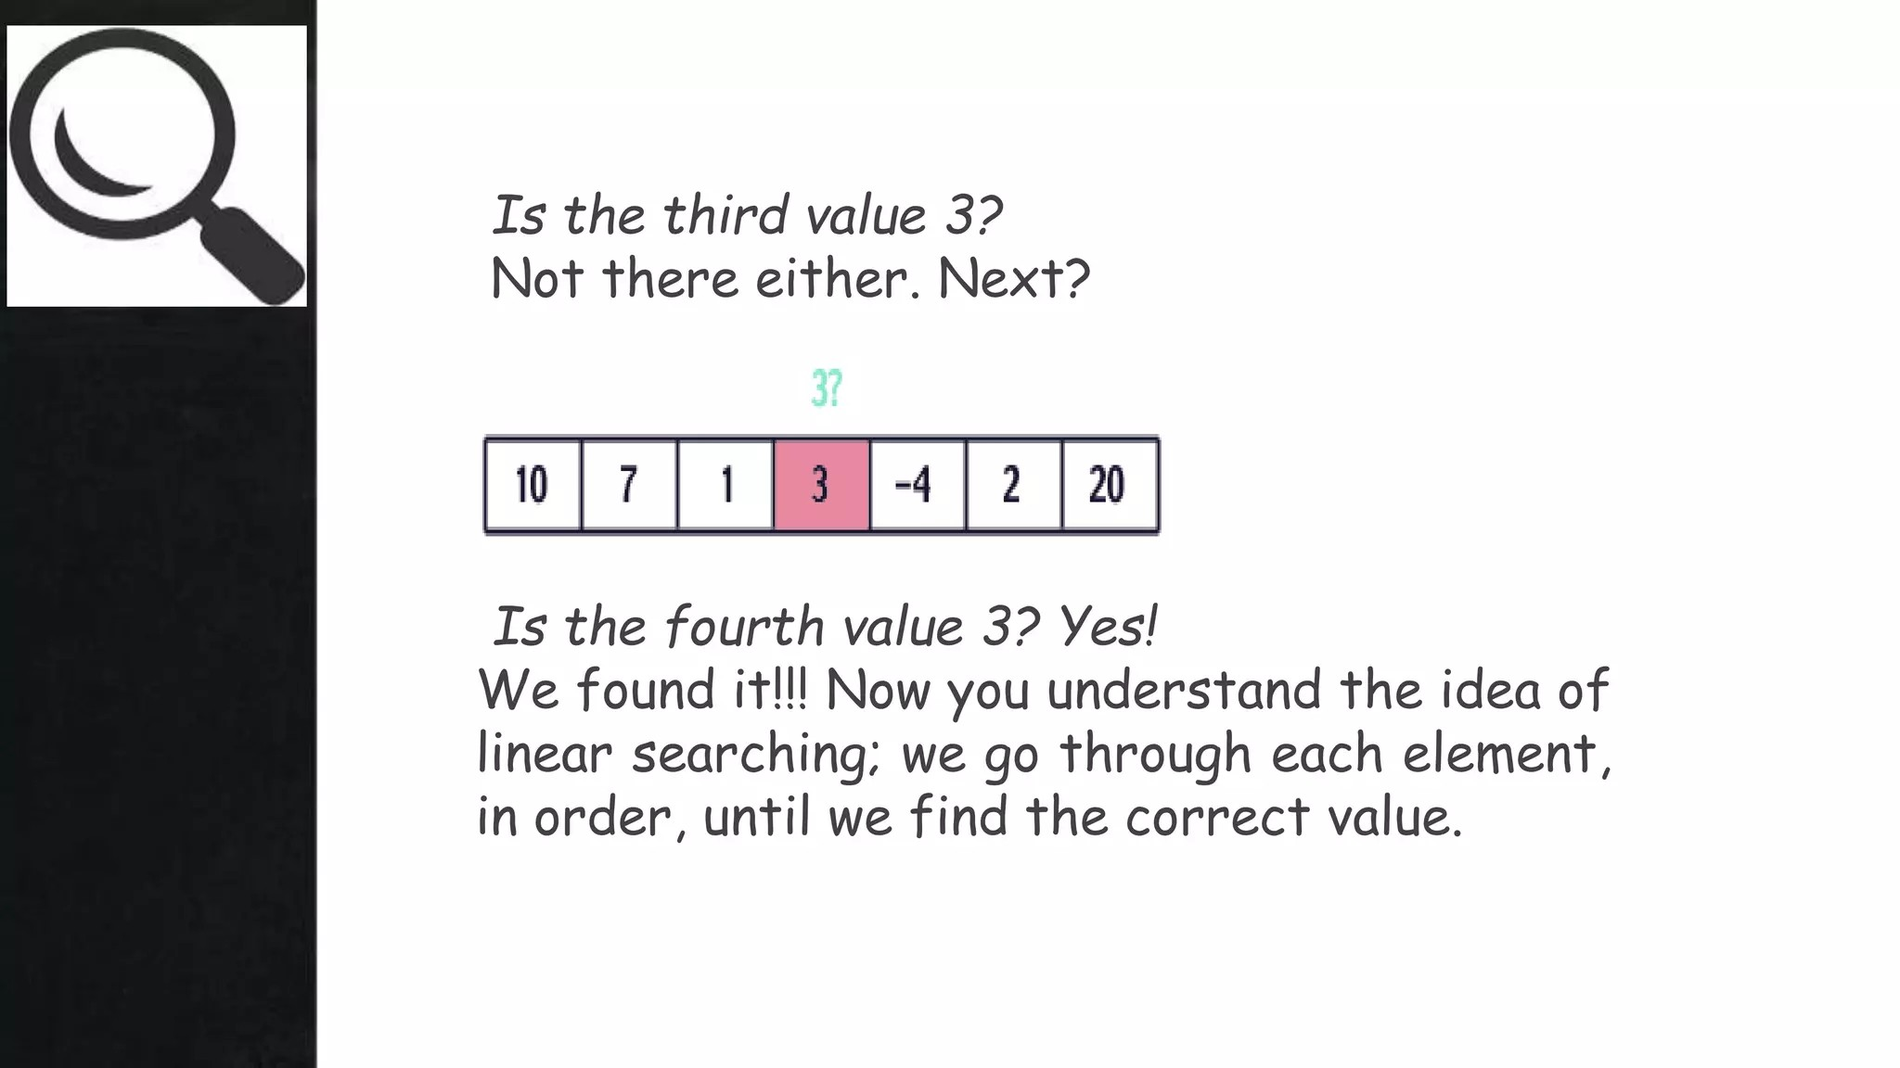

Slide 8
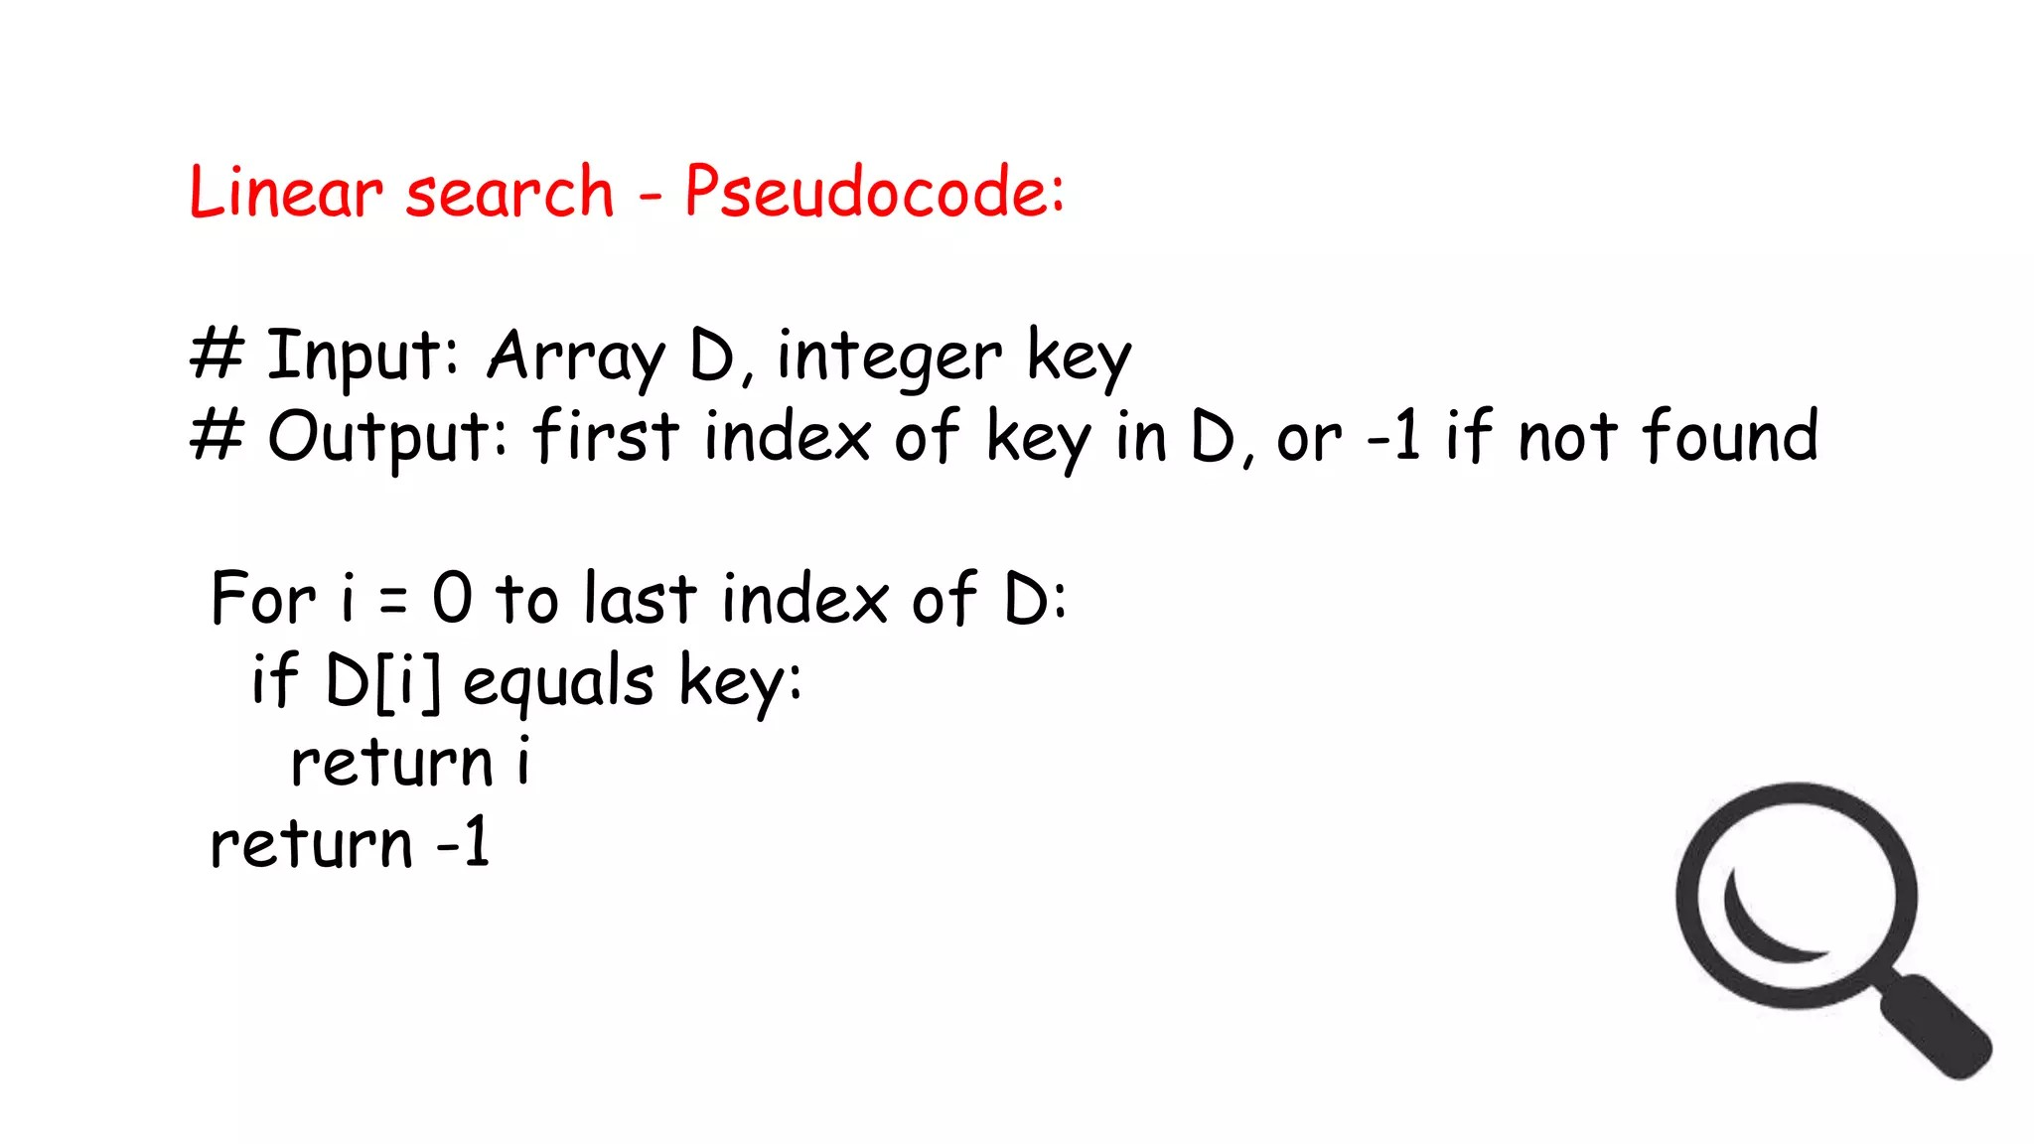

Slide 9
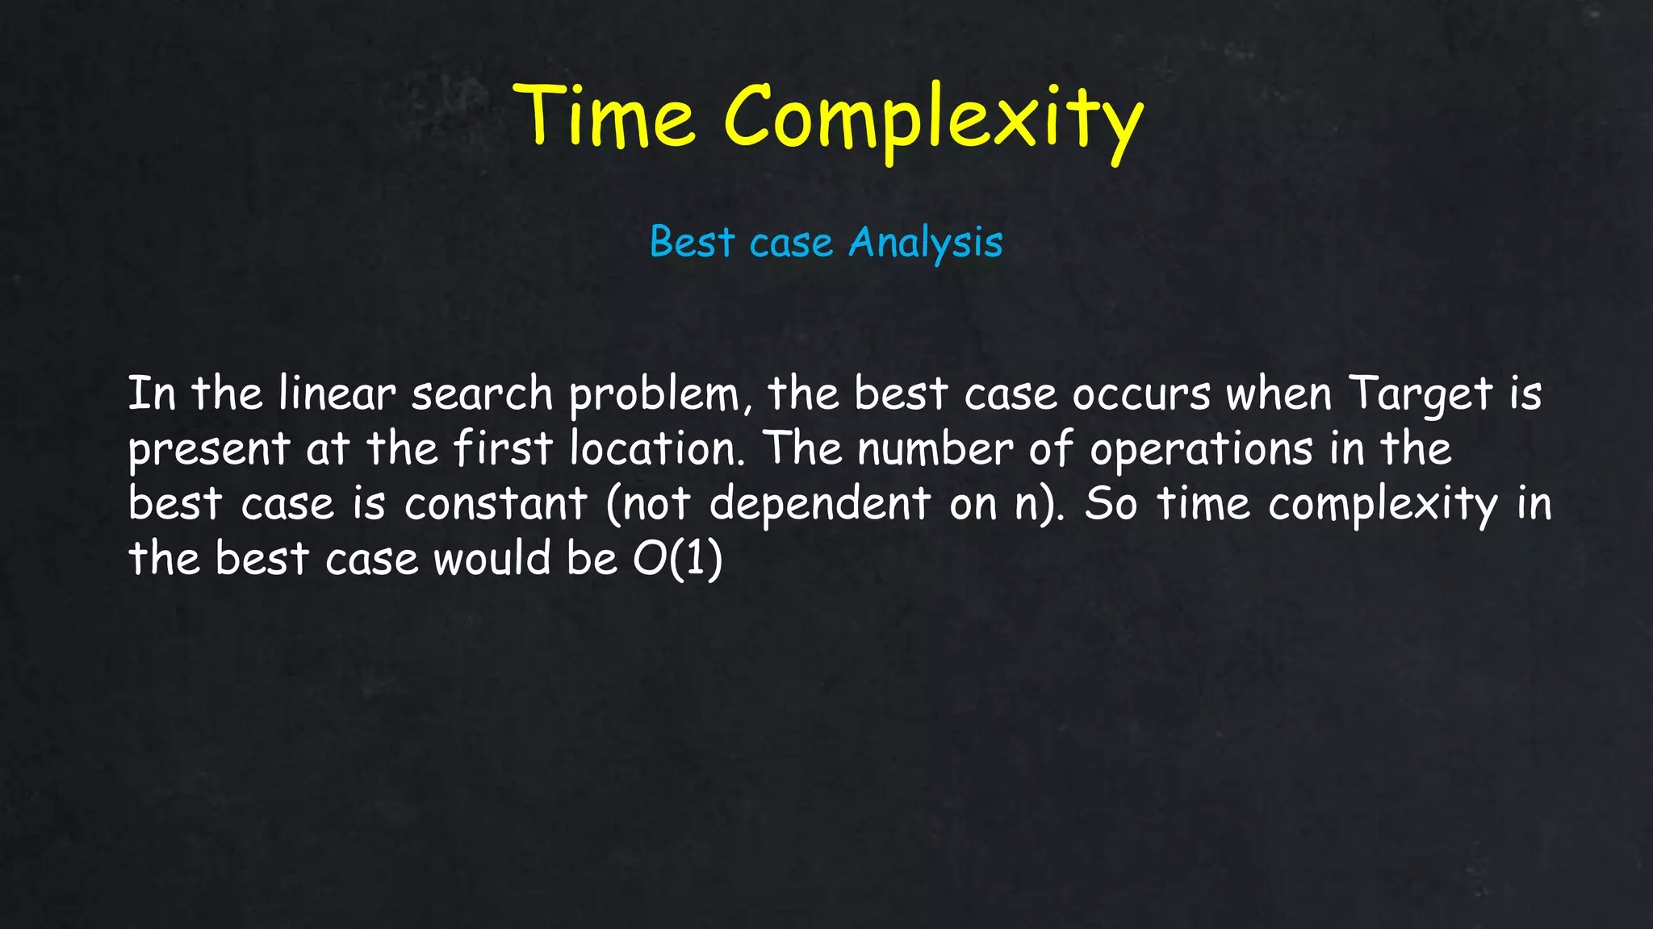

Slide 10
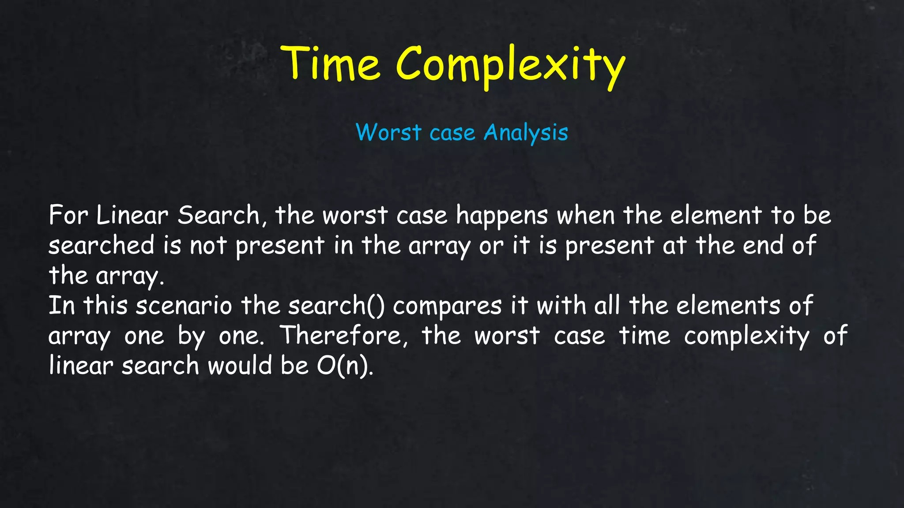

Slide 11
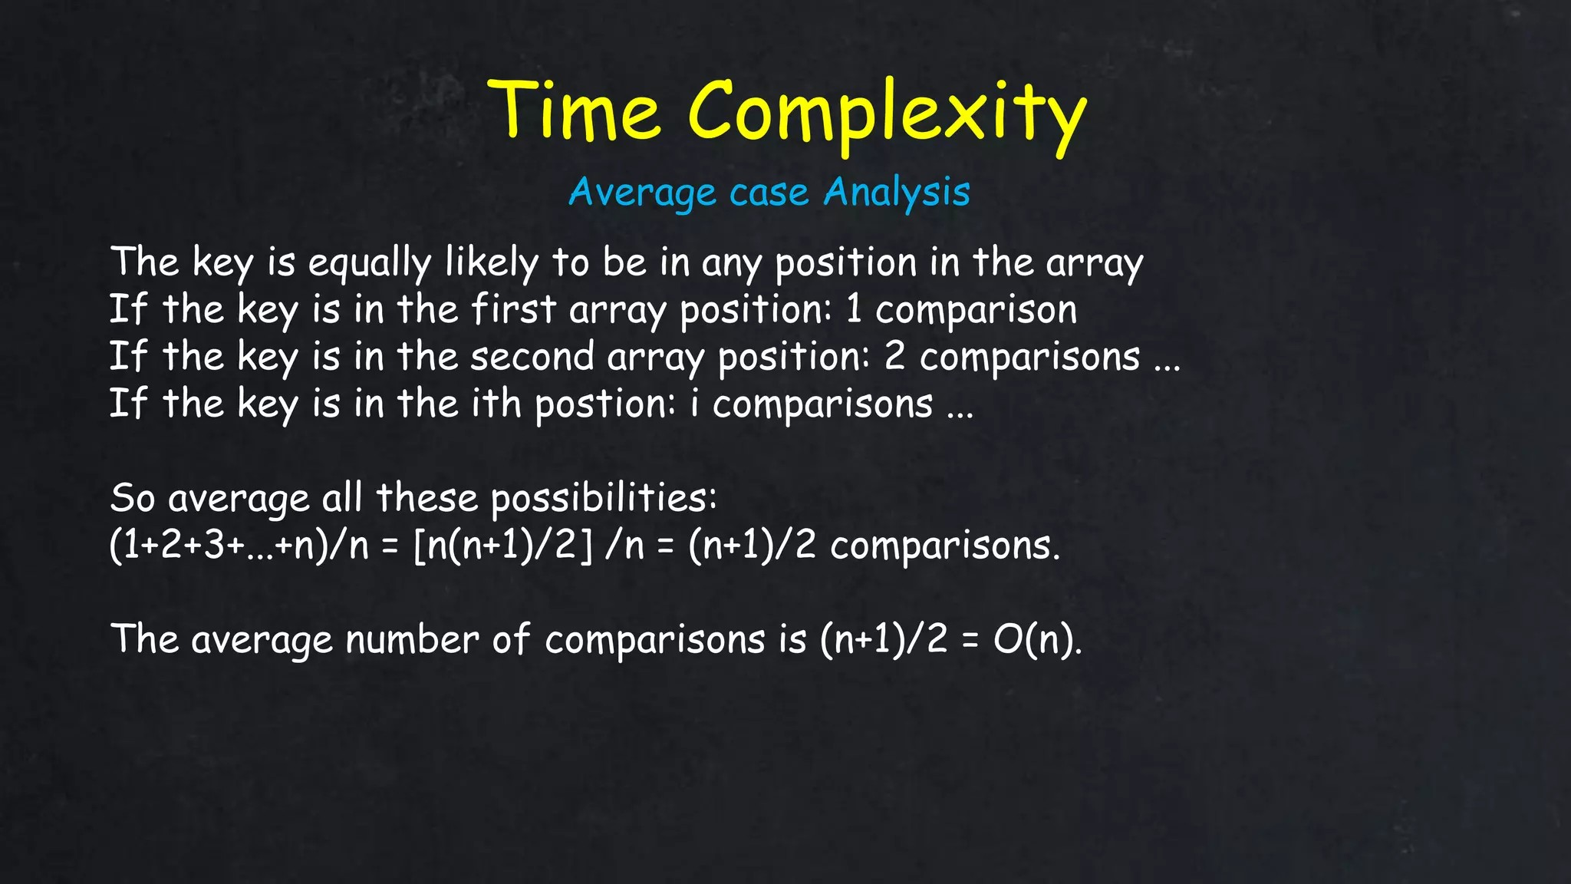

Slide 12
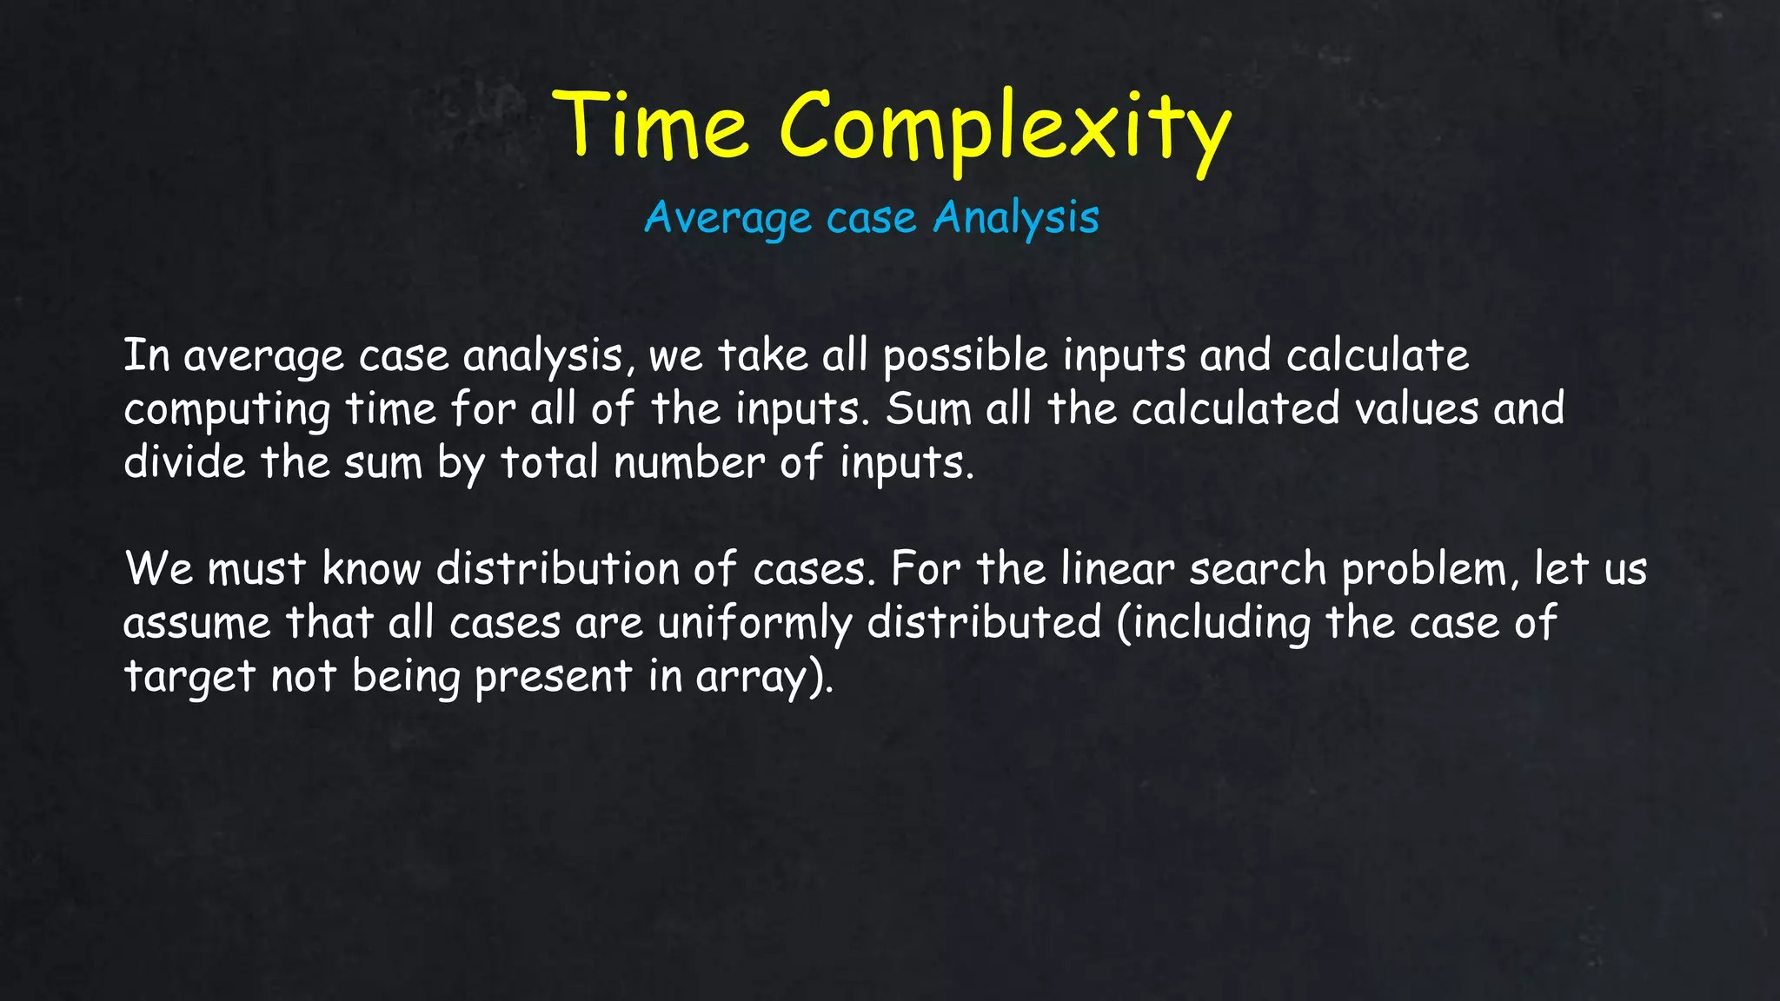

Slide 13
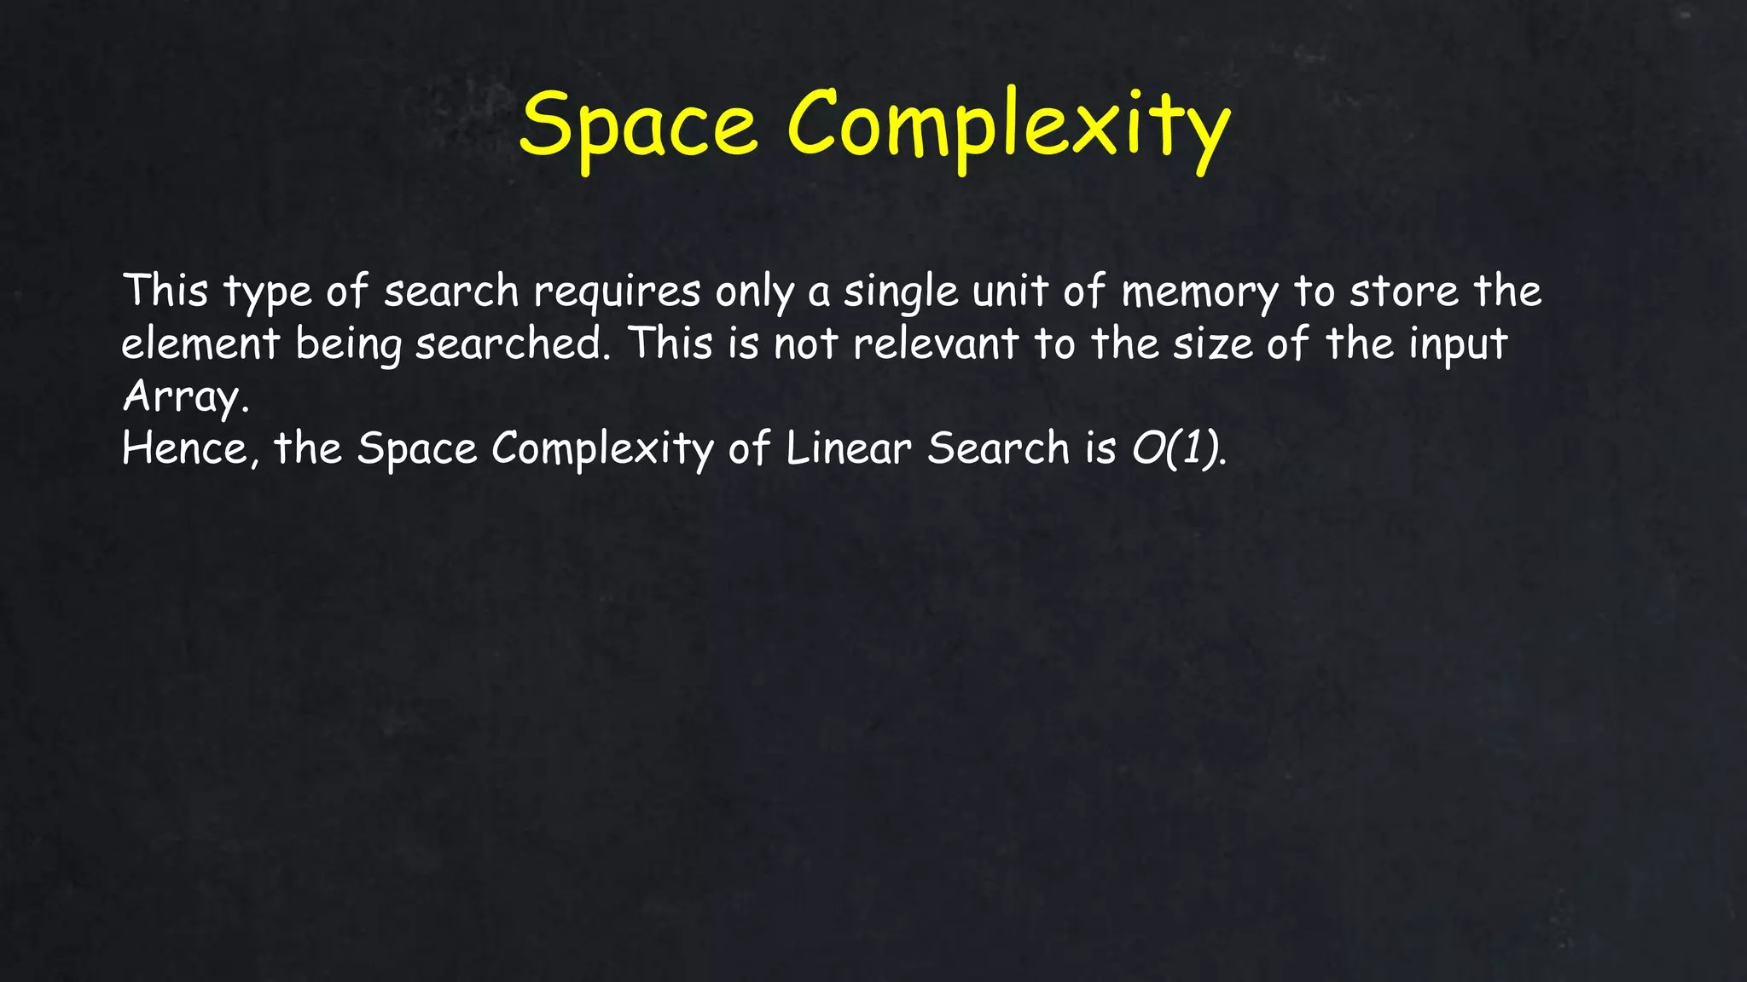

Slide 14
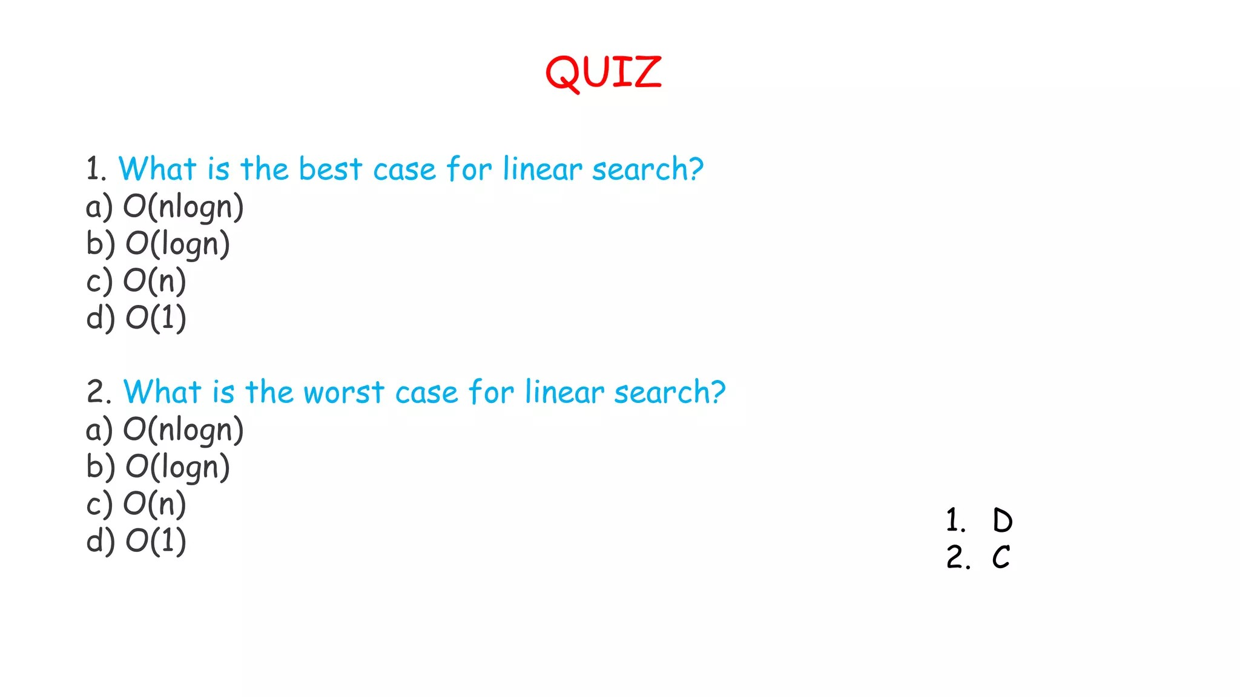

Slide 15
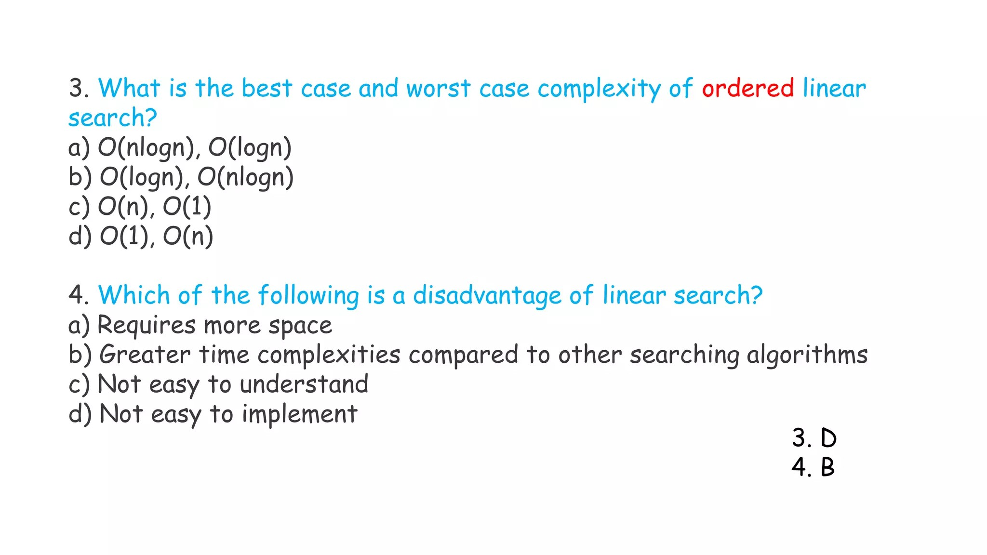

Slide 16
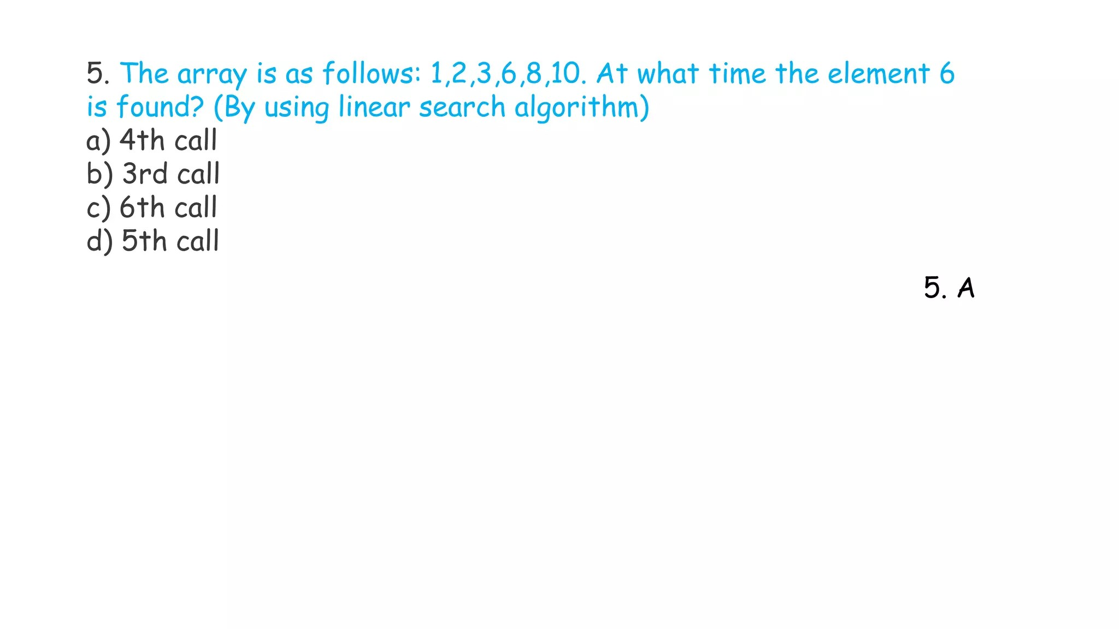

Slide 17
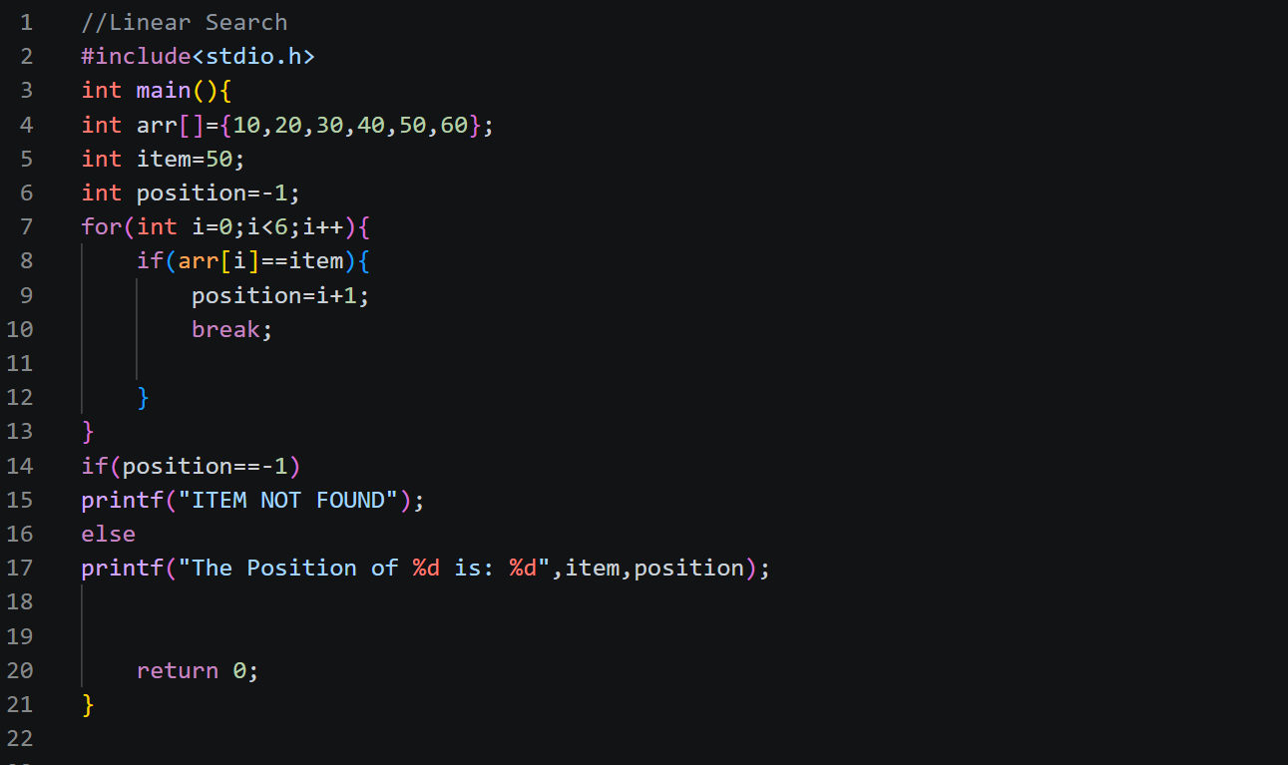

Slide 18


