Slide 1


Lending Club Case Study
Group Members:
Adriza Paul
Rajat Kumar

Slide 2
Abstract
Lending Club is a marketplace for personal loans that match borrowers who are seeking a loan with investors looking to lend money and make a return.
When reviewing loan applications, company faces 2 risks as follows:
  A. Turning down credit worthy loan application, and losing business.
  B. Suffering financial losses by approving loan applicants who are more likely to default.

Slide 3
Objective
The objective of this analysis is to evaluate applicants' creditworthiness using variables like credit history, income, property, and employment stability to reduce these risks.
“In other words, the company wants to understand the driving factors (or driver variables) behind loan default, i.e., the variables which are strong indicators of default. The company can utilize this knowledge for its portfolio and risk assessment. ---[UpGrad] ”

Slide 4
Exploratory Data Analysis Process
Data Cleaning
Data Understanding
Univariate Analysis
Segmented univariate Analysis
Bivariate Analysis
Recommendations

Slide 5
Detailed description for each Task
1. Data Cleaning - Handling Missing value , outlier, duplicates and removing unnecessary variable
2. Data Understanding- Working with the Data dictionary, checking all the variable and domain specific use. Explore the data set by summarizing the main character of the variables.
3. Univariate Analysis- Statistical Technique to summarize the characteristic of a single variable in a data set.
4. Segmented Univariate Analysis- Segmented univariate analysis makes it possible to examine a variable in greater detail by considering the differences between segments. It aids in finding patterns, trends, or anomalies that are unique to a subgroup but may not be seen when analysing the variable as a whole.
5. Bivariate Analysis- Examining the relationship between two variables in a data set and helps in understanding how changes in one variable relate to changes in another.

Slide 6
Basic Information About the data
No of Columns: 111
No of Rows: 39717
No of Missing Values: 2263364
No of Unique Values: 410681
No Of Duplicates:0

Slide 7
Derived Variables
1. issue_d_year
2. issue_d_month
3. issue_d_weekday
4. issue_d_weekday_name
5. earliest_cr_line_year
6. earliest_cr_line_month
7. approved_loan_amnt_ratio

Slide 8
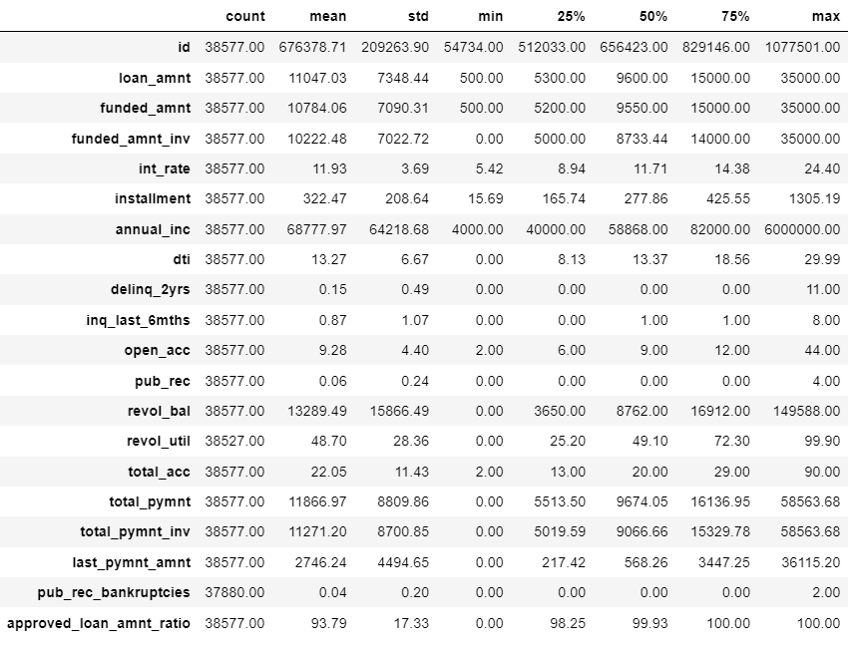
Univariate Analysis
From the summary statistics, we can understand the mean, standard deviation, min, max and 25%, 50% and 75% percentile for all the numerical columns.
Next, we will see the univariate analysis for all these variables in following slides.

Slide 9
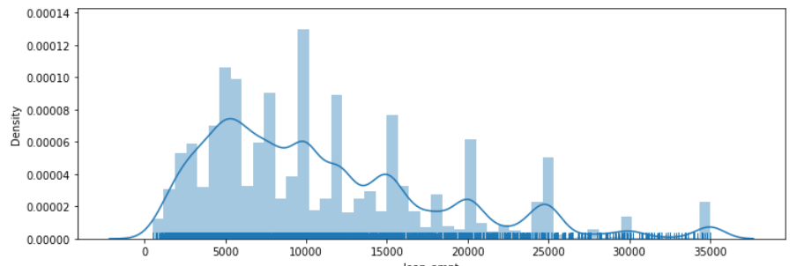
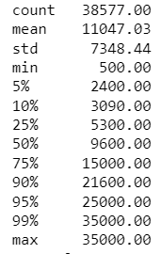
Loan Amount
The listed amount of the loan applied for by the borrower.
Observations:
From the plots, more number of people took loan amount of 9600, and also median of distribution is9600. And very few people took more than 30000 loan amount.

Slide 10
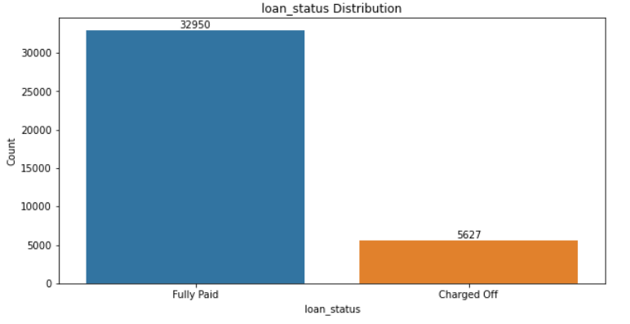
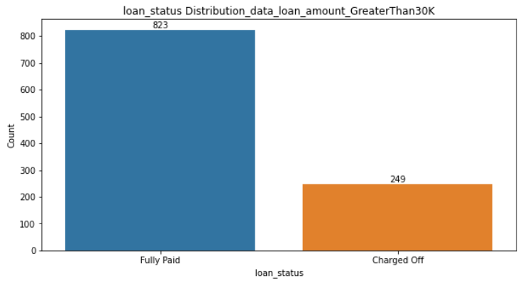
Loan Status
Observations:
85% of borrowers have paid the loan fully where as 15% have defaulted the loan but if we observe the Loan status distribution where loan amount is greater than 30K , 23% have defaulted loan .

Slide 11
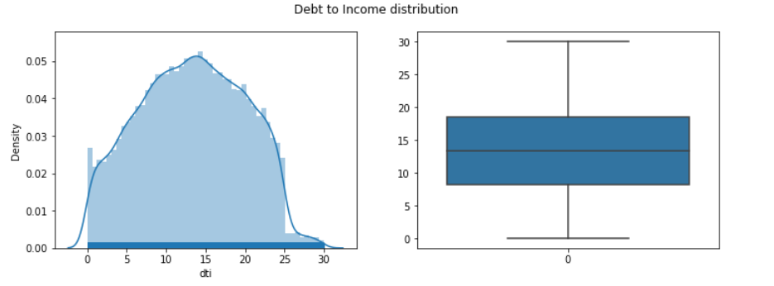
DTI - Debt To Income ratio
Observations: Looks like there are no outliers and the distribution is very much similar to normal distribution. This is a good sign that all the loans were given to borrowers who have Debt To Income ratio less than 30.

Slide 12
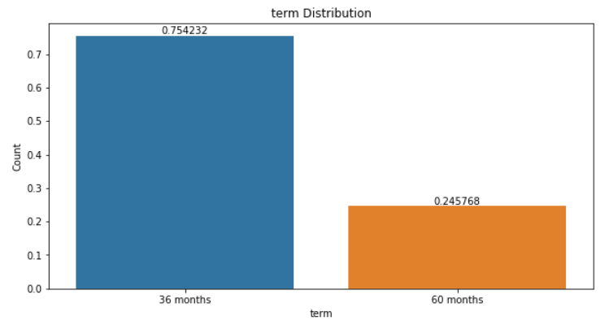
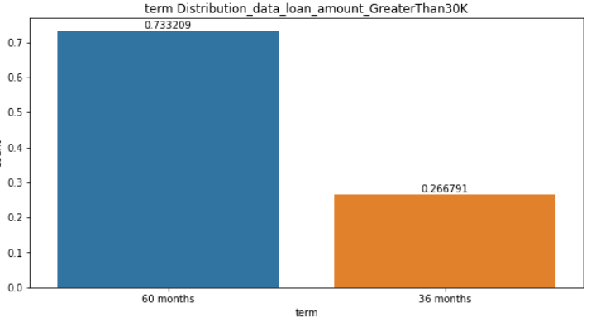
Loan payment Term
Observations:
if we see the overall data, borrowers have taken 36 months tenure more than 60 months but if we see the loan amount greater than 30K, that subset of data, borrowers took 60 months tenure mostly.

Slide 13
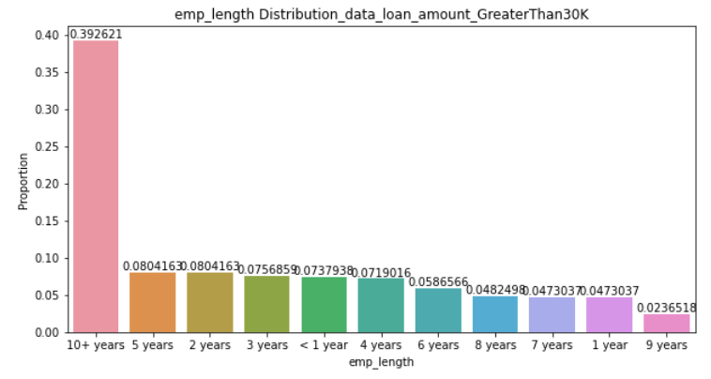
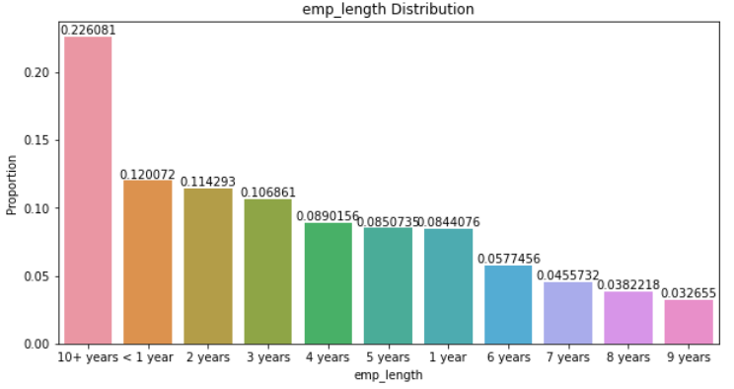
Employment length
Observation:
Borrowers are mostly 10+ years employment length and for higher loan amount most of the borrowers are having higher employment length

Slide 14
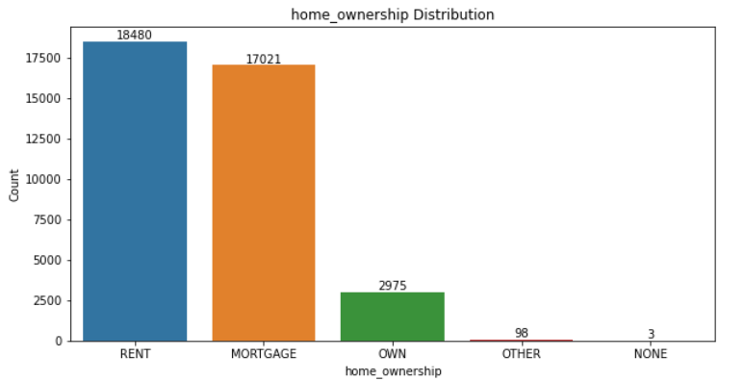
Home Ownership
Observations:
The loan borrowers are mostly having rented and mortgage houses.

Slide 15
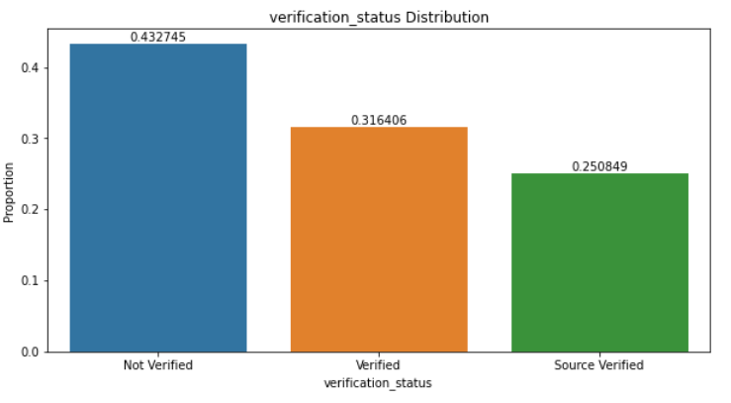
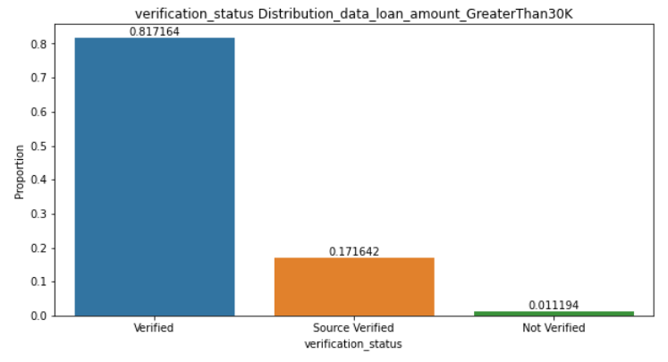
Loan Application Verification
Observation:
Most of the cases, loans are not verified but in case of higher loan amount, applications are mostly verified.

Slide 16
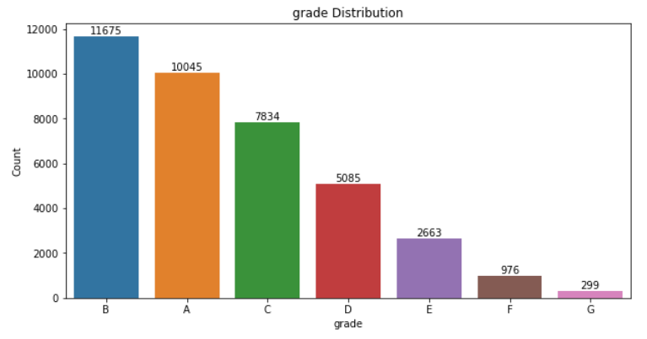
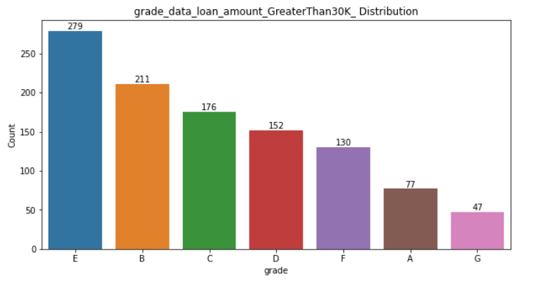
Applicants Grade
Observations:
Most borrowers fall under A and B grades then other grades but if the loan amount greater than 30K, then most of the borrowers fall in Grade E

Slide 17
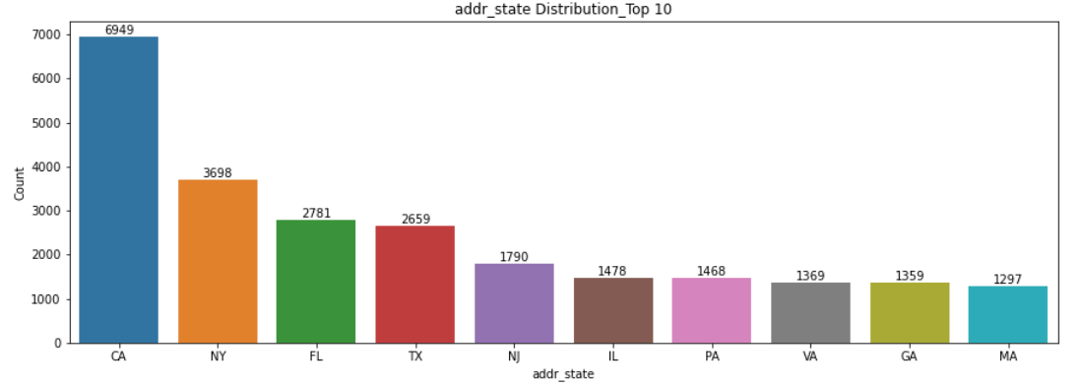
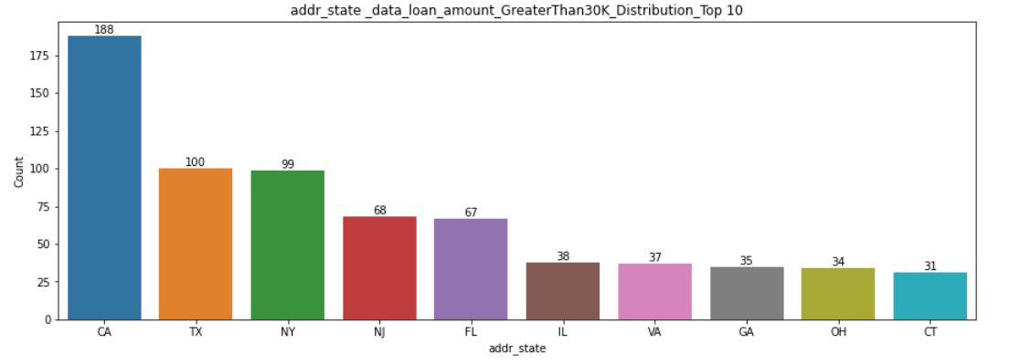
Loan Applicant’s State
Observation:¶
For overall data set, top, Applicants are mostly from CA, NY and FL , whereas for loan amount greater than 30K, Top 3 locations are CA, TX and NY respectively

Slide 18
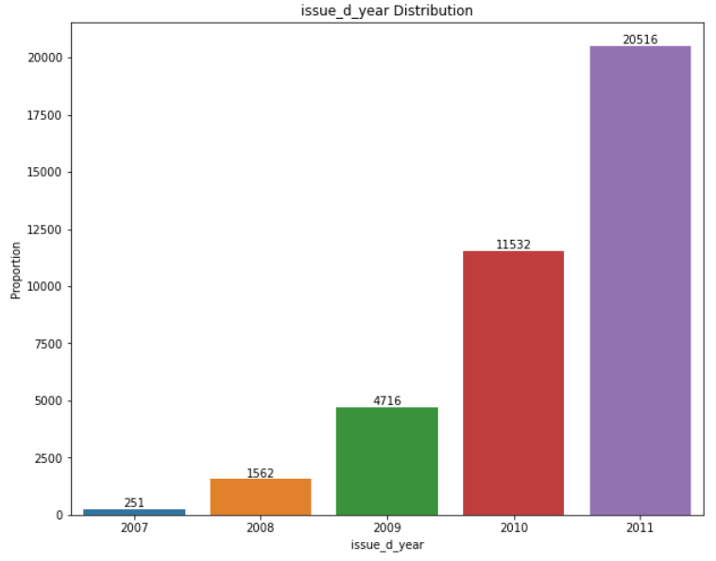
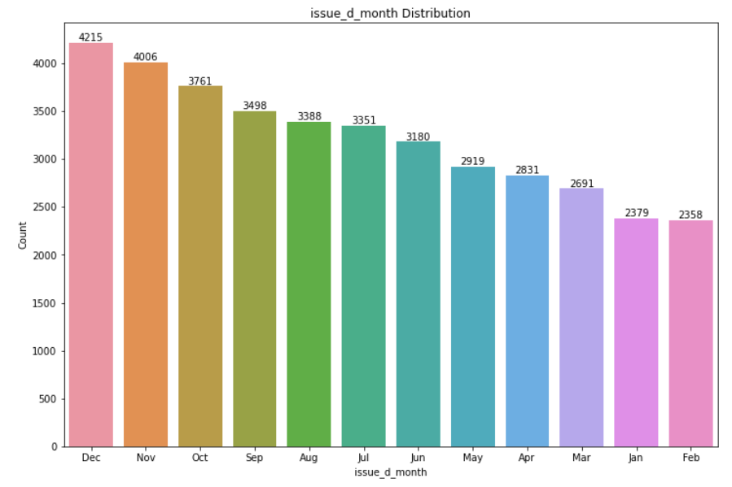
Loan Issue Year- The lending club(LC) has doubling loan issues every year.
Loan Issue Month-There are more issues of loan in last 3 months every end of the year i.e., Oct, Nov and Dec.

Slide 19
SEGMENTED UNIVARIATE ANALYSIS

Slide 20
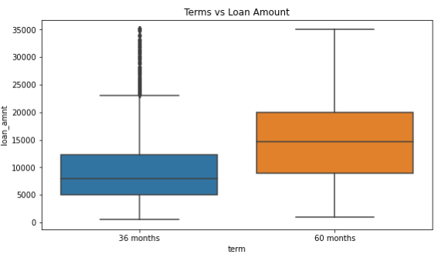
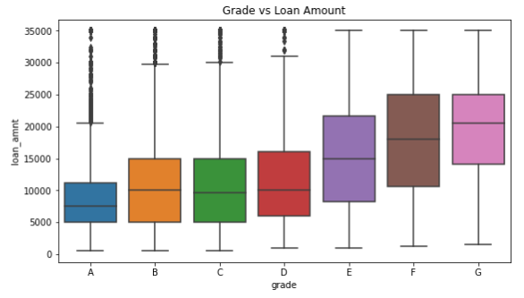
Terms vs Loan Amount-Higher amount loans have high tenure i.e, 60 months.
Grade vs Loan Amount-Grade 'G' have taken max loan amount. From A to G, the loan amount is increasing.

Slide 21
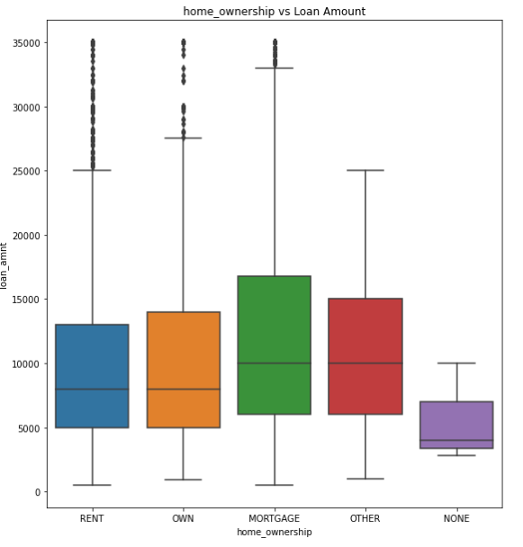
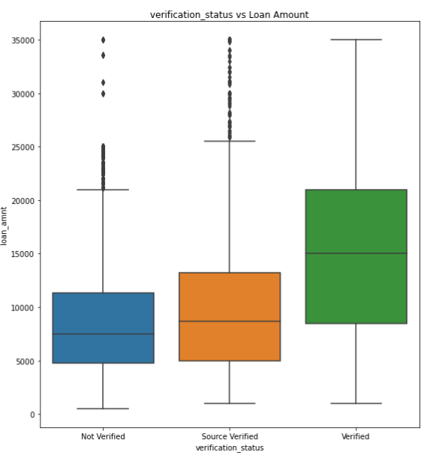
Home_Ownership vs Loan Amount- More borrowers are from MORTGAGE and also the median loan amount is high for MORTGAGE owned borrowers.
Verification_status vs Loan Amount-Median Loan amount for verified borrowers are the highest.

Slide 22
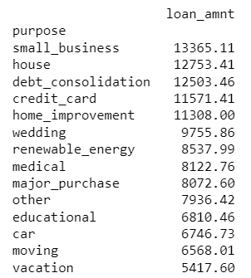
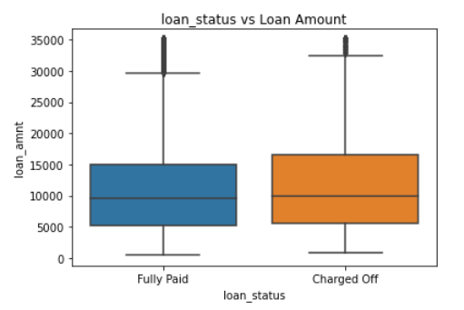
Loan Status vs Loan Amount- Charged Off loans have higher amounts than Fully Paid ones.
Purpose vs Loan Amount- Highest Mean value for Loan taken is for small_business followed by house and debt_reconsolidation.

Slide 23
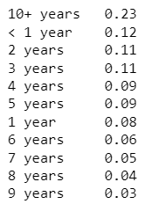
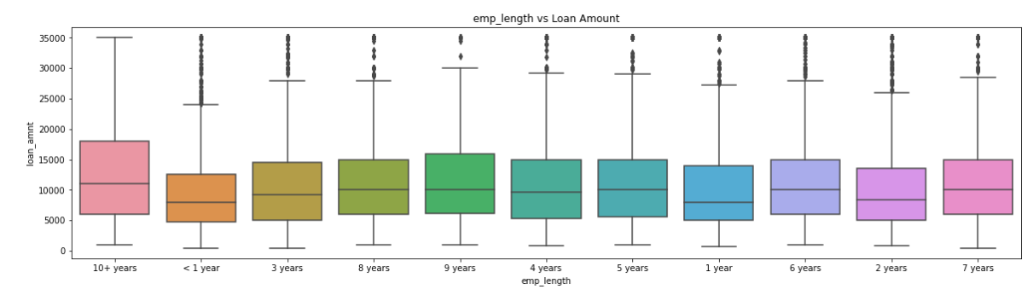
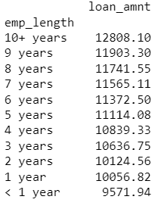
Emp_Length vs Loan Amount
Borrower % as employment length group
With higher employment length borrowers have high tendency to take high loan amount.
In total data, 23% borrowers are having employment length more than 10 years.

Slide 24
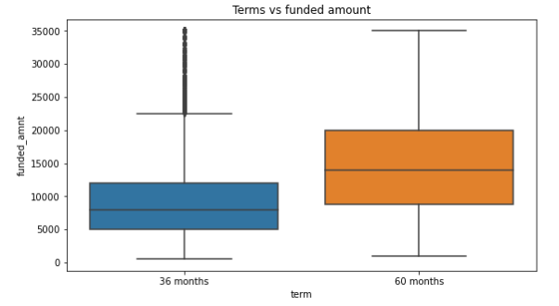
Terms vs funded amount
For 36 months terms, there are a few borrowers who received high loan amount which are shown as outliers.

Slide 25
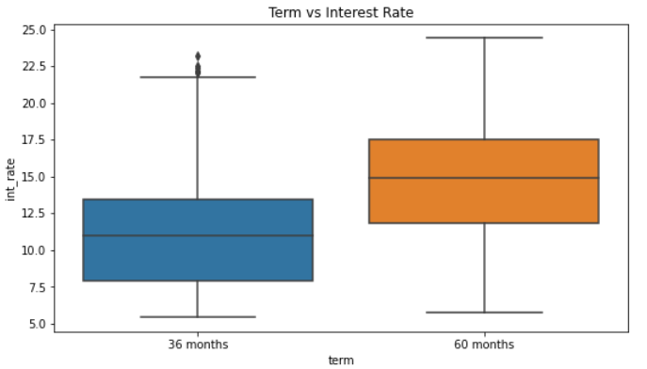
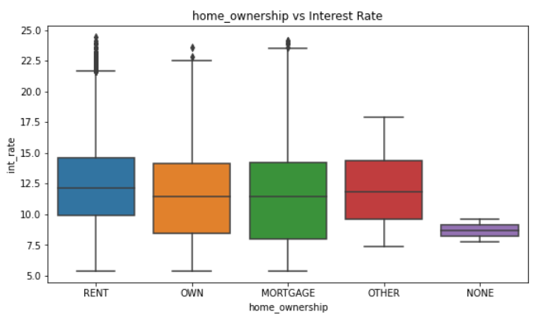
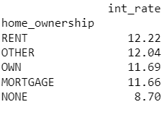
Term vs Interest Rate- The interest rates are higher for higher tenure loans.
Home Ownership vs Interest Rate- Borrowers having own house or kept mortgage for loan, they got less interest rate since Banks have the security.

Slide 26
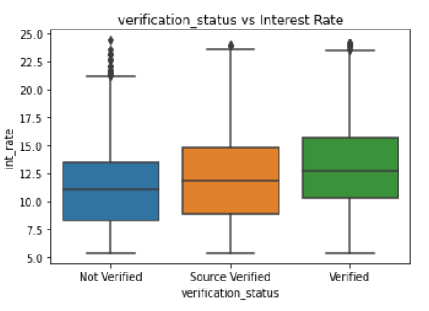
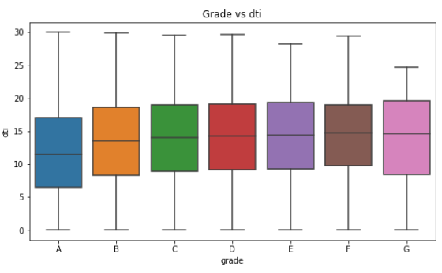
Verification Status vs Interest Rate- Not verified loan applications get less interest which may be risky for the Bank
Grades vs DTI -A Grade borrowers are having low DTI than Other grades. DTI should be low for having high repayment percentage.

Slide 27
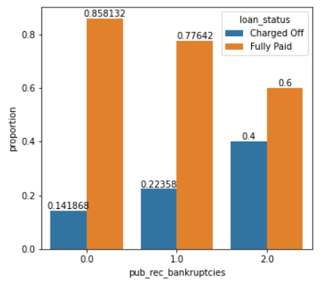
'pub_rec_bankruptcies’ vs 'loan_status’-Borrowers who are having 0 record of bankruptcies, but failed to pay the loan, are the risky borrowers.

Slide 28
Bivariate Analysis

Slide 29
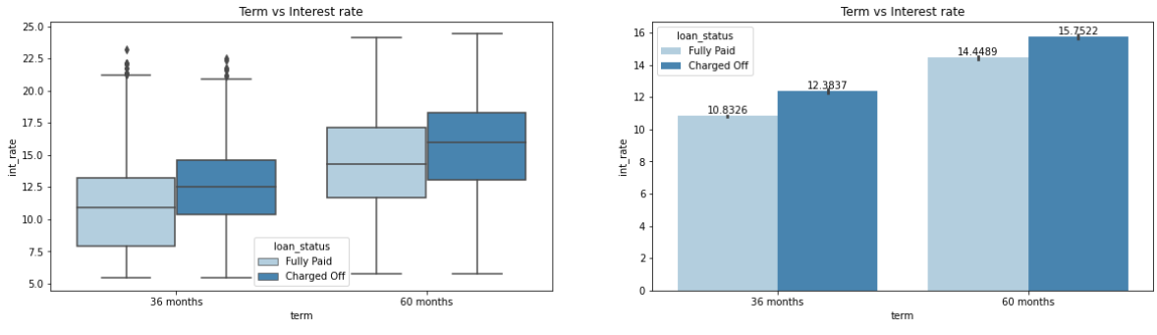
Term vs Interest rate
For higher interest rates the default rate is higher in both 36- and 60-months tenure.

Slide 30
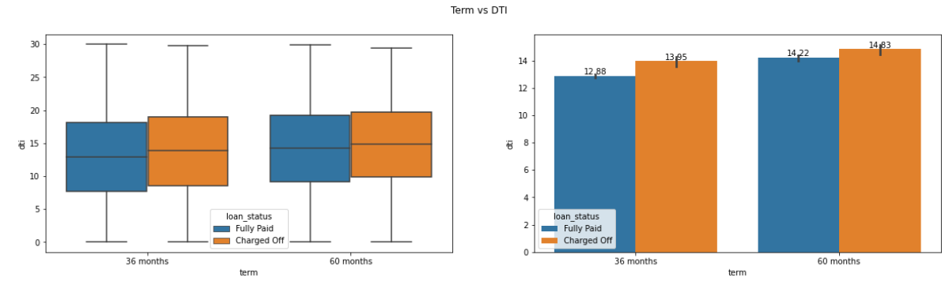
Term vs DTI
For both the tenure, DTI is high for Charged off loan

Slide 31
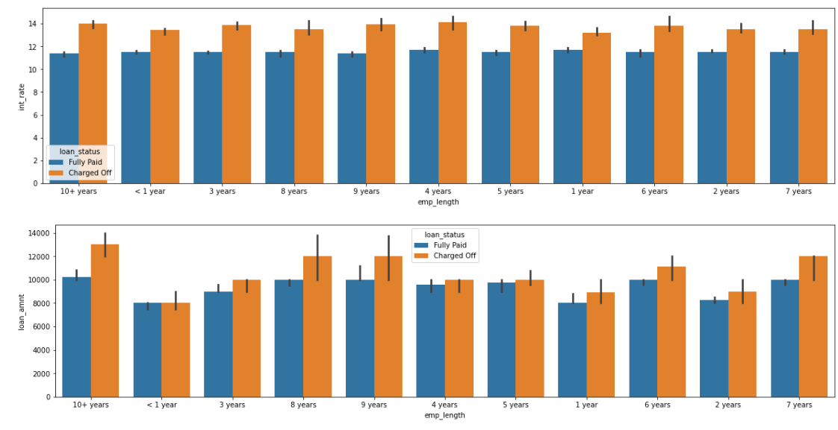
Loan Amount, Int Rate vs Loan Status
Though for in any emp_length group, loan amount difference is not much high for Fully paid and Charged off loans but interest rate for all emp_length group for charged off loan is high. Irrespective of employment length loans with more interest rates got defaulted more.

Slide 32
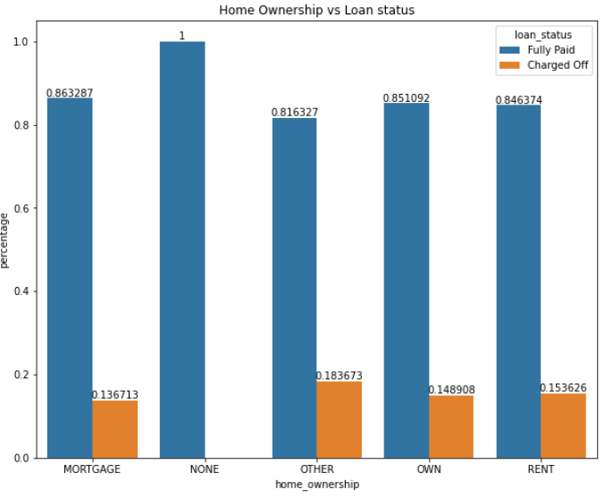
'Home Ownership vs Loan status'
Home Ownership other is having high charged off loan percentage

Slide 33
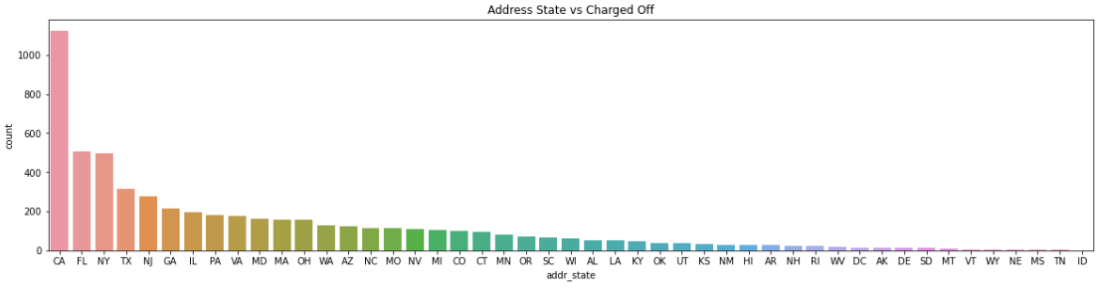
Address State vs Charged Off
More number of borrowers defaulted in CA , FL and NY states.

Slide 34
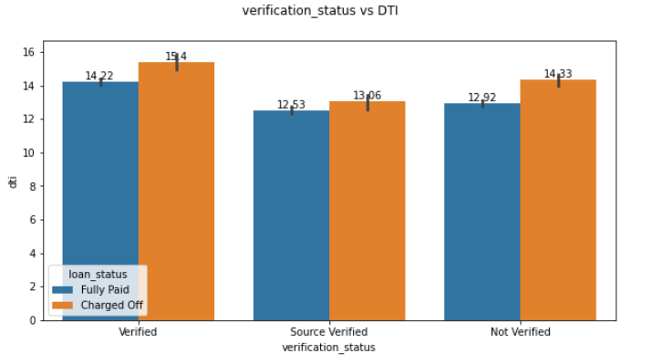
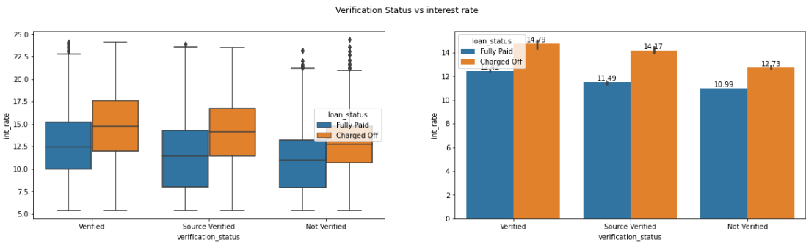
Verification Status vs interest rate
Irrespective of verification status higher interest rates are incurring default of loan. There is slight increase in the dti mean for defaulted laons for all the verification status categories.

Slide 35
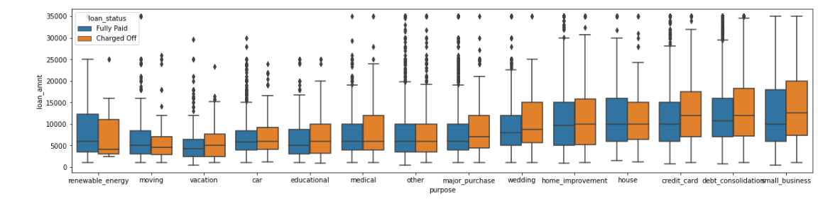
Purpose vs Loan Status
Small Business has more defaults when the loan amount is also high.

Slide 36
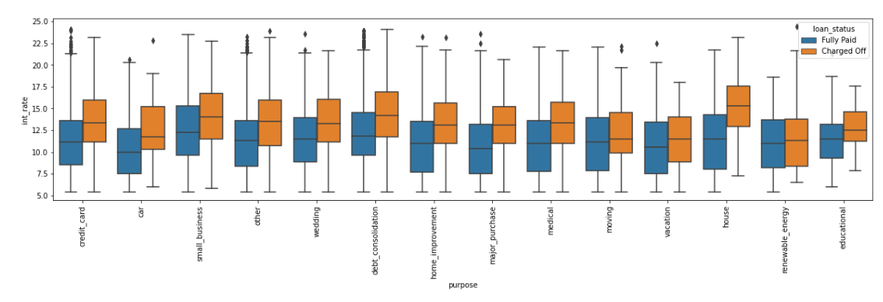
Purpose vs Interest Rate
Home loans with high interest rates are mostly defaulted. Even small business and debt consolidation has similar observation.

Slide 37
Conclusion
Lending Club should scale back its high-interest loans with a 60-month repayment term since they are more likely to default.
Small business loans default more frequently. The loans from Lending Club should cease or be scaled back for them.
People are more likely to file for bankruptcy if they have more publicly available negative records about them.
Grades are a reliable indicator of defaulters. Before making loans to Low grade (G to A) borrowers, Lending Club should investigate more information from the borrowers.
To turn a profit, Lending Club should limit the quantity of loans it extends to residents of California, Florida, and New York.
Homeowners with mortgages are taking out larger loans and defaulting on the authorised loans. When a loan request exceeds $12,000, Lending Club should stop making loans to this category.

