Slide 1
Declarative Workflows
using
Attribute Grammars
vwd group We make financial decisions transparent, simple and comprehensible
Adriaan Middelkoop amiddelkoop@vwd.com

Slide 2
Topic
Specifies what tasks to perform, but not in which order
Allows the user to deviate from the suggested order
Declarative workflow descriptions written as attribute grammars that represent workflows as data flow graphs
Hierarchical description of dynamic data flow graphs
Extensible, aspect-oriented specification
Composition / modularity
Reactive programming
Makes tracking of changes possible, allowing the user to revise tasks
Note: other frameworks typically use control flow graphs (= operational)

Slide 3
Sketch
Attribute grammar describes the tree, attributes and data flow
Attribute evaluation
Workflow: tasks organized in a tree
Task 1
Task 2
Task 3
Workflow execution
Persistent State / System Services
GUI

Slide 4
Meta Goals
Compiler technology can help the everyday framework programmer
Attribute grammars can be used to hierarchically compute data flow graphs
Representations of computations are useful for frameworks

Slide 5
Motivation

Slide 6
Use Case
Financial consulting
Giving clients individual advice
Management of estate of clients
Challenges
Increased regulatory pressure
Decline of active investors
“Das Wertpapierhandelsgesetz verpflichtet zu einer anlage- und anlegergerechten Beratung sowie zur Einholung und Dokumentation von Angaben des Kunden zu seinen Erfahrungen, Anlagezielen, Vermögensverhältnissen und seiner Risikobereitschaft.” (Wikipedia)
Notes:
Failure to adhere the rules

Slide 7
vwd Group
Motto: makes financial decisions transparent, simple and comprehensible
Financial advisory suite: software to support banks and financial advisors
Key strength: actual and historical data of securities
Guides advisors though the consulting and sales process

Slide 8
Wizard-Style Workflows
for financial consulting
Field 1 Field 2 Field 3 Form A
Field 4
Form B
Field 5 Field 6 Form C
Document
Simplifications:
Requirement:
System to user, not business to business
Consultancy session requires freedom in task order
No “orchestration”

Slide 9
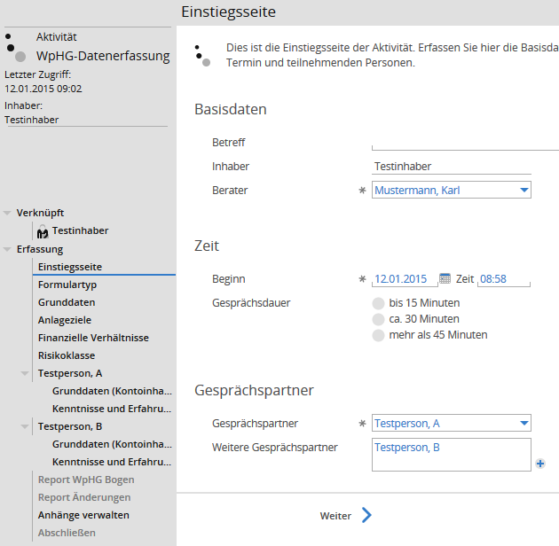
Use Case: Workflow is a Tree
Page: Tree of controls
Navigation area:
Tree of pages
A
B
Active and inactive pages
Input affects the workflow
Entry
Basics A
Expertise A
Basics B
Expertise B

Slide 10
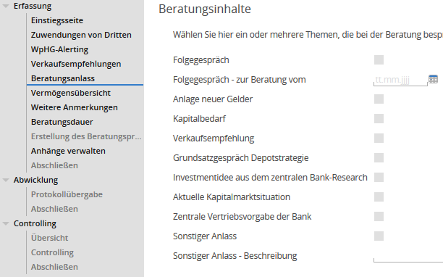
Use Case: Dynamic Tree Structure
Pages appear and disappear depending on selection
Their contents need to be remembered to prevent data loss
Topic Selection
Topic A
Topic C

Slide 11
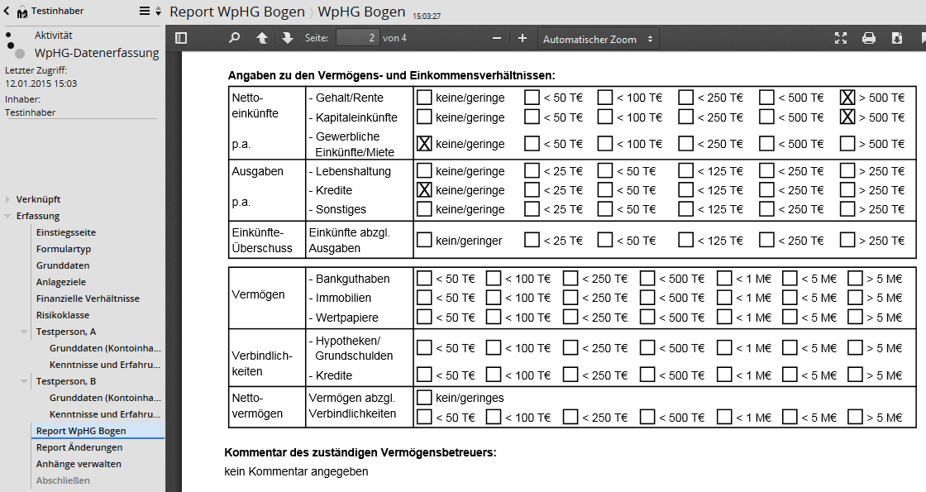
Use Case: Change Propagation
Regeneration of reports upon data changes
Asynchronous generation of reports
Form A
Form B
Generate Report
View Report

Slide 12
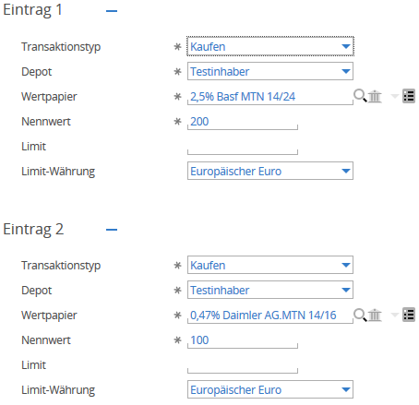
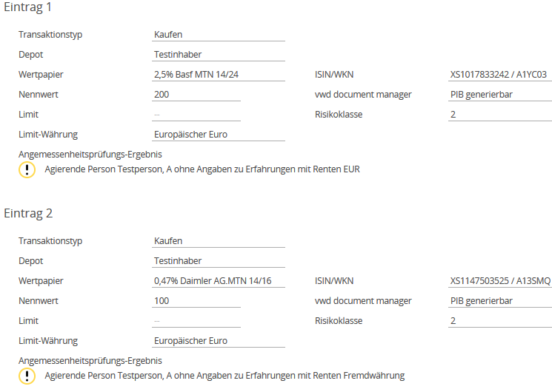
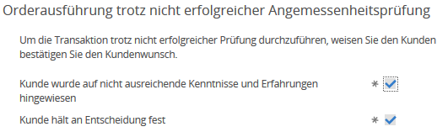
Use Case: Gatekeeper
Overview
Outcome
Generate Report

Slide 13
Use Case: Challenges
User experience
Revision of prior inputs
Flexibility in order of input
Customization
Exploit common structure in processes of customers
Framework challenges
Software changes, data consistency, multi user, scalability, ...
not in this talk

Slide 14
Control Flow versus Data Flow
Which model is more suitable for financial consulting?
financial
situation
entry
financial
situation
report
entry
report
expertise
expertise
Static graph
Dynamic graph
Lots of arrows
Difficult to see the effect of changes

Slide 15
Related Work
Beautiful Workflows: A Matter of Taste? (W.M.P. van der Aalst, M. Westergaard, H.A. Reijers)
Procedural
Control-flow graph Petri-nets
YAWL, jBPM, Apache ODE
A consultancy session is a “case”
Case Handling
State and structure derived from data (“the case”)
Declarative
Linear temporal logic
Constraints by tree and data flow
Functional
Linear, pure data flow
Clean: iTasks
Arrows instead of Monads

Slide 16
Grammars
Parsing?
and Workflows

Slide 17
Grammar
LL(0)
S
BNF:
S -> T b T -> a a
T
b
Regular expression:
((a a) b)
a
a
parser
a
a
b
scanner / lexer

Slide 18
Bottom-up
Data Flow
S-Attributed Grammar
S
f₁
T
f₂
b
a
a
parser
Parser combinators:
pS = pT <**>
sym ‘b’ <$$> f₁
pT = sym ‘a’ <**>
sym ‘a’ <$$> f₂
a
a
b
Happy:
scanner / lexer
S : T b { f₁ $1 $2 }
T : a a { f₂ $1 $2 }

Slide 19
Topdown
Parsing Static Context
S
c₁
T
b
c₂
c₃
a
a
parser
a
a
b
pS = pT <**>
sym c₁ ‘b’ <$$> f₁
pT = sym c₂ ‘a’ <**>
sym c₃ ‘a’ <$$> f₂
scanner / lexer

Slide 20
Topdown
Parsing Data Flow
S
i
g₁
g₂
T
b
i
g₃
g₄
a
a
pS i =
pT (g₁ i) <**>
sym ‘b’ (g₂ i) <$$>
f₁
pT i =
sym ‘a’ (g₃ i) <**>
sym ‘a’ (g₄ i) <$$>
f₂
parser
a
a
b
scanner / lexer
Notes:
Bei

Slide 21
Left-To-Right
Data Flow
L-Attributed Grammar
S
T
b
a
a
Arrow:
parser
pS = proc i -> do
s₁ <- pT -< g₁ i
s₂ <- sym 'b' -< g₂ i s₁
returnA -< f1 s₁ s₂
pT = proc i -> do
s₁ <- sym 'a' -< g₃ i
s₂ <- sym 'a' -< g₄ i s₁
returnA -< f₂ s₁ s₂
a
a
b
scanner / lexer
Notes:
Bei

Slide 22
Higher-order
Dynamic
Higher-Order Grammar
S
g₁
g₂
T
b
Applicative Functor:
pS i = g₁ i <**> g₂ i <$$> f₁
pT i = g₃ i <**> g₄ i <$$> f₂
pS = proc i -> do
s₁ <- app <- g₁ i
s₂ <- app -< g₂ i
returnA -< f₁ s₁ s₂
pT = proc i -> do
s₁ <- app -< g₃ i
s₂ <- app -< g₄ i
returnA -< f₂ s₁ s₂
g₃
g₄
a
a
Arrow:
parser
a
a
b
scanner / lexer

Slide 23
Monadic
In-Order Data Flow
S
Monad:
pS i = return i >>=
g₁ >>=
g₂ >>=
liftM f₁
pT i = return i >>=
g₃ >>=
g₄ >>=
liftM f₂
pS = proc i -> do
s₁ <- app <- g₁ i
s₂ <- app -< g₂ s₁
returnA -< f₁ s₂
pT = proc i -> do
s₁ <- app -< g₃ i
s₂ <- app -< g₄ s₁
returnA -< f₂ s₂
T
b
a
a
Arrow:
parser
a
a
b
scanner / lexer

Slide 24
Idea
Parsing and its Inverse
Data flow between tasks
Attribute Evaluator
parser
tokens
a
a
b
task obligations
scanner / lexer
Workflow Executor
inputs
outputs
Task A₁
Task A₂
Task B
Parsing performed tasks
Generating todo’s

Slide 25
Relaxed Order
(Higher-Order) Attribute Grammar
Data Flow Graph
Arrows
S
T
b
Not only perform tasks from left to right.
Order is only restricted by data flow: allow a task if there exists a defined data flow for all its inputs
a
a
Attribute Evaluator
a
a
b
Workflow Executor
Task A₁, Task A₂, Task B Task A₂, Task B, Task A₁
Task B, Task A₂, Task A₁

Slide 26
Technical Content

Slide 27
Big Picture
Attribute evaluation
Task 1
Task 2
Task 3
Workflow execution

Slide 28
Overview
Presentation order:
Workflow Description Attribute Grammar
3
Code
Attribute Grammar Compiler
Attribute Evaluation Algorithm Arrow
Attribute Evaluator
Attributed Trees + Data Flow Graph
2
Workflow Executor
Task Tree (internal)
Workflow Facade
1
Task Tree (external)
GUI

Slide 29
Task Tree
Workflow Model

Slide 30
Task Tree (external)
Representation for the frontend
abstract view and controller
name
group
Granularity of tasks:
an entire page
individual data point (e.g. control)
status
name
page
status
Tree is replicated to the front end
name
description
section
layout
name
The user affects the tree by submitting values to tasks
The tree is a pure function of the task’ values
(except for database changes external to the workflow -> database snapshots)
description
...
required
task₁
task_{k}
value
submit(value)
attribute of a node (an output)
API procedure

Slide 31
Task Tree (internal)
Representation for the Workflow Executor
name
status
group / page / section / etc.
name
value
description
status
Generate Report
Store Document
Publish Edits
required
edits
user task
system task
input attributes: “configuration”
output attributes
Performed by the system

Slide 32
Task Tree Nodes
i.e.: user tasks, system tasks, pages, sections, etc.
A node of a particular type has input and output attributes; available to procedures associated with the node
For each node type a collection of procedures:
Attach procedure: Initializes the node Determines a name
May use attach-phase attributes
attach
execute
input attributes
output attributes
Execute procedure: Computes output attributes Performs side-effectful operations
May use all attributes and state
idempotent
commutative
local state
(not persistent)
Submit procedure (user tasks only): Changes the local state of the node
workflow state system state

Slide 33
Node Execution
attach execute submit
attach execute submit
attach execute submit
attach execute submit
attach execute submit
attach execute submit
Wenn attach-inputs available: run attach
Wenn all inputs available: run execute
Reruns respectively upon changes to inputs
Upon user inputs: run submit and execute

Slide 34
Attributed Trees
as Data Flow Graph

Slide 35
Trick
The attributed tree contains the nodes of the task tree as leafs with fixed attribute specifications
Provides flexibility in structure of tree and organization of attributes
parent-child relationship:
attributed tree
task tree
Hides the complexity of task tree nodes
page
one or more attributes
attribute data flow
(partially shown)
Separates workflow execution from attribute evaluation
section
section
genreport
task₁
task₂
task₃

Slide 36
Local data flow
Also, between a node and its children
source attributes:
target attributes:
inputs of the parent
outputs of the parent
outputs of its children
inputs of its children
source₁
target_{k} = f_{k} (source₁, …, source_{n})
f_{k}
target_{k}
Local data flow is described by an equation for each target attribute and its corresponding function
source_{n}
⊆ sources(node)

Slide 37
Types of local data flow
2
1
3
4

Slide 38
Global data flow
The local data flows combined:
local data flow of the parent
global data flow of the child
global data flow of the child

Slide 39
Dynamic Tree
A child being itself a target attribute
Higher-order
Conditionals
A
B
child_{k}
Sequencing
A
B
child_{k} = f_{k} (source₁, …, source_{n})

Slide 40
Circular Data Flow
Fixpoints
status
status
“open”
“closed”
For finalizing/closing of workflows
open
closed

Slide 41
Attribute Evaluation
Partial
Incremental
External

Slide 42
Workflow Description
as Attribute Grammar

Slide 43
Data Flow Challenges
Describing the local data flow is tough:
Nodes with many children
Many attributes
Many functions between attributes
The local data flow graph is large
Solution: Attribute Grammars

Slide 44
Attribute Grammar
Notation for the previously presented pictures
Static checks: well-formed, well-typed, non-circular
Aspect oriented:
Equations can be given in arbitrary order and grouped aspect-wise
Type of node: production
Compositional and modular
Abstractions / patterns / syntactic sugar
rules
Type of tree: nonterminal
Task Tree Node / Task: terminal

Slide 45
Workflow
The workflow is described by an attribute grammar such that its terminals represent nodes of the task tree
Framework dictates a number of attributes: task node IDs, parentId, collection of children, explicit sequencing

Slide 46
How?
Attribute Grammar Tutorial
ICFP 2012
http://foswiki.cs.uu.nl/foswiki/HUT/AttributeGrammarSystem

Slide 47
Conclusions

Slide 48
Summary
Workflow Description Attribute Grammar
AG Compiler
Attribute Evaluation Algorithm Arrow
Attribute Evaluator
Attributed Trees + Data Flow Graph
Workflow Executor
Task 1
Task 2
Task 3
Task Tree (internal)
Workflow Facade
Task Tree (external)
Persistent State / System Services
GUI

Slide 49
Application of Attribute Grammars
In compiler construction
Small, deep, mutually-recursive trees with many alternative nodes (e.g. many types of expressions, statements, declarations, …)
Few attributes, complex wiring
In the presented framework
Wide, shallow trees with little recursion and few alternatives (workflow structure rather fixed)
Many attributes, straightforward wiring

Slide 50
Conclusion
Declarative Workflow: what not how
Tasks organized in a tree
Functional data flow between tasks described by an attribute grammar
Attribute Grammar Tutorial, ICFP 2012
Why Attribute Grammars Matter, W. Swierstra

