Slide 1





Slide 3
product development
mobile electronic health record for iOS
in cooperation with Lohmann & Birkner
large parts in Haskell
Scala, Objective-C, Swift, Javascript
http://factisresearch.de
http://checkpad.de

Slide 4

software project development
in many fields
Scala, Clojure, Erlang, Haskell, F#, OCaml
training, coaching
www.active-group.de
funktionale-programmierung.de
Notes:
Wer hat gar keine Ahnung von funktionaler Programmierung?
Wer hat schonmal Clojure-Programm gesehen & verstanden?
Wer hat schonmal Scala-Programm gesehen & verstanden?
Viele Folien, Bonusmaterial, bitte unterbrechen

Slide 5
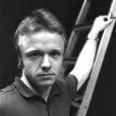
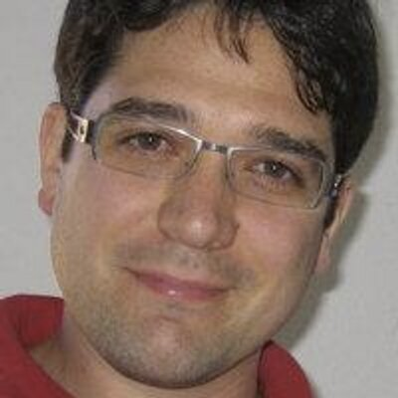
Diversity & Anti Harassment
http://bobkonf.de/richtlinien.html
Be Respectful!

Slide 6
Speakers
Come to the front in break before your talk
contact session chair
check laptop/projector combo
sign release form

Slide 7
Everyone
Move Swiftly

Slide 8
Talk Change
Der Ceph Object Store
^{Lukas Pustina}
^{14:45}
^{Michael Sperber}
^{Active Group GmbH}
^{The Purely Functional Fab}
^{(in English)}

Slide 9
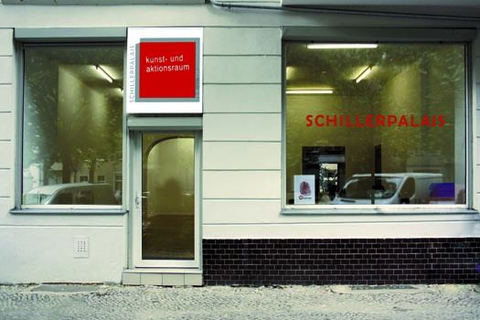
Wind-Down Event
Schiller-Palais
Schillerpromenade 4 D-12049 Berlin
19:00
take U8 from U Paracelsus-Bad direction Hermannstraße
to U Boddinstraße
10€ for food
If you didn’t sign up via Doodle,
talk to registration desk!

Slide 10
Thanks!

Slide 11
Enjoy!

