Slide 1
Big Mountain Ski Resort: Pricing Model Allen Wang Springboard

Slide 2
How should Big Mountain Resort increase revenue to accommodate for the increased cost in expenditures (1.5 mil USD) by the beginning of the next opening season.
H
1
Context
4
Constraints within solution space
<Why are you working on this problem?>
Big Mountain Resort recently just installed a new ski lift that increases their seasonal expenditures by 1.5 million dollars and they are trying to implement different business strategies. They are trying to either cut costs to accommodate or they are to charge a premium on the regular price of the tickets.
<What constraints exist that may prevent this business initiative from succeeding?>
Unreasonable pricing of tickets or undermining the value of the tickets could potentially ruin the ski resort’s reputation leading to a decrease in the amount of customers.
2
Criteria for success
5
Stakeholders to provide key insight
<What is the key criteria that will deem this work successful?>
The business strategy must be implemented before tickets go on sale for the next opening season.
<Who are the key stakeholders that need to be involved in this project? Where will you source your data from and who will you present your recommendation to once you have identified a solution?>
Director of Operations, Jimmy Blackburn
Alesha Eisen, the Database Manager
3
Scope of solution space
6
Key data sources
<What is the focus of this business initiative? I.e. What are you specific items will you focus on exclusively?>
We will focus on the quantity of ticket sales in respect to the seasonal expenditures in order to measure the efficacy of our business strategies.
<What are the key pieces of data you need to answer the questions related to the problem you are trying to solve?>
A single csv file provided by the database manager.
H
D
E
I
P
Notes:
Hypothesis: Create a Hypothesis with an emphasis on SMART principles. (S – Specific, M – Measurable, A – Achievable, R – Realistic, T – Timebound). If you cannot do this, you do not have a good grasp on the business problem.
Context: With context, we have clearly identified the problem at hand and have elucidated on how our initiative may solve this problem, alongside the commercial implications this will have on the business.
Criteria for Success: Clearly defining the criteria for success ensures that the scope of your work is clearly defined and understood. Otherwise, if this isn’t defined – your work will never end which will result in mismatched expectations.
Scope of Solution Space: Scoping out the solution space ensures that the business initiative is SPECIFIC for a certain segment or area. This prevents solutions that have been developed being scaled and applied for all other business units that the solution may not be responsible or scalable for.
Constraints within Solution Space: Looking forward, what are the foreseeable problems we are likely to encounter? Could this be stakeholder resistance? Could this be we don’t have access to the right data?
Stakeholders to provide key insight: Who are the people I need to speak to, to get the answers I need for my data analysis?
What key data sources are required?
Based off my discussions with the key stakeholders – can we clearly list out all the data sources we need so we can make a highly targeted request as opposed to a scatter-gun approach where we ask for a bit of everything?

Slide 3
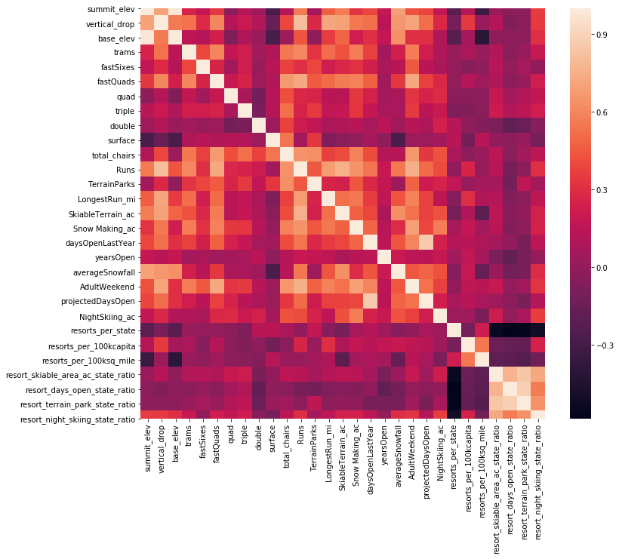
Heatmap of Correlation of Features

Slide 4
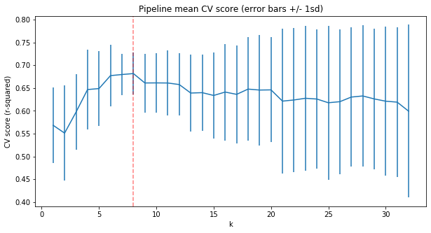
Selecting the best number of features

Slide 5
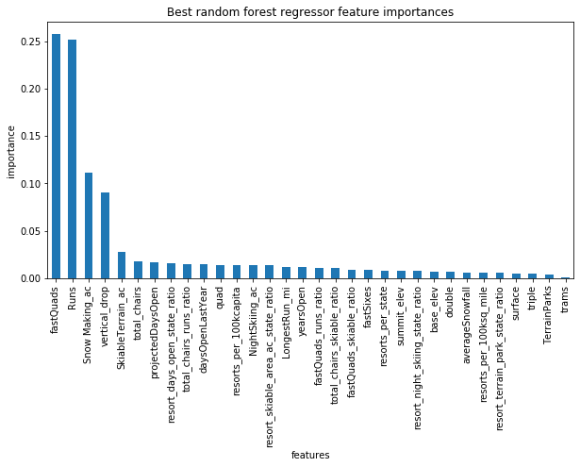
Model Selection We found that using a Random Forest Algorithm generated the best results for this type of problem: to figure out what factors determine pricing. We also tried using linear regression method and the Random Forest generated better results. We got an overall MAE (Mean Absolute Error) score of 9.4955 through cross validation techniques where in the Linear Regression Model we got a MAE of 11.793. The graph shows the most important features in determining pricing in which cross validation selected the top 8.

Slide 6
Scenarios for improving pricing The current price that Big Mountain is charging on average for a day of skiing is $82.00. The modelled price is around $94.22. This suggests room for raising the price. However Big Mountain can cut costs or raise their prices while matching customer expectations. There are 4 modelled scenarios 1. Reduce up to 10 runs and each runs reduced will lead to a price drop listed here [0.0, -0.4057971014492807, -0.6666666666666714, -0.6666666666666714, -0.6666666666666714, -1.2608695652173907, -1.2608695652173907, -1.2608695652173907, -1.7101449275362341, -1.7101449275362341]. Reducing 3, 4, 5 runs will lead to the same difference in price change. Reducing 6, 7, 8 runs will be the same as well. 2. Increase the vertical drop by 150 feet, installing a chair lift. This scenario increases support for ticket price by $1.99 Over the season, this could be expected to amount to $3474638. Suggested implementations: Second scenario is seemingly the most efficient in raising revenue, however scenario one can be implemented as well. It is recommended that runs are either cut by the 2 least used or 5 least used and so on as the modelling shows. The model suggests that Big Mountain is somewhat underpriced so going with the second scenario allows for price increase and not lowering the expectations of customers by improving the vertical drop and installation of a chair lift.

Slide 7
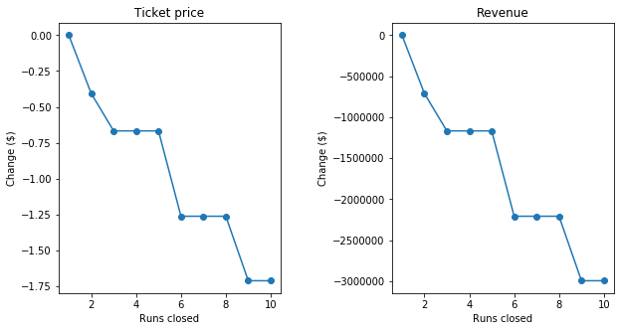
Model of Reducing Runs

Slide 8
Summary of findings
A Random Forest Model is better than a Linear Regression model with significantly better MAE score.
A cross validation technique with the algorithm reveals that there are 8 features that most affect the pricing
of ski resorts.
The Random Forest Model suggests that there is room for around a $12 increase for pricing.
Through these 8 features we created 4 scenarios accordingly and deduced that only two scenarios are viable
and can be implemented
Pricing cuts through reducing operating costs by shutting down the least used runs
Increasing vertical drop and installing a chairlift will increase the price on average by $1.99.
Strategies for implementation:
Graphs for the first scenario reveal that reducing one least used run will not affect pricing and that reducing 2 will.
Reducing 3 will further drop the price, however reducing 4 or 5 will lead to the same drop in price. It is more
efficient to cut 5 of the least used runs.

