Slide 1

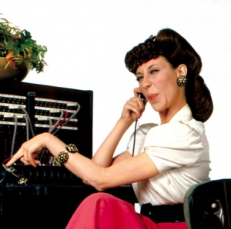
Action Controller
Routes
Controller

Slide 2


Sinatra vs. Rails

Slide 3
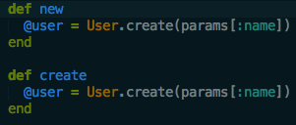
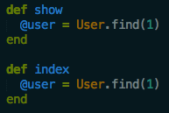
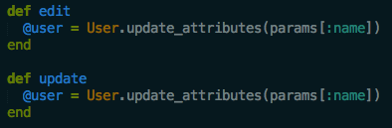
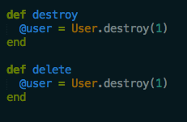
CRUD
Create
Read ---------------------->
Update
Delete --------------------------->

Slide 4
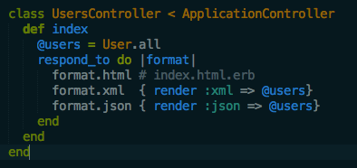
Respond_to
Manage Content Types
JSON
XML

Slide 5


Params
Same as Sinatra!
Wrap Parameters

Slide 6
Sessions
Same as Sinatra!

Slide 7
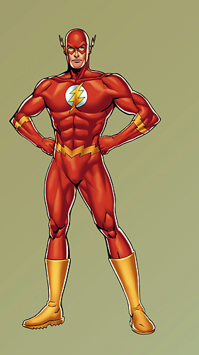
Flash[:key]
Non-persistent session

Slide 8
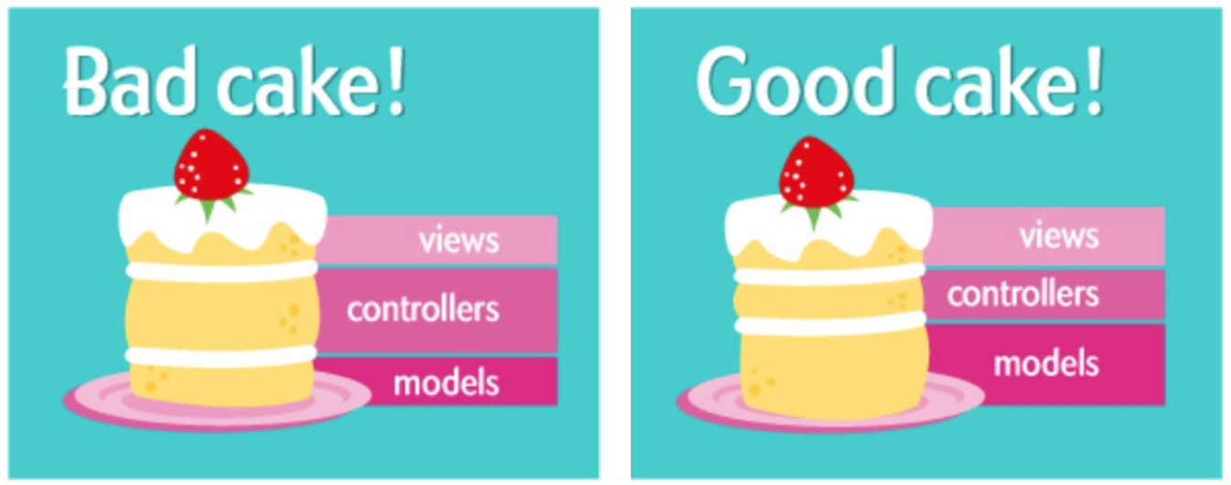
Light Controllers

Slide 9
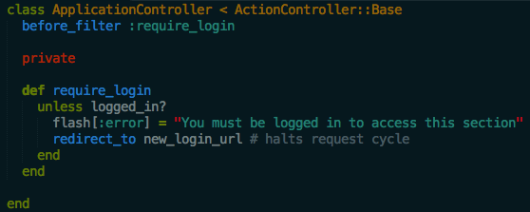
Filters

