Slide 1
References to check for these mappings: 1. Threat flowchart data mapping: TIMP_Risk_Data_Sources_Doc_12132022.xlsx 2. Risk model data mapping (Mariner table) (refer to 6/28/2023 notes)
QRAD Data Variable Mapping 2022.xlsx (sharepoint.com)
3. Steven/Gordon/Jackson
TIMP intermediate
data (ValidationData.gdb, Validation/…)
Mariner Database
GT-GIS
Table: Coating
H-Forms
Column: CoatingLineDomain
Attachment3 – EC Model
Column: ??
EC_LOF_Risk
A-Forms (SAP)
Table: Coating_Condition
Attachment3 – IC Model
Atmospheric corrosion program
Column: CoatingConditionDomain
?
Attachment3 – …
Table: …
Column: ??
Data sources
At different places
Mariner Table on mariner server
SME: Gordon/Steven Liu
Run models
SME: Jackson
Goal: Figure out the data sources so they can
be ingested into Foundry
Different data sources gets pulled into intermediate data storage,
then gets cleaned and aggregated into Mariner database tables,
before being used to do risk model calculations.

Slide 2
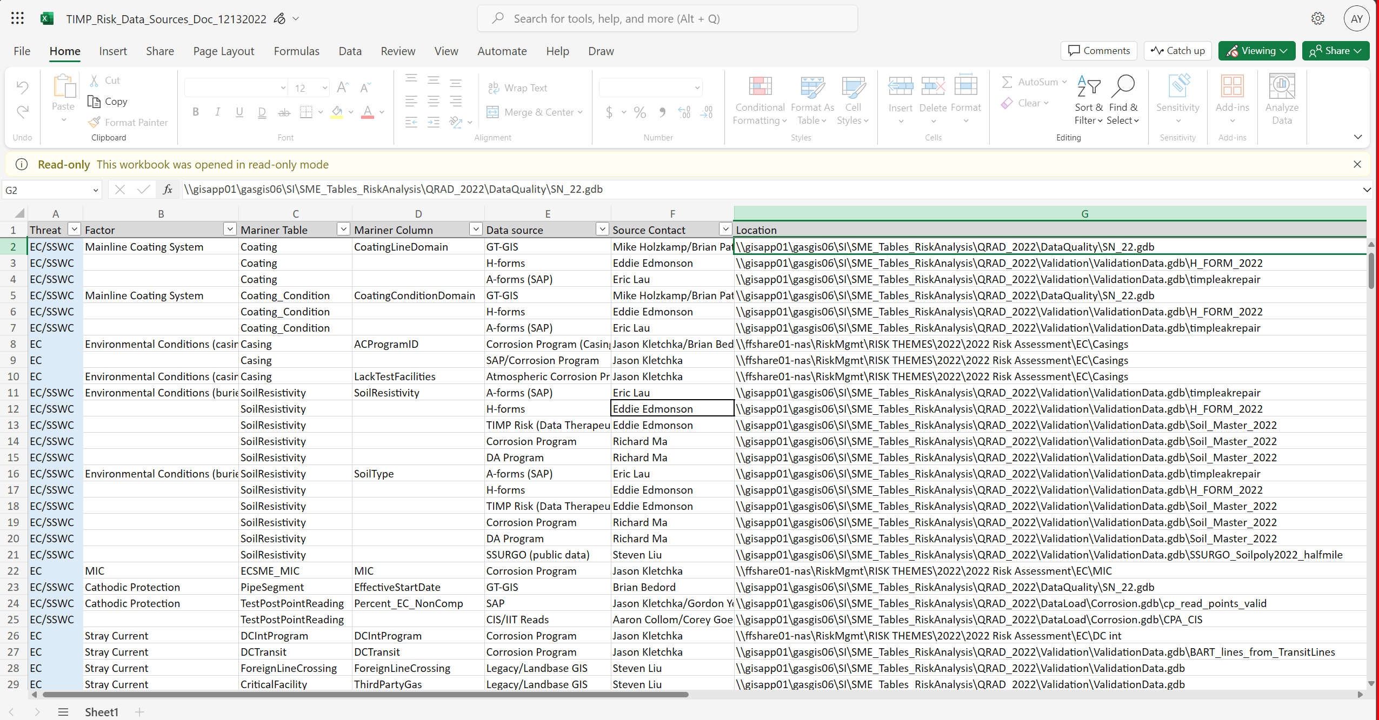
ValidationData.gdb means Gordon/Steve pulled the
data from original sources and compiled them in
this database
DataQuality\?? Gordon/Steven compiled it?
This column (G) are likely all
Intermediate TIMP data storage,
NOT raw sources
Ask Richard/Steven what data and/or transformation this involves

Slide 3
Raw sources:
GT-GIS,
H-Forms,
A-Form (SAP),
DA Program,
Corrosion Program,
…
Intermediate sources:
TIMP_LeakRepair (Leakmaster)
Casing,
Soil_master,
MIC,
…
Steven/Gordon
and other SME magic
In the context of EC, for example:
- How many distinct intermediate sources are needed? (Column G in TIMP_Risk_Data_Sources_Doc_12132022.xlsx)
- How many distinct raw data sources are used to derived these intermediate sources? (Column E in TIMP_Risk_Data_Sources_Doc_12132022.xlsx)
For raw sources, some are more straight forward.
Ex: H-Forms, A-Forms – they are forms that get digitized.
DA program/Corrosion program: need to figure out the specific dataset(s) that get pulled from these data sources.
Note: “Dataset” here can mean a specific table in a database, an excel sheet, or other method of record.
Deliverable 1 example:
Coating condition is derived from GT-GIS pipe specs, H-Forms, and A-Form (SAP)
Soil_Master intermediate data- set is derived from dataset x of DA program, dataset y of Corrosion program, and …
Aggregation deliverable example:
Dataset x of DA program feeds into 20 intermediate sources used for EC
Dataset y of corrosion program feeds into 30 intermediate sources used for EC
H-Forms feed into 50 intermediate sources used for EC..

Slide 4
Example for goal of investigation:
Richard/StevenLiu tells me: Dataset x from Corrosion Program (column E) feeds into “Soil_Master2022” (column G)
JasonKletchka/StevenLiu tells me: Dataset y from Corrosion Progrm feeds into “DC int”
JasonKletchka/StevenLiu tells me: Dataset x from Corrosion Program feeds into “Bart lines into Transit Lines”
Aggregate summary:
Dataset x from Corrosion Program feeds into 2 intermediate datasets
Dataset y from Corrosion Program feeds into 1 intermediate datasets
So in this example, Dataset x should be prioritized for ingestion

