Slide 1

服飾零售商的常客服務系統
TEAM-4
tokpmpm, fychao, allenyllee, Tony7302y2k, gn01928719, RaymondChampion, wjh, jack-XIE, er3215

Slide 2
Agenda
Scenario describe
System Analysis
Work for each member (currently)

Slide 3
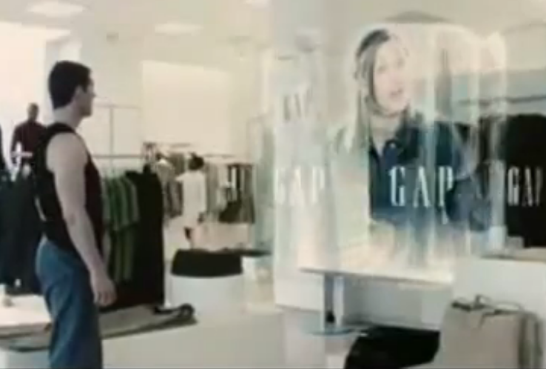
Scenario describe
Based on story about Tom Cruise entering a cloth store in Minority Report (2002).
Use facial recognition, instead of retina recognition.
System identifies frequent customer and ask him about previous shopping experience.
Demo system will also present registering frequent customer to database, and presenting functions incl.
(1) entering customer information,
(2) upload customer photos for indexing, and
(3) practical test on presenting system.

Slide 4
System Analysis
Presenting system incl. following sub-modules:
Registering Module (常客會員註冊系統)
上傳一張照片
填上使用者名稱，其本上只要1~2個常客資料即可。
Facial Recognition Module (人臉識別系統)
串接 webcam
即時上傳、索引及計算。
Product & Selling Database (商品資料庫及購物歷史資料庫)
在識別出常客後從系統中找出此位常客上次購買的商品。
若沒有商品…則隨便推薦個商品。
Customer Relation Module (使用經驗管理)
使用經驗問題及紀綠資料庫

Slide 5
Work for each member (currently)
I’ve received volunteering to work on, as following:
Webber Hsu
Working on using OpenCV w/ webcam to build facial recognition module.
August Chao
System integration, incl. registering, product & selling DB, and CRM module.

Slide 6
Thanks for your listening
.

