Slide 1
Parallel Computing for Science & Engineering Spring 2013: MPI point-to-point 1
Instructors:
Victor Eijkhout, Research Scientist, TACC
Kent Milfeld, Research Associate, TACC
Notes:
Check Single and Section have implied barrier.
25 continue fortran “&”

Slide 2
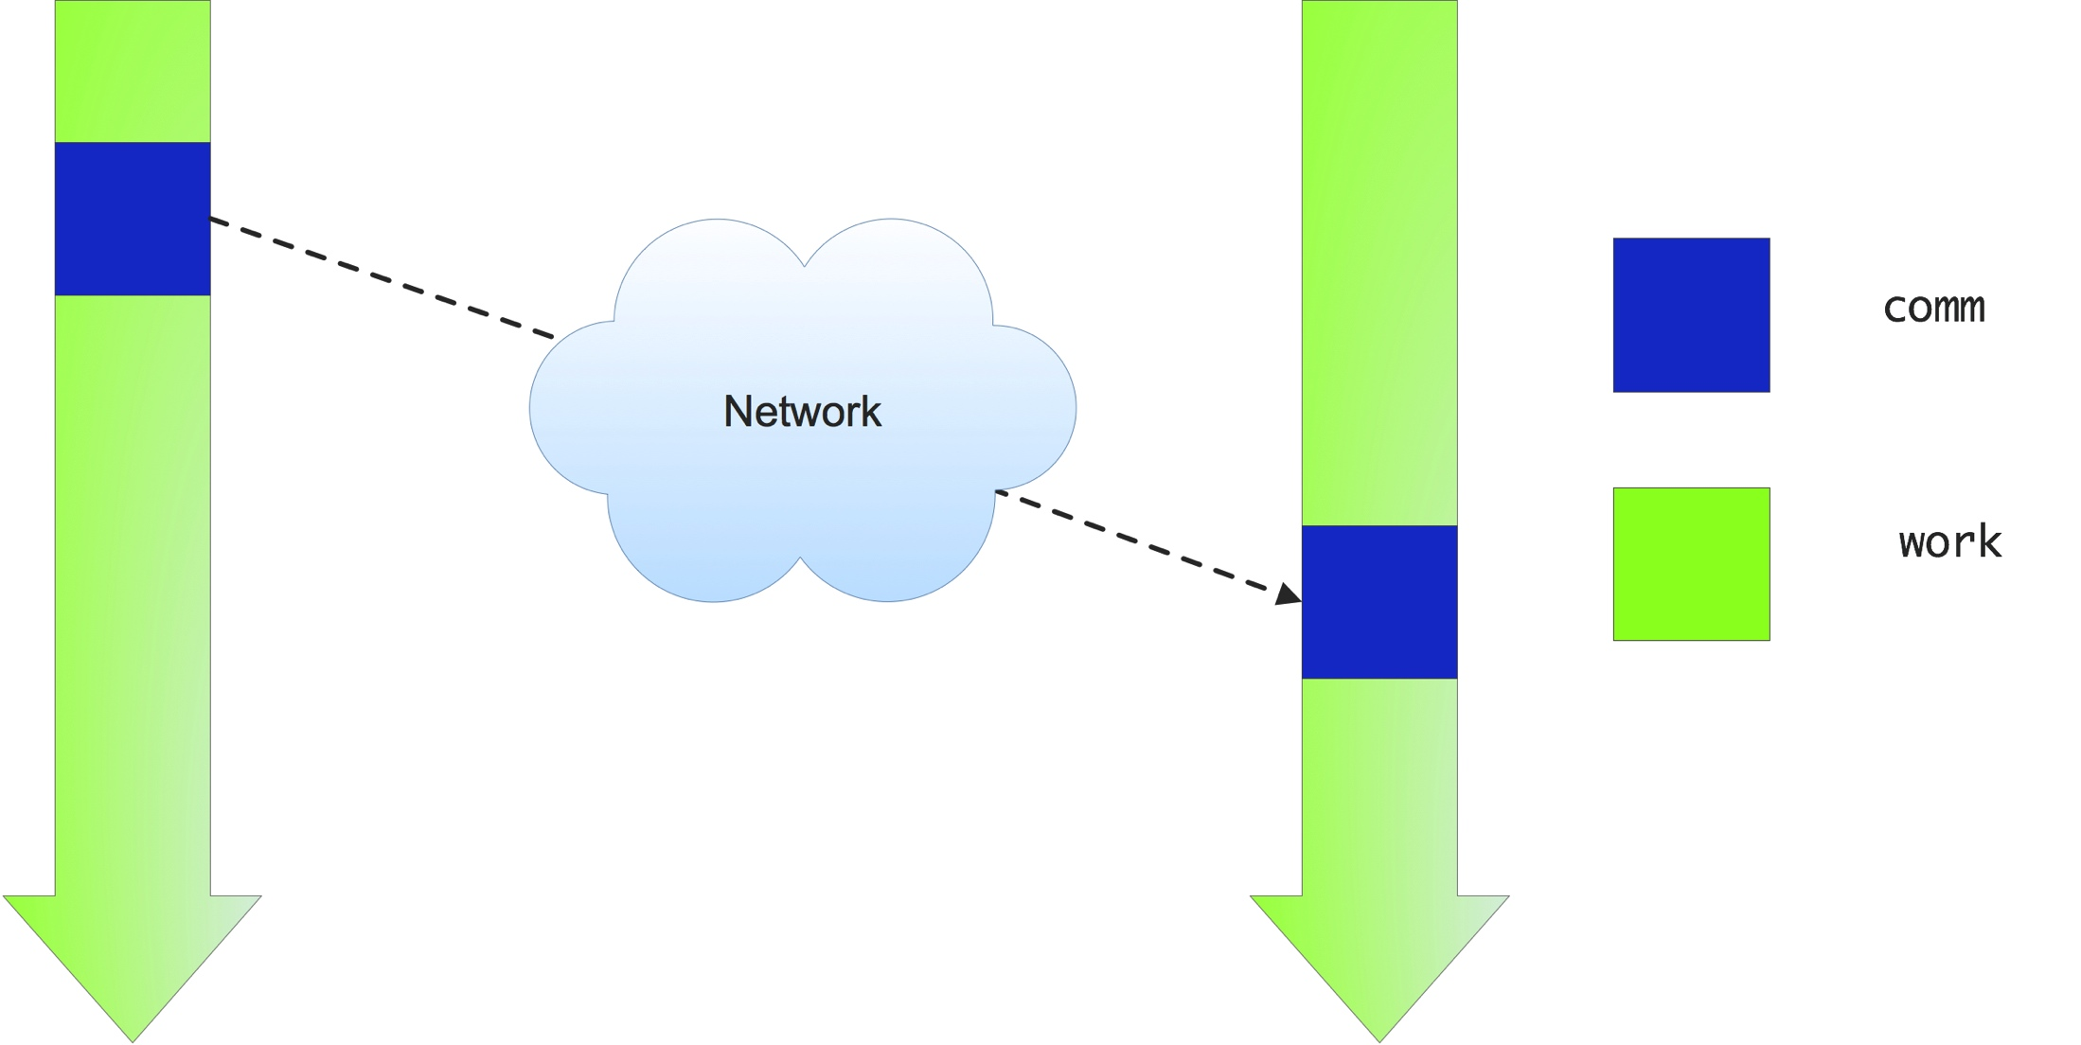
Life would be simple if….
Processors would just send and receive, and the network would DWIM

Slide 3
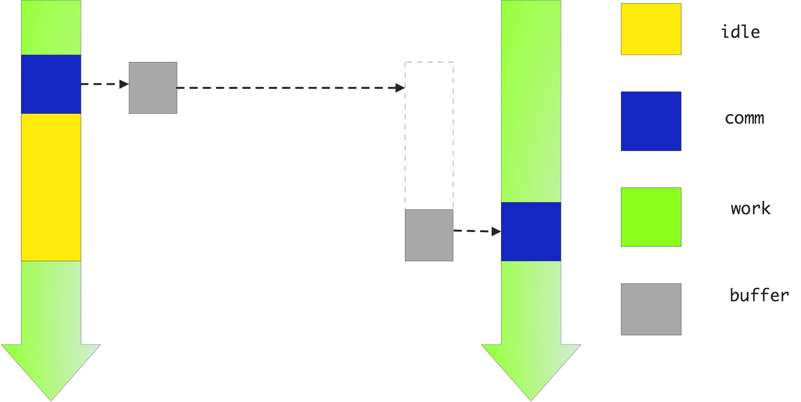
Unfortunately
Data has to be somewhere: on one process or the other

Slide 4
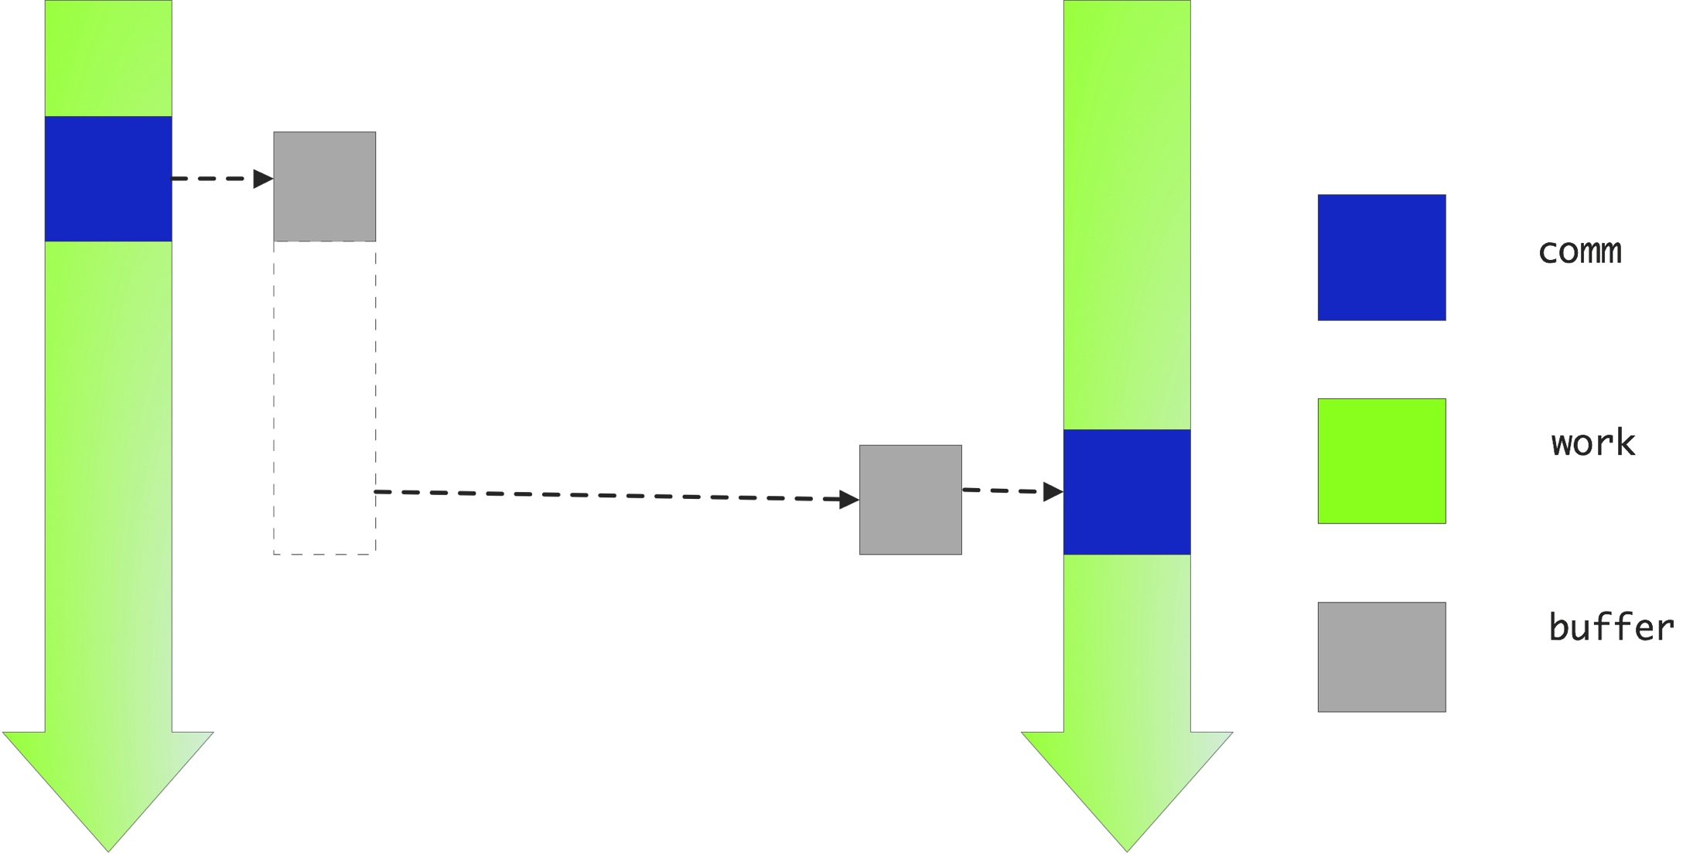
Non-blocking solution
Create a buffer and let the send data sit there until someone picks it up

Slide 5
Blocking Send/Receive
MPI_Send
MPI_Recv
Generic Syntax
task 0
data
task 1
data
data
data
MPI_Send(buf, count, datatype, dest, tag, comm)
MPI_Recv(buf, count, datatype, source, tag, comm, status)
When MPI sends a message, it doesn’t just send the contents; it also sends an envelope describing the contents:
network
Parts of a P-2-P
Communication:
Data
Send to/Recv from
Message ID
Argument | Description
buf | initial address of send/receive buffer (reference)
count | number of items to send (integer)
datatype | MPI data type of items to send/receive
dest | MPI rank of task receiving the data (integer)
source | MPI rank of task sending the data (integer)
tag | message ID (integer)
comm | MPI communicator (set of exchange processors)
status | returns information on the message received
Notes:
Both send and receive are quite the same:
Data description usually the same
Send has dest, Recv has source
Both require a tag for additional control
Both require a communicator
Recv has status information.

Slide 6
Details
buffer | data (address in C, name of array/value in Fortran)
count | Length of source array (in elements, 1 for scalars)
datatype | Data Type: e.g. MPI_INT (C), MPI_INTEGER (F90), MPI_DOUBLE_PRECISION (F90), MPI_DOUBLE (C), etc.
source | Rank (proc #) of source in communicator group
tag | Message identifier (arbitrary integer)
communicator | Group of processors
status | Information about message
ierr | Error (argument in Fortran, returned in C)
 | C | Fortran
status | MPI_Status mystat; | integer mystat(MPI_STATUS_SIZE)
datatype | MPI_Datatype mytype; | integer mytype
comm. | MPI_Comm mycomm; | integer mycomm
Notes:
change “call block until message is in buffer”

Slide 7
Language Example
C
ierr=MPI_Send(&a[0],cnt,type,dest,tag,com);
F
call MPI_Send( a, cnt,type,dest,tag,com,ierr)
C
ierr=MPI_Recv(&b[0],cnt,type, src,tag,com,&status);
F
call MPI_Recv( b, cnt,type, src,tag,com, status,ierr)
Call blocks until send data of a has been sent or copied to a buffer. Recv’s block until data is in b.

Slide 8
P-2-P Example
#include <mpi.h>
int main(int argc, char* argv[]){
MPI_Comm Comm=MPI_COMM_WORLD;
int npes,iam=-1,ierr;
ierr=MPI_Init(&argc, &argv);
ierr=MPI_Comm_size(Comm,&npes);
ierr=MPI_Comm_rank(Comm, &iam);
ierr=MPI_Finalize();
printf("iam=%d\n",iam);
}

Slide 9
P-2-P Example
#include <mpi.h>
int main(int argc, char* argv[]){
MPI_Comm Comm=MPI_COMM_WORLD;
MPI_Status status;
int npes,iam=-1,ierr,irec=-1;
ierr=MPI_Init(&argc, &argv);
ierr=MPI_Comm_size(Comm,&npes);
ierr=MPI_Comm_rank(Comm, &iam);
if(iam==0)
ierr=MPI_Send(&iam, 1,MPI_INT, 1,9, Comm);
if(iam==1)
ierr=MPI_Recv(&irec,1,MPI_INT, 0,9, Comm,&status);
ierr=MPI_Finalize();
printf("iam=%d, received=%d\n",iam,irec);
}

Slide 10
The 6 Basic MPI Call Summary
MPI is used to create parallel programs based on message passing
Usually the same program is run on multiple processors
The 6 basic calls in MPI are
MPI_Init(&argc, &argv);
MPI_Comm_Rank(MPI_COMM_WORLD,&myid);
MPI_Comm_Size(MPI_COMM_WORLD,&numprocs);
MPI_Send(buffer,count,MPI_TYPE, dest,tag,MPI_COMM_WORLD);
MPI_Recv(buffer,count,MPI_TYPE, src, tag,MPI_COMM_WORLD,&stat);
MPI_Finalize();
MPI_TYPE is an MPI Parameter or User Data Type
buffer is passed by reference

Slide 11
MPI_SendRecv
MPI_SendRecv(senddat,sendcount,sendtype, dest,sendtag, recvdat,recvcount,recvtype, src, recvtag, comm, status)
Initiates send and receive at the same time.
Completes when both send and receive buffers are safe to use
Useful for communications patterns where each node sends and receives messages (two-way communication). Good for avoiding deadlock, implementing shifts/rings.
Executes a standard mode send & receive operation for dest and src, respectively.
The send and receive operations use the same communicator, but have distinct tags.

Slide 12
Bidirectional Communication with MPI_Sendrecv
C
ierr=MPI_Sendrecv(&sb[0],scnt,stype,dest,stag,
&rb[0],rcnt,rtype, src,rtag,
MPI_COMM_WOLRD,&status);
Fortran
call MPI_Sendrecv( sb, scnt,stype,dest,stag, rb, rcnt,rtype, src,rtag,
MPI_COMM_WOLRD, status,ierr)

Slide 13
Blocking vs Non-blocking
Blocking
Non-blocking
A blocking send routine will only return after it is safe to modify the data area.
Safe means that modifications in the data area will not affect the data to be sent.
A Safe send does not imply that the data was actually received.
A blocking send can be either synchronous or asynchronous.
Send/receive routines return immediately.
Non-blocking operations request the MPI library to perform the operation when possible.
It is unsafe to modify the data area until the requested operation has been performed. There are wait routines used to do this (MPI_Wait)
Primarily used to overlap computation with communication

Slide 14
Blocking vs non-Blocking Routines
Description | Syntax for C bindings
Blocking send | MPI_Send(buf, count, datatype, dest, tag, comm)
Non-blocking send | MPI_Isend(buf,count, datatype, dest, tag, comm, request)
Blocking receive | MPI_Recv(buf, count, datatype, source, tag, comm, status)
Non-blocking receive | MPI_Irecv(buf,count, datatype, source, tag, comm, request)
Wait for completion | MPI_Wait(request, status)
request: used by non-blocking send and receive operation.

Slide 15
Non-blocking Communication
Non-blocking send
send call returns immediately
send actually occurs later
Non-blocking receive
receive call returns immediately
when received data is needed, call a wait subroutine
Non-blocking communication used to overlap communication with computation (and communication with communication!).
Can be used to prevent deadlock.

Slide 16
Non-blocking Send with MPI_Isend
C
MPI_Request request;
ierr = MPI_Isend(&data, count, datatype,
dest, tag, comm, &request);
Fortran
integer request
call MPI_Isend( data, count, datatype,
dest, tag, comm, request, ierr)
request is the id for the message call
Don't use data area until communication is complete

Slide 17
Non-blocking Receive with MPI_Irecv
C
MPI_Request request;
ierr = MPI_Irecv(&data, count, datatype,
source, tag, comm, &request);
Fortran
integer request
call MPI_Irecv( data, count, datatype,
source, tag, comm, request, ierr)
request is an id for communication
Note: There is no status parameter.
Don't use data area until communication is complete

Slide 18
MPI_Wait Used to Complete Communication
request from MPI_Isend or MPI_Irecv
the completion of a send operation indicates that the sender is now free to update the data in the send buffer
the completion of a receive operation indicates that the receive buffer contains the received message
MPI_Wait blocks until message specified by request completes

Slide 19
MPI_Wait Usage
C
MPI_Request request;
MPI_Status status;
...
ierr = MPI_Wait(&request, &status)
Fortran
integer request
integer status(MPI_STATUS_SIZE)
...
call MPI_Wait( request, status, ierr)

Slide 20
Nonblocking Examples

Slide 21
Two-way Communication: Deadlock
Deadlock 1 (always deadlocks)
other = 1-mytid
call MPI_Recv( recvbuf,count,MPI_REAL,
other,tag,MPI_COMM_WORLD,status,ierr)
call MPI_Send( sendbuf,count,MPI_REAL,
other,tag,MPI_COMM_WORLD,ierr)
Deadlock 2 (deadlocks when system buffer is too small)
other = 1-mytid
call MPI_Send( sendbuf,count,MPI_REAL,
other,tag,MPI_COMM_WORLD,ierr)
call MPI_Recv( recvbuf,count,MPI_REAL,
other,tag,MPI_COMM_WORLD,status,ierr)
Notes:
1 will always deadlock, even if Sends are made non-blocking.

Slide 22
Two-way Communication: Solutions
Solution 1 (but this doesn’t allow bidirectional communication)
if (rank==0) then
call MPI_Send( sendbuf,count,MPI_REAL, 1,tag,MPI_COMM_WORLD,ierr)
call MPI_Recv( recvbuf,count,MPI_REAL, 1,tag,MPI_COMM_WORLD,status,ierr)
elseif (rank==1) then
call MPI_Recv( recvbuf,count,MPI_REAL, 0,tag,MPI_COMM_WORLD,status,ierr)
call MPI_Send( sendbuf,count,MPI_REAL, 0,tag,MPI_COMM_WORLD,ierr)
endif
Solution 2
other = 1-mytid
call MPI_SendRecv( sendbuf,sendcount,sendtype,other,sendtag,
recvbuf,recvcount, recvtype,other,recvtag,MPI_COMM_WORLD,status,ierr)

Slide 23
Two-way Communication: Solutions
Solution 3
other = 1-mytid
call MPI_ISend( sendbuf,count,MPI_REAL,
other,tag,MPI_COMM_WORLD,req1,ierr)
call MPI_IRecv( recvbuf,count,MPI_REAL,
other,tag,MPI_COMM_WORLD,req2,ierr)
call MPI_Wait( req1,status,ierr)
call MPI_Wait( req2,status,ierr)
Solution 4 (buffered sends are not part of this class)
if (rank==0) then
call MPI_BSend( sendbuf,count,MPI_REAL,1,tag,MPI_COMM_WORLD,ierr)
call MPI_Recv( recvbuf,count,MPI_REAL,0,tag,MPI_COMM_WORLD,status,ierr)
elseif (rank==1) then
call MPI_BSend( sendbuf,count,MPI_REAL,1,tag,MPI_COMM_WORLD,ierr)
call MPI_Recv( recvbuf,count,MPI_REAL,0,tag,MPI_COMM_WORLD,status,ierr)
endif

Slide 24
Two-way Communications Summary
 | CPU 1 | CPU 2
Deadlock 1 | Recv/Send | Recv/Send
Deadlock 2 | Send/Recv | Send/Recv
Solution 1 | Send/Recv | Recv/Send
Solution 2 | SendRecv | SendRecv
Solution 3 | Isend/Irecv/Wait | Isend/Irecv/Wait
Solution 4 | Bsend/Recv | Bsend/Recv

Slide 25
Wait types
MPI_Wait : wait for one request
MPI_Waitall : wait for an array of requests, good for load balanced tasks, or when all needed
MPI_Waitany : wait for one in an array of requests, good for unbalanced tasks, or if they can be processed individually
MPI_Waitsome : wait for any number in an array, much like MPI_Waitany

Slide 26
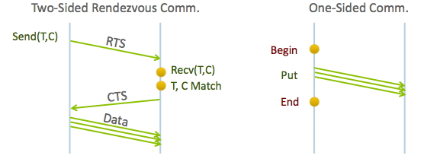
One-Sided or RMA
It would be nice to avoid that two-way orchestration: just write into another process’ memory or read from it
Less overhead, easier to code

Slide 27
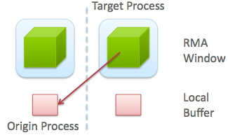
One-Sided concepts
Target & origin processes: origin issues the call, target does nothing explicit
Window & local memory: window is accessible to others

Slide 28
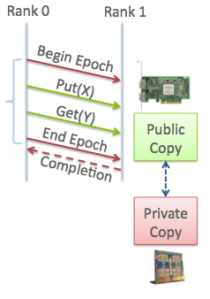
More RMA concepts
Origin vs Target, window vs local mem
Actions: Put, Get, Accumulate
Epoch: just like MPI_Wait: you have to make sure data has arrived

Slide 29
RMA routines
int MPI_Win_create(void *base, MPI_Aint size, int disp_unit, MPI_Info info,
MPI_Comm comm, MPI_Win *win)
MPI_Get( origin_addr, origin_count, origin_datatype, target_rank, target_disp, target_count, target_datatype, win)
MPI_Win_fence(assert,win)
int MPI_Win_free(MPI_Win *win)
Use of fences is one way to synchronize. There are more.

Slide 30
Fences
MPI_Win_fence(assert,win)
Assertions:
MPI_MODE_NOSTORE
MPI_MODE_NOPUT
MPI_MODE_NOPRECEDE
MPI_MODE_NOSUCCEED
Example: MPI_Win_fence( (MPI_MODE_NOSTORE|MPI_MODE_NOPRECEDE), win);

Slide 31
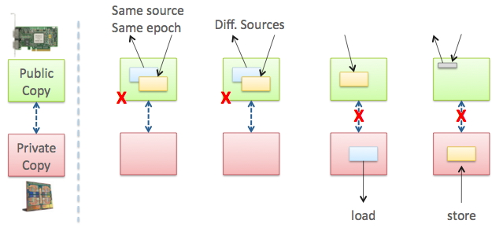
RMA limitations

Slide 32
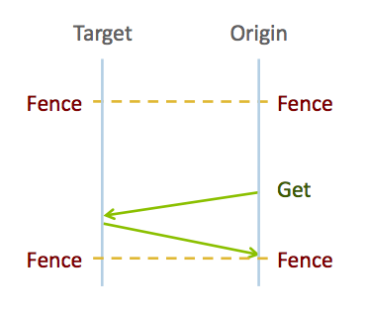
Active target synchronization
The target does not do any communication calls, but is aware of the epoch

Slide 33
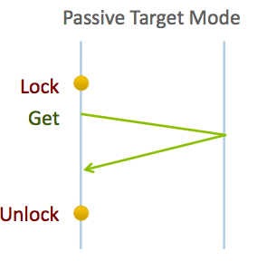
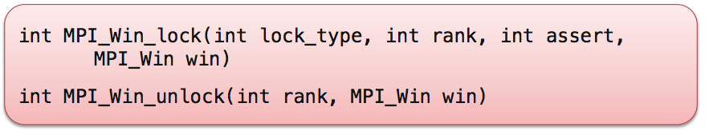
Passive target synchronization
The origin locks the target window, the target is not involved at all

Slide 34
Passive target mode example
MPI_Win_create(&other_number,1,sizeof(int),MPI_INFO_NULL,comm,&the_window);
int target;
if (mytid!=target) {
MPI_Win_lock(MPI_LOCK_EXCLUSIVE,target,0,the_window);
MPI_Accumulate(&my_number,1,MPI_INT,target,0,1,MPI_INT,MPI_SUM,the_window);
//sleep(1);
MPI_Win_unlock(target,the_window);
}
MPI_Barrier(comm);
if (mytid==target)
printf("I got the following: %d\n”,other_number);
MPI_Win_free( &the_window );

