Slide 1
SSC 374/394 PCSE 2013
Computer Architectures: parallel computers

Slide 2
The basic idea
Spread operations over many processors
If n operations take time t on 1 processor,
Does this become t/p on p processors (p<=n)?
for (i=0; i<n; i++)
a[i] = b[i]+c[i]
Idealized version: every process has one array element
a = b+c

Slide 3
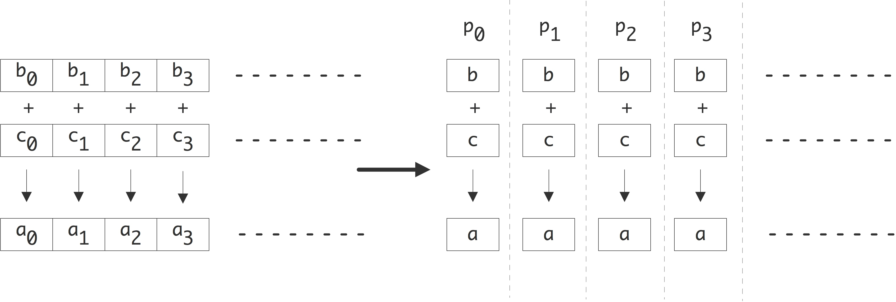

Slide 4
The basic idea
Spread operations over many processors
If n operations take time t on 1 processor,
Does this become t/p on p processors (p<=n)?
for (i=0; i<n; i++)
a[i] = b[i]+c[i]
Idealized version: every process has one array element
a = b+c
for (i=my_low; i<my_high; i++)
a[i] = b[i]+c[i]
Slightly less ideal: each processor has part of the array

Slide 5
The basic idea (cont’d)
Spread operations over many processors
If n operations take time t on 1 processor,
Does it always become t/p on p processors (p<=n)?
s = sum( x[i], i=0,n-1 )

Slide 6
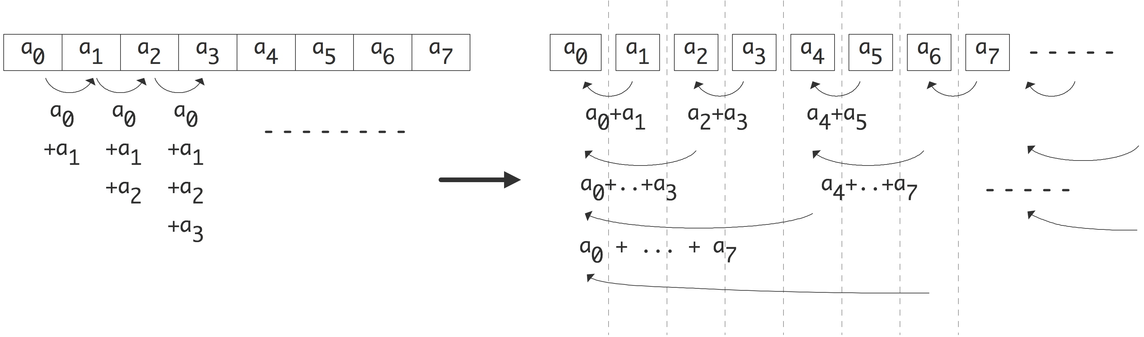

Slide 7
The basic idea (cont’d)
Spread operations over many processors
If n operations take time t on 1 processor,
Does it always become t/p on p processors (p<=n)?
s = sum( x[i], i=0,n-1 )
Conclusion: n operations can be done with n/2 processors, in total time log₂n
Theoretical question: can addition be done faster?
Practical question: can we even do this?
for (p=0; p<n/2; p++)
x[2p,0] = x[2p]+x[2p+1]
for (p=0; p<n/4; p++)
x[4p,1] = x[4p]+x[4p+2]
for ( .. p<n/8 .. )
Et cetera

Slide 8
Theoretical characterization of architectures

Slide 9
Parallel Computers Architectures
Parallel computing means using multiple processors, possibly comprising multiple computers
Flynn's (1966) taxonomy is a first way to classify parallel computers into one of four types:
  (SISD) Single instruction, single data
    Your desktop (unless you have a newer multiprocessor one)
  (SIMD) Single instruction, multiple data:
    Thinking machines CM-2
    Cray 1, and other vector machines (there’s some controversy here)
    Parts of modern GPUs
  (MISD) Multiple instruction, single data
    Special purpose machines
    No commercial, general purpose machines
  (MIMD) Multiple instruction, multiple data
    Nearly all of today’s parallel machines

Slide 10
Characterization by Memory structure

Slide 11
Parallel Computer Architectures
Top500 List now dominated by MPPs and Clusters
The MIMD model “won”.
SIMD exists only on smaller scale
A much more useful way to classification is by memory model
  shared memory
  distributed memory

Slide 12
Two memory models
Shared memory: all processors share the same address space
  OpenMP: directives-based programming
  PGAS languages (UPC, Titanium, X10)
Distributed memory: every processor has its own address space
  MPI: Message Passing Interface

Slide 13
Shared and Distributed Memory
P
P
P
P
P
P
P
P
P
P
P
P
Bus/Crossbar
B
U
S
M
M
M
M
M
M
Memory
Network
P
P
P
P
P
P
FBC
FBC
FBC
FBC
FBC
FBC
…
…
…
…
…
…
Buses
B
U
S
…
…
…
…
…
…
M
M
M
M
M
M
Shared memory: single address
space. All processors have access
to a pool of shared memory.
(e.g., Single Cluster node (2-way, 4-way, ...))
Methods of memory access :
- Bus
- Distributed Switch
- Crossbar
Distributed memory: each processor
has its own local memory. Must do
message passing to exchange data
between processors.
(examples: Linux Clusters, Cray XT3)
Methods of memory access :
- single switch or switch hierarchy
with fat tree, etc. topology

Slide 14
Interconnects

Slide 15
Topology of interconnects
What is the actual ‘shape’ of the interconnect? Are the nodes connect by a 2D mesh? A ring? Something more elaborate?
=> some graph theory

Slide 16
Completely Connected and Star Networks
Completely Connected : Each processor has direct communication link to every other processor (compare ranger node)
Star Connected Network : The middle processor is the central processor; every other processor is connected to it.

Slide 17
Arrays and Rings
Linear Array :
Ring :
Mesh Network (e.g. 2D-array)

Slide 18
Torus
2-d Torus (2-d version of the ring)

Slide 19
Hypercubes
Hypercube Network : A multidimensional mesh of processors with exactly two processors in each dimension. A d dimensional processor consists of
p = 2^{d} processors
Shown below are 0, 1, 2, and 3D hypercubes
0-D 1-D 2-D 3-D hypercubes

Slide 20
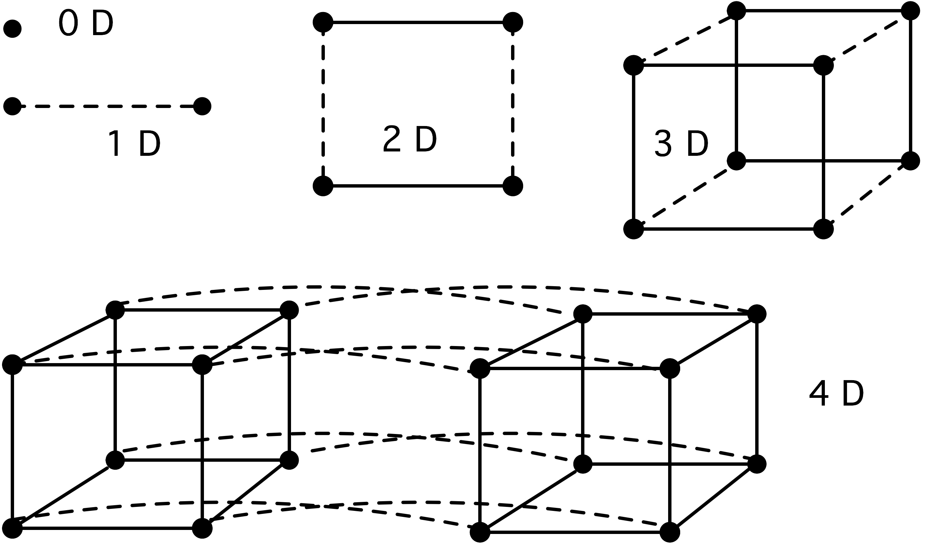
Inductive definition

Slide 21
Bisection
Hypercubes are a good match to bisection algorithms.
Example: quicksort
  Find a pivot
  Separate low/high elements on two subcubes
  Recurse in each subcube

Slide 22
Pros and cons of hypercubes
Pro: processors are close together: never more than log(P)
Lots of bandwidth
Little chance of contention
Con: the number of wires out of a processor depends on P: complicated design
Values of P other than 2^p not possible.

Slide 23
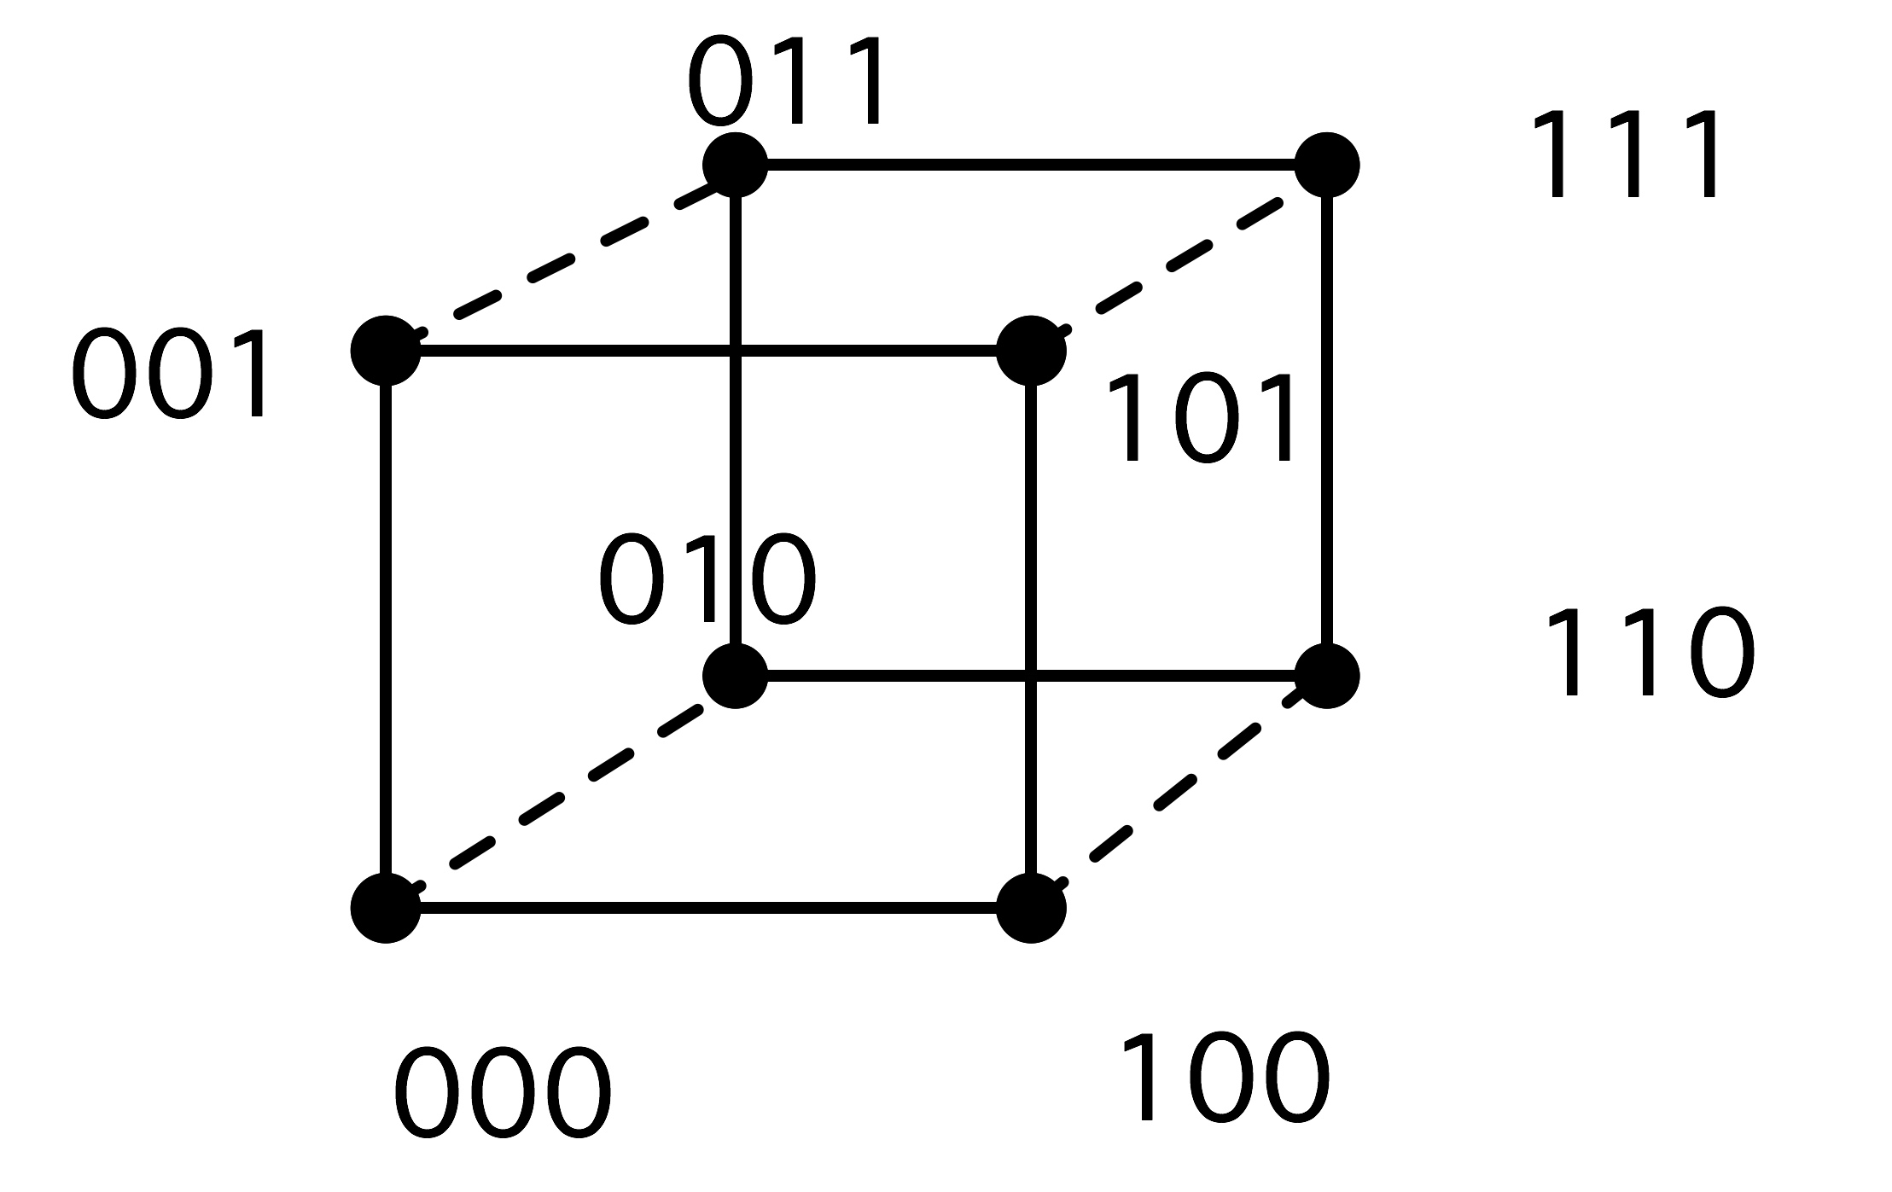
Mapping applications to hypercubes
Is there a natural mapping from 1,2,3D to a hypercube?
Naïve node numbering does not work:
Nodes 0 and 1 have distance 1, but
3 and 4 have distance 3
(so do 7 and 0)

Slide 24
Mapping applications to hypercubes
Is there a natural mapping from 1,2,3D to a hypercube?
=> Gray codes
Recursive definition: number subcube, then other subcube in mirroring order.
Subsequent processors (in the
Linear ordering) all one link apart
4
5
6
Recursive definition:
0 | 1
0 0 | 1 1
0 1 | 1 0
0 0 0 0 | 1 1 1 1
0 0 1 1 | 1 1 0 0
0 1 1 0 | 0 1 1 0
3
2
7
3
2
0
1
0
1

Slide 25
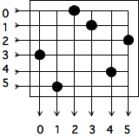
Busses/Hubs and Crossbars
Hub/Bus: Every processor shares the communication links
Crossbar Switches: Every processor connects to the switch which routes communications to their destinations

Slide 26
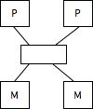
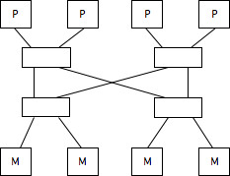
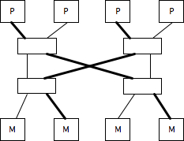
Butterfly exchange network
Built out of simple switching elements
Multi-stage; #stages grows with #procs
Multiple non-colliding paths possible
Uniform memory access

Slide 27
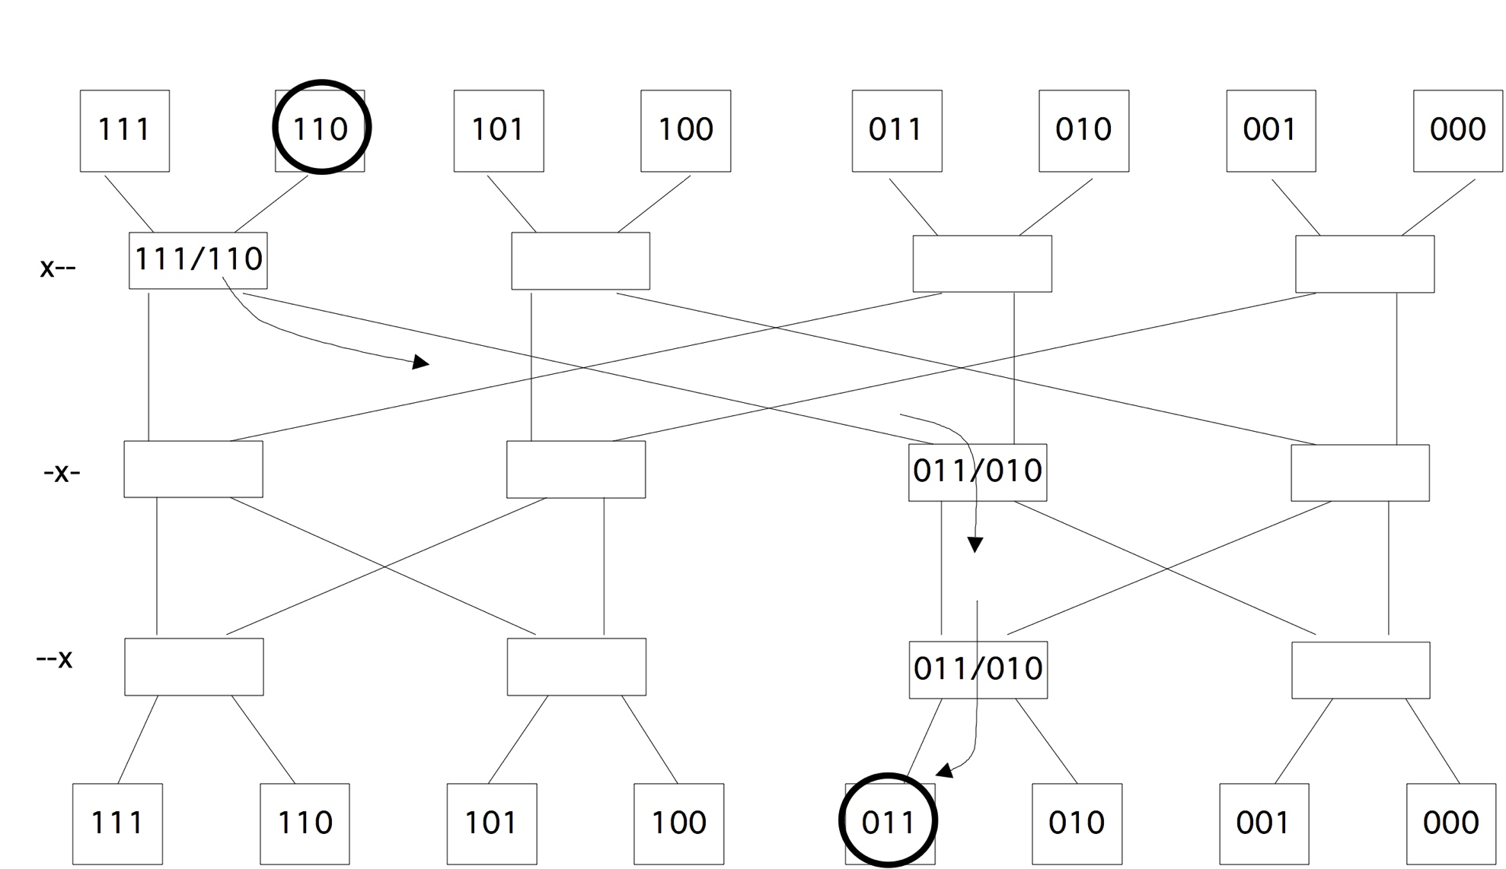
Routing in a butterfly network

Slide 28
Fat Trees
Multiple switches
Each level has the same number of links in as out
Increasing number of links at each level
Gives full bandwidth between the links
Added latency the higher you go

Slide 29
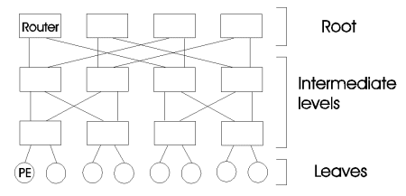
Fat Trees
in practice emulated by switching network

Slide 30
Interconnect graph theory
Degree
  How many links to other processors does each node have?
  More is better, but also expensive and hard to engineer
Diameter
  maximum distance between any two processors in the network.
  The distance between two processors is defined as the shortest path, in terms of links, between them.
  completely connected network is 1, for star network is 2, for ring is p/2 (for p even processors)
Connectivity
  measure of the multiplicity of paths between any two processors (# arcs that must be removed to break the connection).
  high connectivity is desired since it lowers contention for communication resources.
  1 for linear array, 1 for star, 2 for ring, 2 for mesh, 4 for torus
  technically 1 for traditional fat trees, but there is redundancy in the switch infrastructure

Slide 31
Practical issues in interconnects
Latency : How long does it take to start sending a "message"? Units are generally microseconds or milliseconds.
Bandwidth : What data rate can be sustained once the message is started? Units are Mbytes/sec or Gbytes/sec.
  Both point-to-point and aggregate bandwidth are of interest
Multiple wires: multiple latencies, same bandwidth
Sometimes shortcuts possible: `wormhole routing’

Slide 32
Measures of bandwidth
Aggregate bandwidth: total data rate if every processor sending: total capacity of the wires. This can be very high and quite unrealistic.
Imagine linear array with processor i sending to P/2+i: `Contention’
Bisection bandwidth: bandwidth across the minimum number of wires that would split the machine in two.

Slide 33
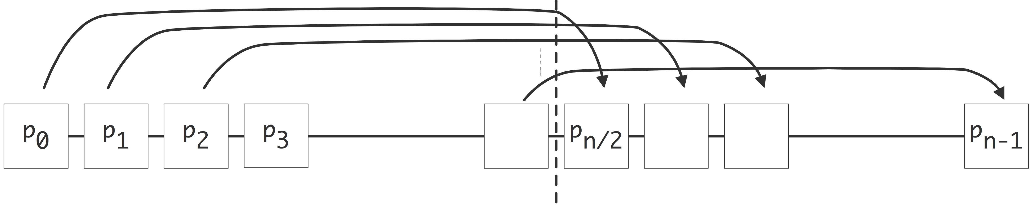

Slide 34
Interconnects
Bisection width
  Minimum # of communication links that have to be removed to partition the network into two equal halves. Bisection width is
  2 for ring, sq. root(p) for mesh with p (even) processors, p/2 for hypercube, (p*p)/4 for completely connected (p even).
Channel width
  of physical wires in each communication link
Channel rate
  peak rate at which a single physical wire link can deliver bits
Channel BW
  peak rate at which data can be communicated between the ends of a communication link
  = (channel width) * (channel rate)
Bisection BW
  minimum volume of communication found between any 2 halves of the network with equal # of procs
  = (bisection width) * (channel BW)

