Slide 1
Debugging and Profiling Lab
Carlos Rosales, Kent Milfeld, Yaakoub Y. El Kharma,
Victor Eijkhout
carlos@tacc.utexas.edu

Slide 2

Setup
Login to stampede or lonestar:
ssh -X username@lonestar.tacc.utexas.edu
Make sure you can export graphics to your laptop screen:
xclock
If you do not see a clock, contact an instructor
Get the lab files:
https://bitbucket.org/VictorEijkhout/parallel-computing-book
booksources/projects-public/debug_lab

Slide 3
Debugging LAB

Slide 4
Finding a deadlock with DDT
In this example we will use DDT to debug a code that deadlocks.
Compile the deadlock example:
% cd debug_lab
% mpicc –g –O0 ./deadlock.c
Load the DDT module:
% module load ddt
Start up DDT:
% ddt ./a.out
Notes:
Mention that the status of the DDT license server can be obtained from http://129.114.4.217:4241/status.html
Ranger can currently use 4096 licenses.
Floating Exception error -> restart the x-window server in the local machine. (problem appeared in a Mac OS X 10.5.6 machine)

Slide 5
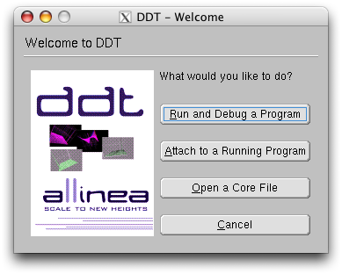
Configure DDT: Welcome
When you see the welcome screen below click the button that says “Run and Debug a Program”.

Slide 6
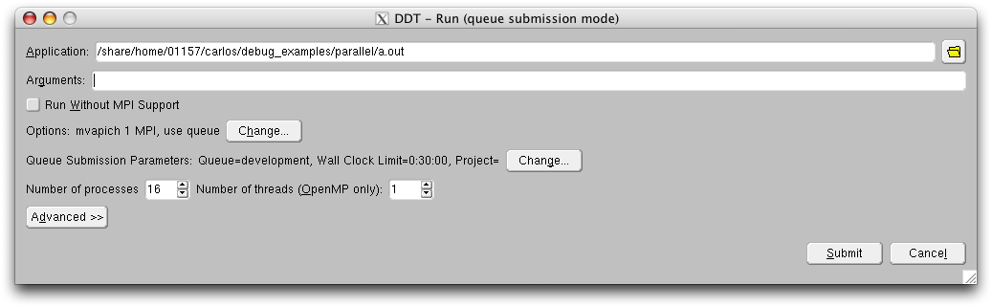
Configure DDT: Job Submision
Don’t click submit yet! We need to configure:
General Options
Queue Submission Parameters
Processor and thread number
Advanced Options
Click on Options -> Change

Slide 7
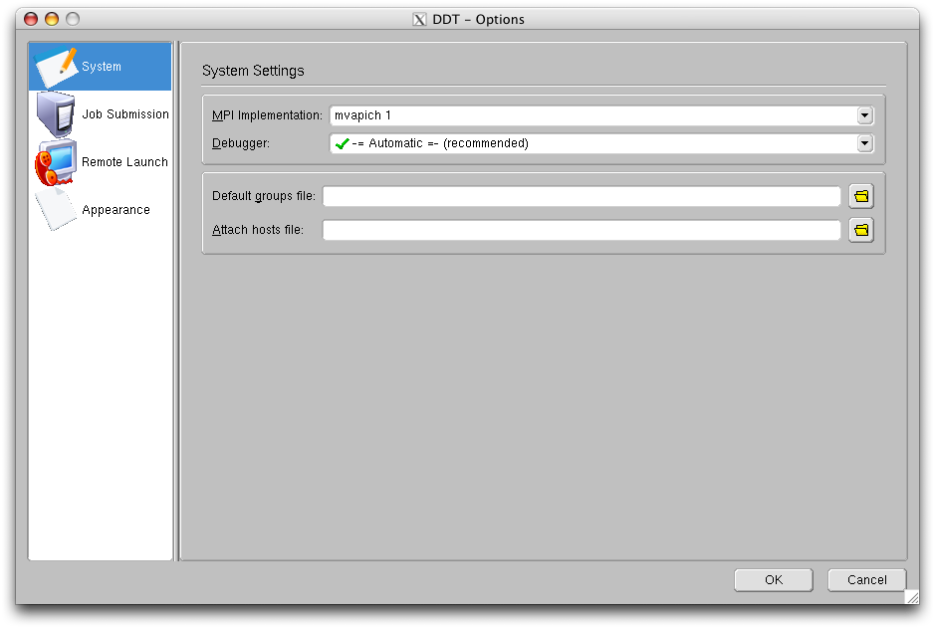
Configure DDT: Options
Choose the correct version of MPI
mvapich 1
mvapich 2
openMPI
Leave the default MPI (mvapich 2)
Leave Debugger on the Automatic setting
Notes:
Tell users to get more info on the recommended MPI version depending on application size from the Ranger User Guide.

Slide 8
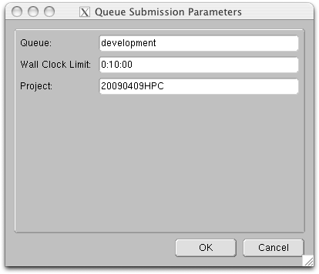
Configure DDT: Queue Parameters
Choose the “development” queue
Set the Wall Clock Limit to 10 minutes (H:MM:SS)
Set your project code - for this class use TACC-PCSE
Click OK and double check that you have selected 12/16 CPUs / 1 thread in the main Job Submission window.
20100408HPC
Notes:
Tell them that it is possible to use less than 16 cores. See Ranger User Guide.

Slide 9
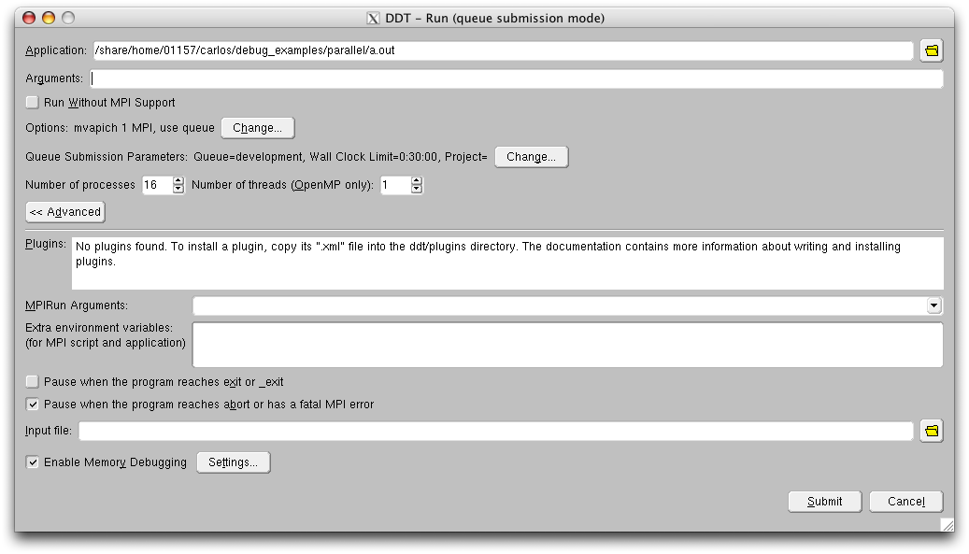
Configure DDT: Memory Checks
Open the Advanced tab.
Enable Memory Debugging (bottom left check box)
Open the Memory Debug Settings

Slide 10
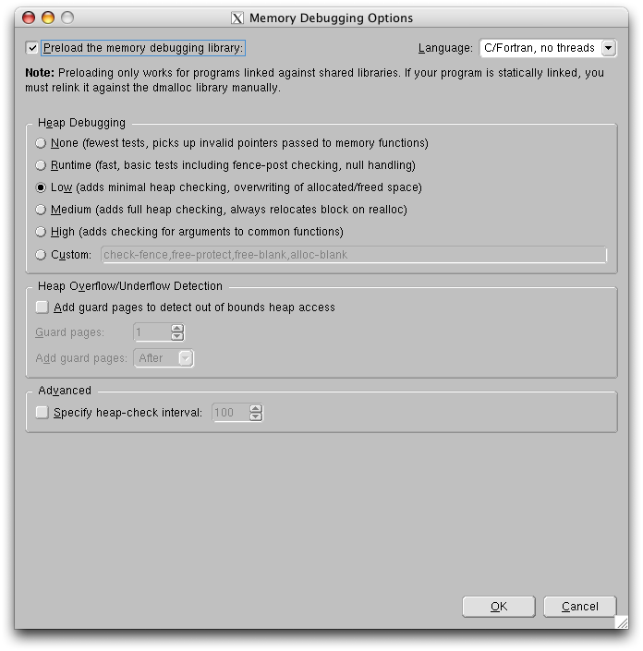
Configure DDT: Memory Options
Change the Heap Debugging option from the default Runtime to Low
Even the option None provides some memory checking
Leave Heap and Advanced unchecked

Slide 11
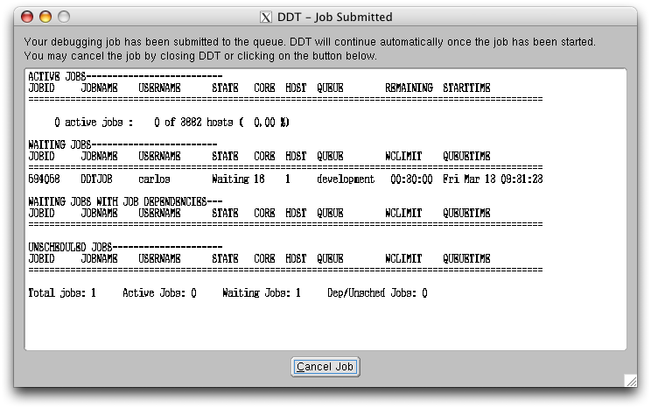
DDT: Job Queuing
Add any necessary arguments to the program (none for the example)
Click the Submit button. A new window will open:
The job is submitted to the specified queue.
An automatically refreshing job status window appears.
The debug session will begin when the job starts.

Slide 12
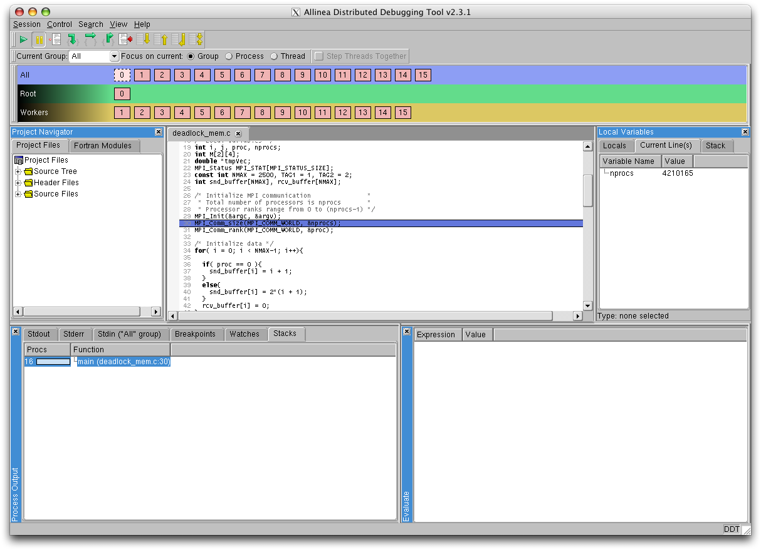
DDT: The debug session
Process controls
Process groups
window
Project navigation
window
Variable window
Code window
Stack view and output window
Evaluation window

Slide 13
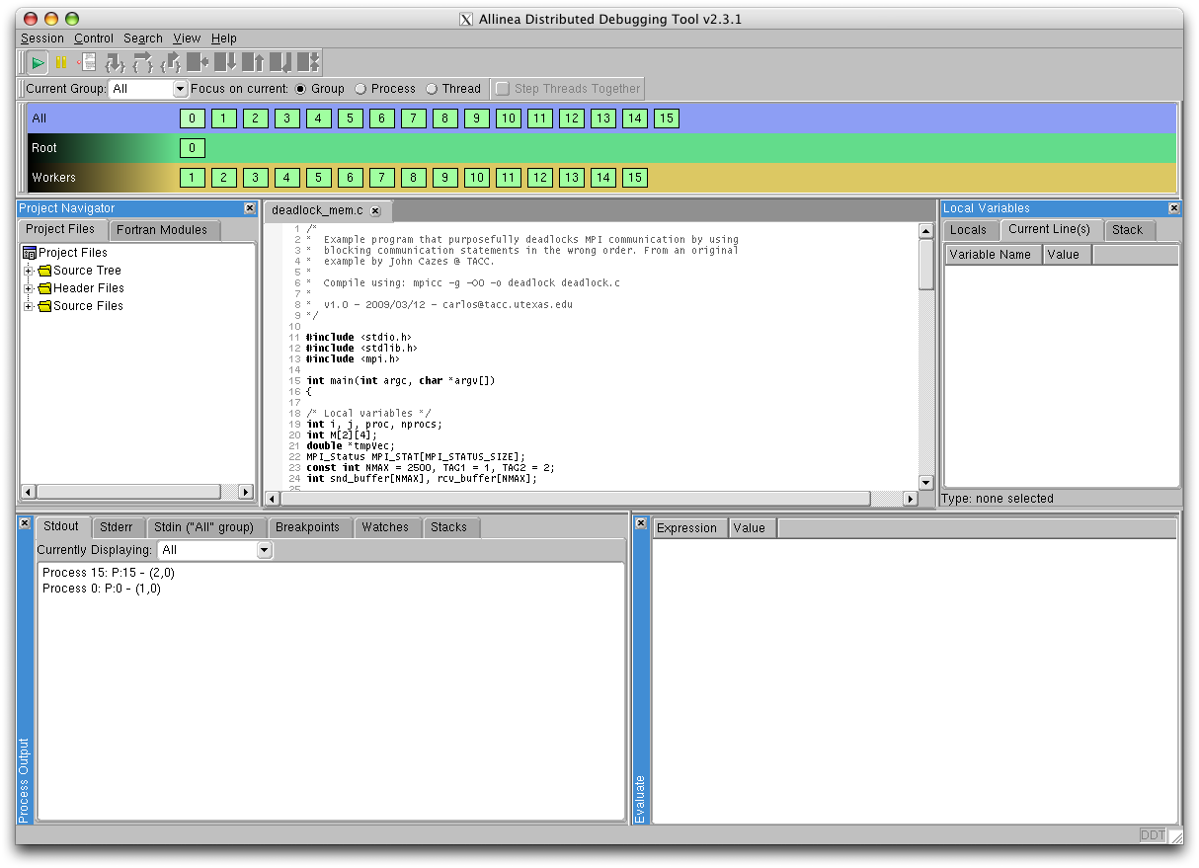
DDT: Program Hangs
The output we expect does not appear in the Stdout window.
No active communication between procs.
Stop execution to analyze the program status (top left).

Slide 14
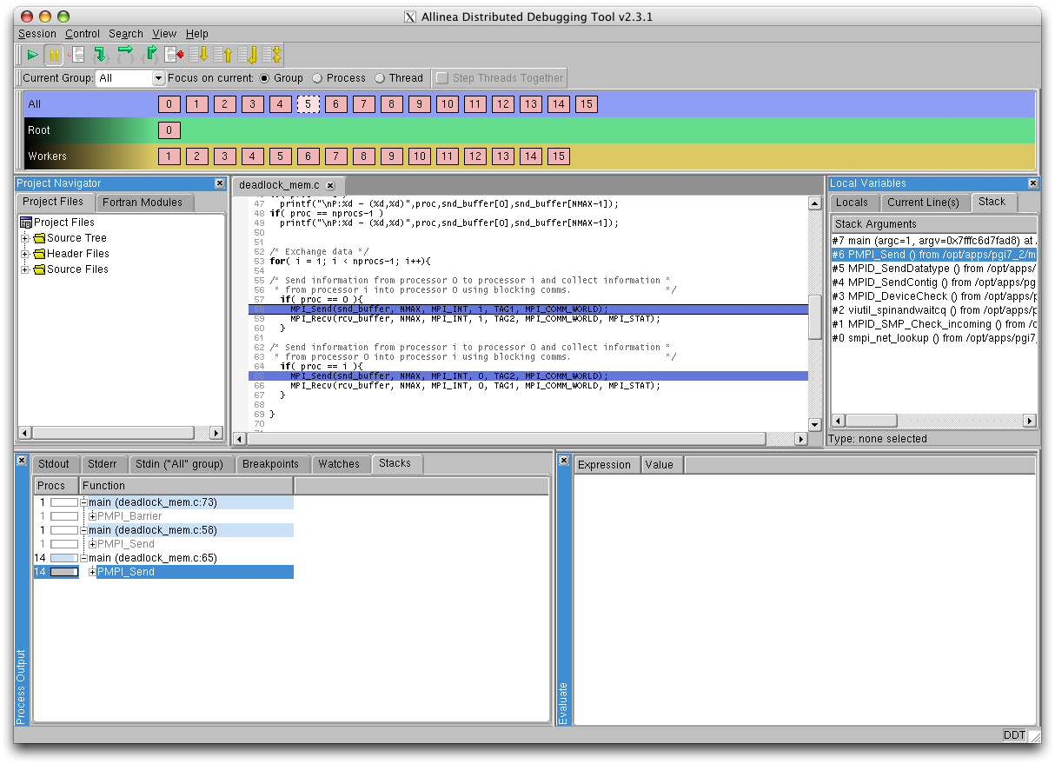
DDT: Stacks
On the bottom left window select the Stacks view.
All processors seem to be stuck on a MPI_Send().

Slide 15
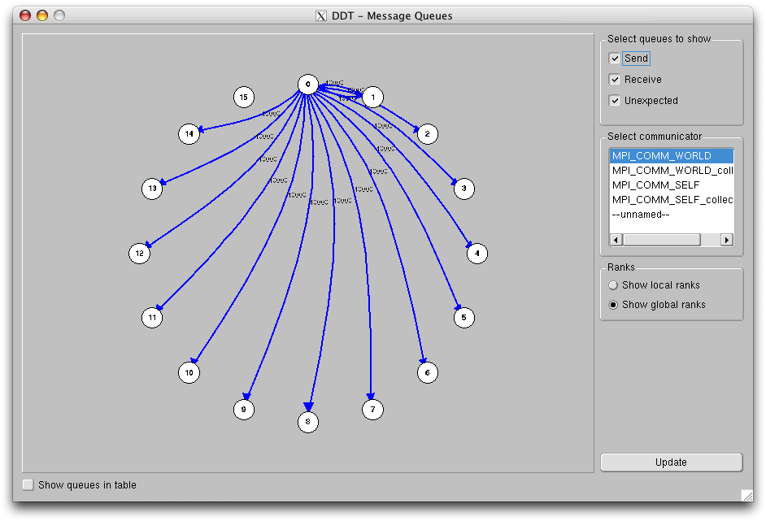
DDT: Message Queues
Go to View -> Message Queues
There are uncompleted Send messages everywhere!
You can double-check that all communications are in the “Unexpected queue” (select on top right)
This is characteristic of a deadlock.
Find the source of the deadlock in the code.

Slide 16
Parallel Scalability Lab

Slide 17
Parallel Scalability: IPM
In this example you will use IPM to evaluate the scalability of a matrix multiplication code.
Load the IPM module:
module load ipm
module list
Compile the matmult.c or matmult.f90 source with the -g flag:
mpicc -g./matmult.c
mpif90 -g./matmult.f90
Open the Sun Grid Engine script ipm_job.sge and make sure the following lines appear before the ibrun command is invoked:
export LD_PRELOAD=$TACC_IPM_LIB/libipm.so
export IPM_REPORT=full

Slide 18
Parallel Scalability: IPM
Submit the job through the SGE queue system:
qsub ./ipm_job.sge
When the job is done IPM will generate an xml file with a name like:
username.1298314568.32191.0
Have a look at the basic text report by typing:
ipm_parse username.1298314568.32191.0
You can also read the full text report:
ipm_parse -full username.1298314568.32191.0

Slide 19
Parallel Scalability: IPM
Try transforming the output file to HTML:
ipm_parse -html username.1298314568.32191.0
A new directory containing an index.html file will be created. You can copy this directory to your laptop and view the contents with any web browser.
In your laptop, open the index.html file and explore the different performance data provided by IPM.

Slide 20
Parallel Scalability: mpiP
In this example you will use mpiP to evaluate the scalability of a matrix multiplication code.
Load the mpiP module:
module load mpiP
module list
Compile the matmult.c or matmult.f90 source with the flags required to link in the mpiP library:
mpicc -g -L$TACC_MPIP_LIB -lmpiP -lbfd -liberty ./matmult.c
mpif90 -g -L$TACC_MPIP_LIB -lmpiP -lbfd -liberty ./matmult.f90
Set the environmental variables that control mpiP data collection behavior:
setenv MPIP ‘-t 10 -k 2‘

Slide 21
Parallel Scalability: mpiP
Submit the job through the SGE queue system:
qsub ./parallel_job.sge
The initial submission using 2 processing cores only (-pe 2way 16). Check execution and MPI times in the .mpiP file created.
Change the submission script to use 4 cores (-pe 4way 16), 8 and 16, and build a table with the execution times.
Does the execution time decrease linearly with the number of cores? Why?
SIZE | 2 cores | 4 cores | 8 cores | 16 cores
1000 x 1000
2000 x 2000

Slide 22
PROFILING lab

Slide 23
Profiling with Tau: Compilation
Load the papi and tau modules:
module load papi
module load tau
Set the TAU_MAKEFILE environmental variable
setenv TAU_MAKEFILE $TACC_TAU_LIB/Makefile.tau-multiplecounters-mpi-papi-pdt-pgi
If you have changed to the Intel compiler use instead:
setenv TAU_MAKEFILE $TACC_TAU_LIB/Makefile.tau-icpc-multiplecounters-mpi-papi-pdt
Compile the matrix multiplication example using the Tau compiler wrappers:
tau_cc.sh matmult.c
tau_f90.sh matmult.f90

Slide 24
Profiling with Tau: Job Script
Open tau_job.sge and make sure the following lines - which define the hardware counters to measure- appear before the ibrun invocation:
export COUNTER1=GET_TIME_OF_DAY
export COUNTER2=PAPI_FP_OPS
export COUNTER3=PAPI_L1_DCM
Submit the job through the batch queue system:
qsub tau_job.sge
When the job completes execution you should have three new directories:
MULTI__GET_TIME_OF_DAY
MULTI__PAPI_FP_OPS
MULTI__PAPI_L1_DCM

Slide 25
Profiling with Tau: Analysis
Analize the results:
paraprof
Get used to the interface
Unstack the bars to get a clearer view
Open a window with the function names corresponding to each color
Generate a derived metric that gives you the floating point operation to L1 data cache miss ratio
Remember that you can copy these directories and analyze them in your own laptop as well

