Slide 1
Parallel Computing for Science & Engineering Spring 2013: MPI collectives 1
Instructors:
Victor Eijkhout, Research Scientist, TACC
Kent Milfeld, Research Associate, TACC
Notes:
Check Single and Section have implied barrier.
25 continue fortran “&”

Slide 2
MPI Collective Communications
Involves a group of processes.
Basic Routines
Broadcast— MPI_Bcast()
Reduce— MPI_Reduce()
Gather/Scatter— MPI_Gather()/MPI_Scatter()...
“All” versions
MPI_Allreduce()
MPI_Allgather()
MPI_Alltoall()...
Others
MPI_Barrier ...

Slide 3
before
after
p0
A
broadcast
p0
A
p1
p1
A
p2
p2
A
p3
p3
A
p0
A
B
C
D
p0
A op B op C op D
p1
reduce
p1
Root
p2
p2
“send” array
element or
single variable
p3
p3
p0
A
p0
A
B
C
D
p1
B
gather
p1
task or
process
p2
C
p2
p3
D
p3
p0
A
B
C
D
scatter
p0
A
p1
p1
B
p2
p2
C
p3
p3
D

Slide 4
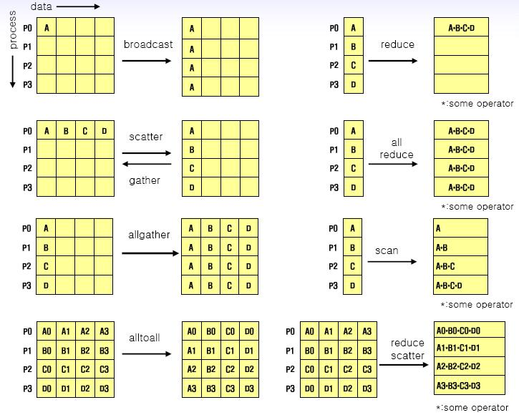
Collective Communication: Summary

Slide 5
MPI Collective Communications
Every process MUST call the routine
All calls are blocking
A task may return when participation is complete
May or may not synchronize (implementation dependent)
Must have “matching” arguments
no status
no tags
Send and Receive sizes must match
mapping may vary
Basic calls have a root—”all” versions don’t

Slide 6
Broadcast Operation: MPI_Bcast
All nodes call MPI_Bcast
One node (root) sends a message to all
all others receive the message
C
ierr=MPI_Bcast(&dat[0], cnt, datatype, root, comm);
Fortran
call MPI_Bcast( dat, cnt, datatype, root, comm, ierr)

Slide 7
Reduction Operations
Used to combine (reduce) partial results from all processors
Result returned to root processor
pre-defined or user-defined operations
Predefined: associative & commutative (com) Order may not be canonical (rank order)
User defined: Must be associative. com or non-com “Canonical” evaluation
Works on a scalar variable or arrays (elemental)
Notes:
We know, though, that order can make a difference. (.05 + 1.0) + (.05+2.0) = 2.0 for two digit accuracy cf (0.05+0.05) + (1 + 2) = 3.1

Slide 8
MPI_Reduce
C
ierr=MPI_Reduce(&sbuf[0], &rbuf[0], count, datatype, operator, root, comm)
Fortran
call MPI_Reduce( sbuf, rbuf, count, datatype, operator, root, comm, ierr)
Parameters
like MPI_Bcast, a root is specified
operation is a type of mathematical operation
Applies the operator to each element globally
send and receive buffers are the same size
Use MPI_Op_create for user-defined operation.

Slide 9
Operations for MPI_Reduce
MPI_PROD Product
MPI_SUM Sum
MPI_LAND Logical and
MPI_LOR Logical or
MPI_LXOR Logical exclusive or
MPI_BAND Bitwise and
MPI_BOR Bitwise or
MPI_BXOR Bitwise exclusive or
MPI_MAX Maximum
MPI_MIN Minimum
MPI_MAXLOC Maximum value and location
MPI_MINLOC Minimum value and location
Notes:
MAXLOC uses pairs (MPI_2Real) or usually MPI_DOUBLE_INT pg 167 good example

Slide 10
Dot Product of Two Vectors
double a[N], b[N];
double globalSum=0.0, localSum=0.0;
...
for(i=0;i<N;++i) localSum+=a[i]*b[i];
MPI_Reduce(&localSum,&globalSum,1, MPI_DOUBLE
MPI_SUM,root,MPI_COMM_WORLD);

Slide 11
Dot Product of Two Vectors
real*8 :: a(N), b(N);
real*8 :: globalSum=0.0, localSum=0.0;
...
localSum = dot_product(a,b);
MPI_Reduce( localSum, globalSum,1, MPI_REAL8 &
MPI_SUM,root,MPI_COMM_WORLD,ierr);

Slide 12
Scatter Operation using MPI_Scatter
Similar to Broadcast but sends a section of an array to each processor
Data in an array on root node, P₀ , sending 1 element to each task:
P₀
S(0) S(1) S(2) … S(N-1)
Goes to processors:
P₀ P₁ P₂ … P_{n-1}
R R R … R

Slide 13
Scatter Operation using MPI_Scatter
2-elements per processor
Data in an array on root node, P₀ , sending 2 elements:
P₀
S(0)S(1) S(2)S(3) S(4)S(5) … S(N-2)(S(N-1)
Goes to processors:
P₀ P₁ P₂ … P_{n-1}
R(0) R(1) R(1) … R(1)
R(1) R(2) R(2) … R(2)

Slide 14
MPI_Scatter Syntax
C
ierr = MPI_Scatter(&sbuf[0], scnt, stype, &rbuf[0], rcnt, rtype, root, comm );
Fortran
call MPI_Scatter( sbuf, scnt, stype, rbuf, rcnt, rtype, root, comm,ierr)
Parameters
sbuf = array of size np*scnt (np = # of ranks)
scnt = number of elements sent to each processor
rcnt = number of element(s) obtained from the root processor
rbuf = element(s) obtained from the root processor (rcnt in size)
e.g. MPI_Scatter( S, 1, stype, R, 1, rtype, root, comm )
Array
Scalar

Slide 15
A word about implementation

Slide 16
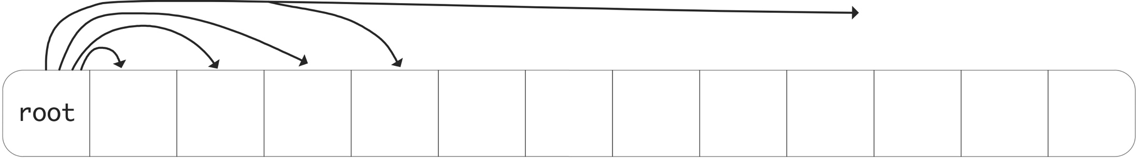
How do you do a broadcast?
Complexity?

Slide 17
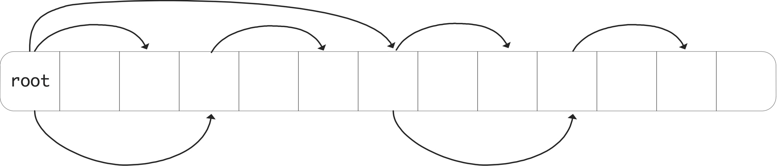
How really to do a broadcast
Complexity?

