Slide 1
Parallel Computing for Science & Engineering Spring 2013: MPI introduction
Instructors:
Victor Eijkhout, Research Scientist, TACC
Kent Milfeld, Research Associate, TACC
Notes:
Check Single and Section have implied barrier.
25 continue fortran “&”

Slide 2
Outline
Executing OpenMP and MPI
Paradigm/Key Concepts/Advantages
MPI History version 1 and 2, implementations
Compiling, Running
MPI Initialize, Finalize and task-id/task-count
MPI Communicators

Slide 3
OpenMP (shared memory)
program myomp
real*8 a(100), b(100)
…
!$omp parallel
… end program
int main () {
double a(100), b(100);
…
#pragma omp parallel
…}
Compile→ a.out
Set OMP_NUM_THREADS to N
./a.out
Single Node
Master thread - 0
thread 1
thread N-1
…
0
A(1)
…
A(100)
B(1)
…
B(100)
Code
…
Fork
threads
Code
Forked
thread
Code
Forked
thread
1
…
…
N
N-1
SAME address space for each thread
Thread Private Memory
Shared Memory
Code Execution

Slide 4
MPI (distributed memory)
program mympi
real*8 a(100), b(100)
…
end program
int main () {
double a(100), b(100);
…
}
Compile→ a.out
Launch on N cores
ibrun ./a.out
…
Process (task) 0
Process (task) 1
Process (task) N-1
A(1)
…
A(100)
B(1)
…
B(100)
code
A(1)
…
A(100)
B(1)
…
B(100)
code
A(1)
…
A(100)
B(1)
…
B(100)
code
…
Separate Address Space for each Process/Task
Process Memory
Code Execution
Different Variables!

Slide 5
Message Passing Paradigm
A Parallel MPI Program is launched as separate processes (tasks), each with their own address space.
Requires partitioning data across tasks.
Data is explicitly moved from task to task
A task accesses the data of another task through a transaction called “message passing” in which a copy of the data (message) is transferred (passed) from one task to another.
There are two classes of message passing (transfers)
Point-to-Point messages involve only two tasks
Collective messages involve a set of tasks
Access to subsets of complex data structures is simplified
A data subset is described as a single Data Type entity
Transfers use synchronous or asynchronous protocols
Messaging can be arranged into efficient topologies

Slide 6
Key Concepts-- Summary
Used to create parallel SPMD programs on distributed-memory machines with explicit message passing
Routines available for
Point-to-Point Communication
Collective Communication
1-to-many
many-to-1
many-to-many
Data Types
Synchronization (barriers, non-blocking MP)
Parallel IO
Topologies

Slide 7
Advantages of Message Passing
Universality
Message passing model works on separate processors connected by any network (and even on shared memory systems)
matches the hardware of most of today’s parallel supercomputers as well as ad hoc networks of computers
Performance/Scalability
Scalability is the most compelling reason why message passing will remain a permanent component of HPC (High Performance Computing)
As modern systems increase core counts, management of the memory hierarchy (including distributed memory) is the key to extracting the highest performance
Each message passing process only directly uses its local data, avoiding complexities of process-shared data, and allowing compilers and cache management hardware to function without contention.

Slide 8
MPI-1
MPI-1 - Message Passing Interface (v. 1.2)
Library
Specification: defined by committee of vendors, implementers, and parallel programmers
Designed with SPMD (single program, multiple data) technique in mind.
Available on almost all parallel machines in C/C++ and Fortran
About 125 routines
6 basic routines
the rest are extensions that can simplify algorithm implementation and optimize performance

Slide 9
MPI-1
Web
www-unix.mcs.anl.gov/mpi/
www.mcs.anl.gov/research/projects/mpich2/
hwww.mpi-forum.org/
Books
Using MPI, by Gropp, Lusk, and Skjellum
MPI Annotated Reference Manual, by Marc Snir, et al
Parallel Programming with MPI, by Peter Pacheco
Using MPI-2, by Gropp, Lusk and Thakur
Getting Started
www.mcs.anl.gov/research/projects/mpi/tutorial/gropp/talk.html
http://ci-tutor.ncsa.illinois.edu/
www.nersc.gov/nusers/help/tutorials/mpi/intro/ (simple, direct)
https://computing.llnl.gov/?set=training&page=index
Advanced: www.mcs.anl.gov/research/projects/mpi/tutorial/
Standard
www.mpi-forum.org/docs/

Slide 10
MPI-1 Implementations
Many parallel machine, HPC interconnect, and commercial software vendors have optimized versions
Hardware vendors: IBM, Sun, HP, Intel
Interconnect vendors: Myricomm, Quadrics, InfiniBand*
* InfiniBand: open source drivers/university MPI collaboration
http://www.openib.org/
http://mvapich.cse.ohio-state.edu/
Software vendors: MPI/Pro, Platform MPI (was Scali MPI), etc.
Others
MPICH, www-unix.mcs.anl.gov/mpi/mpich/
MPICH-G2, Globus-based www3.niu.edu/mpi/
MPICH-VMI, Virtual Machine Interface http://vmi.ncsa.uiuc.edu/
MVAPICH http://mvapich.cse.ohio-state.edu/
OpenMPI (the MPI formerly LAM/MPI) http://www.open-mpi.org/

Slide 11
MPI-2
Includes features left out of MPI-1
One-sided communications
Dynamic process control
More complicated collectives
MPI-IO
Implementations
not quickly undertaken after the standard document was released (in 1997)
now OpenMPI, MPICH2 (and its descendants), and the vendor implementations are pretty complete or fully complete
Notes:
Didn’t mention MPI-IO

Slide 12
Compiling MPI Programs
Generally use a special compiler or compiler wrapper script
not defined by the standard
consult your implementation
handles correct include path, library path, and libraries
MPICH-style (the most common)
C
mpicc –o mycexe mycode.c
Fortran
mpif90 –o myfexe mycode.f

Slide 13
Running MPI Programs
MPI programs require some help to get started
what computers should I run on?
how do I access them?
MPICH-style
mpirun –np 10 –machinefile mach ./a.out
When batch systems are involved, all bets are off
@TACC Lonestar/Longhorn/Ranger (via a job script)
ibrun tacc_affinity ./a.out
SGE (Sun Grid Engine) batch utility handles the rest
Notes:
Explain Information in job script, Batch scripts take over, otherwise just launcher a.out.

Slide 14
The Parallel Code
Parallel executables are nothing more than independent processes launches by ssh commands: ssh <nodename> <environment> executable.
Executables need organization info (initialize).
Executable needs to synchronize.
Program needs to know its id and # of execs.
Executable needs to clean up at end.
Notes:
Id/# for partitioning, id used in communications.

Slide 15
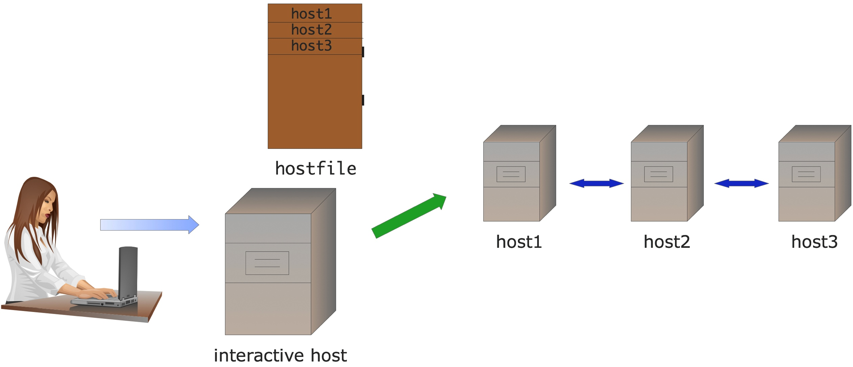
Interactive scenario
User type:
mpirun –np 5 hostfile ./myprogram arguments

Slide 16
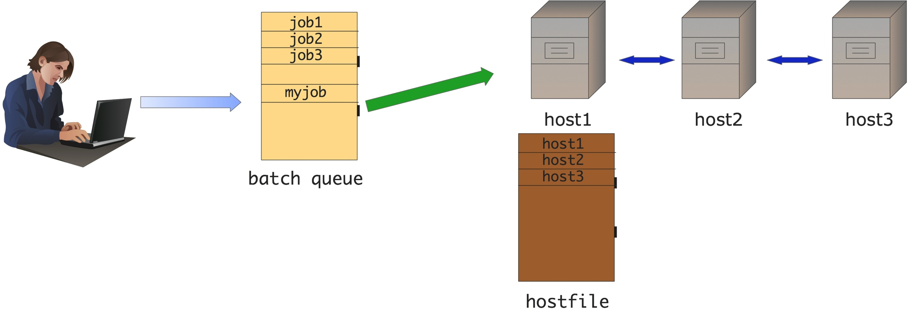
Batch scenario
User submits batch job to queue, executed later by scheduler

Slide 17
Minimal MPI program
Every MPI program needs these…
C version
#include <mpi.h>
...
ierr=MPI_Init(&argc, &argv);
ierr=MPI_Comm_size(MPI_COMM_WORLD,&npes); ierr=MPI_Comm_rank(MPI_COMM_WORLD,&iam);
...
ierr=MPI_Finalize();
In C MPI routines are functions which return the error value

Slide 18
Minimal MPI program
Every MPI program needs these…
Fortran version
include 'mpif.h’ or use mpi
...
call MPI_Init(ierr)
call MPI_Comm_size(MPI_COMM_WORLD, npes,ierr)
call MPI_Comm_rank(MPI_COMM_WORLD, iam, ierr)
...
call MPI_Finalize(ierr)
In Fortran, MPI routines are subroutines with the last parameter as the error value
Notes:
What can go wrong. If you don’t include mpif.h a wrong value for MPI_COMM_WORLD might be used.

Slide 19
MPI Initialization & Termination
All processes must initialize and finalize MPI (each is a collective call*).
MPI_Init : starts up the MPI runtime environment
MPI_Finalize : shuts down the MPI runtime environment
Must include header files – provides basic MPI definitions and types.
Header File
Format of MPI calls
Fortran 77 | Fortran 90 | C/C++
include ‘mpif.h’ | use mpi | #include <mpi.h>
Fortran 77/90 binding (upper or lower case) | C/C++ binding
CALL MPI_XYYY(parameters…, ierr) | ierr = MPI_Xyyy(parameters…)
* Means the entire group of tasks must execute this call.
Notes:
What can go wrong. If you don’t include mpif.h a wrong value for MPI_COMM_WORLD might be used.

Slide 20
Run Parameters
MPI_Comm_size : gets the number of processes in a run
Integer
(typically called just after MPI_Init).
MPI_Comm_rank : gets the process ID (rank) of the current process, integer between 0 and NP-1 inclusive
(typically called just after MPI_Init).
Notes:
What can go wrong. If you don’t include mpif.h a wrong value for MPI_COMM_WORLD might be used.

Slide 21
Communicators
Communicators
MPI uses a communicator objects (and groups) to identify a set of processes which communicate only within their set.
MPI_COMM_WORLD is defined in the MPI include file as all processes (ranks) of your job
Required parameter for most MPI calls
You can create subsets of MPI_COMM_WORLD
Rank
Unique process ID within a communicator
Assigned by the system when the process initializes (for MPI_COMM_WORLD)
Processors within a communicator are assigned numbers 0 to n-1 (C/F90)
Used to specify sources and destinations of messages, process specific indexing and operations.
Notes:
Identifies a collection of tasks (ranks) working on some part of a parallel job

Slide 22
Include files
The MPI include file
C:
mpi.h
Fortran
mpif.h
MPI module → use MPI
Defines many constants used within MPI programs
In C, defines the interfaces for the functions
In C++, the interfaces are different, so be careful
In F90, module defines interface for subroutines
Compilers know where to find the include files
regular compilers are usually called through mpif90/mpicc wrapper scripts

Slide 23
OpenMP World
MPI World
Login node
Compute Nodes
Login node
Compute Nodes
Run
Run
Run
Run
Run
…
…
Compile
Run
Compile
idev RUN interactively
idev RUN interactively
ibrun ./a.out
submit “sleeper” job
ssh to master node RUN interactively
Batch
#$ -pe 1-way 12
Batch
Submit production job
Wait for output
Job script
Submit production job
Wait for output
…
OMP_NUM_THREADS = #
sleep 900
#$ -pe 1-way 12
#$ -pe 12-way 24
Job script
…
OMP_NUM_THREADS = #
Job script
./a.out
ibrun ./a.out
Development
Production
Notes:
Talk about environments
Different OS’s
Limits same (but may vary)
env, watch –n x, and <util cmd> | xargs cmd are frinds

Slide 24
Parallel Code
The programmer is responsible for determining all parallelism.
Data Partitioning
Deriving Parallel Algorithms
Moving Data between Processes
Tasks (independent processes executing anywhere) send and receive “messages” to exchange data.
Data transfer requires cooperative operation to be performed by each process (point to point communications).
Message Passing Interface (MPI) was released in 1994. (MPI-2 in 1996) Now the MPI is the de facto standard for message passing.
http://www-unix.mcs.anl.gov/mpi/
MEMORY
data
MEMORY
data
data
(original)
data
(copy)
CPU
CPU
message

Slide 25
Point-to-Point Communication
Sending data from one point (process/task) to another point (process/task)
One task sends while another receives
task 0
data
task 1
data
MPI_Send
MPI_Recv
data
data
network

Slide 26
Basic Communications in MPI
Standard MPI_Send/MPI_Recv routines
Used for basic messaging
Modes of Operation
Blocking
Call does not return until the data area is safe to use
Non-blocking
Initiates send or receive operation, returns immediately
Can check or wait for completion of the operation
Data area is not safe to used until completion.
Synchronous and Buffered (later)

Slide 27
Data Types (basics)
Data types (more a mapping than declaration)
Specifies the data type and size in MPI routines
Predefined MPI types correspond to language types
Methods exists for creating user-defined types
Simple (just combinations of normal data types)
Advanced (a map of data to be send)
Representation | MPI Type Fortran | Fortran | MPI Type C | C
32-bit floating point | MPI_REAL | REAL | MPI_FLOAT | float
64-bit floating point | MPI_DOUBLE_PRECISION | DOUBLE_PRECISION | MPI_DOUBLE | double
32-bit integer | MPI_INTEGER | INTEGER | MPI_INT | int
Notes:
In certain cases it does operations, in most it doesn’t.

