Slide 1
SSC 374/394: Parallel Computing
Computer Architectures single CPU

Slide 2
Von Neumann Architecture
Instruction decode: determine operation and operands
Get operands from memory
Perform operation
Write results back
Continue with next instruction

Slide 3
Contemporary Architecture
Multiple operations simultaneously “in flight”
Operands can be in memory, cache, register
Results may need to be coordinated with other processing elements
Operations can be performed speculatively

Slide 4
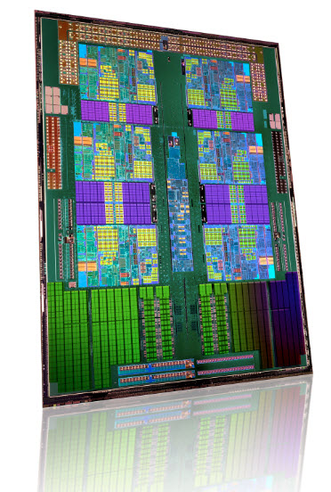
What does a CPU look like?

Slide 5
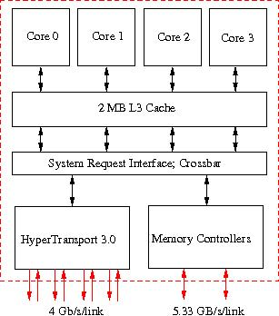
What does it mean?

Slide 6
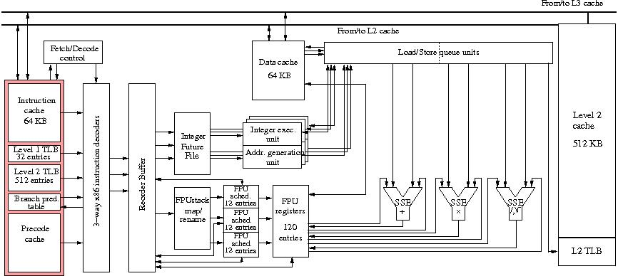
What is in a core?

Slide 7
Functional units
Traditionally: one instruction at a time
Modern CPUs: Multiple floating point units, for instance 1 Mul + 1 Add, or 1 FMA
x <- c*x+y
Peak performance is several ops/clock cycle (currently up to 4)
This is usually very hard to obtain

Slide 8
Pipelining
A single instruction takes several clock cycles to complete
Subdivide an instruction:
  Instruction decode
  Operand exponent align
  Actual operation
  Normalize
Pipeline: separate piece of hardware for each subdivision
Compare to assembly line

Slide 9
Pipeline
Pipelining
4-Stage FP Pipe
CP 1
CP 2
CP 3
CP 4
A serial multistage functional unit.
Each stage can work on different
sets of independent operands
simultaneously.
Memory
Pair 1
Floating Point Pipeline
After execution in the final stage,
first result is available.
Memory
Pair 2
Latency = # of stages * CP/stage
CP/stage is the same for
each stage and usually 1.
Memory
Pair 3
Register Access
Memory
Pair 4
Argument Location

Slide 11
Pipeline analysis: n_{1/2}
With s segments and n operations, the time without pipelining is sn
With pipelining it becomes s+n-1+q where q is some setup parameter, let’s say q=1
Asymptotic rate is 1 result per clock cycle
With n operations, actual rate is n/(s+n)
This is half of the asymptotic rate if s=n

Slide 12
Instruction pipeline
The “instruction pipeline” is all of the processing steps (also called segments) that an instruction must pass through to be “executed”
Instruction decoding
Calculate operand address
Fetch operands
Send operands to functional units
Write results back
Find next instruction
As long as instructions follow each other predictably everything is fine.

Slide 13
Branch Prediction
The “instruction pipeline” is all of the processing steps (also called segments) that an instruction must pass through to be “executed”.
Higher frequency machines have a larger number of segments.
Branches are points in the instruction stream where the execution may jump to another location, instead of executing the next instruction.
For repeated branch points (within loops), instead of waiting for the loop to branch route outcome, it is predicted.
Pentium III processor pipeline
1
2
3
4
5
6
7
8
9
10
Pentium 4 processor pipeline
1
2
3
4
5
6
7
8
9
10
11
12
13
14
15
16
17
18
19
20
Misprediction is more “expensive” on Pentium 4’s.

Slide 14
Memory Hierarchies
Memory is too slow to keep up with the processor
  100--1000 cycles latency before data arrives
  Data stream maybe 1/4 fp number/cycle; processor wants 2 or 3
At considerable cost it’s possible to build faster memory
Cache is small amount of fast memory

Slide 15
Memory Hierarchies
Memory is divided into different levels:
  Registers
  Caches
  Main Memory
Memory is accessed through the hierarchy
  registers where possible
  ... then the caches
  ... then main memory

Slide 16


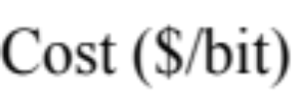
Memory Relativity
CPU
Registers: 16
L1 cache
(SRAM, 64k)
L2 cache
(SRAM, 1M)
MEMORY
(DRAM, >1G)

Slide 17
Latency and Bandwidth
The two most important terms related to performance for memory subsystems and for networks are:
  Latency
    How long does it take to retrieve a word of memory?
    Units are generally nanoseconds (milliseconds for network latency) or clock periods (CP).
    Sometimes addresses are predictable: compiler will schedule the fetch. Predictable code is good!
  Bandwith
    What data rate can be sustained once the message is started?
    Units are B/sec (MB/sec, GB/sec, etc.)

Slide 18
Implications of Latency and Bandwidth: Little’s law
Memory loads can depend on each other: loading the result of a previous operation
Two such loads have to be separated by at least the memory latency
In order not to waste bandwidth, at least latency many items have to be under way at all times, and they have to be independent
Multiply by bandwidth:
Little’s law: Concurrency = Bandwidth x Latency

Slide 19
Latency hiding & GPUs
Finding parallelism is sometimes called `latency hiding’: load data early to hide latency
GPUs do latency hiding by spawning many threads (recall CUDA SIMD programming): SIMT
Requires fast context switch

Slide 20
How good are GPUs?
Reports of 400x speedup
Memory bandwidth is about 6x better
CPU peak speed hard to attain:
  Multicores, lose factor 4
  Failure to pipeline floating point unit: lose factor 4
  Use of multiple floating point units: another 2

Slide 21
The memory subsystem in detail

Slide 22
Registers
Highest bandwidth, lowest latency memory that a modern processor can acces
  built into the CPU
  often a scarce resource
  not RAM
AMD x86-64 and Intel EM64T Registers
127
63
31
0
79
0
X87
x86
SSE
GP
x86-64 EM64T

Slide 23
Registers
Processors instructions operate on registers directly
  have assembly language names names like:
    eax, ebx, ecx, etc.
  sample instruction:
    addl %eax, %edx
Separate instructions and registers for floating-point operations

Slide 24
Data Caches
Between the CPU Registers and main memory
L1 Cache: Data cache closest to registers
L2 Cache: Secondary data cache, stores both data and instructions
  Data from L2 has to go through L1 to registers
  L2 is 10 to 100 times larger than L1
  Some systems have an L3 cache, ~10x larger than L2
Cache line
  The smallest unit of data transferred between main memory and the caches (or between levels of cache)
  N sequentially-stored, multi-byte words (usually N=8 or 16).

Slide 25
Cache line
The smallest unit of data transferred between main memory and the caches (or between levels of cache; every cache has its own line size)
N sequentially-stored, multi-byte words (usually N=8 or 16).
If you request one word on a cache line, you get the whole line
  make sure to use the other items, you’ve paid for them in bandwidth
  Sequential access good, “strided” access ok, random access bad

Slide 26
Main Memory
Cheapest form of RAM
Also the slowest
  lowest bandwidth
  highest latency
Unfortunately most of our data lives out here

Slide 27
Multi-core chips
What is a processor? Instead, talk of “socket” and “core”
Cores have separate L1, shared L2 cache
  Hybrid shared/distributed model
Cache coherency problem: conflicting access to duplicated cache lines.

Slide 28
That Opteron again…

Slide 29
Approximate Latencies and Bandwidths in a Memory Hierarchy
Latency
Bandwidth
Registers
L1 Cache
L2 Cache
Memory
Dist. Mem.
~5 CP
~15 CP
~300 CP
~10000 CP
~2 W/CP
~1 W/CP
~0.25 W/CP
~0.01 W/CP

Slide 30
Example: Pentium 4
2 W (load)
CP
1 W (load)
CP
@533MHz FSB
3GHz CPU
0.18 W
CP
0.5 W (store)
CP
0.5 W (store)
CP
Regs.
on die
Memory
L2
L1 Data
8KB
256/512KB
Latencies
2/6 CP
7/7 CP
~90-250 CP
Int/FLT
Int/FLT
Line size L1/L2 =8W/16W
Notes:
What is the width of these connections?

Slide 31
Cache and register access
Access is transparent to the programmer
  data is in a register or in cache or in memory
  Loaded from the highest level where it’s found
  processor/cache controller/MMU hides cache access from the programmer
…but you can influence it:
  Access x (that puts it in L1), access 100k of data, access x again: it will probably be gone from cache
  If you use an element twice, don’t wait too long
  If you loop over data, try to take chunks of less than cache size
  C declare register variable, only suggestion

Slide 32
Register use
for (i=0; i<m; i++) {
for (j=0; j<n; j++) {
y[i] = y[i]+a[i][j]*x[j];
}
}
y[i] can be kept in register
Declaration is only suggestion to the compiler
Compiler can usually figure this out itself
register double s;
for (i=0; i<m; i++) {
s = 0.;
for (j=0; j<n; j++) {
s = s+a[i][j]*x[j];
}
y[i] = s;
}

Slide 33
Hits, Misses, Thrashing
Cache hit
  location referenced is found in the cache
Cache miss
  location referenced is not found in cache
  triggers access to the next higher cache or memory
Cache thrashing
  Two data elements can be mapped to the same cache line: loading the second “evicts” the first
  Now what if this code is in a loop? “thrashing”: really bad for performance

Slide 34
Cache Mapping
Because each memory level is smaller than the next-closer level, data must be mapped
Types of mapping
  Direct
  Set associative
  Fully associative

Slide 35
Direct Mapped Caches
Direct mapped cache: A block from main memory can go in exactly one place in the cache. This is called direct mapped because there is direct mapping from any block address in memory to a single location in the cache. Typically modulo calculation
cache
main memory

Slide 36
Direct Mapped Caches
If the cache size is N_{c} and it is divided into k lines, then each cache line is N_{c}/k in size
If the main memory size is N_{m}, memory is then divided into N_{m}/(N_{c}/k) blocks that are mapped into each of the k cache lines
Means that each cache line is associated with particular regions of memory
Notes:
Are these blocks contiguous? In other words, is assignment done by dropping leading or trailing bits?

Slide 37
Direct mapping example
Memory is 4G: 32 bits
Cache is 64K (or 8K words): 16 bits
Map by taking last 16 bits
(why last?)
(how many different memory locations map to the same cache location?)
(if you walk through a double precision array, i and i+k map to the same cache location. What is k?)

Slide 38
The problem with Direct Mapping
Example: cache size 64k=2¹⁶ byte = 8192 words
a[0] and b[0] are mapped to the same cache location
Cache line is 4 words
Thrashing:
  b[0]..b[3] loaded to cache, to register
  a[0]..a[3] loaded, gets new value, kicks b[0]..b[3] out of cache
  b[1] requested, so b[0]..b[3] loaded again
  a[1] requested, loaded, kicks b[0..3] out again
double a[8192],b[8192];
for (i=0; i<n; i++) {
a[i] = b[i]
}

Slide 39
Fully Associative Caches
Fully associative cache : A block from main memory can be placed in any location in the cache. This is called fully associative because a block in main memory may be associated with any entry in the cache. Requires lookup table.
cache
main memory

Slide 40
Fully Associative Caches
Ideal situation
Any memory location can be associated with any cache line
Cost prohibitive

Slide 41
Set Associative Caches
Set associative cache : The middle range of designs between direct mapped cache and fully associative cache is called set-associative cache. In a n-way set-associative cache a block from main memory can go into n (n at least 2) locations in the cache.
2-way set-associative cache
main memory

Slide 42
Set Associative Caches
Direct-mapped caches are 1-way set-associative caches
For a k-way set-associative cache, each memory region can be associated with k cache lines
Fully associative is k-way with k the number of cache lines

Slide 43
Intel Woodcrest Caches
L1
  32 KB
  8-way set associative
  64 byte line size
L2
  4 MB
  8-way set associative
  64 byte line size
Notes:
Really? Cache line size the same?

Slide 44
Caches and shared memory
Processors (cores) have private & shared cache.
What if two cores have a private copy of the same item? Both reading: no problem. Both writing: problem!
Cache coherence: hardware mechanism to ensure that private copies are always current
Notes:
Really? Cache line size the same?

Slide 45
TLB
Translation Look-aside Buffer
Translates between logical space that each program has and actual memory addresses
Memory organized in ‘small pages’, a few Kbyte in size
Memory requests go through the TLB, normally very fast
Pages that are not tracked through the TLB can be found through the ‘page table’: much slower
=> jumping between more pages than the TLB can track has a performance penalty.
This illustrates the need for spatial locality.

Slide 46
Prefetch
Hardware tries to detect if you load regularly spaced data:
“prefetch stream”
This can be programmed in software, often only in-line assembly.

Slide 47
Theoretical analysis of performance
Given the different speeds of memory & processor, the question is: does my algorithm exploit all these caches? Can it theoretically; does it in practice?

Slide 48
Data reuse
Performance is limited by data transfer rate
High performance if data items are used multiple times
Example: vector addition x_{i}=x_{i}+y_{i}: 1op, 3 mem accesses
Example: inner product s=s+x_{i}*y_{i}: 2op, 2 mem access (s in register; also no writes)

Slide 49
Data reuse: matrix-matrix product
Matrix-matrix product: 2n³ ops, 2n² data
for (i=0; i<n; i++) {
for (j=0; j<n; j++) {
s = 0;
for (k=0; k<n; k++) {
s = s+a[i][k]*b[k][j];
}
c[i][j] = s;
}
}
Is there any data reuse in this algorithm?

Slide 50
Data reuse: matrix-matrix product
Matrix-matrix product: 2n³ ops, 2n² data
If it can be programmed right, this can overcome the bandwidth/cpu speed gap
Again only theoretically: naïve implementation inefficient
Do not code this yourself: use mkl or so
(This is the important kernel in the Linpack benchmark.)

Slide 51
Reuse analysis: matrix-vector product
for (i=0; i<m; i++) {
for (j=0; j<n; j++) {
y[i] = y[i]+a[i][j]*x[j];
}
}
y[i] invariant but not reused: arrays get written back to memory, so 2 accesses just for y[i]
for (i=0; i<m; i++) {
s = 0.;
for (j=0; j<n; j++) {
s = s+a[i][j]*x[j];
}
y[i] = s;
}
s stays in register

Slide 52
Reuse analysis^{(1):} matrix-vector product
for (j=0; j<n; j++) {
for (i=0; i<m; i++) {
y[i] = y[i]+a[i][j]*x[j];
}
}
Reuse of x[j], but the gain is outweighed by multiple load/store of y[i]
for (j=0; j<n; j++) {
t = x[j];
for (i=0; i<m; i++) {
y[i] = y[i]+a[i][j]*t;
}
}
Different behaviour matrix stored by rows and columns

Slide 53
Reuse analysis^{(2):} matrix-vector product
for (i=0; i<m; i+=2) {
s1 = 0.; s2 = 0.;
for (j=0; j<n; j++) {
s1 = s1+a[i][j]*x[j];
s2 = s2+a[i+1][j]*x[j]
}
y[i] = s1; y[i+1] = s2;
}
Loop tiling:
x is loaded m/2 times, not m
Register usage for y as before
Loop overhead half less
Pipelined operations exposed
Prefetch streaming
for (i=0; i<m; i+=4) {
for (j=0; j<n; j++) {
s1 = s1+a[i][j]*x[j];
s2 = s2+a[i+1][j]*x[j]
s3 = s3+a[i+2][j]*x[j]
s4 = s4+a[i+3][j]*x[j]
Matrix stored by columns:
Now full cache line of A used

Slide 54
Reuse analysis^{(3):} matrix-vector product
a1 = &(a[0][0]);
a2 = a1+n;
for (i=0,ip=0; i<m/2; i++) {
s1 = 0.; s2 = 0.;
xp = &x;
for (j=0; j<n; j++) {
s1 = s1+*(a1++)**xp;
s2 = s2+*(a2++)**(xp++);
}
y[ip++] = s1; y[ip++] = s2;
a1 += n; a2 += n;
}
Further optimization: use pointer arithmetic instead of indexing

Slide 55
Locality
Programming for high performance is based on spatial and temporal locality
Temporal locality:
  Group references to one item close together:
Spatial locality:
  Group references to nearby memory items together

Slide 56
Temporal Locality
Use an item, use it again before it is flushed from register or cache:
  Use item,
  Use small number of other data
  Use item again

Slide 57
Temporal locality: example
for (loop=0; loop<10; loop++) {
for (i=0; i<N; i++) {
... = ... x[i] ...
}
}
Original loop:
long time between uses of x,
Rearrangement:
x is reused
for (i=0; i<N; i++) {
for (loop=0; loop<10; loop++) {
... = ... x[i] ...
}
}

Slide 58
Spatial Locality
Use items close together
Cache lines: if the cache line is already loaded, other elements are ‘for free’
TLB: don’t jump more than 512 words too many times

Slide 59
Illustrations

Slide 60
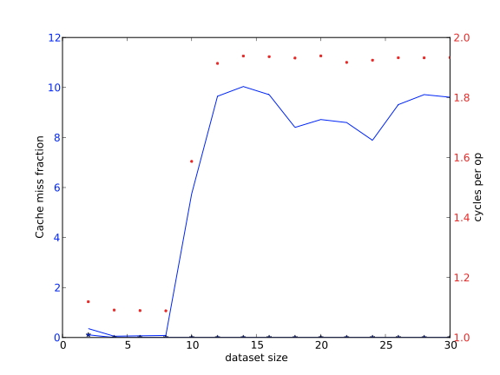
Cache size
for (i=0; i<NRUNS; i++)
for (j=0; j<size; j++)
array[j] = 2.3*array[j]+1.2;
If the data fits in L1 cache, the transfer is very fast
If there is more data, transfer speed from L2 dominates

Slide 61
Cache size
for (i=0; i<NRUNS; i++) {
blockstart = 0;
for (b=0; b<size/l1size; b++)
for (j=0; j<l1size; j++)
array[blockstart+j] = 2.3*array[blockstart+j]+1.2;
}
Data can sometimes be arranged to fit in cache:
Cache blocking

Slide 62
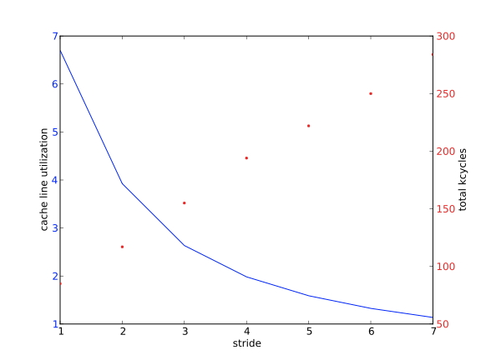
Cache line utilization
for (i=0,n=0; i<L1WORDS; i++,n+=stride)
array[n] = 2.3*array[n]+1.2;
Same amount of data, but increasing stride
Increasing stride: more cachelines loaded, slower execution

Slide 63
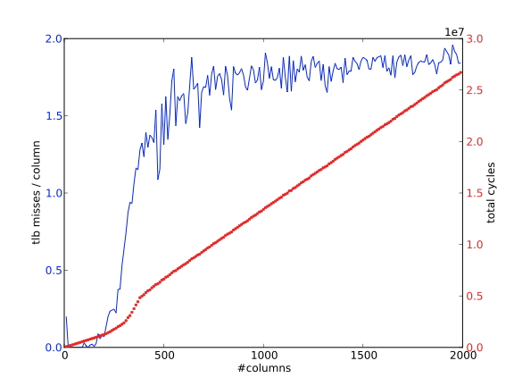
TLB
#define INDEX(i,j,m,n) i+j*m
array = (double*) malloc(m*n*sizeof(double));
/* traversal #1 */
for (j=0; j<n; j++)
for (i=0; i<m; i++)
array[INDEX(i,j,m,n)] = array[INDEX(i,j,m,n)]+1;
Array is stored with columns contiguous
Loop traverses the columns:
No big jumps through memory
(max: 2000 columns, 3000 cycles)

Slide 64
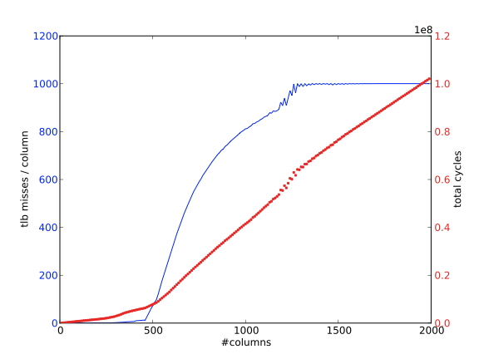
TLB
#define INDEX(i,j,m,n) i+j*m
array = (double*) malloc(m*n*sizeof(double));
/* traversal #2 */
for (i=0; i<m; i++)
for (j=0; j<n; j++)
array[INDEX(i,j,m,n)] = array[INDEX(i,j,m,n)]+1;
Traversal by columns:
Every next column is n words away
If n more than page size: TLB misses
(max: 2000 columns, 10Mcycles, 300 times slower)

Slide 65

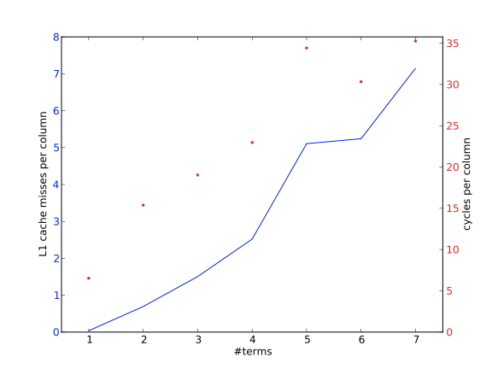
Associativity
Opteron: L1 cache 64k=4096 words
Two-way associative, so m>1 leads to conflicts:
Cache misses/column goes up linearly
(max: 7 terms, 35 cycles/column)

Slide 66
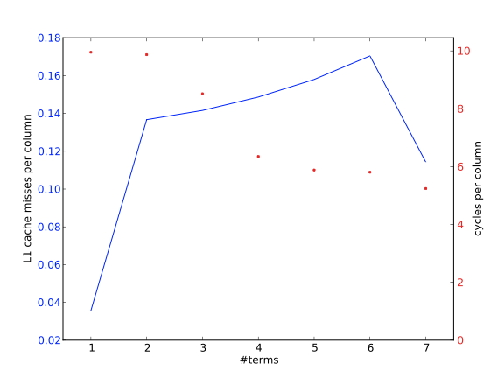
Associativity
Opteron: L1 cache 64k=4096 words
Allocate vectors with 4096+8 words: no conflicts: cache misses negligible
(7 terms: 6 cycles/column)

