Slide 1
Parallel Computing for Science & Engineering 23/2/2012
Instructors:
Kent Milfeld, Research Associate, TACC
Yaakoub El Khamra, Research Associate, TACC
Notes:
Check Single and Section have implied barrier.
25 continue fortran “&”

Slide 2
Blocking Send/Receive
MPI_Send
MPI_Recv
Generic Syntax
task 0
data
task 1
data
data
data
MPI_Send(buf, count, datatype, dest, tag, comm)
MPI_Recv(buf, count, datatype, source, tag, comm, status)
When MPI sends a message, it doesn’t just send the contents; it also sends an envelope describing the contents:
network
Parts of a P-2-P
Communication:
Data
Send to/Recv from
Message ID
Argument | Description
buf | initial address of send/receive buffer (reference)
count | number of items to send (integer)
datatype | MPI data type of items to send/receive
dest | MPI rank of task receiving the data (integer)
source | MPI rank of task sending the data (integer)
tag | message ID (integer)
comm | MPI communicator (set of exchange processors)
status | returns information on the message received
Notes:
Both send and receive are quite the same:
Data description usually the same
Send has dest, Recv has source
Both require a tag for additional control
Both require a communicator
Recv has status information.

Slide 3
Details
buffer | data (address in C, name of array/value in Fortran)
count | Length of source array (in elements, 1 for scalars)
datatype | Data Type: e.g. MPI_INT (C), MPI_INTEGER (F90), MPI_DOUBLE_PRECISION (F90), MPI_DOUBLE (C), etc.
source | Rank (proc #) of source in communicator group
tag | Message identifier (arbitrary integer)
communicator | Group of processors
status | Information about message
ierr | Error (argument in Fortran, returned in C)
 | C | Fortran
status | MPI_Status mystat; | integer mystat(MPI_STATUS_SIZE)
datatype | MPI_Datatype mytype; | integer mytype
comm. | MPI_Comm mycomm; | integer mycomm
Notes:
change “call block until message is in buffer”

Slide 4
Language Example
C
ierr=MPI_Send(&a[0],cnt,type,dest,tag,com);
F
call MPI_Send( a, cnt,type,dest,tag,com,ierr)
C
ierr=MPI_Recv(&b[0],cnt,type, src,tag,com,&status);
F
call MPI_Recv( b, cnt,type, src,tag,com, status,ierr)
Call blocks until send data of a has been sent or copied to a buffer. Recv’s block until data is in b.

Slide 5
P-2-P Example
#include <mpi.h>
int main(int argc, char* argv[]){
MPI_Comm Comm=MPI_COMM_WORLD;
int npes,iam=-1,ierr;
ierr=MPI_Init(&argc, &argv);
ierr=MPI_Comm_size(Comm,&npes);
ierr=MPI_Comm_rank(Comm, &iam);
ierr=MPI_Finalize();
printf("iam=%d\n",iam);
}

Slide 6
P-2-P Example
#include <mpi.h>
int main(int argc, char* argv[]){
MPI_Comm Comm=MPI_COMM_WORLD;
MPI_Status status;
int npes,iam=-1,ierr,irec=-1;
ierr=MPI_Init(&argc, &argv);
ierr=MPI_Comm_size(Comm,&npes);
ierr=MPI_Comm_rank(Comm, &iam);
if(iam==0)
ierr=MPI_Send(&iam, 1,MPI_INT, 1,9, Comm);
if(iam==1)
ierr=MPI_Recv(&irec,1,MPI_INT, 0,9, Comm,&status);
ierr=MPI_Finalize();
printf("iam=%d, received=%d\n",iam,irec);
}

Slide 7
P-2-P Example
program main
use mpi
integer :: Comm=MPI_COMM_WORLD
integer ::status(MPI_STATUS_SIZE),npes,iam,ierr, ierc=-1
call MPI_INIT(ierr)
call MPI_COMM_SIZE(Comm, npes,ierr)
call MPI_COMM_RANK(Comm, iam,ierr)
if(iam==0)&
call MPI_SEND( iam, 1,MPI_INTEGER, 1,9, Comm,ierr)
if(iam==1)&
call MPI_RECV( irec, 1,MPI_INTEGER, 0,9, Comm,status,ierr)
call MPI_FINALIZE(ierr);
print*,"iam=",iam," received=",irec
end program

Slide 8
More on Status
C
status (type MPI_Status) is a structure which contains three fields MPI_SOURCE, MPI_TAG, and MPI_ERROR
status.MPI_SOURCE, status.MPI_TAG, and status.MPI_ERROR contain the source, tag, and error code respectively of the received message
Fortran
status is an array of INTEGERs of length MPI_STATUS_SIZE, and the 3 constants MPI_SOURCE, MPI_TAG, MPI_ERROR are the indices of the entries that store the source, tag, & error
status(MPI_SOURCE), status(MPI_TAG), status(MPI_ERROR) contain respectively the source, the tag, and the error code of the received message.
Notes:
how to access information: C status.MPI_SOURCE
Function in Fortran, Careful, status returns an integer!!

Slide 9
The 6 Basic MPI Call Summary
MPI is used to create parallel programs based on message passing
Usually the same program is run on multiple processors
The 6 basic calls in MPI are
MPI_INIT(ierr)
MPI_COMM_RANK(MPI_COMM_WORLD, myid,ierr)
MPI_COMM_SIZE(MPI_COMM_WORLD, numprocs,ierr)
MPI_SEND(buffer,count,MPI_TYPE, dest,tag,MPI_COMM_WORLD,ierr)
MPI_RECV(buffer,count,MPI_TYPE, src, tag,MPI_COMM_WORLD,stat,ierr)
MPI_FINALIZ(ierr)
MPI_TYPE is an MPI Parameter or User Data Type

Slide 10
The 6 Basic MPI Call Summary
MPI is used to create parallel programs based on message passing
Usually the same program is run on multiple processors
The 6 basic calls in MPI are
MPI_Init(&argc, &argv);
MPI_Comm_Rank(MPI_COMM_WORLD,&myid);
MPI_Comm_Size(MPI_COMM_WORLD,&numprocs);
MPI_Send(buffer,count,MPI_TYPE, dest,tag,MPI_COMM_WORLD);
MPI_Recv(buffer,count,MPI_TYPE, src, tag,MPI_COMM_WORLD,&stat);
MPI_Finalize();
MPI_TYPE is an MPI Parameter or User Data Type
buffer is passed by reference

Slide 11
Numerical Problems are of all forms:
Time (dependent and independent)
Grid point versus function
Finite Difference vs Basis Sets (Ocean Models/Electronic Structure)
Particle methods
Particle-particle,
Particle-mesh,
Particle-particle particle mesh
Mesh-free methods

Slide 12
Pi Calculation
1
0
1
Task division: partial sums for each task
Communication: pi=sum of partial sums
Floating Point Intensive
No Data Partitioning
No Communication
No IO
Notes:
http://www.pdc.kth.se/training/Tutor/MPI/Templates/pi/index.html
http://books.google.com/books?id=QlbzjN_5pDoC&pg=PA592&lpg=PA592&dq=pi+calculation+integral&source=bl&ots=bKYEiiRGC0&sig=oXSNLtr4RDKRYItAybquL71aC5s&hl=en&ei=ajZpTcS2Dcugtgfkg9XmAg&sa=X&oi=book_result&ct=result&resnum=7&ved=0CEMQ6AEwBjgK#v=onepage&q=pi%20calculation%20integral&f=false
http://mathrule.wordpress.com/2011/01/27/mpi-calculation-of-pi-using-the-monte-carlo-method/
http://en.wikipedia.org/wiki/Area_of_a_disk
http://www.analyzemath.com/calculus/Integrals/area_circle.htmlhttp://comscigate.com/Books/IntroSedgewick/90scientific/93integration/index.html

Slide 13
More Complex, 2D Heat Equation
2D, Time-dependent, Finite Difference
Describes the flow of thermal energy via conduction in a continuous medium (solid, stationary fluid, etc.)
Solve on the unit square with simple conditions and a known solution
Notes:
This is a parabolic partial differential equation, laplacian operator

Slide 14
Exact Solution and RHS
Right-hand side
Exact solution
Finite difference approximation
Forward Time
No matrices to invert
Stability issues to worry about later
Central Space
Equal spacing in x and y (h)
Second-order accurate

Slide 15
Approximation
Solution at n+1 requires 5 solutions and 1 function value from time step n
Each time step is dependent on the previous one
Each space point is dependent on its neighbors
Task division: task update set of μ’s
Data Partition: into sets of μ’s + Boundary
Communication: some adjacent μ’s
Floating Point Intensive (arrays in memory)
Data Partitioning: Arrays/Tasks as Data Parallel
Communication: Border elements to adjacent tasks.
IO – large if time sequence needed

Slide 16
Approximation
Solution at n+1 requires 5 solutions and 1 function value from time step n
Each time step is dependent on the previous one
Each space point is dependent on its neighbors
Floating Point Intensive (use arrays in memory)
Data Partitioning:
Arrays/Tasks as Data Parallel
Communication: Make border elements accessing to adjacent tasks.
IO – large if time sequence needed
Task division: task update set of μ’s
Data Partition: into sets of μ’s + Boundaries
Communication: some adjacent μ’s

Slide 17
Boundary and Initial Conditions

Slide 18
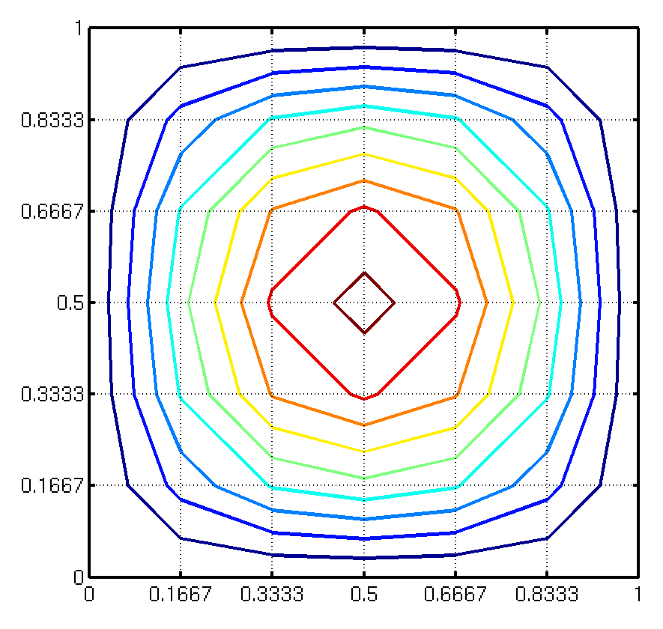
Computational Mesh

Slide 19
Partitioning + Ghost Cells
2-D Array for each Task
Extended 2-D Array for each Task
Data Partition
Ghost Cells for Updating

Slide 20
Parallelization
Partition space (data) into blocks
Put one block on each processor
But updates on edges have to be shared
Sharing here means using duplicated data (a copy for each adjacent process).
Use “hidden” (ghost) edges to hold the updated data for the other process.
Update required after each time step

Slide 21
Stability & Performance
Stability considerations state (Vdt<cell length) or
Otherwise, small errors grow exponentially
Small meshes can fit on a single node, but small time steps imply long solution times
Hence, parallel processing is a must to get solutions in reasonable times
Notes:
e Courant–Friedrichs–Lewy condition (CFL condition)

Slide 22
Run Time Analysis
floating point operations/point/time step
points physical simulation time
total # of time steps
total FLOPS (floating point operations)

Slide 23
Run Time Analysis
cycles per second flops/cycle
computational efficiency
= wall-clock time to run
Run Time Analysis
N | Time (s) actual | Equal-time Proc. Grid
1024 | 42 | 1x1
2048 | 687 | 4x4
4096 | 10,995 | 16x16

Slide 24
Communication Costs
Small messages are expensive
Every communication has a fixed startup overhead
Need to amortize this overhead over the length of the message
Try to aggregate communications into the longest possible messages

Slide 25
Latency
Notes:
At 10B 8x10**-8 s/B
At 100B 1x10**-8 s/B
10MB/Time = 1/(8x10**-8 s/B) ➔ 10MB*8x10**-8s/B = 0.8x10**-6 sec
Actual communication cost=10B/1000MB/s = 0.01x10-6 s
100MB/Time = 1/(1x10**-8 s/B) ➔ 100MB*1x10**-8s/B = 1.0x10**-6 sec
Actual communication cost=100B/1000MB/s = 0.1x10-6 s
Actual communication cost=1000B/1000MB/s = 1x10-6 s -- almost a factor of 10 larger

Slide 26
Effective Bandwidth
Notes:
The dip is because of the change of algorithm from eager to rendezvous. The change is about 12kb for lonestar.
Eager - An asynchronous protocol that allows a send operation to complete without acknowledgement from a matching receive
Rendezvous - A synchronous protocol which requires an acknowledgement from a matching receive in order for the send operation to complete.
Eager Protocol
The assumption is made by the sending process that the receiving process can store the message if it is sent. It is the responsibility of the receiving process to buffer the message upon its arrival, especially if the receive operation has not been posted.
This assumption may be based upon the implementation's guarantee of a certain amount of available buffer space on the receive process.
Generally used for smaller message sizes (up to Kbytes). Message size may be limited by the number of MPI tasks as well.
Potential Advantages:
Reduces synchronization delays - send process does not need acknowledgement from receive process that it's OK to send message.
Simplifies programming - only need to use MPI_Send.
Potential Disdvantages:
Most important disadvantage is that it is not scalable. Significant buffering may be required to provide space for messages from an arbitrary number of senders.
Can cause memory exhaustion and program termination when receive process buffer is exceeded.
Buffer "wastage" - allocated even if only a few messages are sent
May consume CPU cycles by the receive process side to pull messages from the network and/or copy the data into buffer space.
Rendezvous Protocol
This protocol is used when assumptions about the receiving process buffer space can't be made, or when the limits of the eager protocol are exceeded.
Requires some type of "handshaking" between the sender and the receiver processes. For example:
Sender process sends message envelope to destination process
Envelope received and stored by destination process
When buffer space is available, destination process replies to sender that requested data can be sent
Sender process receives reply from destination process and then sends data
Destination process receives data
Potential Advantages:
Scalable, compared to eager protocol
Robustness by preventing memory exhaustion and termination on receive process
Only required to buffer small message envelopes
Possibility for eliminating a data copy - user space to user space direct
Potential Disdvantages:
Inherent synchronization delays due to necessary handshaking between sender and receiver.
More programming complexity - may need to use non-blocking sends with waits/tests to prevent program from blocking while waiting on the OK from receive process.

Slide 27
Effective Bandwidth
total # of time steps
Bytes Transferred
X 8 exchanges/step x ghost elements x 8B/element
For 4x4 process grid with partitions of 1024 x 1024 (compute time = ~40sec.)
Message passing will take:
[0.01sec x 2 x (1024)**2]steps x 8/step x 1024 elements * 8B/element = 4.6 sec.
-------------------------------------------------------------------------------------------------
300MB/sec

