Slide 1
Parallel Computing for Science & Engineering 3/6/2012
Instructors:
Kent Milfeld, Research Associate, TACC
Yaakoub El Khamra, Research Associate, TACC
Notes:
Check Single and Section have implied barrier.
25 continue fortran “&”

Slide 2
Outline
Tricks
Data Types
Predefined
Status and Wildcards
Pt-2-Pt Communication Modes
Blocking
Standard, Buffered, Synchronous, Ready
Non-blocking
Standard, Buffered, Synchronous, Ready
Deadlocking

Slide 3
Tricks
mpicc/mpif90 –v myprog.c/f90
Shows details of compiling and loading
Shows where include files are located.
watch –n 8 qstat
Shows results of qstat every 8 seconds
“qstat” can be any command.

Slide 4
MPI Data Types
MPI data types are used in data communication operation.
MPI has many different predefined data types
Defined to match C/Fortran data types
MPI handles endianness conversion (though a mixed architecture system is rare)
Packed/opaque types– User Defined Types can be made to handle C/F90 structures
Notes:
endian or endianness refers to the ordering of individually addressable sub-components within the representation of a larger data item as stored in external memory (or, sometimes, as sent on a serial connection). Each sub-component in the representation has a unique degree of significance, like the place value of digits in a decimal number. These sub-components are typically 16-, 32- or 64-bit words, 8-bit bytes, or even bits. Endianness is a difference in data representation at the hardware level and may or may not be transparent at higher levels, depending on factors such as the type of high level language used.
Well-known processor architectures that use the little-endian format include x86 (including x86-64), 6502 (including 65802, 65C816), Z80 (including Z180, eZ80 etc.), MCS-48, 8051, DEC Alpha, AlteraNios, Atmel AVR, SuperH, VAX, and, largely, PDP-11.
Well-known processors that use the big-endian format include Motorola 6800 and 68k, Xilinx Microblaze, IBM POWER, and System/360 and its successors such as System/370, ESA/390, andz/Architecture. The PDP-10 also used big-endian addressing for byte-oriented instructions. SPARC historically used big-endian until version 9, which is bi-endian just like the ARM architecture, and the PowerPC and Power Architecture descendants of IBM POWER are also bi-endian (see below).

Slide 5
MPI Predefined Data Types in C

Slide 6
MPI Predefined Data Types in F90
MPI Parameter | F90 type
MPI_INTEGER | Integer
MPI_REAL | Real
MPI_DOUBLE_PRECISION | Double Precision
MPI_COMPLEX | Complex
MPI_LOGICAL | Logical
MPI_CHARACTER | Character
MPI_BYTE | Raw Byte (no conversion)
MPI_PACKED | MPI calls pack/unpack

Slide 7
Wildcards
Enables programmer to avoid having to specify a tag and/or source.
Example:
MPI_ANY_SOURCE and MPI_ANY_TAG are wild cards
status structure is used to get wildcard values
MPI_Status status;
int data[5];
int ierr;
ierr = MPI_Recv(&data[0], 5, MPI_INT,
MPI_ANY_SOURCE, MPI_ANY_TAG,
MPI_COMM_WORLD,&status);

Slide 8
Wildcards
Enables programmer to avoid having to specify a tag and/or source.
Example:
MPI_ANY_SOURCE and MPI_ANY_TAG are wild cards
status structure is used to get wildcard values
integer :: status;
integer :: data(5);
integer :: ierr;
call MPI_Recv( data, 5, MPI_INTEGER,
MPI_ANY_SOURCE, MPI_ANY_TAG,
MPI_COMM_WORLD, status, ierr);

Slide 9
Wildcards
MPI_PROC_NULL
can be used for destination or source in send or receive calls
operation completes immediately
no communications involved
Great for handling edges of partitioned data
Useful with MPI_Sendrecv
Notes:
The special value MPI_PROC_NULL can be used MPI_PROC_NULL instead of a rank wherever a source or a destination argument is required in a communication function. A communication with process MPI_PROC_NULL has no effect. A send to MPI_PROC_NULL succeeds and returns as soon as possible. A receive from MPI_PROC_NULL succeeds and returns as soon as possible with no modifications to the receive buffer. When a receive with source = MPI_PROC_NULL is executed then the status object returns source = MPI_PROC_NULL, tag = MPI_ANY_TAG and count = 0.

Slide 10
Blocking Pt-2-Pt communications
Standard
Buffered
Synchronous
Ready
← Mode
call MPI_
Recv Posted
Send
Start
MPI_Send
MPI_Bsend
MPI_Ssend
MPI_Rsend
Blocked until
data area free
In System buffer
or Recv posted
and data copied
Receive
posted &
data copied
i.e. Send
Complete
data moved
to user buffer
data copied
Return
local
non-local
local
non-local
Call Interaction
non-local
MPI_Recv is used with MPI_Send, MPI_Bsend & MPI_Ssend and MPI_Rsend.
Notes:
http://www.pdc.kth.se/training/Tutor/MPI/Pt2pt.Fortran/index-frame.html

Slide 11
MPI Receive Modes
IMPORTANT: From the MPI-2 Standard:
There is only one receive operation, but it matches any of the send modes. The receive operation described in the last section is blocking: it returns only after the receive buffer contains the newly received message. A receive can complete before the matching send has completed (of course, it can complete only after the matching send has started).

Slide 12
Buffered Communication
CPU 1
CPU 2
task 0
task 1
data
data
User Buffer
User buffer
data
data
MPI_Bsend
MPI_Recv
The contents of the message is copied into a system-controlled block of memory (User Buffer).
MPI_Bsend returns when copy to User buffer is complete.
There is no MPI_Brecv.
Use MPI_BSend_OVERHEAD to provide room for message headers
Fails if there isn’t enough space for buffering
Buffer area must contain (MPI_BSEND_OVERHEAD) room for each message.
Notes:
http://www.lam-mpi.org/tutorials/one-step/ezstart.php
MPI_Buffer_attach
Attaches a user-provided buffer for sendingint MPI_Buffer_attach( void *buffer, int size ); Parameters
buffer[in] initial buffer address (choice)size[in] buffer size, in bytes (integer)
Remarks
Provides to MPI a buffer in the user's memory to be used for buffering outgoing messages.
The buffer is used only by messages sent in buffered mode. Only one buffer can be attached
to a process at a time.The size given should be the sum of the sizes of all outstanding Bsends
that you intend to have, plus MPI_BSEND_OVERHEAD for each Bsend that you do.
For the purposes of calculating size, you should useMPI_Pack_size. In other words, in the code
MPI_Buffer_attach( buffer, size ); MPI_Bsend( ..., count=20, datatype=type1, ... ); ...
MPI_Bsend( ..., count=40, datatype=type2, ... ); the value of size in the MPI_Buffer_attach
call should be greater than the value computed by MPI_Pack_size( 20, type1, comm, &s1 );
MPI_Pack_size( 40, type2, comm, &s2 ); size = s1 + s2 + 2 * MPI_BSEND_OVERHEAD; The
MPI_BSEND_OVERHEAD gives the maximum amount of space that may be used in the buffer
for use by the BSEND routines in using the buffer. This value is in mpi.h (for C) and mpif.h (for Fortran).
MPI_Buffer_detach
Removes an existing buffer (for use in MPI_Bsend etc)int MPI_Buffer_detach( void *buffer, int *size ); Parameters
buffer[out] initial buffer address (choice)size[out] buffer size, in bytes (integer)
Remarks
Detach the buffer currently associated with MPI. The call returns the address and the
size of the detached buffer. This operation will block until all messages currently in the
buffer have been transmitted. Upon return of this function, the user may reuse or
deallocate the space taken by the buffer.The reason that MPI_Buffer_detach returns the
address and size of the buffer being detached is to allow nested libraries to replace and
restore the buffer. For example, consider
int size, mysize, idummy; void *ptr, *myptr, *dummy; MPI_Buffer_detach( &ptr, &size );
MPI_Buffer_attach( myptr, mysize ); ... ... library code ... ...
MPI_Buffer_detach( &dummy, &idummy ); MPI_Buffer_attach( ptr, size );
This is much like the action of the Unix signal routine and has the same strengths
(it is simple) and weaknesses (it only works for nested usages).
Note that for this approach to work, MPI_Buffer_detach must return MPI_SUCCESS
even when there is no buffer to detach. In that case, it returns a size of zero.
The MPI 1.1 standard for MPI_BUFFER_DETACHcontains the text
The statements made in this section describe the behavior of MPI for buffered-mode sends.
When no buffer is currently associated, MPI behaves as if a zero-sized buffer is associated
with the process. This could be read as applying only to the various Bsend routines.
This implementation takes the position that this applies toMPI_BUFFER_DETACH as well.
Advice to users.
Even though the C functions MPI_Buffer_attach and MPI_Buffer_detach both have a first
argument of type void*, these arguments are used differently: A pointer to the buffer is
passed to MPI_Buffer_attach; the address of the pointer is passed to MPI_Buffer_detach,
so that this call can return the pointer value.

Slide 13
User-Buffer Communication
BSend
...
character,allocatable,dimension(:) :: cbuffer
call MPI_Init(ierr)
call MPI_Comm_rank(MPI_COMM_WORLD, irank, ierr)
i=1
isize_bytes = sizeof(i) + MPI_BSend_OVERHEAD
allocate( cbuffer(isize_bytes) )
call MPI_Buffer_attach (cbuffer , isize_bytes , ierr )
if(irank == 0) then
call MPI_Bsend(i, 1, MPI_INTEGER, 1, 9, MPI_COMM_WORLD, ierr)
else
call MPI_Recv( j, 1, MPI_INTEGER, 0, 9, MPI_COMM_WORLD, status, ierr)
endif
Notes:
https://computing.llnl.gov/tutorials/mpi/
http://www.mpi-forum.org/docs/mpi-11-html/node42.html#node42
There is a wide spectrum of possible implementations of buffered communication:
buffering can be done at sender, at receiver, or both; buffers can be dedicated to
one sender-receiver pair, or be shared by all communications; buffering can be done
in real or in virtual memory; it can use dedicated memory, or memory shared by other
processes; buffer space may be allocated statically or be changed dynamically; etc.
It does not seem feasible to provide a portable mechanism for querying or controlling
buffering that would be compatible with all these choices, yet provide meaningful information.

Slide 14
User-Buffer Communication
BSend
...
char* cbuffer;
MPI_Init(&argc, &argv);
MPI_Comm_rank(MPI_COMM_WORLD, &irank);
i = 1;
isize_bytes = sizeof(i) + MPI_BSend_OVERHEAD ;
cbuffer = malloc((size_t)isize_bytes );
MPI_Buffer_attach(cbuffer , isize_bytes );
if(irank == 0) {
MPI_Bsend(&i, 1, MPI_INT, 1, 9, MPI_COMM_WORLD);
} else {
MPI_Recv( &j, 1, MPI_INT, 0, 9, MPI_COMM_WORLD, &status);
}
Notes:
https://computing.llnl.gov/tutorials/mpi/
http://www.mpi-forum.org/docs/mpi-11-html/node42.html#node42
There is a wide spectrum of possible implementations of buffered communication: buffering can be done at sender, at receiver, or both; buffers can be dedicated to one sender-receiver pair, or be shared by all communications; buffering can be done in real or in virtual memory; it can use dedicated memory, or memory shared by other processes; buffer space may be allocated statically or be changed dynamically; etc. It does not seem feasible to provide a portable mechanism for querying or controlling buffering that would be compatible with all these choices, yet provide meaningful information. ( End of rationale.)

Slide 15
Synchronous Communication
CPU 1
CPU 2
task 0
MPI_Ssend
task 1
MPI_Recv Post
request
to send
ready to
receive
data
data
MPI_Ssend
MPI_Recv
Data isn’t sent until Receive has been posted.
Synchronous send returns when data area is safe for re-use.
There is no MPI_Srecv
Notes:
http://www.mcs.anl.gov/research/projects/mpi/tutorial/gropp/node50.html
Great examples: http://www.mpi-forum.org/docs/mpi-11-html/node61.html

Slide 16
Synchronous Communication
Ssend C
...
i=1;
if(irank == 0){
MPI_Ssend(&i, 1, MPI_INT, 1, 9, MPI_COMM_WORLD);
}else {
MPI_Recv( &j, 1, MPI_INT, 0, 9, MPI_COMM_WORLD, &status);
}
Ssend F90
...
i=1
if(irank == 0) then
call MPI_Ssend( i, 1, MPI_INTEGER, 1, 9, MPI_COMM_WORLD, ierr)
else
call MPI_Recv( j, 1, MPI_INTEGER, 0, 9, MPI_COMM_WORLD, status,ierr)
endif
Notes:
https://computing.llnl.gov/tutorials/mpi/
http://www.mpi-forum.org/docs/mpi-11-html/node42.html#node42
There is a wide spectrum of possible implementations of buffered communication: buffering can be done at sender, at receiver, or both; buffers can be dedicated to one sender-receiver pair, or be shared by all communications; buffering can be done in real or in virtual memory; it can use dedicated memory, or memory shared by other processes; buffer space may be allocated statically or be changed dynamically; etc. It does not seem feasible to provide a portable mechanism for querying or controlling buffering that would be compatible with all these choices, yet provide meaningful information. ( End of rationale.)

Slide 17
Ready Communication
CPU 1
CPU 2
task 0
MPI_Rsend
task 1
MPI_Recv Post
data
data
MPI_Rsend
MPI_Recv
Receive is guaranteed to be posted.
Ready returns when data area is safe for re-use.
Not often used. Behavior is not defined if receive has not been posted first.
There is no MPI_Rrecv. You might find it in some MPI implementations but it is NOT part of the MPI-2 standard
Notes:
http://www.mcs.anl.gov/research/projects/mpi/tutorial/gropp/node50.html
Great examples: http://www.mpi-forum.org/docs/mpi-11-html/node61.html

Slide 18
Ready Communication
Rsend F90
...
i=1;
if(irank == 0)then
call MPI_Barrier(MPI_COMM_WORLD, ierr);
call MPI_Rsend(i, 1, MPI_INTEGER, 1, 9, MPI_COMM_WORLD, ierr);
else
call MPI_Irecv(…);
call MPI_Barrier(MPI_COMM_WORLD, ierr);
...
endif
Rsend C
...
i=1;
if(irank == 0){
MPI_Barrier(MPI_COMM_WORLD);
MPI_Rsend(&i, 1, MPI_INT, 1, 9, MPI_COMM_WORLD);
}else {
MPI_Irecv(…);
MPI_Barrier(MPI_COMM_WORLD);
...}
More about this later. This allows Recv to be posted
without blocking--
the call returns immediately.
Notes:
https://computing.llnl.gov/tutorials/mpi/
http://www.mpi-forum.org/docs/mpi-11-html/node42.html#node42
There is a wide spectrum of possible implementations of buffered communication: buffering can be done at sender, at receiver, or both; buffers can be dedicated to one sender-receiver pair, or be shared by all communications; buffering can be done in real or in virtual memory; it can use dedicated memory, or memory shared by other processes; buffer space may be allocated statically or be changed dynamically; etc. It does not seem feasible to provide a portable mechanism for querying or controlling buffering that would be compatible with all these choices, yet provide meaningful information. ( End of rationale.)

Slide 19
MPI_SendRecv
MPI_SendRecv(senddat,sendcount,sendtype, dest,sendtag, recvdat,recvcount,recvtype, src, recvtag, comm, status)
Initiates send and receive at the same time.
Completes when both send and receive buffers are safe to use
Useful for communications patterns where each node sends and receives messages (two-way communication). Good for avoiding deadlock, implementing shifts/rings.
Executes a standard mode send & receive operation for dest and src, respectively.
The send and receive operations use the same communicator, but have distinct tags.

Slide 20
Bidirectional Communication with MPI_Sendrecv
C
ierr=MPI_Sendrecv(&sb[0],scnt,stype,dest,stag,
&rb[0],rcnt,rtype, src,rtag,
MPI_COMM_WOLRD,&status);
Fortran
call MPI_Sendrecv( sb, scnt,stype,dest,stag, rb, rcnt,rtype, src,rtag,
MPI_COMM_WOLRD, status,ierr)

Slide 21
Blocking vs Non-blocking
Blocking
Non-blocking
A blocking send routine will only return after it is safe to modify the data area.
Safe means that modifications in the data area will not affect the data to be sent.
A Safe send does not imply that the data was actually received.
A blocking send can be either synchronous or asynchronous.
Send/receive routines return immediately.
Non-blocking operations request the MPI library to perform the operation when possible.
It is unsafe to modify the data area until the requested operation has been performed. There are wait routines used to do this (MPI_Wait)
Primarily used to overlap computation with communication

Slide 22
Blocking vs non-Blocking Routines
Description | Syntax for C bindings
Blocking send | MPI_Send(buf, count, datatype, dest, tag, comm)
Non-blocking send | MPI_Isend(buf,count, datatype, dest, tag, comm, request)
Blocking receive | MPI_Recv(buf, count, datatype, source, tag, comm, status)
Non-blocking receive | MPI_Irecv(buf,count, datatype, source, tag, comm, request)
Wait for completion | MPI_Wait(request, status)
request: used by non-blocking send and receive operation.

Slide 23
Non-blocking Communication
Non-blocking send
send call returns immediately
send actually occurs later
Non-blocking receive
receive call returns immediately
when received data is needed, call a wait subroutine
Non-blocking communication used to overlap communication with computation (and communication with communication!).
Can be used to prevent deadlock.

Slide 24
Non-Blocking Pt-2-Pt communications
Standard
Buffered
Synchronous
Ready
← Mode
call MPI_
Recv Posted
Send
Start
MPI_Isend
MPI_Ibsend
MPI_Issend
MPI_Irsend
Return
data area
not free
In System buffer
or Recv posted
and data copied
Receive
posted &
data copied
Complete
When
data moved
to user buffer
data copied
Completeness
Test→
Guarantee→
MPI_Test
MPI_Wait
local
non-local
local
non-local
Call Interaction
non-local
MPI_Irecv or MPI_Recv is used with MPI_Isend, MPI_Ibsend, MPI_Issend,
MPI_Irsend & blocking versions.
Notes:
http://www.mpi-forum.org/docs/mpi-11-html/node44.html#Node44
http://www.pdc.kth.se/training/Tutor/MPI/Pt2pt.Fortran/index-frame.html

Slide 25
Non-blocking Send with MPI_Isend
C
MPI_Request request;
ierr = MPI_Isend(&data, count, datatype,
dest, tag, comm, &request);
Fortran
integer request
call MPI_Isend( data, count, datatype,
dest, tag, comm, request, ierr)
request is the id for the message call
Don't use data area until communication is complete

Slide 26
Non-blocking Receive with MPI_Irecv
C
MPI_Request request;
ierr = MPI_Irecv(&data, count, datatype,
source, tag, comm, &request);
Fortran
integer request
call MPI_Irecv( data, count, datatype,
source, tag, comm, request, ierr)
request is an id for communication
Note: There is no status parameter.
Don't use data area until communication is complete

Slide 27
MPI_Wait Used to Complete Communication
request from MPI_Isend or MPI_Irecv
the completion of a send operation indicates that the sender is now free to update the data in the send buffer
the completion of a receive operation indicates that the receive buffer contains the received message
MPI_Wait blocks until message specified by request completes

Slide 28
MPI_Wait Usage
C
MPI_Request request;
MPI_Status status;
...
ierr = MPI_Wait(&request, &status)
Fortran
integer request
integer status(MPI_STATUS_SIZE)
...
call MPI_Wait( request, status, ierr)

Slide 29
MPI_Test
Value of flags signifies whether a message has been delivered
Similar to MPI_Wait, but does not block
C
int flag;
ierr= MPI_Test(&request, &flag, &status);
Fortran
logical flag
call MPI_Test( request, flag, status, ierr)

Slide 30
MPI_Cancel
Cancel a pending non-blocking send or receive
C
MPI_Request request;
ierr= MPI_Cancel(&request);
Fortran
integer request
call MPI_Cancel( request, ierr)

Slide 31
Order Semantics
Messages with the same tag are ordered
the first receive always matches the first send in the following
tag=123456
if (rank.EQ.0) then
call MPI_BSend(b1,cnt,MPI_REAL,1,tag,comm,err)
call MPI_BSend(b2,cnt,MPI_REAL,1,tag,comm,err)
ELSE ! rank.EQ.1
call MPI_Recv(b1,cnt,MPI_REAL,0,tag,comm, status,ierr)
call MPI_Recv(b2,cnt,MPI_REAL,0,tag,comm, status, ierr)
END if

Slide 32
Nonblocking Examples

Slide 33
One-way Send/Recv Communication
Blocking Send & Non-blocking Recv
if (rank==0) then
call MPI_send( sendbuf, count, MPI_REAL, 1, tag, MPI_COMM_WORLD, ierr)
elseif (rank==1) then
call MPI_Irecv( recvbuf, count, MPI_REAL, 0, tag, MPI_COMM_WORLD, req, ierr)
call MPI_Wait( req,status,ierr)
endif
Non-blocking Send & Non-blocking Recv
if (rank==0) then
call MPI_Isend( sendbuf,count,MPI_REAL,1,tag,MPI_COMM_WORLD,req,ierr)
elseif (rank==1) then
call MPI_Irecv( recvbuf,count,MPI_REAL,0,tag,MPI_COMM_WORLD,req,ierr)
endif
call MPI_Wait( req,status,ierr)

Slide 34
Two-way Communication: Deadlock
Deadlock 1 (always deadlocks)
if (rank==0) then
call MPI_Recv( recvbuf,count,MPI_REAL,1,tag,MPI_COMM_WORLD,status,ierr)
call MPI_Send( sendbuf,count,MPI_REAL,1,tag,MPI_COMM_WORLD,ierr)
elseif (rank==1) then
call MPI_Recv( recvbuf,count,MPI_REAL,0,tag,MPI_COMM_WORLD,status,ierr)
call MPI_Send( sendbuf,count,MPI_REAL,0,tag,MPI_COMM_WORLD,ierr)
endif
Deadlock 2 (deadlocks when system buffer is too small)
if (rank==0) then
call MPI_Send( sendbuf,count,MPI_REAL,1,tag,MPI_COMM_WORLD,ierr)
call MPI_Recv( recvbuf,count,MPI_REAL,1,tag,MPI_COMM_WORLD,status,ierr)
elseif (rank==1) then
call MPI_Send( sendbuf,count,MPI_REAL,0,tag,MPI_COMM_WORLD,ierr)
call MPI_Recv( recvbuf,count,MPI_REAL,0,tag,MPI_COMM_WORLD,status,ierr)
endif
Notes:
1 will always deadlock, even if Sends are made non-blocking.

Slide 35
Two-way Communication: Solutions
Solution 1 (but this doesn’t allow bidirectional communication)
if (rank==0) then
call MPI_Send( sendbuf,count,MPI_REAL, 1,tag,MPI_COMM_WORLD,ierr)
call MPI_Recv( recvbuf,count,MPI_REAL, 1,tag,MPI_COMM_WORLD,status,ierr)
elseif (rank==1) then
call MPI_Recv( recvbuf,count,MPI_REAL, 0,tag,MPI_COMM_WORLD,status,ierr)
call MPI_Send( sendbuf,count,MPI_REAL, 0,tag,MPI_COMM_WORLD,ierr)
endif
Solution 2
if (rank==0) then
call MPI_SendRecv( sendbuf,sendcount,sendtype,dest,sendtag,
recvbuf,recvcount, recvtype,source,recvtag,MPI_COMM_WORLD,status,ierr)
elseif (rank==1) then
call MPI_SendRecv( sendbuf,sendcount,sendtype ,dest,sendtag,
recvbuf,recvcount, recvtype,source,recvtag,MPI_COMM_WORLD,status,ierr)
endif

Slide 36
Two-way Communication: Solutions
Solution 3
if (rank==0) then
call MPI_ISend( sendbuf,count,MPI_REAL,1,tag,MPI_COMM_WORLD,req1,ierr)
call MPI_IRecv( recvbuf,count,MPI_REAL,0,tag,MPI_COMM_WORLD,req2,ierr)
elseif (rank==1) then
call MPI_ISend( sendbuf,count,MPI_REAL,0,tag,MPI_COMM_WORLD,req1,ierr)
call MPI_IRecv( recvbuf,count,MPI_REAL,1,tag,MPI_COMM_WORLD,req2,ierr)
endif
call MPI_Wait( req1,status,ierr)
call MPI_Wait( req2,status,ierr)
Solution 4
if (rank==0) then
call MPI_BSend( sendbuf,count,MPI_REAL,1,tag,MPI_COMM_WORLD,ierr)
call MPI_Recv( recvbuf,count,MPI_REAL,0,tag,MPI_COMM_WORLD,status,ierr)
elseif (rank==1) then
call MPI_BSend( sendbuf,count,MPI_REAL,1,tag,MPI_COMM_WORLD,ierr)
call MPI_Recv( recvbuf,count,MPI_REAL,0,tag,MPI_COMM_WORLD,status,ierr)
endif

Slide 37
Two-way Communications Summary
 | CPU 1 | CPU 2
Deadlock 1 | Recv/Send | Recv/Send
Deadlock 2 | Send/Recv | Send/Recv
Solution 1 | Send/Recv | Recv/Send
Solution 2 | SendRecv | SendRecv
Solution 3 | Isend/Irecv/Wait | Isend/Irecv/Wait
Solution 4 | Bsend/Recv | Bsend/Recv

Slide 38
MPI_Probe
MPI_Probe allows incoming messages to be checked without actually receiving them
the user can then decide how to receive the data
Used when different actions need to be taken, depending on the "who, what, and how much" information of the message.

Slide 39
MPI_Probe
C
ierr=MPI_Probe(source, tag, comm, &status);
Fortran
MPI_Probe(source, tag, comm, status, ierr)
Parameters
source: source rank or MPI_ANY_SOURCE
tag: tag value or MPI_ANY_TAG
comm: communicator
status: status object

Slide 40
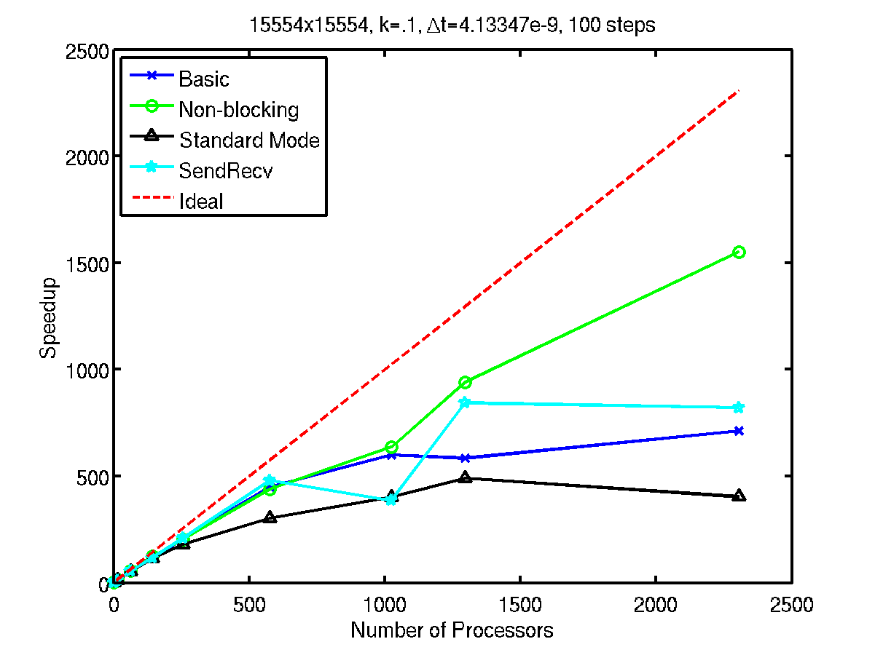
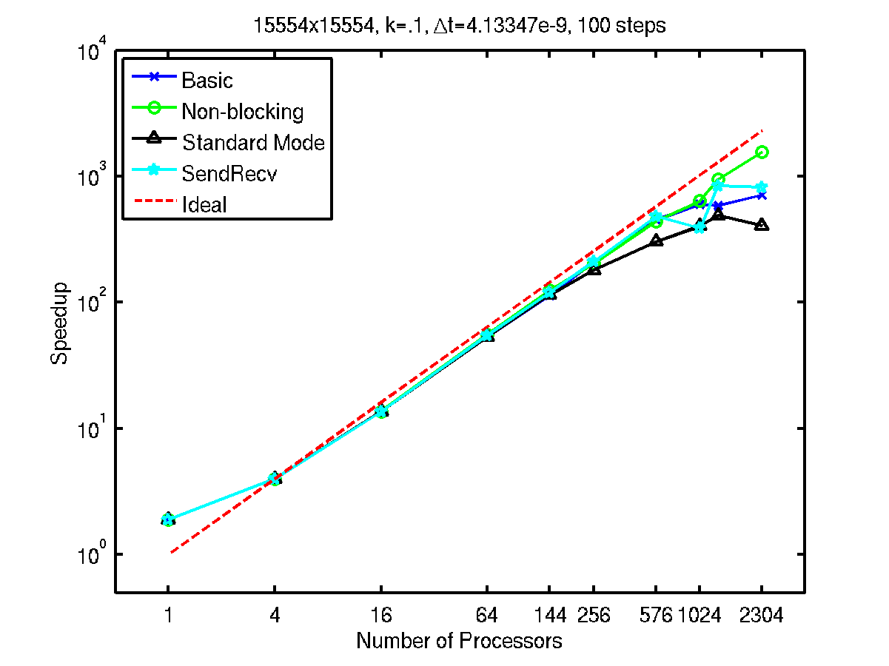
Scaling

