Slide 1
Parallel Computing for Science & Engineering Spring 2013: MPI applications
Instructors:
Victor Eijkhout, Research Scientist, TACC
Kent Milfeld, Research Associate, TACC
Notes:
Check Single and Section have implied barrier.
25 continue fortran “&”

Slide 2
Numerical Problems are of all forms:
Time (dependent and independent)
Grid point versus function
Finite Difference vs Basis Sets (Ocean Models/Electronic Structure)
Particle methods
Particle-particle,
Particle-mesh,
Particle-particle particle mesh
Mesh-free methods

Slide 3
Pi Calculation
1
0
1
Task division: partial sums for each task
Communication: pi=sum of partial sums
Floating Point Intensive
No Data Partitioning
No Communication
No IO
Notes:
http://www.pdc.kth.se/training/Tutor/MPI/Templates/pi/index.html
http://books.google.com/books?id=QlbzjN_5pDoC&pg=PA592&lpg=PA592&dq=pi+calculation+integral&source=bl&ots=bKYEiiRGC0&sig=oXSNLtr4RDKRYItAybquL71aC5s&hl=en&ei=ajZpTcS2Dcugtgfkg9XmAg&sa=X&oi=book_result&ct=result&resnum=7&ved=0CEMQ6AEwBjgK#v=onepage&q=pi%20calculation%20integral&f=false
http://mathrule.wordpress.com/2011/01/27/mpi-calculation-of-pi-using-the-monte-carlo-method/
http://en.wikipedia.org/wiki/Area_of_a_disk
http://www.analyzemath.com/calculus/Integrals/area_circle.htmlhttp://comscigate.com/Books/IntroSedgewick/90scientific/93integration/index.html

Slide 4
More Complex, 2D Heat Equation
2D, Time-dependent, Finite Difference
Describes the flow of thermal energy via conduction in a continuous medium (solid, stationary fluid, etc.)
Solve on the unit square with simple conditions and a known solution
Notes:
This is a parabolic partial differential equation, laplacian operator

Slide 5
Exact Solution and RHS
Right-hand side
Exact solution
Finite difference approximation
Forward Time
No matrices to invert
Stability issues to worry about later
Central Space
Equal spacing in x and y (h)
Second-order accurate

Slide 6
Approximation
Solution at n+1 requires 5 solutions and 1 function value from time step n
Each time step is dependent on the previous one
Each space point is dependent on its neighbors
Task division: task update set of μ’s
Data Partition: into sets of μ’s + Boundary
Communication: some adjacent μ’s
Floating Point Intensive (arrays in memory)
Data Partitioning: Arrays/Tasks as Data Parallel
Communication: Border elements to adjacent tasks.
IO – large if time sequence needed

Slide 7
Approximation
Solution at n+1 requires 5 solutions and 1 function value from time step n
Each time step is dependent on the previous one
Each space point is dependent on its neighbors
Floating Point Intensive (use arrays in memory)
Data Partitioning:
Arrays/Tasks as Data Parallel
Communication: Make border elements accessing to adjacent tasks.
IO – large if time sequence needed
Task division: task update set of μ’s
Data Partition: into sets of μ’s + Boundaries
Communication: some adjacent μ’s

Slide 8
Boundary and Initial Conditions

Slide 9
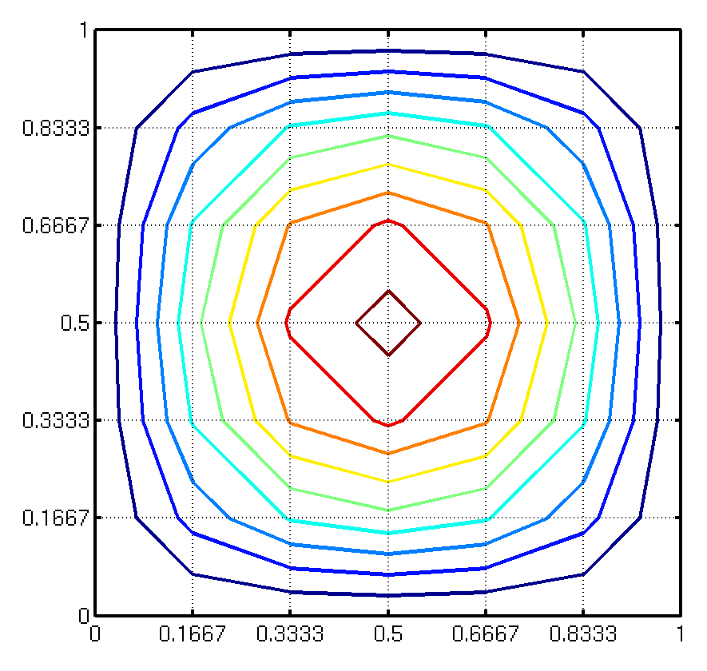
Computational Mesh

Slide 10
Partitioning + Ghost Cells
2-D Array for each Task
Extended 2-D Array for each Task
Data Partition
Ghost Cells for Updating

Slide 11
Parallelization
Partition space (data) into blocks
Put one block on each processor
But updates on edges have to be shared
Sharing here means using duplicated data (a copy for each adjacent process).
Use “hidden” (ghost) edges to hold the updated data for the other process.
Update required after each time step

Slide 12
Stability & Performance
Stability considerations state (Vdt<cell length) or
Otherwise, small errors grow exponentially
Small meshes can fit on a single node, but small time steps imply long solution times
Hence, parallel processing is a must to get solutions in reasonable times
Notes:
e Courant–Friedrichs–Lewy condition (CFL condition)

Slide 13
Run Time Analysis
floating point operations/point/time step
points physical simulation time
total # of time steps
total FLOPS (floating point operations)

Slide 14
Run Time Analysis
cycles per second flops/cycle
computational efficiency
= wall-clock time to run
Run Time Analysis
N | Time (s) actual | Equal-time Proc. Grid
1024 | 42 | 1x1
2048 | 687 | 4x4
4096 | 10,995 | 16x16

Slide 15
Communication Costs
Small messages are expensive
Every communication has a fixed startup overhead
Need to amortize this overhead over the length of the message
Try to aggregate communications into the longest possible messages

Slide 16
Latency
Notes:
At 10B 8x10**-8 s/B
At 100B 1x10**-8 s/B
10MB/Time = 1/(8x10**-8 s/B) ➔ 10MB*8x10**-8s/B = 0.8x10**-6 sec
Actual communication cost=10B/1000MB/s = 0.01x10-6 s
100MB/Time = 1/(1x10**-8 s/B) ➔ 100MB*1x10**-8s/B = 1.0x10**-6 sec
Actual communication cost=100B/1000MB/s = 0.1x10-6 s
Actual communication cost=1000B/1000MB/s = 1x10-6 s -- almost a factor of 10 larger

Slide 17
Effective Bandwidth
Notes:
The dip is because of the change of algorithm from eager to rendezvous. The change is about 12kb for lonestar.
Eager - An asynchronous protocol that allows a send operation to complete without acknowledgement from a matching receive
Rendezvous - A synchronous protocol which requires an acknowledgement from a matching receive in order for the send operation to complete.
Eager Protocol
The assumption is made by the sending process that the receiving process can store the message if it is sent. It is the responsibility of the receiving process to buffer the message upon its arrival, especially if the receive operation has not been posted.
This assumption may be based upon the implementation's guarantee of a certain amount of available buffer space on the receive process.
Generally used for smaller message sizes (up to Kbytes). Message size may be limited by the number of MPI tasks as well.
Potential Advantages:
Reduces synchronization delays - send process does not need acknowledgement from receive process that it's OK to send message.
Simplifies programming - only need to use MPI_Send.
Potential Disdvantages:
Most important disadvantage is that it is not scalable. Significant buffering may be required to provide space for messages from an arbitrary number of senders.
Can cause memory exhaustion and program termination when receive process buffer is exceeded.
Buffer "wastage" - allocated even if only a few messages are sent
May consume CPU cycles by the receive process side to pull messages from the network and/or copy the data into buffer space.
Rendezvous Protocol
This protocol is used when assumptions about the receiving process buffer space can't be made, or when the limits of the eager protocol are exceeded.
Requires some type of "handshaking" between the sender and the receiver processes. For example:
Sender process sends message envelope to destination process
Envelope received and stored by destination process
When buffer space is available, destination process replies to sender that requested data can be sent
Sender process receives reply from destination process and then sends data
Destination process receives data
Potential Advantages:
Scalable, compared to eager protocol
Robustness by preventing memory exhaustion and termination on receive process
Only required to buffer small message envelopes
Possibility for eliminating a data copy - user space to user space direct
Potential Disdvantages:
Inherent synchronization delays due to necessary handshaking between sender and receiver.
More programming complexity - may need to use non-blocking sends with waits/tests to prevent program from blocking while waiting on the OK from receive process.

Slide 18
Effective Bandwidth
total # of time steps
Bytes Transferred
X 8 exchanges/step x ghost elements x 8B/element
For 4x4 process grid with partitions of 1024 x 1024 (compute time = ~40sec.)
Message passing will take:
[0.01sec x 2 x (1024)**2]steps x 8/step x 1024 elements * 8B/element = 4.6 sec.
-------------------------------------------------------------------------------------------------
300MB/sec

