Slide 1
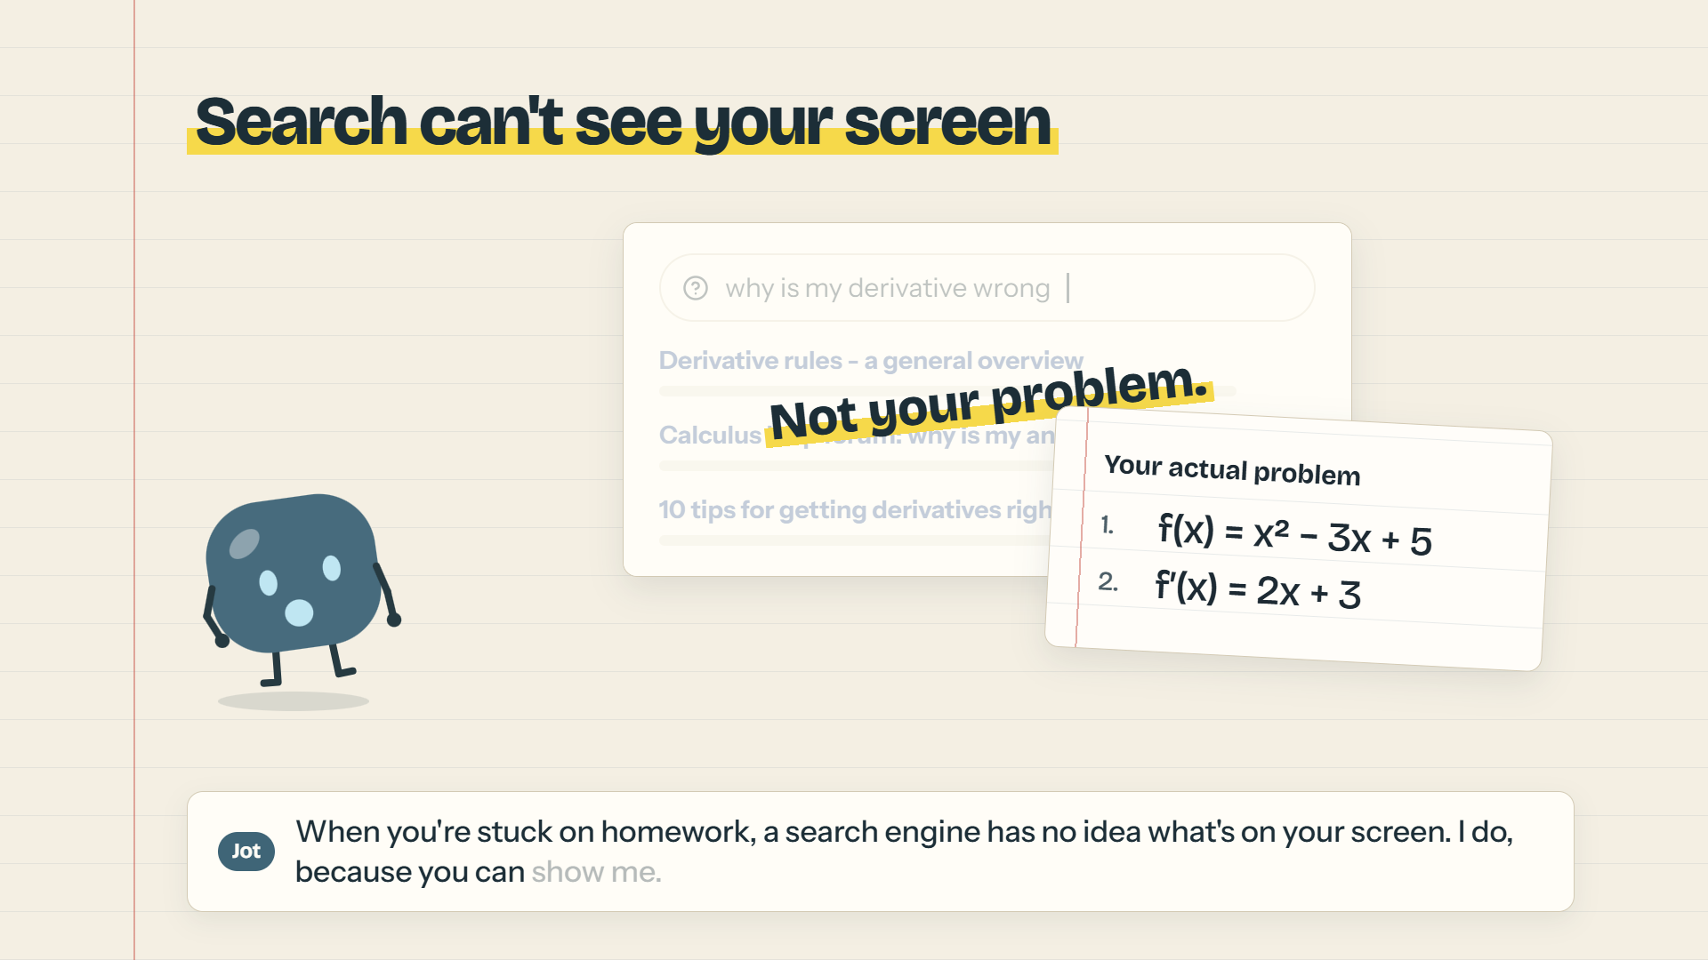
HACKRU FALL 2026
GOOGLE GEMINI TRACK
EDUCATION TRACK
Jot (Screen Tutor)
The Real-Time Multimodal AI Study Buddy
An in-browser AI tutor powered by Gemini Live that sees the screen you choose to share, talks through your homework in real time, and places non-destructive visual notes right on your work.
Starts with Socratic hints, checks your steps proactively, and turns your class syllabi, PDFs, and lectures into interactive quizzes and flashcards.
Devpost Submission: HackRU 2026 • Live Demo Included • Built with FastAPI & Google Gemini Live

Slide 2
INSPIRATION & PROBLEM
Why Homework Help Is Broken Today
Traditional tools either cheat for the student or can't see the context.
[X] 1. LLMs are Visually Blind
• Standard chat boxes force students to type out multi-step equations or code bugs manually.
• Text descriptions lose crucial spatial context (diagrams, graphs, compiler logs, and notebook steps).
• Copy-pasting formulas and homework sheets breaks the natural study flow.
[!] 2. The 'Answer-Cheat' Trap
• Search engines and chatbots vomit the direct solution immediately.
• Students develop an illusion of competence without genuine conceptual understanding.
• Zero pedagogical restraint: no guided questioning, no hints, and no active recall.
[?] 3. Siloed Course Context
• Generic AI tools have no clue about your professor's specific syllabus or notation.
• Course slides, past exam PDFs, and audio lectures sit idle in Downloads folders.
• Students lack an integrated study partner tailored to each specific class.

Slide 3
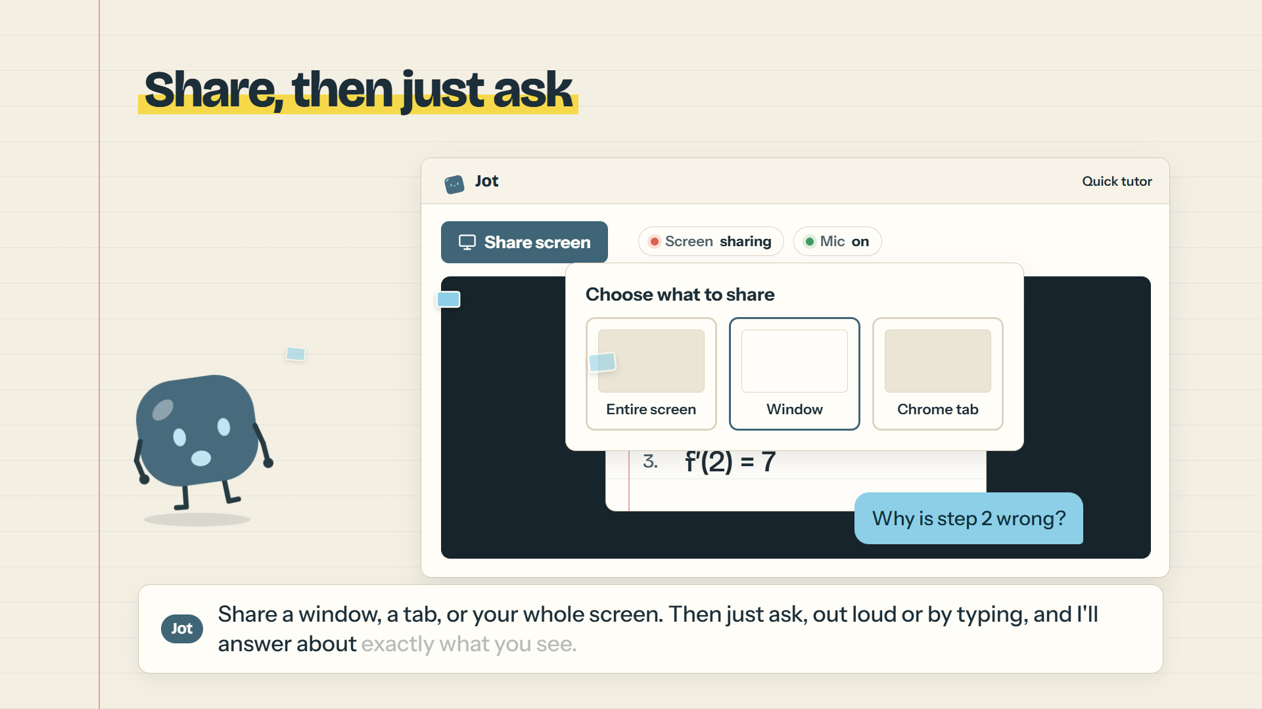
THE SOLUTION
Meet Jot: Your Real-Time Screen-Sharing Tutor
A private, conversational peer that sees your screen and points where it counts.
★ Core Capabilities
• In-Browser Screen Sharing: Share a tab, window, or entire monitor with zero external desktop plugins.
• Natural Voice Dialogue: Ask aloud or type; Jot listens, speaks back naturally, and supports fluid voice interruption (barge-in).
• Visual Pointer & Annotations: The model calls add_annotations to highlight equations, box minus signs, or circle code bugs directly over your preview.
• Socratic Hinting: Gives pedagogical nudges first so you do the actual thinking and learning.
• Proactive 'Check My Steps': Silently follows your math or code and only interrupts when you make a mistake.
• Class Knowledge Hub: Ingests syllabi, lecture slides, and recordings to power custom quizzes, flashcards, and study guides.
Visual Grounding in Action: Jot highlights the exact step where an algebraic sign flipped without modifying or touching the user's host OS.

Slide 4
LIVE DEMONSTRATION
Full Walkthrough: Jot in Action
Click the player below to watch the complete 115-second narrated walkthrough.
▶ Demo Chapters
• 0:00 - Introduction & Motivation
• 0:15 - Seamless In-Browser Screen Share
• 0:32 - Visual Annotations ('add_annotations')
• 0:44 - Socratic Hints over Direct Answers
• 0:55 - Class Hub & Material Uploads
• 1:07 - AI Quizzes, Flashcards & Study Guides
• 1:18 - In-Stage PDF Document Tutoring
• 1:29 - 'Check My Steps' Proactive Coaching
• 1:40 - Zero-Retention Privacy Architecture

Slide 5
HACKRU TRACK DEEP DIVE
Google Gemini Track: Real-Time Multimodal Power
Harnessing gemini-3.8-live for bidirectional low-latency audio, video, and tool use.
⚡ Bidirectional Live Stream
• Model: Powered by Google's latest gemini-3.8-live multimodal streaming API.
• Sub-Second Latency: Continuous bidirectional audio and visual frame streaming over WebSockets.
• Native Voice Barge-In: Natural conversational audio allows students to interrupt the tutor mid-explanation without delay or feedback loops.
🎯 Tool-Calling: add_annotations
• Real-Time Visual Actions: The model invokes add_annotations to draw bounding boxes, underlines, and labels.
• Normalized Coordinates: Gemini outputs bounding boxes [ymin, xmin, ymax, xmax] normalized from 0.0 to 1.0.
• DOM Overlay Translation: Frontend dynamically aligns marks over the responsive video preview corresponding to the exact captured frame.
👁 Contextual Multimodality
• Adaptive Frame Rate: Samples video frames dynamically on motion/content changes to optimize bandwidth and tokens.
• Multimodal Socratic Grounding: Merges live visual frame tokens with spoken audio tokens in a unified attention stream.
• Document & Math OCR: Recognizes LaTeX, messy student handwriting, and code terminal outputs effortlessly.

Slide 6
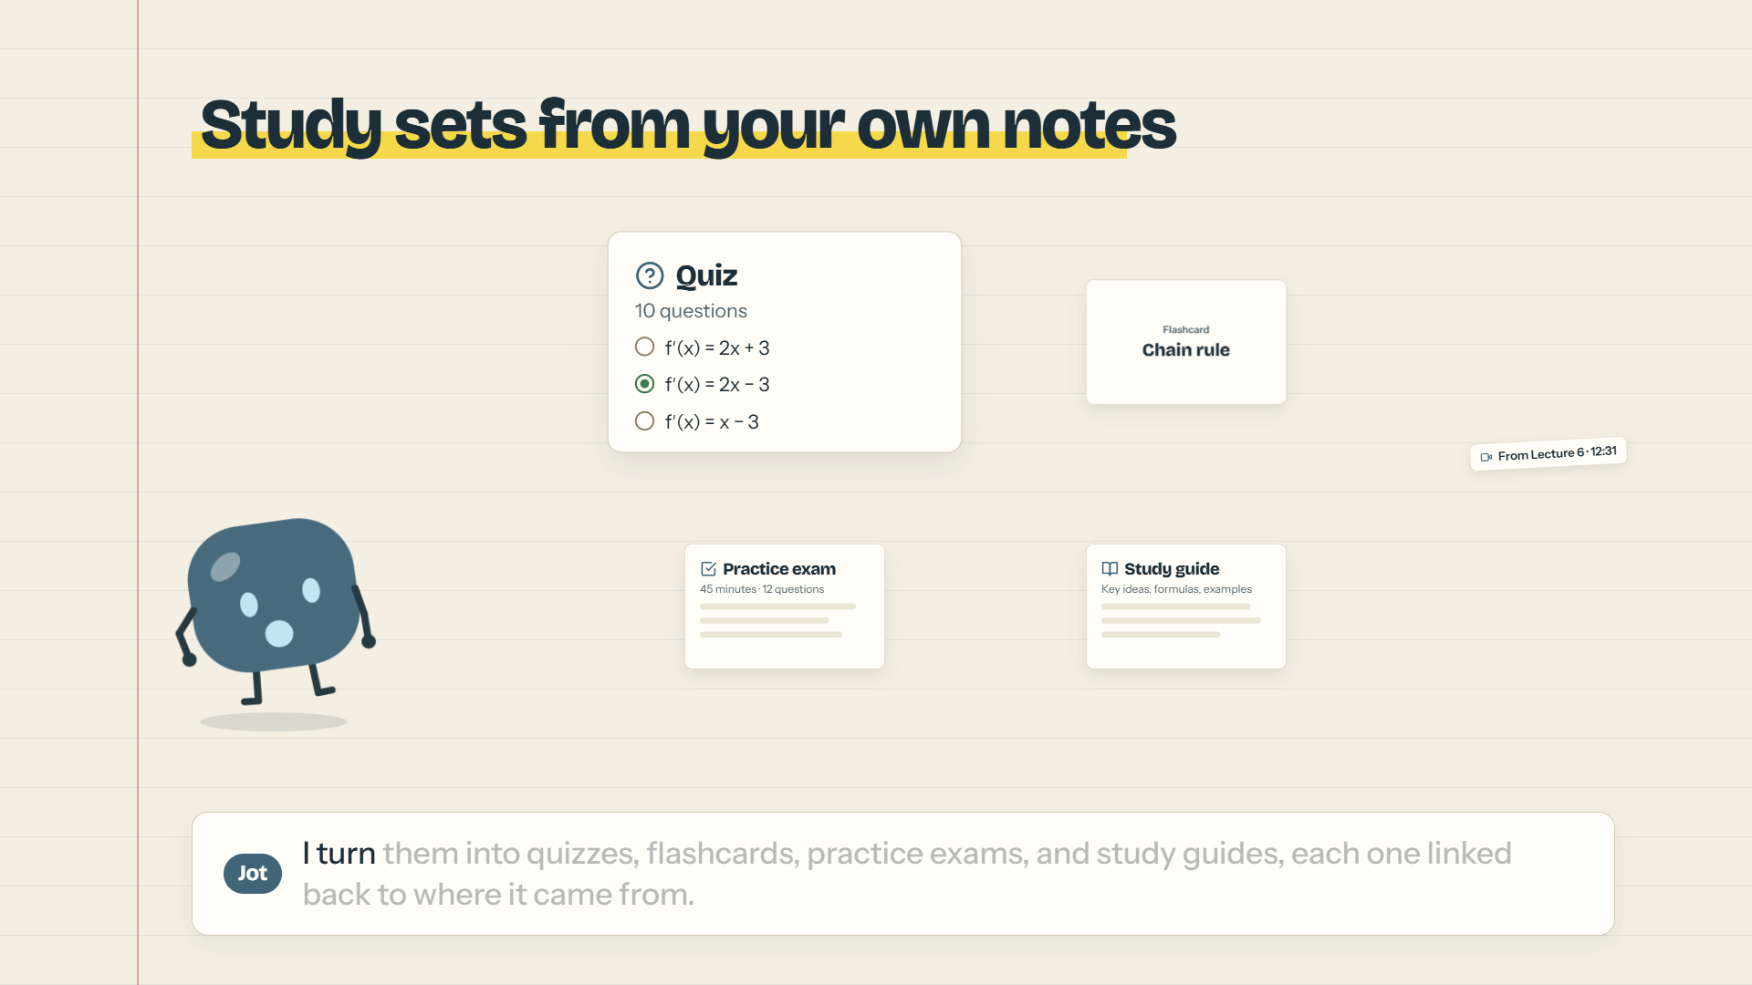
HACKRU TRACK DEEP DIVE
Education Track: Pedagogical Design & Active Learning
Built from the ground up to empower learning rather than replace critical thinking.
🎓 Pedagogical Principles
• Socratic First-Principles: System prompts explicitly enforce progressive hinting. The tutor asks guiding questions ('What is the sign of that term?') rather than solving problems outright.
• Proactive 'Check My Steps': A dedicated coaching loop watches math or code steps silently. If a student makes a miscalculation, Jot chimes in with a timely voice hint before they dig into a rabbit hole.
• Anti-Cheating Architecture: Quiz and exam APIs strictly separate questions from answer keys until submission, verifying conceptual mastery.
• Active Recall & Spaced Repetition: Interactive Flashcard Player featuring mastered vs. review sorting piles, shuffle mode, and instant review cycles.
Grounded Class Materials: Ingests syllabi, past exams, and lecture slides to synthesize customized study packs with direct source page citations.

Slide 7
TECHNICAL ARCHITECTURE
End-to-End System & Zero-Retention Privacy
FastAPI session gateway, provider-neutral WebSocket proxy, and sandboxed SVG overlay.
💻 Browser Frontend
• Vanilla JS + Vite: Ultra-lean, lightning-fast client with zero bloated dependencies.
• WebRTC DisplayMedia: Native browser screen capture (window, tab, or monitor).
• Sandboxed SVG Overlays: Annotations render strictly within the page over the preview; no external desktop injection or OS hooking.
• Provider-Neutral Client: Browser never sees model names, system prompts, or Gemini API keys.
⚙ FastAPI Backend
• Session Gateway: Issues short-lived, one-time WebSocket connection tickets.
• Streaming Proxy: Relays sampled video frames and audio chunks directly into Google GenAI SDK.
• SQLite Persistence: Stores user class libraries, syllabi metadata, and generated quizzes locally with zero external DB dependencies.
• Tool Execution Engine: Validates and marshals visual annotation payloads.
🔒 Zero-Retention Privacy
• Ephemeral Media: Audio and video frames exist purely in server RAM during live streaming.
• Zero Screen Recording: Video feeds and microphone streams are never recorded or written to disk.
• User-Owned Data: Course files remain strictly in private local storage.
• Memory Reset: Instant 'Reset memory' button flushes conversation history on command.

Slide 8
ENGINEERING FEATS
Challenges We Overcame & What We're Proud Of
From cross-origin WebSockets to normalized bounding box rendering.
⚡ Key Technical Challenges
• Coordinate Normalization: Matching Gemini's normalized [0,1] visual coordinates to dynamically scaling browser elements with varying aspect ratios and devicePixelRatio.
• Full-Duplex Audio & Interruption: Implementing clean barge-in so the student's voice instantly interrupts model speech playback without creating echo feedback.
• Dual-Mode Tutoring Engine: Architecting the transition between active conversational Q&A and silent proactive step-monitoring ('Check my steps').
• Zero-Leakage Security: Ensuring Google API keys and credentials are 100% backend-owned and never exposed to the client bundle.
🏆 Key Accomplishments
• Sub-Second Multimodal Responsiveness: Created a snappy, truly conversational experience that feels like sitting next to a human peer tutor.
• Non-Destructive Annotation Engine: High-fidelity visual markup overlay that highlights errors without ever modifying the user's host OS or application.
• Complete Study Ecosystem: Automated synthesis of study guides, practice tests, and interactive flashcards with source citations from uploaded course materials.
• Automated Video Synthesis: Built an end-to-end headless browser rendering pipeline that records full 1080p demo videos directly from code.

Slide 9
FUTURE ROADMAP
Where We're Taking Jot Next
Expanding accessibility, collaborative learning, and classroom integrations.
🏫 Classroom & LMS Sync
• Canvas & Blackboard Integration: Direct one-click import of course syllabi, assignments, and lecture slide decks.
• Teacher Analytics Dashboard: Anonymized insight reports showing professors the exact concepts students struggle with most.
• Custom Teacher Personas: Allow professors to calibrate tutor strictness and pedagogical style.
📱 Multi-Device & Stylus
• Tablet & Stylus Mode: Native iPad and Chromebook whiteboard mode with handwriting recognition and digital ink assistance.
• Mobile Companion: Use phone as a live document camera pointing down at physical paper homework sheets.
• Real-time Scratchpad: Shared collaborative digital canvas inside the app.
👥 Collaborative Study Pods
• Peer Study Rooms: Multi-user study rooms where multiple classmates share screens and solve problem sets together.
• AI Co-Facilitator: Jot acts as an impartial peer facilitator, moderating group discussions and nudging the group toward consensus.
• Global Language Lock: Real-time bilingual translation for international study groups.

Slide 10
HACKRU FALL 2026
Thank You! Questions & Discussion
Jot: Share your screen, ask anything, and actually understand it.
📄 Devpost Submission Summary
• Project Name: Jot (Screen Tutor)
• Tracks: Google Gemini Track • Education Track
• Tech Stack: Python, FastAPI, Google GenAI SDK (gemini-3.8-live), SQLite, WebSockets, Vanilla JS, HTML5, CSS3
• Live Video: 115s Narrated Walkthrough embedded on Slide 4 (demo-video/out/jot-demo.mp4)
• Privacy Standard: Zero screen/audio recording, fully in-memory live streaming
• GitHub Repository: Open-source, production-ready codebase with full unit and integration tests
🚀 Quick Start Instructions
• 1. Start Backend Gateway:
• backend\.venv\Scripts\python.exe -m uvicorn screen_tutor_backend.app:app --port 8000
• 2. Start Frontend Server:
• cd frontend && npm run dev
• 3. Open Browser:
• Visit http://localhost:5173
• 4. Replay Presentation Video:
• Open Slide 4 in PowerPoint or run demo-video\out\jot-demo.mp4

