Slide 1
Assessing Performance of CrossFit Athletes
by Alejandro Llera Fábregas

Slide 2
Introduction
To understand the characteristics and performance of Crossfit Athlete, a comprehensive dataset from competitions and events around the world will be analyze. As a data analyst the main objective is understand the physiological and psychological factors that contribute to successful Crossfit Performance. Crossfit is a sport of high intensity work-outs combine with weightlifting, gymnastics and cardio exercises. This dataset includes information on athlete demographics, such as age,gender and training experience, as well as their performance metrics, such as time, weight lifted, eating habits, experience and background.
It was carried out an Exploratory Data Analysis (EDA) key performance indicator (KPI) identification, hypothesis testing, , and a comprehensive review on athlete performance in different context and settings.

Slide 3

Data Overview
Present an Overview of a Crossfit Athletes Dateset:
Demographics:
age,gender,
weight,
height
Training Experience
2. Performance Metrics:
time
weightlifting
Cardio exercises
eat habits and background as ahtletes
Data was extracted from Kaggle
01

Slide 4
Data Cleaning
Steps:
Copying df to a new df to avoid manipulated the original df
Dropped unwanted columns [ID, Names, teams, affiliates]
Deal with Nan values:
Calculate % of missing values for each columns
Checked columns with large numbers of Nan values
Dropped Nan values
Feature engineer:
Create a function to divide eat column into 3 groups
Normal diet
Strict Diet
No diet

Slide 5
Outliers
Drop outliers using upper and limit function for height
Rows: 1639
Columns: 23
Code to drop Outliers for height:
df3 = df3[(df3['height'] < upper_limit) & (df3['height'] > lower_limit)]
df3.shape
For the rest of the columns it was create a function to find upper and lower limit, then drop outliers:
Rows: 1258
Columns: 23
Code to drop outliers from rest of columns:
def find_outliers(df3,col):
q1 = df3[col].quantile(0.25)
q3 = df3[col].quantile(0.75)
iqr = q3-q1
lower_limit = q1 - 1.5*iqr
upper_limit = q3 + 1.5*iqr
df3 = df3[(df3[col] < upper_limit) & (df3[col] > lower_limit)]
return df3

Slide 6
Exploratory Data Analysis (EDA)
Basic EDA Steps
Checking for outliers
checking distribution
checking correlation
Plotting Points of Interest

Slide 7
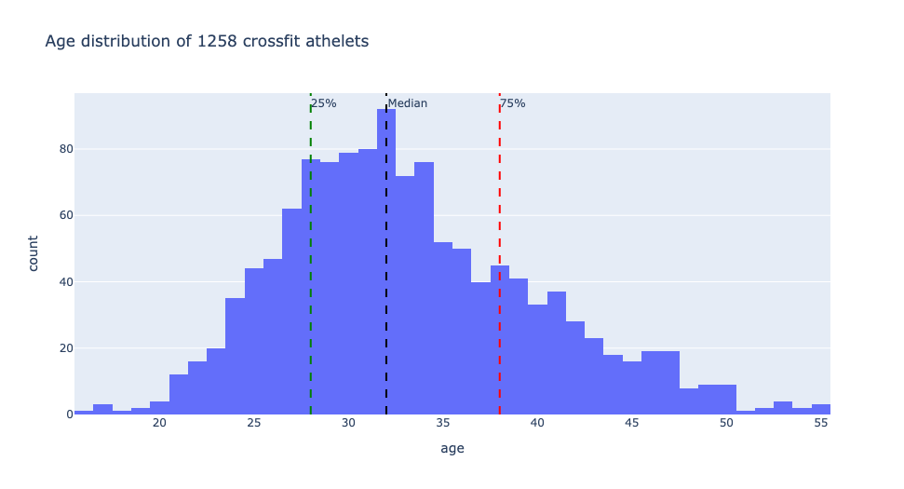
Age Insights
count 1258.000000
mean 33.244833
std 6.793850
min 16.000000
25% 28.000000
50% 32.000000
75% 38.000000
max 55.000000

Slide 8
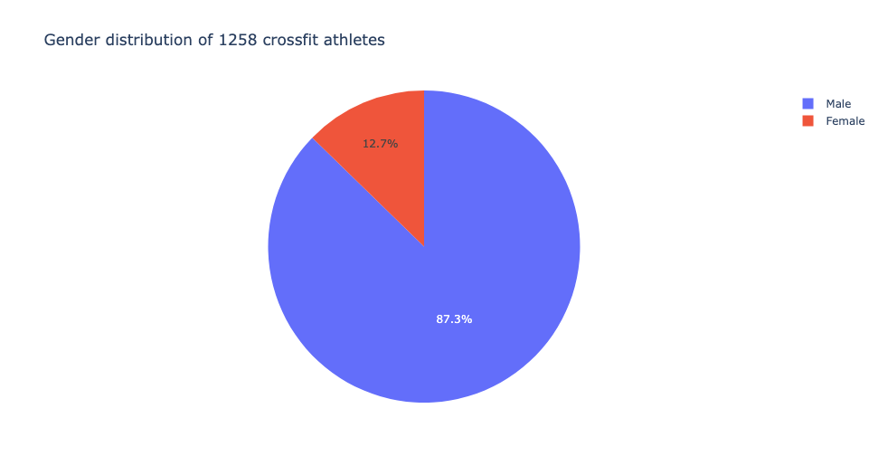
Gender Insights
gender
Male 1098
Female 160

Slide 9
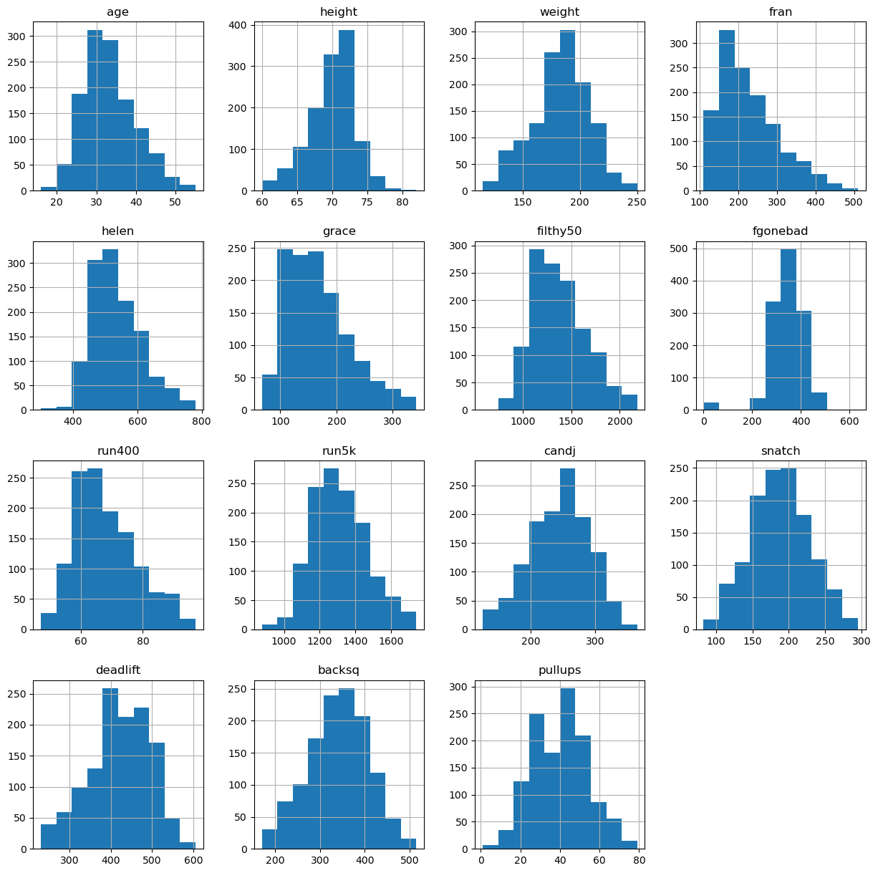
Distribution of Demographics and Performance
Metrics

Slide 10
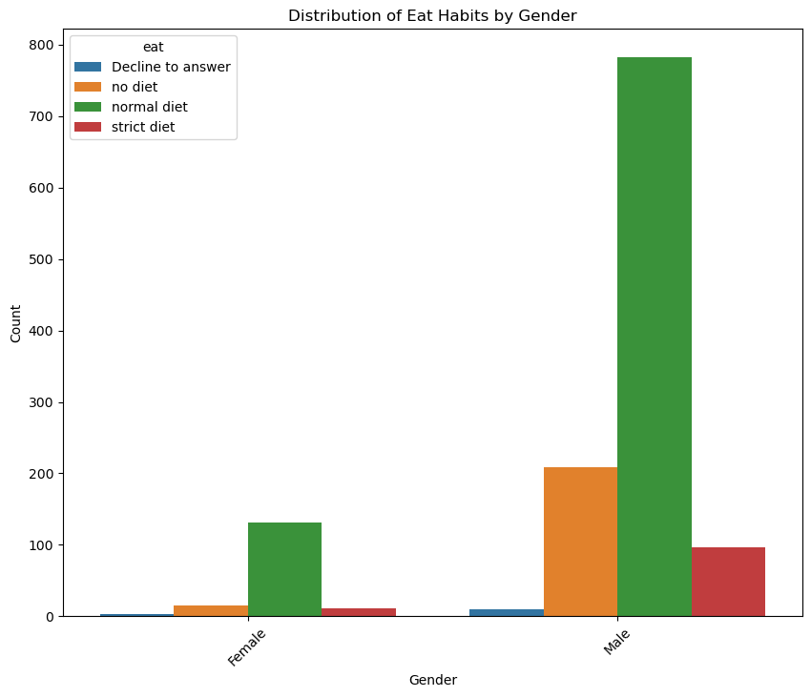
Distribution of Eat Habits by Gender

Slide 11
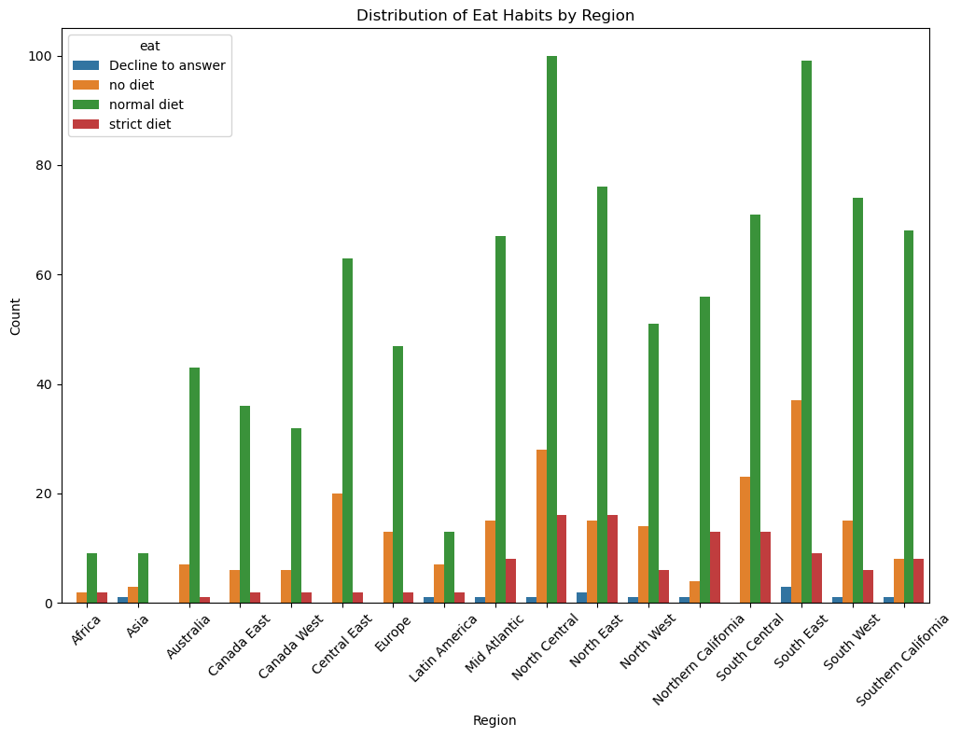
Distribution of Eat Habits by Region

Slide 12
Questions to be answer
Does age have any impact on aerobic or anaerobic exercise performance
How does training habits affect the performance of an athlete?
How does athletic background affect the performance of an athlete

Slide 13
Findings
Weight and height are highly correlated
People with more weight is correlated with increased weightlifting
Backsquat and deadlift are positive correlated, a good back squat could transfer to a better deadlift performance and viceversa, but slightly lesser to a snatch.
Cardio and weightlifting are negative correlated.
Height and weightlifing are positive correlated
Age doesn’t have any significant correlation with any other column

Slide 14
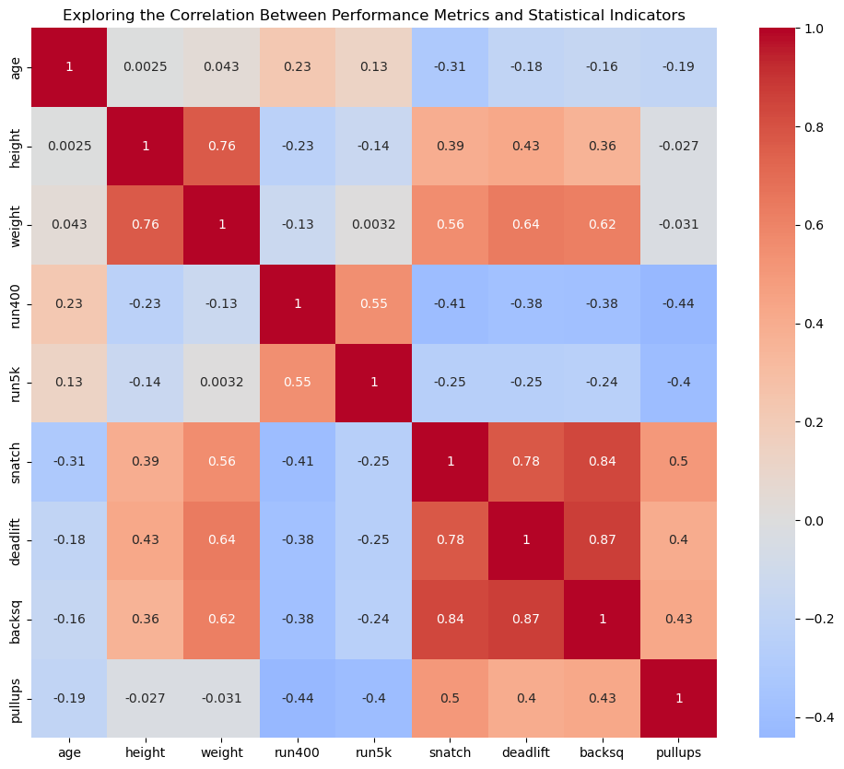
Correlations

Slide 15
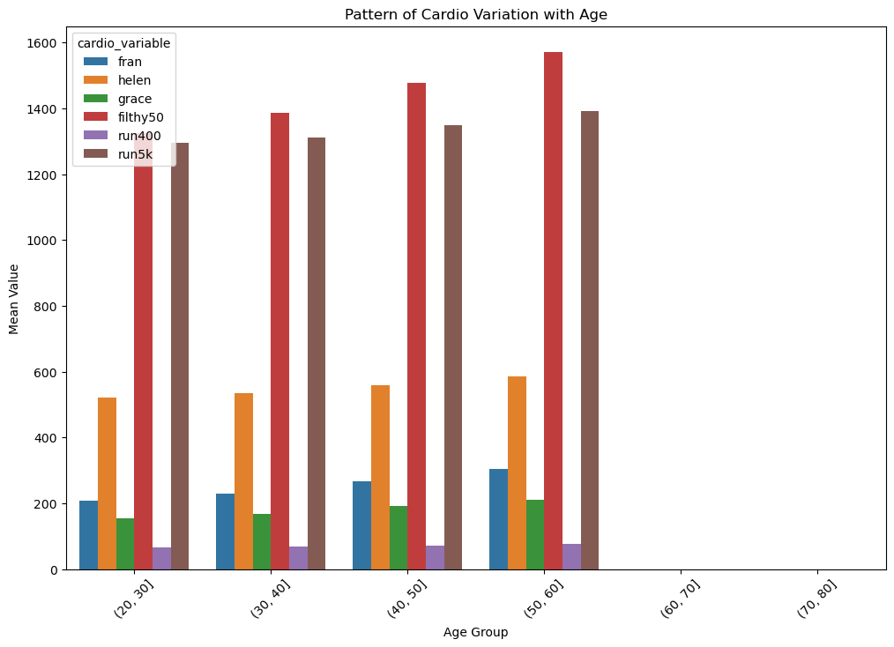
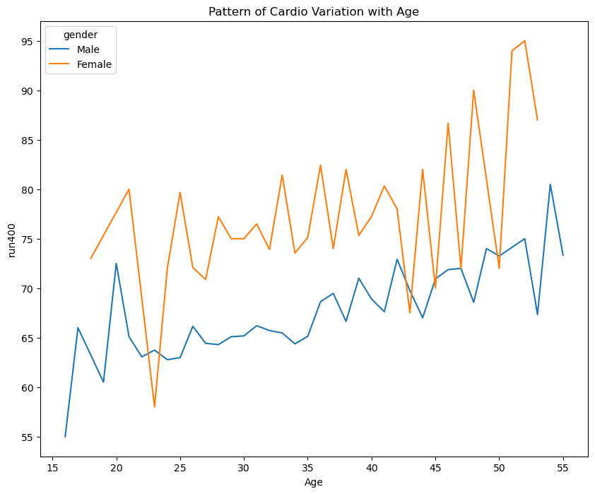
Pattern of Cardio Variation with Age

Slide 16
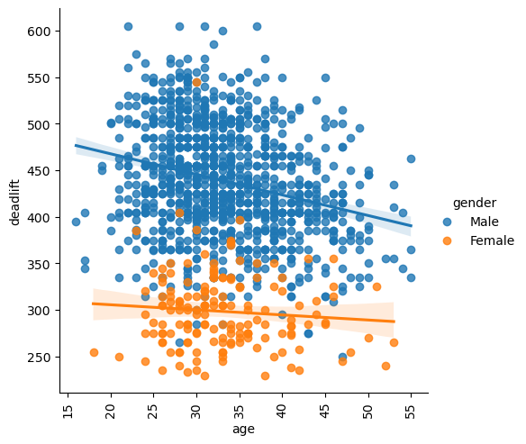
Correlation between Age and Weightlifting Performance

Slide 17
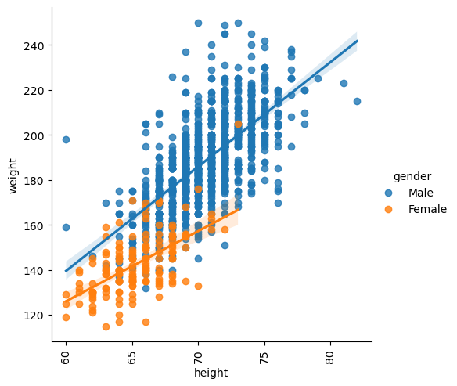
Correlation between height and weight

Slide 18
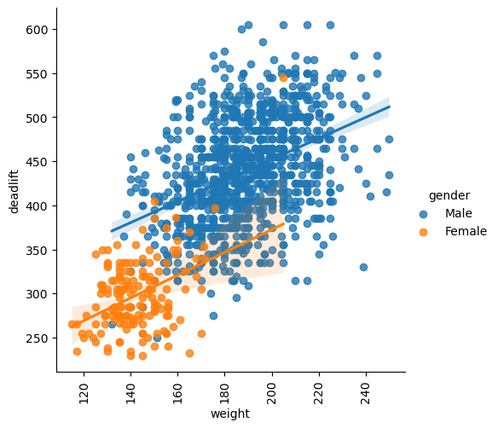
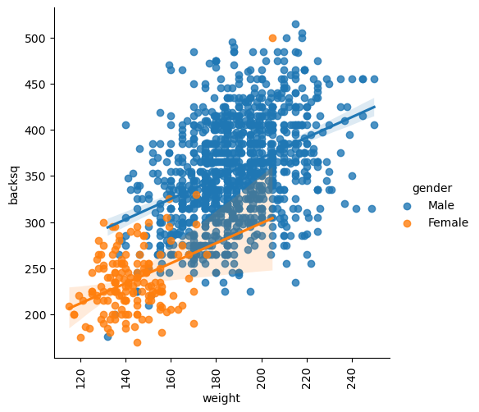
Correlation between Weight and Weightlifting Performance

Slide 19
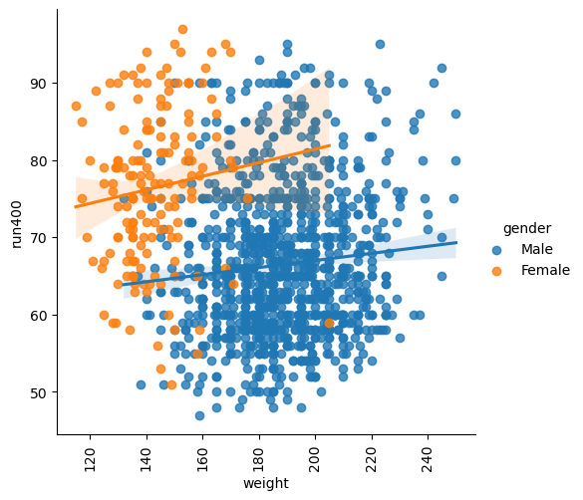
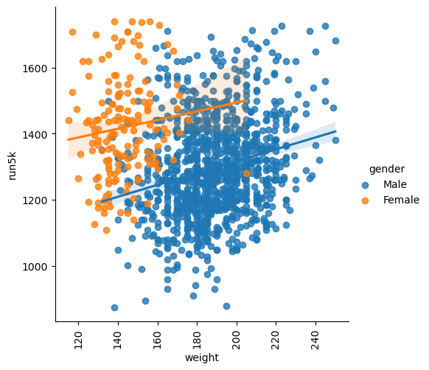
Correlation between Weight and Cardio Exercise

Slide 20
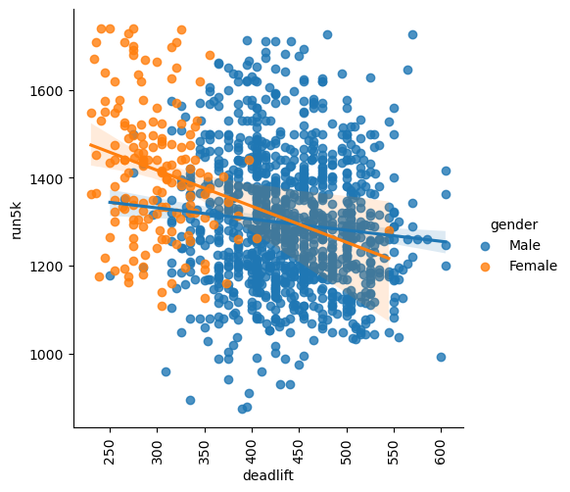
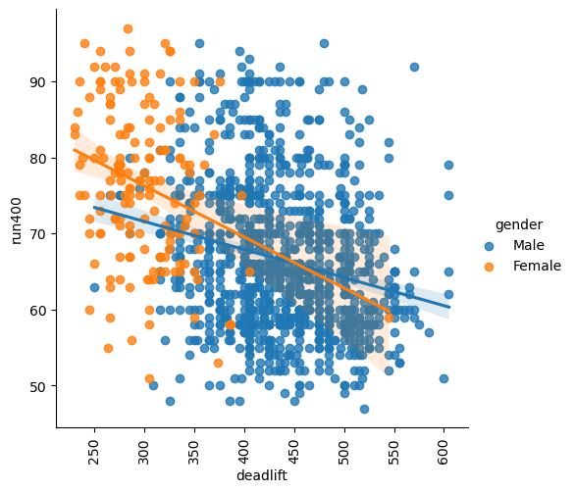
Correlation between Weightlifting vs Cardio Performance

Slide 21
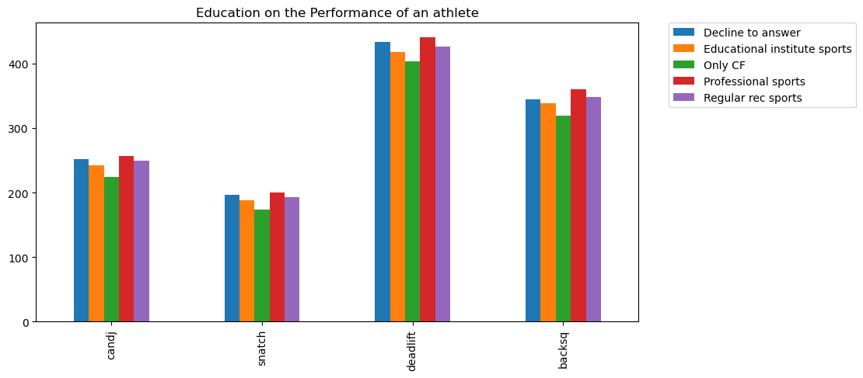
Education on the Performance of an athlete

Slide 22
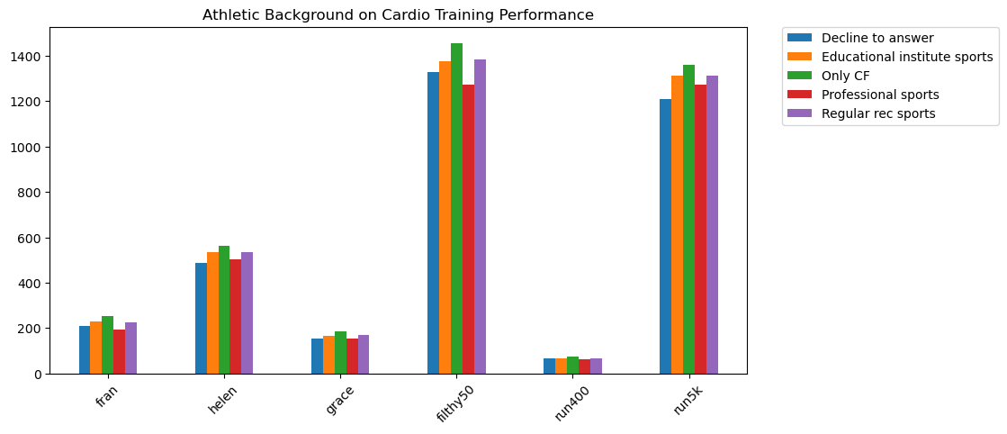
Athletic Background on Cardio Training Performance

Slide 23
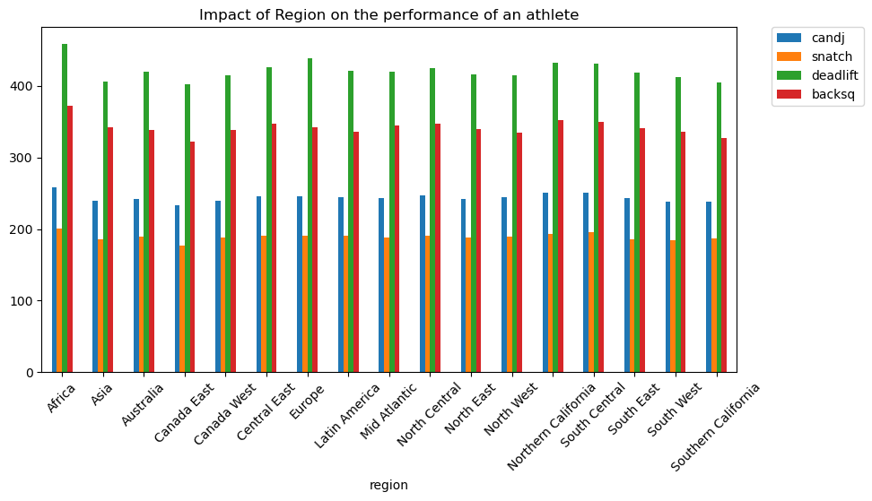
Impact of Region on the performance of an athlete

Slide 24
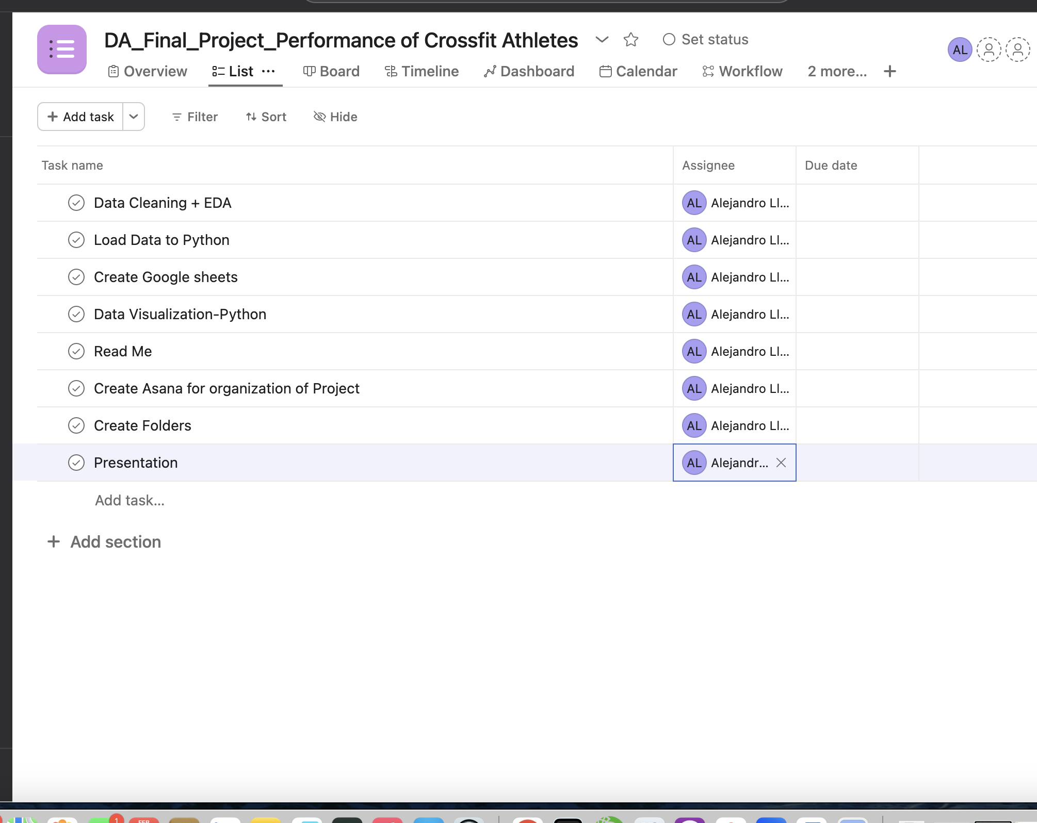
Project Management
I used ASANA as Kanban board

Slide 25
Experiment Evaluation
Suggestion for the Project
Demographic Information: Have a dataset with more variability of the female gender, this could yield greater insights and more precise analysis.
Data Set: Look for the possibilities to performed the analysis with a bigger data set, to get more variability of the sample to get more specific information between the stats versus performance of CrossFit Athletes.

Slide 26
Conclusion
Investigate more insight the relation between diet habits and performance on athletes
Performed the Analysis with a bigger Data Set, more variability on female gender and regions around the world to assess with more details the performance on athletes
Null Values: Too much Null values in all categories.

Slide 27
Conclusion
This project could provide useful insight information into the characteristics and performance of Crossfit Athletes, enabling crossfit trainers develop evidence-based science training programs that support athletes to achieve their highest performance, optimize their physical abilities and reduce the risk of injury.

Slide 28

THANK YOU

