Slide 1
SmartCity

Slide 2
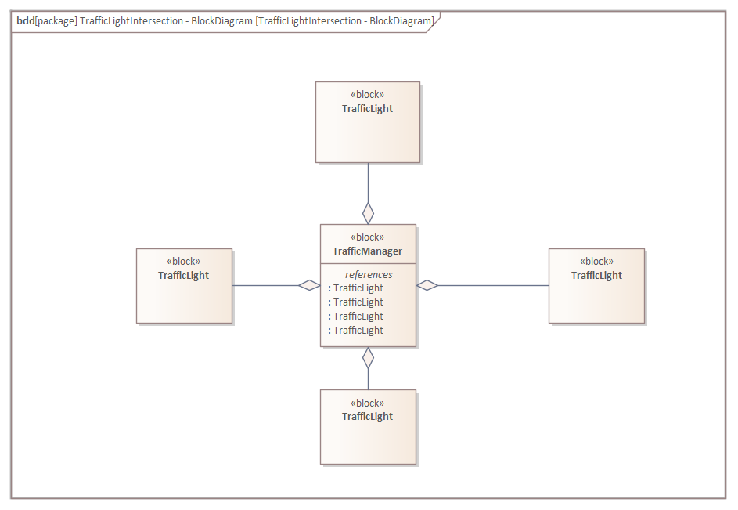

Case Scenario
Emergency Vehicles going through an intersection.
Implementation of the the basic use case that was going to be implemented.

Slide 3
Intersection controlled by a traffic manager.
Traffic Lamps are end nodes.
Receive current state.
Transmit if emergency vehicle is detected.

Slide 4
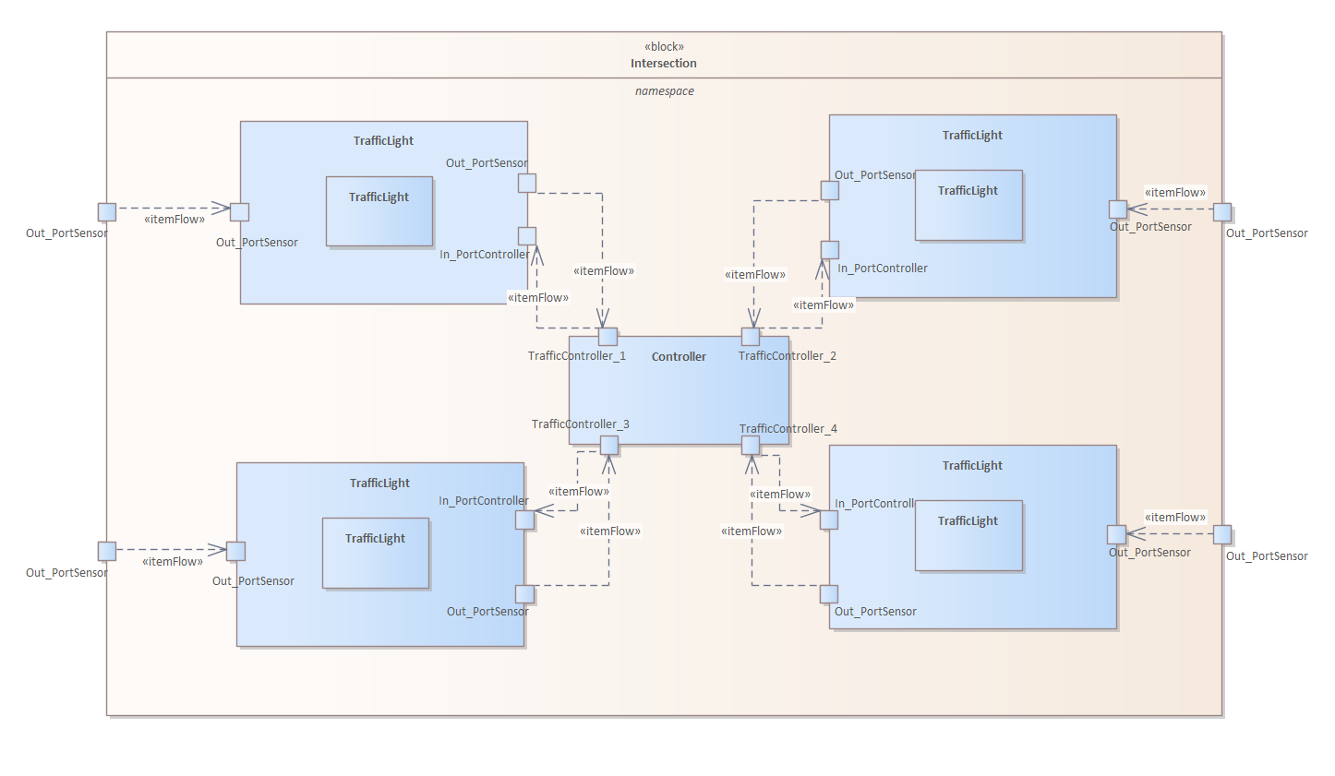

Traffic Manager
One system will control the intersection.
One system will communicate with city system to coordinate.
One system to coordinate them all.

Slide 5
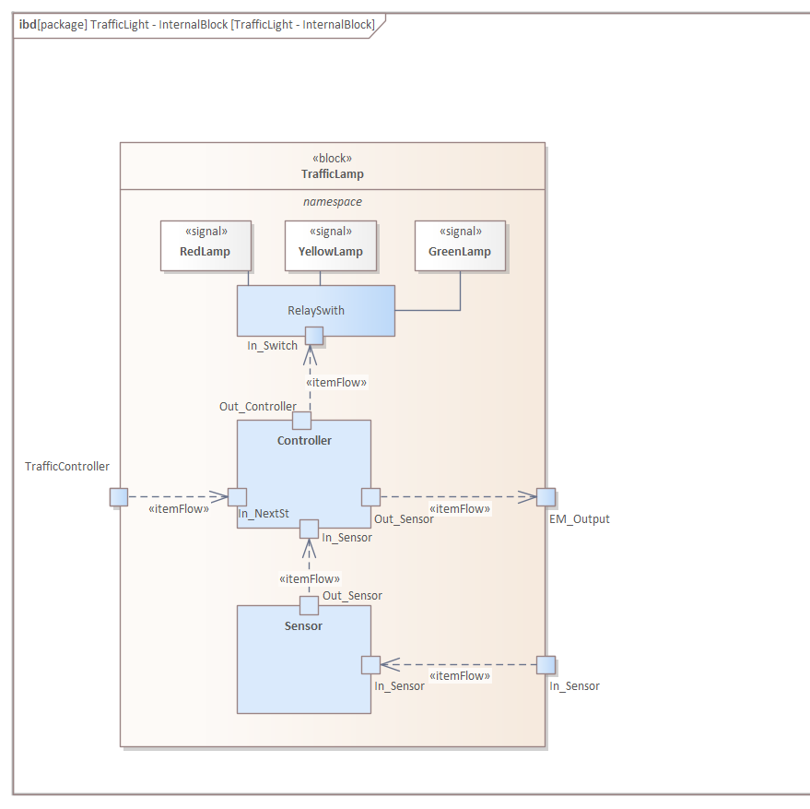
Traffic Lamp
Definition of the components inside the traffic light.

Slide 6
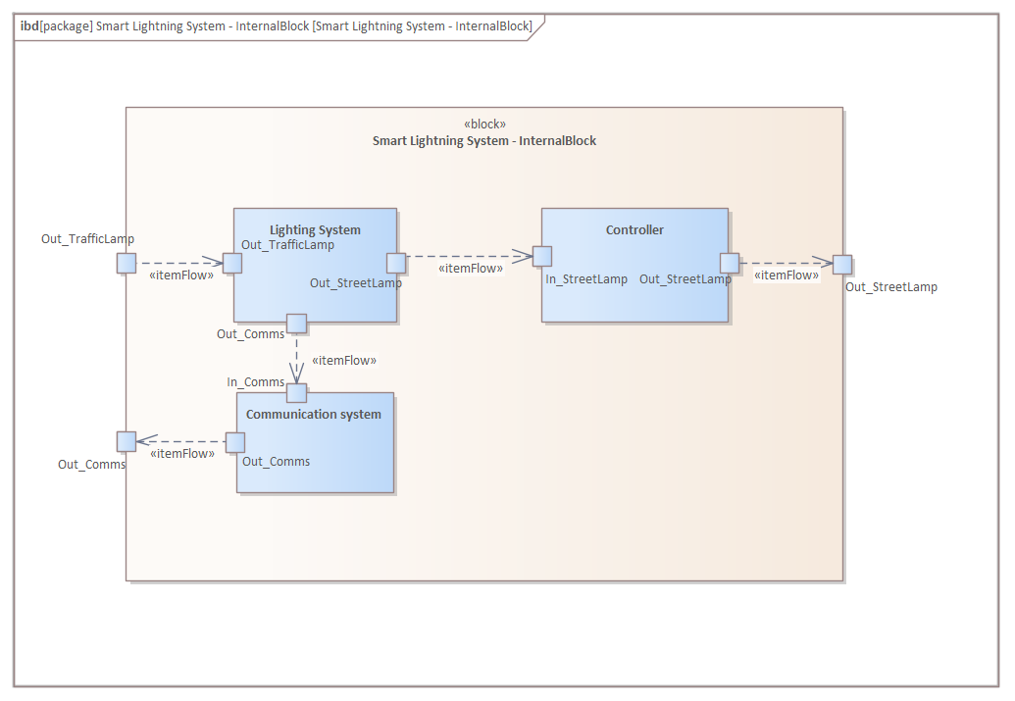
Lightning System
Definition of the components inside the traffic light.

Slide 7
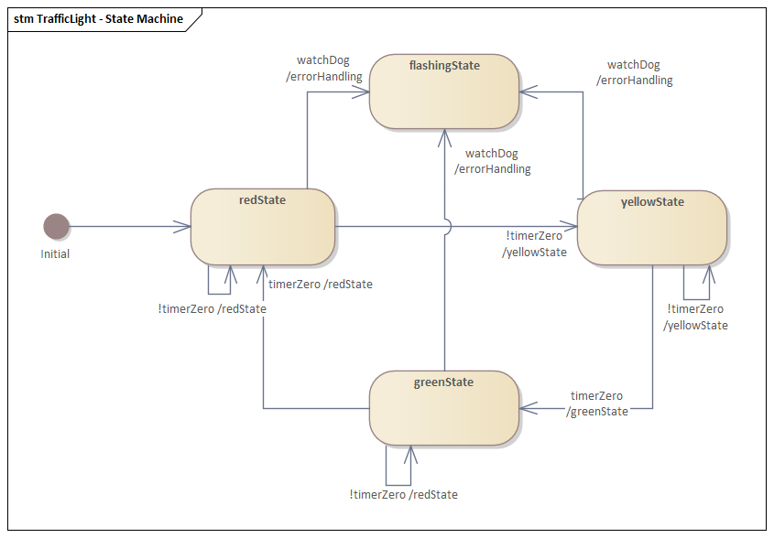
Internal State Machine
Definition of the most basic state machine of a traffic light.
Refinement of the state machine to accommodate our use case scenario.

Slide 8
