Slide 1

Smart-City
Team members:
Luis Fernando Rodriguez Gutierrez
Leander Hackmann
Hazhir Amiri
Mohammed Al-Salihi
“FH Dortmund" by FH Dortmund, https://shorturl.at/joAU1

Slide 2
Table of contents
Requirements and the project’s elements
Scheduling and hazards
Overview of the simulation
Implementation of the Traffic Manager & the scheduler
Implementation of the End Nodes
Unit testing

Slide 3
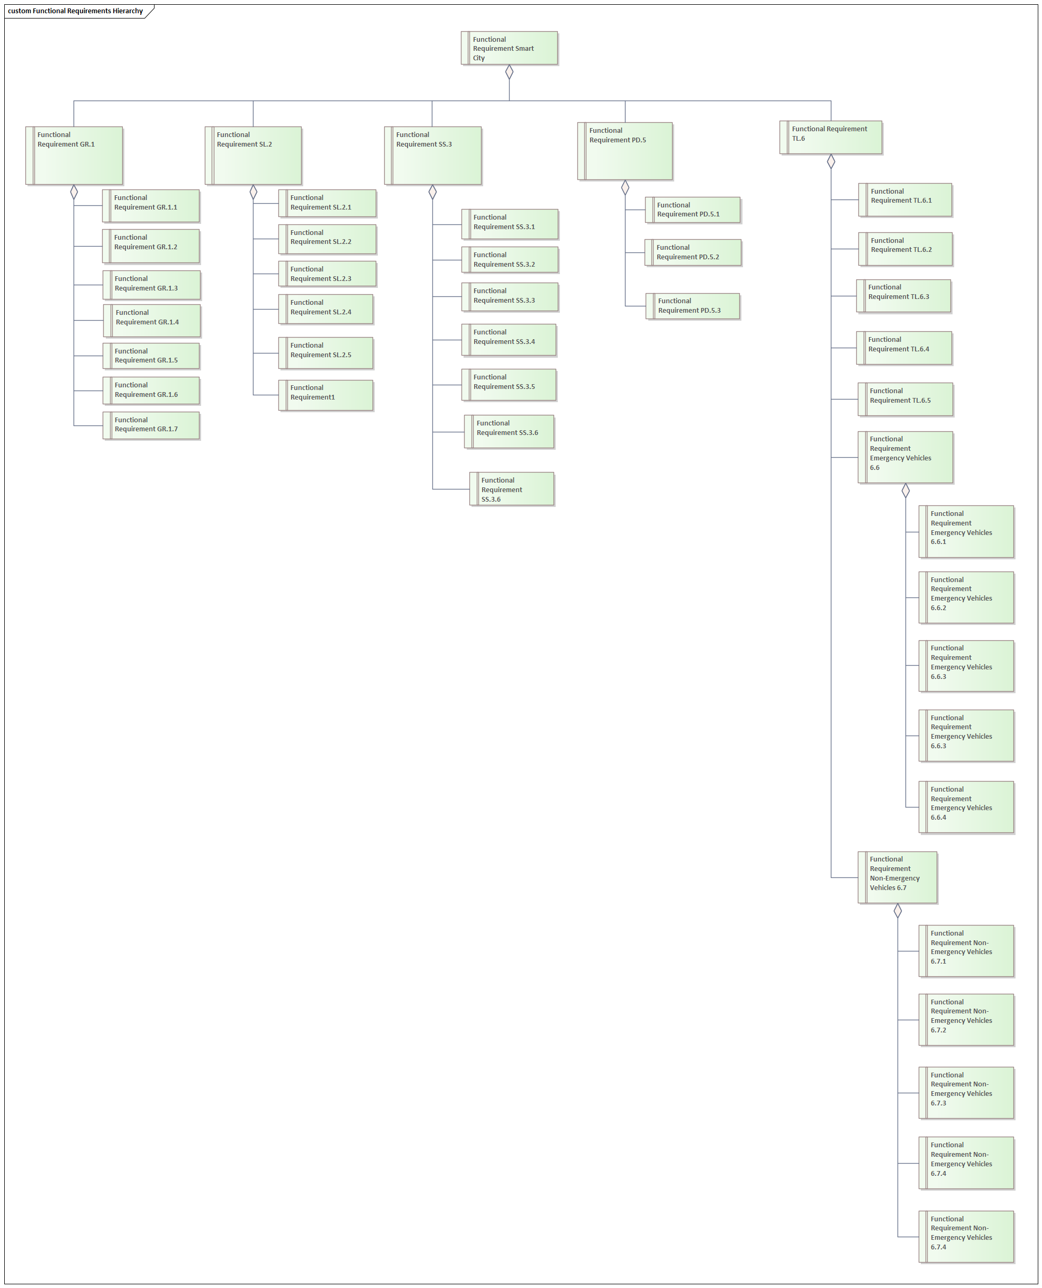
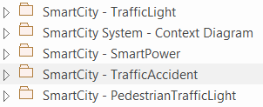
Requirements Analysis
Specification of every case scenario for the smart city.
Each case scenario needed it requirements.
More attention was given to the case scenario to implement.

Slide 4
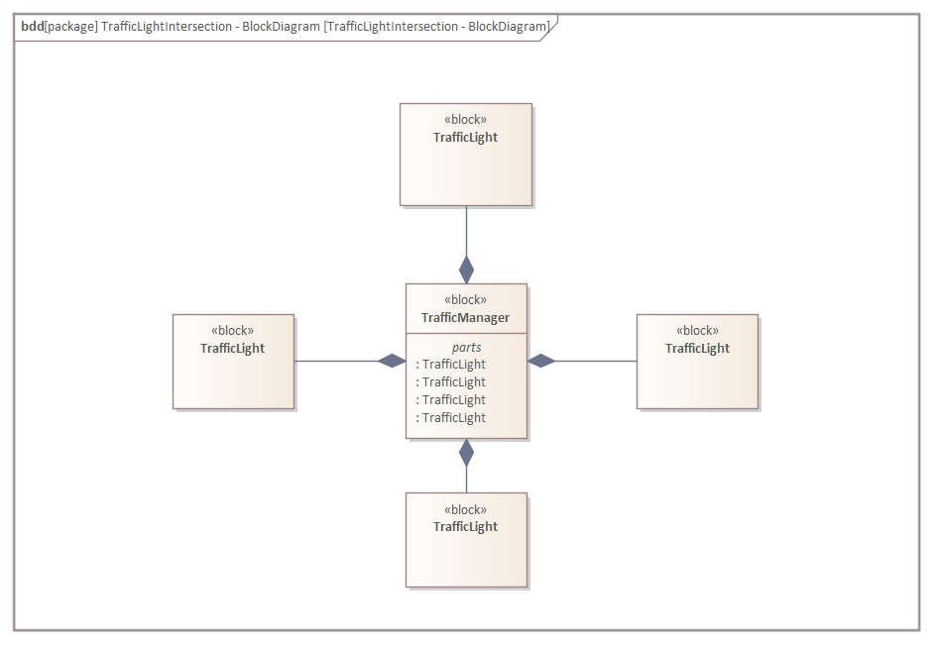

Case Scenario Analysis
Emergency Vehicles going through an intersection.
Implementation of the basic use case that was going to be implemented.

Slide 5


Implementation of the diagrams of case scenario to simulate using Enterprise Architect.

Slide 6
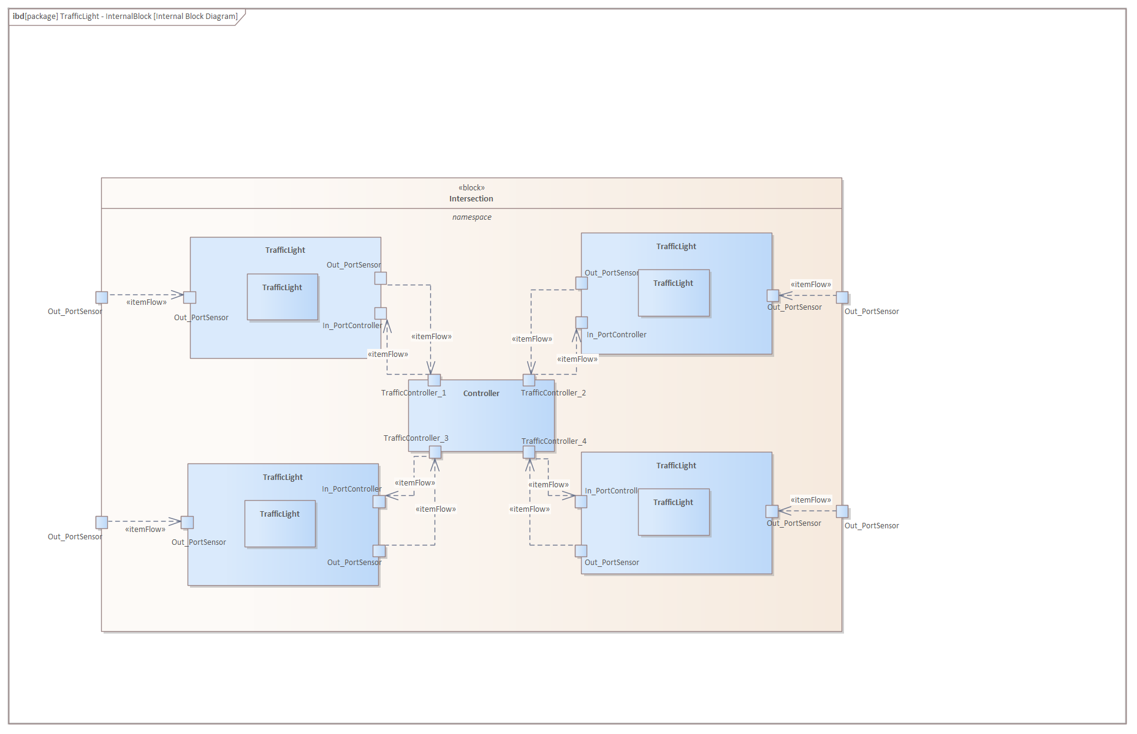
Traffic Manager
One Manager will control each intersection.
One Manager will communicate with city system to coordinate.

Slide 7
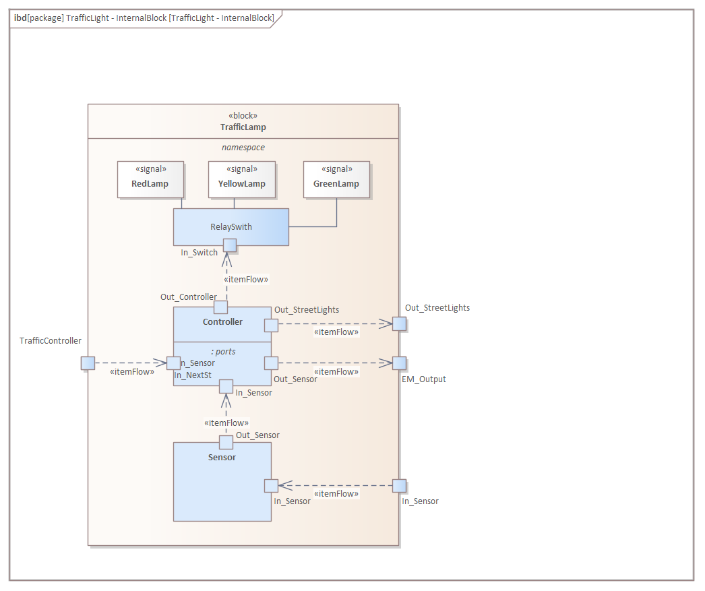
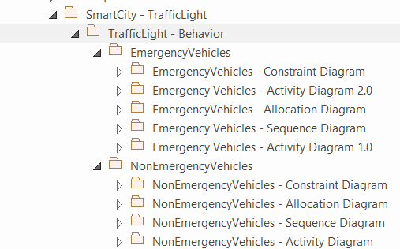
Traffic Lamp
Definition of the components inside the traffic light.

Slide 8
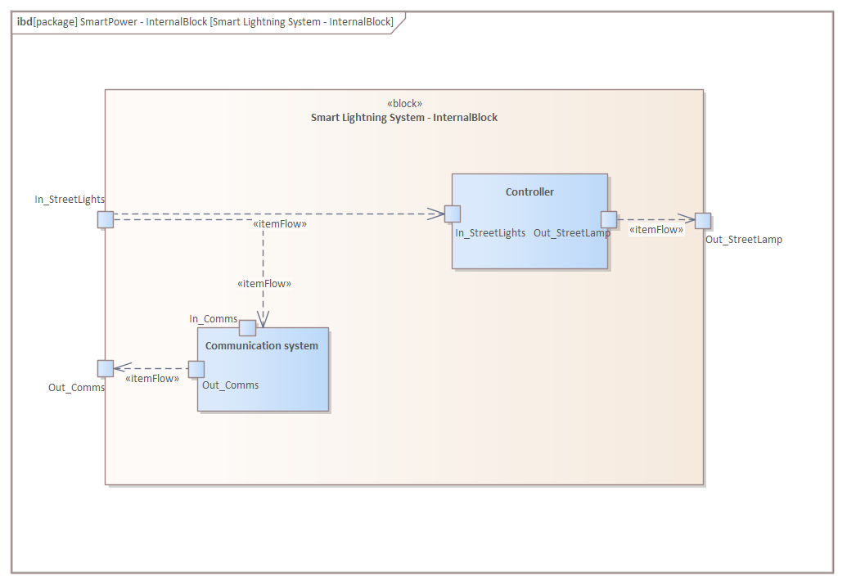
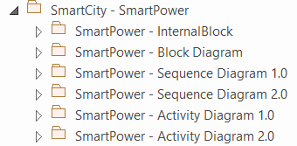
Lightning System
Definition of the components inside the traffic light.

Slide 9
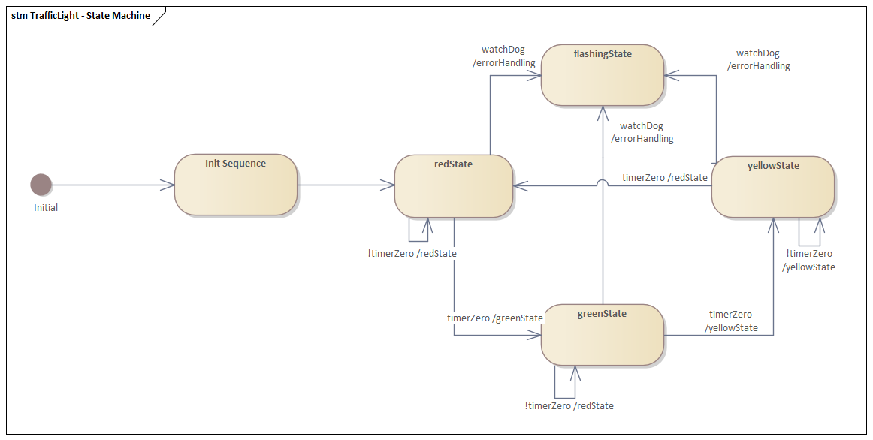
Internal State Machine
Definition of the most basic state machine of a traffic light.
Refinement of the state machine to accommodate our use case scenario.

Slide 10
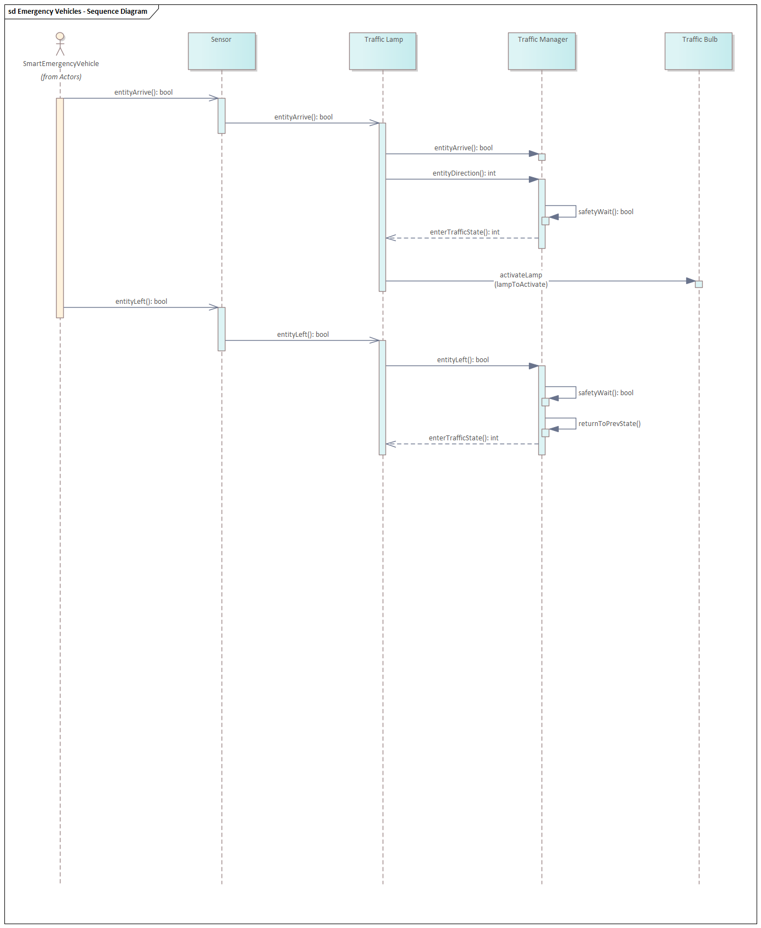
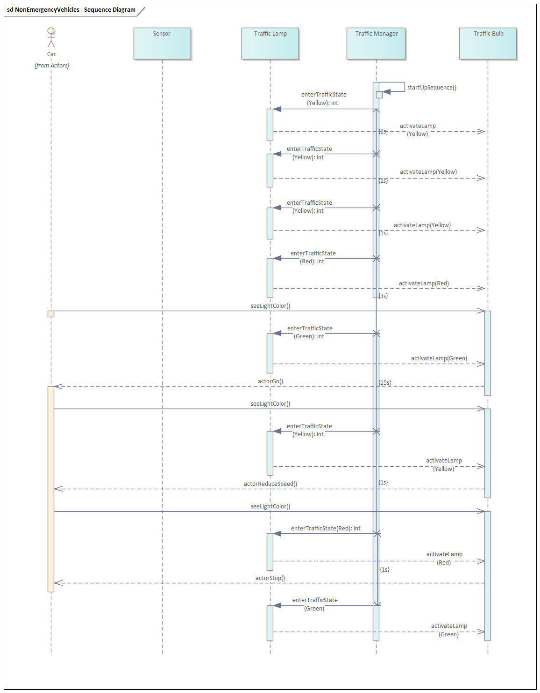
Sequence Diagrams Analysis
Definition for 2 scenarios:
Emergency Vehicles
Non-Emergency Vehicles
Refinement of the sequence diagrams to fit a correct behavior.

Slide 11
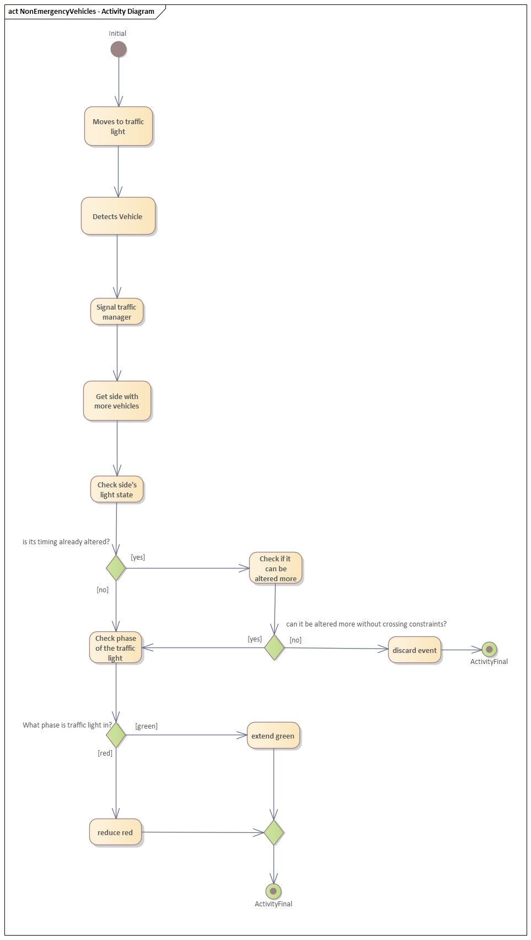
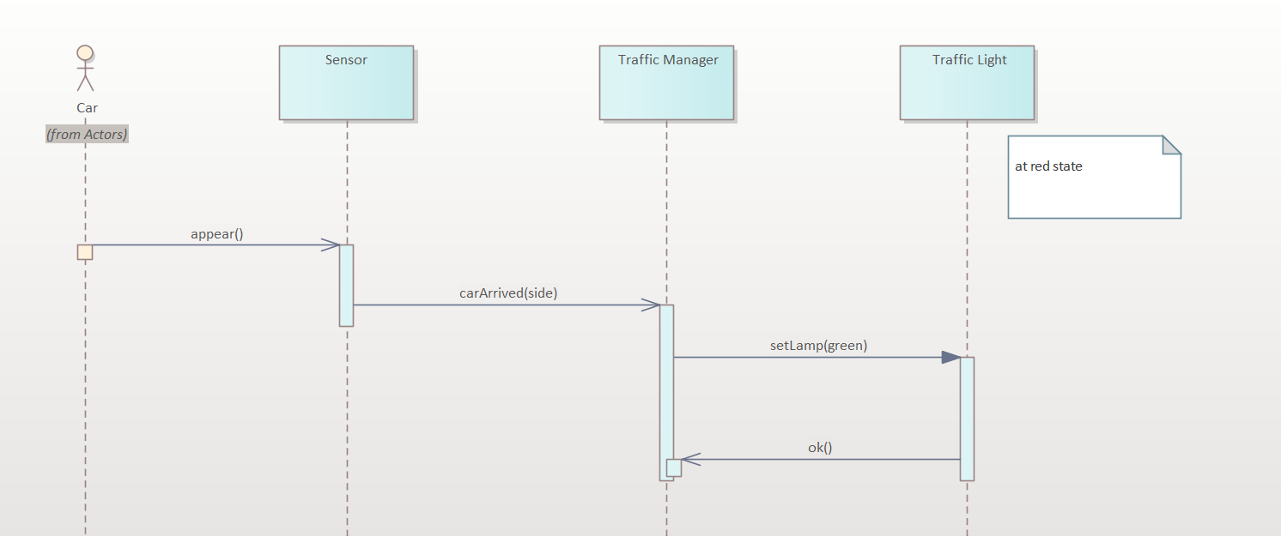

Prioritization For Better Traffic Flow
Prioritize vehicles as they arrive at the intersection
More side with the higher volume gets priority
2s
5s

Slide 12
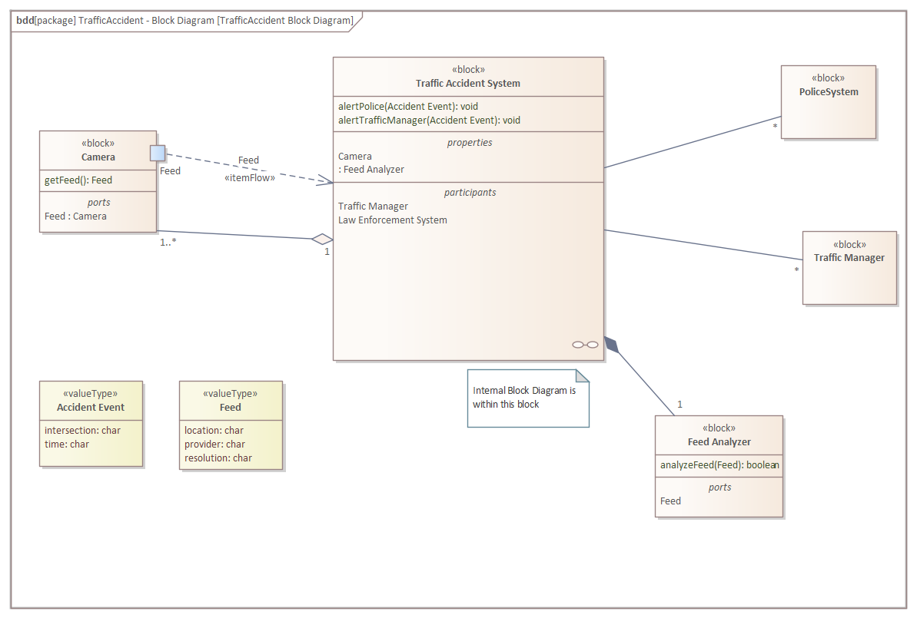
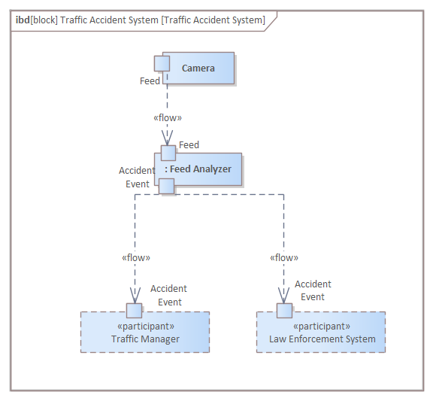
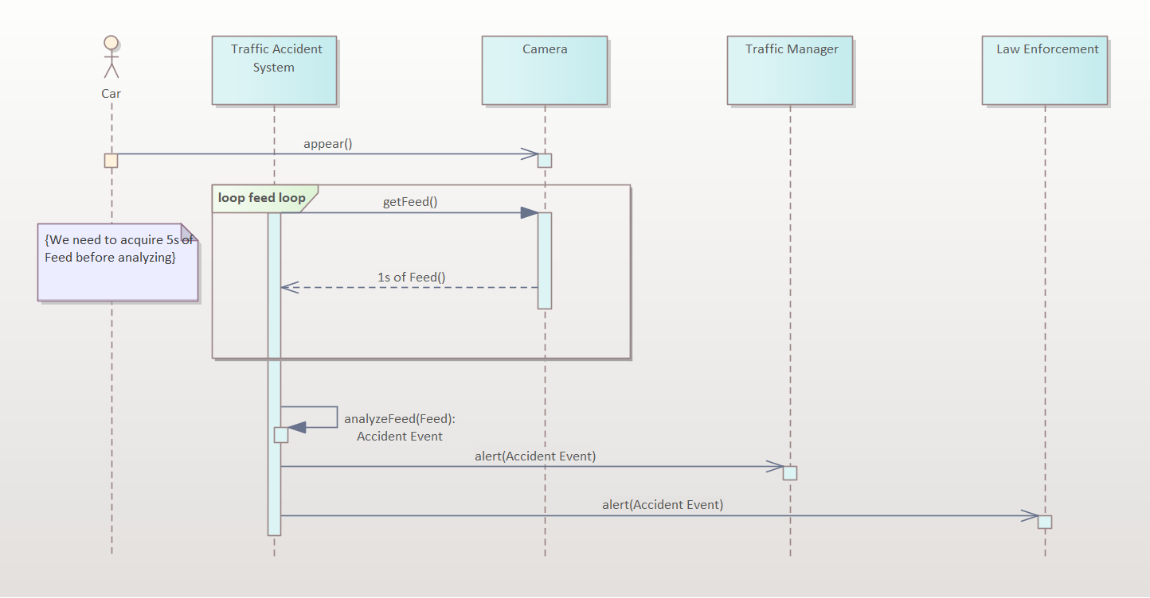
Accident-aware Intersection
Monitors inside the intersection for traffic accidents
Halts intersection to a stop upon accident by turning all lights to red

Slide 13
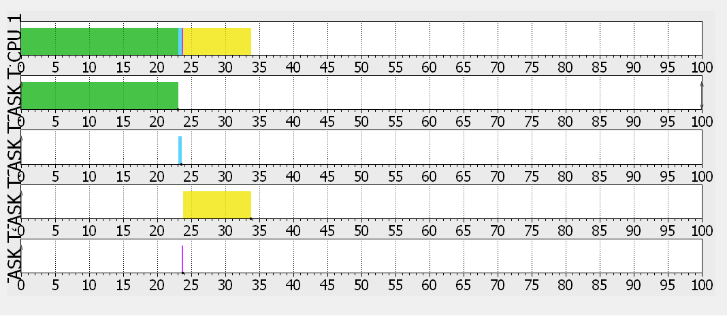
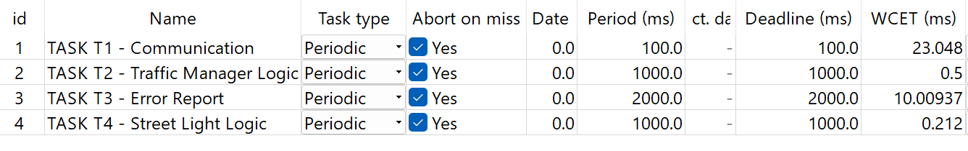
Scheduler
A set of independent, repeating tasks that require about the same amount of CPU on each run.
RMS assumes as the highest priority (most critical) should be the task with the shortest period.
Since we are using sensors that use specific time, the time response is critical that does not change.
Rate Monotonic Scheduling

Slide 14
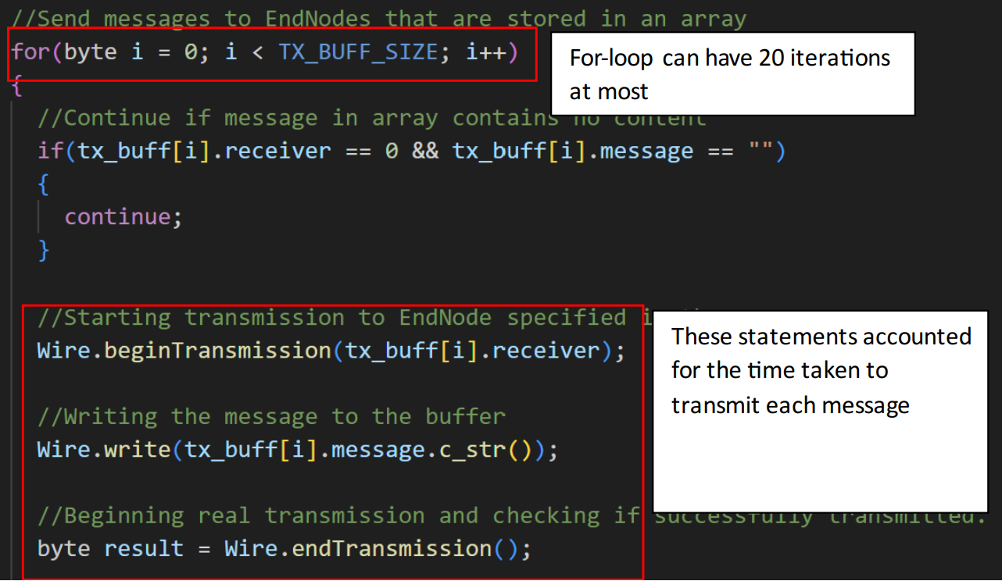


WCET Analysis
Analysis of value and control-flow not possible due to simulation limitations
A naïve flow analysis was carried out for all 4 tasks
Even at worst cases, tasks still met their deadlines by a large margin
$$loop execution time= \left[number of iterations\right]×\left[bytes per message\right]×\left[time needed for transmiting each byte\right]$$
$${WCET}_{task 1}=20400+2648=23048 μs=23.048 ms<100ms$$

Slide 15
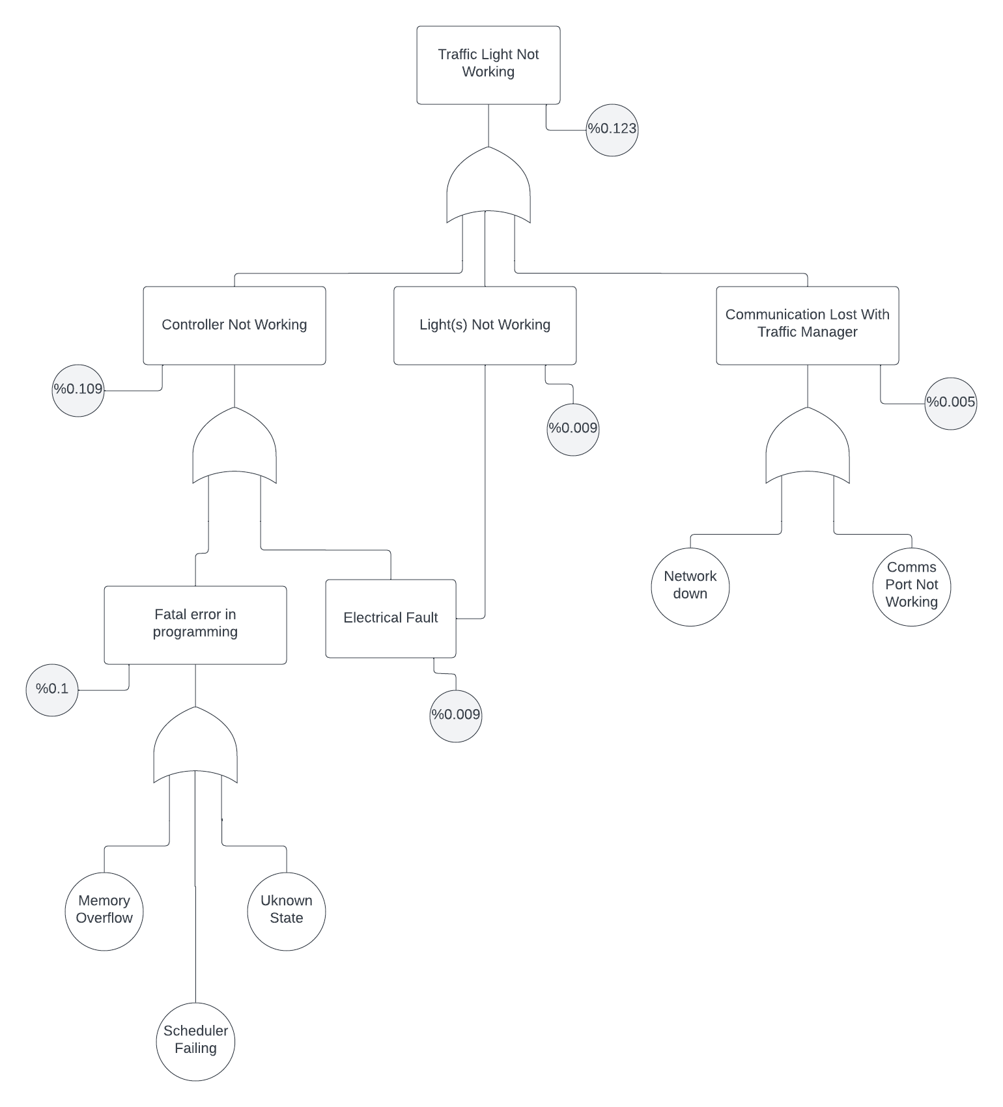
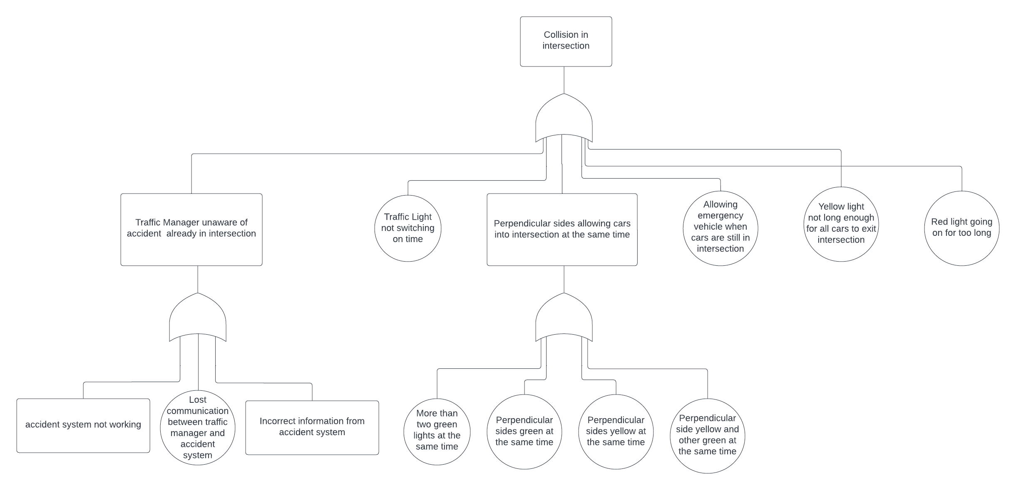
Fault Tree Analysis
Traffic light fault tree
Collision in intersection fault tree
Hazards can be addressed by checking and implementing safeguards within the system

Slide 16

Implementation and simulation in TinkerCAD
Implemented the architecture and two of our basic use cases in TinkerCAD:
Acceleration of emergency vehicles
Smart street lighting
Used Arduino Unos as a hardware platform for the Traffic Manager and the End Nodes.

Slide 17
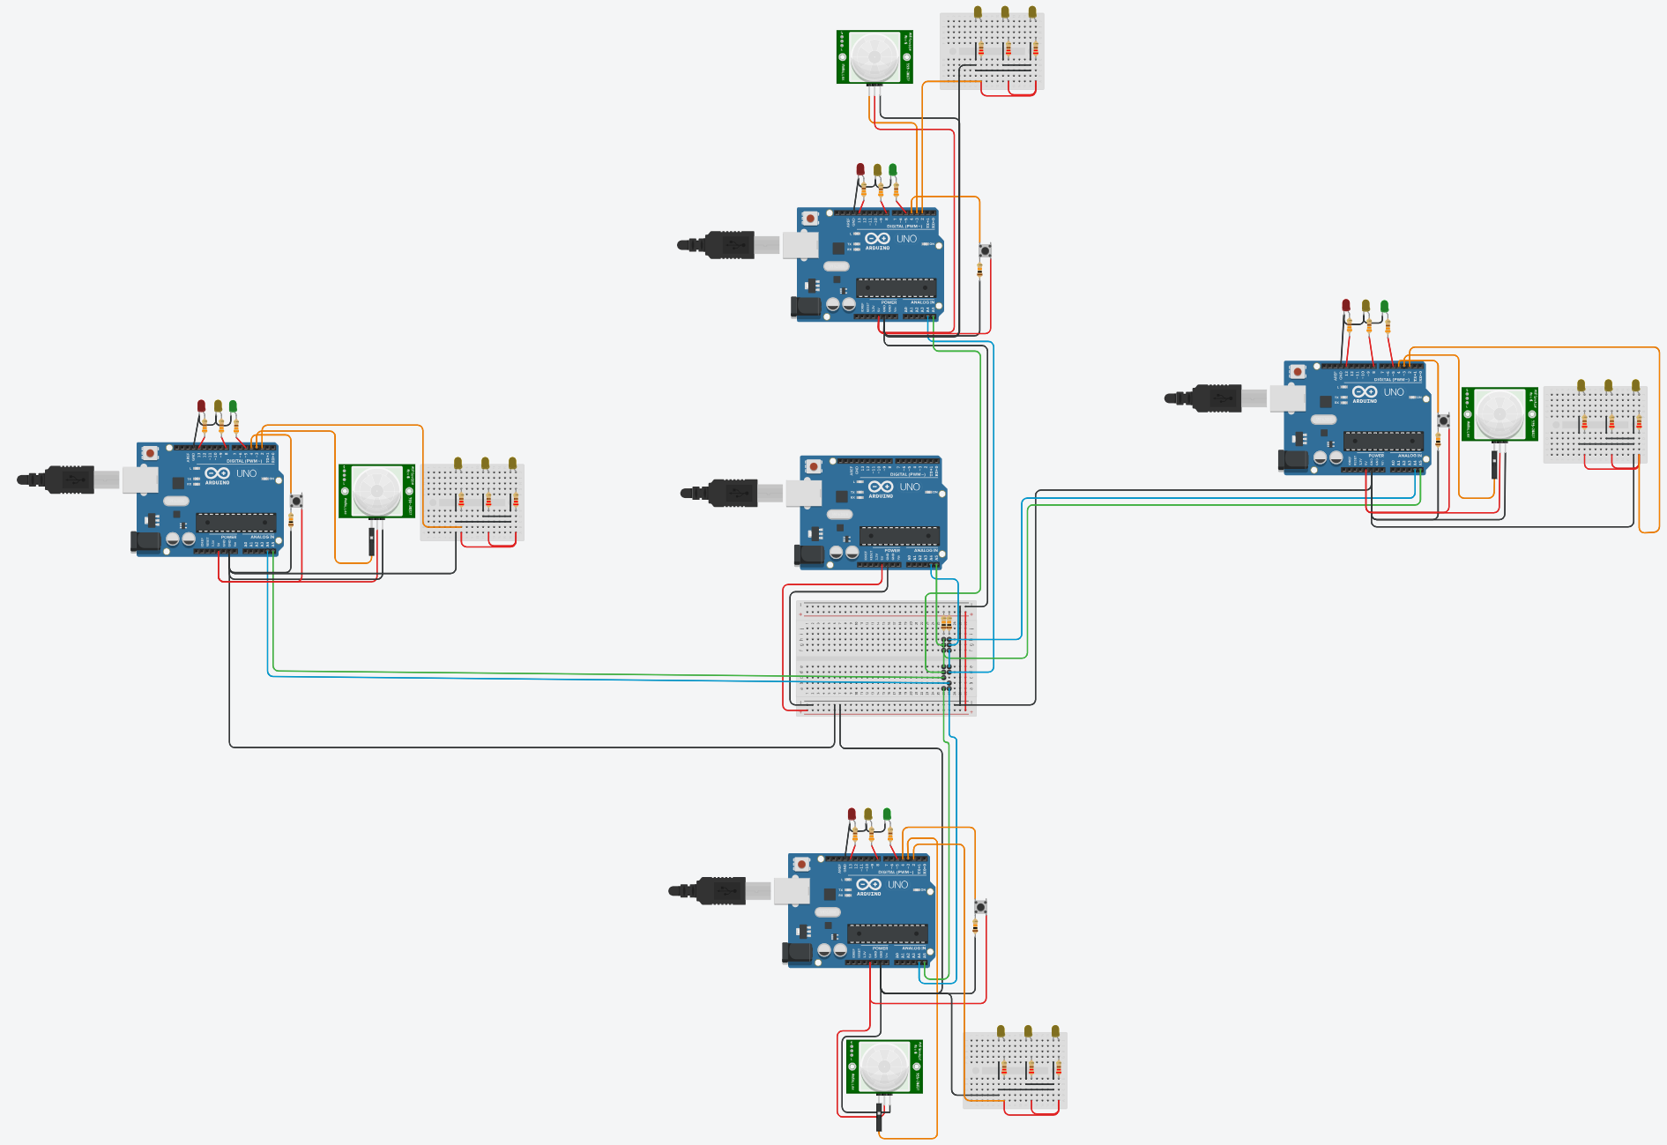
Overview of the simulation
Simulation replicates a simple street intersection with four arms.
Traffic Manager is located in the middle.
Four End Nodes that are located in every direction.
The traffic lights and the street lights are resembled by LEDs.
The camera for recognizing entities is resembled by:
PIR sensor for detecting approaching citizens that want to cross straight ahead
Button for approaching emergency vehicles
Communication between the Traffic Manager and the End Nodes via I²C.

Slide 18
Overview of the simulation
Intersection is working in a fixed-time mode after starting up.
Every direction has a green signal for 15s by default.
Events:
Approaching emergency vehicle signs up:
Intersection switches to a green light as fast as possible and holds the state.
Emergency vehicle signs off after crossing:
Intersection continues normal operation.
Citizen that wants to cross the intersection detected:
Street lights are turned on for 15s.
Notes:
Intersection is working in a fixed-time mode after starting up
Every direction has a green signal for 15s by default
Three events that influence the behavior:
Citizen that wants to cross the intersection straight ahead detected:
→Street lights of the opposite arm are turned on for 15s
Approaching emergency vehicle signs up (via wireless telegram in real life):
→Intersection switches to a green light as fast as possible and holds the state
Emergency vehicle signs off after crossing:
→Intersection continues normal operation

Slide 19
Implementation of the Traffic Manager
Functionality was divided into four tasks:
T₁: Communication via I²C
P₁ = 100ms, measured WCET(T₁) = 2152us
T₂: Logic of traffic lights of the intersection
P₂ = 1s, measured WCET(T₂) = 40us
T₃: Displaying status of the system
P₃ = 2s, measured WCET(T₃) = 29512us
T₄: Controlling the street lighting
P₄ = 1s, measured WCET(T₄) = 212us
Notes:
Some words about the most interesting part: implemented a rate-monotonic scheduler without preemption
First created a struct called “Task” that contains the attributes:
ID
Period (in ms)
Execution time (measured duration in us)
Last execution time (timestamp)
Function pointer to the task’s function to know what needs to be executed
Scheduler uses a “task set” consisting out of an array of tasks
Method “runRMS” needs to be called in the main loop, decides which task needs to be executed next, executes it, measures execution time and updates the last execution time
Preemption is not supported because it was not needed to implement the example and would have

Slide 20
Implementation of the Traffic Manager
To allow the execution of tasks we implemented a rate-monotonic scheduler without preemption:
Created a struct called “Task” that contains the attributes:
ID
Period (in ms)
Execution time (measured duration in us)
Last execution time (timestamp)
Function pointer to the task’s function
Scheduler uses a “task set” consisting out of an array of tasks.
Method “runRMS” needs to be called in the main loop with the task set; decides which task needs to be executed next, executes it, measures execution time and updates the last execution time.
Notes:
Some words about the most interesting part: implemented a rate-monotonic scheduler without preemption
First created a struct called “Task” that contains the attributes:
ID
Period (in ms)
Execution time (measured duration in us)
Last execution time (timestamp)
Function pointer to the task’s function to know what needs to be executed
Scheduler uses a “task set” consisting out of an array of tasks
Method “runRMS” needs to be called in the main loop, decides which task needs to be executed next, executes it, measures execution time and updates the last execution time
Preemption is not supported because it was not needed to implement the example and would have

Slide 21
Implementation of Traffic Manager
To conclude:
Way of implementation and the separation into tasks resulted in clean code.
Implementation of the scheduler made it easy and fast to add new tasks.
Periodicity could be utilized by task 2 and 4 to implement a counter to count seconds (used for guarded transitions).
Because of the scheduler lacking a preemption feature:
The functions of the tasks needed to be designed carefully not to block the whole system.
The need of locking mechanisms for shared resources was removed.
Notes:
To conclude a little on the implementation of the Traffic Manager:
The implementation of the scheduler resulted in a suprisingly clean code (clean in terms of what is normally archievable on an Arduino)
For example : Task 4 (functionality of the street lights) was added after the traffic lights; effort payed off
Periodicity was utilized by task 2 (logic of the traffic lights) and task 4 (control of the street lights) to implement a counter for seconds used for the guarded transitions in the SM and the timers of the street lights. Measurements showed it to be surprisingly precise.
Because the scheduler implements no preemption, the tasks needed to be designed in a non-blocking way
Lack of preemption removes the need of locking mechanisms: →shared resources are not accessed in a concurrent way

Slide 22
Implementation and Testing in Tinkercard
Created the code and hardware connections for the End Node.
Created the Unit Tests for the project.

Slide 23
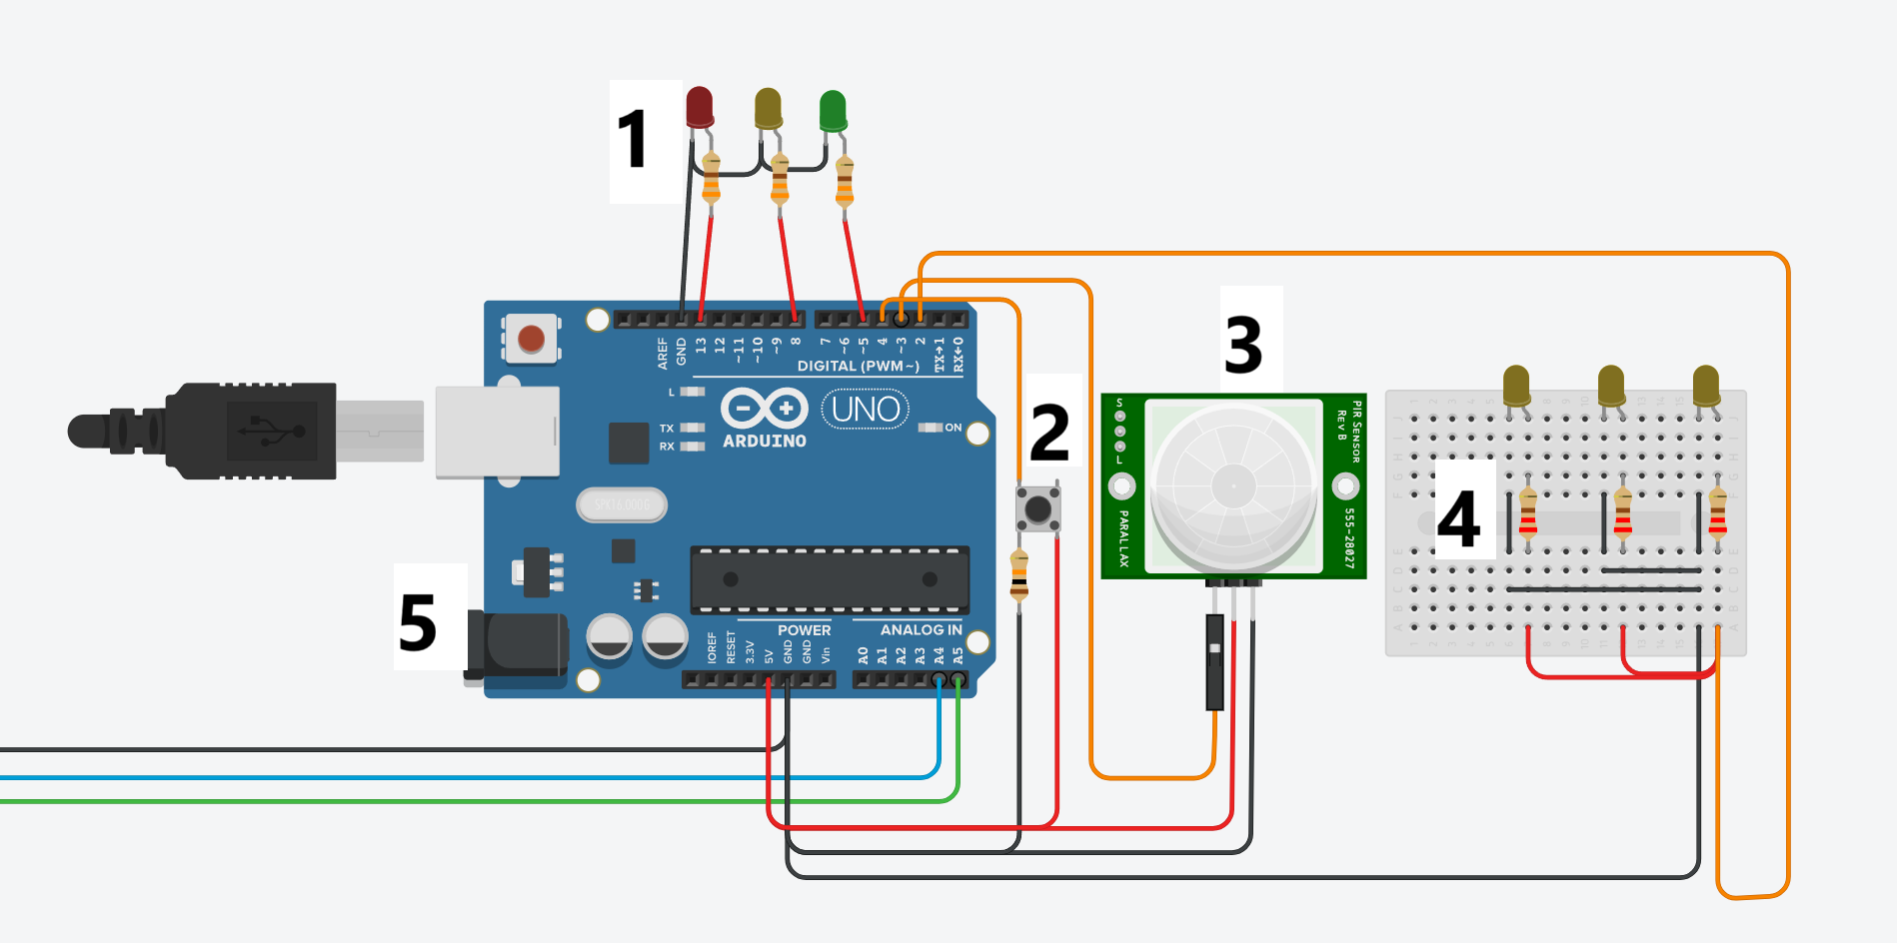
The End Node Components
The lights for the traffic lights.
The digital signal button.
The PIR Sensor for detecting movement.
The lights for the road.
The Arduino for the end node.

Slide 24
The End Node Functionality
Receive signals from the Manager to turn on/off the traffic lights.
Receive signals from the Manager to turn on/off the road lights.
Send an emergency signal to the manager with the digital button is clicked.
Send a movement signal when movement is detected from the PIR sensor.
Send an emergency signal when the digital button is clicked.

Slide 25
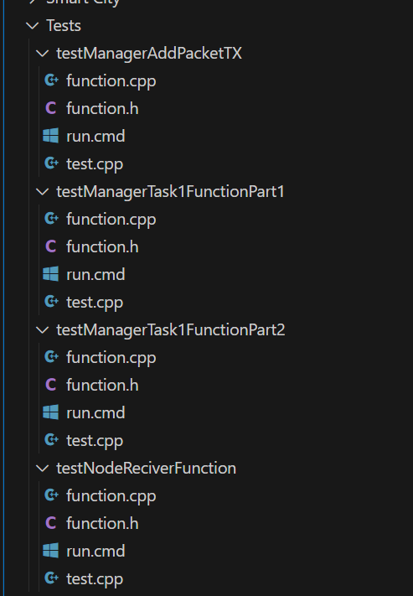
Testing the code
Tests were written in C++ (same language as Arduino).
4 unit cases were tested.
The tests covered ideal cases & defected cases.
The functions/code for the tested cases were copied from the Tinkercard environment into the testing environment (the function.cpp file).

Slide 26
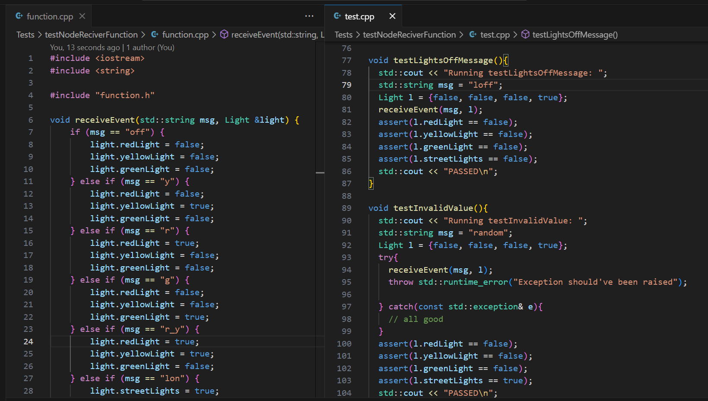
Tested the receiveEvent() function
Tested all possible valid signals from the manager to the end node.
Tested invalid signals from the manger to end node.
Test if end node updates as needed.

Slide 27
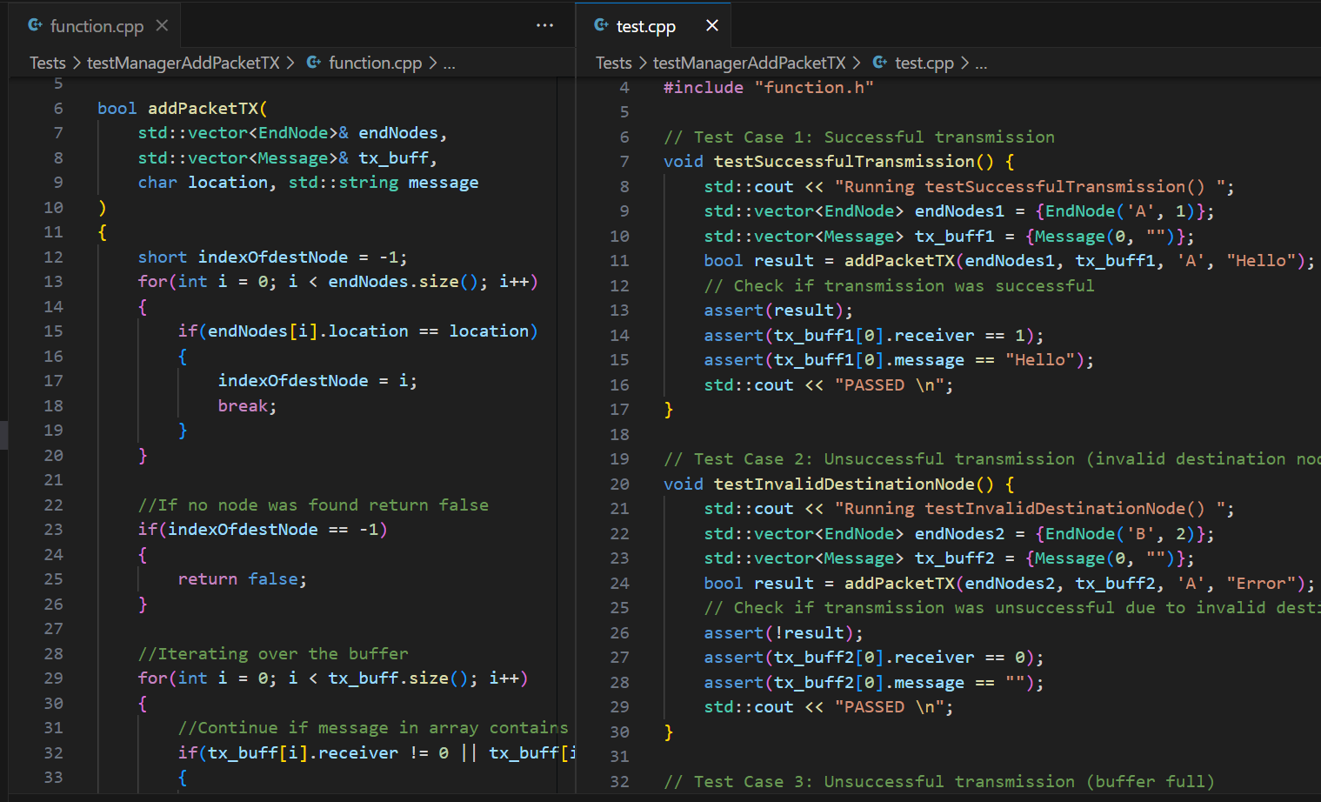
Tested the addPacketTX() function
This is function from the Traffic Manager Code.
Tested adding a value packet to the buffer.
Test trying to add an invalid packet to the buffer.

Slide 28
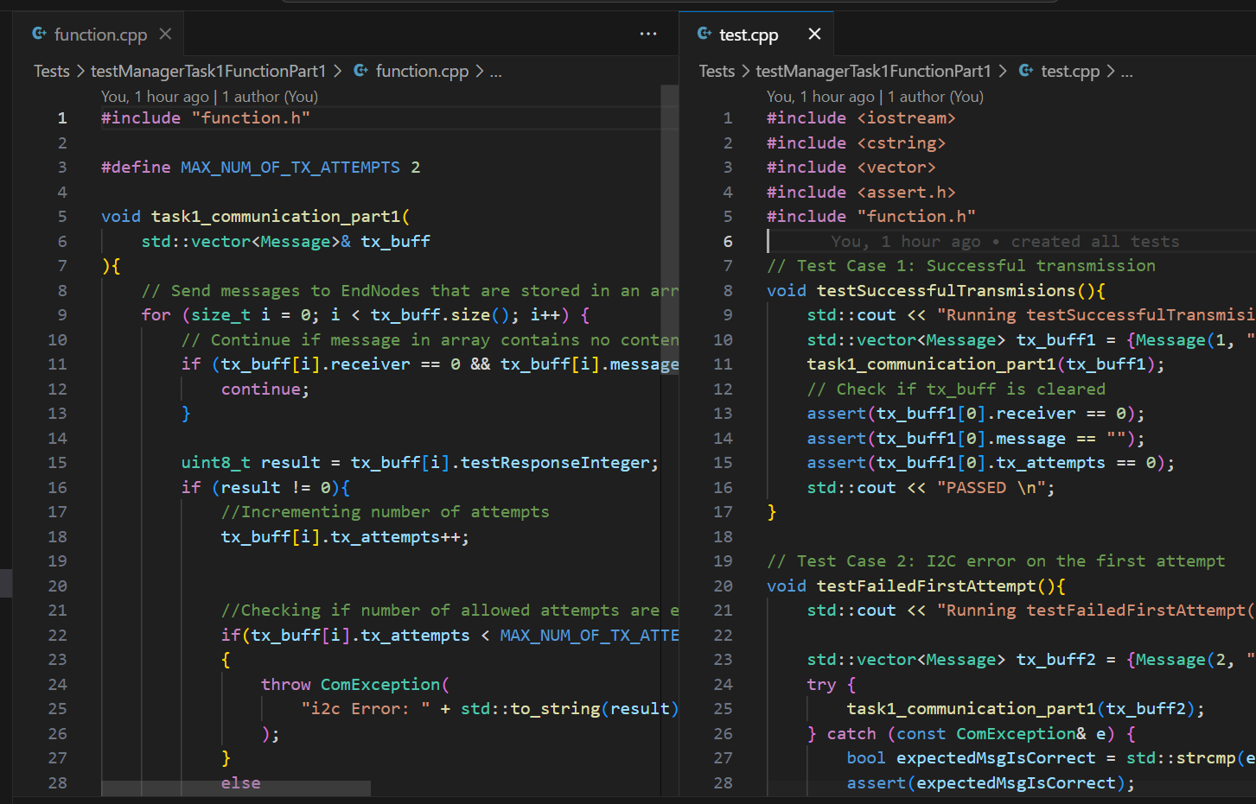
Tested task1_communication() function
This is function from the Traffic Manager Code.
The function is meant to send signals from the traffic manager to the end nodes & Receive the emergency and road lights signal from them.
In the test environment the function was split into 2 to simplify debugging and testing.

Slide 29

Questions?

Slide 30

Thanks for your attention

