Slide 1
Implementation and Testing in Tinkercard
Created the code and hardware connections for the End Node
Created the Unit Tests for the project

Slide 2
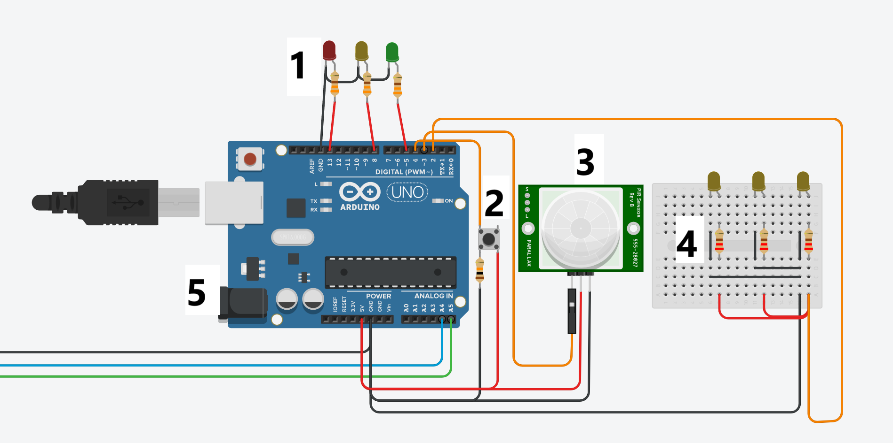
The End Node Components
The lights for the traffic lights
The digital signal button
The PIR Sensor for detecting movement
The lights for the road
The Arduino for the end node

Slide 3
The End Node Functionality
Receive signals from the Manager to turn on/off the traffic lights
Receive signals from the Manager to turn on/off the road lights
Send an emergency signal to the manager with the digital button is clicked
Send a movement signal when movement is detected from the PIR sensor
Send an emergency signal when the digital button is clicked

Slide 4
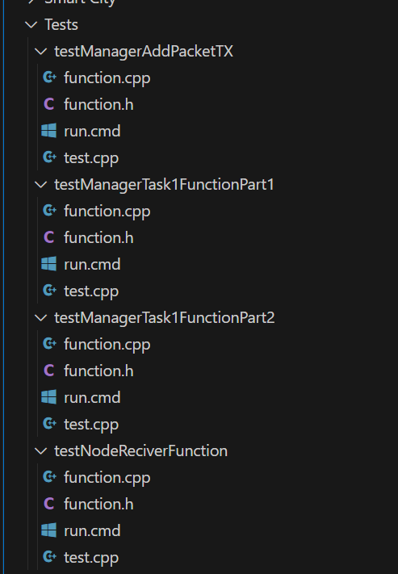
Testing the code
Tests were written in C++ (same language as Arduino)
4 unit cases were tested
The tests covered ideal cases & defected cases
The functions/code for the tested cases were copied from the Tinkercard environment into the testing environment (the function.cpp file)

Slide 5
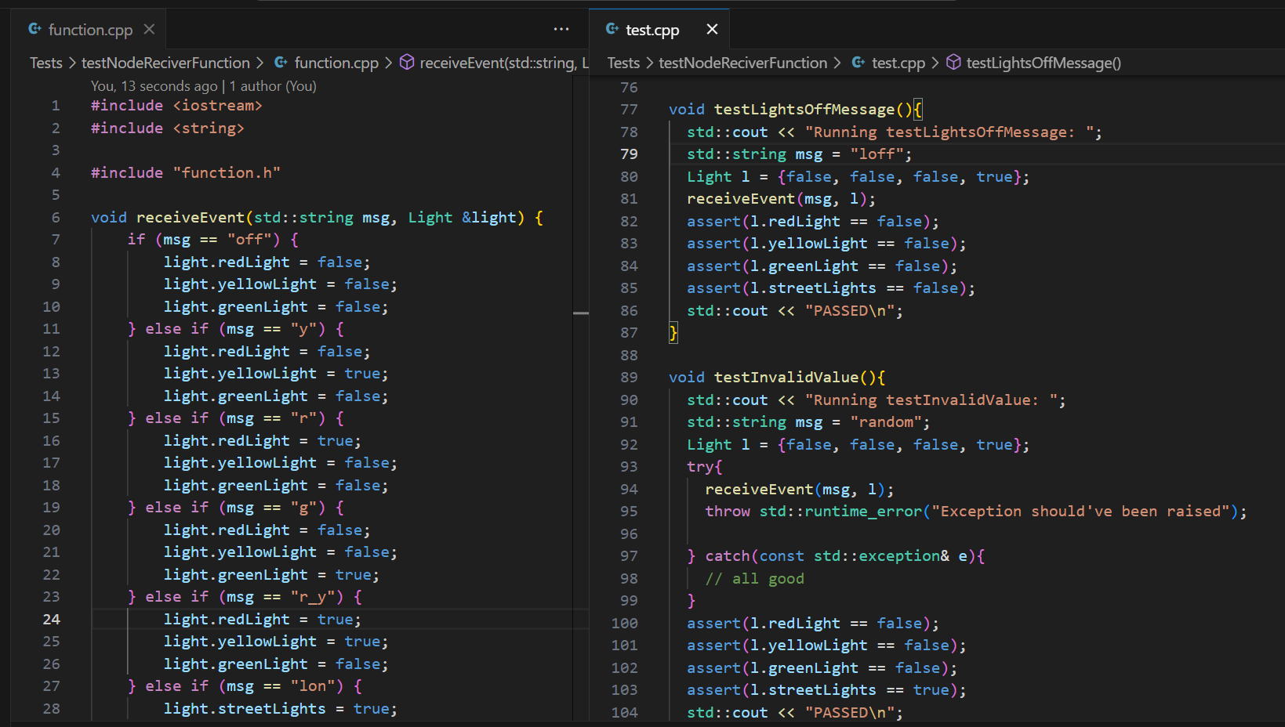
Tested the End Node Signal Handler
Tested all possible valid signals from the manager to the end node
Tested invalid signals from the manger to end node
Test if end node updates as needed

Slide 6
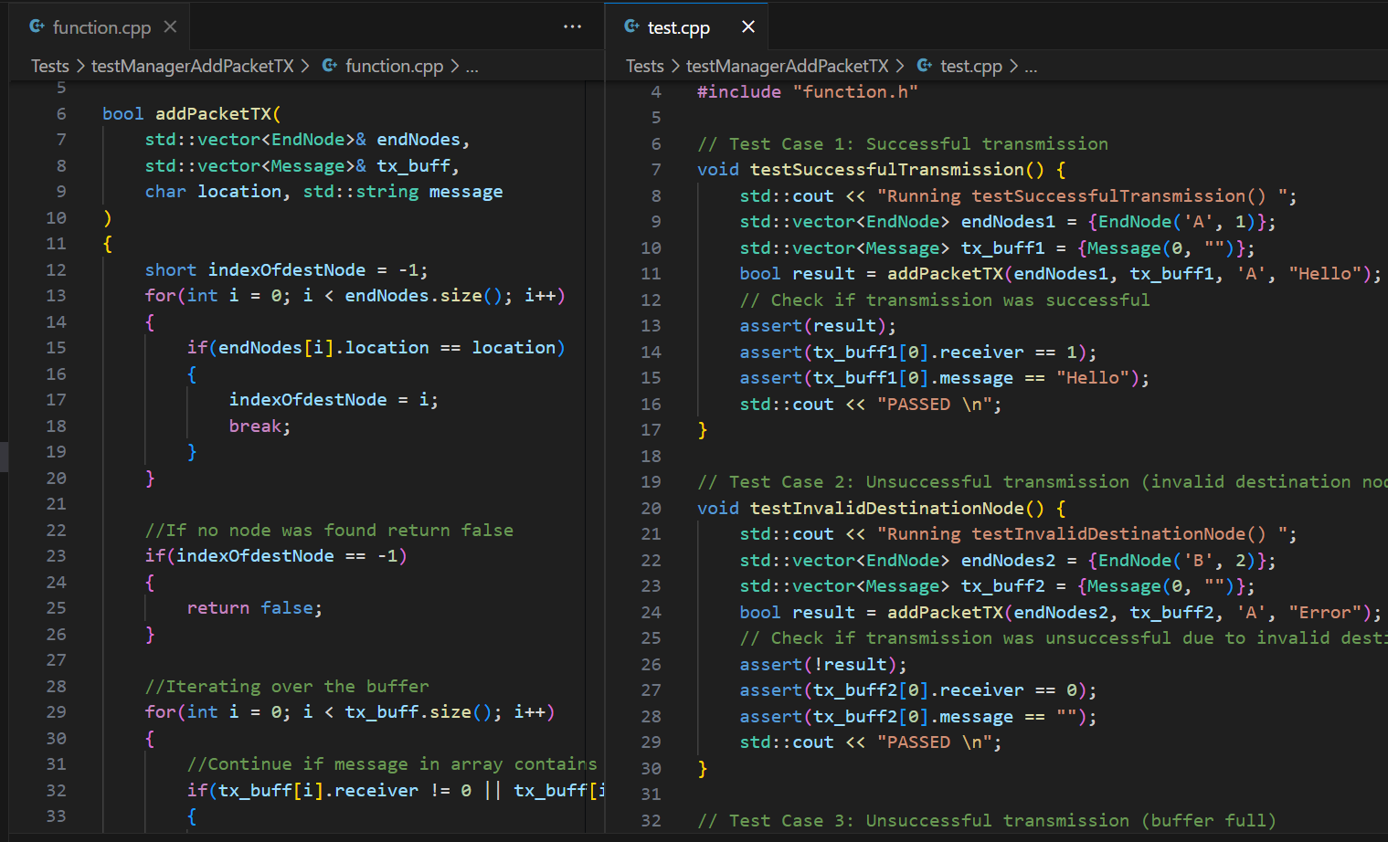
Tested the addPacketTX() function
This is function from the Traffic Manager Code
Tested adding a value packet to the buffer
Test trying to add an invalid packet to the buffer

Slide 7
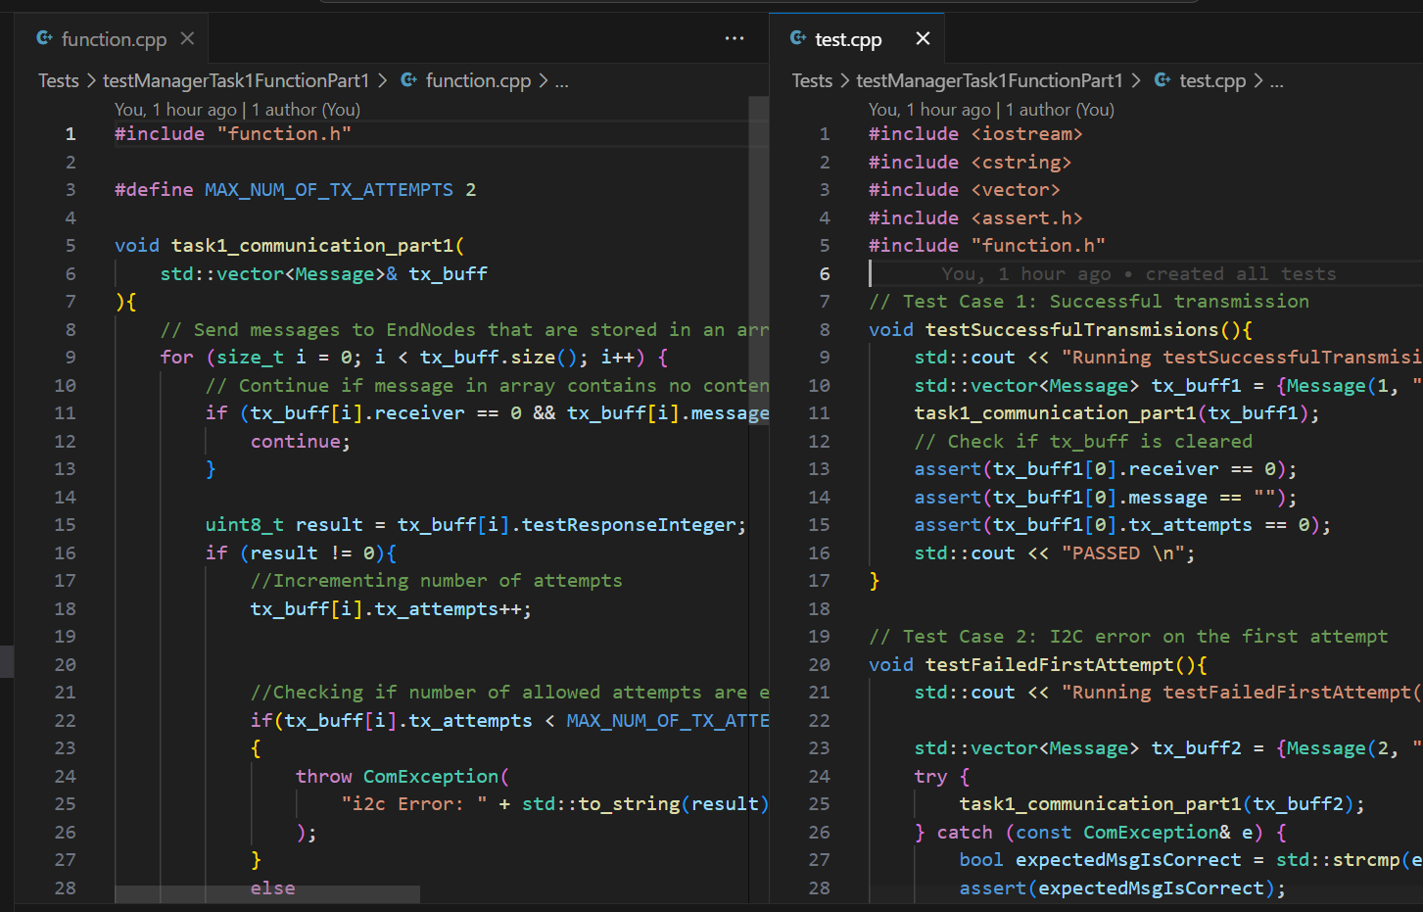
Tested task1_communication() function
This is function from the Traffic Manager Code
The function is meant to send signals from the traffic manager to the end nodes & Receive the emergency and road lights signal from them
In the test environment the function was split into 2 to simplify debugging and testing

