Slide 1
SmartCity

Slide 2
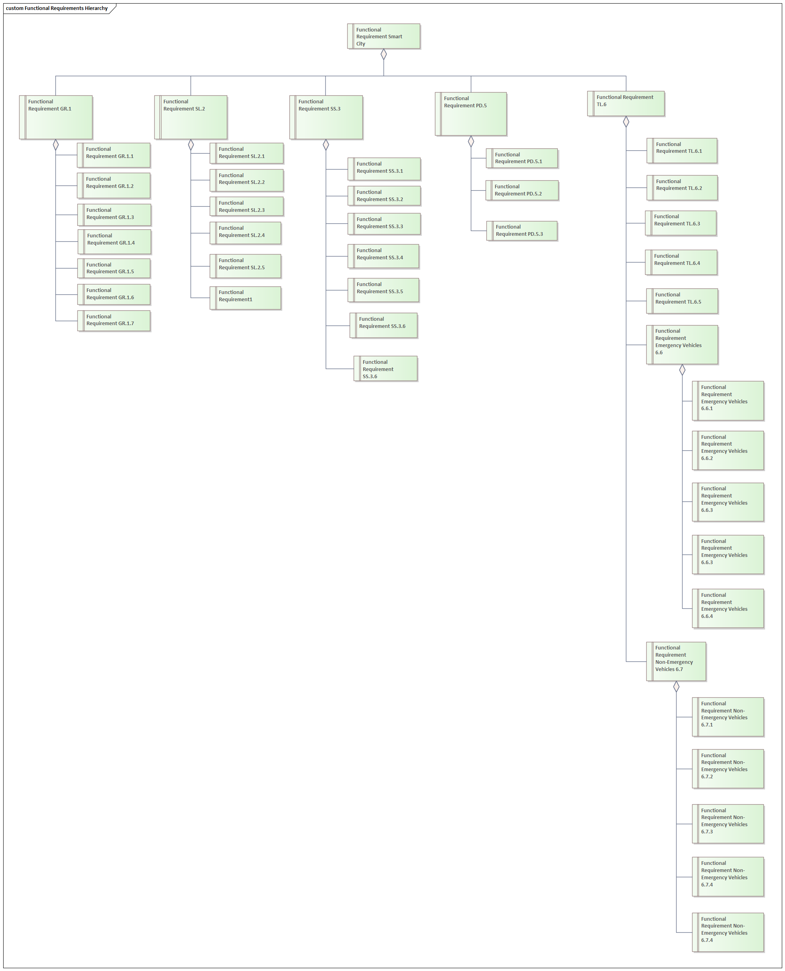
Requirements
Specification of every case scenario for the smart city.
Each case scenario needed it requirements.
More attention was given to the case scenario to implement.

Slide 3
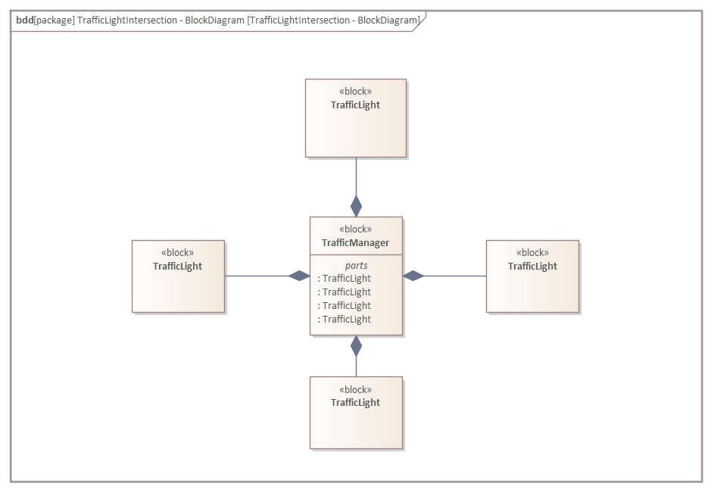

Case Scenario
Emergency Vehicles going through an intersection.
Implementation of the the basic use case that was going to be implemented.

Slide 4
Intersection controlled by a traffic manager.
Traffic Lamps are end nodes.
Receive current state.
Transmit if emergency vehicle is detected.

Slide 5
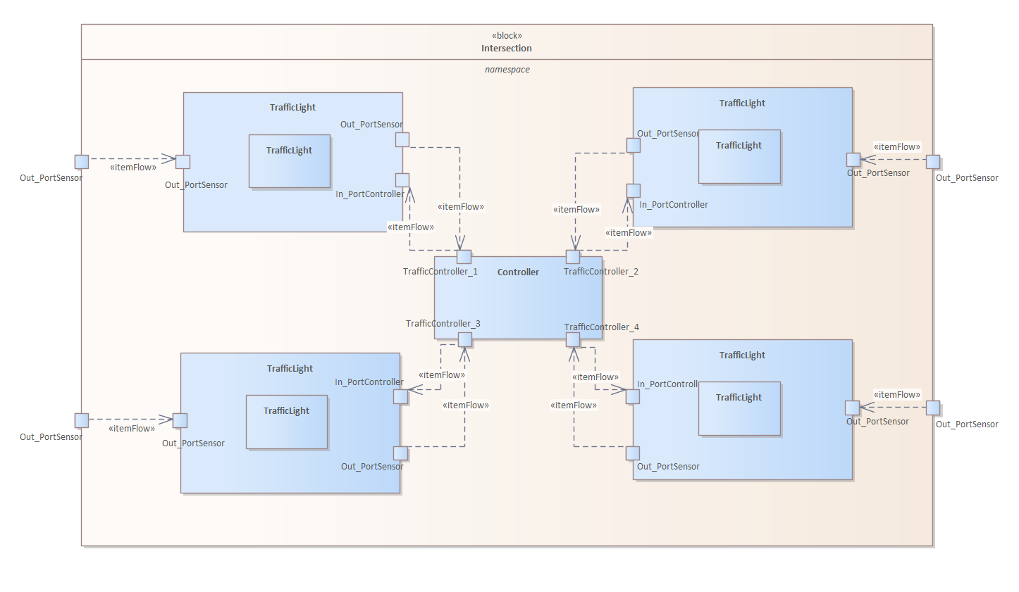
Traffic Manager
One Manager will control each intersection.
One Manager will communicate with city system to coordinate.

Slide 6
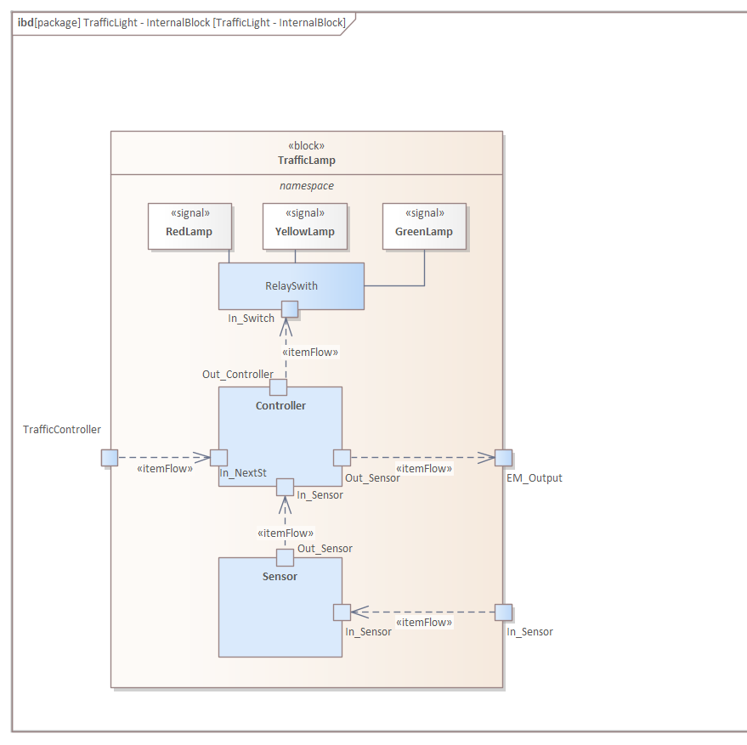
Traffic Lamp
Definition of the components inside the traffic light.

Slide 7
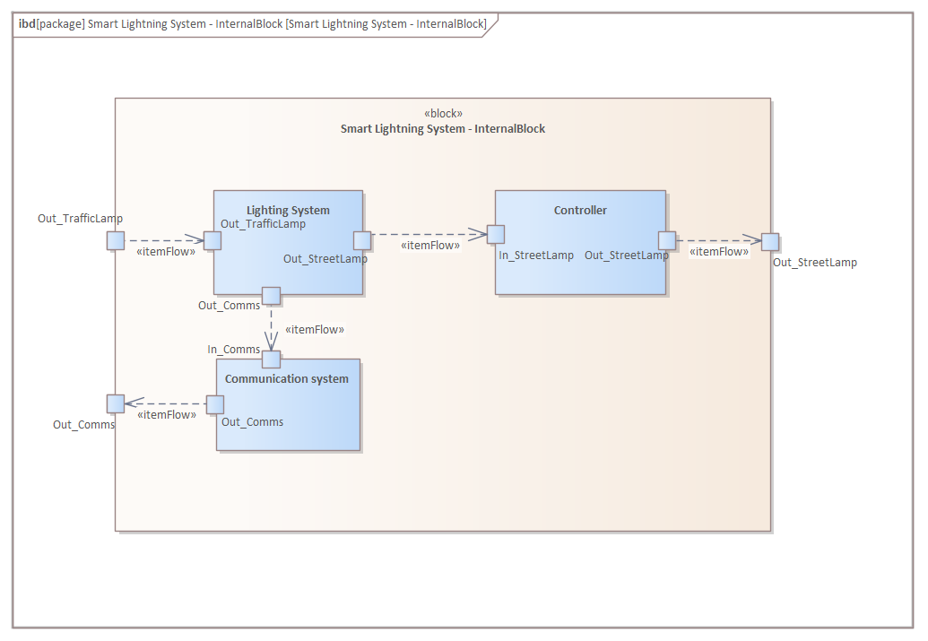
Lightning System
Definition of the components inside the traffic light.

Slide 8
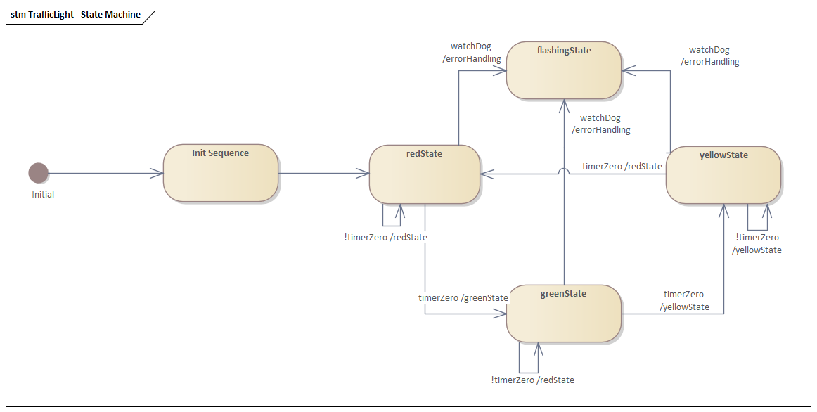
Internal State Machine
Definition of the most basic state machine of a traffic light.
Refinement of the state machine to accommodate our use case scenario.

Slide 9
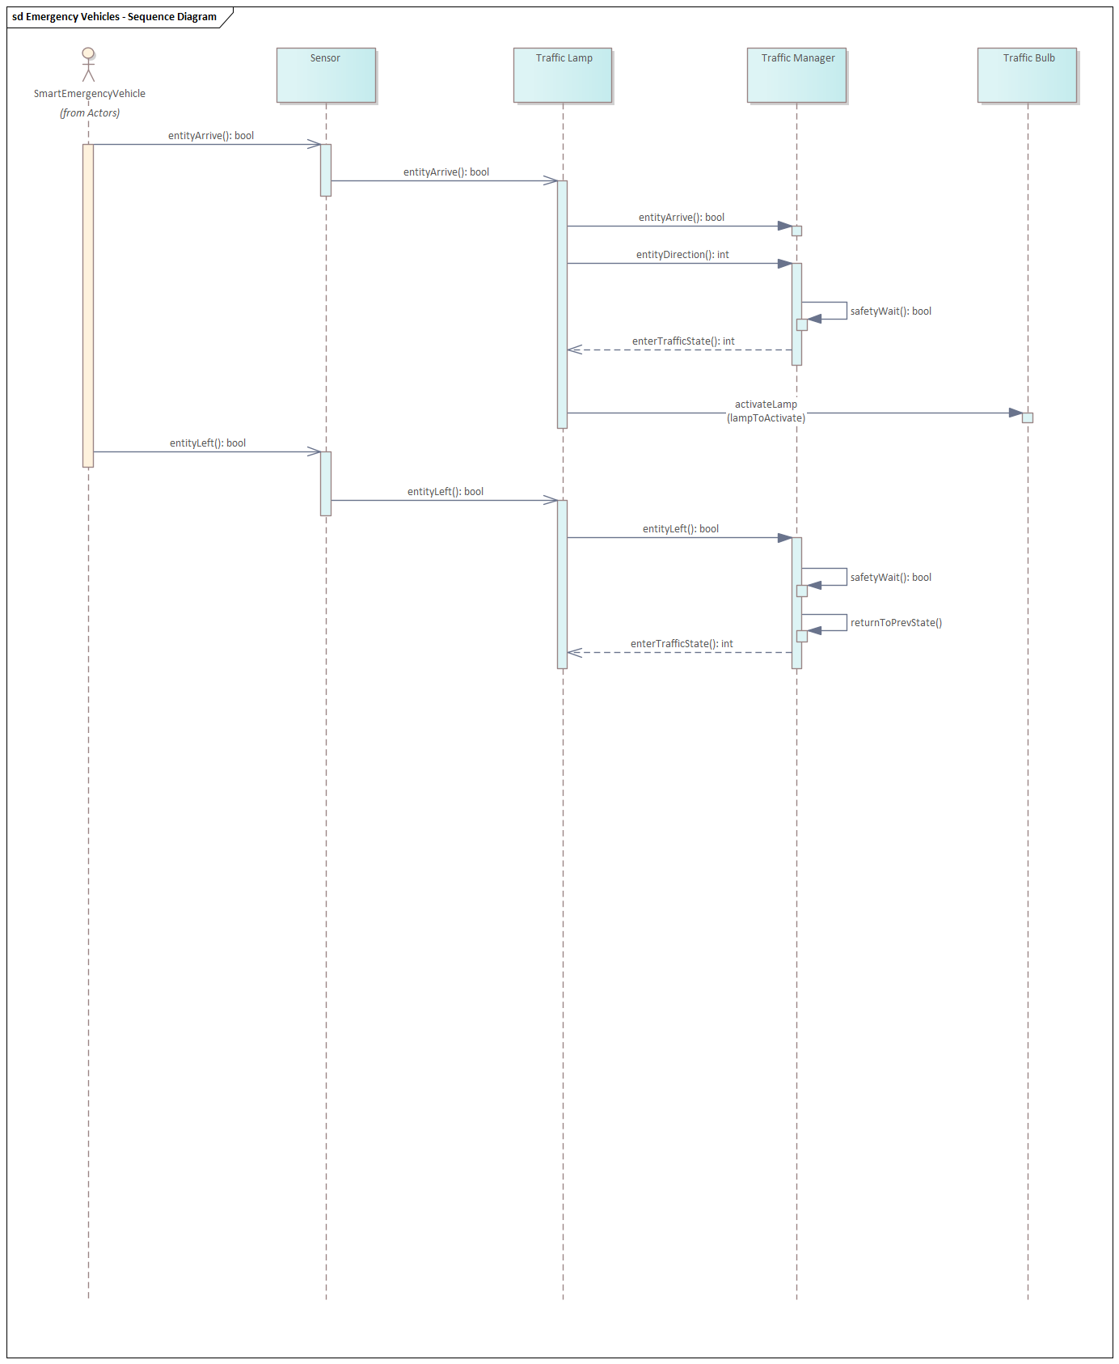
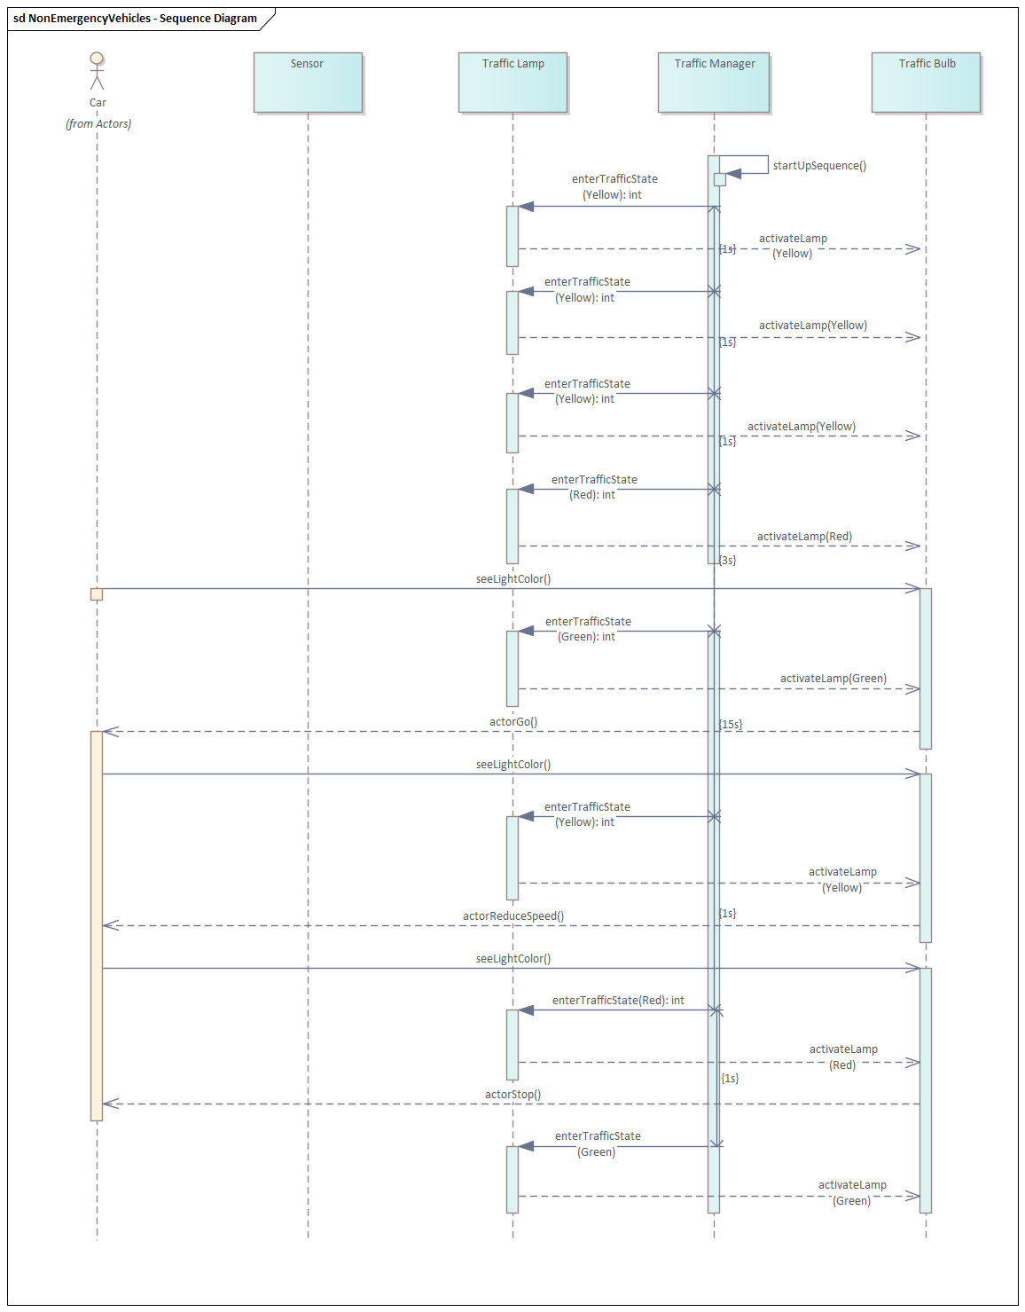
Sequence Diagrams
Definition for 2 use cases.
Emergency Vehicles
Non-Emergency Vehicles
Refinement of the sequence diagrams to fit a correct behavior.

