Slide 1
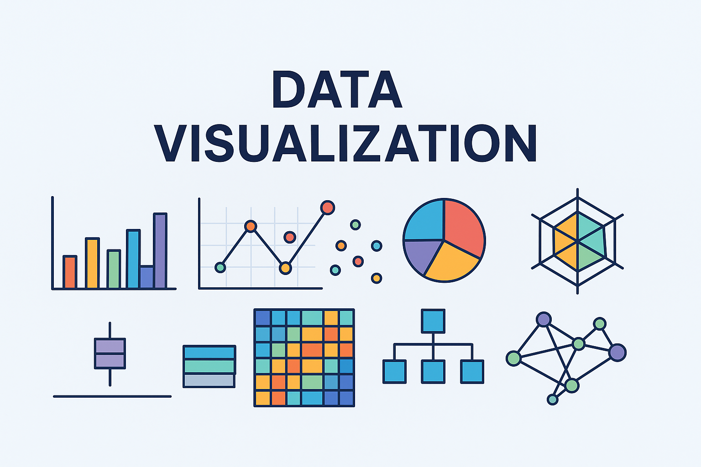
2025

Slide 2
Section 1. Basics of Data Visualization
Lection 1. Intro. The role of visualization. Examples of data visualization. Visualization tools (Excel, Google Sheets, Tableau, Power BI, Python, R).

Slide 3
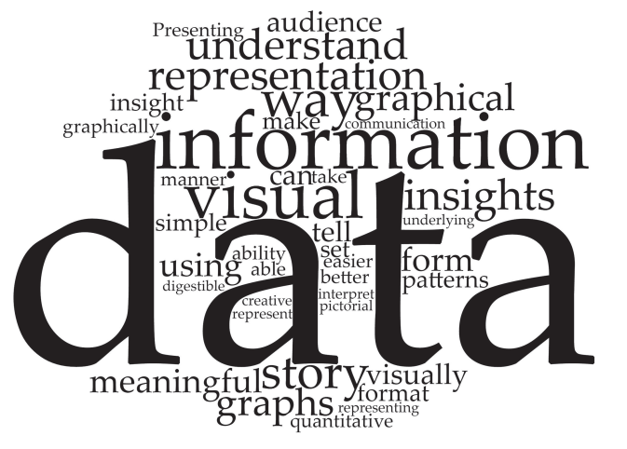
What Is Data Visualization?
A word cloud that shows the frequencies of the top 40 words used by students when asked to define data visualization

Slide 4


Slide 5
Why Visualize Data?
Notes:
Перетворення чисел на образи
Засіб швидкого розуміння даних
Міст між статистикою та сприйняттям

Slide 6
Why Visualize Data?
Visualization helps analytics
raw data → insights for making decisions
(business, sports, science, medicine, …)
Analytics:
Descriptive (e.g. summary statistics, data visualization)
Predictive (regression analysis, time series forecasting, computer simulation)
Prescriptive (math optimization models, decision analysis, and heuristic or rule-based systems)
Notes:
Перетворення чисел на образи
Засіб швидкого розуміння даних
Міст між статистикою та сприйняттям

Slide 7


Why Visualize Data?
Visualization helps analytics through
Exploration
Explanation
for further
Confirmation
Notes:
Перетворення чисел на образи
Засіб швидкого розуміння даних
Міст між статистикою та сприйняттям

Slide 8
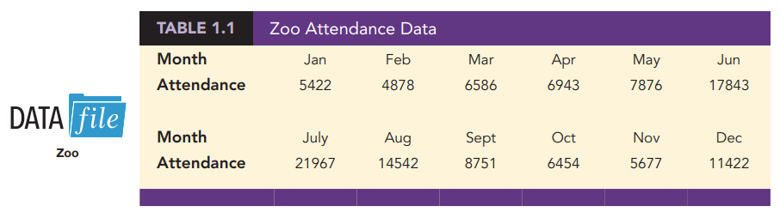
Why Visualize Data?
Data Visualization for Exploration
Notes:
Перетворення чисел на образи
Засіб швидкого розуміння даних
Міст між статистикою та сприйняттям

Slide 9
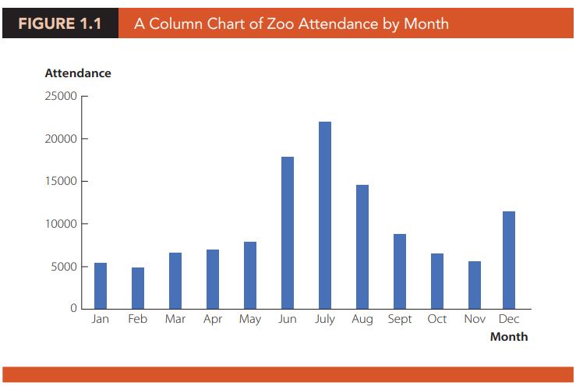
Why Visualize Data?
Data Visualization for Exploration
Notes:
«Один графік вартий тисячі чисел»

Slide 10
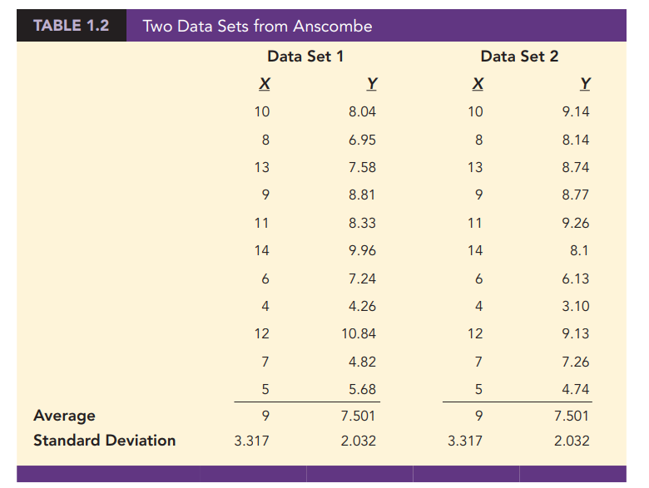
Why Visualize Data?
Data Visualization for Exploration

Slide 11
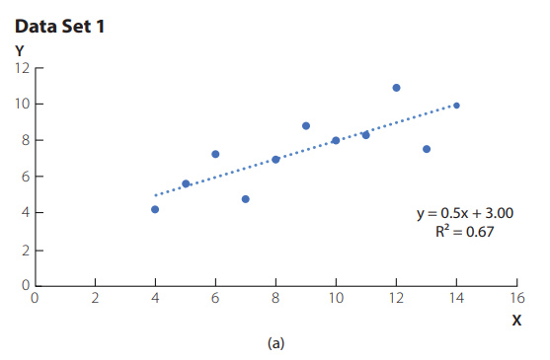
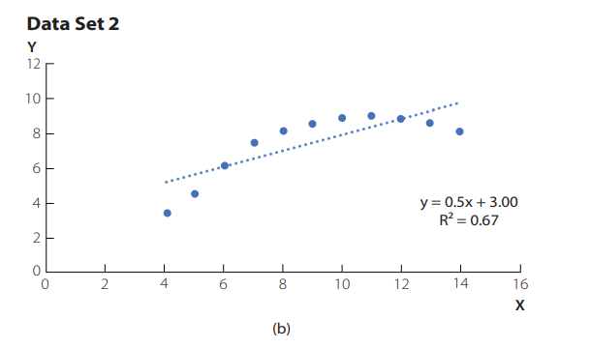
Why Visualize Data?
Data Visualization for Exploration
Notes:
Пояснює складні дані простими образами

Slide 12
Why Visualize Data?
Data Visualization for Explanation

Slide 13
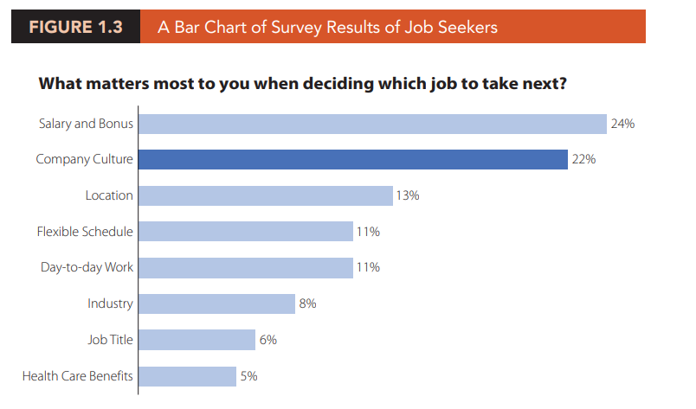
Why Visualize Data?
Data Visualization for Explanation

Slide 14
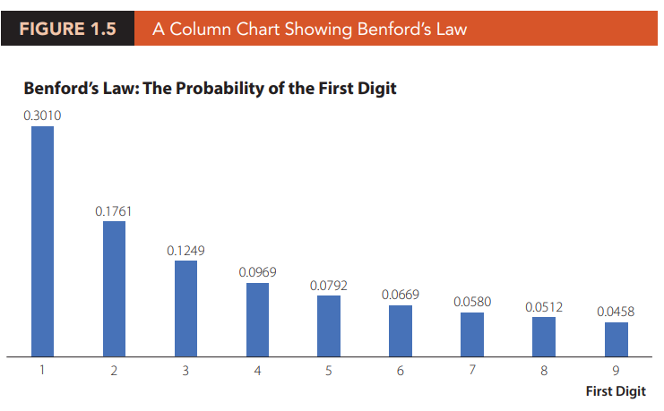
Why Visualize Data?
Data Visualization in Practice (Accounting)
Notes:
Бугалтерскій облік. gives the expected probability that the first digit of a reported number takes on the values one through nine, based on many real-life numerical data sets such as company expense accounts

Slide 15
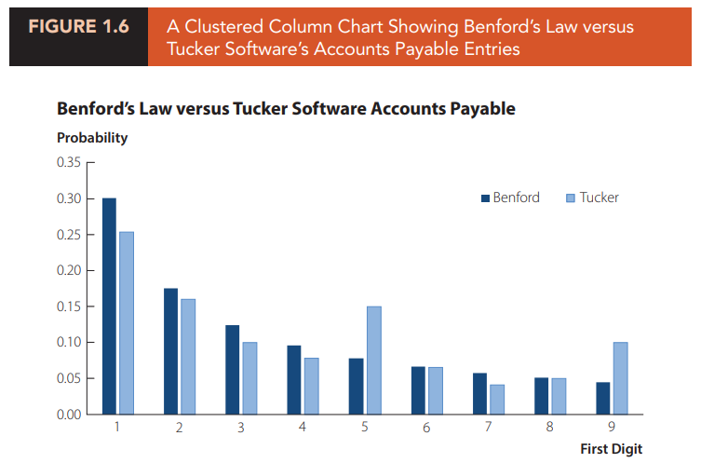
Why Visualize Data?
Data Visualization in Practice (Accounting) side-by-side column chart
Notes:
the first digit data for a random sample of 500 of Tucker’s accounts payable entries.. It appears that there are an inordinate number of first digits of 5 and 9 and a lower than expected number of first digits of 1. These might warrant further investigation by Tucker’s auditors.

Slide 16
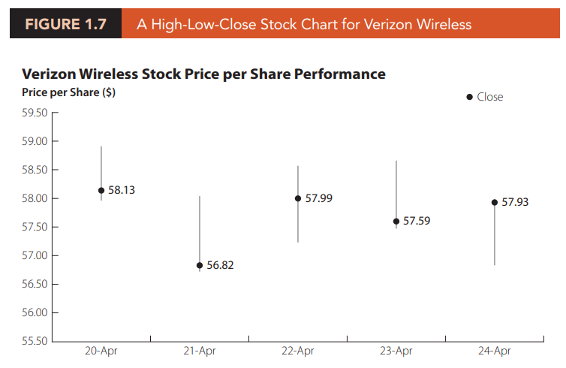
Why Visualize Data?
Data Visualization in Practice (Finance)
Notes:
Динаміка цін акцій. a high-low-close stock chart, a chart that shows the high value, low value, and closing value of the price of a share of stock over time. For each date shown, the bar indicates the range of the stock price per share on that day, and the labelled point on the bar indicates closing price per share for that day. The chart shows how the closing price is changing over time and the volatility of the price on each day.

Slide 17
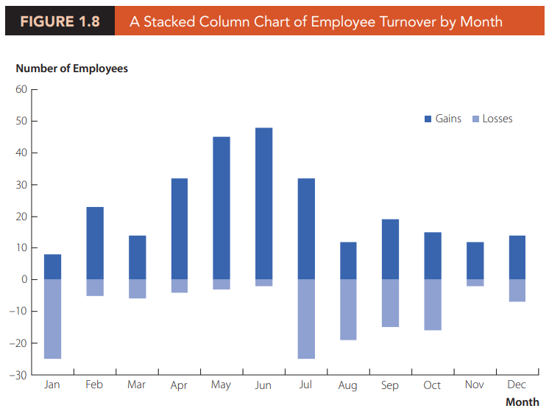
Why Visualize Data?
Data Visualization in Practice (HR management)
Notes:
Динаміка цін акцій. a high-low-close stock chart, a chart that shows the high value, low value, and closing value of the price of a share of stock over time. For each date shown, the bar indicates the range of the stock price per share on that day, and the labelled point on the bar indicates closing price per share for that day. The chart shows how the closing price is changing over time and the volatility of the price on each day.

Slide 18
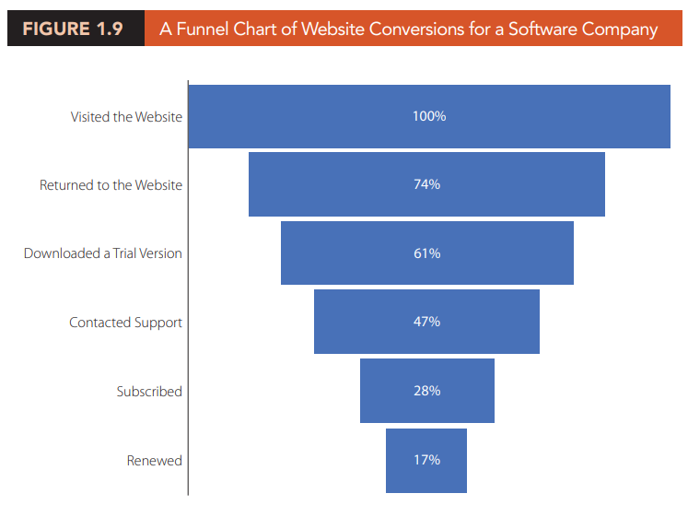
Why Visualize Data?
Data Visualization in Practice (operations function of business)
Notes:
Динаміка цін акцій. a high-low-close stock chart, a chart that shows the high value, low value, and closing value of the price of a share of stock over time. For each date shown, the bar indicates the range of the stock price per share on that day, and the labelled point on the bar indicates closing price per share for that day. The chart shows how the closing price is changing over time and the volatility of the price on each day.

Slide 19
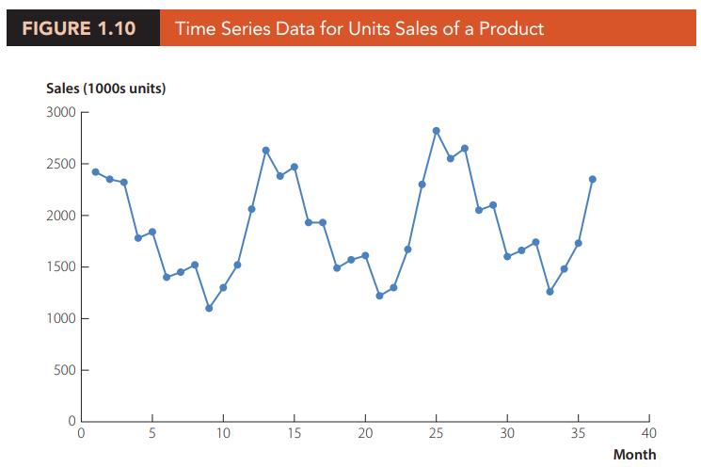
Why Visualize Data?
Data Visualization in Practice (operations function of business)
Notes:
Динаміка цін акцій. a high-low-close stock chart, a chart that shows the high value, low value, and closing value of the price of a share of stock over time. For each date shown, the bar indicates the range of the stock price per share on that day, and the labelled point on the bar indicates closing price per share for that day. The chart shows how the closing price is changing over time and the volatility of the price on each day.

Slide 20
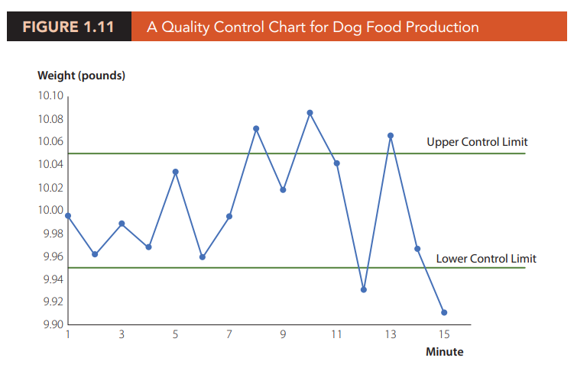
Why Visualize Data?
Data Visualization in Practice (quality control)
Notes:
Динаміка цін акцій. a high-low-close stock chart, a chart that shows the high value, low value, and closing value of the price of a share of stock over time. For each date shown, the bar indicates the range of the stock price per share on that day, and the labelled point on the bar indicates closing price per share for that day. The chart shows how the closing price is changing over time and the volatility of the price on each day.

Slide 21
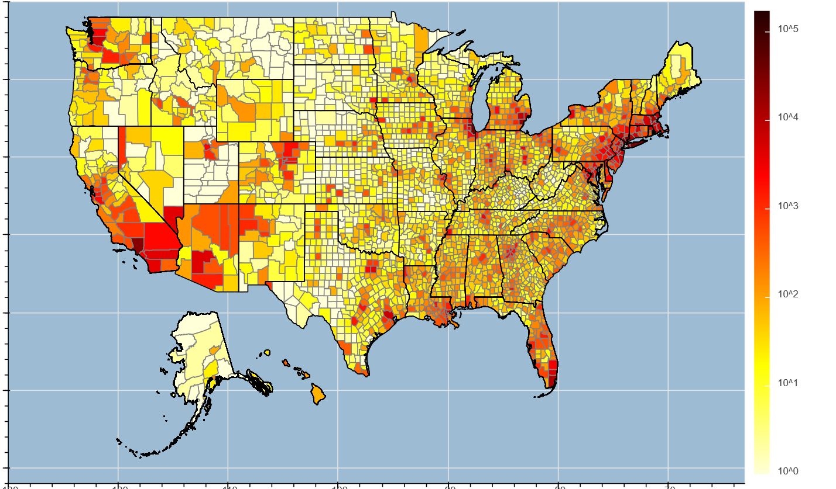
Why Visualize Data?
Data Visualization in Practice (COVID-19 spread across US)
Number of confirmed cases
1,151,933, Day 103, May 3, 2020
Notes:
Динаміка цін акцій. a high-low-close stock chart, a chart that shows the high value, low value, and closing value of the price of a share of stock over time. For each date shown, the bar indicates the range of the stock price per share on that day, and the labelled point on the bar indicates closing price per share for that day. The chart shows how the closing price is changing over time and the volatility of the price on each day.

Slide 22
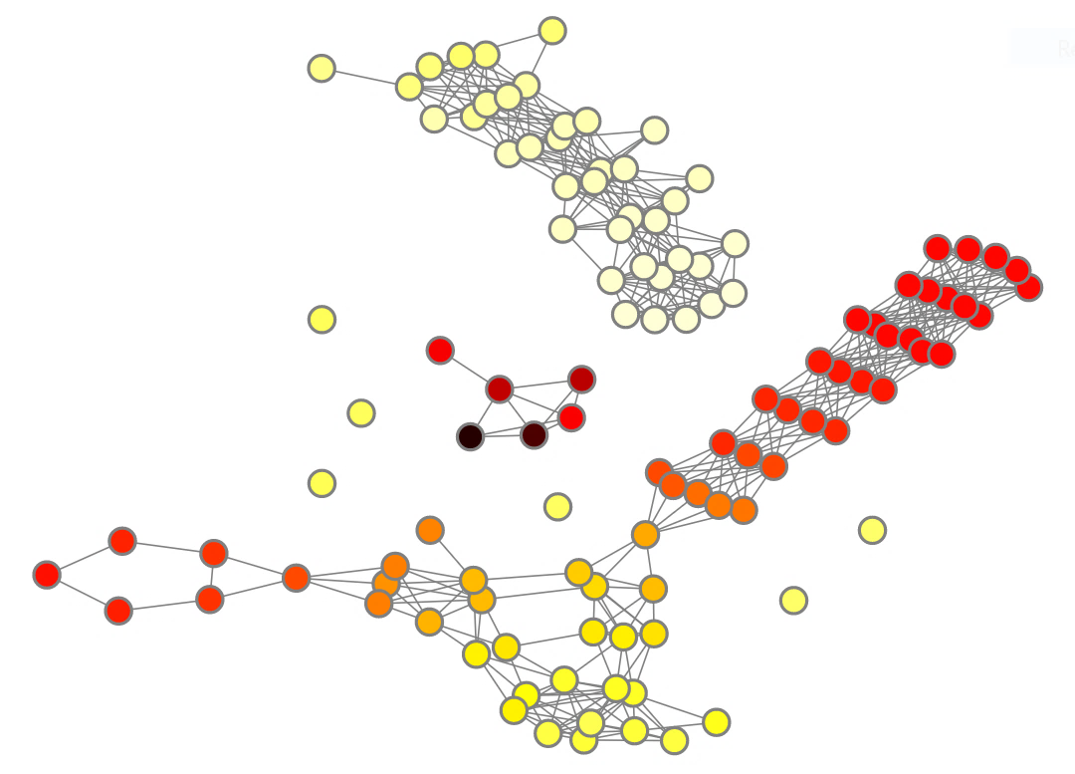
Why Visualize Data?
Data Visualization in Practice (TDA)
TDA algorithm
Unstructured raw data
Topological data model
(a TDA graph)

Slide 23
Why Visualize Data?
A little secret about data visualization:
it illuminates the truth, but it also empowers us to deceive

Slide 24
Tools for visualization
Excel, Google Sheets – easy and simple, but limited
Tableau, Power BI – fast, interactive dashboard
Python/R – most flexible, needs coding
Python (matplotlib, seaborn, plotly) – analytics & ML
R (ggplot2, shiny) – statistical study (e.g Clinical Study)
…
…
Notes:
Dashboard - приладова панель

Slide 25
Tools for visualization
Excel/Google Sheets
TOTCHOL_2 | TOTCHOL_3 | AGE_1 | AGE_2 | AGE_3
 | 209 | 39 |  | 52
260 | 237 | 46 | 52 | 58
283 |  | 48 | 54
232 |  | 61 | 67
343 |  | 46 | 51 | 58
230 | 220 | 43 | 49 | 55
220 |  | 63 | 70
Notes:
Dashboard - приладова панель

Slide 26
Tools for visualization
Excel/Google Sheets
Notes:
Dashboard - приладова панель

Slide 27
Tools for visualization
Excel/Google Sheets
Notes:
Dashboard - приладова панель

Slide 28
Tools for visualization
Excel/Google Sheets
Notes:
Dashboard - приладова панель

Slide 29
Tools for visualization
Excel/Google Sheets
Notes:
Dashboard - приладова панель

Slide 30
Tools for visualization
Excel/Google Sheets
Notes:
Dashboard - приладова панель

Slide 31
Tools for visualization
Google Sheets
Notes:
Dashboard - приладова панель

Slide 32
Tools for visualization
Tableau/Power BI
https://public.tableau.com/app/learn/sample-data
https://app.powerbi.com/
Notes:
Dashboard - приладова панель

Slide 33
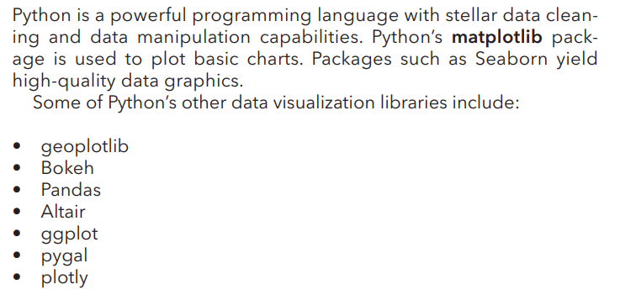
Tools for visualization
Python
Notes:
Dashboard - приладова панель

Slide 34
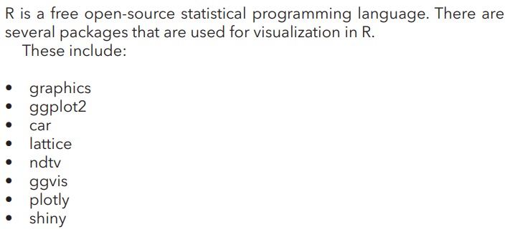
Tools for visualization
R and RSTUDIO
Notes:
Dashboard - приладова панель

Slide 35
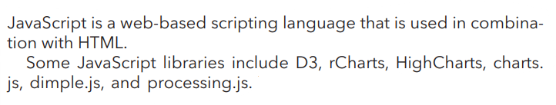
Tools for visualization
JavaScript
knowledge_graph_example.html
Notes:
Dashboard - приладова панель

Slide 36
Resources, References, Materials
TG group for communication: https://t.me/+b3jhNX3o54I2MTE6
Books:
- Муляр В. П. Візуалізація даних та інфографіка. - Camm, J. D., Cochran, J. J., Fry, M. J., & Ohlmann, J. W.. Data Visualization: Exploring and Explaining with Data.
- Claus O. Wilke. Fundamentals of Data Visualization.
- Jack Dougherty Ilya Ilyankou. Hands-On Data Visualization Interactive Storytelling from Spreadsheets to Code. (https://handsondataviz.org/HandsOnDataViz.pdf)
- Kieran Healy. Data Visualization: A Practical Introduction. - Kristen Sosulski, Data Visualization Made Simple Insights into Becoming Visual.
Other:
- GitHub Гіт for Claus O. Wilke. https://github.com/clauswilke/dataviz and https://github.com/clauswilke/dviz.supp
- Visualize It! A Comprehensive Guide to Data Visualization https://www.netquest.com/hubfs/docs/ebook-data-visualization-EN.pdf

Slide 37
Чому важливо якісно візуалізувати дані та 10 принципів, як це зробити https://dou.ua/forums/topic/43516/
What Is Data Visualization? Definition, Examples, And Learning Resources https://www.tableau.com/visualization/what-is-data-visualization
Як і для чого використовувати візуалізацію даних? http://eidos.org.ua/novyny/yak-i-dlya-choho-vykorystovuvaty-vizualizatsiyu-danyh/
Візуалізація. Відкритий посібник з відкритих даних https://socialdata.org.ua/manual5/
Візуалізація даних з використанням умовного форматування і sparklines. Аналітика даних в Excel https://youtu.be/zljVZT2V_xA?si=usGlUnWfEACKzxtk
10 Advanced Excel Charts https://youtu.be/lUjZa4YBixI
13 Scientific Reason Why Your Brain Craves Infographics https://neomam.com/13reasons/

