Slide 1

US Housing Market Prediction
Big Data – hands on project usuc alexandru

Slide 2


Introduction
The housing market plays a crucial role in the US economy, affecting everything from personal wealth to national financial stability
Predicting housing prices is a challenge due to the vast amount of data and the complex factors involved, such as location, economy, demographics and market trends.

Slide 3

Objectives
The objectives for this project are:
Analyze the large dataset with millions of records and over 3GB of real estate data
Preprocess the data
Generate helpful diagrams which will help us understand the dataset better
Choose the relevant features for the training process

Slide 4
Dataset
The current dataset contains information from year 2012 until 2024, having features such as:
period of time
region
state code
property type
median sale price
median list price
median days on the market
medina price per square foot
pending sales
homes sold, etc…
Out of all 58 features that this dataset has, I chose just the relevant columns which will help the model predict the median sale price better.

Slide 5
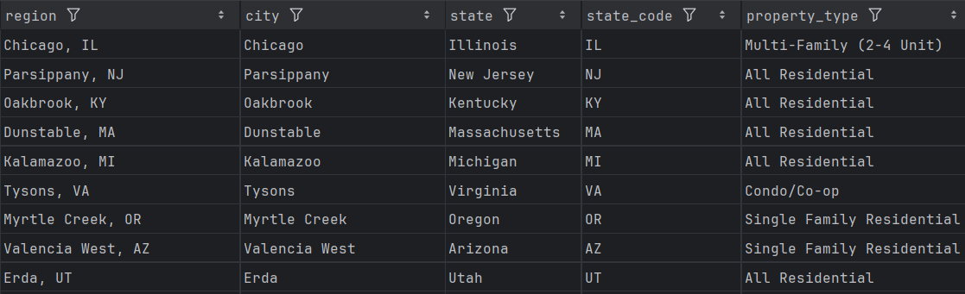
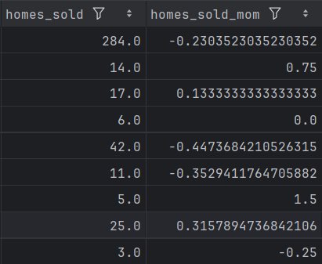
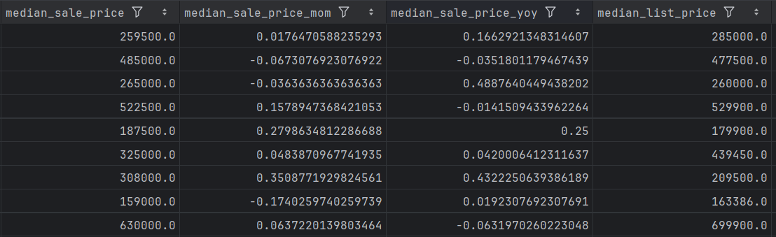
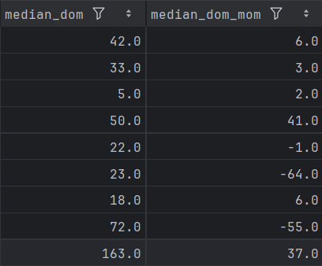

Slide 6
Tools
Tools used during the implementation of this project:
Libraries
numpy
pandas
matplotlib
seaborn
sklearn
Development environments
Pycharm
Jupyter notebook
Google colab

Slide 7
Implementation
The implementation process consists of multiple steps:
Analyze the dataset
Cleansing
Add new relevant columns
Normalize the data
Generate helpful diagrams
Choose the most relevant columns for the training process
Train the model

Slide 8
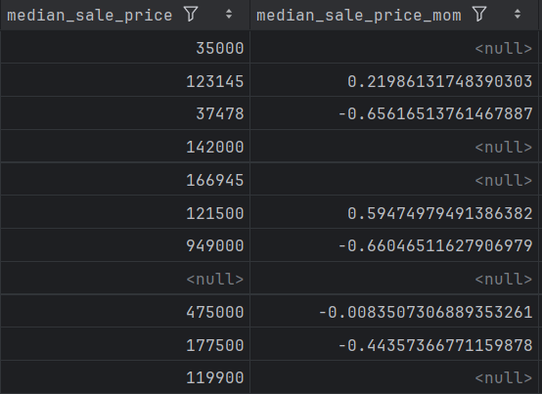
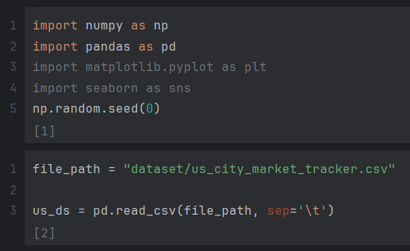

Analyze the data
Cleansing
drop records with null features

Slide 9
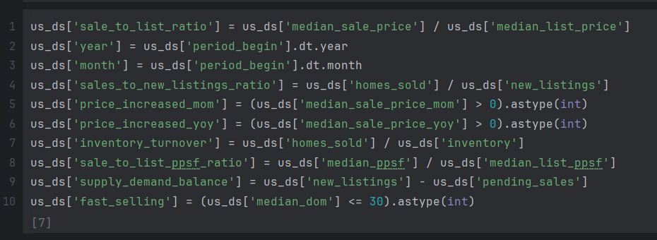
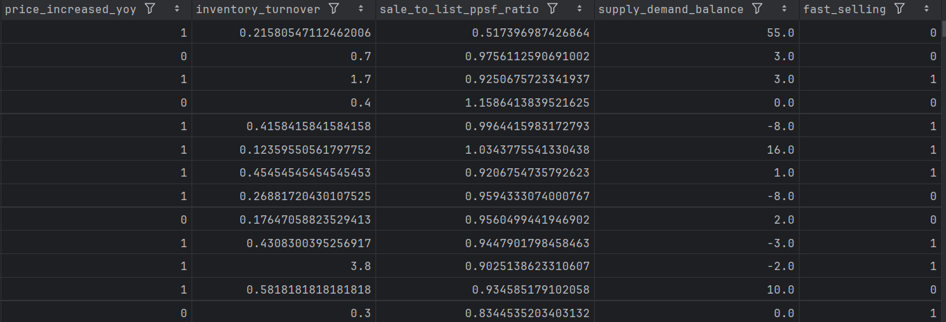
3. Add new relevant columns

Slide 10
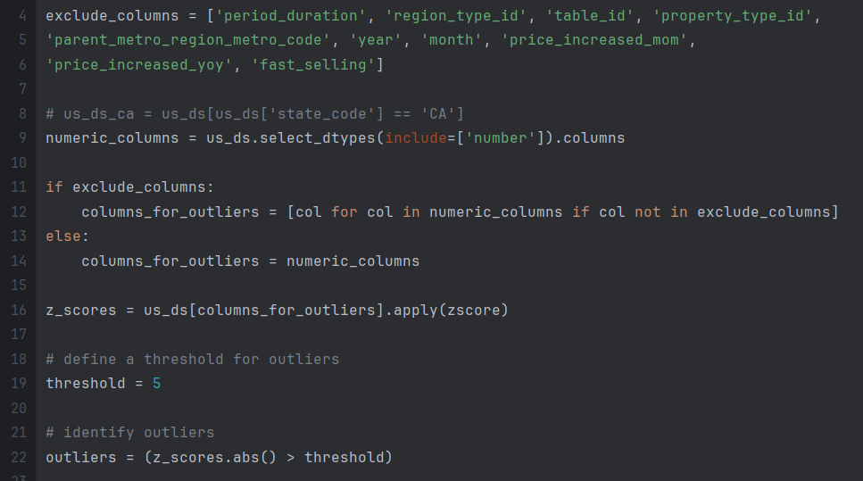
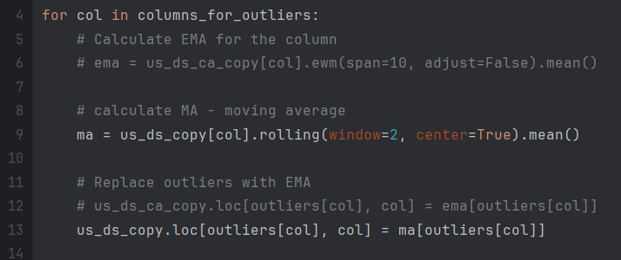
4. Identify the outliers and replace them with moving average (MA)

Slide 11
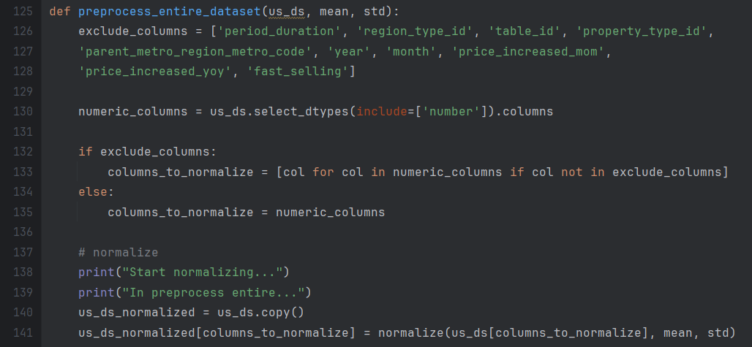
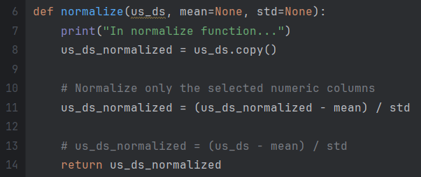
5. Normalize the data

Slide 12
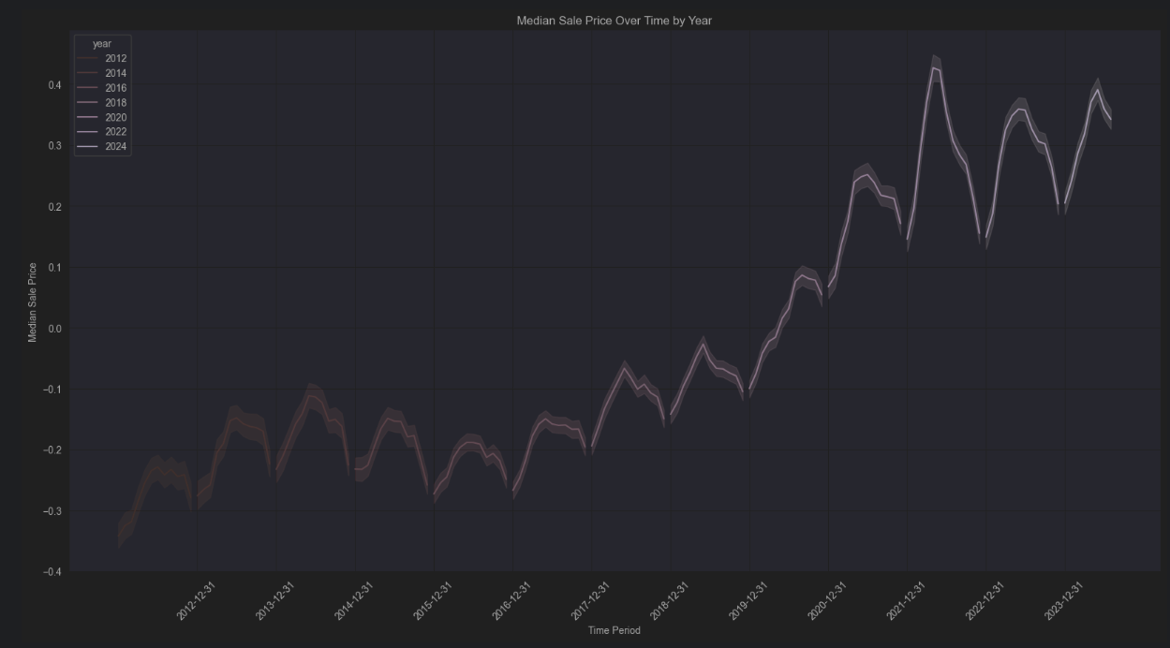
6. Generate diagrams

Slide 13
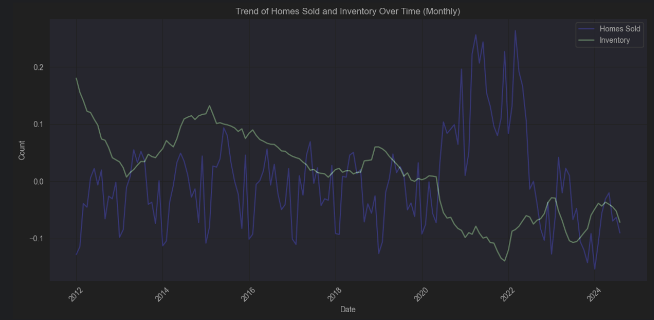

Slide 14
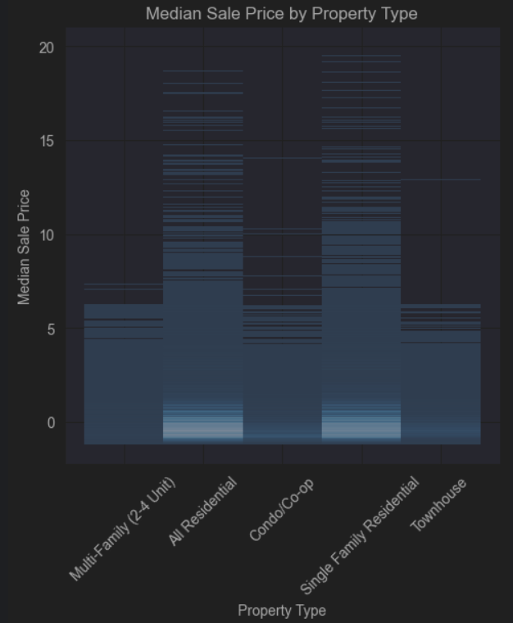
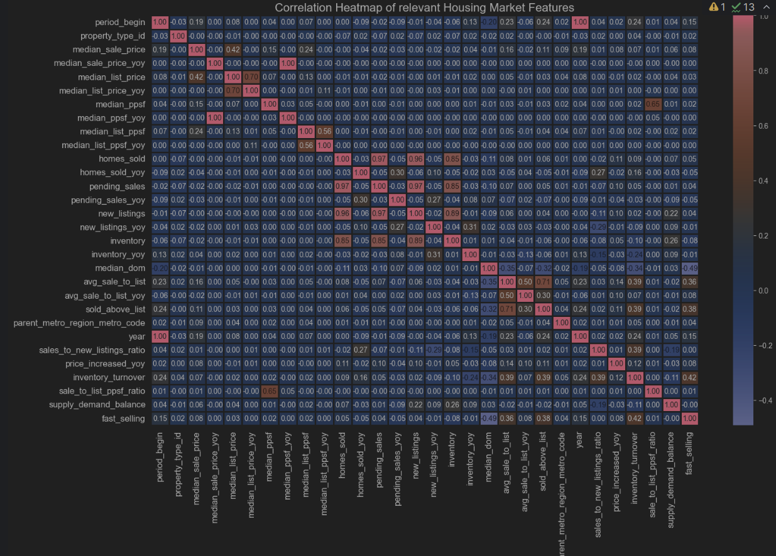

Slide 15
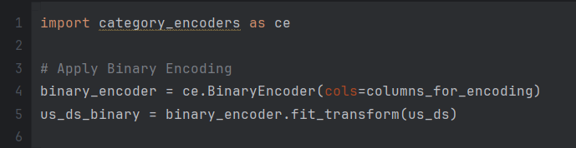

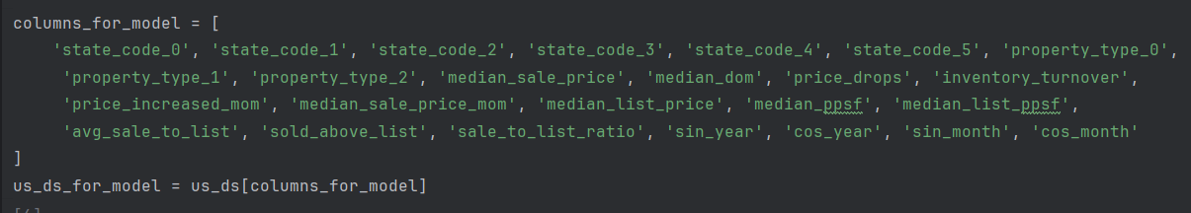
7. Encoding string columns
8. Select the most relevant columns

Slide 16
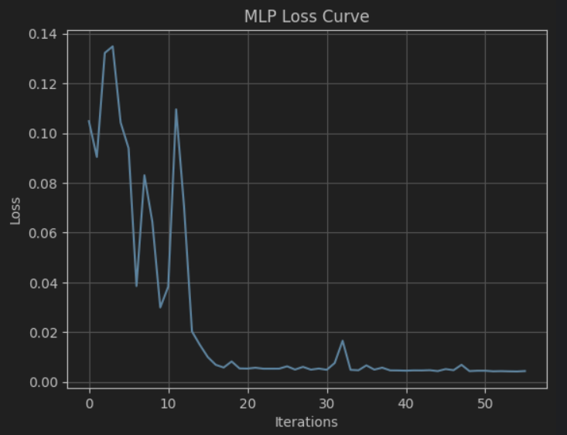
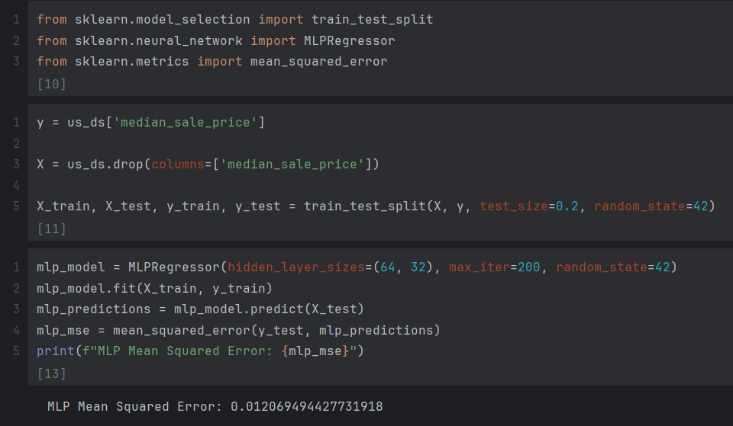
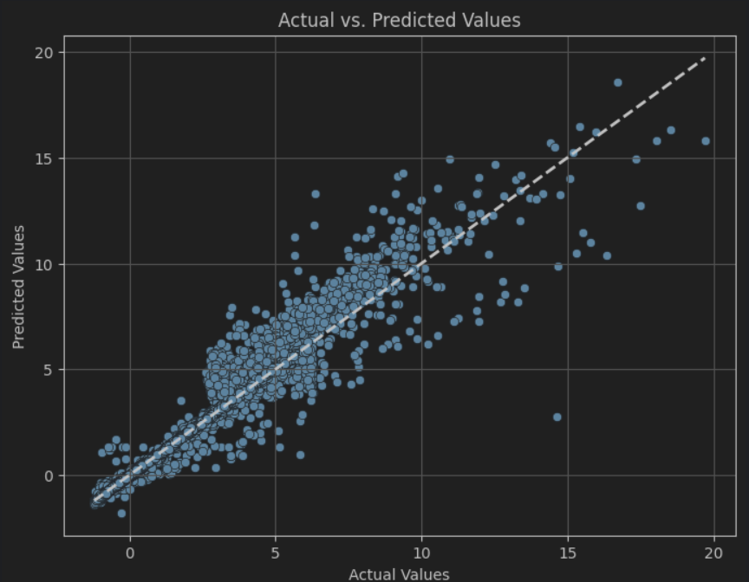
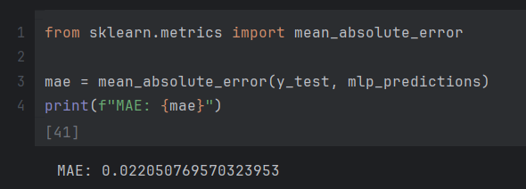
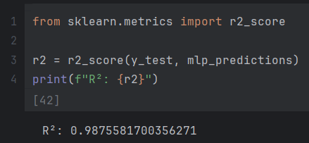
9. Model Training

Slide 17
Bibliography
https://contrib.scikit-learn.org/category_encoders/
https://developer.nvidia.com/blog/three-approaches-to-encoding-time-information-as-features-for-ml-models/
https://www.datacamp.com/tutorial/multilayer-perceptrons-in-machine-learning
https://towardsdatascience.com/multilayer-perceptron-explained-a-visual-guide-with-mini-2d-dataset-0ae8100c5d1c#:~:text=A%20Multilayer%20Perceptron%20%28MLP%29%20is%20a%20type%20of,connects%20to%20all%20nodes%20in%20the%20next%20layer.
https://pythongeeks.org/data-preprocessing-in-machine-learning/

Slide 18
Thank you!

