Slide 1
Thorough Analysis of The Database Issues
The primary factors of the database issues
and strategies for effectively resolving them

Slide 2
1. The primary factors of the database issues
Transaction size that is too large
Table structure that is not optimized
Pragma statement that is unstable
The operations are conflicting with each other

Slide 3
Transaction size that is too large
WAL
Journal File
When x is too large:
Increased Memory Usage
Locking and Concurrency
Journaling and Disk I/O
Rollback and Undo Operations
Crash Recovery
Save Journal File
Database
Transaction with
X rows
Lock and Write
Compose Transaction in Memory
Data to be inserted into the database

Slide 4
Table structure that is not optimized
Values with high frequency should be separated from the main table and stored in a separate table. These values should then be linked to their corresponding ID.
For example, in the AmdPmfSamples table, the field named “display_info” has frequent values.

Slide 5
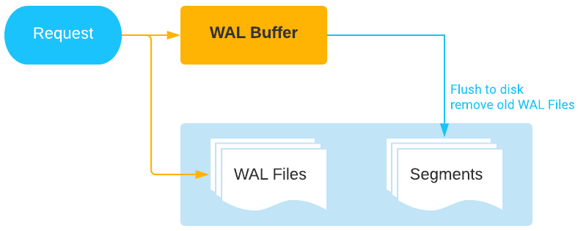
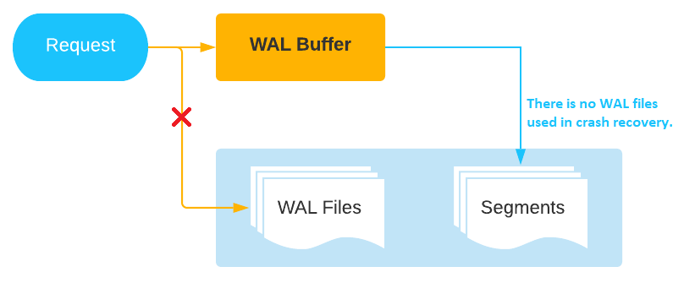
Pragma statement that is unstable
According to the current Pragma statement, WAL Files are not saved, and would not be used for crash recovery.
To avoid this problem, WAL shoud be saved into the journal files.

Slide 6
The operations are conflicting with each other
Operation concurrency | INSERT | VACUUM | SELECT
INSERT | O | X | O (but slower)
VACUUM | X | X | X
SELECT | O (but slower) | X | O

Slide 7
2. Strategies for effectively resolving ISSUES
Minimize the size of transactions to avoid excessive bulk
Optimize the database structure and performance
Implement a partitioned database by the values of date field
Ensure the stability and reliability of the SQLite database
Create an index on the time field to improve query efficiency

Slide 8
Minimize the size of transactions to avoid excessive bulk
WAL
Journal File
Crash Recovery
Save Journal File
To ensure efficient insertion, we should select the appropriate transaction size, X.
Database
Transaction with
X rows
Lock and Write
Compose Transaction in Memory
Data to be inserted into the database

Slide 9
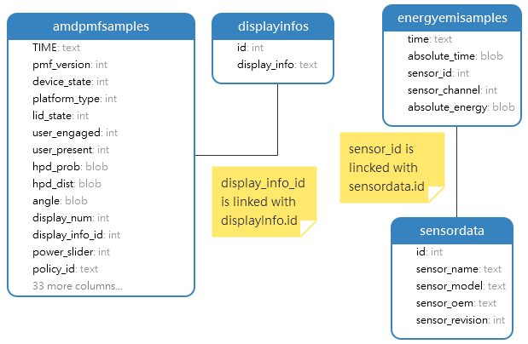
Optimize the database structure and performance

Slide 10
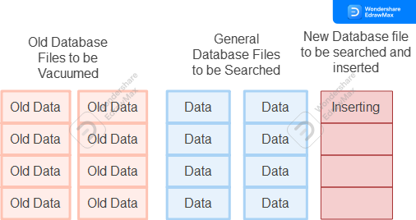
Implement a partitioned database by the values of date field
Instead of vacuuming, file deletion should be used.
New rows are inserted into a fresh file every day.
Searching can be performed on the individual inaccessible files and isolated from vacuum and insertion.
So all operations would be invoked in parallel.

Slide 11
Ensure the stability and reliability of the SQLite database
This Pragma would not generate journal file(WAL).
PRAGMA synchronous=OFF;PRAGMA journal_mode=MEMORY;PRAGMA temp_store=MEMORY;
The primary cause of database crashes is the inability of SQLite to locate the journal file containing logs upon program restart.
So we use the default Pragma options to maintain the journal files.

Slide 12
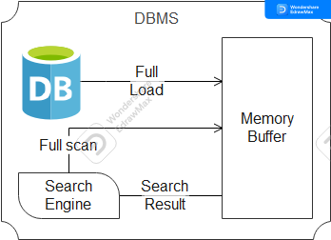
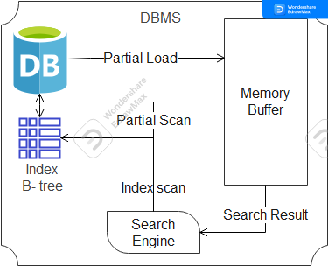
Create an index on the time field to improve query efficiency
Improving search speed is a crucial factor in enhancing system performance.

Slide 13
3. Performance Comparison
Device environment: Core i7 3.4GHz, 8GB RAM, SATA HDD 1TB
Record count: 5,000,000
 | Insertion Speed | Vacuum Time | Search Time
Current method | 110K/s | 75s | 10s
Suggested Method | 50K/s | 0s | 0s

Slide 14
Conclusion
To effectively address database issues, it is vital to implement the following strategies:
Partition the database into multiple files per day.
Create an index on the time field.
Utilize the default Pragma settings and select an appropriate transaction size.
Redesign the database structure to minimize table size.

