Slide 1
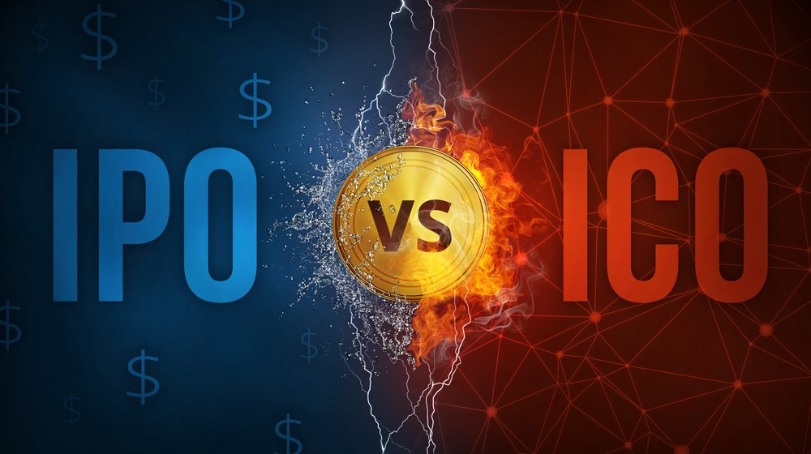
Notes:
Start up is exciting, we might bootstrap, or start with angle investments or other VCs and foundations… if we do well, we probably scale up, and finally biggest milestone and the most exciting thing for most companies, is … I think is to go to the public.
IPO is the way traditional companies raise capitals from the public, ICO is also a crowdfunding method, however that only exist for blockchain companies and they collect cryptocurrencies like Bitcoin or Ethereum rather than US dollars ,,,, in exchange for the company’s token rather than equity, because the investors think the company is gonna do well, and the token price will appreciate.

Slide 2
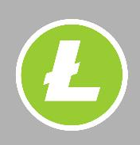
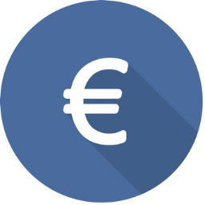
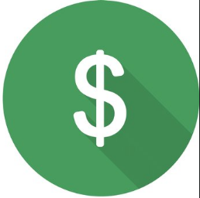

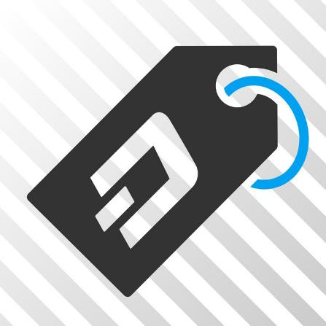


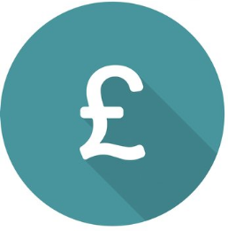
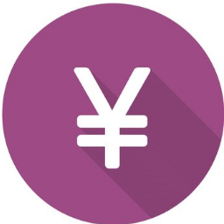


Product
Token
cryptocurrency
Service
Notes:
As Blockchain technology applied to traditional industries, many assets, entities, services are being valued with token. Token is a type of cryptocurrency; and blockchain companies use token to price their product or services, and customers pay token to get the product and services.

Slide 3
List Token.io
Make Token Registration Exponentially Easier
Zoen Lin & Juned Munshi
180 John Street
Toronto, Ontario
Canada, M4Y 3B6
Join Our Telegram
t.me/ListTokenCommunity
t.me/alleymist
Contact us
+1 6478660231
listtoken@gmail.com
z25lin@ryerson.ca
http://listtoken.io/
Notes:
But for blockchain companies to start use the token, it is not easy at all, and ListToken.io makes the Token Registration Exponentially easier.
需要更强的开头
网站不需要文字，ppt也要尽可能少的文字。

Slide 4



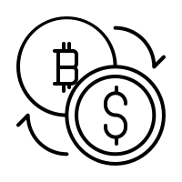
Blockchain Company
ICO List Websites
Wallets
Exchanges
IWEs
Collect Information by Google form
many ICO scams
Problems for Token Registration process
Notes:
Let’s talk about the problems
To do this, they have to register their token information on ICO list website, where most cryptocurrency investor will frequent for invest opportunity. But the registration process are very complicated, and those websites are blocked by Google. so New BC are hard to find them.
为什么屏蔽了，他们做什么。日后需要validate单独加一个ppt来说这个in addition
Secondly, BC have to register token in all kinds of crypto wallets, if not, users’ wallet simply can’t recognize the token. So they can’t use the token.
Thirdly, BC need to register in Exchanges for
Savage so you can apply many internet startup in bc.

Slide 5
Blockchain Company
ICO List Websites
Wallets
Exchanges
IWEs
Collect Information by Google form
many ICO scams
Problems for Token Registration process
Up to 60 IWEs
One month worth of work
Notes:
Let’s talk about the problems
Firstly a blockchain company use ICO to raise capital. Compared to IPO, ICO stand for Initial coin offer and collect cryptocurrencies like Bitcoin or Ethereum. To do this, they have to register their token information on ICO list website, where most cryptocurrency investor will frequent for invest opportunity. But the registration process are very complicated, and those websites are blocked by Google. so New BC are hard to find them.
Secondly, BC have to register token in all kinds of crypto wallets, if not, users’ wallet simply can’t recognize the token. So they can’t use the token.
Thirdly, BC need to register in Exchanges for
BC companies might need register up to 60 ICO list Websites, Wallets and Exchanges. And quicker presentation Let’s call them IWEs

Slide 6

Solution:
http://listtoken.io/
Blockchain Company
ICO List Websites
Wallets
Exchanges
Sign up around 60 IWEs
IWEs
Collect Information by Google form
many ICO scams
Notes:
The solution is simple think of Kijiji or any other realtor website, Companies register token information in our site, and we will help do the batch registration to our partner IWEs.
Kijiji没有registration但是这里有。换个说法，fill one form, you will get all your customer 结果导向。
ListToken also validate the token’s project, and provide an credible regulatory evaluation report for IWEs. We just filter out bad projects.

Slide 7
How it works
http://listtoken.io/
Batch Registration
Register token info using an one standard form
Automatically register through API
Keep updated
Reg fee
Notes:
So how does it work?
ListToken provide one standard form, and use the front end coding to explain the Blockchain terminology.
After filling the form, ListToken will use APIs to automatically push the data to our partners, to do the registration.
Listtoken will register all existing IWEs and also new IWEs that pop up in the future, so that company won’t have to keep an eye for
分开写更好，这样会不confusing
用更多slide
Also we will charge each of out partners some money, and hire blockchain experts, and lawyers to do the validation and write the report. We will prepare a funding pool to take the liability for validation.
So generally speaking, we connect the two group of people

Slide 8
How it works
http://listtoken.io/
Batch Registration
Register token info using an one standard form
Automatically register through API
Keep updated
Platform Service
Regulation compliance validation
Expertise Validation report.
Funding pool for liability
Reg fee Subscription
Notes:
So how does it work?
ListToken provide one standard form, and use the front end coding to explain the Blockchain terminology.
After filling the form, ListToken will use APIs to automatically push the data to our partners, to do the registration.
Listtoken will register all existing IWEs and also new IWEs that pop up in the future, so that company won’t have to keep an eye for
分开写更好，这样会不confusing
用更多slide
Also we will charge each of out partners some money, and hire blockchain experts, and lawyers to do the validation and write the report. We will prepare a funding pool to take the liability for validation.
So generally speaking, we connect the two group of people

Slide 9
Batch Registration
Register token info using an one standard form
Automatically register through API
Keep updated
http://listtoken.io/
Platform Service
Regulation compliance validation
Expertise Validation report.
Funding pool for liability
Saves one month work for blockchain companies.
Cut the validation fee by 90%
Notes:
The VP 不需要这个slide了
In this way, Blockchain companies can save around one month work,
The connection, the consulting, the search work and so on.
And Cut the validation fee for each IWE partners by 90%

Slide 10
Market Size
TAM:
By statistic from coinmarketcap, averagely 1,900 new token registration per month
SAM:
From statistic from icodata.io and icoservice.io there are 600 ICO available in NA.
SOM:
According to validation, 80% of SAM
Means: $86,400 revenue per month.
1,900 ICO / mo. globally
600 ICO / mo. Available globally
480 ICO / mo. Servable
^{市}
Notes:
这个是针对投资人的，但是不需要对customer说。
了解自己的听众非常重要。
对customer说，
有很多竞争， 你需要marketing。Seriously
This
[重要] 要获取每个客户需要花多少钱？？【这一点很重要】
你已经帮助了多少人？？

