Slide 1
List Token.io
Make Token Registration Exponentially Easier
Zoen Lin & Yesbit Co. Ltd.
180 John Street
Toronto, Ontario
Canada, M4Y 3B6
Join Our Telegram
t.me/ListTokenCommunity
t.me/alleymist
Contact us
+1 6479799207
zlin@yesbit.ca
z25lin@ryerson.ca
http://listtoken.io/
Notes:
Hello everyone, this is ListToken.io, an IT company that serves blockchain companies. As Blockchain technology applied to traditional industries, many assets, entities, services are being valued with token. Token is a type of cryptocurrency; and blockchain companies use token to price their product or services, and customers pay token to get the product and services.
But for blockchain companies to start use the token, it is not easy at all, and ListToken.io makes the Token Registration Exponentially easier.
需要更强的开头
网站不需要文字，ppt也要尽可能少的文字。

Slide 2



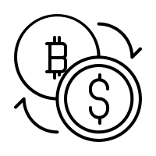
Blockchain Company
ICO List Websites
Wallets
Exchanges
IWEs
Collect Information by Google form
many ICO scams
Problems for Token Registration process
Notes:
Let’s talk about the problems
Firstly a blockchain company use ICO to raise capital. Compared to IPO, ICO stand for Initial coin offer and collect cryptocurrencies like Bitcoin or Ethereum. To do this, they have to register their token information on ICO list website, where most cryptocurrency investor will frequent for invest opportunity. But the registration process are very complicated, and those websites are blocked by Google. so New BC are hard to find them.
为什么屏蔽了，他们做什么。日后需要validate单独加一个ppt来说这个in addition
Secondly, BC have to register token in all kinds of crypto wallets, if not, users’ wallet simply can’t recognize the token. So they can’t use the token.
Thirdly, BC need to register in Exchanges for
Savage so you can apply many internet startup in bc.

Slide 3
Blockchain Company
ICO List Websites
Wallets
Exchanges
IWEs
Collect Information by Google form
many ICO scams
Problems for Token Registration process
Up to 60 IWEs
One month worth of work
Notes:
Let’s talk about the problems
Firstly a blockchain company use ICO to raise capital. Compared to IPO, ICO stand for Initial coin offer and collect cryptocurrencies like Bitcoin or Ethereum. To do this, they have to register their token information on ICO list website, where most cryptocurrency investor will frequent for invest opportunity. But the registration process are very complicated, and those websites are blocked by Google. so New BC are hard to find them.
Secondly, BC have to register token in all kinds of crypto wallets, if not, users’ wallet simply can’t recognize the token. So they can’t use the token.
Thirdly, BC need to register in Exchanges for
BC companies might need register up to 60 ICO list Websites, Wallets and Exchanges. And quicker presentation Let’s call them IWEs

Slide 4

Solution：
http://listtoken.io/
Blockchain Company
ICO List Websites
Wallets
Exchanges
Sign up around 60 IWEs
IWEs
Collect Information by Google form
many ICO scams
Notes:
The solution is simple think of Kijiji or any other realtor website, Companies register token information in our site, and we will help do the batch registration to our partner IWEs.
Kijiji没有registration但是这里有。换个说法，fill one form, you will get all your customer 结果导向。
ListToken also validate the token’s project, and provide an credible regulatory evaluation report for IWEs. We just filter out bad projects.

Slide 5
How it works
http://listtoken.io/
Batch Registration
Register token info using an one standard form
Automatically register through API
Keep updated
Reg fee
Notes:
So how does it work?
ListToken provide one standard form, and use the front end coding to explain the Blockchain terminology.
After filling the form, ListToken will use APIs to automatically push the data to our partners, to do the registration.
Listtoken will register all existing IWEs and also new IWEs that pop up in the future, so that company won’t have to keep an eye for
分开写更好，这样会不confusing
用更多slide
Also we will charge each of out partners some money, and hire blockchain experts, and lawyers to do the validation and write the report. We will prepare a funding pool to take the liability for validation.
So generally speaking, we connect the two group of people

Slide 6
How it works
http://listtoken.io/
Batch Registration
Register token info using an one standard form
Automatically register through API
Keep updated
Platform Service
Regulation compliance validation
Expertise Validation report.
Funding pool for liability
Reg fee Subscription
Notes:
So how does it work?
ListToken provide one standard form, and use the front end coding to explain the Blockchain terminology.
After filling the form, ListToken will use APIs to automatically push the data to our partners, to do the registration.
Listtoken will register all existing IWEs and also new IWEs that pop up in the future, so that company won’t have to keep an eye for
分开写更好，这样会不confusing
用更多slide
Also we will charge each of out partners some money, and hire blockchain experts, and lawyers to do the validation and write the report. We will prepare a funding pool to take the liability for validation.
So generally speaking, we connect the two group of people

Slide 7
Batch Registration
Register token info using an one standard form
Automatically register through API
Keep updated
http://listtoken.io/
Platform Service
Regulation compliance validation
Expertise Validation report.
Funding pool for liability
Saves one month work for blockchain companies.
Cut the validation fee by 90%
Notes:
The VP 不需要这个slide了
In this way, Blockchain companies can save around one month work,
The connection, the consulting, the search work and so on.
And Cut the validation fee for each IWE partners by 90%

Slide 8
Why ListToken?
Essential Procedure for every ICO
Best Investing Timing
Cryptocurrency market burst
PEST Analysis
Political, Economic, Social, Technological factors
^{必}
^{量}
First group of explorers
No competitors
High Risk, High return
The cryptocurrency market has already calm down, ICO scams are little now.
^{竞}
^{替}
Notes:
Token registration is inevitable for every ICO, and 2018 is the hottest time to invest as public’s consensus on blockchain are starting to form up. the market is great. Billions of capitals want to enter the market.
Canada’s policy to blockchain is friendly, People are open to new technology,
Please remember that we are the first group of explorer, no competitior . I have to say it’s risky. But high risk high return, that’s the golden law.
提一下自己之前做的工作。

Slide 9
Market Size
TAM:
By statistic from coinmarketcap, averagely 1,900 new token registration per month
SAM:
From statistic from icodata.io and icoservice.io there are 600 ICO available in NA.
SOM:
According to validation, 80% of SAM
Means: $86,400 revenue per month.
1,900 ICO / mo. globally
600 ICO / mo. Available globally
480 ICO / mo. Servable
^{市}
Notes:
这个是针对投资人的，但是不需要对customer说。
了解自己的听众非常重要。
对customer说，
有很多竞争， 你需要marketing。Seriously
This
[重要] 要获取每个客户需要花多少钱？？【这一点很重要】
你已经帮助了多少人？？

Slide 10
Roadmap of first milestone
Development
Dev+Marketing
Business Plan
2018.06
2018.05
Gov/Angel Funding
Pre-seed/seed funding
Other VC
201806
Website development
2018.09
2019.04
Marketing + development/maintenance.
2018.02
Hire Advisor team
Scale up
2018.12
2018
2019.01
Notes:
When will be ready???
You can sign a beta
Google不直接，我需要更多的帮助，to best answer the question.
我现在就可以帮助你们解决问题了。
只要你填了表，就可以帮你注册。
多长时间就可以用？
我现在就可以赚钱了，就算是manually的。
到时候就是instant的注册了。
之前需要很久才能注册，
投资人和用户关注的东西是不一样的
Validation用单独的
I have built the prototype of the product, you can visit listtoken.io anytime.
there will be two milestones.
Firstly, I will hire a team to finish the minimal viable website, which has all core functions. So that I can choose to bootstrap or start pre-seed and seed.
With that funding, I will start digital marketing and hire a IT team to keep updating the website. Better look, better interaction, better experience.
We will also cooperate with BC advisor group to cooperate with the validation, say, catallaxy is a Montreal based advisor group that has 50 people help enterprise do the blockchain transformation.

Slide 11
Business Model
^{商}
Revenue
Pricing
Strategy
+
+
+
^{Blockchain Companies:}
^{-One-time service fee}
^{IWEs:}
^{-Subscription}
^{Blockchain Companies:}
^{-3 ETH per ICO}
^{IWEs:}
^{-$2,000 per month}
-Digital marketing
-Blockchain conference branding
Notes:
对投资人有用，
但是对customer没用

Slide 12
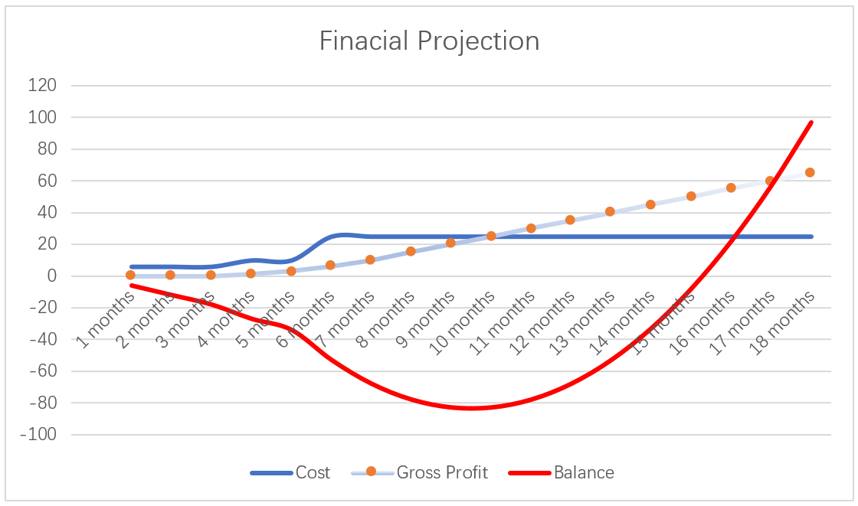
From month 1 - 18
^{财}
Financial Forecast
Revenue
Cost
Financing
+
+
+
^{Blockchain Companies:}
^{-One-time service fee}
^{IWEs:}
^{-Subscription}
^{-Development}
^{-Marketing}
^{-Team}
Pre-seed
Seed

Slide 13
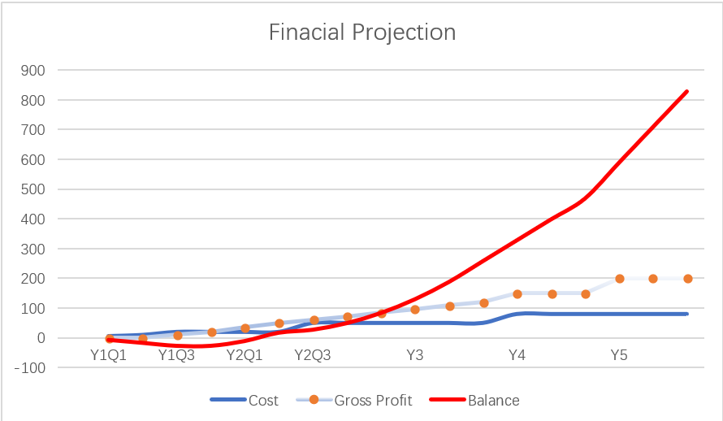
From year 1 - 5
^{财}
Financial Forecast
Revenue
Cost
Financing
+
+
+
^{Blockchain Companies:}
^{-One-time service fee}
^{IWEs:}
^{-Subscription}
^{-Development}
^{-Marketing}
^{-Team}
Pre-seed
Seed
Notes:
It is clear we are sustainable.
And we will earn much more as the ICO amount increasing.
投资人有用用户没用，
大会的时候我可以现场问

Slide 14





Peoples
Team Members
队
Jiakang Liu
David Andrews
CTO
Advisor
Rytta Group Co.
Zoen Lin
Blues Q
We are Looking for a CEO
Founder & Director
Advisor
Yesbit. Co. Ltd.
Notes:
How you gonna believer we can do this??
There is only two team members and two advisors, this is enough for the first milestone.
But to operate as a business, I still need 1 manager, 2 programmers, 2 marketers, 1 UI designer, shoot me a message if you are interested.

Slide 15
Reference
SAM and SOM reference:
https://www.icodata.io/
http://icoservice.co/
TAM reference:
https://coinmarketcap.com/
Product Reference:
http://listtoken.io/
PEST reference:
https://www.quora.com/How-can-we-carry- out-a-forward-PESTLE-analysis-for-blockchain- companies

Slide 16
Root Cause
For Blockchain Companies:
Crypto-market is primitive and disordered
Token registration need blockchain expertise.
For of ICO website, Wallets and Exchanges
Hard to collect information / no template
Government has no supervision.
Validating regulation is very expensive.
Blockchain Company
ICO List Websites
Wallets
Exchanges
Sign up around 60 IWEs
IWEs
Collect Information by Google form
many ICO scams
Notes:
The problem section is different from what I wrote in the Business Plan.
Savage so you can apply many internet startup in bc.

