Slide 1
Lecture 1
Content:
Introduction to the course.
Introduction to HTML
HTML tags
list
Table
Form
Css Layouts
Css Flexbox

Slide 2
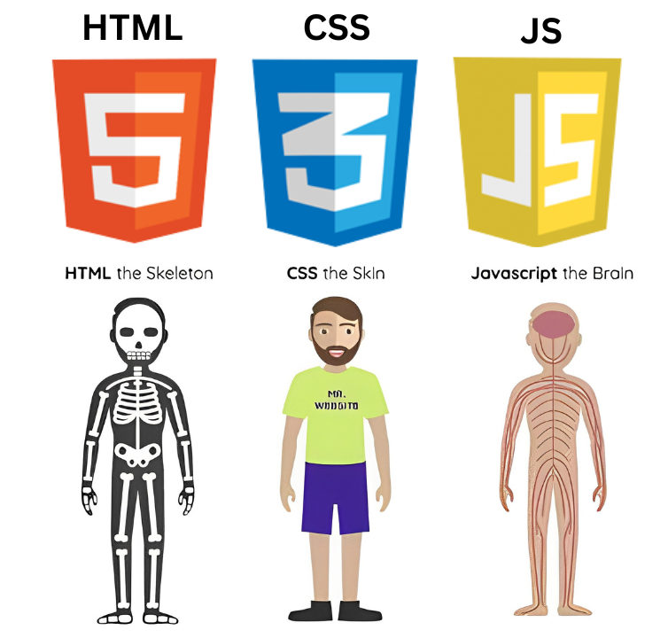
Difference between HTML, CSS, JS.

Slide 3
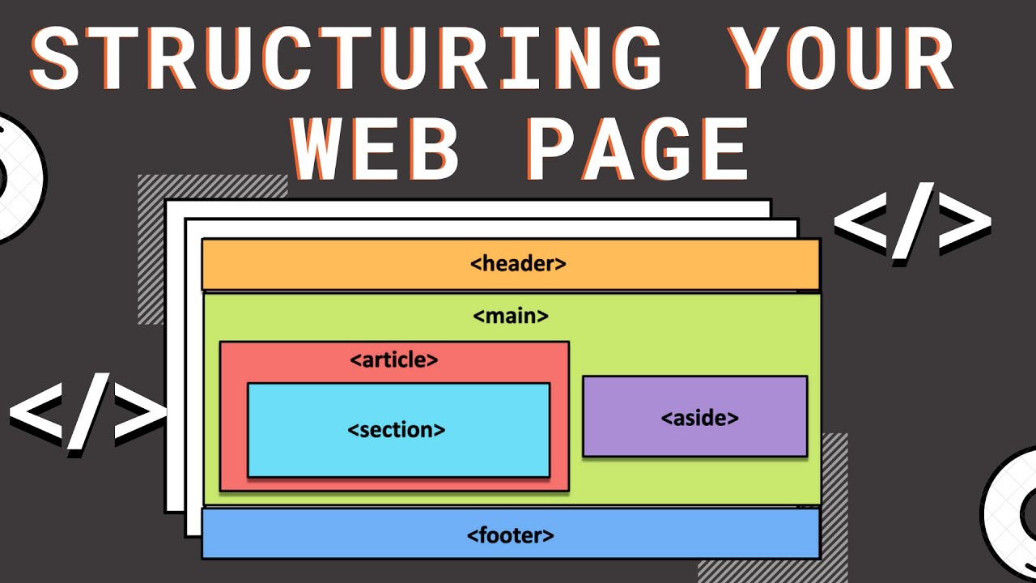
HTML is used to structure a webpage

Slide 4
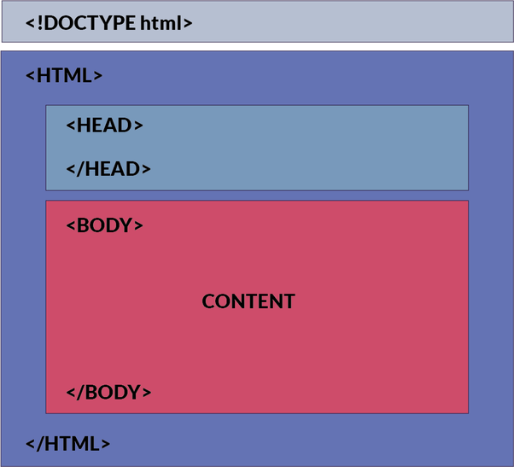
HTML tags are the containers used to structure a webpage

Slide 5
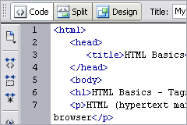
Basic HTML tags

Slide 6
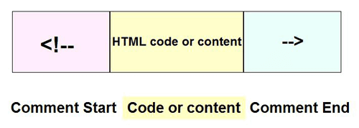
Comments in HTML

Slide 7
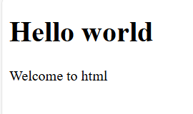
Activity
Use all the basic tags to display the following

Slide 8
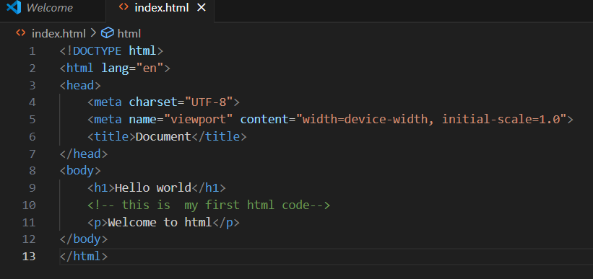
Solution

Slide 9
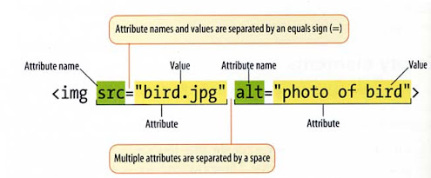
HTML attributes are used to add information to the tags

Slide 10
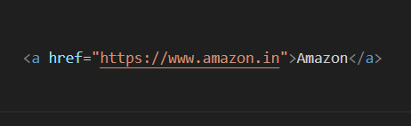
Anchor tag is used to add links to the web page

Slide 11
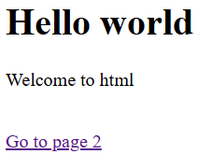
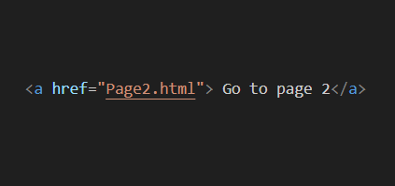
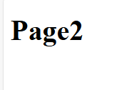
Navigating between pages

Slide 12
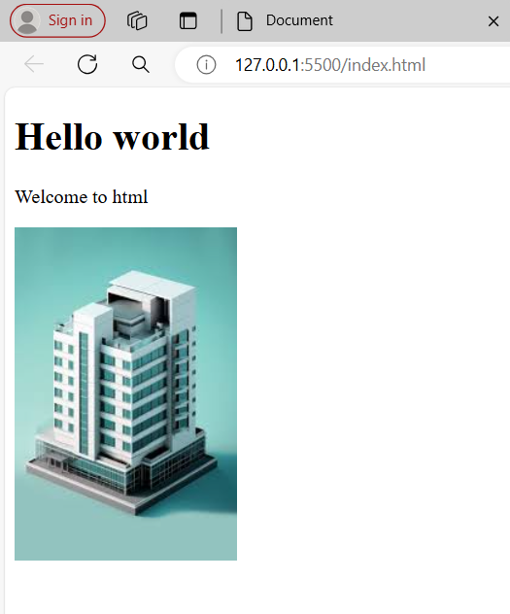
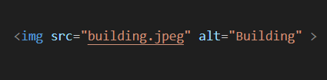

Inserting images

Slide 13

Use <br> tag to add next line break to the page

Slide 14
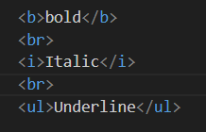
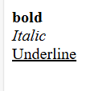
Bold, Italic & Underline tags

Slide 15

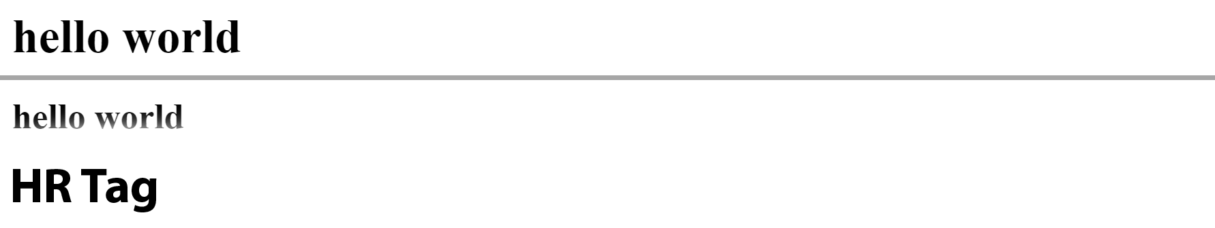
Horizontal ruler

Slide 16
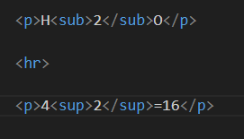
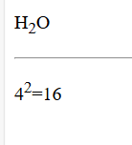
Subscript & superscript

Slide 17
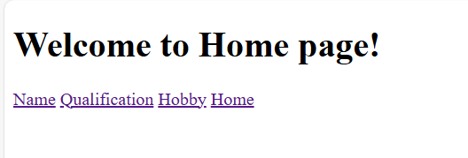
Activity
Create 4 webpages ( Home, Name, Qualification, Hobby). User should be able to navigate between these pages.

Slide 18
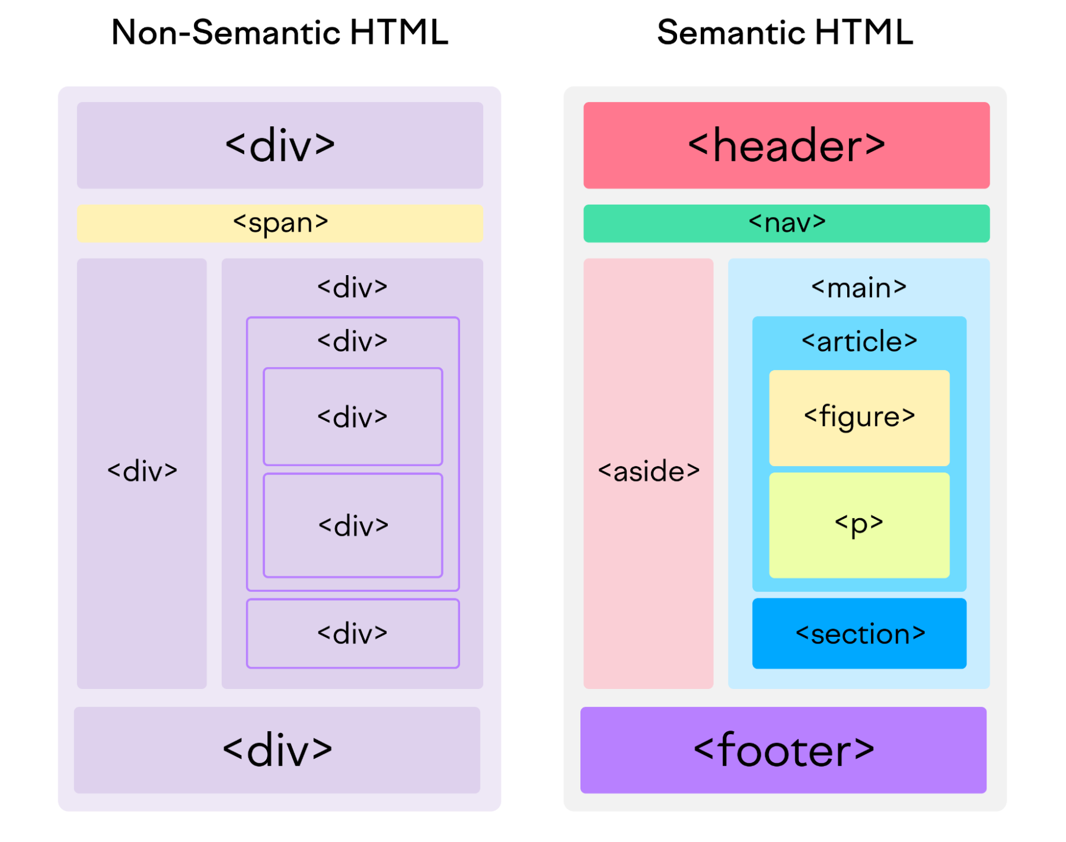
Semantic & non-semantic tags

Slide 19
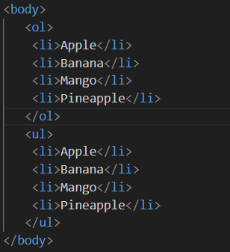
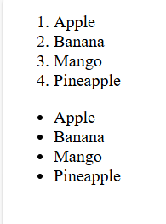
List

Slide 20
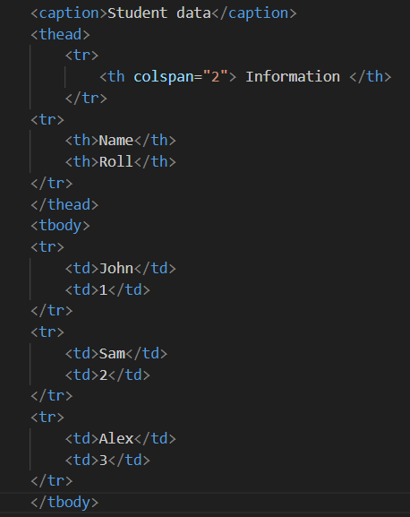
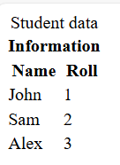
Tables: <tr> <td> <th>

Slide 21
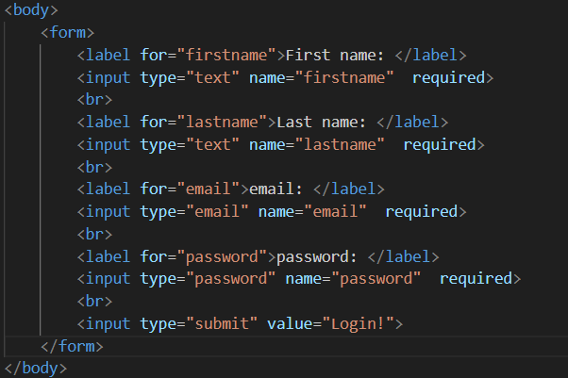
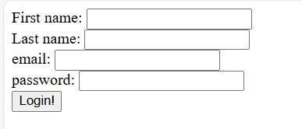
Forms

Slide 22
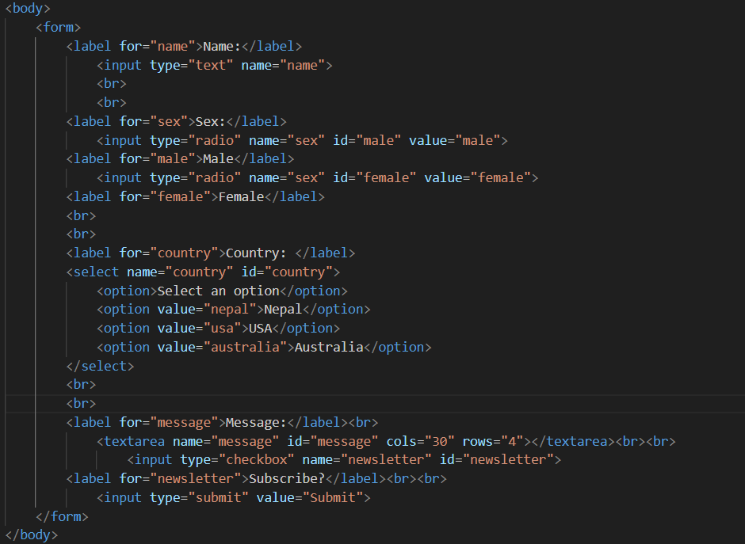
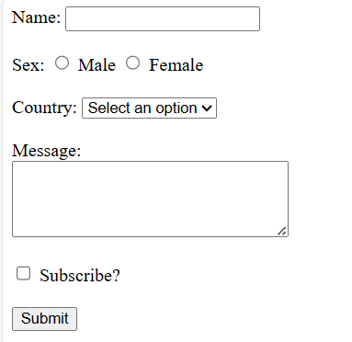
Forms

Slide 23
CSS
Cascading Style Sheets (CSS) is a stylesheet language used to describe the presentation of a document written in HTML or XML.
CSS is what you use to selectively style HTML elements.

Slide 24
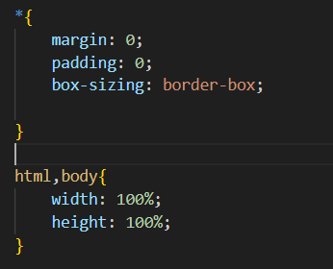
Boiler plate for css file

Slide 25
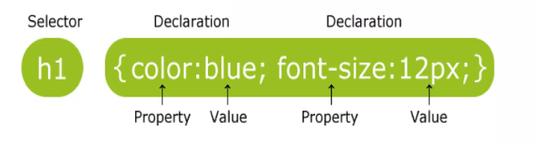
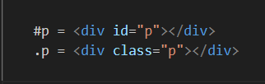
Targeting a block from HTML file

Slide 26
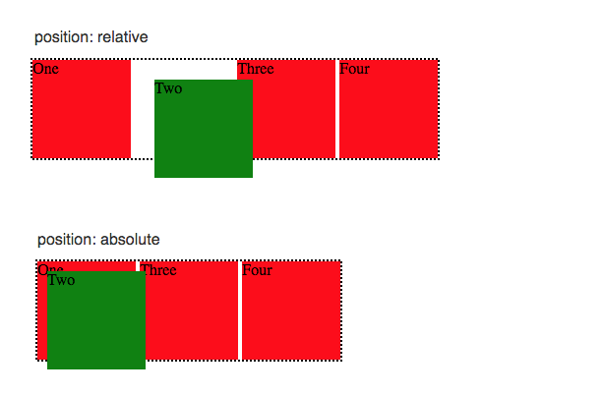
CSS layouts: Absolute & relative positions

Slide 27
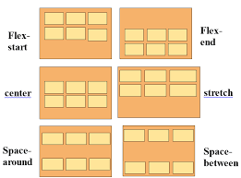
Flexbox

Slide 28
THANKYOU!
For any queries contact me at reactwithprabal@gmail.com

