Slide 1
Crop Yields Australia
Generated on 02-10-2023

Slide 2
Crop Run Details
This involved a run with no nitrogen stress and all crops planted in all available cropland in Australia. The DSSAT crop 4.7.5 crop model was used. Yields are estimated circa approximately 2010. Cultivars for soybean are accurate, but wheat and maize are using US averages. Average yield is shown in the figures below in units kg/ha. Existing irrigated area is used and incorporated into the estimate. Comparison historical yields are for SPAM2010.

Slide 3
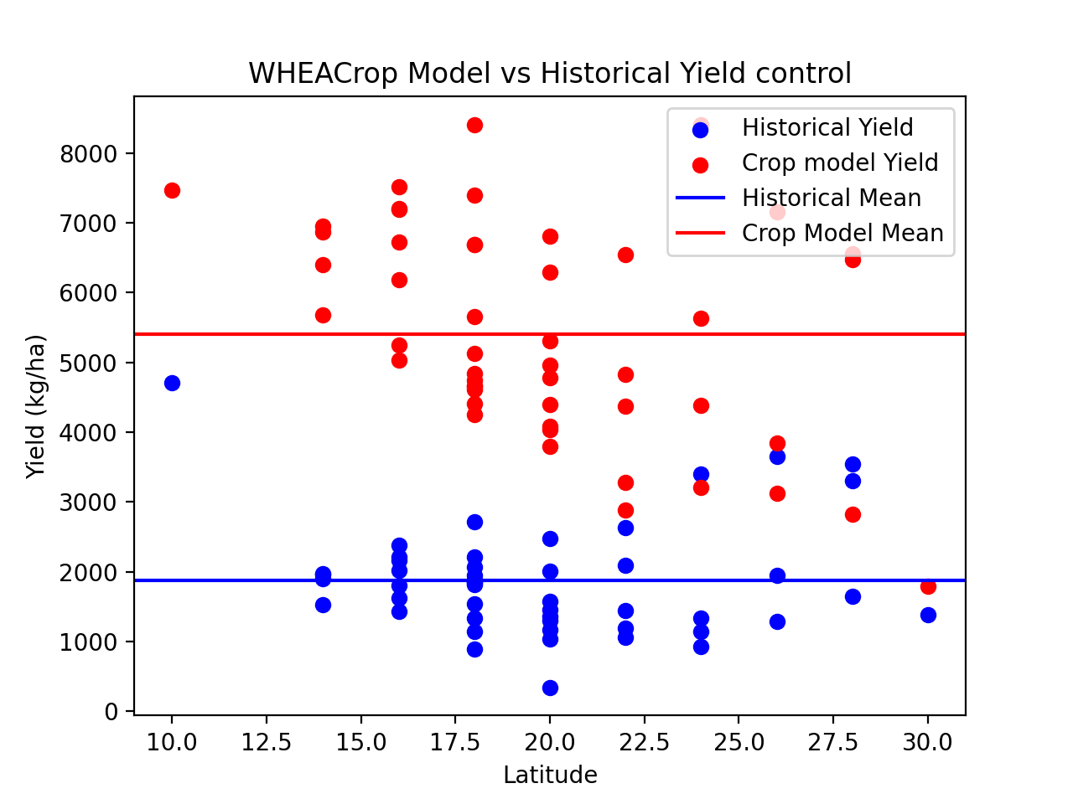
WHEA control

Slide 4
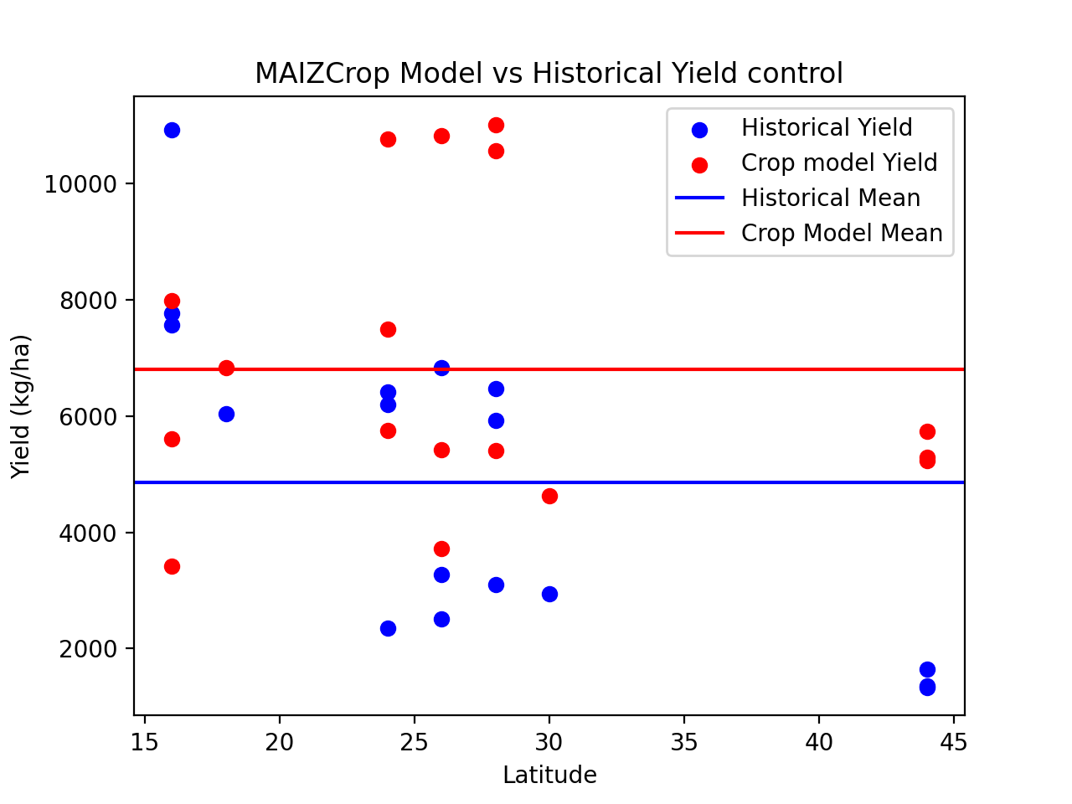
MAIZ control

Slide 5
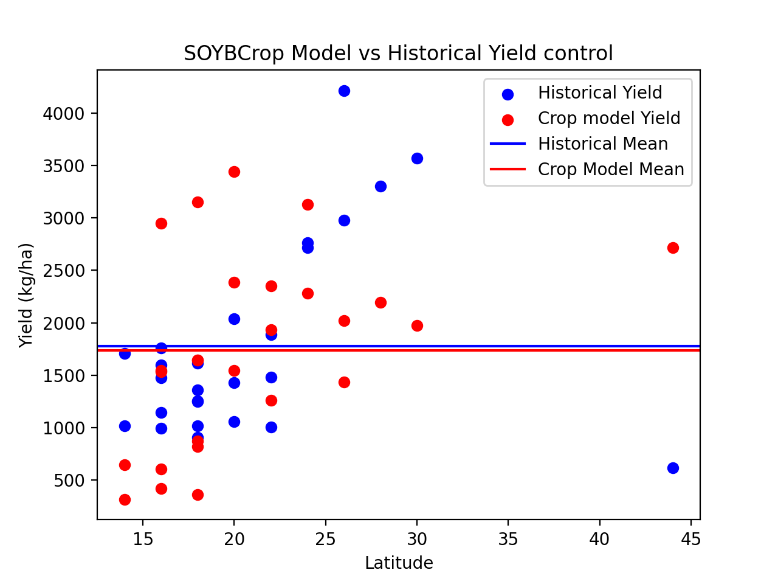
SOYB control

Slide 6
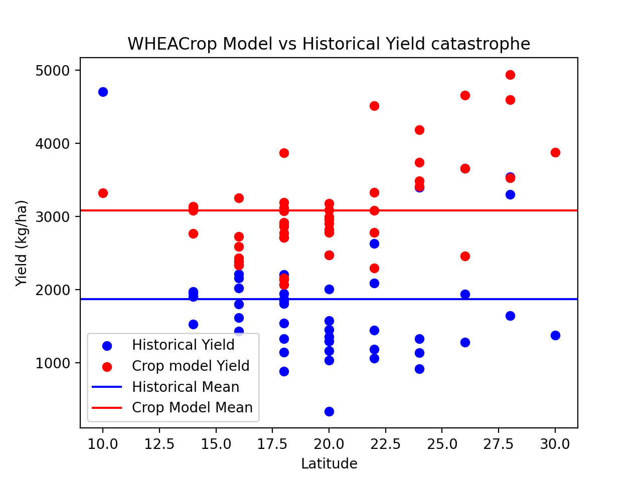
WHEA catastrophe

Slide 7
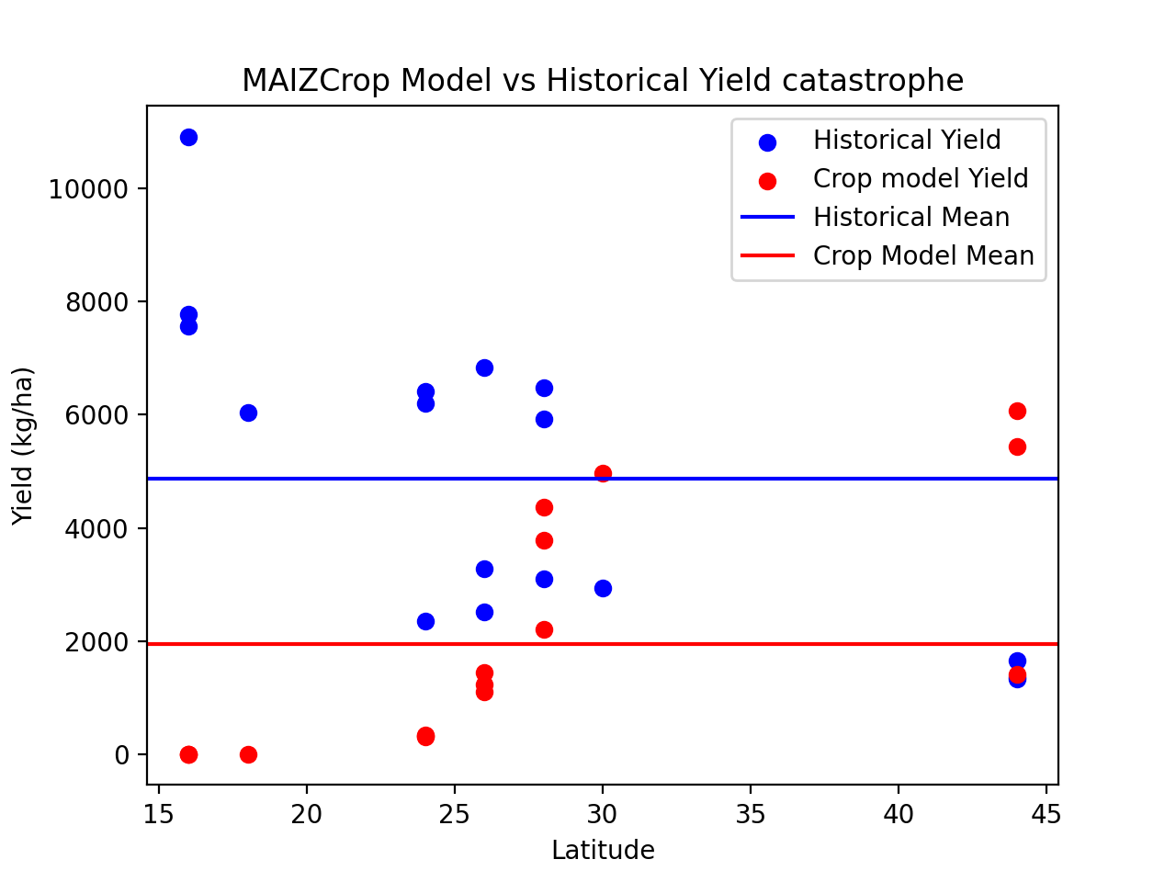
MAIZ catastrophe

Slide 8
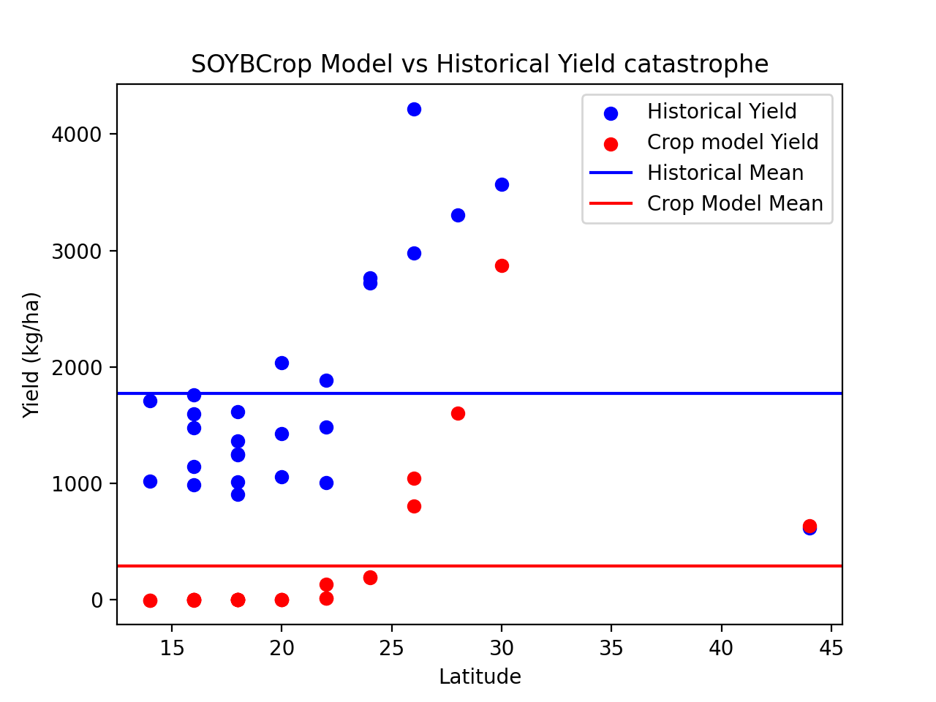
SOYB catastrophe

