Slide 1


Public Transport Fare and Route Information
GROUP 10 - Sonnet 4.2

Slide 2
Introduction
WE’RE MAKING THIS SYSTEM TO MAKE COMMUTING FEEL LESS STRESSFUL AND MORE PREDICTABLE BY FOCUSING ON CLEAR SOLUTIONS THAT HELP BOTH RIDERS AND OPERATORS.

Slide 3
Objectives of the System
01
ACCURATE ROUTE INFORMATION
02
BEST ROUTE ASSISTANCE
Ensures users have timely details
Guides users to optimal travel paths
03
ENHANCED COMMUTING EXPERIENCE
04
SUPPORT FOR TRANSPORT MANAGEMENT
Makes travel straightforward and efficient
Facilitates efficient system operation and oversight
05
DISPLAY ACCURATE AND UPDATED FARE AMOUNT
Providing the users the fare amount of their chosen route

Slide 4
Target Users of the System
01
COMMUTERS
02
TRANSPORT OPERATORS
Students, employees, and tourists seeking routes
Organizations managing public transport services efficiently
03
LOCAL GOVERNMENT UNITS
Administrators overseeing transport systems and policies

Slide 5
User Features Overview
01
ROUTE SEARCH
02
ROUTE OPTIONS
Find routes easily from start to end
Choose cheapest or fastest travel plans
03
FARE ESTIMATION
04
TRANSPORT FILTERING
Get accurate fare information instantly
Filter options by vehicle type efficiently
05
ANNOUNCEMENTS
Stay updated with important transport news

Slide 6
User Reporting
ENSURING ACCURATE TRANSPORT INFORMATION SYSTEM
Users can report inaccuracies in routes, fares, and stops, enabling timely updates and maintaining a reliable transport system that benefits all users and operators.

Slide 7
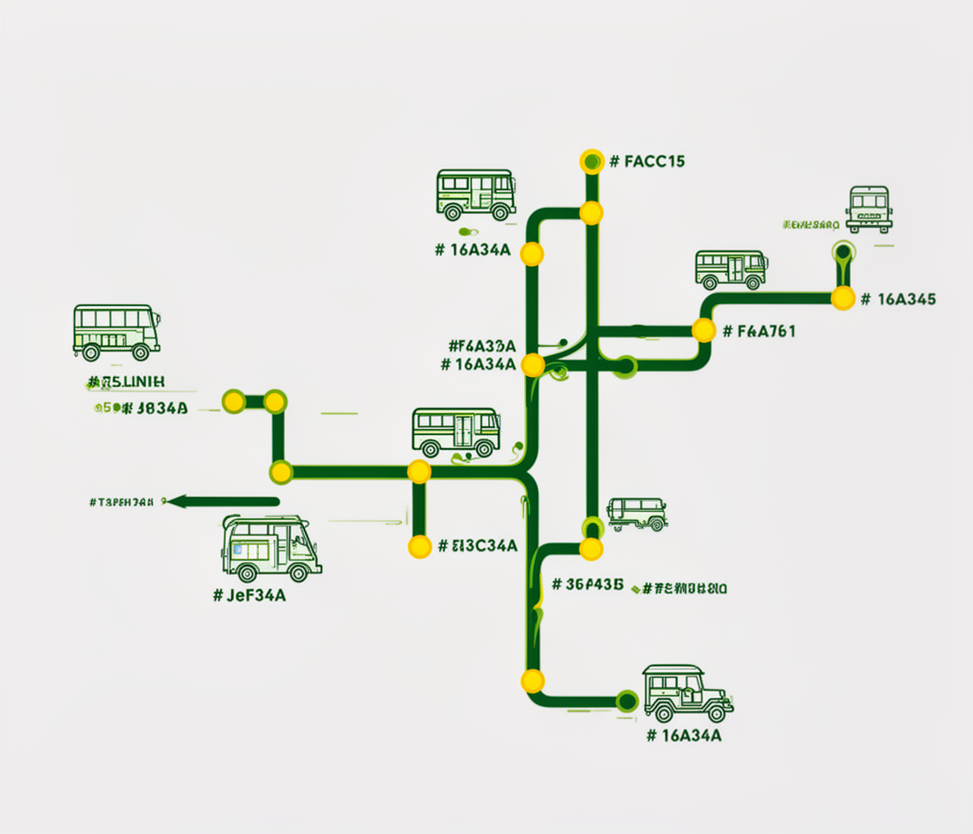
Simplified Route Map
VISUAL REPRESENTATION OF TRANSPORT ROUTES

Slide 8
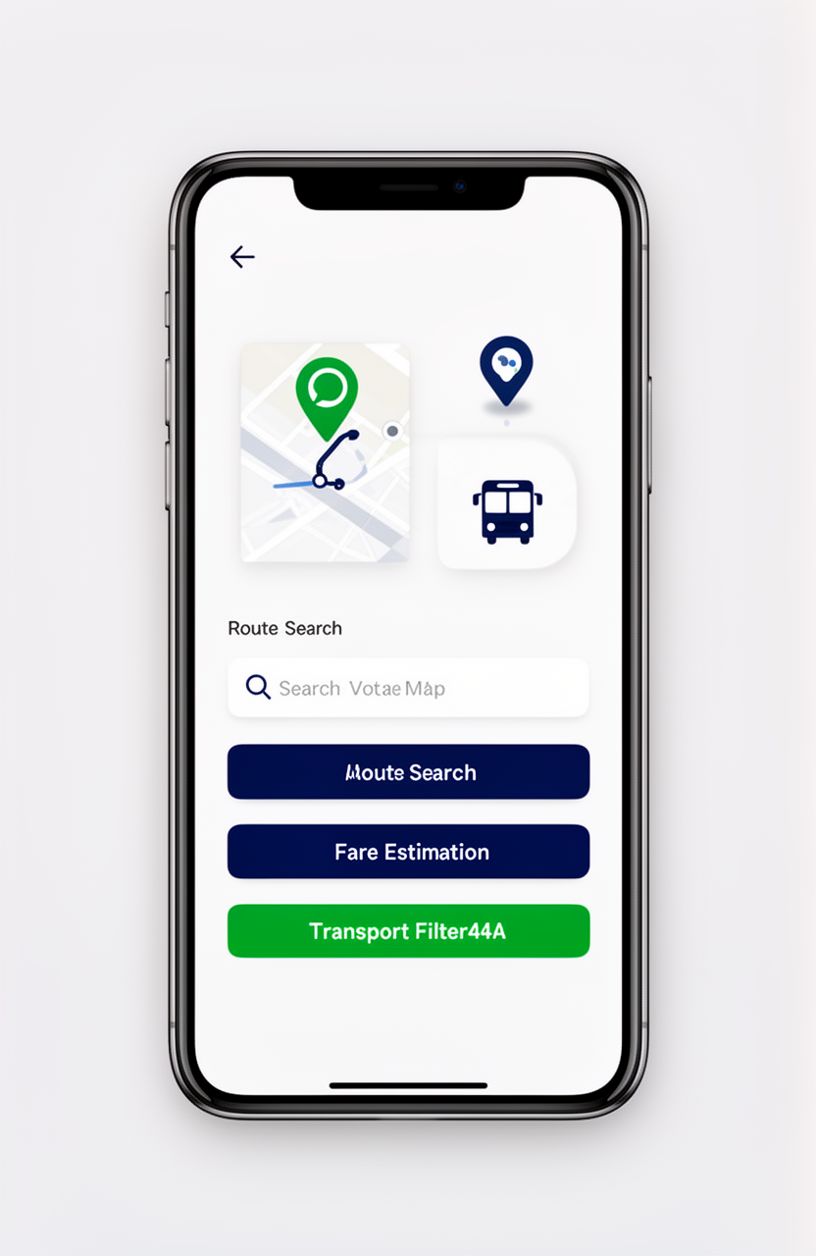
System Design: Clean Interface
Our system features a user-friendly layout with intuitive navigation, enhancing accessibility for all commuters and administrators.

Slide 9
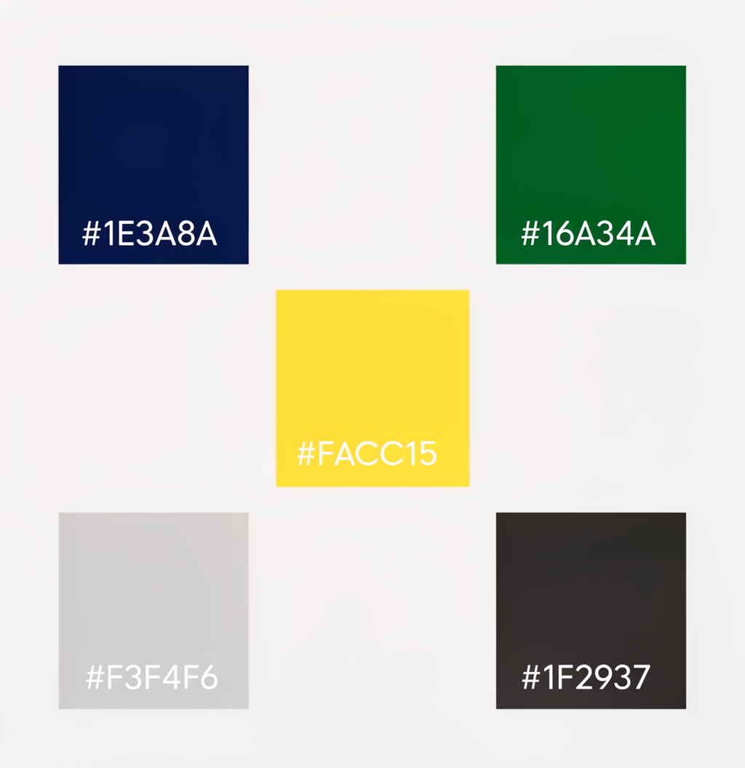

Color Scheme Overview

Slide 10
Admin Dashboard Features
01
MANAGE ROUTES AND STOPS
02
MANAGE FARES
Admins can edit and update routes
Set and modify fare structures easily
03
VIEW REPORTS
04
POST ANNOUNCEMENTS
Analyze user feedback and system performance
Communicate updates to users effectively
05
VIEW ANALYTICS
Monitor usage patterns and trends consistently

Slide 11
System Architecture
UNDERSTANDING FRONTEND AND BACKEND TECHNOLOGIES
FRONTEND TECHNOLOGIES
BACKEND TECHNOLOGIES
The system utilizes HTML, CSS, and JavaScript to create a user-friendly interface, ensuring seamless navigation and responsive design across various devices for optimal user experience.
The backend is powered by Laravel (Blade), MySQL database, facilitating efficient data management, secure user interactions, and real-time updates for route and fare information.

Slide 12
System Workflow Steps
01
USER ROUTE ENTRY
02
OPTIONS DISPLAY
Users input desired starting point
System shows routes with fares
03
ROUTE SELECTION
04
ISSUE REPORTING
Users choose preferred travel option
Users can report problems encountered
05
REVIEW
06
CONTINUOUS IMPROVEMENT
Admin updates system with feedback
System evolves based on user input

Slide 13
Key Strengths of the System
01
EASY TO USE
02
PRACTICAL AND REALISTIC
Intuitive interface for all users
Designed for real-world commuting needs
03
FEEDBACK SYSTEM INCLUDED
04
VISUAL MAP IMPROVES UNDERSTANDING
Allows users to report issues easily
Clear routes enhance trip planning
05
SUPPORTS USERS AND ADMIN
Facilitates efficient transport management

Slide 14
Reliable Transport Information
ENHANCING COMMUTING WITH ACCURATE TRANSIT DETAILS

Slide 15
THANK YOU!

