Slide 1
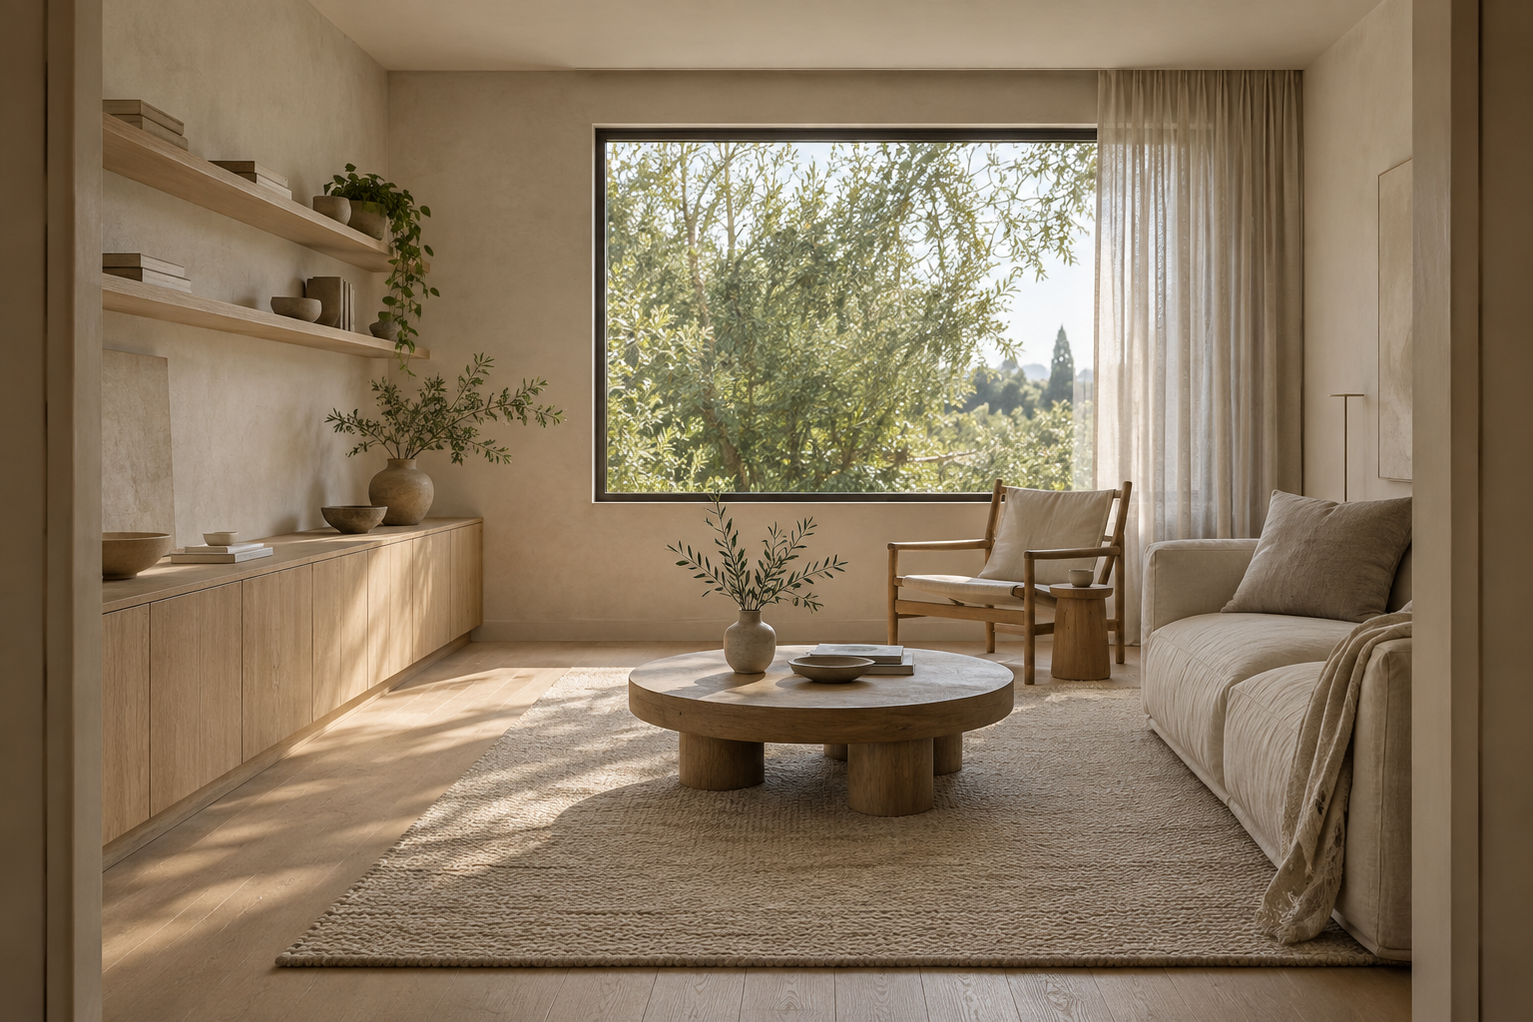
OPENLINTEL / DESIGN REVIEW
The Window Room
One review. A clear decision.
Discuss the material direction for a room to read, gather and store everyday belongings.
Quiet Oak continues into the illustrative drawings.
Example scope: concept discussion only.
Survey, supplier selection and technical review remain outstanding.
AI-generated illustration. Not verified application output or completed client work.
Illustrative teaching example. Pending review. No purchasing or construction approval.
01
Notes:
Authored educational example; no real client approval or verified application output. The shapes and text remain editable. Replace imagery with licensed project material.

Slide 2
OPENLINTEL / INPUTS & BOUNDARIES
Keep the brief in view
Priorities
Retained conditions
Reading, conversation and storage. Confirm the household routines behind each activity.
Existing oak floor, window and entrance positions. Condition and dimensions need verification.
Source information
Outside this review
Nominal room: 5000 x 4000 mm. This is teaching data, not a measured survey.
No product approval, purchase authorization or construction instruction. Budget and dates are unresolved.
Illustrative teaching example. Pending review. No purchasing or construction approval.
02
Notes:
Authored educational example; no real client approval or verified application output. The shapes and text remain editable. Replace imagery with licensed project material.

Slide 3
OPENLINTEL / MATERIAL DIRECTION
Quiet Oak
Retained oak
Pale joinery
Mineral wall
Linen study
The design argument
A lighter material relationship supports reading and conversation while keeping the existing floor as the anchor.
Palette swatches are illustrative, not physical samples. AI-generated room imagery. Product, cost and technical suitability remain unresolved.
Selected illustrative direction. Retain the oak floor; explore pale oak, mineral walls and linen.
Illustrative teaching example. Pending review. No purchasing or construction approval.
03
Notes:
Authored educational example; no real client approval or verified application output. The shapes and text remain editable. Replace imagery with licensed project material.

Slide 4
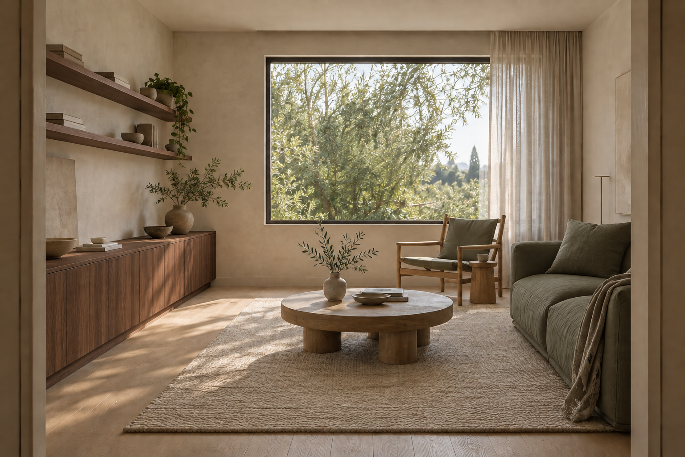
OPENLINTEL / MATERIAL DIRECTION
Deep Olive
Retained oak
Dark joinery
Olive textile
Warm neutral
The design argument
A deeper contrast tests the atmosphere without silently changing the retained floor, openings or activities.
Palette swatches are illustrative, not physical samples. AI-generated room imagery. Product, cost and technical suitability remain unresolved.
Alternative study only. Darker joinery and olive upholstery; keep the same room and brief.
Illustrative teaching example. Pending review. No purchasing or construction approval.
04
Notes:
Authored educational example; no real client approval or verified application output. The shapes and text remain editable. Replace imagery with licensed project material.

Slide 5
OPENLINTEL / EDITABLE REFERENCE DIAGRAM
Connect the layout to the records
Cross-check before advancing
J-01 / storage on west wall
F-01: final product and dimensions unresolved.
F-02: seating location to review.
J-01: coordinate plan and elevation.
WR-01 / WR-02: illustrative, revision R0.
F-02
F-01 / sofa
All shapes and labels on this slide are editable. Replace this teaching diagram with reviewed project information.
Diagram only. Do not scale or use for installation.
Illustrative teaching example. Pending review. No purchasing or construction approval.
05
Notes:
Authored educational example; no real client approval or verified application output. The shapes and text remain editable. Replace imagery with licensed project material.

Slide 6
OPENLINTEL / SELECTION & COORDINATION
Make the open questions visible
Reference / selection
Next information request
Status
F-01 / proposed sofa
Final model, dimensions and fabric
Pending review
J-01 / pale oak joinery
Fabrication details and site interfaces
Pending review
FIN-01 / retained floor
Existing condition and protection
Survey needed
FIN-02 / wall finish
Area, substrate and actual product
Not specified
Keep the same references in the spec sheet, FF&E schedule and finish schedule.
Illustrative teaching example. Pending review. No purchasing or construction approval.
06
Notes:
Authored educational example; no real client approval or verified application output. The shapes and text remain editable. Replace imagery with licensed project material.

Slide 7
OPENLINTEL / FEEDBACK & APPROVAL SCOPE
Record the decision separately
Decision requested
Response and owner
Which material direction should be developed? Confirm the reasons, including any elements requiring another study.
No actual client response is represented. Record the appointed decision-maker and feedback in your own project record.
Affected records
Next action
Brief, concept record, F-01/J-01 specifications and relevant drawings. Preserve the prior revision.
Resolve source information and professional reviews before developing products or ordering. The sample does not authorize either.
Illustrative teaching example. Pending review. No purchasing or construction approval.
07
Notes:
Authored educational example; no real client approval or verified application output. The shapes and text remain editable. Replace imagery with licensed project material.

Slide 8
OPENLINTEL / WORKING WITH THE TEMPLATE
Make this deck your own
Edit the native objects
Retain the audit trail
Text, palette swatches, diagram shapes and placeholders are separate objects. Replace picture objects with your own licensed visuals.
Keep sources, item references, units, revision and unresolved information together. Store client information in your own project system.
Continue the workflow
Use the DOCX storyboard to plan the narrative; the XLSX spec, FF&E and finish templates to record selections; and the handoff guide to prepare the next issue.
openlintel.com/templates/ | openlintel.com/resources/interior-design-handoff-package/
Illustrative teaching example. Pending review. No purchasing or construction approval.
08
Notes:
Authored educational example; no real client approval or verified application output. The shapes and text remain editable. Replace imagery with licensed project material.

