Slide 1
Credit Card Fraud
Austin Wen, Jayvis Hanna, Nic Colon, Shayon Keating, Luminda Kulasiri

Slide 2
Intro
Credit card fraud is a persistent issue and one that credit card companies and banks constantly need to consider. Many banks and credit card companies offer free monitoring and alerts in an attempt to identify potentially fraudulent activity as soon as possible. With the standard practice of reimbursing customers for fraudulent charges on their credit cards and accounts, it is in the best interest of credit card companies and banks to identify, stop and prevent fraudulent activity.

Slide 3
ETL

Slide 4
Resampling
The data set contains 284,807 credit card transactions. Only 492 (0.17%) of them are fraud transactions. The ‘class’ variable is ‘0’ for non-fraud and ‘1’ for fraud truncations. In this situation, any model that always predicts ‘0’ will be accurate 99.83% of the time. The ‘accuracy’ of the model would be misleading. The ‘resample’ module in ‘sklearn’ helps to account for this data imbalance by oversample the fraud data in the training sample. The Re-sampled training data set contains an equal number of fraud and non-fraud transactions. We then used the confusion matrix to evaluate and compare our results.

Slide 5
Models
We have trained the following classification models:
K-Nearest Neighbor (KNN)
Random Forest
Deep Neural Network (with 2-hidden layers)
Logistic
Simple Neural Network
Support Vector Machines (SVM)

Slide 6
KNN

Slide 7
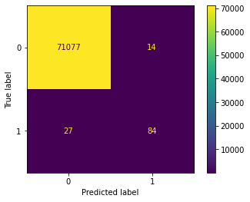
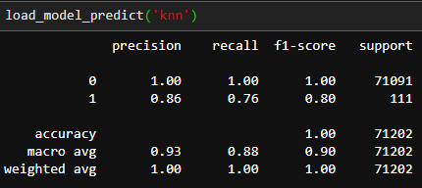
KNN

Slide 8
Random Forest

Slide 9
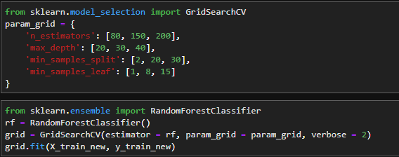
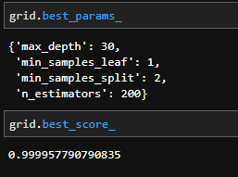
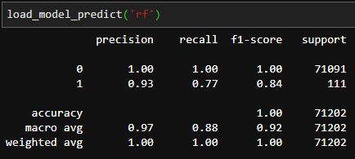
Random Forest

Slide 10
Deep Neural Network

Slide 11

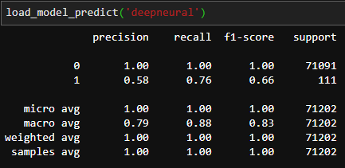
Deep Neural Network

Slide 12
Logistic

Slide 13
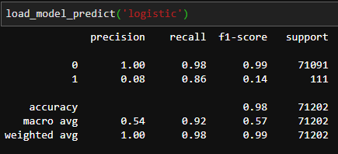
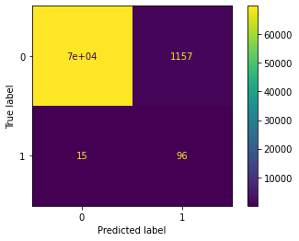
Logistic

Slide 14
Simple Neural Network

Slide 15
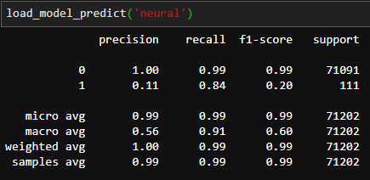
Simple Neural Network

Slide 16
Support Vector Machines (SVM)

Slide 17
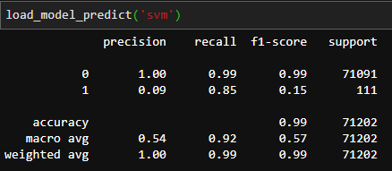
Support Vector Machines (SVM)

Slide 18
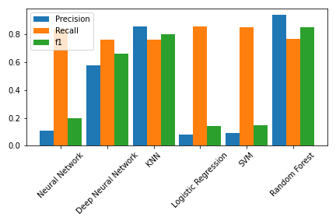
Model Comparison

Slide 19
Future Usage

Slide 20
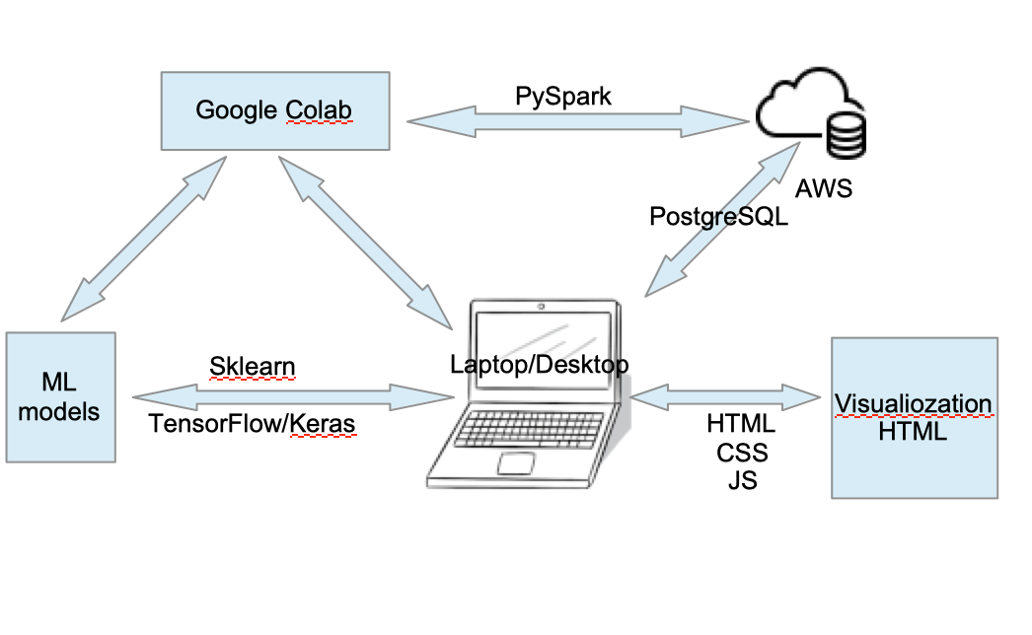
Flowchart

Slide 21
Conclusion

