Slide 1
Credit Card Fraud
Austin Wen, Jayvis Hanna, Nic Colón, Shayon Keating, Luminda Kulasiri
Notes:
Jayvis - Discuss intro during this slide

Slide 2



Initial ETL Process
Extract Transform Load
*workpaper: CreditCardFraud_cloud_ETF.ipynb
Notes:
Austin

Slide 3
Flowchart
PySpark
PostgreSQL
ML Models
Sklearn
TensorFlow/Keras
Notes:
Austin

Slide 4
Resampling
Highly Imbalanced Data Set:
Total transactions: 284,807
Fraud-transactions: 492 (0.17%)
Problem:
Any model that always predicts ‘0 (non-fraud)’ will be accurate 99.83% of the time.
Solutions:
Use precision/recall values and confusion matrix to compare models
Try different models (six models),
Resample the training data (used ‘resample’ module in ’sklearn’)
Notes:
Luminda

Slide 5
Models
We have trained the following classification models:
K-Nearest Neighbor (KNN)
Logistic
Simple Neural Network
Deep Neural Network (with 2-hidden layers)
Support Vector Machines (SVM)
Random Forest
Notes:
Jayvis

Slide 6
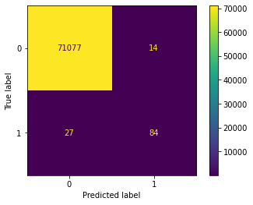
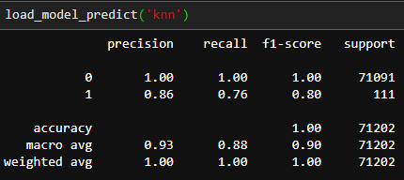
K-Nearest Neighbor (KNN)
K=1 provides the best model
Training time is about 3 hours
Model works reasonably well.
Notes:
Luminda

Slide 7
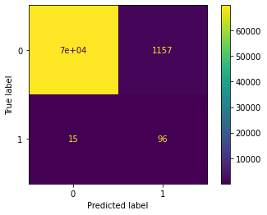
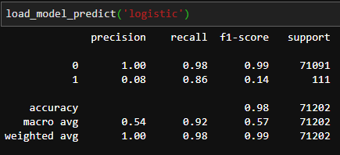
Logistic
Faster, ~30 min.
High number of wrong fraud predictions.
Notes:
Luminda

Slide 8
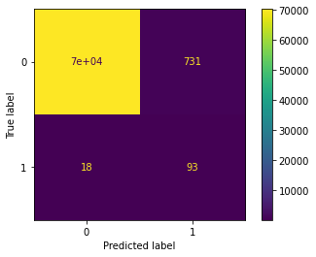
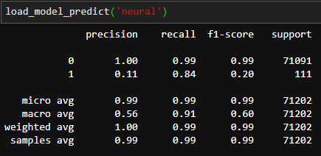
Simple Neural Network
1 hidden layer.
29 input and two output nodes. Middle layer has 58 nodes.
200 epochs, ~4 hours
Low precision on predicting fraud transactions
Notes:
Luminda

Slide 9

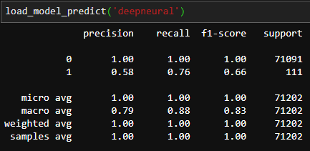
Deep Neural Network
2 hidden layers.
29 input and two output nodes. Hidden layers have 58 nodes each.
200 epochs, ~3 hours
Not a bad model. Poor precision for 1 is due to 61 incorrectly predicted 1’s. There is space for improvement.
Notes:
Luminda

Slide 10
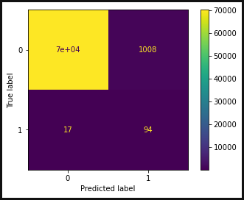
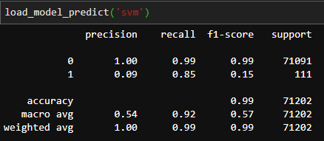
Support Vector Machine (SVM)
Training time ~2 hours
Similar performance to Logistic Regression model.
Notes:
Nic

Slide 11
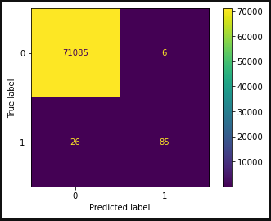
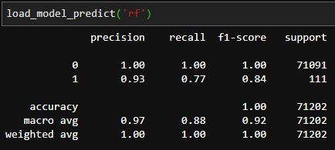
Random Forest
Potentially the fastest to train at 15-20 min.
Best performing model.
Hyperparameter tuning was mostly unnecessary.
Notes:
Nic

Slide 12
Model Comparison
Notes:
Nic

Slide 13
Application
Real-time Fraud Detection
*workpaper: recall_model.ipynb
Transaction Data
Random Forest Model
Alert
Notes:
Austin

Slide 14


Overnight Re-ETL and Re-Train
Task Scheduler re-ETL and re-Train
*workpaper: overnight_process.py
Notes:
Austin

Slide 15
Conclusion
Random Forest gives the highest precision
Easy to explain which variable contributed to the fraud
Presents a significant improvement in the deep neural network
With more time we can improve the deep neural network and we can add more layers and nodes
This can provide real time fraud detection and alert
Notes:
Shayon

