Slide 1
Credit Card Fraud
Austin Wen, Jayvis Hanna, Nic Colón, Shayon Keating, Luminda Kulasiri
Notes:
Jayvis - Discuss intro during this slide

Slide 2



Initial ETL Process
Extract Transform Load
*workpaper: CreditCardFraud_cloud_ETF.ipynb
Notes:
Austin

Slide 3
Resampling
Data Set:
Total transactions: 284,807
Fraud-transactions: 492 (0.17%)
Problem:
Any model that always predicts ‘0’ will be accurate 99.83% of the time.
Solutions:
Use precision/recall values and confusion matrix to compare models
Try different models (six models),
Resample the training data (used ‘resample’ module in ’sklearn’)
Notes:
Luminda

Slide 4
Models
We have trained the following classification models:
K-Nearest Neighbor (KNN)
Logistic
Simple Neural Network
Deep Neural Network (with 2-hidden layers)
Random Forest
Support Vector Machines (SVM)
Notes:
Luminda or Jayvis?

Slide 5
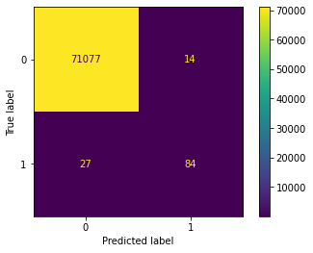
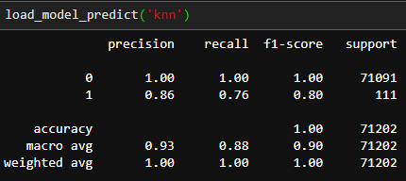
K-Nearest Neighbor (KNN)
K=1 provides the best model
Training time is about 3 hours
Model works reasonably well.
Notes:
Luminda

Slide 6
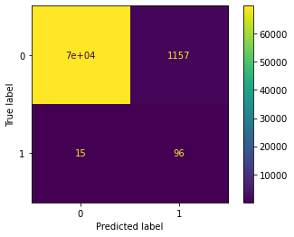
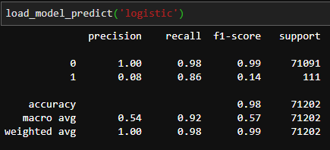
Logistic
Faster, ~30 min.
High number of wrong fraud predictions.
Notes:
Luminda

Slide 7

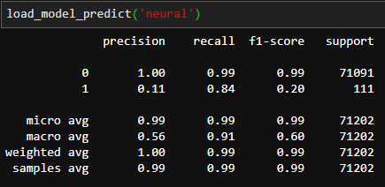
Simple Neural Network
1 deep layer.
29 input and two output nodes. Middle layer has 58 nodes.
200 epochs, ~4 hours
Low precision on predicting fraud transactions
Notes:
Luminda

Slide 8
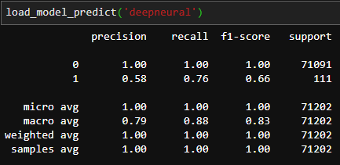
Deep Neural Network
2 deep layers.
29 input and two output nodes. Middle layers have 58 nodes each.
200 epochs, ~3 hours
Not a bad model. Poor precision for 1 is due to 61 incorrectly predicted 1’s. There is space for improvement.
Notes:
Luminda

Slide 9
Random Forest
Notes:
Nic

Slide 10
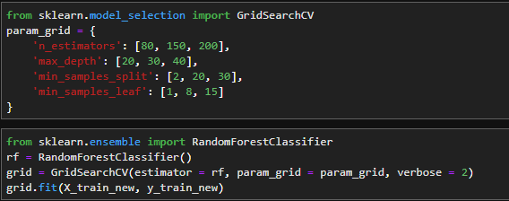
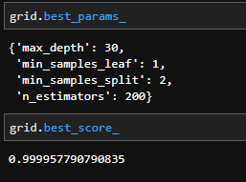
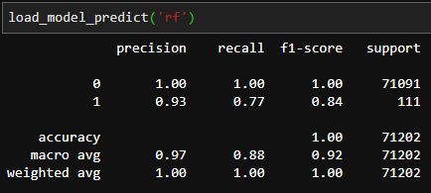
Random Forest
Notes:
Nic

Slide 11
Support Vector Machines (SVM)
Notes:
Nic

Slide 12
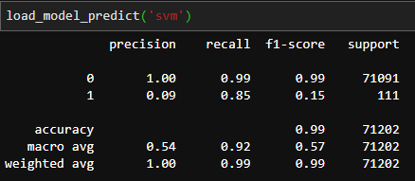
Support Vector Machines (SVM)
Notes:
Nic

Slide 13
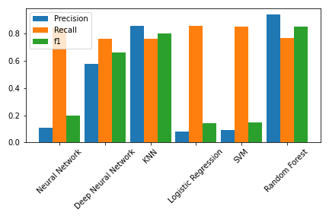
Model Comparison
Notes:
Nic

Slide 14
Flowchart
PySpark
PostgreSQL
Visualization
ML Models
Sklearn
TensorFlow/Keras
HTML
CSS/JS
Notes:
Luminda

Slide 15
Application
Real-time Fraud Detection
*workpaper: recall_model.ipynb
Transaction Data
Machine Learning Models*
Alert
Notes:
Austin

Slide 16


Overnight Re-ETL and Re-Train
Task Scheduler re-ETL and re-Train
*workpaper: overnight_process.py
Notes:
Austin

Slide 17
Conclusion

